Slide 1
GYRUS
“Minds Advancing Medicine”
TEAM NYX
Ananya Sajwan
Soumyadeepta Das
(VIT Chennai)

Slide 2
THEME
The Gyrus Project is developed under the Healthcare theme of Hack Gujarat to provide a faster and accurate mechanism for diagnosis of breast cancer by doctors and speeds up the process significantly providing patients with a better chance at treatment.
Our project, in a way, while mainly targeting the healthcare theme, also successfully integrates the following themes of Hack Gujarat:
Healthcare
AI/ML

Slide 3
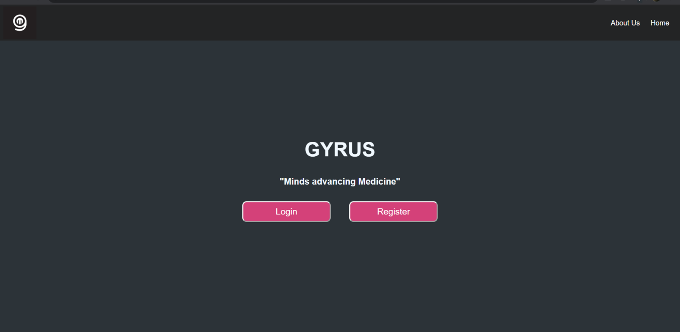
A brief introduction
GYRUS is a state of the art breast cancer prediction interface that employs the best machine learning tools available to accurately predict the occurrence of cancer in an individual.
The need of the hour is a technical based prediction system which using historical data can predict the likelihood of cancer in a patient, saving a lot of time and effort diagnosis of the disease thus revolutionizing the healthcare industry.

Slide 4
Problem Statement
SOLUTION
Current diagnosis and prediction of a disease by doctors are based on control values used by doctors to assess the condition(status) .
Normal ranges used are not always revised to consider the variance of a lot of factors such as age, lifestyle and demographics.
Patients and doctors require to meet just for report reviewing, which is time taking and strenuous.
Creating a website interface for both doctors and patients, that simplifies the overall management and communication.
Our website harnesses the power of Machine Learning to predict the status of a tumour, whether it is malignant or benign, based on inputs from a mammogram test of a tumour tissue.
This solution simplifies the prediction process for doctors with enhanced accuracy and also eases the work for both patients and doctors.

Slide 5
FEATURES OF THE WEBSITE
Predicting whether a tumour is malignant or benign with an accuracy of around 95% to 97%
Login for exist patients and doctors and signup for new users
Dashboard for doctors include:
    Displays details of patients under them
    Creating appointments on website with patients
    Reviewing patient reports using ML
    Chat function to communicate with patient group
    Sending e-mails through registered e-mail ID

Slide 6
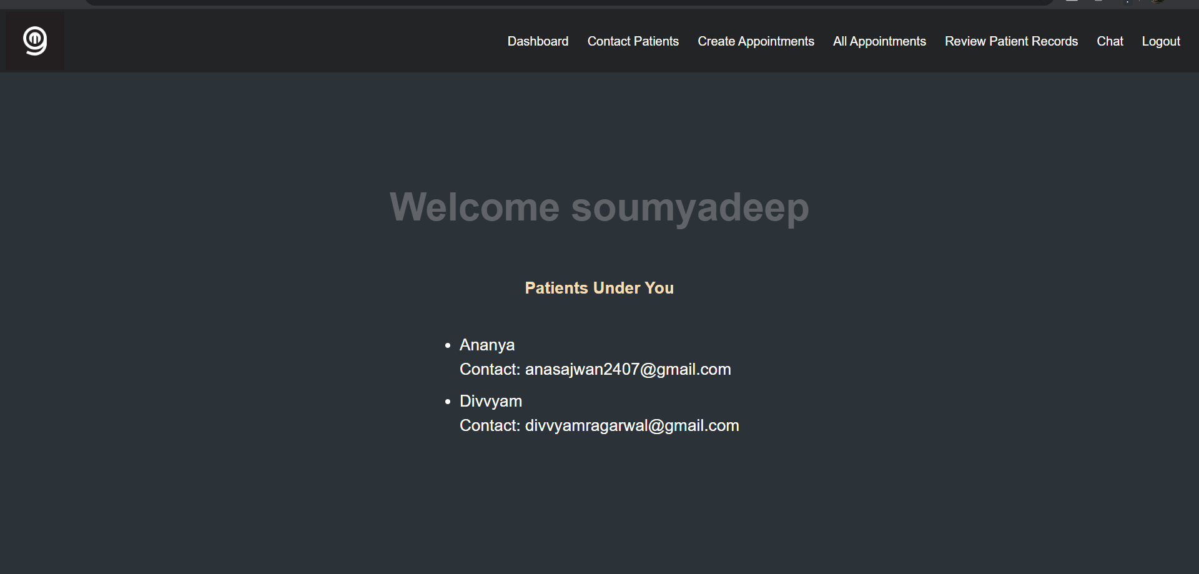
Dashboard for doctor

Slide 7
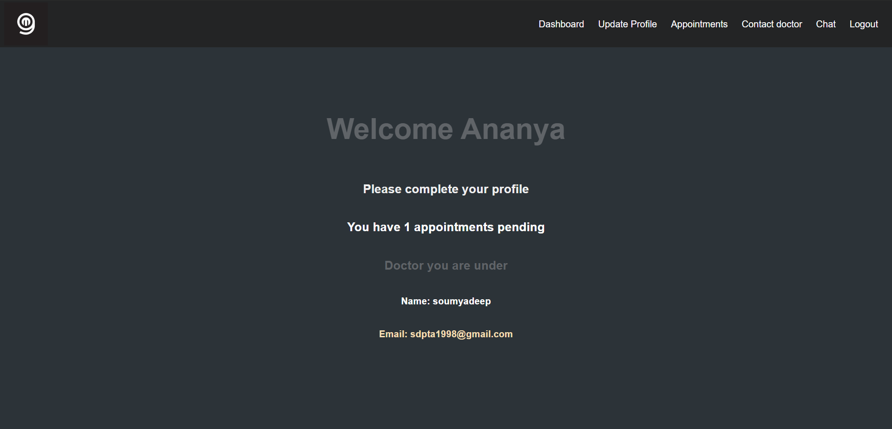
Dashboard for Patient

Slide 8
FEATURES OF THE WEBSITE
Dashboard for patients include
    Function like uploading of reports
    Sending e-mail to doctor using registered e-mail ID
    Chat with respective doctor
Management can manage the users and their activities through admin controls

Slide 9
FRAMEWORK FOR DEVELOPMENT
The linking of frontend and backend is done using Django web framework which is build upon Python.
When the doctor reviews a patient record, then the Machine Learning model is called and the prediction along with the accuracy is displayed on the page.
All the modules and pages are closely tied and managed using the implicit Django project administration files.

Slide 10
BACKEND
We used the Breast Cancer Wisconsin (Original) Dataset and used Python as the coding platform.
Our methodology involves the use of logistic regression with dimensionality reduction i.e. Principal Component Analysis (PCA).
The dataset used is divided into:
Training data – 80%
Test data – 20%

Slide 11
BACKEND
We have used “Logistic Regression” for the classification of the tumour as either benign or malignant.
The tumour features are given to the model and logistic regression is applied after hypothesis formulation and cost function fitting to generate the plot with the regression line that depicts whether the tumours in the given data are malignant or benign.
After this, the user can input the data for the above-mentioned parameters for a patient and predict whether the tumour is malignant or benign, i.e. whether the patient has cancer or is cancer-free.

Slide 12
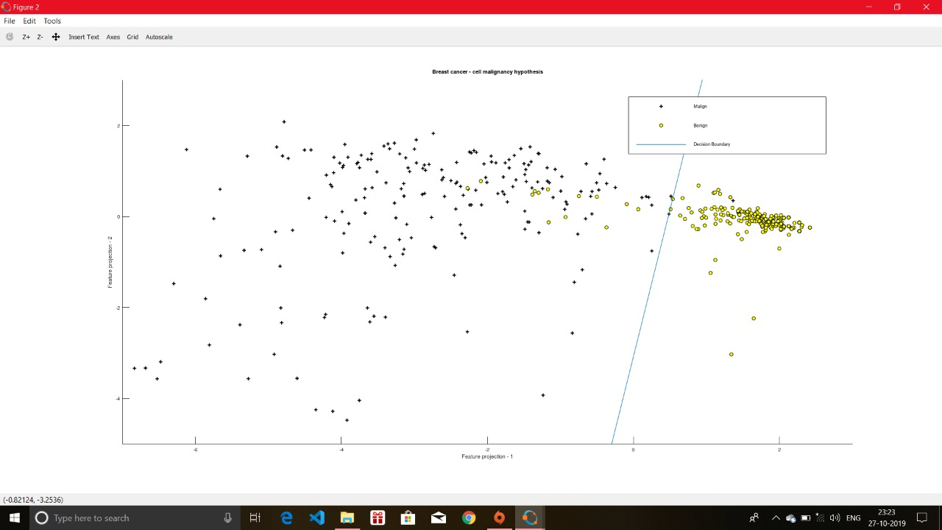
CLASSIFICATION – REGRESSION LINE

Slide 13
BACKEND
We have also arranged the features according to their importance using ExtraTreesClassifier which arranges the features according to their importance scores.
We have also visualized the correlation of the features Correlation Heat Map from seaborn library.
LIBRARIES USED FOR MACHINE LEARNING:
    numpy
    matplotlib.pyplot
    pandas
    sklearn
    seaborn

Slide 14
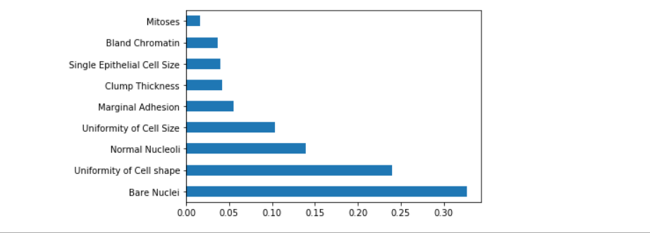
IMPORTANCE OF FEATURES

Slide 15
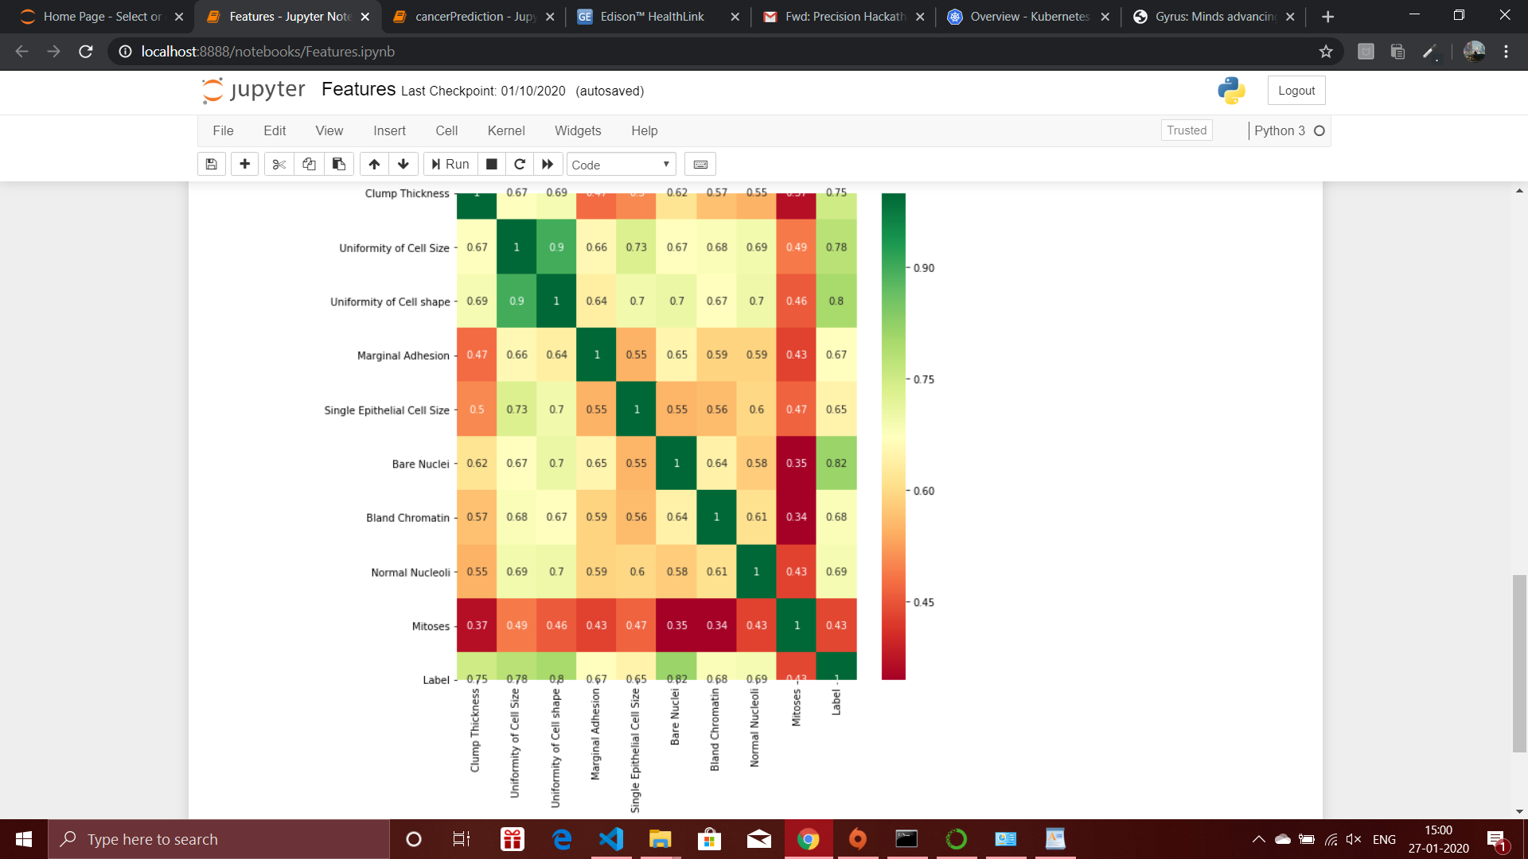
CORRELATION OF FEATURES

Slide 16
PARAMETERS USED
Clump thickness
Uniformity of Cell Size
Uniformity of Cell Shape
Marginal Adhesion
Single Epithelial Cell Size
Bare Nuclei
Bland Chromatin
Normal Nucleoli
Mitoses
Label (Benign=0/Malignant=1)

Slide 17
FRONTEND
The frontend has been developed to provide a medium between doctors and patients whilst simultaneously allowing the doctors to predict the status of the patient.
The frontend has been developed using Django, HTML and CSS.
The interface provides two logins – one for the PATIENT and one for the DOCTOR.
A superuser is created who manages the entire system and its technicalities.

Slide 18
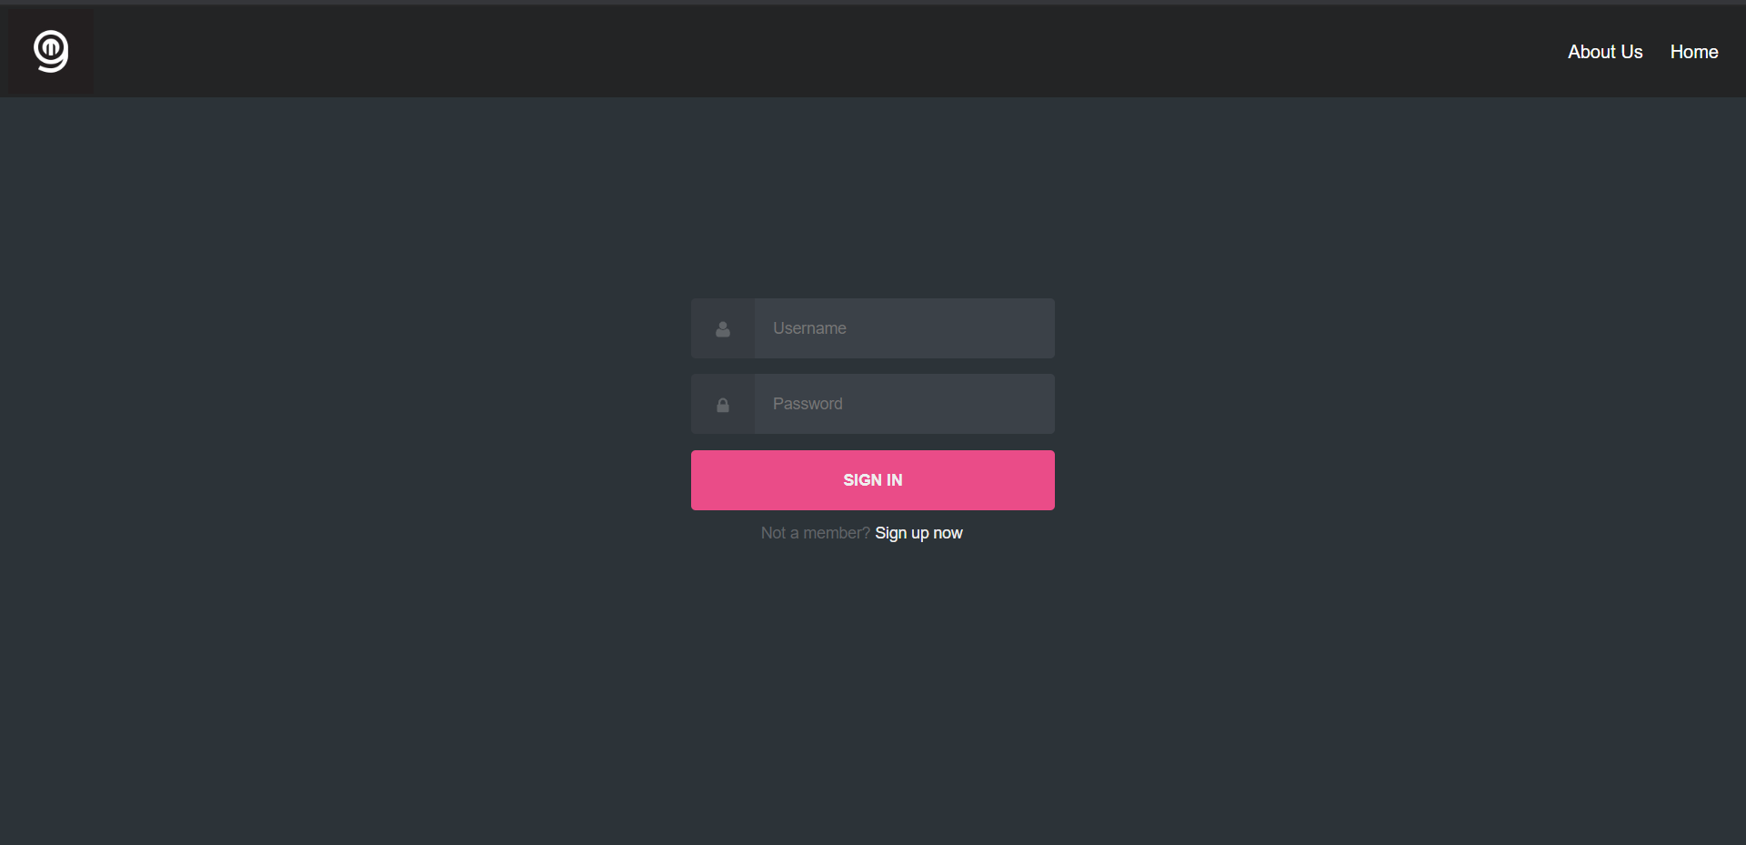
SIGN IN

Slide 19
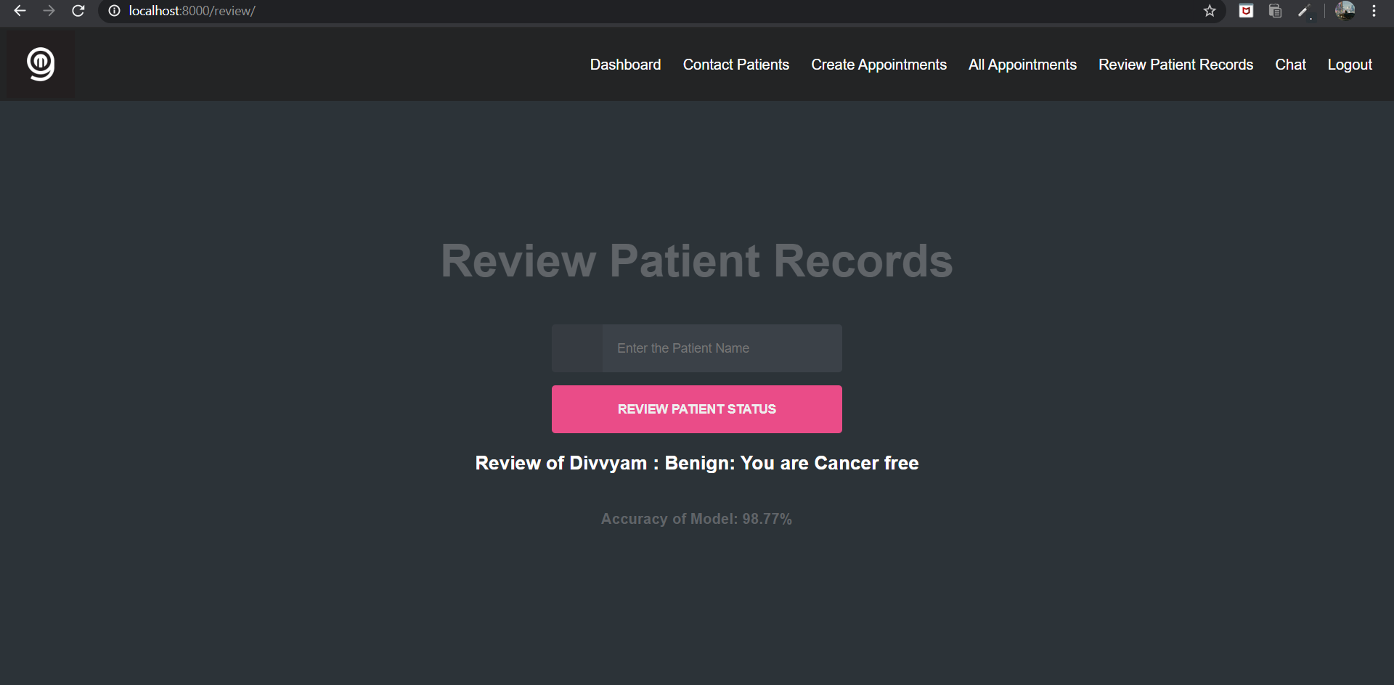
Review by the doctor

Slide 20
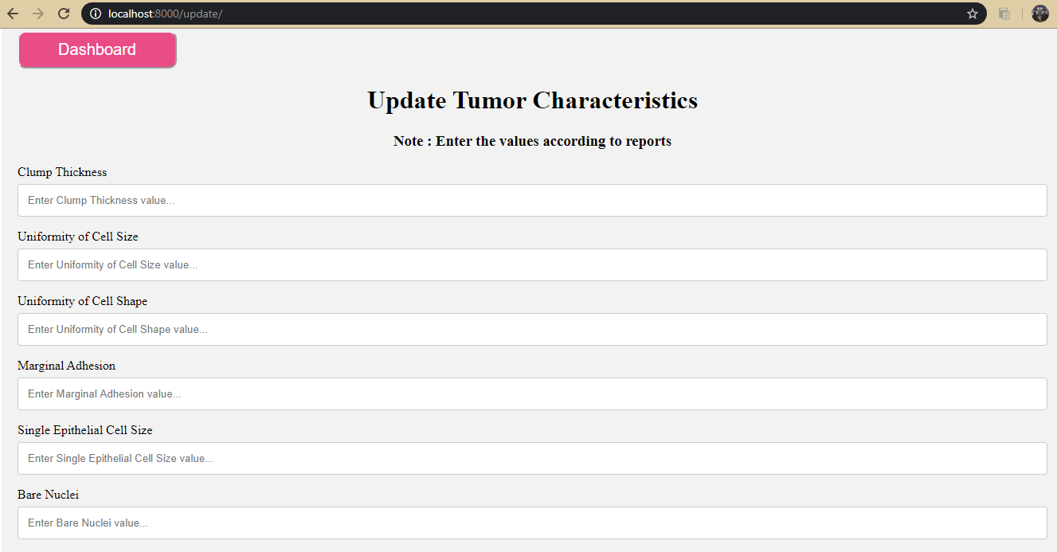
UPDATE REPORT

Slide 21
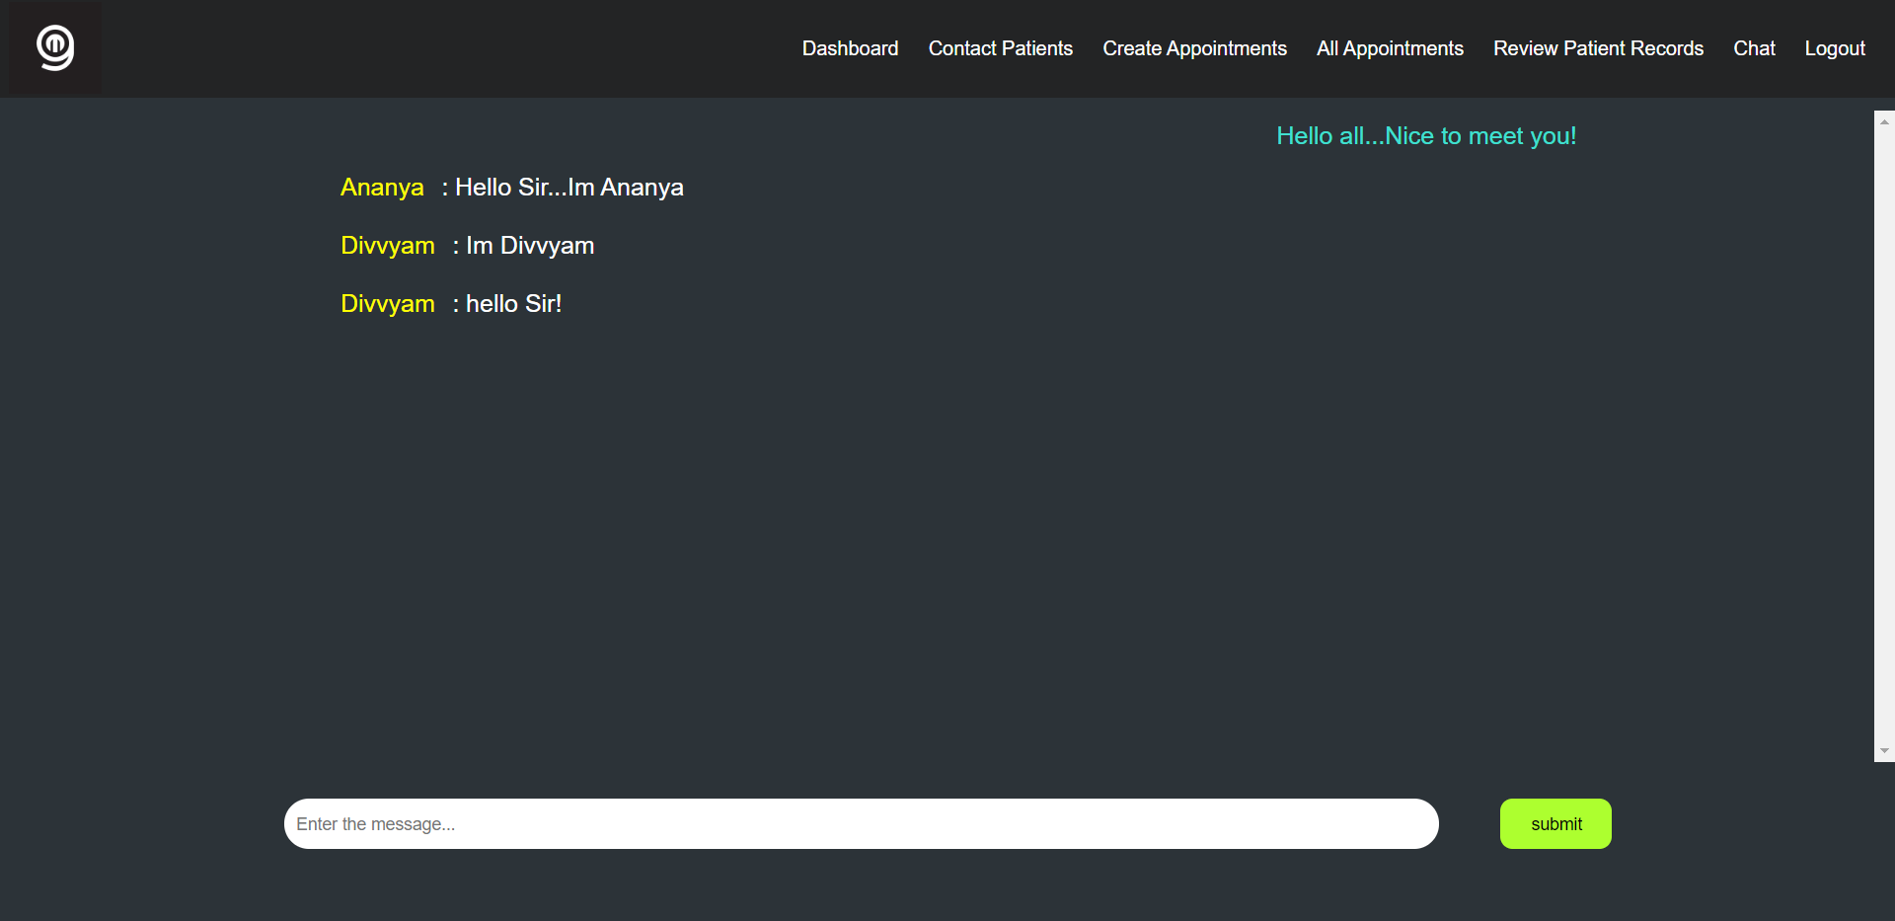
CHAT FACILITY

Slide 22
ADVANTAGES
It makes the prediction process faster and more accurate.
More reliable as it compares with historical data and not just by human assumption.
It eases out the work of the doctors via the website interface and saves a lot of time and effort.
It is easy for patients as they do not need to do round trip appointments to show and get their reports reviewed.
Email communication between doctor and patient and vice versa possible with a single click.
Patient group under one doctor can be kept informed through the chat feature.

Slide 23
BUSINESS PROSPECT
Monetization of the software can be done on a license basis to the hospitals.
We aim to charge per 100 users and marginally increase the price as number of users increase.
Partnering with online medicine delivery apps to allow patients and hospitals to order medicine at ease. This can be done on the basis of commission by partnership.

Slide 24
Thank You

