Slide 1
IBM University Engagement Project Submission
“Exploring the Power of Agentic AI with IBM Granite and LangFlow”

Slide 2

Project Tile – [FinSaathi AI — An AI-Powered Financial Literacy Assistant]
Domain of Project – [Financial Literacy / FinTech (Financial Technology)]
Student Name | Recent Passport Photo | Email ID | Mobile number [WhatsApp]
Ananya Das |  | ananyadas09092004@gmail.com | 7002291448
Recommended font style and size:
Font Style: Arial
Font Size (Heading): 28
Font Size (Content): 20

Slide 3
Problem Statement -
Problem Statement: FinSaathi AI
The Challenge
Many people struggle to understand basic financial concepts such as budgeting, savings, interest calculations, digital payments and online financial fraud. Financial information can be scattered across multiple sources, making it difficult for beginners to find clear and understandable explanations.
The Objective
To develop an AI-powered financial literacy assistant that helps users understand financial concepts through conversational question answering.
The solution aims to:
Explain financial concepts in simple language.
Retrieve relevant information from a financial knowledge base.
Generate context-aware responses using IBM Granite.
Promote awareness of budgeting, saving and digital-payment safety.
Make financial education accessible through a web-based interface.
Existing Challenges
Financial information is spread across different sources.
Beginners may find financial terminology difficult to understand.
Generic AI responses may contain incomplete or inaccurate information.
Users need a simple interface to ask questions naturally.
Proposed Approach
FinSaathi AI combines knowledge retrieval and generative AI to provide accessible explanations supported by relevant information from its financial knowledge base.
Target Users: Students, beginners in personal finance and individuals seeking basic financial education.

Slide 4
Proposed Solution -
Proposed Solution: FinSaathi AI
FinSaathi AI is a web-based financial literacy assistant developed using Python and Streamlit, integrated with IBM watsonx.ai and IBM Granite.
The application uses a Retrieval-Augmented Generation (RAG) approach to connect user questions with relevant information from a financial knowledge base before generating responses.
Core Components
User Interface: Accepts questions through the Streamlit application.
Knowledge Retrieval: Searches for relevant information from the available financial knowledge base.
Context Preparation: Supplies retrieved information as context for answer generation.
AI Response Generation: Uses IBM watsonx.ai and a configured IBM Granite model.
Response Display: Presents the generated explanation to the user.
Expected Outcome: A simple and accessible AI-powered tool for learning fundamental financial concepts.

Slide 5
Technology Used
Technology Stack
Python: Core programming language.
Streamlit: Interactive web application interface.
IBM watsonx.ai: Access to foundation models through an AI service.
IBM Granite: Generates natural-language answers.
Retrieval-Augmented Generation (RAG): Retrieves relevant financial knowledge to support responses.
PyPDF: Extracts text from PDF documents.
Pandas: Data processing.
Scikit-learn: Machine-learning utilities and similarity workflows, where applicable.
python-dotenv: Manages local environment variables.
Streamlit Community Cloud: Hosts the deployed application.
Live Demo: https://finsaathi-ai-h6rrnqqbameargbappahgvk.streamlit.app/

Slide 6
Langflow component Used -
1) Chat Input – Interface where users enter queries about UPI payments, online scams, digital banking, budgeting, interest rates, and personal finance.
2) IBM watsonx.ai Agent – Processes user queries using an AI model to generate personalized financial literacy explanations and recommendations.
3) Name of IBM Granite Model – IBM Granite 3.3 8B Instruct (ibm/granite-3-3-8b-instruct) — intended for instruction-following and financial question answering, subject to successful model configuration.
4) Chat Output – Displays AI-generated responses, financial guidance, budgeting suggestions, and online scam-prevention advice.
5) File Component – Loads and retrieves financial knowledge from RBI financial literacy documents (FAME PDF) to support answers with relevant information.
6) RAG (Retrieval-Augmented Generation) Component – Uses document chunking, embeddings, FAISS vector search, and retrieval to provide relevant financial information as context for AI-generated responses.
7) Streamlit UI Component – Provides the interactive web interface for users to ask questions and view financial literacy responses.
8) Budget Planner Component – Helps users organise income, expenses, savings, and budget allocations.
9) Multilingual Support Component – Supports financial literacy interactions in English, Hindi, and Bengali, where implemented.
10) Safety and Disclaimer Component – Encourages safe financial practices, warns users about potential scams, and clarifies that AI-generated guidance is educational rather than professional financial advice.

Slide 7
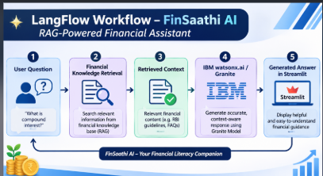
FinSaathi AI — RAG Workflow

Slide 8
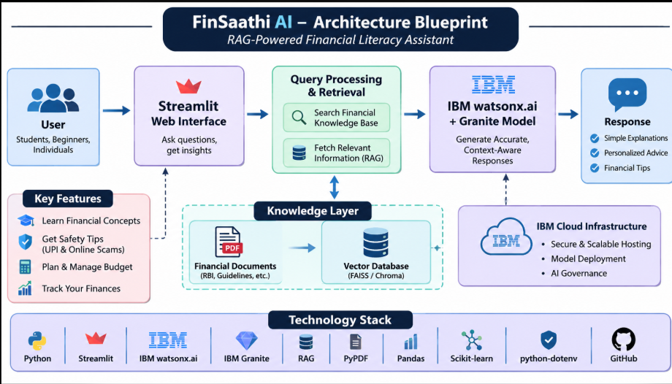
Architecture blueprint

Slide 9

Role of Agentic AI in the solution
Role of AI in FinSaathi AI
FinSaathi AI uses generative AI and Retrieval-Augmented Generation to answer questions about financial literacy.
Context-Aware Responses: Retrieved financial information provides context for answer generation.
Natural-Language Understanding: Users can ask questions in everyday language.
Knowledge-Grounded Generation: RAG connects the question to relevant information in the knowledge base.
Accessible Learning: Financial concepts can be explained conversationally.
Potential Agentic Extension: Future versions could use specialized agents for budgeting education, fraud awareness and financial knowledge retrieval.
The current implementation demonstrates a RAG-based AI assistant. Multi-agent orchestration should be described as implemented only after it has been built and tested.

Slide 10
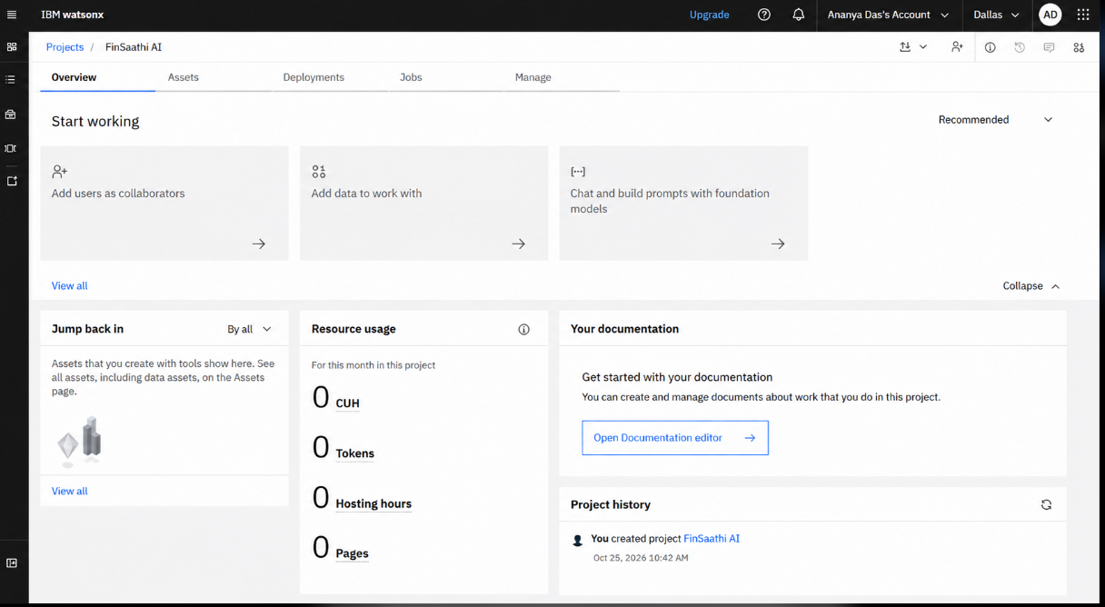
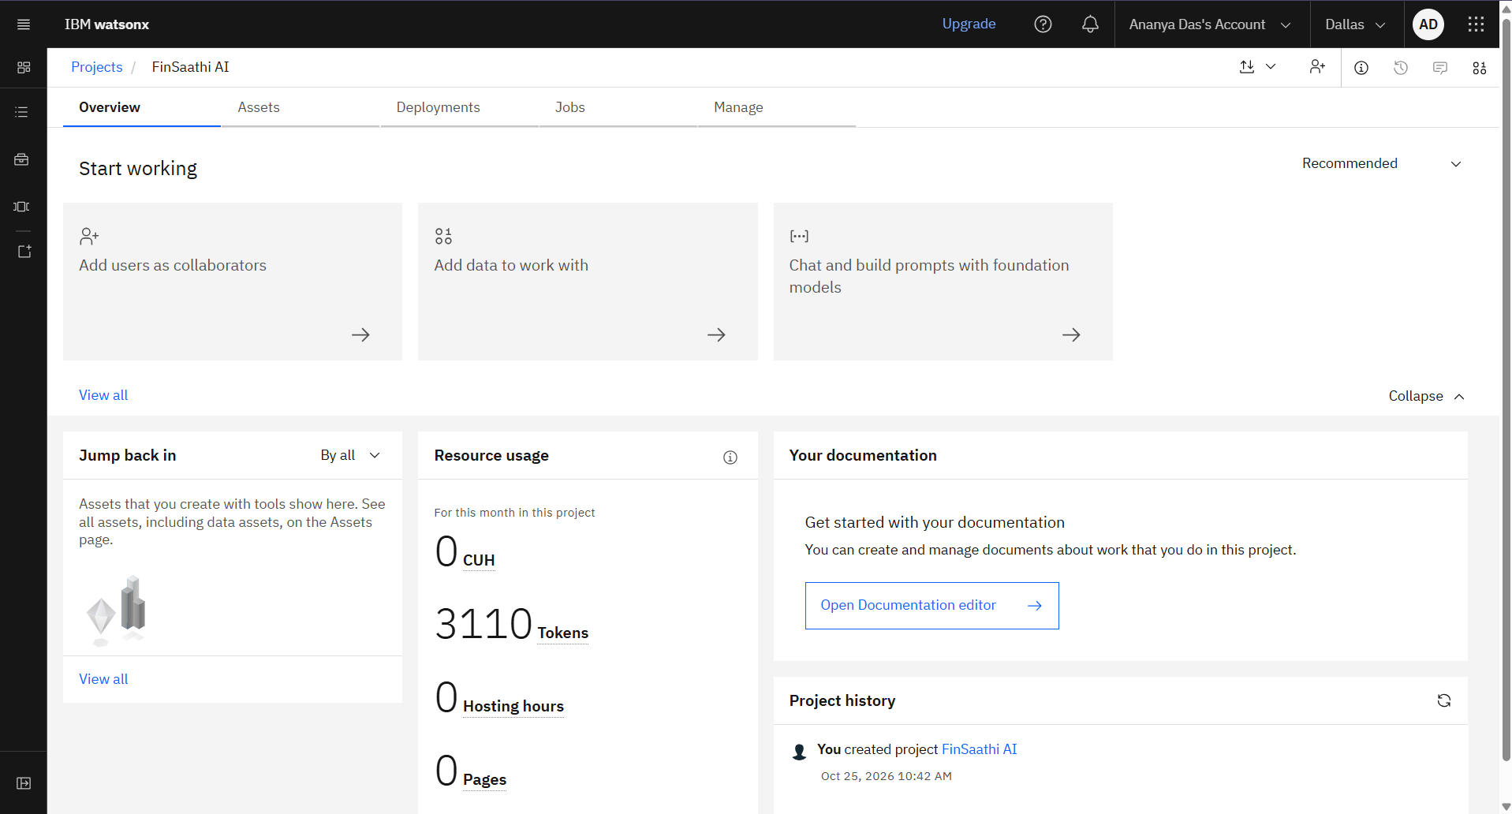
Token Usage
3,110 tokens token are used
Before Prompt
After the Prompt
·
·
·

Slide 11
Novelty and Uniqueness
Financial Literacy Focus: Addresses beginner-friendly financial education.
RAG-Based Question Answering: Connects user questions with a financial knowledge base.
Generative AI Integration: Uses IBM Granite through IBM watsonx.ai.
Conversational Learning: Allows users to ask questions naturally.
Accessible Web Interface: Provides browser-based access through Streamlit.
Cloud Deployment: Makes the application accessible through a live web link.
Scope for Expansion: Can be extended with multilingual explanations, guided budgeting education and specialized AI agents.
FinSaathi AI explores how RAG and generative AI can support accessible financial education.

Slide 12
Git Hub Link
Please create public github repository (Enable Add README button while creating repository) with format –
Please test and Paste the working Github URL –https://github.com/ananya348/finsaathi-ai?utm_source=chatgpt.com
Make sure you have Uploaded following three files into your github repository
1) app.json file , 2) yourproblemstatement.pdf file 3) your projectpresntation.pptx file 4)any other files
·
·
·

Slide 13
Future Scope
Agentic AI Integration: Develop specialized agents for financial education, budgeting and fraud awareness.
Multilingual Support: Provide financial explanations in Bengali, Hindi and other languages.
Interactive Budgeting Tools: Add educational budget planners and savings calculators.
Improved Knowledge Retrieval: Expand and validate the financial knowledge base.
Evaluation and Reliability: Test answer relevance, factual accuracy and retrieval quality.
Financial Safety Awareness: Include guidance on recognizing common digital-payment scams.
Enhanced User Experience: Introduce guided learning paths and user feedback features.
·
·
·

Slide 14
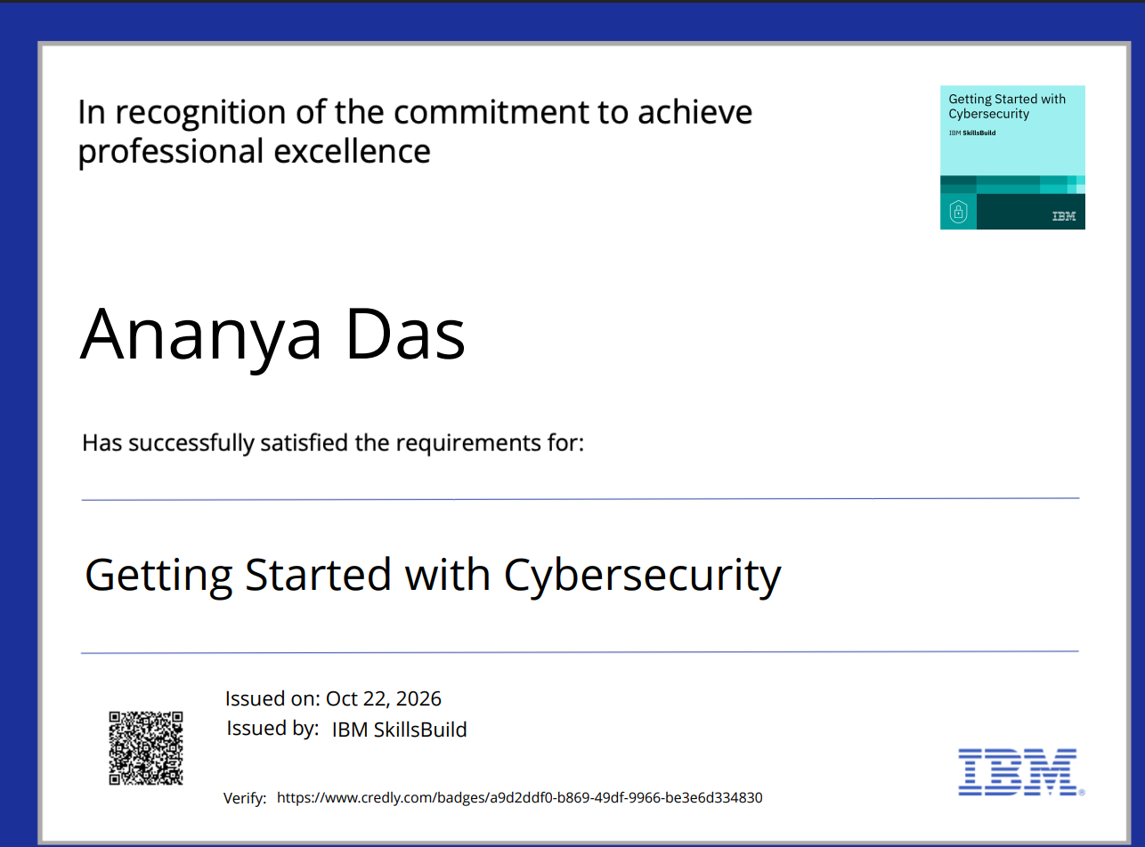
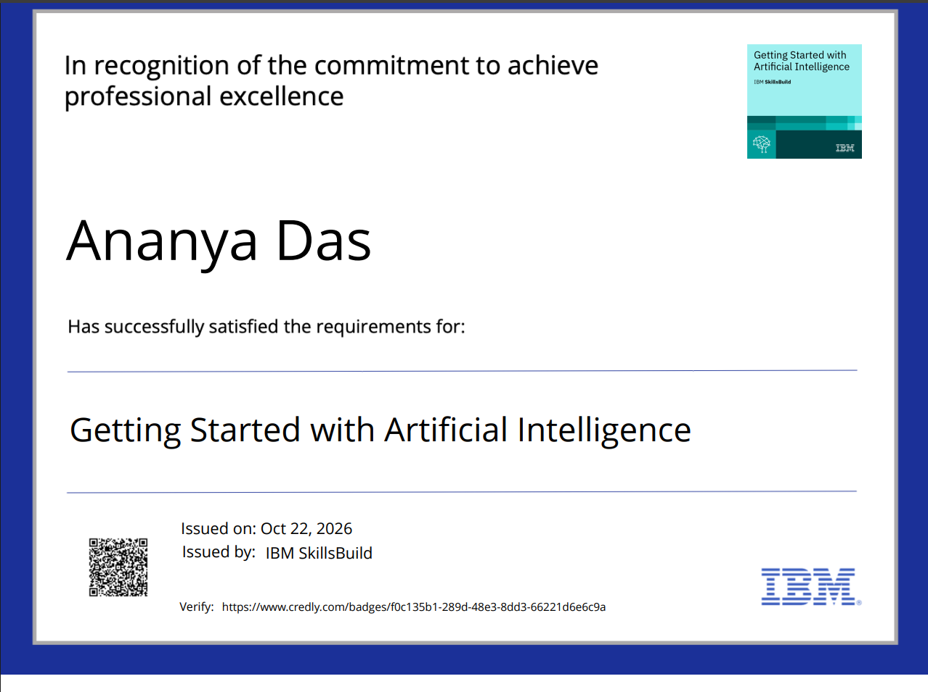
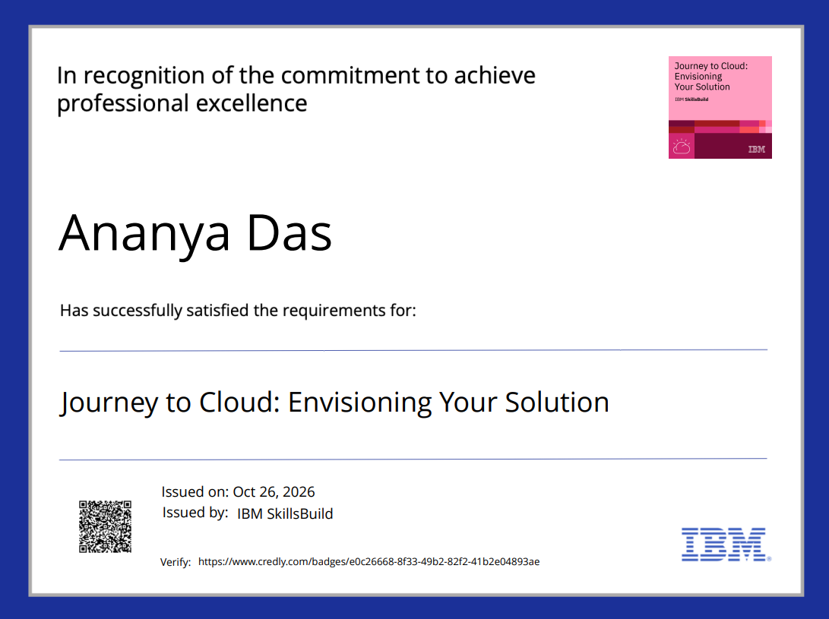
Certificates Earned:
Please add your credly certificate

Slide 15
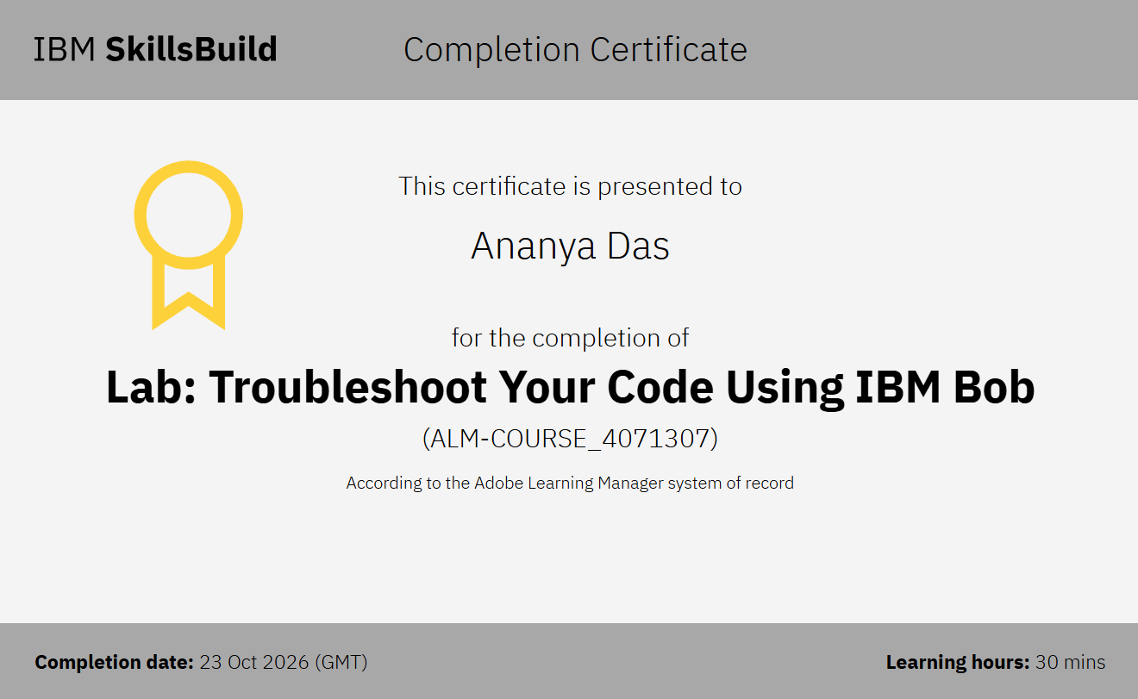
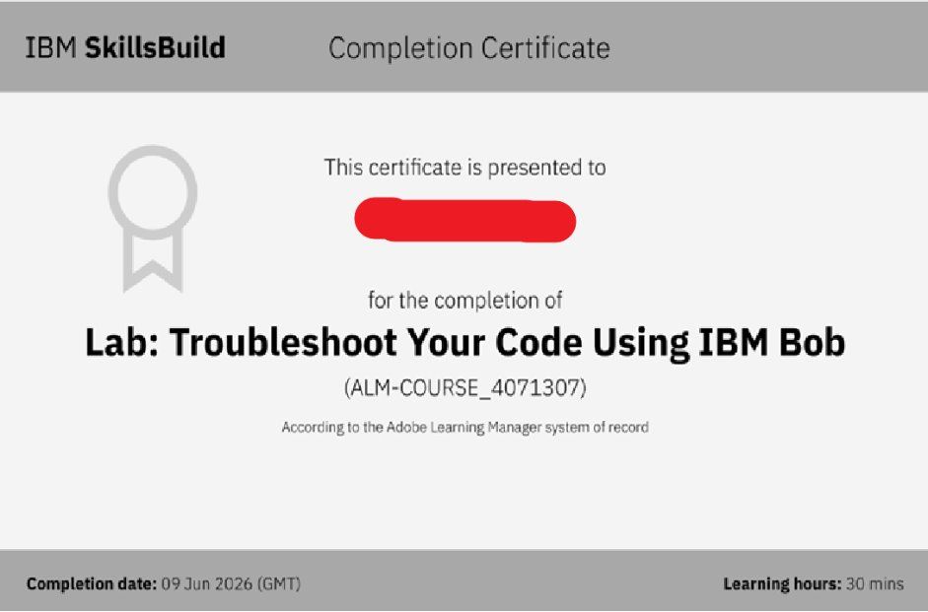
Certificates Earned:​
Add your IBM BOB Certificate

Slide 16


