Slide 1
Fused Decompression in Compiled GPU Engines
Ananya Gupta
Supervisor: Dr. Antonio Boffa
Adviser: Prof. Dr. Anastasia Ailamaki

Slide 2
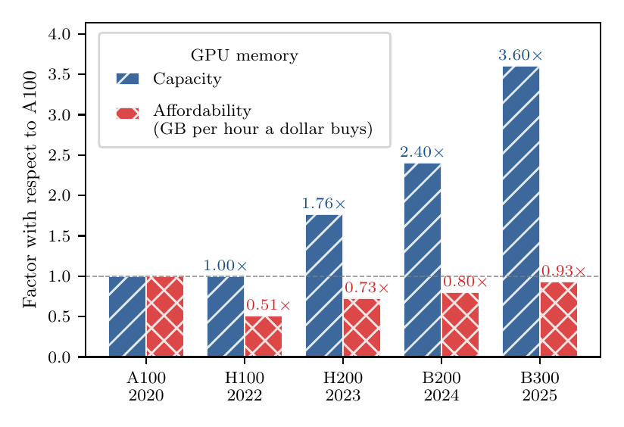
GPU-based Query engines show blazing fast performance
■ But only while the working set fits in HBM (High Bandwidth Memory).
■ Capacity is not getting cheaper!
■ GPUs are often shared among multiple processes.
Capacity grows; the memory a dollar buys does not.
Blazing fast yet cheap queries → Reduce HBM footprint

Slide 3
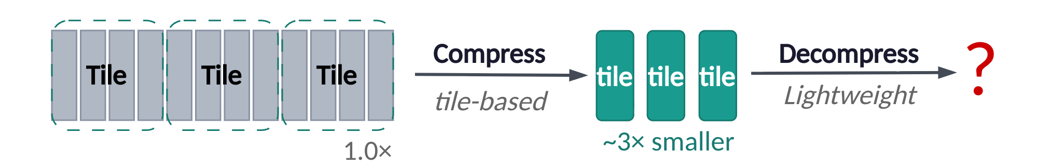
Promising way to reduce HBM footprint
Less data to move
Less data to store in GPU
1
Fewer bytes over PCIe / host→GPU transfer
Faster Data Movement
2
Smaller HBM footprint - more data can fit now
Tile Based Compression Methods (RFOR, Fastlanes etc.)
Compression is useful but where and how to decompress in compiled GPU engines?

Slide 4
Existing Solutions
Pre-decom: Decompress eagerly into HBM
Separate Decompression Kernel
Large HBM footprint
Extra round trip
✗ Wastes the very footprint and bandwidth it meant to save
Can a compiled GPU engine keep data compressed and decompress it within the fused kernel?

Slide 5

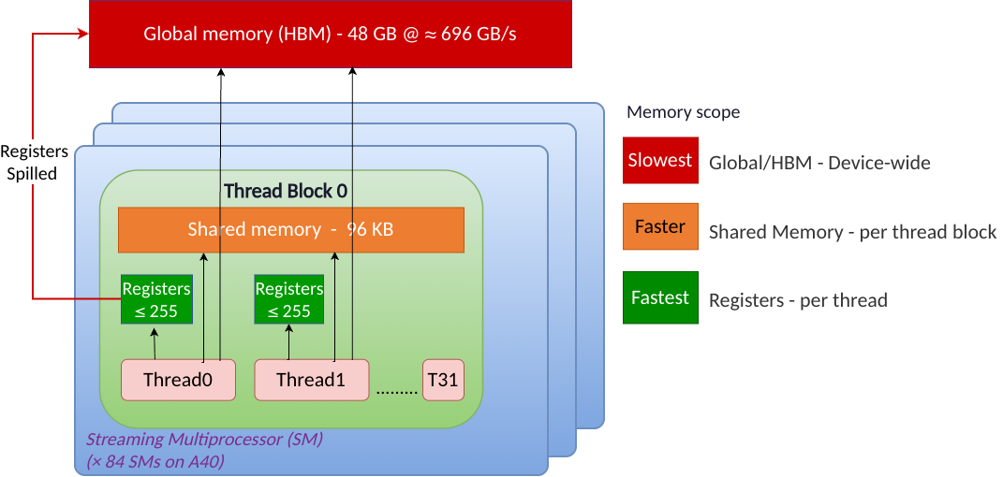
GPU Memory Hierarchy
Notes:
.

Slide 6
Decompression as a first-class citizen Operator
Configuration Knobs:
Decode Placement: Shared Memory/Registers
Threads/Tile Configuration: Tile size(T), Threads Count, Work per thread etc
2 Knobs decide the Fused Kernel performance (decompression plus query execution)

Slide 7
Tradeoffs with Fusion
✅ Reduces Global Memory footprint
✅ Saves the extra round trip to Global Memory
❌ Pressure on Global Memory ,but on Shared/Registers
❌ Single Kernel → Single configuration shared by both Decompression and query execution →Each thread does decompression and execution.
Fused Decompression Mixes the effects of decompression with query Execution

Slide 8
Main Questions
Is fused decompression always better? What are the costs/tradeoffs?
How to choose the best configuration for fused? Decode Placement, Tile Configuration

Slide 9
Setup
NVIDIA A40, 48 GB
Configuration space swept
Workload
(query) × (codec) × (placement) × (T, TPB, IPT)
Fastest config picked per (query, codec);
SSB, SF = 100
Queries
Q1.1 (no joins) → Q4.1 (join-heavy)
Codecs
Uncompressed · FLBP · RFOR
Profiling & Analysis Stack
Decode Placements
Baselines: Uncompressed, Pre-decom
Fused: shared, registers
■ NCU — Occupancy, Shared Memory, DRAM throughput
■ ptxas — register count and spills
■ Wall-clock — end to end execution time
Tile Configurations
T(tile size) · TPB(Threads Per Block) · IPT(Integers Per Thread)

Slide 10
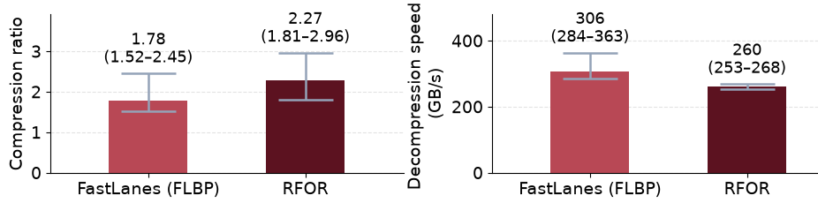
Codecs (Compression Methods)
Fastlanes | RFOR
FOR + bitpack | RLE + FOR + bitpack
Simpler but highly data parallel | Slightly heavy but higher compression ratio
Faster (Warp-parallel decode) | Slightly slower (Cooperative decode in Thread block)
Codecs Comparison
RFOR has higher compression ratio; FLBP decode is faster.

Slide 11
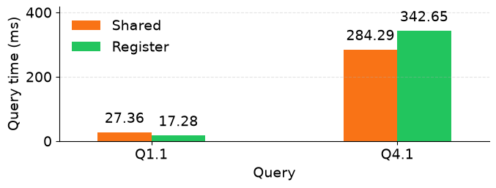
Decode Placement: Where to decompress?
Setup: FLBP, (BT,IPT)=(128,8)
Shared
Q1.1: 4 cols, 0 joins
Q4.1: 6 cols, 4 joins
Decompress into a shared-memory staging buffer
Pressure grows with the num of cols projected
Registers
No staging, Decompress straight into registers.
Pressure grows with num of cols AND Query complexity
Regs Spilled → Slowdown

Slide 12
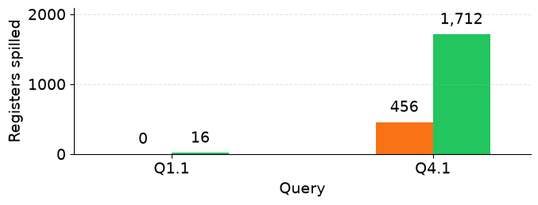
Decode Placement: Where to decompress?
Q1.1: 4 cols, 0 joins
Q4.1: 6 cols, 4 joins
Setup: FLBP, (BT,IPT)=(128,8)
Q1.1(Simple Scan): No spill risk→ Register wins
Q4.1(Join Heavy): Already high reg count → decode in reg, adds to the spill→ slowdown
Register wins in narrow/simple Queries until complexity overflows registers. Then Shared’s staging buffer pays off.

Slide 13
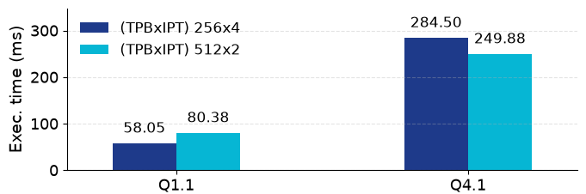

Tile Configuration: Work Per Thread
Setup: RFOR, shared, Tile Size T= 1024
Q1.1: 4 cols, 0 joins
Q4.1: 6 cols, 4 joins
T = TPB X IPT
Fixed chunk size
(Tile-Size)
Thread count
(Threads Per Block)
Work Per Thread
(Int Per Thread)

Slide 14
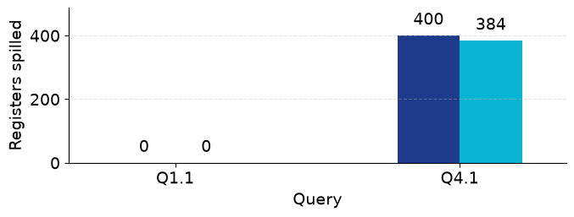
Tile Configuration: Work Per Thread
Q1.1: 4 cols, 0 joins
Q4.1: 6 cols, 4 joins
Setup: RFOR, shared, Tile Size T= 1024
Q1.1(Simple Scan): Zero Spill anyways→ High IPT is a free lunch.
Q4.1(Join Heavy): Already high reg count → high IPT, Causes more reg spills → slowdown
High work-per-thread is free lunch on simple queries but causes slowdown for complex queries

Slide 15
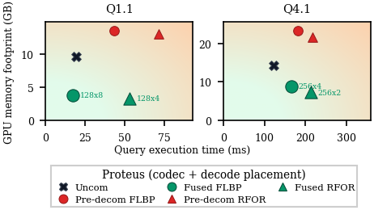
Query Execution time VS Memory Footprint
Fused sits bottom-left — lowest memory footprint AND faster/comparable speed.
Pre-decom sits top-right — high memory use AND slower.
Speed: FLBP wins (faster decode)
Footprint: RFOR wins (better compression)
Fused decompression beats pre-decom on memory with equal or faster query speed

Slide 16
Conclusion
Q1 Is fused decompression always better?
→ Yes. Smaller memory footprint, equal or faster query speed.
Q2 How to choose the best configuration?
→ No single winner. Depends on the query.
Use Register for simple scans │ Use Shared when joins dominate.
Future Work
Workload-aware Fusion - Dynamically select of decode placement and tile configuration from query shape and workload
More codecs – Extending support to Floats, strings and other datatypes

Slide 17
Thank you
Questions?
Ananya Gupta

