Slide 1
Task:2
Scan Vulnerabilities using Netsparker

Slide 2
STEPS TO BE FOLLOWED:-
STEP 1: OPEN VIRTUAL BOX AND LOGIN TO LINUX STEP 2: OPEN A VIRTUAL BANK WEBSITE , for example --http://zero.webappsecurity.com STEP 3: OPEN NETSPARKER , IF IT IS NOT AVAILABLE YOU CAN DO THIS USING OWASP ZAP APP FOR VULNERABILITY FINDING STEP 4: OPEN OWASP ZAP THEN GIVE THE DETAILS OF THE WEBSITE EITHER THE URL OR IP ADDRESS STEP 5: THEN START ATTACKING STEP 6: U CAN SEE THE PROCESS , AFTER THE COMPLETION CLICK ON REPORT THEN SAVE IT AS .html FILE NOW THE REQUIRED REPORT IS SAVED STEP 7 : IN THE REPORT ,ALL THE REQUIRED WILL BE OBTAINED like., vulnerabilities ,url’s and the solution

Slide 3
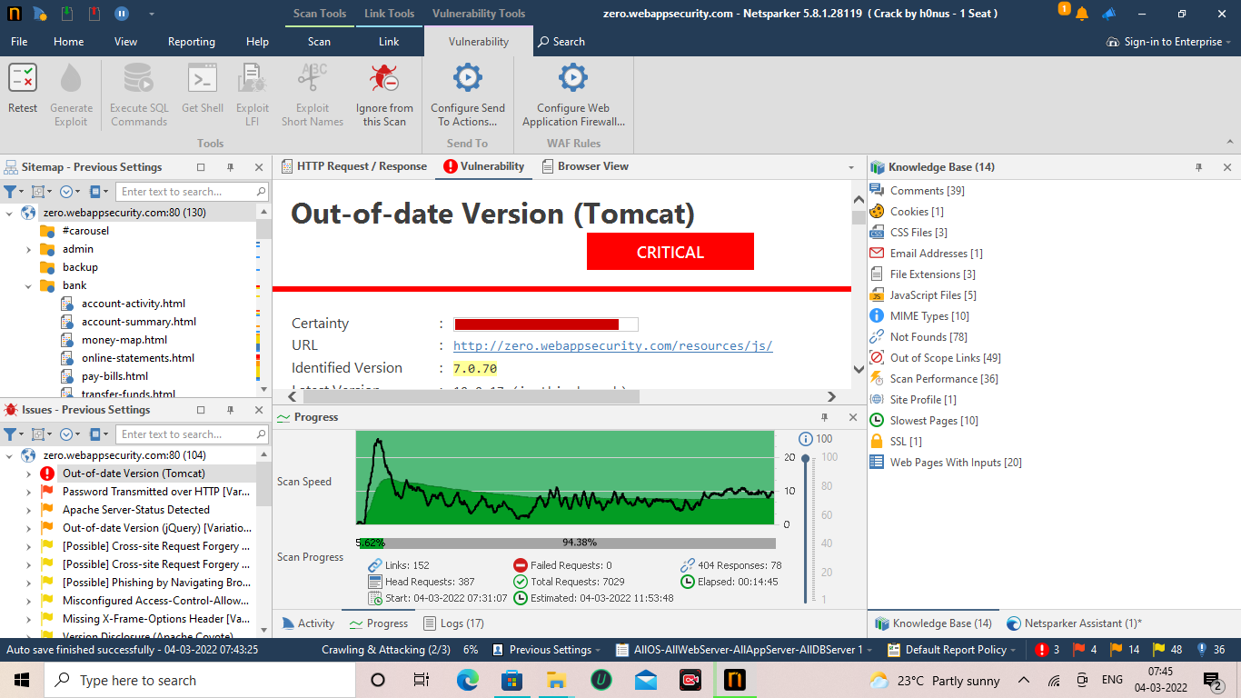

Slide 4
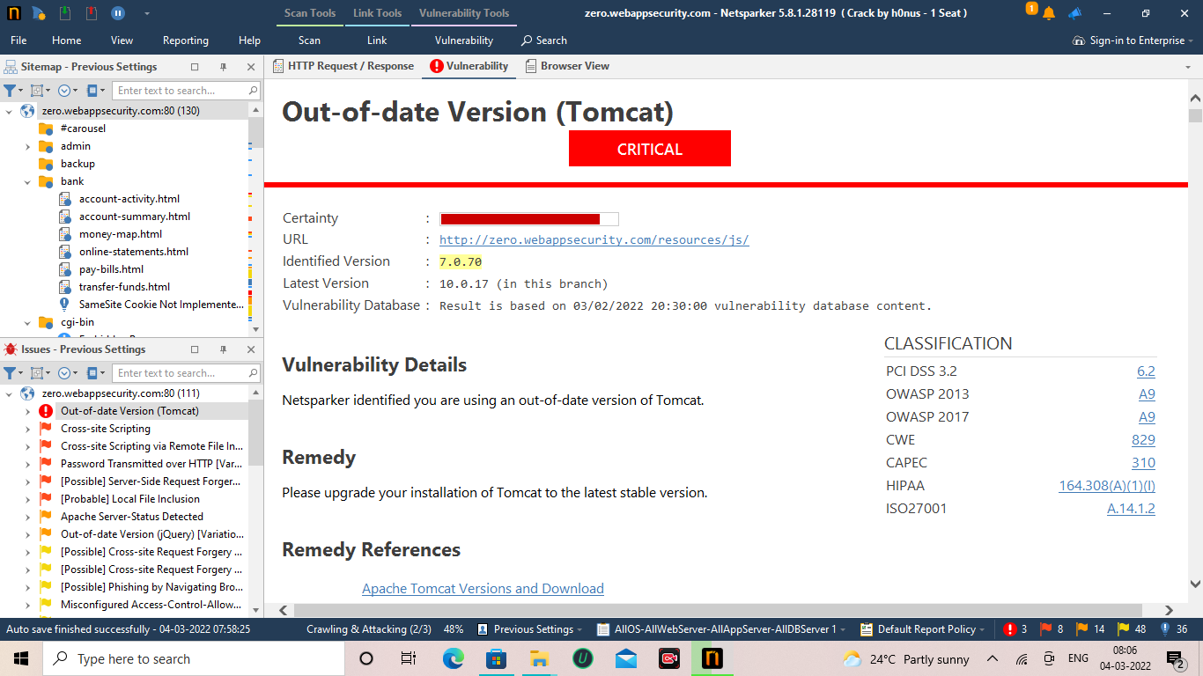

Slide 5
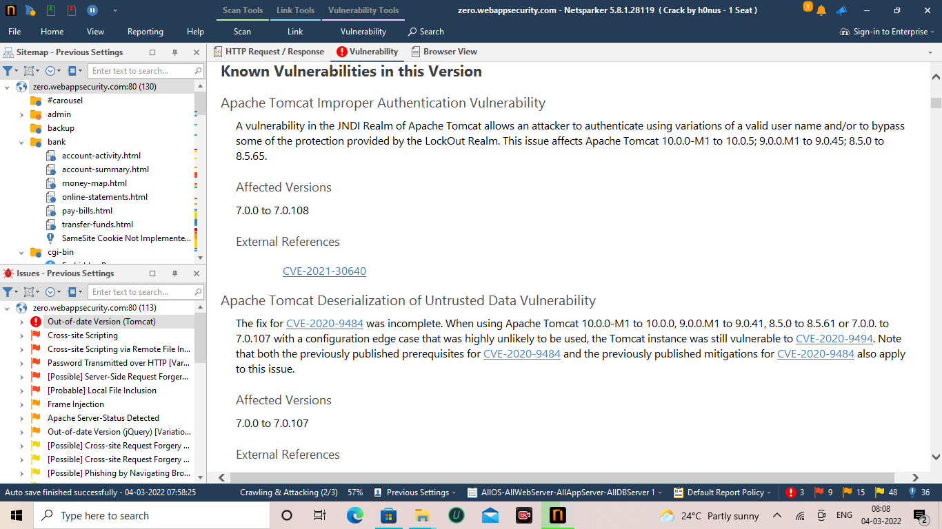


Slide 6
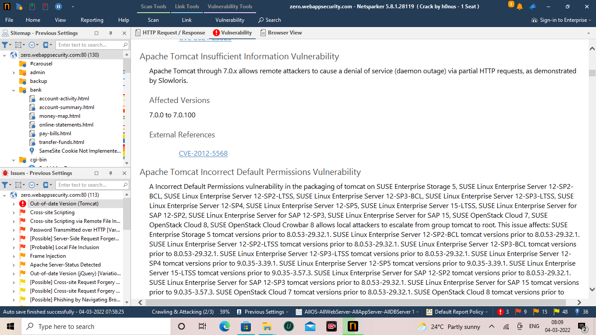

Slide 7
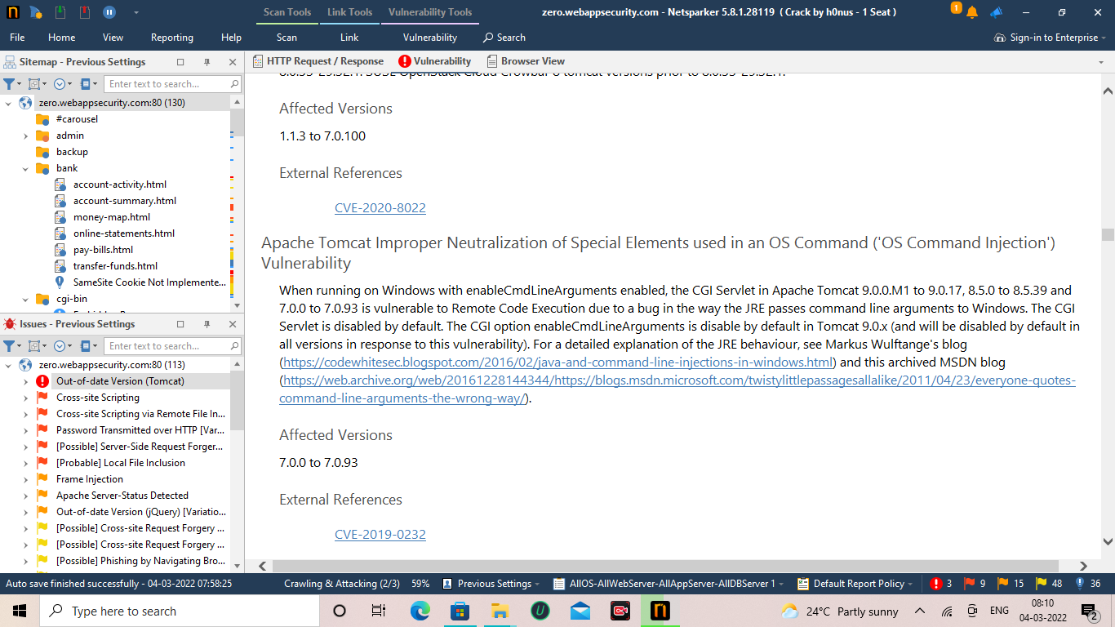

Slide 8
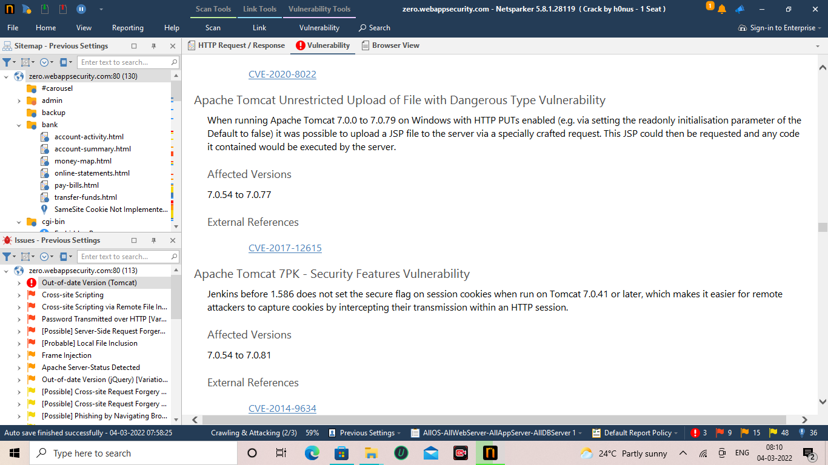

Slide 9
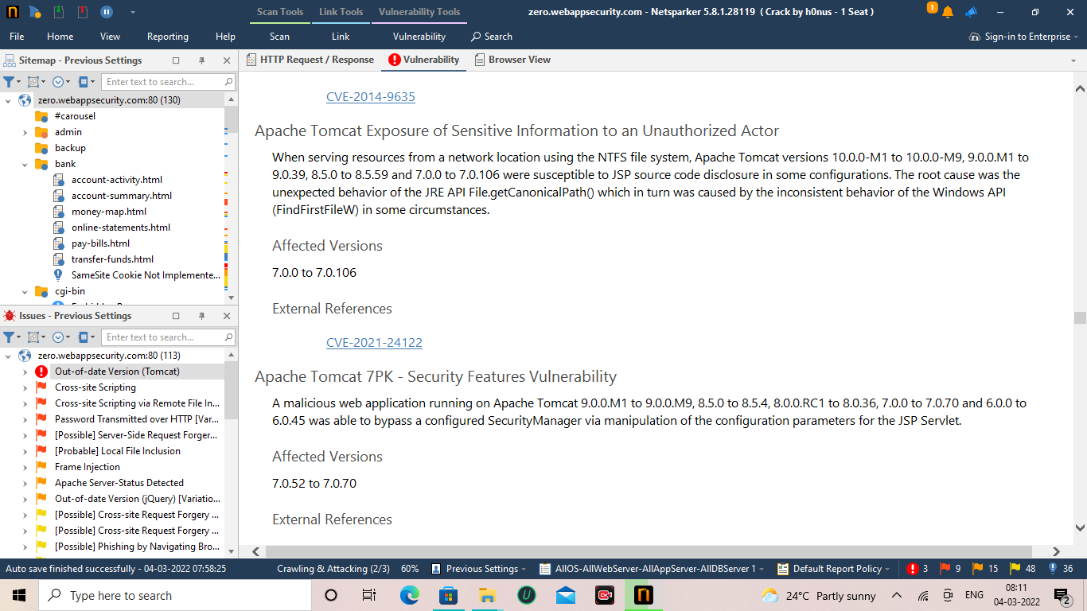

Slide 10
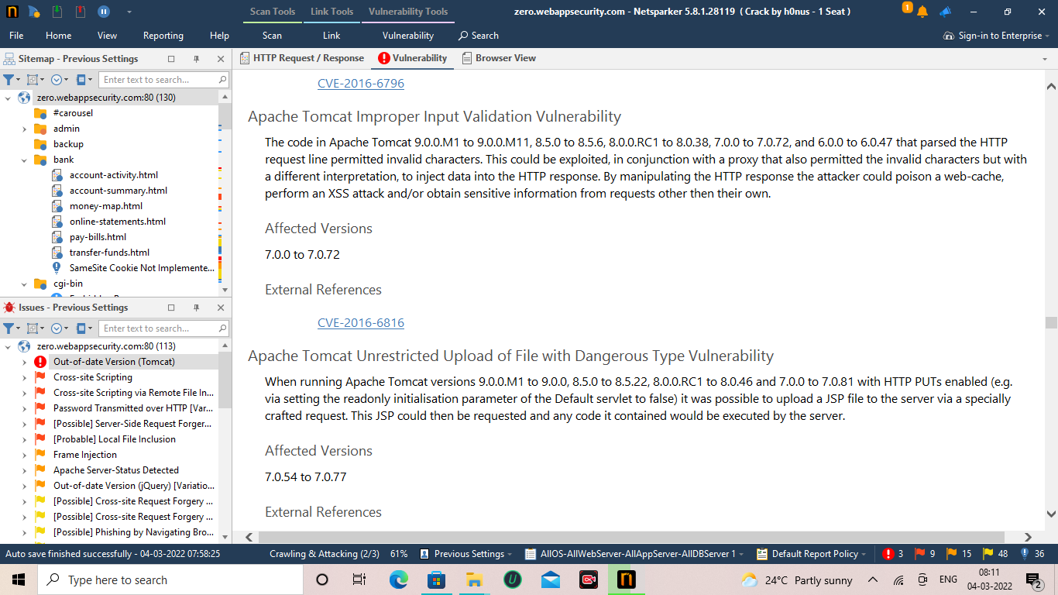

Slide 11
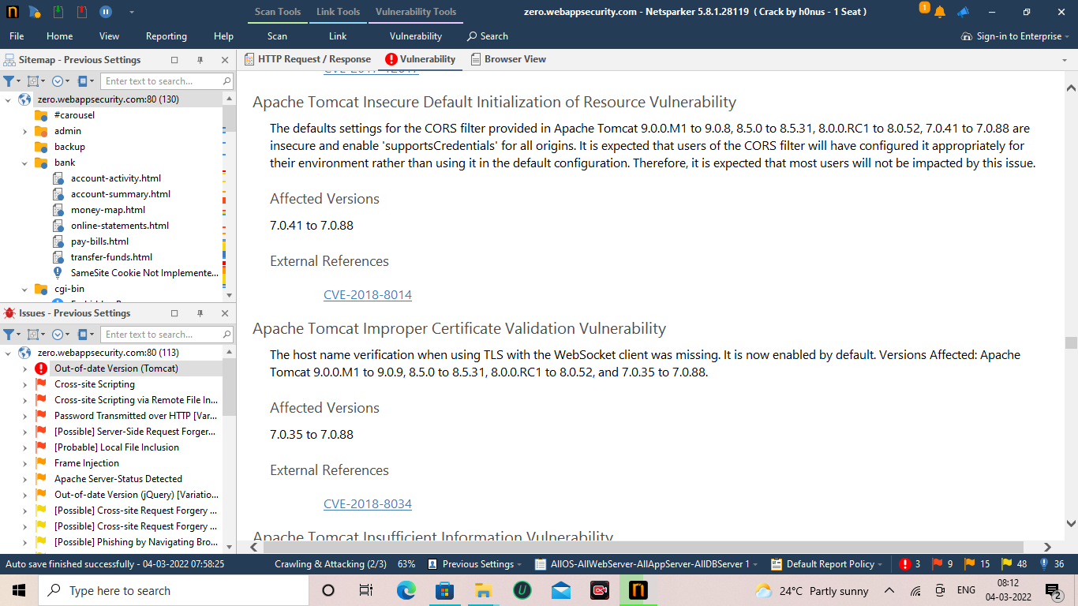

Slide 12
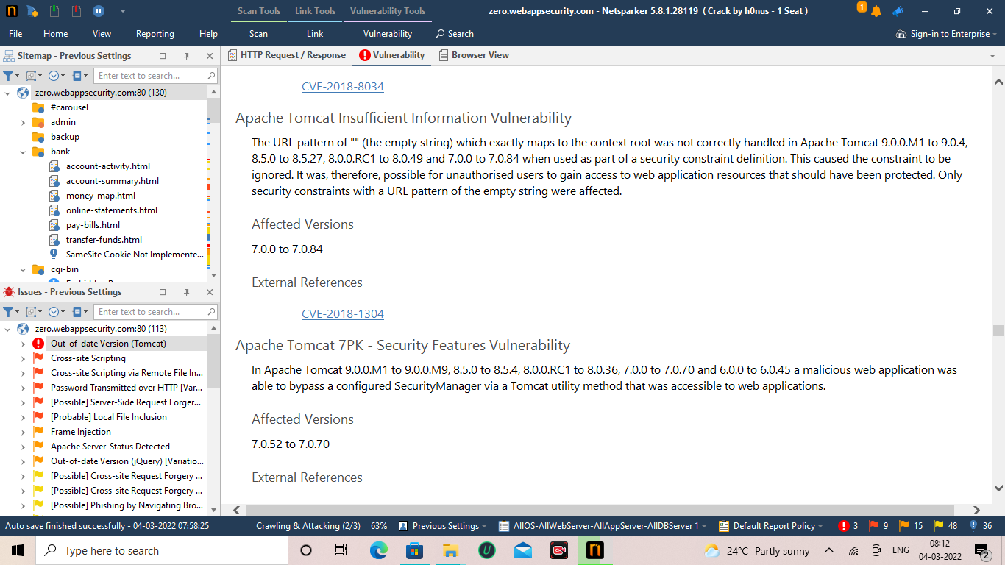

Slide 13
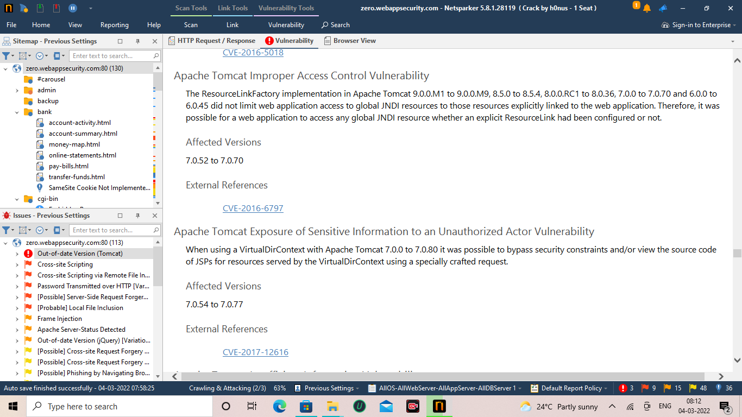

Slide 14
