Slide 1

DevCheckpoint
A memory layer for developer workflow
Git saves your code.
DevCheckpoint saves your working context.
Track 3 • Workflow & Context Management
Pitch Deck

Slide 2

The Problem
Developers do not only lose time writing code. They lose time rebuilding context.
What was I doing?
What did I change?
What broke?
Which files matter?
What should I do next?
This context usually lives in memory, terminal history, browser tabs, and unfinished experiments.
DevCheckpoint
02

Slide 3
Why GitHub is not enough
GitHub is excellent for code history. But it does not capture the full working story.
GitHub / Git remembers
DevCheckpoint remembers
commits and code diff
the task and intent
changed files and branches
errors and commands tried
pull requests and comments
failed experiments and reasoning
final history after work is saved
clear next step to resume
Code history → Working memory
DevCheckpoint
03

Slide 4
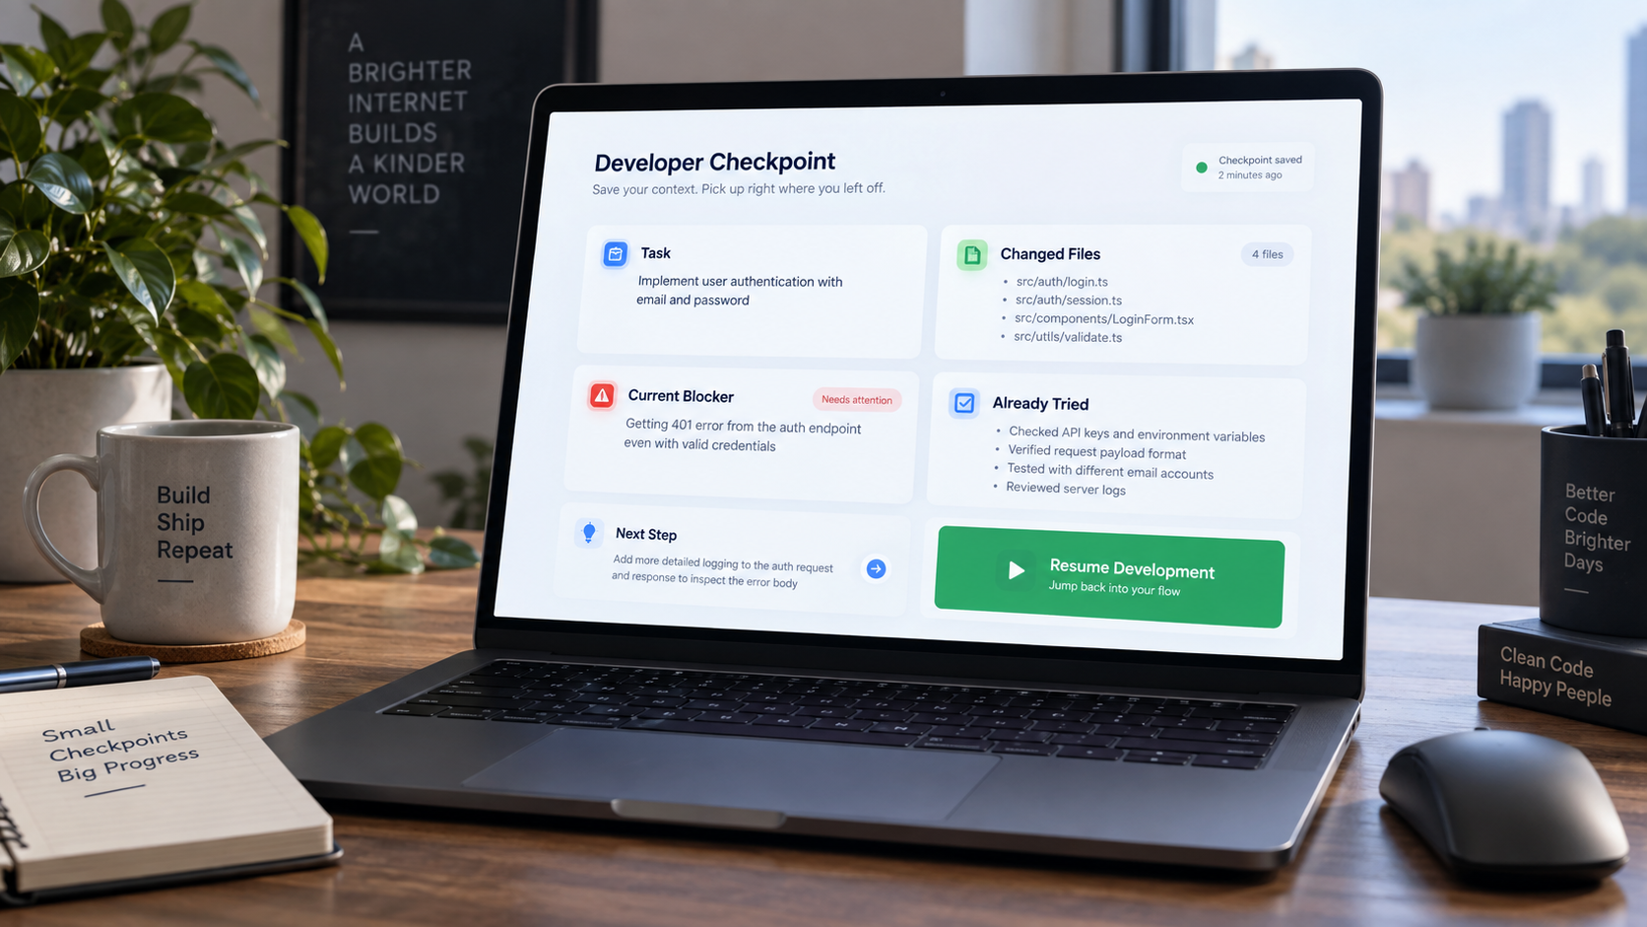
The Solution
DevCheckpoint creates smart save-points for programming tasks.
One checkpoint includes
Task: what the developer is trying to solve
Files: changed and relevant files
Errors: terminal logs, failed tests, blockers
Attempts: what was already tried
Next Step: what to do when returning
Result: resume work without rebuilding context.
DevCheckpoint
04

Slide 5
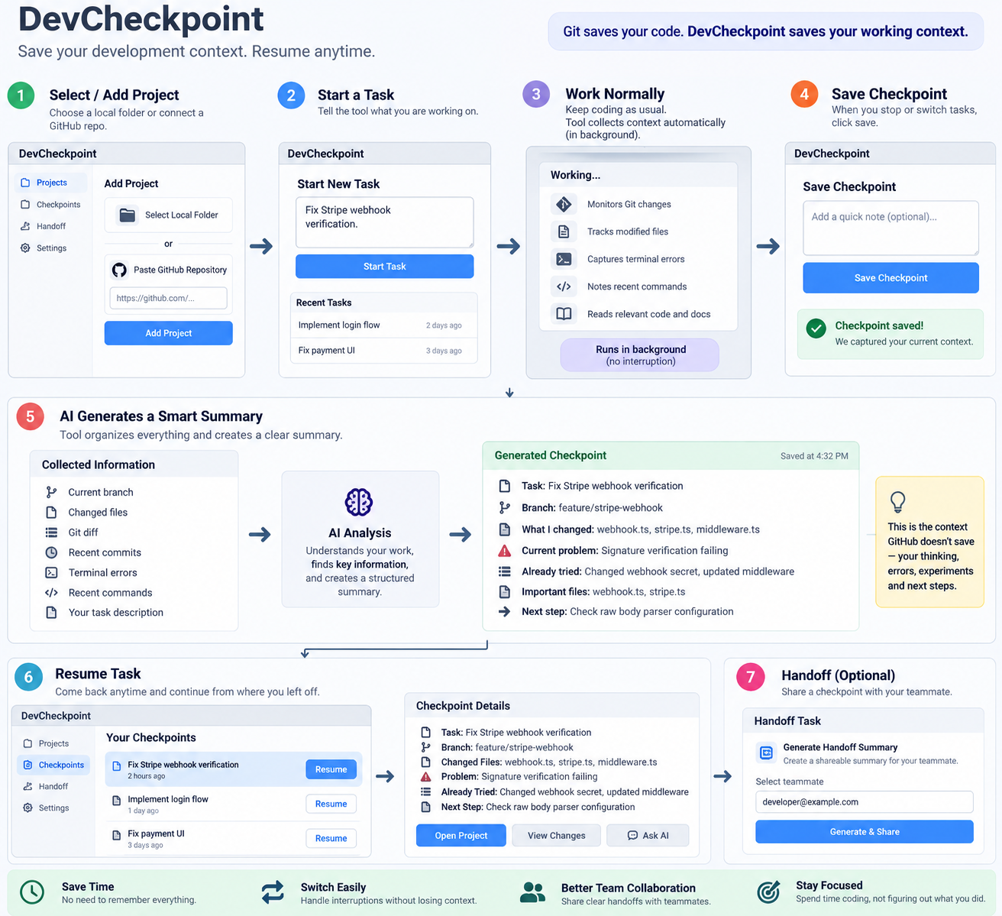
How It Works
A simple flow developers can understand in one minute.
DevCheckpoint
05

Slide 6
Core MVP Features
Small enough to build in a hackathon. Useful enough to demo clearly.
1
Start Task
2
Save Checkpoint
3
AI Summary
Describe what you are working on before coding.
Collect branch, diff, files, commands, errors and notes.
Turn raw developer activity into a clean working summary.
4
Resume Task
5
Handoff
Return later and instantly know where to continue.
Share a clear task summary with another developer.
DevCheckpoint
06

Slide 7
Demo Scenario
A developer is fixing a Stripe webhook bug, gets interrupted, then resumes later in seconds.
1
Start task
“Fix Stripe webhook verification.”
2
Work normally
Modify files, run commands, see errors.
3
Save checkpoint
AI summarizes problem, attempts and next step.
4
Resume later
Open checkpoint and continue immediately.
Pitch moment: “Git saves the change. DevCheckpoint saves why the change exists.”

Slide 8
How It Stands Out
It does not compete with existing tools. It connects the missing context between them.
GitHub
Copilot / Cursor
DevCheckpoint
Stores code history, commits, branches and PRs.
Helps generate and edit code inside the IDE.
Stores task memory across Git, terminal, errors, notes and AI summaries.
Does not capture thinking, failed attempts or next steps.
Often needs the developer to explain current context again.
Built for pause, switch, resume and handoff.
Simple difference: not code generation, but workflow memory.
DevCheckpoint
08

Slide 9
MVP Build Plan
The first version can be built quickly with normal web app tools and an LLM.
Next.js
Node / FastAPI
SQLite
Qwen / OpenAI
Frontend
Backend
Storage
AI Summary
Inputs captured
Outputs generated
task description and developer notes
clean checkpoint summary
Git branch, status, diff and changed files
resume view with next step
terminal errors, recent commands and tests
shareable developer handoff
DevCheckpoint
09

Slide 10
Why it matters
Save time
No need to rebuild context every time.
Switch faster
Move between bugs, features and projects safely.
Collaborate better
Hand off work without long explanations.
Stay focused
Spend more time coding, less time remembering.
DevCheckpoint: save your development context, resume anytime.
Thank you

