Slide 1
CONTINUUM CROWD DYNAMICS
Room Evacuation Problem
UGP Presentation
Ananya Narayani

Slide 2
Introduction
Room evacuation studies the movement of a crowd from an enclosed space through available exits.
Evacuation efficiency depends on factors such as crowd density, pedestrian movement and exit configuration.
At high densities, pedestrian interactions can lead to congestion and slower evacuation.
A continuum crowd model can represent the crowd through its density and velocity fields, providing a computationally efficient way to study large crowds.
The present work focuses on applying this framework to a room evacuation problem and investigating the effect of multiple exits on evacuation time.
3

Slide 3
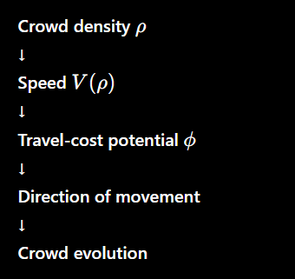
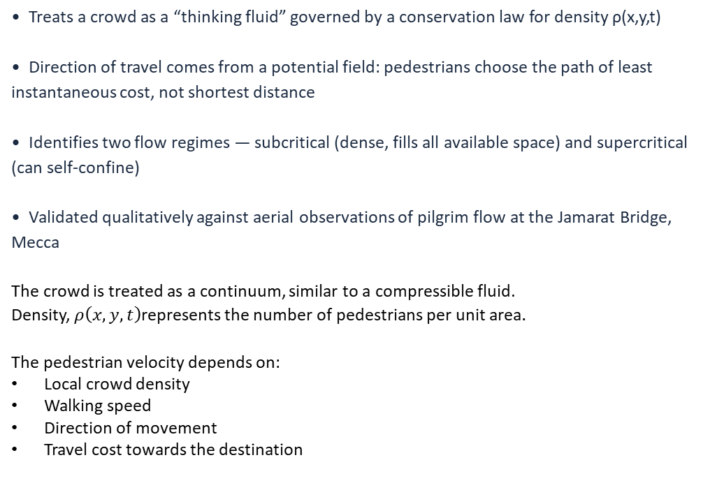
PAPER 1
Hughes' continuum theory of pedestrian flow
Hughes, R. L. (2002). A continuum theory for the flow of pedestrians. Transportation Research Part B: Methodological, 36(6), 507–535.
• Treats a crowd as a “thinking fluid” governed by a conservation law for density ρ(x,y,t)
• Direction of travel comes from a potential field: pedestrians choose the path of least instantaneous cost, not shortest distance
• Identifies two flow regimes — subcritical (dense, fills all available space) and supercritical (can self-confine)
• Validated qualitatively against aerial observations of pilgrim flow at the Jamarat Bridge, Mecca
The crowd is treated as a continuum, similar to a compressible fluid.
Density, $ρ\left(x , y , t\right)$represents the number of pedestrians per unit area.
The pedestrian velocity depends on:
Local crowd density
Walking speed
Direction of movement
Travel cost towards the destination
3

Slide 4
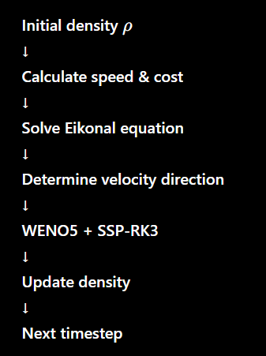
PAPER 2
An efficient solution algorithm for Hughes' model
Huang, L., Wong, S. C., Zhang, M., Shu, C.-W., & Lam, W. H. K. (2009). Revisiting Hughes’ dynamic continuum model for pedestrian flow and the development of an efficient solution algorithm. Transportation Research Part B: Methodological, 43(1), 127–141.
• Reformulates Hughes’ model and connects it to reactive dynamic user equilibrium: each pedestrian minimizes their own instantaneous travel cost
• Proposes a concrete numerical scheme: WENO for the conservation law + Fast Sweeping Method for the Eikonal (potential) equation
• Demonstrates the algorithm on a numerical benchmark — a corridor with an obstacle, two exits, and a time-varying inflow pulse
Continuum Crowd Dynamics — UGP Progress
4

Slide 5
THE MODEL
Governing equations
CONSERVATION LAW
SPEED LAW
∂ρ/∂t + ∇·(ρv) = 0
v(ρ) = 2 (1 − ρ/10)
Density ρ(x,y,t) is neither created nor destroyed — it only redistributes through the velocity field v.
Walking speed falls off linearly with local density, reaching zero at the maximum packing density.
EIKONAL EQUATION
COST FUNCTION
|∇φ| = cost(ρ)
cost = 1/v(ρ) + discomfort(ρ)
φ is a travel-cost potential toward the nearest exit; pedestrians always move down its steepest gradient.
Combines slowdown from crowding with an explicit “crowding penalty” that discourages dense regions.
5

Slide 6
THE MODEL
Numerical method: two coupled solves per timestep
1. Compute fields
2. Solve Eikonal eqn.
3. Get velocity field
speed(ρ), discomfort(ρ), cost(ρ) from current density
1st-order Godunov fast sweep → refined by high-order WENO fast sweep
v = speed · (−∇φ / |∇φ|), CFL-based adaptive Δt
4. WENO5 flux (space)
5. SSP-RK3 (time)
6. Boundary + repeat
5-point reconstruction with Lax–Friedrichs flux splitting at each cell face
3-stage strong-stability-preserving Runge–Kutta update for ρ
Apply exit/wall boundary conditions, extrapolate ghost cells, advance t
6

Slide 7
VALIDATION
Benchmark problem: reproducing Huang et al. (2009)
• Domain: 100m × 50m corridor, zero initial density
• One rectangular obstacle placed centrally, blocking the direct path
• Two exits on the right wall
• Unsteady inflow at the left wall: ramps up for 60s, back down over the next 60s, then stops — modelling a pulse of arriving pedestrians
Exit 1
Obstacle
IN
Exit 2
Pedestrian inflow enters at the left wall (pulse, t = 0–120s) • Exits on the right wall
100m × 50m corridor
7

Slide 8
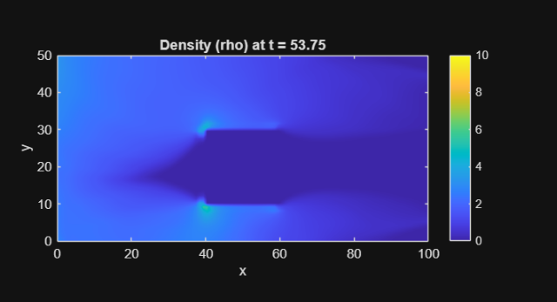
VALIDATION
Benchmark problem: reproducing Huang et al. (2009)
Observation:
The crowd flow splits around the central obstacle and converges towards the available exits
IN
Pedestrian inflow enters at the left wall (pulse, t = 0–120s) • Exits on the right wall
100m × 50m corridor
7

Slide 9
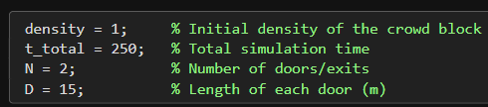
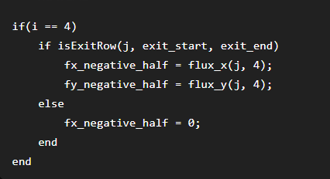

NEW SCENARIO
Extending the model: single-room evacuation
• Room: 100m × 100m, initially empty
• Crowd occupies the right half (100m × 50m block) at a chosen density
• N equally-spaced exits of width D on the left wall
• Problem: How does evacuation time change as N (number of doors) varies?
Make a final graph with total evacuation time with number of doors
With the solver validated, I moved to a second, practically-motivated scenario: how many exits does a room need to evacuate quickly?
Crowd block
(100m × 50m)
100m × 100m room
N doors, width D,
equally spaced
9

Slide 10
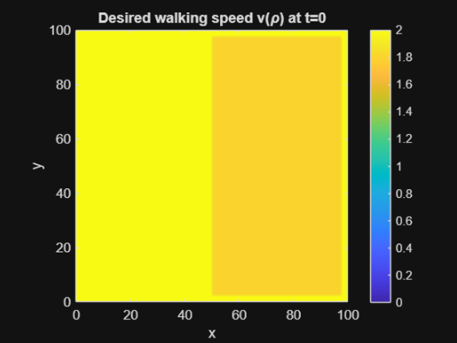
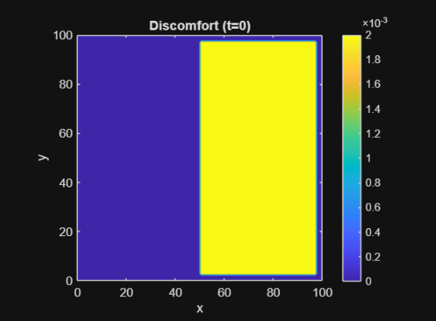
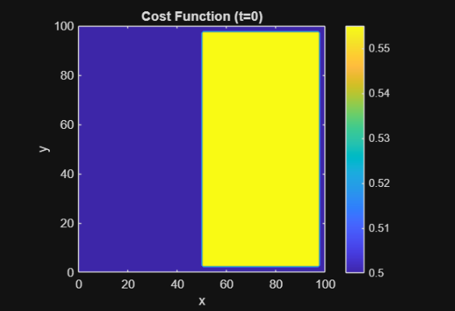
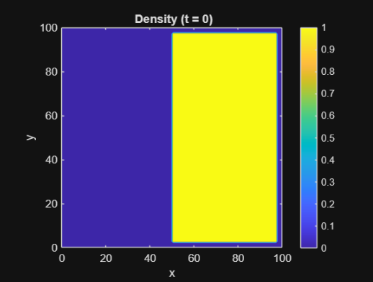
Parameters:

Slide 11
DESIGN CONSTRAINTS
What bounds the range of N tested?
NO-CHOKING CONDITION
GEOMETRIC FIT CONDITION
N · D · 5 ≥ 100 · ρ
N · D ≤ wall length
Total exit throughput (doors × width × max flux) must meet or exceed crowd demand — otherwise density piles up faster than doors can drain it.
The doors must physically fit along the wall without overlapping — the code enforces this and errors out if violated.
With D = 15m, ρ = 1: this requires N ≥ 2 — which is why the sweep starts at N = 2, not N = 1.
With D = 15m on a 100m wall: N ≤ 6 — which sets the upper end of the sweep.
Continuum Crowd Dynamics — UGP Progress
11

Slide 12
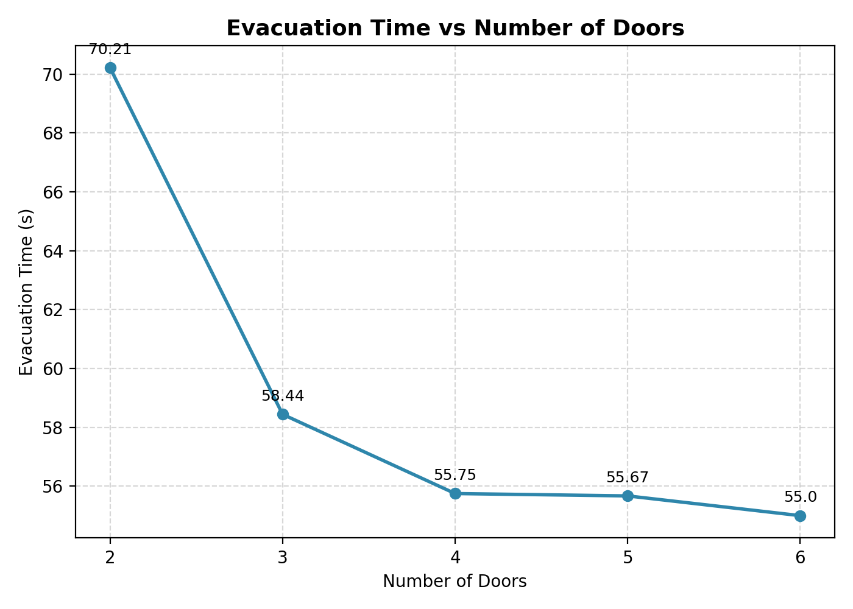
RESULTS
Evacuation time vs. number of doors
Observations:
Total evacuation time is decreasing with increasing the number of doors.
N_doors EvacTime_s
2 70.21
3 58.44
4 55.75
5 55.67
6 55.00
12

Slide 13
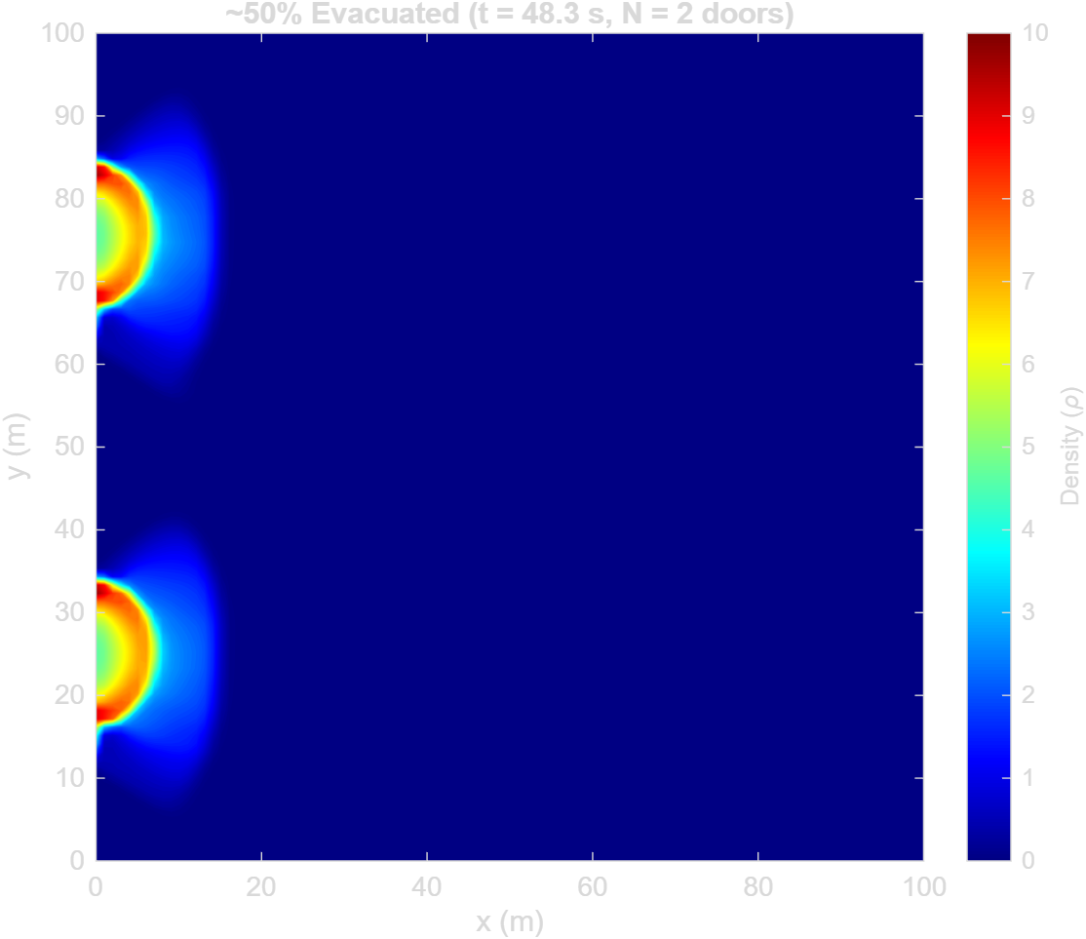
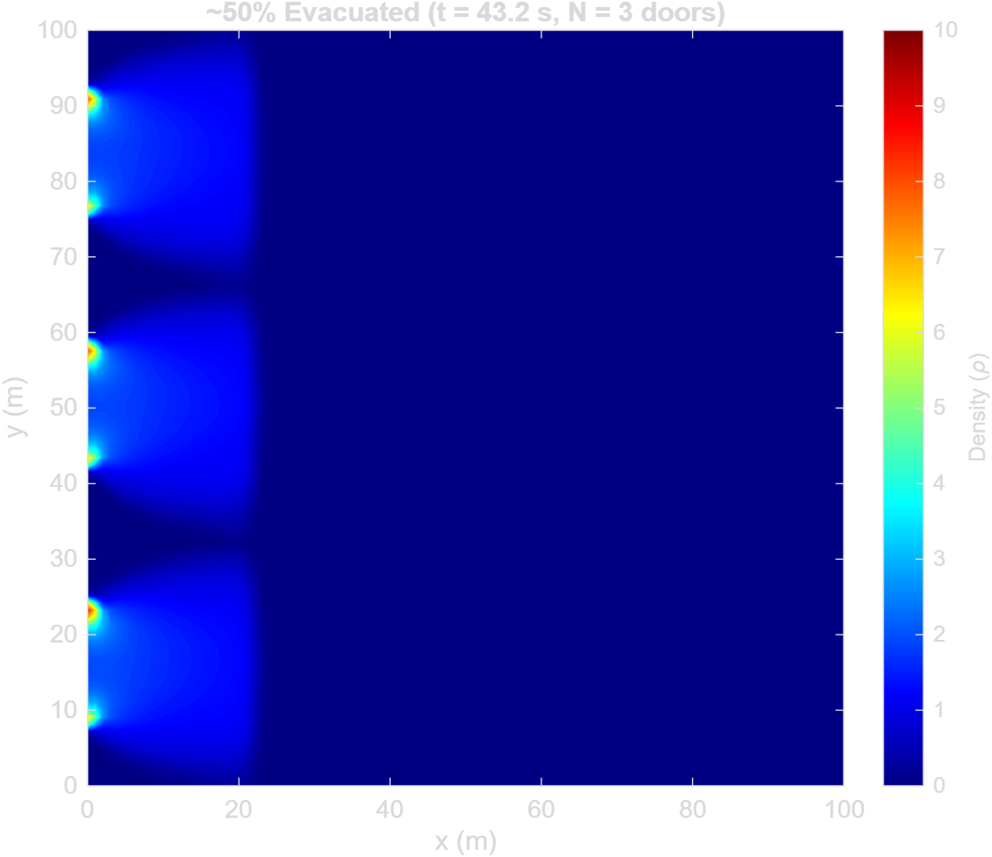
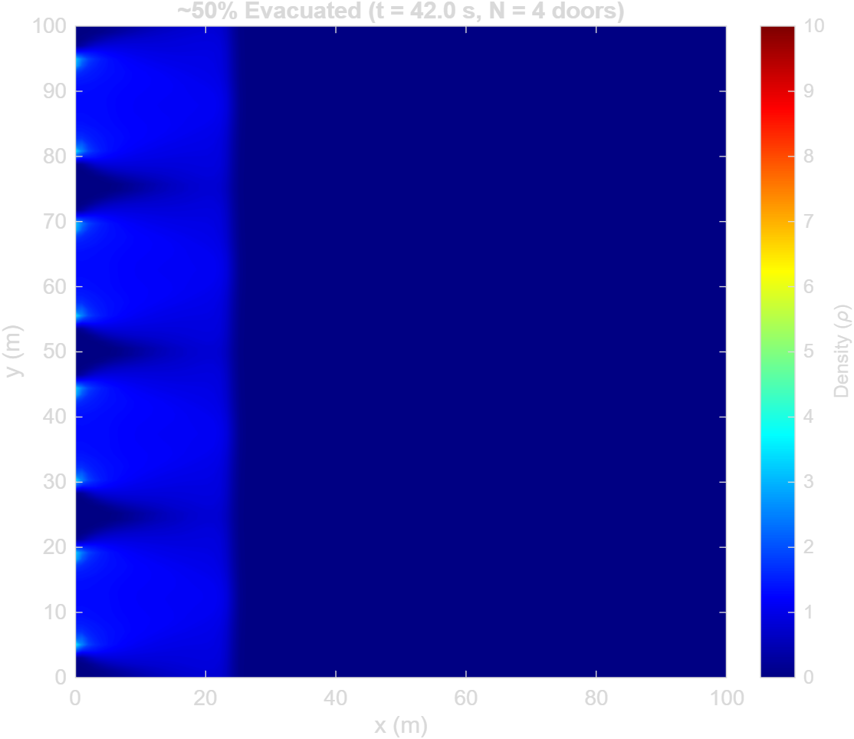
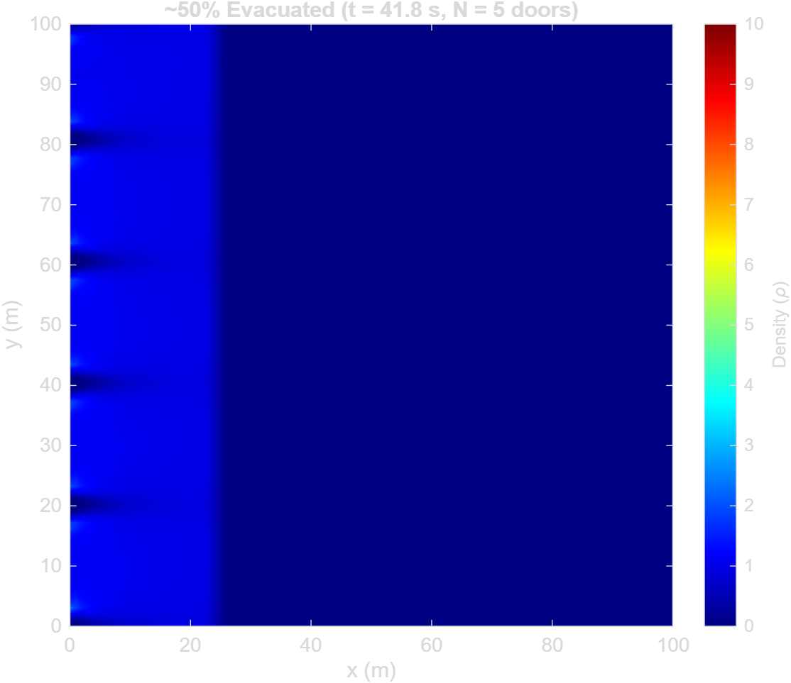
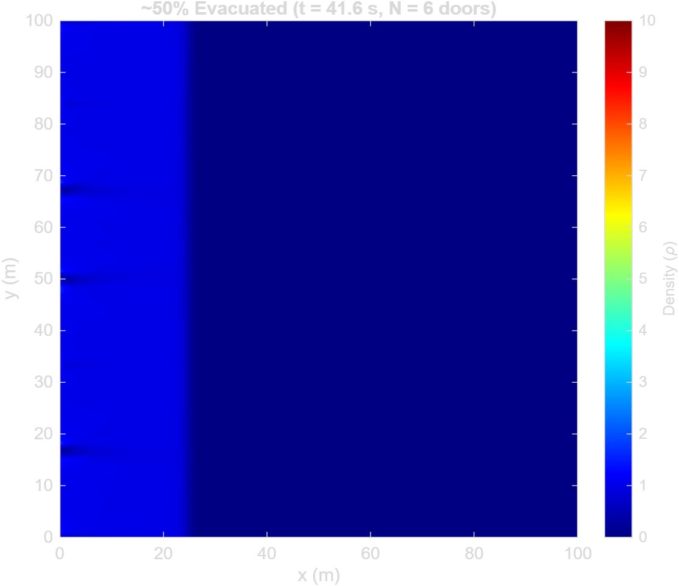
RESULTS
Density state, by number of doors
N = 2
N = 3
N = 4
N = 5
N = 6
13

Slide 14
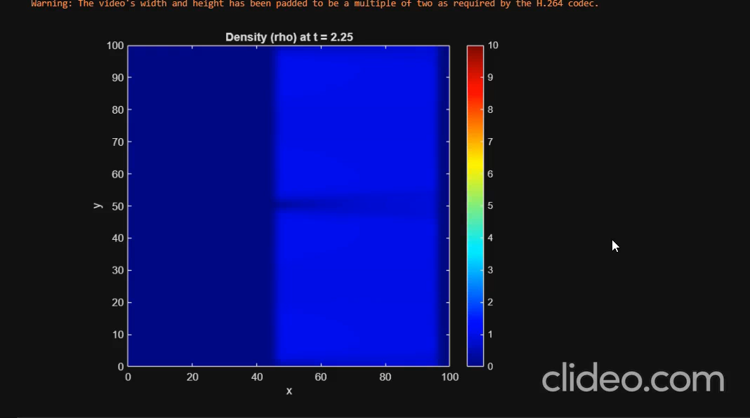
RESULTS
Simulation for N=2
13

Slide 15
Future Work
Study the effect of different crowd densities on evacuation time.
Vary the door width and analyze its influence on evacuation efficiency.
Induce some obstacles in between the room
Perform simulations with a different number of doors.
Calculate the total evacuation time for each door configuration.
Plot Evacuation Time vs. Number of Doors to study the effect of increasing exits.
Compare the results for different densities and door widths to identify their influence on evacuation performance.
Analyze the effectiveness of additional exits and identify the point beyond which adding more doors provides limited improvement.
15

Slide 16
REFERENCES
References
[1]
Hughes, R. L. (2002). A continuum theory for the flow of pedestrians. Transportation Research Part B: Methodological, 36(6), 507–535.
[2]
Huang, L., Wong, S. C., Zhang, M., Shu, C.-W., & Lam, W. H. K. (2009). Revisiting Hughes’ dynamic continuum model for pedestrian flow and the development of an efficient solution algorithm. Transportation Research Part B: Methodological, 43(1), 127–141.
15

Slide 17
Thank you

