Slide 1
ParkPulse AI
Parking records
2,98,450
Parking Congestion Intelligence for Bengaluru
Transforms illegal-parking violation records into ranked enforcement zones, daily deployment plans, live simulation, and explainable congestion impact scores.
Hotspot cells
8,972
Priority units
3
Flipkart Gridlock Hackathon | Poor Visibility on Parking-Induced Congestion
01

Slide 2
PARKPULSE AI
Why Parking Visibility Fails Today
Illegal parking blocks carriageways near markets, metro stations, junctions, and commercial corridors.
Problem Direction
Patrol-led enforcement often sees symptoms only after congestion has already formed.
Violation counts alone do not reveal which locations create the highest traffic-flow impact.
Detect illegal parking hotspots and quantify their impact on traffic flow to enable targeted enforcement.
Police teams need a ranked view of where to deploy, when to deploy, and what action to take.
Flipkart Gridlock Hackathon | Poor Visibility on Parking-Induced Congestion
02

Slide 3
PARKPULSE AI
Data-Backed Hotspot Intelligence
Impact Score Inputs
Violation density
Road-obstruction severity
Peak-hour recurrence
Junction proximity
Evidence confidence
Flipkart Gridlock Hackathon | Poor Visibility on Parking-Induced Congestion
03

Slide 4
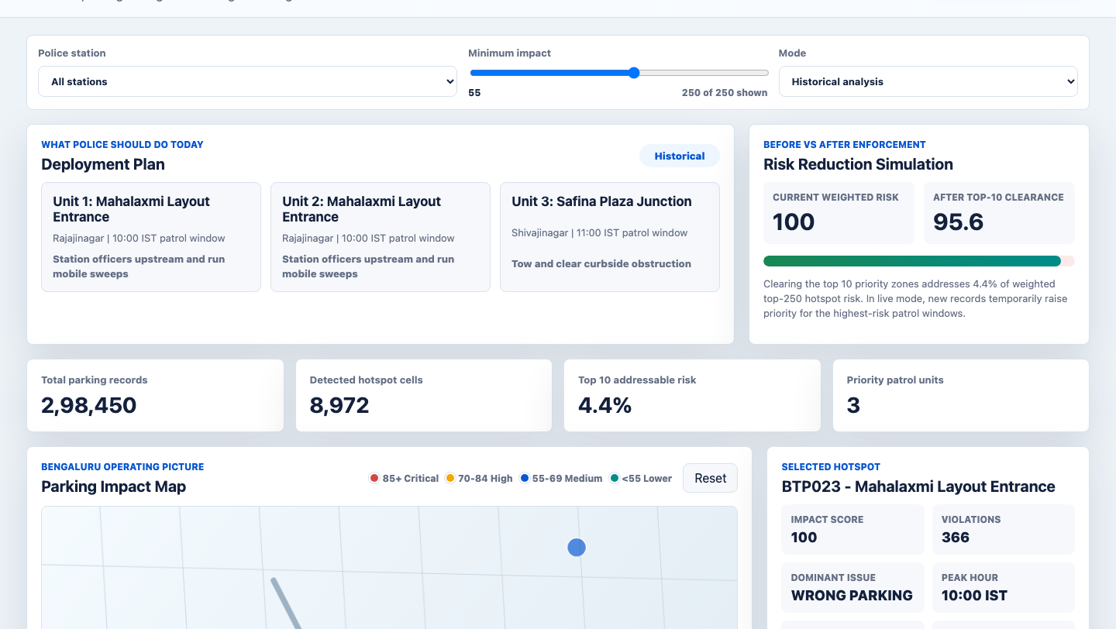
PARKPULSE AI
Prototype: Operational Command Center
What reviewers can test
Filter by station, switch live mode, click hotspots, inspect the score, and view the deployment plan.
Top detected zone
Mahalaxmi Layout Entrance: 366 records, impact score 100.
New: before/after risk, daily patrol plan, score explainability, and live mode are visible.
Flipkart Gridlock Hackathon | Poor Visibility on Parking-Induced Congestion
04

Slide 5
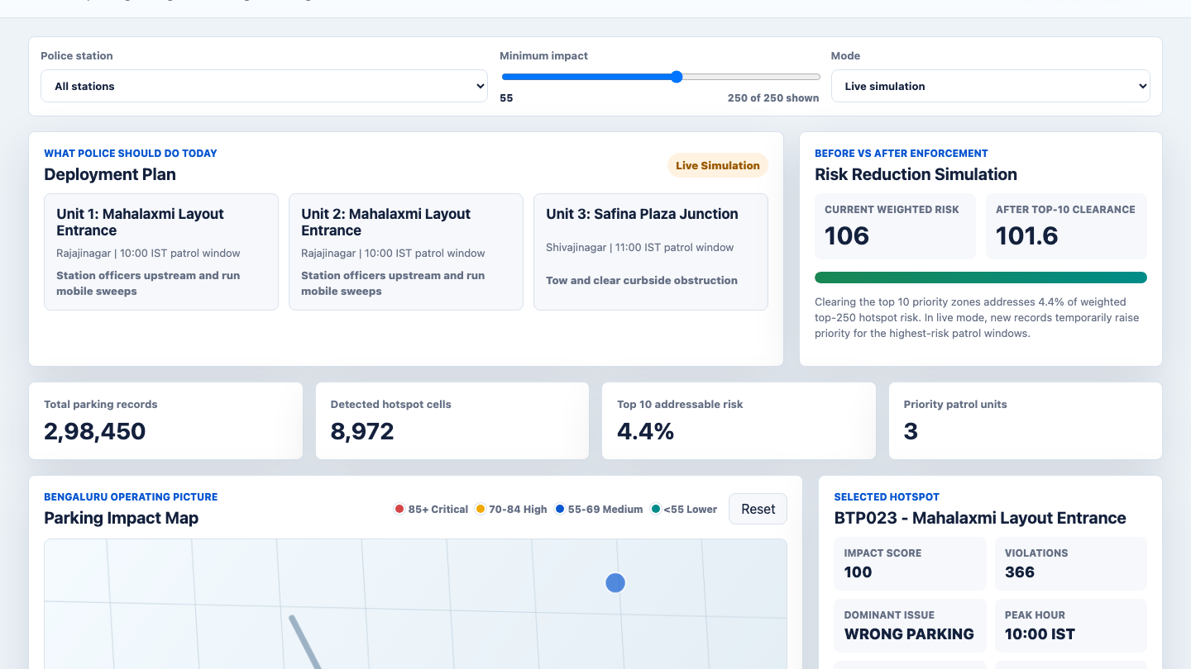
PARKPULSE AI
Live Mode and Before/After Impact
Live simulation mimics incoming parking violation pressure. High-priority hotspots pulse on the map and the weighted risk score updates, giving reviewers a clear operational demo without using any external dataset.
The demo stays fully inside the parking-violation theme dataset.
Flipkart Gridlock Hackathon | Poor Visibility on Parking-Induced Congestion
05

Slide 6
PARKPULSE AI
Six Capabilities Implemented
1
2
3
4
Daily Plan
Explainable AI
Hotspot Priority
Live Mode
Unit-level deployment plan with patrol window and recommended action.
Impact score broken down by density, severity, recurrence, and confidence.
Repeat violation zones are ranked for targeted enforcement action.
Simulated incoming violations pulse on the map and adjust risk priority.
5. Before/After Simulation
6. Stronger Pitch Story
Top 10 clearance addresses 4.4% of weighted risk.
Not just a heatmap: an enforcement decision-support system.
Flipkart Gridlock Hackathon | Poor Visibility on Parking-Induced Congestion
06

