Slide 1

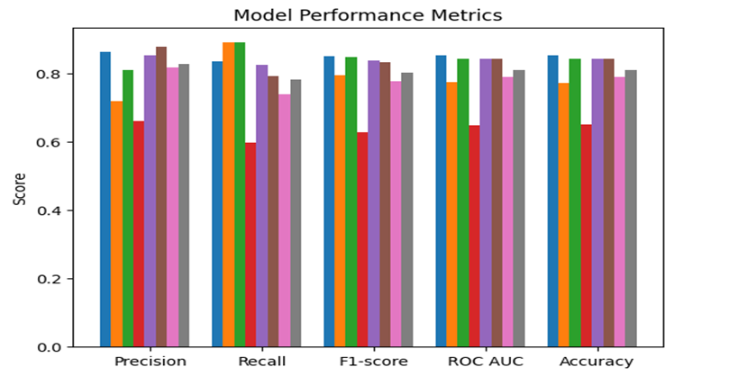
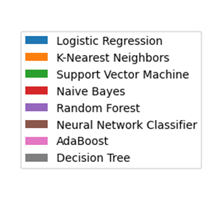
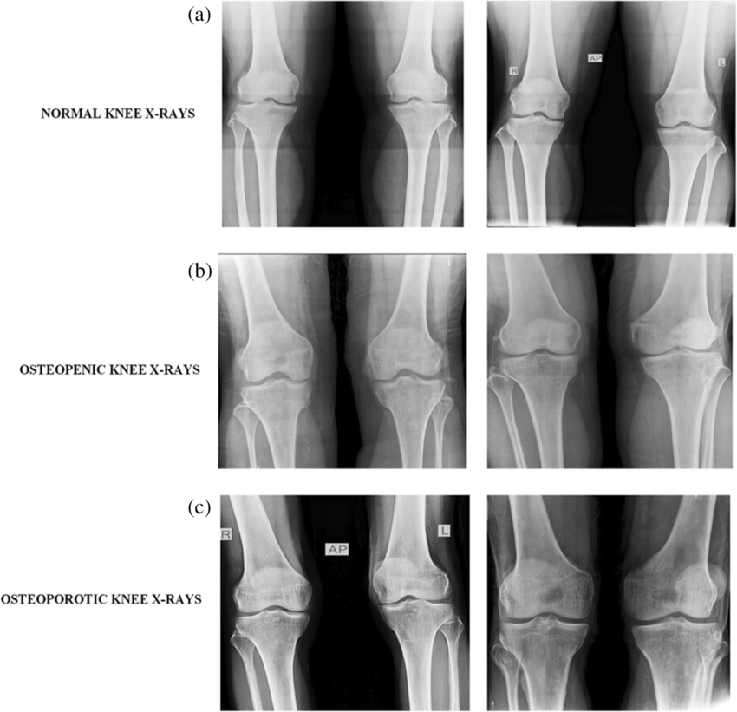
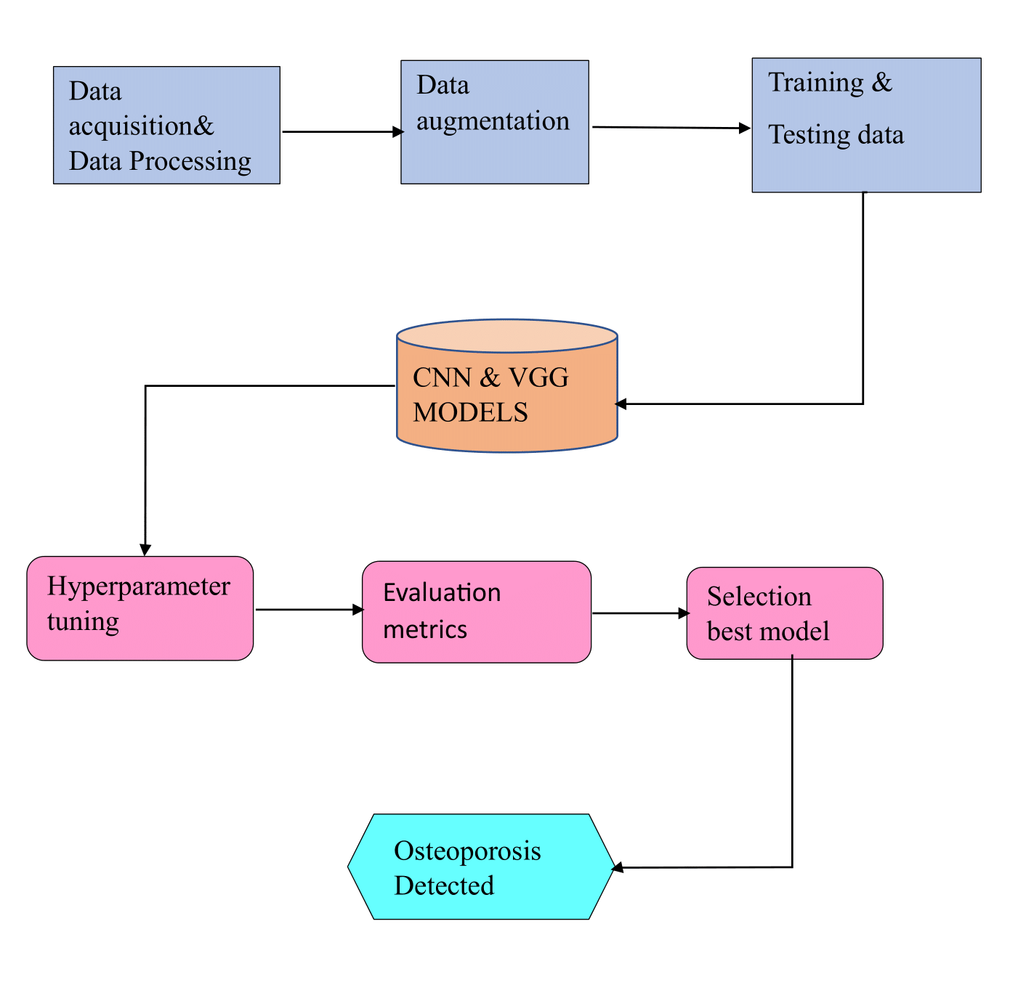
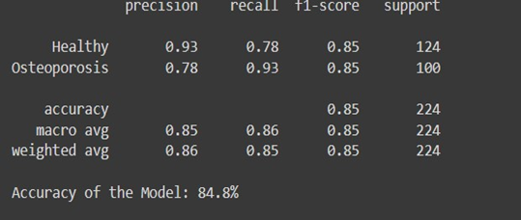
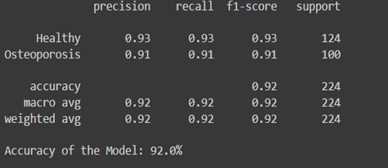
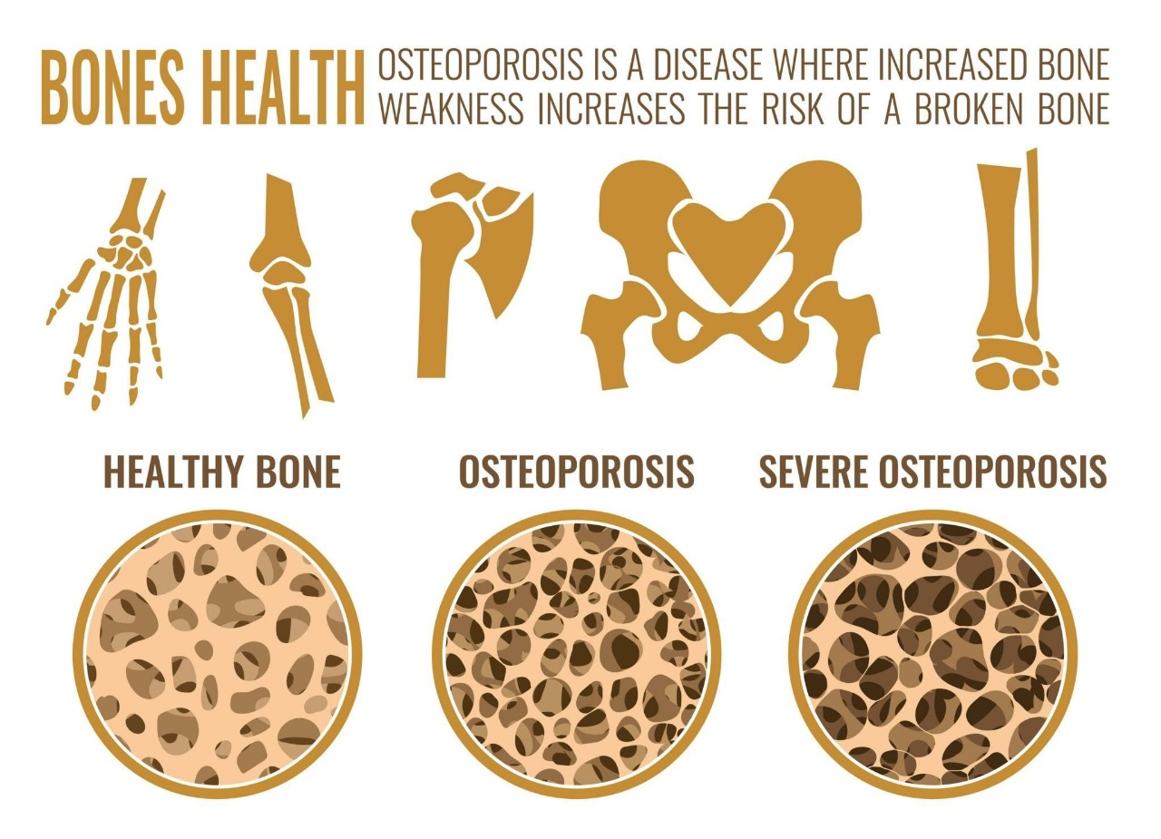
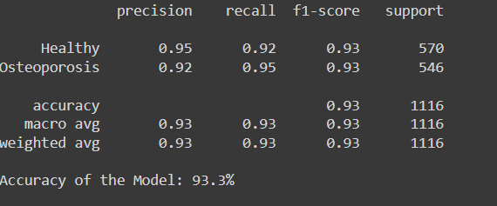
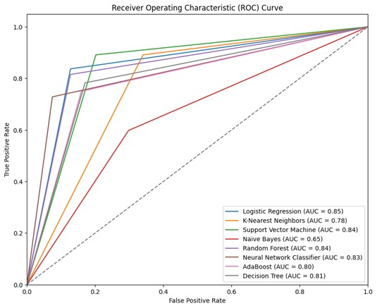
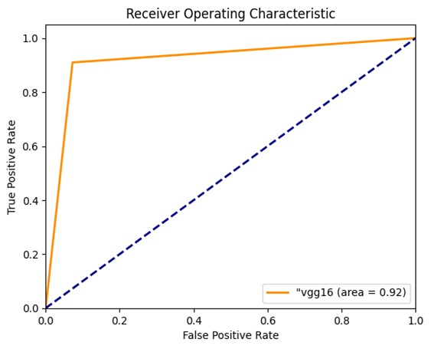
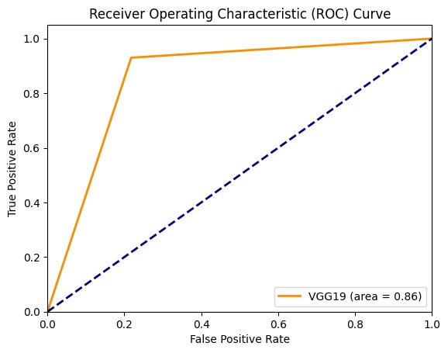
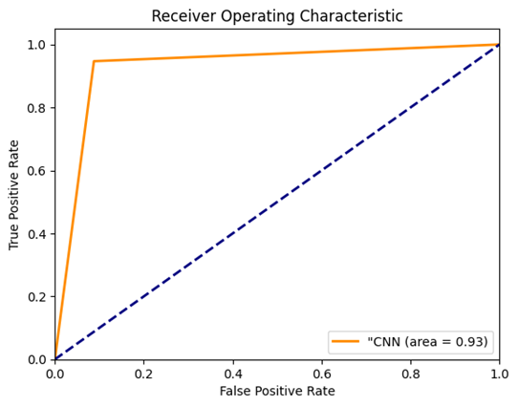
Classification of Osteoporosis Bone Disease using an
advanced Deep-Learning
2103A52037 - U. Reethu Varma
2103A52047 - Ch. Preethi
2103A52051 - K. Srinidhi
2103A52095 - M. Ananya Darshini
2103A52186 - N. Anuhya
SR UNIVERSITY
SCHOOL OF COMPUTER SCIENCE AND ARTIFICIAL INTELLIGENCE
Introduction
Proposed Methodology
Osteoporosis, a prevalent skeletal disorder characterized by reduced bone mineral density and increased fracture risk, poses a significant public health concern. and timely classification of osteoporosis is crucial for early intervention and effective management. This project's main objective is to develop a deep learning model that creates a scalable and reliable method for correctly detecting osteoporosis, which will eventually improve patient outcomes and care. The dataset used for this project includes the x-rays and CT scans of the knees of the various patients. The proposed model utilizes state-of-the-art deep learning techniques to extract meaningful features from bone imaging modalities. This research help us identify the best model, which is a scalable and reliable method for the detection of osteoporosis. In conclusion, it helps organizations improve patient outcomes. It enables more efficient and accessible healthcare solutions for individuals at risk of osteoporosis, enhances healthcare efficiency, leads to better-informed clinical decisions, and advances our understanding and management of osteoporosis.
Add your information, graphs and images to this section.
VGG-19
VGG-16
Results
CNN
Conclusion
Models Used
In research we analyzed that sophisticated deep learning methods can effectively classify osteoporosis bone condition. This work intends to create a non-invasive, cost-effective, and accurate solution for osteoporosis screening and classification by combining deep learning with medical imaging data. Our results highlight deep learning's potential as a useful tool for improving osteoporosis detection and management, which will eventually lead to better patient outcomes.
We used some of the Machine Learning Models and also Deep Learning Models like CNN(Convolutional Neural Network) and VGG-16(Visual Geometry Group) to detect and provide accuracy of our data.
Overview
Limitations
Acknowledgements
The dataset contains images of X-rays. Our Original dataset consists of 372 normal images and 372 Osteo images. We performed image augmentation for each image file where it takes one image as input and generates augmented versions of each image. After performing all these techniques the augmented data consists of 1860 Normal images and 1860 Osteo images.
We would like to express our sincere gratitude to Dr. Martha
We would like to express our sincere gratitude to Dr. Martha Sheshikala Madam HOD of CS & AI and our guide and co-Ordinator Md. Sallauddin , Asst. Prof., CSE Dept, – P. Praveen , Prof., CSAI Dept for the valuable guidance throughout the completion of project.
There's a risk of bias in Deep Learning models if the training data itself is biased. This could lead to misclassification for certain demographics or patient populations.
The model might struggle to capture the full spectrum of the disease if the training data doesn't represent this variability.
References
Alyahyan, S. (2024). Applying machine learning classification techniques for disease diagnosis from medical imaging data using Transformer based Attention Guided CNN (TAGCNN). Multimedia Tools and Applications, 1-27.
Ghosh, D., & Sahu, P. K. (2024). Osteoporosis detection with microwave signals: An investigation into natural resonance frequencies. Sensors and Actuators A: Physical, 365, 114867.
V

