Slide 1
Group A
Feb'25 Data Modelling
presentation
ANANYA | DEVANG | HARSHNIL | Nilakshi | poonam | RIYAN | raj |shailesh

Slide 2
Agenda
Introduction
Our Considerations
Entity Relationship Diagram
Data Overview

Slide 3
Data modelling
Introduction

Slide 4
Introduction
Objective: Designing a database model for cost allocation and employee management
Goal: Ensure efficient tracking of project expenses and workforce contributions.
Model defines various entities, their attributes and the relationships among them in a structured ER diagram.
Relationships between costs, employees, and projects
Data integrity through well-defined attributes and constraints
Scalability
Helps in budget planning and financial analysis
Monitors employee performance and compensation growth
Key Features
Business Use Case

Slide 5
Introduction
ER concepts
Entity
Weak Entity
Relationship
__________
Associated Entity
Attributes
Key Attributes

Slide 6
Our considerations
Currently gearing up for a ground-breaking launch
Our new offerings will captivate the market
Our marketing campaign will generate anticipation
P1
Current Date: 01-01-2025
P2
Master: Project | Category | Asset Breakdown
P5
Categories: Infra & Hardware | Software | Others
P6
Employee salary & appraisal
P3
P4
All project starts in 2024
Assets: Jira | Tableau | Office365 | Laptop | Workspace Costs
P7
Employee Roles: Data Engineer | Data Analysts

Slide 7
Entity Relationship
Diagram & Data Overview
DATA MODELLING

Slide 8
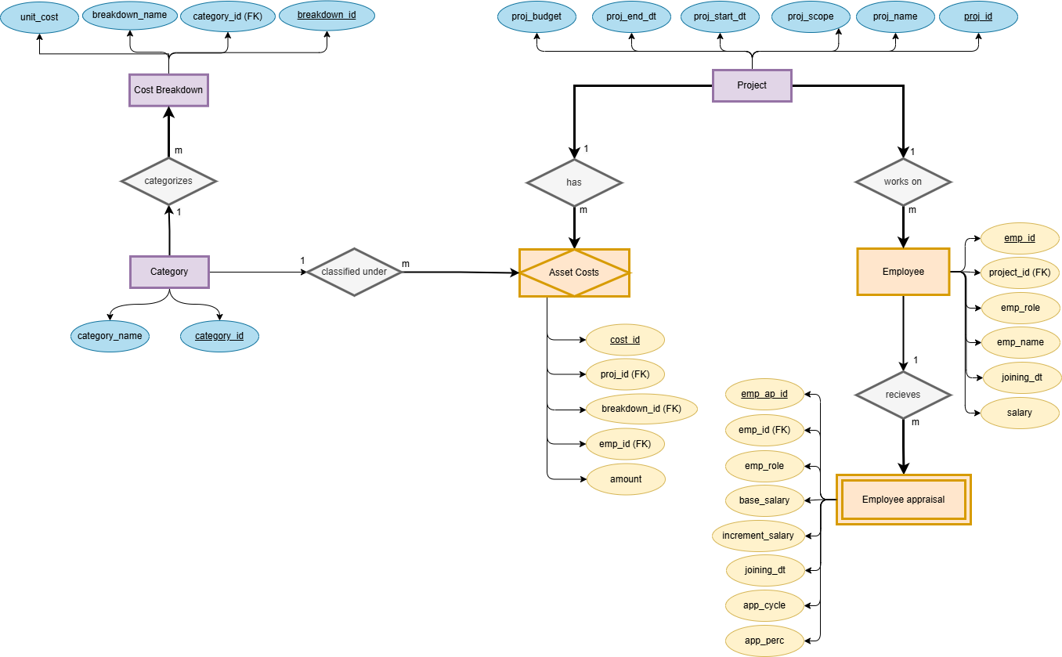
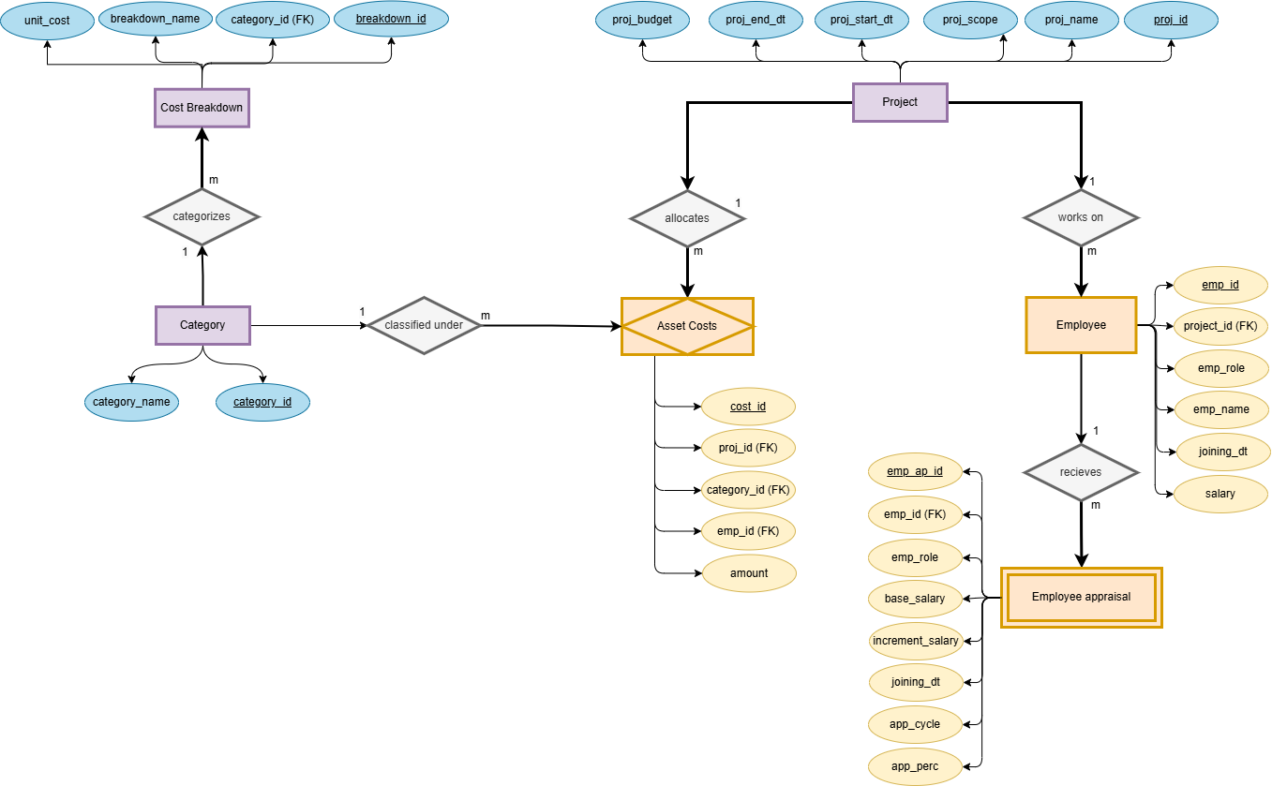
ER diagram of the flow

Slide 9
Data modelling
Employee Table
Emp id | Emp name | Emp role | Joining dt | salary | Proj_id
1 | Aakash | Data Engineer | 2022-01-08 | 80000.00 | 1
2 | Gauri | Data Engineer | 2024-01-15 | 55000.00 | 1
3 | Kalpesh | Data Analyst | 2024-01-06 | 50000.00 | 1
4 | Anup | Data Analyst | 2024-01-10 | 53000.00 | 1
5 | Priyanka | Data Engineer | 2022-01-20 | 75000.00 | 2
6 | Mohit | Data Engineer | 2024-01-05 | 50000.00 | 2
7 | Aniket | Data Analyst | 2024-01-08 | 51000.00 | 2
8 | Soham | Data Analyst | 2024-01-14 | 54000.00 | 2
Employee Appraisal
Emp ap id | Emp id | Emp role | Joining date | Base salary | Incremented salary | App cycle | App perc
1 | 1 | Data Engineer | 2022-01-08 | 80,000.00 | 80,000.00 | 0 | 10
2 | 1 | Data Engineer | 2022-01-08 | 80,000.00 | 88,000.00 | 1 | 10
3 | 1 | Data Engineer | 2022-01-08 | 80,000.00 | 96,800.00 | 2 | 10
4 | 1 | Data Engineer | 2022-01-08 | 80,000.00 | 1,06,480.00 | 3 | 10
5 | 7 | Data Analyst | 2024-01-08 | 51,000.00 | 51,000.00 | 0 | 10
6 | 7 | Data Analyst | 2024-01-08 | 51,000.00 | 56,100.00 | 1 | 10

Slide 10
Data Modelling
Project Table
Proj_id | Proj_name | Proj_budget | Proj_st_dt | Proj_end_dt | Proj_scope
1 | FF1 | 30,00,000.00 | 2024-01-20 | 2026-01-01
2 | SS1 | 50,00,000.00 | 2024-03-01 | 2027-03-01
Category Table
Category_id | Category_name
1 | Software
2 | Infra and Hardware
3 | Others

Slide 11
Asset Cost Table
Cost_id | Proj_id | Emp_id | Breakdown_id | amount
1 | 1 | 1 | 1 | 15,000.00
2 | 1 | 1 | 3 | 20,000.00
3 | 1 | 1 | 4 | 5,000.00
4 | 1 | 1 | 5 | 10,000.00
5 | 1 | 1 | 6 | 5,0000.00
6 | 1 | 3 | 1 | 15,000.00
7 | 1 | 3 | 2 | 20,000.00
8 | 1 | 3 | 3 | 10,000.00
9 | 1 | 3 | 4 | 5,000.00
10 | 1 | 3 | 5 | 10,000.00
11 | 1 | 3 | 6 | 5,000.00
Asset Cost Breakdown Table
breakdown_id | category_id | breakdown_name | unit_cost(month)
1 | 1 | Jira | 15,000.00
2 | 1 | Tableau | 20,000.00
3 | 1 | Office 365 | 10,000.00
4 | 2 | Laptop | 5,000.00
5 | 2 | Workspace Costs | 10,000.00
6 | 3 | Others | 5,000.00
11

Slide 12
Thank you
GROUP a

