Slide 1

Predicting Osteoporosis Risk in Postmenopausal Women: A Data-Driven Approach for Early Detection Using SMOTE and Explainable AI
19CSE304 – Foundation of Data Science Faculty – Uma Maheshwari CSE A – Sem V: 2022-26
Team Members: 1. Ananya Ganapathi – BL.EN.U4CSE22006
2. Deivanai Saravanan – BL.EN.U4CSE22052
3.Sneha T Raghavan – BL.EN.U4CSE22057

Slide 2
Overview
Introduction
Problem Statement
Background and Motivation
Literature Review
Research Gaps
System Architecture
Methodology
Result and Analysis
Conclusion
Future Work
Conferences
References

Slide 3
Introduction
Osteoporosis is a medical condition which leads to weakened bones that become brittle and fragile, increasing the risk of fractures, even from minor falls or injuries. In the United States, about 1 in 2 women over the age of 50 experience osteoporosis-related fracture in their lifetime. The condition often progresses without symptoms until a fracture occurs, which is why it is sometimes referred to as a "silent disease."
Osteoporosis primarily affects older adults, particularly postmenopausal women, due to hormonal changes that affect their bone density. The factors include age, family history, low body weight, sedentary lifestyle, and certain medical conditions or medications that affect bone health. This research develops a data science model to predict osteoporosis risk in postmenopausal women based on factors like age, BMI, and medical history.

Slide 4
Problem Statement
The problem addressed by this project is the early detection and prediction of osteoporosis in postmenopausal women. Osteoporosis often develops without noticeable symptoms, making it difficult to diagnose until a fracture occurs. Current healthcare tools lack personalized risk assessment models that can predict osteoporosis based on factors like age, BMI, medical history, and lifestyle. This project aims to develop a predictive model using data science and machine learning techniques to assess the likelihood of osteoporosis in postmenopausal women, helping healthcare providers identify at-risk individuals early for timely intervention and improved management of bone health.

Slide 5
Background and Motivation
Osteoporosis is a silent yet prevalent condition characterized by weakened bones, primarily affecting women due to hormonal changes after menopause leading to bone loss. Left undiagnosed, it significantly increases the risk of fractures, leading to reduced quality of life and higher healthcare costs. Traditional diagnostic methods like bone density scans are costly, invasive, and often inaccessible in low-resource settings, making early detection a challenge.
Motivated by the need for an affordable, non-invasive, and scalable solution, this project leverages machine learning to predict osteoporosis risk using readily available demographic and health-related data. By identifying at-risk individuals early, this approach aims to support preventive care and reduce the burden of osteoporosis on patients and healthcare systems.

Slide 6
Literature Review
S. No | Journal, Author, Year | Objective | Advantage | Research Gap
1 | Application of Machine Learning Algorithms to Predict Osteoporotic Fractures in Women. Kang SJ, Kim MJ, Hur YI, Haam JH, Kim YS 2024 | To evaluate the effectiveness of machine learning algorithms in predicting fractures in osteoporotic women. | Machine learning algorithms offer improved predictive accuracy over traditional models like FRAX by leveraging complex patterns. | The study highlights the need for further research to integrate diverse datasets and validate machine learning models to ensure broader applicability and clinical utility.
2 | Osteoporosis risk prediction using machine learning and conventional methods Kim, S.K., Yoo, T.K. and Kim, D.W 2013 | To develop machine learning models for predicting the risk of osteoporosis in postmenopausal women and compare their performance with conventional clinical decision tools. | The study demonstrates that machine learning models provide higher accuracy in identifying individuals at risk of osteoporosis compared to traditional methods | The study highlights the lack of an in-depth analysis of the interpretability and usability of these models in clinical settings.

Slide 7
Literature Review
S. No | Journal, Author, Year | Objective | Advantage | Research Gap
3 | Application of machine learning approaches for osteoporosis risk prediction in postmenopausal women. Shim, JG., Kim, D.W., Ryu, KH 2020 | To develop machine learning models for improving early diagnosis and enabling primary care providers to identify high-risk individuals effectively. | The machine learning models showcased superior predictive performance compared to traditional methods. | There is a need to assess the cost-effectiveness and scalability of implementing machine learning-based risk prediction tools in real-world healthcare settings.
4 | Prediction model for the risk of osteoporosis incorporating factors of disease history and living habits in physical examination of population in Chongqing, Southwest China: based on artificial neural network. Wang, Yuqi 2021 | To develop and compare prediction models, including artificial neural networks, for assessing osteoporosis risk by incorporating disease history and lifestyle factors. | The study demonstrates that artificial neural networks outperform traditional statistical models. | The research highlights the need for longitudinal studies to validate the predictive reliability of artificial neural network models over time.

Slide 8
Literature Review
S. No | Journal, Author, Year | Objective | Advantage | Research Gap
5 | Machine learning‐based prediction of osteoporosis in postmenopausal women with clinical examined features: A quantitative clinical study KA Ullah, F Rehman, M Anwar, M Faheem, N Riaz 2023 | To develop ML models (ANN, SVM, KNN) for osteoporosis prediction and compare them with traditional tools like OSTA for more accurate and reliable results. | The study leverages diverse datasets and demonstrates ML models' superiority over conventional methods in early detection and prediction accuracy. | Lacks focus on explainable AI, detailed handling of class imbalance, and real-time clinical applicability.
6 | Predicting the risk of osteoporosis in older Vietnamese women using machine learning approaches HM Bui, MH Ha, HG Pham, TP Dao, TTT Nguyen, ML Nguyen, NT Vuong, XHT Hoang 2022 | To design machine learning models for predicting osteoporosis in Vietnamese women over 50 using clinical and blood test data, addressing the limitations of DXA-based screening. | Uses diverse predictors, validates existing models across populations, and emphasizes cost-effective community screening. | Lack of model explainability which reduces transparency for clinical adoption. And relies on DXA as a reference, which is costly and less accessible.

Slide 9
Literature Review
S. No | Journal, Author, Year | Objective | Advantage | Research Gap
7 | Osteoporosis risk prediction using data mining algorithms E Jabarpour, A Abedini, A Keshtkar 2020 | To develop predictive models for osteoporosis diagnosis using data mining techniques like SVM and Tree Augmented Naïve Bayes, aiming to identify effective factors, improve diagnostic accuracy, and reduce costs. | Analyzes a large dataset with 45 features, achieving high accuracy (91.29% with TAN) and identifying key factors like calcium intake and hypothyroidism for personalized prediction. | Uses a single geographic dataset and lacks techniques like SMOTE to address class imbalance, limiting global applicability and accuracy for minority classes.
8 | Development of machine learning models for prediction of osteoporosis from clinical health examination data WY Ou Yang, CC Lai, MT Tsou, LC Hwang 2021 | To develop machine learning models for osteoporosis screening in individuals over 50 using easily available features like physical characteristics, personal and medical history for early detection and fracture prevention. | The study uses a large dataset of 5982 participants, including both men and women, with 16–19 features, to improve prediction accuracy and outperform traditional models like OSTA, achieving high sensitivity (83–96%) and specificity (53–73%) in osteoporosis risk prediction. | The study lacks explainable AI methods, does not address class imbalance effectively, and relies on costly DXA for diagnosis

Slide 10
Research Gaps
Explainability and Transparency: Existing studies lack a focus on XAI, whereas our project integrates XAI to make predictions transparent and trustworthy, enhancing clinical usability and aligning with ethical standards.
Personalized Risk Assessment: The project offers personalized risk assessments by analyzing factors like age, BMI, lifestyle habits, and family medical history, unlike other studies that focused on generic populations or limited features.
Integration of Modern Techniques: Most reviewed studies use traditional machine learning models without tackling class imbalance or ensuring robustness, while this project uses SMOTE and XAI to enhance reliability, accuracy, and interpretability.

Slide 11
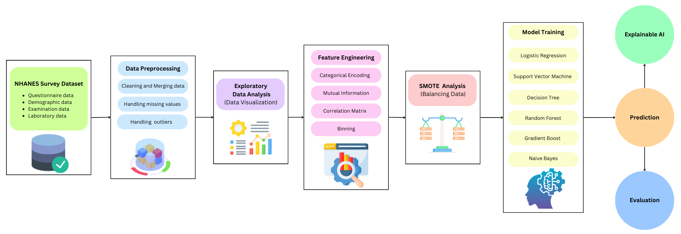
System Architecture

Slide 12
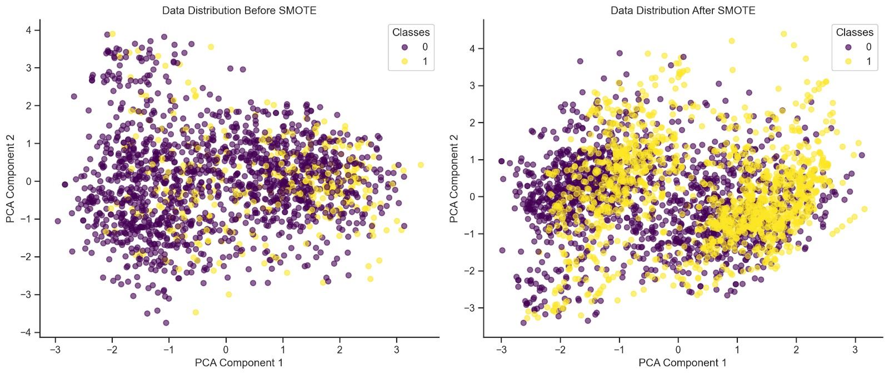
Methodology
Data Description: The study uses data from the NHANES Survey to predict osteoporosis risk in postmenopausal women, focusing on factors like age, BMI, smoking, alcohol consumption, sleep patterns, health conditions, family history, and use of hormones.
Data Pre-processing: The dataset was cleaned by handling missing values, removing outliers, and converting categorical data to numerical values. SMOTE was used to balance the dataset, and feature scaling standardized the data. The data was split into 80% for training and 20% for testing.

Slide 13
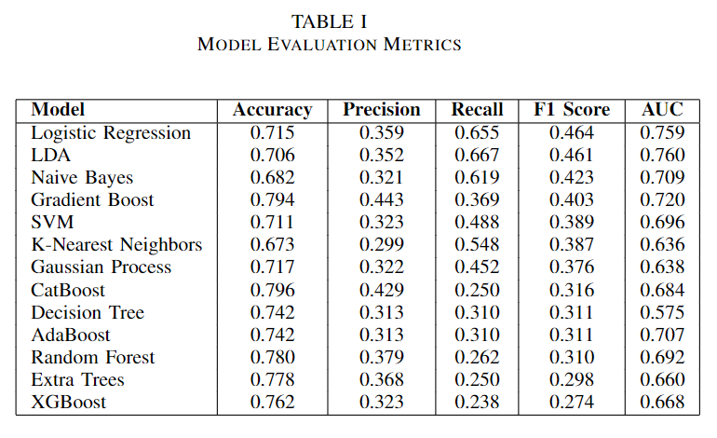
Methodology
Model Training: Multiple machine learning models, including Logistic Regression, Decision Tree, Random Forest, SVM, Gradient Boosting, and Naive Bayes, were trained to predict osteoporosis risk.
Model Evaluation: Models were evaluated using accuracy, precision, recall, F1-score,and ROC-AUC to identify the best-performing model for predicting osteoporosis risk.

Slide 14
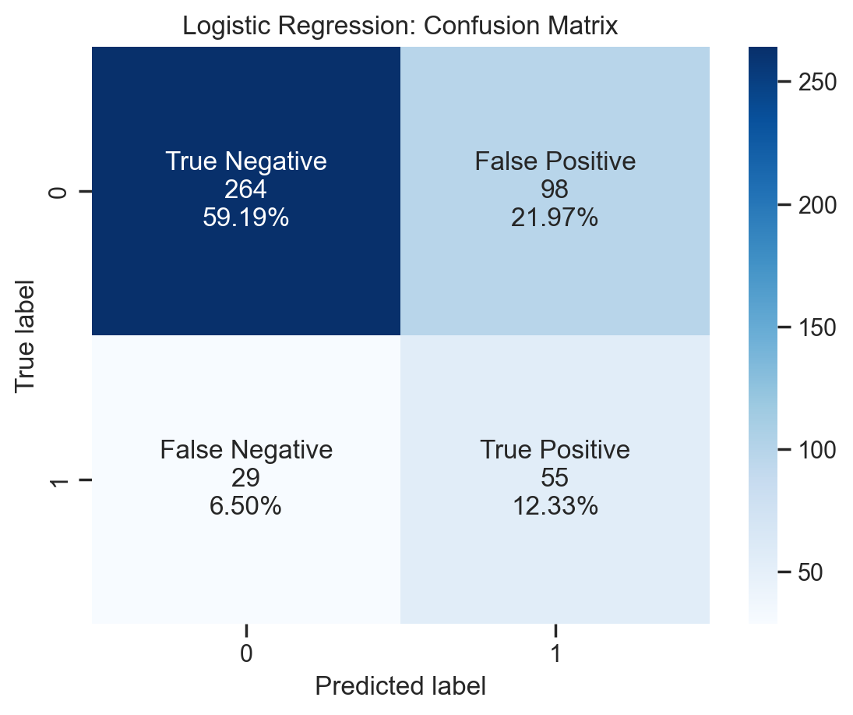
Result and Analysis
Model Performance and Accuracy
The Logistic Regression model achieved the highest AUC-ROC score and accuracy, with feature importance identifying age and parental osteoporosis as key predictors. Its low false-negative rate ensures reliable detection of osteoporosis cases, critical for medical diagnostics.

Slide 15
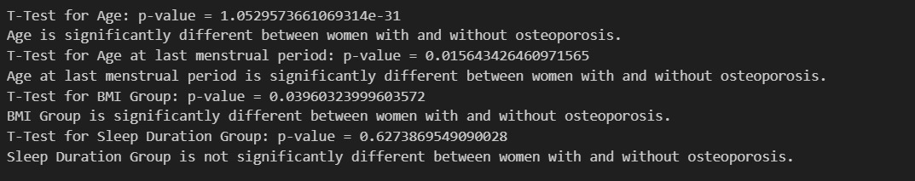
Result and Analysis
Hypothesis testing
T-tests showed that age, age at last menstrual period, and BMI were significant factors in predicting osteoporosis risk, while sleep duration did not show a significant impact. These factors are important for feature selection in predictive modeling.

Slide 16
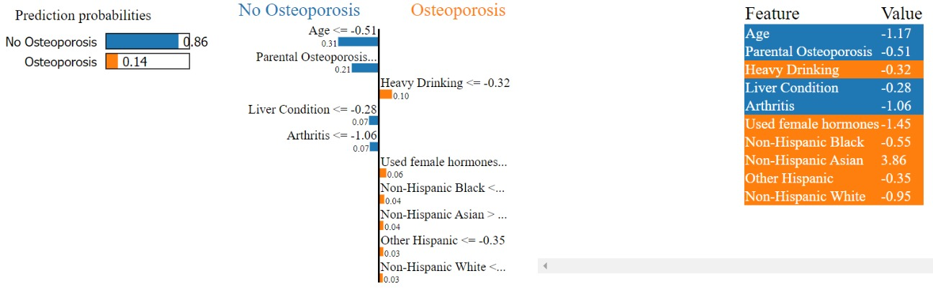
Result and Analysis
Explainable AI:
LIME: Using LIME, the model predicts 86% probability of "No Osteoporosis." Key factors for this prediction are low age and no family history of osteoporosis, while heavy drinking and hormone use have a smaller influence. The output highlights the most impactful factors, guiding further analysis or health interventions.

Slide 17
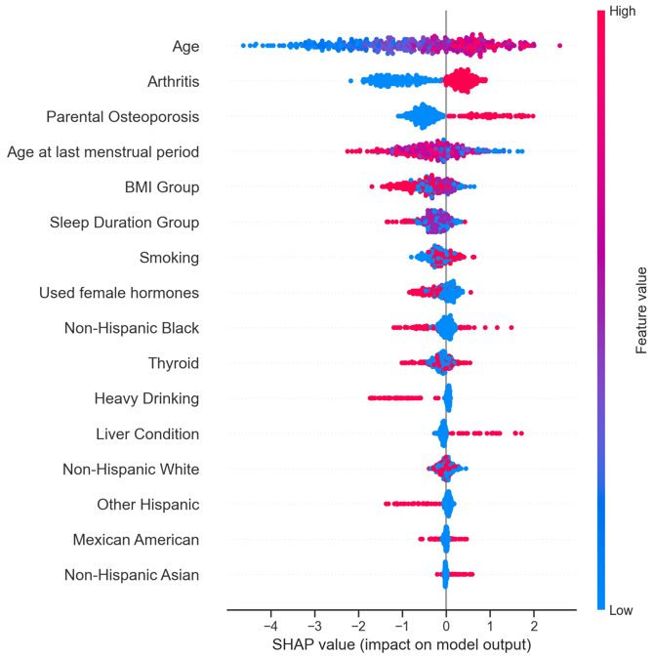
Result and Analysis
Explainable AI:
SHAP: SHAP analysis found that age is the most important factor, with older age increasing the risk of osteoporosis. Other factors like ethnicity, BMI, arthritis, and lifestyle choices such as smoking also affect the risk, offering useful information for doctors in making decisions and managing osteoporosis.

Slide 18
Conclusion
The study presents a machine learning approach combined with SMOTE and XAI methods for early osteoporosis risk detection in postmenopausal women, identifying Random Forest as the best-performing model with the highest ROC-AUC and lowest false negative rate.
Key predictors identified were age, BMI, and parental history of osteoporosis, while robust data preprocessing for missing values, outliers, and class imbalance improved model performance.
XAI tools like SHAP and LIME enhanced interpretability, making the model more transparent and usable for healthcare professionals.

Slide 19
Future work
Dataset Expansion: Collect real-time or region-specific data to analyze geographic or demographic disparities in osteoporosis prevalence.
Algorithm Enhancements: Implement deep learning models, such as neural networks, for capturing complex patterns in the dataset.
Real-World Application: Collaborate with healthcare providers to validate the model's effectiveness in clinical settings. Develop a user-friendly tool or mobile app that integrates the model for real-time osteoporosis risk assessment.

Slide 20

Conference
International Conference on Recent Advances in Engineering and Computer Applications-2025
https://www.iferp.in/icraeca/
Date of paper submission: 5th december

Slide 21
References
[1] Kang SJ, Kim MJ, Hur YI, Haam JH, Kim YS. Application of Machine Learning Algorithms to Predict Osteoporotic Fractures in Women. Korean J Fam Med. 2024 May;45(3):144-148. doi: 10.4082/kjfm.23.0186. Epub 2024 Jan 29. PMID: 38282437; PMCID: PMC11116127.
[2] Kim, S.K., Yoo, T.K. and Kim, D.W., 2013, July. Osteoporosis risk prediction using machine learning and conventional methods. In 2013 35th Annual International Conference of the IEEE Engineering in Medicine and Biology Society (EMBC) (pp. 188-191). IEEE.
[3] Wu, Xuangao, and Sunmin Park. "A prediction model for osteoporosis risk using a machine-learning approach and its validation in a large cohort." Journal of Korean Medical Science 38.21 (2023)
[4] Wang, Yuqi, et al. "Prediction model for the risk of osteoporosis incorporating factors of disease history and living habits in physical examination of population in Chongqing, Southwest China: based on artificial neural network." BMC Public Health 21.1 (2021): 991.
[5] Shim, JG., Kim, D.W., Ryu, KH. et al. Application of machine learning approaches for osteoporosis risk prediction in postmenopausal women. Arch Osteoporos 15, 169 (2020).
[6] Yoo, T.K., Kim, S.K., Kim, D.W., Choi, J.Y., Lee, W.H., Oh, E. and Park, E.C., 2013. Osteoporosis risk prediction for bone mineral density assessment of postmenopausal women using machine learning. Yonsei medical journal, 54(6), pp.1321-1330.
[7] Ullah, Kainat A., et al. "Machine learning‐based prediction of osteoporosis in postmenopausal women with clinical examined features: A quantitative clinical study." Health Science Reports 6.10 (2023): e1656.
[8] Bui, Hanh My, et al. "Predicting the risk of osteoporosis in older Vietnamese women using machine learning approaches." Scientific Reports 12.1 (2022): 20160.

Slide 22
References
[9] Jabarpour, E., Abedini, A. and Keshtkar, A., 2020. Osteoporosis risk prediction using data mining algorithms. Journal of Community Health Research.
[10] Ou Yang, Wen-Yu, et al. "Development of machine learning models for prediction of osteoporosis from clinical health examination data." International journal of environmental research and public health 18.14 (2021): 7635.
[11] Smets, Julien, et al. "Machine learning solutions for osteoporosis—a review." Journal of bone and mineral research 36.5 (2020): 833-851.
[12] Wang, Z., Li, Y. and Xu, Y., 2023, February. Osteoporosis risk prediction method based on relational network and GNN. In 2023 IEEE 6th Information Technology, Networking, Electronic and Automation Control Conference (ITNEC) (Vol. 6, pp. 1242-1247). IEEE.

