Slide 1

DISastAr
Code.FUN.do++

Slide 2
What is the problem ?
Disaster
Short sighted design of buildings and cities
Lack of informed decisions and planning by architects and government to restructure disaster prone regions
Lack of means to analyse efficiency of buildings that are built to withstand damage
Professional architects unable to visualise and model such special buildings at ease

Slide 3
Estimates suggest that by 2050, urban population exposed to cyclones will increase from 310 million to 680 million while exposure to major earthquake will increase from 370 million to 870 million (World Bank, 2013b). Urban development investment is also set to increase from US$7.2 trillion in 2011 to US$12 trillion by 2020. (UNISDR, 2013)

Slide 4
What can we do ? (Our solution)
Disastar
A mobile app that uses AR (augmented reality) and image processing to help architects design disaster-safe 3D models of buildings and cities on the move
Use artificial intelligence to simulate real-life disasters of varying intensity and at different locations
Distribute final designs of apartments, offices etc to the people so that they can be informed
Use AR to show exit paths to strangled people in buildings in time of emergency

Slide 5
DiSASTAR
There also is the plight that comes from natural disasters; these natural disasters could be alleviated or dealt with; we only need some time to do it.
Bhumibol Adulyadej

Slide 6

OUR APP
DISASTAR
App made using Unity and Vuphoria, uses Azure services
Uses AR to detect planes and create models of buildings on them
Custom buildings that have disaster-safe properties can be designed and visualised
3D visualisation and modelling

Slide 7
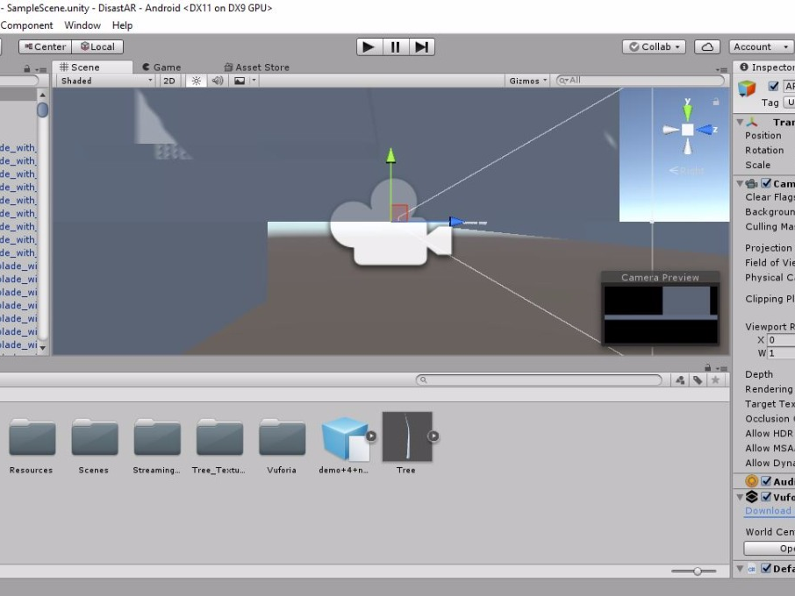

Slide 8
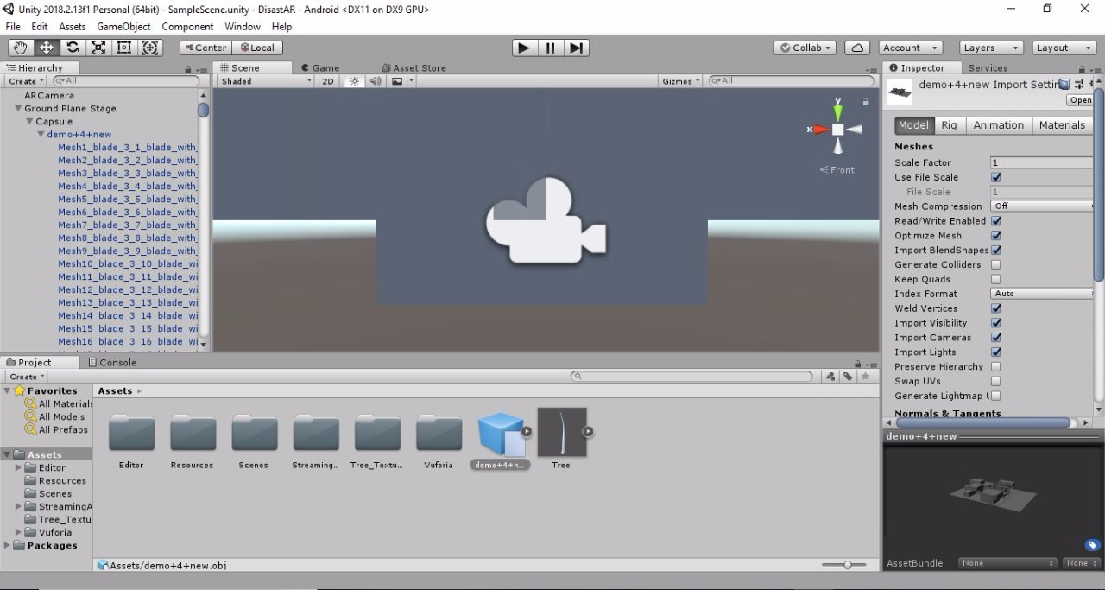

Slide 10
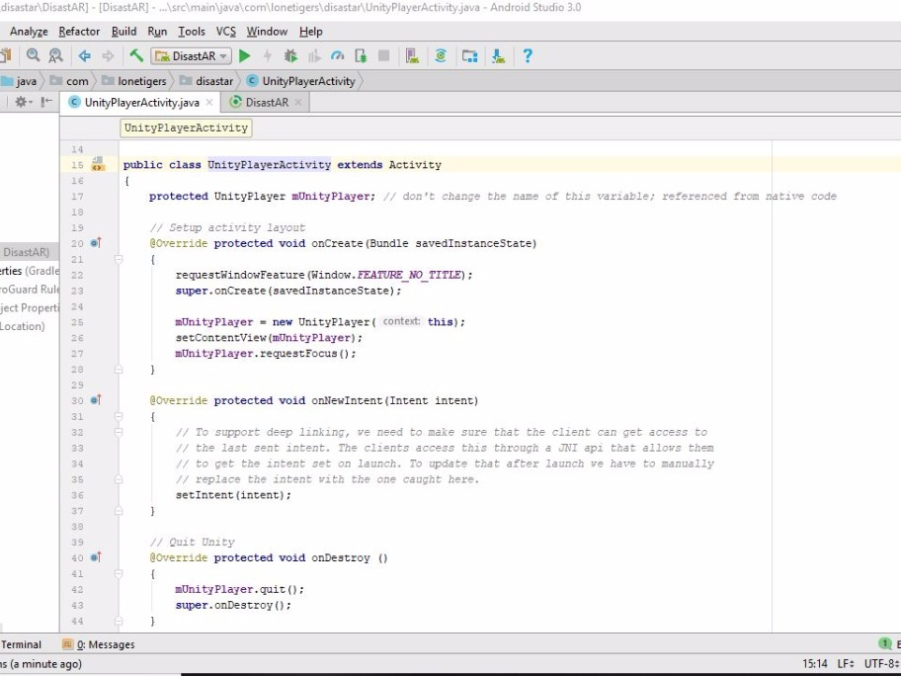

Slide 11
Future additions
Disastar
Enable simulations of earthquakes, cyclones, tornadoes etc on the models and use AI to find out the strength and resistance of such building/city designs
Allow more advanced and complicated architectural structures
Provide access to such building structure using same app to people in that building
Additional feature to show path using arrows on live camera to exit buildings/move towards relief area in time of emergency

Slide 12
Thank you!

