Slide 1
Drug Discovery: an Industrial Process
How are drugs discovered and developed?
Lecture 3

Slide 2
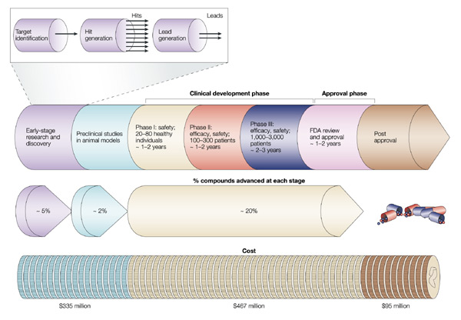

Slide 3
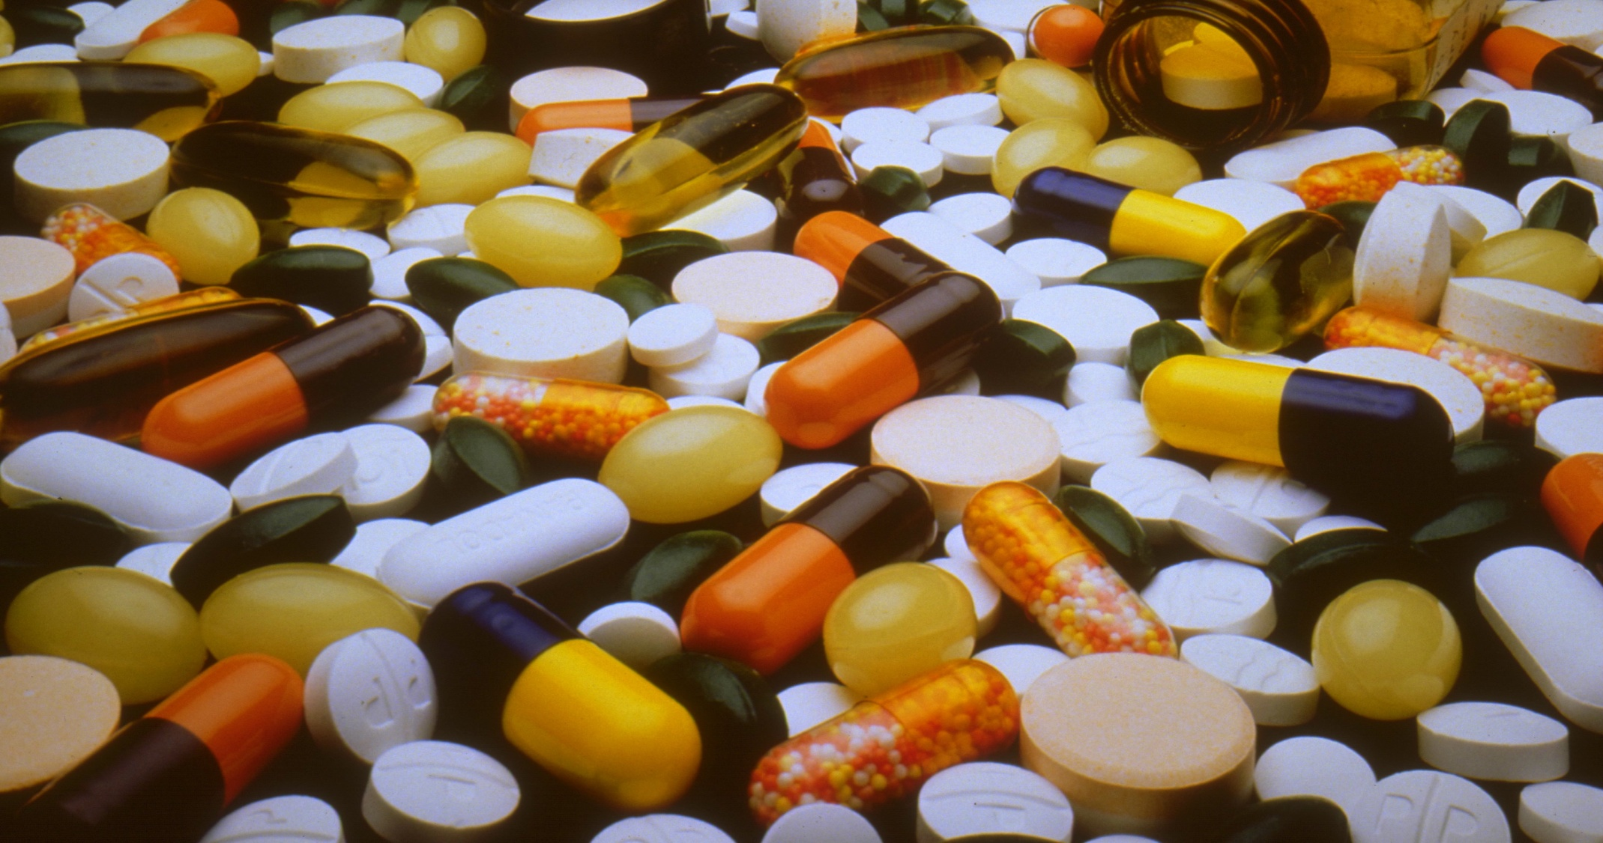
Just how much does it cost?
Broken down, the cost broadly works out at
  Around $335 million in the preclinical phases
  Around $467 million in the clinical trial phases
  Around $100 million in Post approval costs

Slide 4
Don’t forget, it also costs to develop the ones that fail
Although these figures are a little out of date* (they are probably worse now with the introduction of HTS), it gives an idea of how wasteful the process is
For every 30,000 compounds synthesized
  2000 (6.7%) enter preclinical development
  200 (0.67%) enter phase 1 trials
  40 (0.13%) enter phase 2 clinical trials
  12 (0.04%) enter phase 3 clinical trials
  8 (0.027%) are approved
  1 (0.003%) makes a satisfactory ROI
*Christine A. Shillingford and Colin W. Vose Effective decision-making: progressing compounds through clinical development DDT Vol. 6, No. 18 September 2001

Slide 5
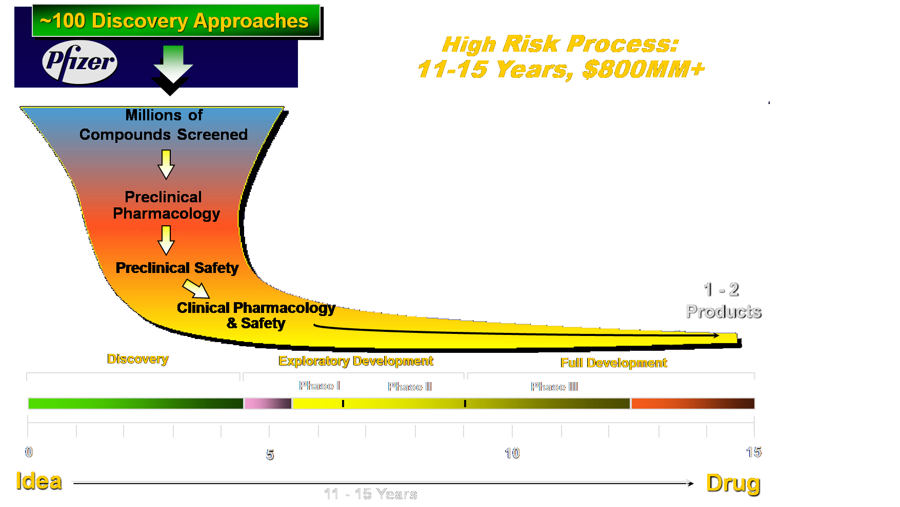
Drug Discovery is a very wasteful game

Slide 6
Don’t forget, it also costs to develop the ones that fail!
Attrition at late clinical trial phase is very expensive and can be disastrous for smaller companies
It is important to point out that in the last few years, some compounds have been pulled out late because it was thought that they would not make a ROI.
Clearly just getting a drug on the market is not a case of the goose laying the golden egg

Slide 7
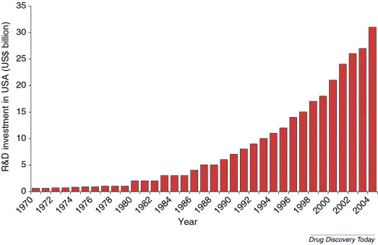
It’s an expensive business
R&D investment in the USA between 1970 and 2004. Source is the PhRMA annual survey (www.phrma.org/publications/publications/17.03.2005.1142.cfm).

Slide 8
Example: the development of antidepressant drugs
Initially it was observed that modulation of biogenic amine (ex. dopamine) levels were implicated in the development of depression
The hypothesis was that pharmacological modulation of biogenic amines could be a process useful in the treatment of depression
How could this be achieved?
  By increasing the synthesis of transmitter
  By preventing its breakdown
  By producing agonists capable of stimulating post synaptic receptors
  By preventing the reuptake of neurotransmitter from the synaptic cleft

Slide 9
What does that mean?
2. “Pharmacological modulation of biogenic amines”
This simply means: Use drugs to change the amount or activity of these neurotransmitters.
A. Increase synthesis of the transmitter
Synthesis = making the neurotransmitter.
Imagine a neuron as a factory: Raw materials → neurotransmitter
If we give the neuron more raw material or stimulate the enzymes involved, it may produce more serotonin, noradrenaline, etc.
⬆️ Synthesis → ⬆️ neurotransmitter available

Slide 10
What does that mean?
B. Prevent its breakdown
Normally, neurotransmitters don't stay around forever. They are broken down by enzymes.
For example:
Monoamine oxidase (MAO) helps break down serotonin, noradrenaline and dopamine. If a drug inhibits this breakdown:
Less breakdown → more neurotransmitter remains available

Slide 11
What does that mean?
C. Produce agonists that stimulate postsynaptic receptors\
Presynaptic neuron → neurotransmitter → postsynaptic receptor
The neurotransmitter binds to the receptor and produces an effect.
An agonist is a drug that can activate that receptor, essentially mimicking the neurotransmitter.
So instead of increasing the actual amount of serotonin, for example, you could theoretically give a drug that acts like serotonin at its receptor.
Agonist → receptor activation → similar effect to neurotransmitter

Slide 12
What does that mean?
D. Prevent reuptake of the neurotransmitter
Neuron A → serotonin → synaptic cleft → receptor → serotonin gets taken back
If a drug blocks the reuptake transporter:
Neuron A → serotonin → reuptake blocked → serotonin stays longer in synaptic cleft
⬆️ serotonin/noradrenaline in synaptic cleft → more/longer receptor stimulation

Slide 13
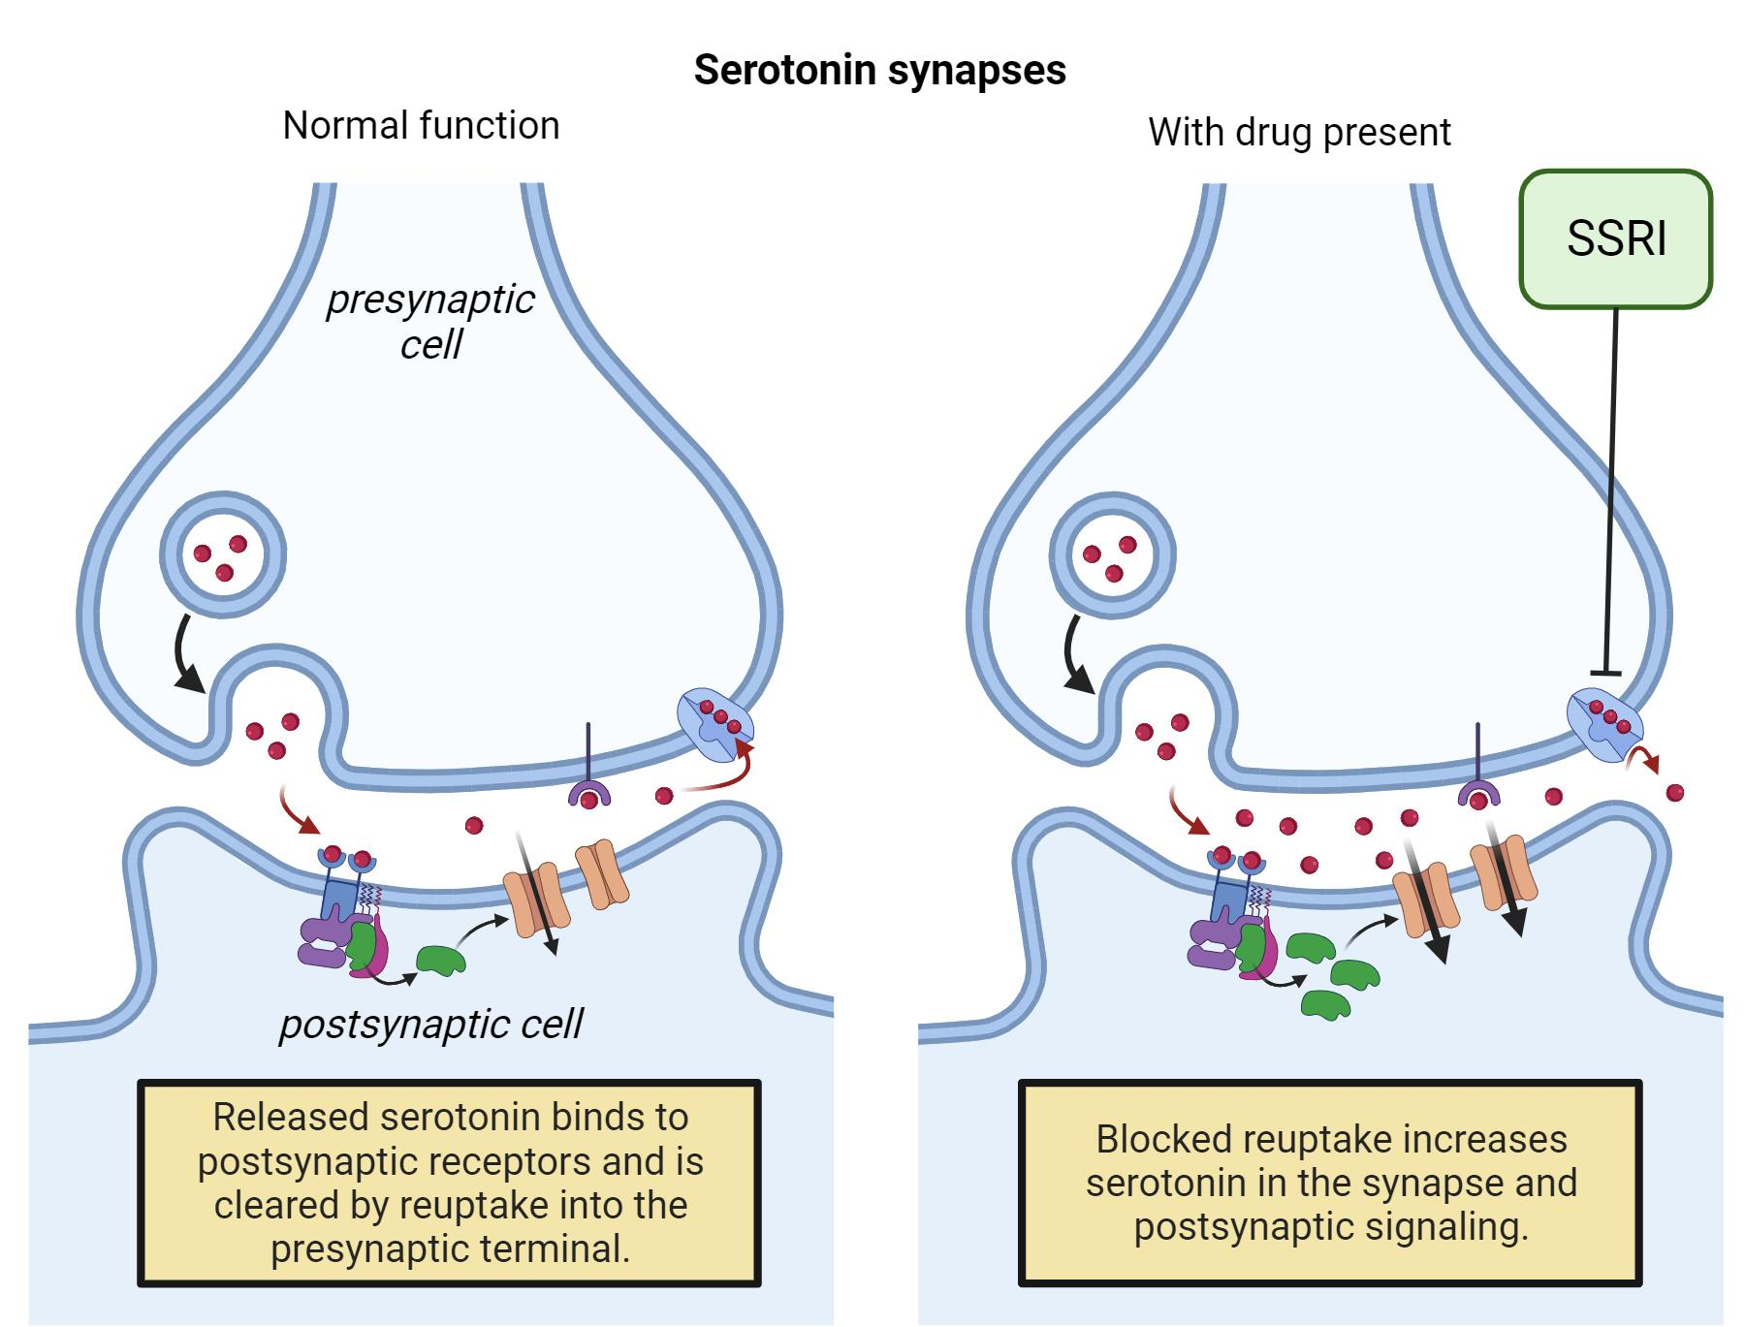

Slide 14
Which hypothesis was adopted?
Actually, all of those hypotheses have been used in the past, some to greater effect than others
For the sake of example let us consider the final hypothesis
  Preventing the reuptake of neurotransmitter from the synaptic cleft will have an effect on their synaptic concentration
  Increasing the levels of biogenic amine will produce an antidepressant effect
  Such increases could be achieved by inhibiting the appropriate neurotransmitter transporter

Slide 15
How would we go about developing a drug based upon this hypothesis?
We have now identified our target – the serotonin reuptake transporter
The next part of the process involved validating the target
Target validation involved a number of approaches:
  Collecting all available information in the public domain that support the hypothesis
  Developing in vitro and in vivo systems that can be used to support the hypothesis
  Entering into agreements with external experts who can help with verifying the hypothesis
  Assuming the hypothesis is sufficiently well validated, the team can move to the next phase which is hit identification.

Slide 16
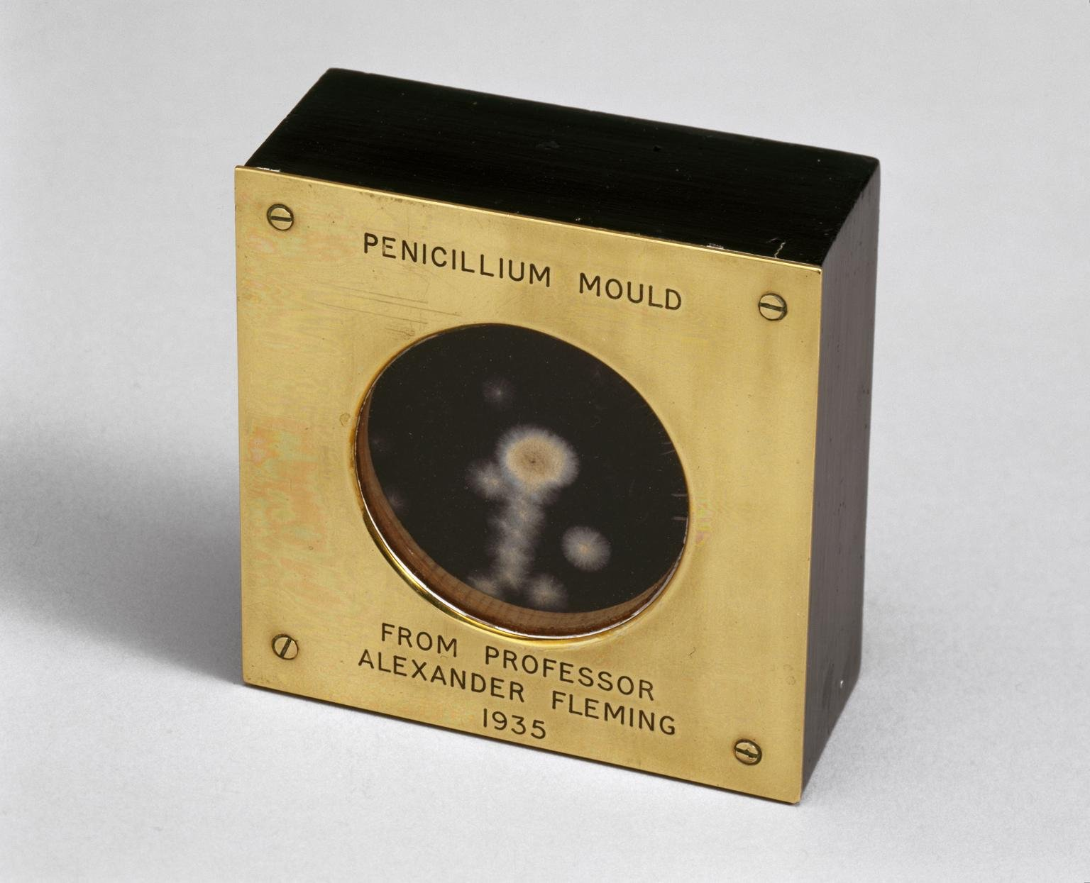

Slide 17
Myth 2: We can do all of this by computer
At present, this is not possible
This is not a problem of computer power as such, but the intrinsic problem of how to predict conformation from scratch
If you have a starting point, i.e. a molecule that you know interacts with your target, it will help you design the next molecule
The value of computer simulation is in getting you to the optimal compound as quickly as possible, not in designing ligands de novo

Slide 18
Clinical Trials
Once a candidate has been selected and the various safety hurdles addressed it can be entered into clinical trial.

Slide 20
Phase 1 clinical trials
Phase 1 trials generally focus on safety, tolerability and bioavailability properties rather than efficacy
The drug is administered to a small number of healthy volunteer trial participants

Slide 21
Phase 2 clinical trials
Phase 2 trials are focused on determining the efficacy of the drug in a larger number of patients (perhaps several hundred) suffering from the condition that the drug is intended to treat
These trials may be performed globally and give information on efficacy and allow for a further estimation of safety in a larger population

Slide 22
Phase 3 clinical trials
Assuming satisfactory results from phase 2 studies, the drug will enter phase 3 clinical trials
Phase 3 clinical trials are in essence larger versions of the previous trials intended to answer specific questions with respect to efficacy
The trials would routinely involve several thousand patients and compare the i.n.d. with drugs that are currently in use for the treatment of the disease (“comparators”)
The results from these trials essentially form the basis of the risk/benefit analysis that will be submitted to the regulatory authorities

Slide 23
Phase 4 clinical trials
These trials are often referred to as post-marketing studies and they are performed after the medicine has been approved
These give a greater idea of long term risk and benefit and may give indications as to how use can be modified
The trials may involve many thousands of patients and go on for many years
Such trials may assist in indicating other uses for the medicine

Slide 24
Observations
Over the past 20 years there has been a number of changes in the Pharmaceutical industry
There has been a shift from a “black box” discovery process to a “mechanistic” approach to drug discovery
Although there are benefits to this approach, there are some issues:
  The approach is predicated on the “one-disease one-gene” hypothesis, which clearly has limitations, not least for disorders such as schizophrenia amongst others, where effective drugs seem to target multiple receptors

Slide 25
Remember why you do it
That is a hell of a rewarding feeling when you have made something that has become a medicine and people turn round and thank you for doing it. When you talk about professional reward, the people aspect is really something.
  Robin Ganellin, inventor of Tagamet™

Slide 26

Thank you for your attention, I hope this mesmerises you enough to prevent you from asking difficult questions!

