Slide 1

Secure Data Hiding in Image Using Steganography
AICTE B4-INTERNSHIP (CYBER SECURITY JAN-2025)
Presented By:
Student Name : Eemani Ananya Krishna
College Name & Department : Sreyas (SIET) CSE-DS
AICTE Student ID: STU66b5cc0662dec1723190278
AICTE Internship ID: INTERNSHIP_173892172667a5d6fed4b6a

Slide 2
OUTLINE
Problem Statement
Technology used
Wow factor
End users
Result
Conclusion
Git-hub Link
Future scope

Slide 3
Problem Statement
With the increasing need for secure communication, traditional encryption methods often raise suspicion when transmitting sensitive information. Steganography provides a discreet way to hide messages within images, making them appear unchanged to unauthorized viewers. However, existing solutions lack user-friendly interfaces and password-protected security for added privacy. This project aims to create a simple, secure, and efficient image steganography tool using Streamlit, allowing users to encrypt and decrypt messages within images while ensuring password-based access control.

Slide 4
Technology used
Platforms & Tools
GitHub – Version control and project hosting
Streamlit Cloud – For easy web deployment
Jupyter Notebook / VS Code
Programming Language & Frameworks
Python – Core language for encryption and decryption
Streamlit – For building an interactive web-based UI
Libraries & Modules
OpenCV (cv2) – Image processing and manipulation
NumPy – Handling image arrays efficiently
Hashlib – Secure password hashing for authentication

Slide 5
Wow factors : Unique Features of This Project
Password-Protected Encryption – Unlike basic steganography, this project secures hidden messages with a password, ensuring only authorized users can decrypt the data.
Invisible Message Embedding – The encrypted image appears unchanged to the human eye, making it highly discreet and resistant to detection.
Enhanced Security with Randomized Embedding – Instead of sequentially embedding bits into pixels, this project randomly distributes the hidden message across the image using a password-based seed.
End-to-End Security – Uses SHA-256 hashing for password verification, preventing unauthorized access even if the image is intercepted.
No External Dependencies for Storage – Unlike cloud-based solutions, this project runs locally, ensuring that sensitive data is not stored or transmitted over the internet.
Lightweight and Fast Processing – Utilizes OpenCV and NumPy for optimized image processing, making encryption and decryption quick and efficient.

Slide 6
End users
This project is designed for individuals and organizations that require secure and discreet communication. The potential end users include:
Journalists & Activists – Can securely exchange sensitive information without raising suspicion.
Government & Intelligence Agencies – Useful for covert communication and protecting classified data.
Corporate Professionals – Helps safeguard confidential business information.
Researchers & Academics – Can hide sensitive research data for secure storage and sharing.
General Users Concerned About Privacy – Individuals who want to protect personal messages from unauthorized access.
Cybersecurity Enthusiasts & Ethical Hackers – A learning tool to explore steganography techniques and encryption methods.

Slide 7
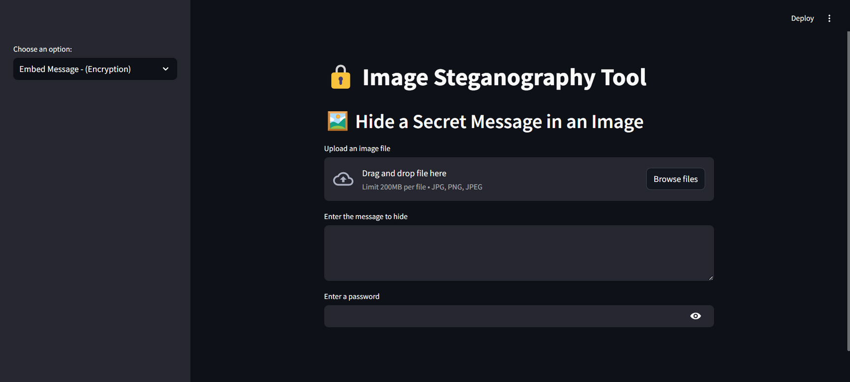
Results
The output of the project, it has side bar menu to Encrypt or decrypt the messages.

Slide 8
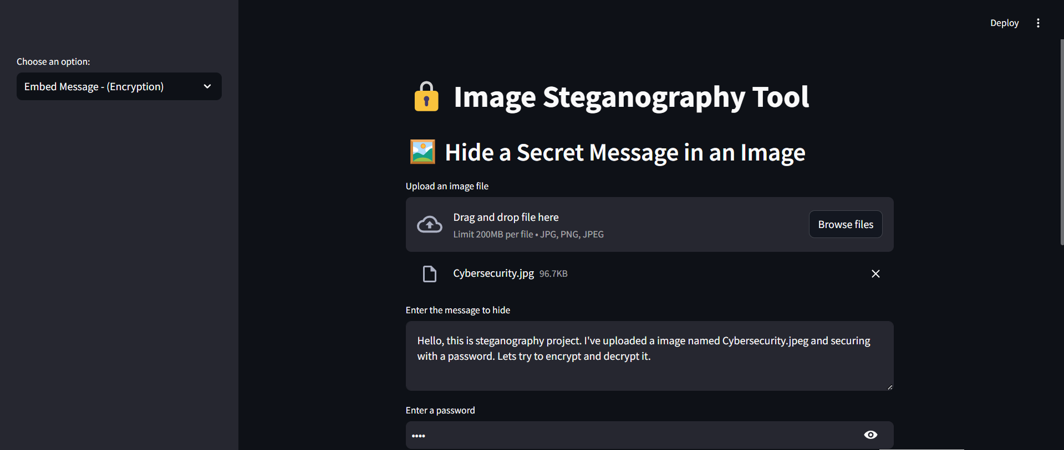
Results
Select "Encrypt Message" from the sidebar menu. Upload an Image – Choose a .jpg or .png image where the message will be hidden. Enter Your Secret Message – Type the text you want to hide inside the image. Set an Encryption Password – Enter a secure password that will be required for decryption.

Slide 9
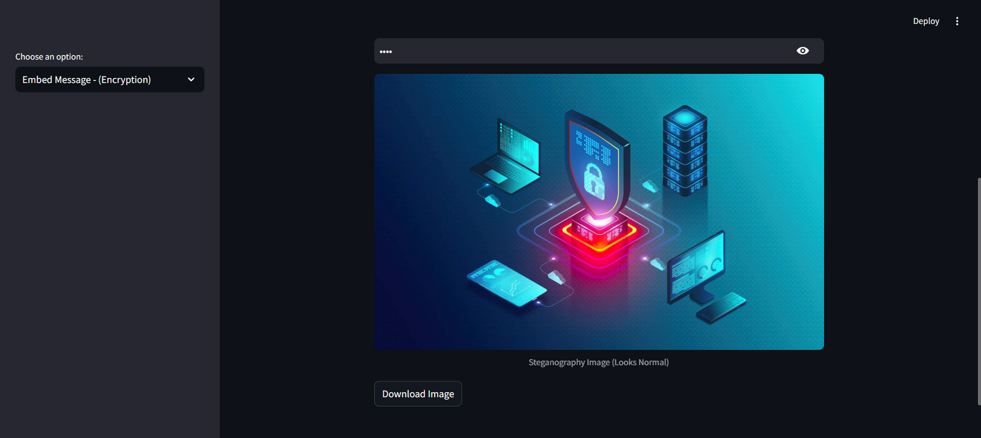
Results
Encrypt the Image, Click the button to process the image. Download the Encrypted Image, Save the modified image, which looks the same but contains hidden data.

Slide 10
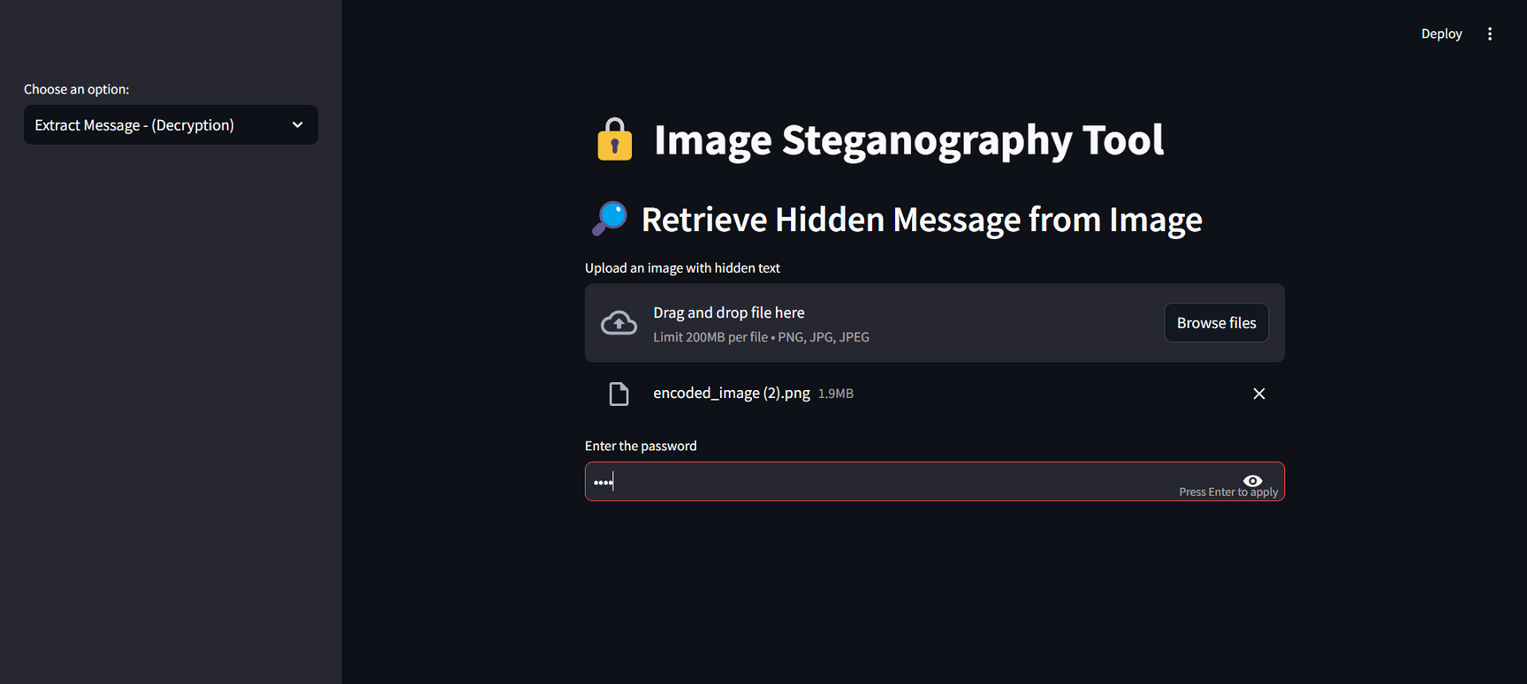
Results
Select "Decrypt Message" from the sidebar menu. Upload the Encrypted Image – Choose the .png or .jpg file containing the hidden message. Enter the Decryption Password – Provide the same password used during encryption

Slide 11
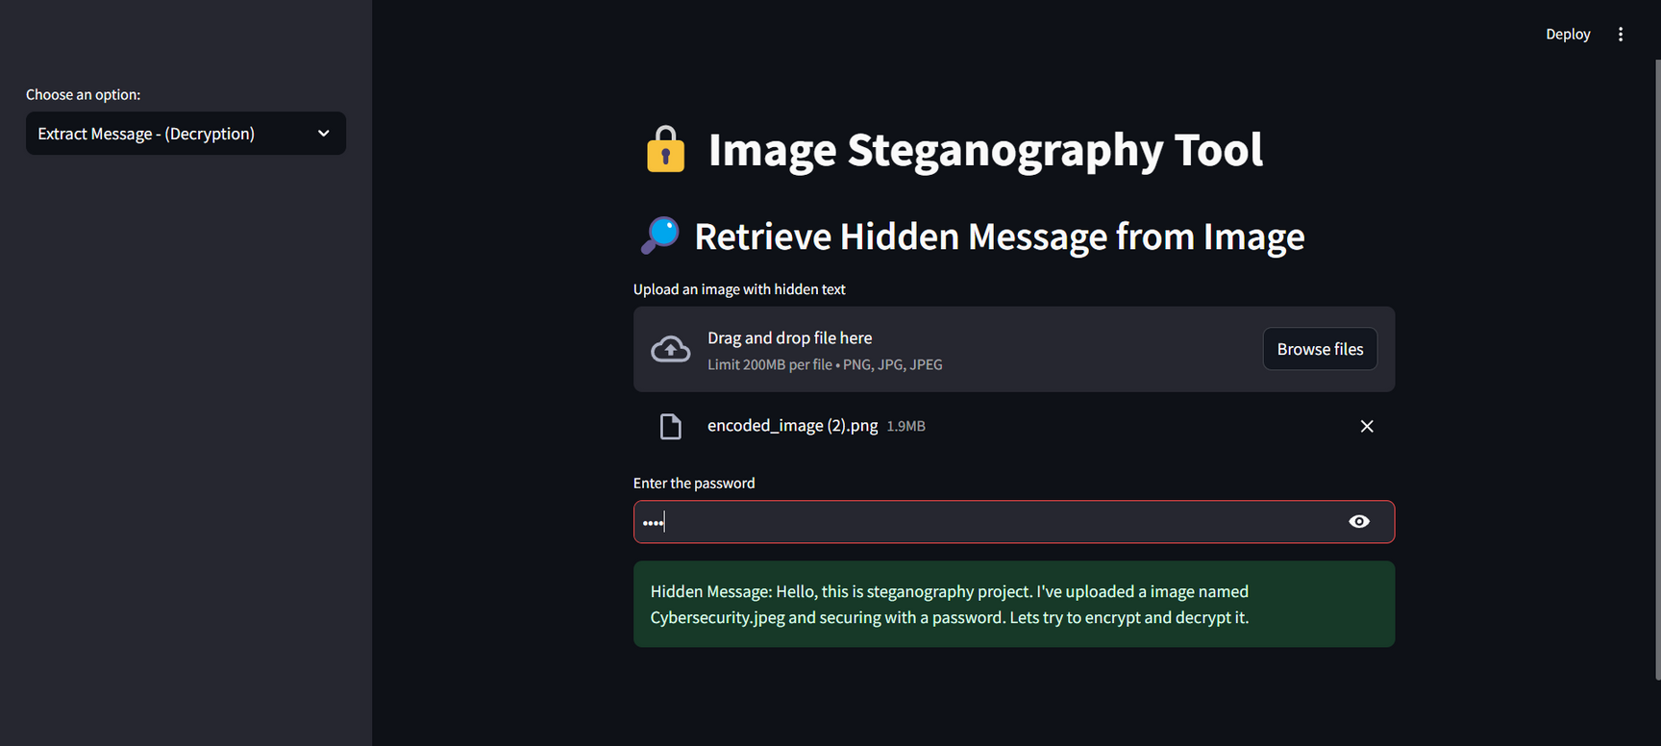
Results
Retrieve the Hidden Message – If the password is correct, the hidden text will be displayed.

Slide 12
Conclusion
This Secure Image Steganography App successfully addresses the problem of secure and discreet communication by embedding encrypted messages within images. Unlike traditional encryption methods, which can raise suspicion, this project provides a covert way to hide sensitive information without altering the visible appearance of the image.
With features like password-protected encryption, randomized message embedding, and an intuitive web interface, the project ensures enhanced security, ease of use, and resistance to brute-force attacks. By eliminating external storage dependencies and offering local processing, it further enhances privacy and data protection.
Overall, this project serves as a robust, efficient, and user-friendly solution for individuals and organizations needing secure message transmission, fulfilling the objectives outlined in the problem statement.

Slide 13
GitHub Link
🔗 Check out the project on GitHub: https://github.com/ananyakrishnaeemani/Steg-It
🔗 Try the live demo here:
https://encrypt-image-on-stego-it.streamlit.app/

Slide 14
Future scope(optional)
Enhanced Security & Encryption
Implement AES/RSA encryption for stronger message protection.
Use salting and hashing to prevent brute-force attacks.
Improved Image Formats & Storage
Support lossless formats like TIFF and RAW for better data retention.
Utilize advanced steganography techniques like LSB++ or F5 for improved efficiency.
Secure Sharing & Cloud Integration
Develop a web or mobile application for easy access.
Enable secure cloud storage and sharing through platforms like Google Drive or AWS.
AI-Powered Steganalysis Defense
Use deep learning models to enhance the invisibility of hidden messages.
Implement AI-based detection resistance to prevent message extraction.
Real-World Applications
Ensure secure communication for journalists and forensic experts.
Enable copyright protection by embedding ownership details in images.

Slide 15
THANK YOU

