Slide 1
ENGI 301 Simon Says PCB Project
Ananya Lingineni
Due 12/12/2023 @ 11:59pm

Slide 2
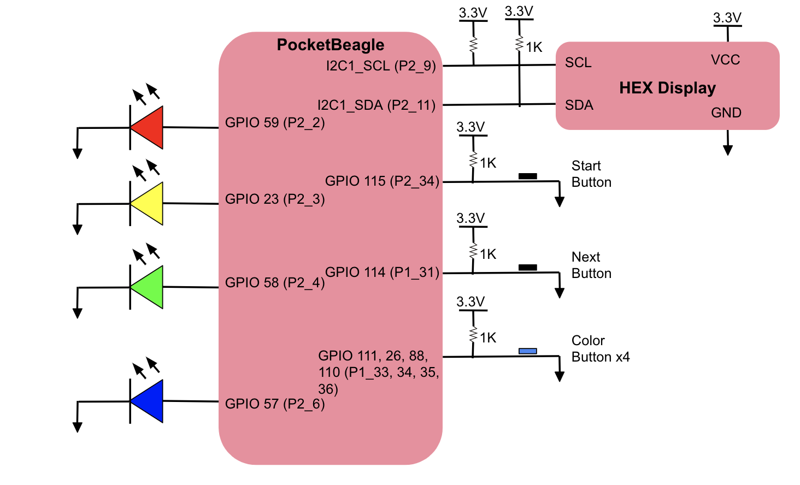
System Block Diagram

Slide 3
Mechanical Drawing
1.5”
= LED
3”
0.3”
.35”
Hex Display
Button
Pocket Beagle
Button
USB
2”
Button
Button
Button
Button
0.3”
0.45”
0.2”
0.3”
FRONT
BACK

