Slide 1
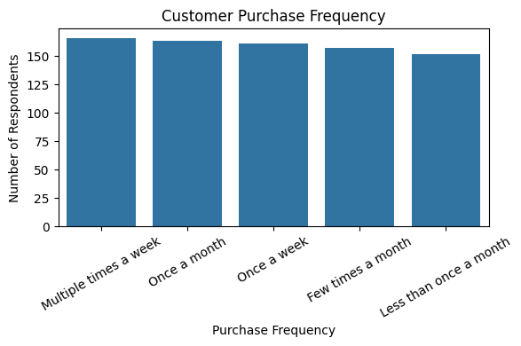
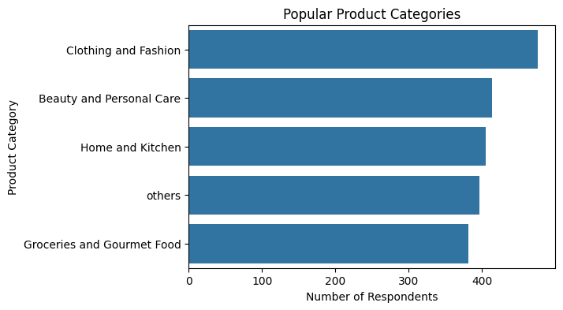
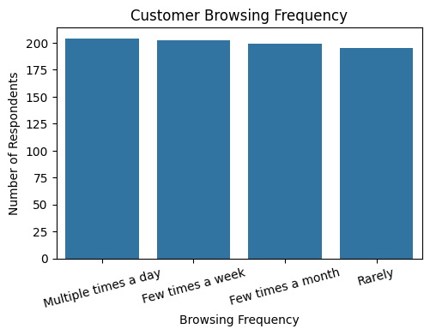
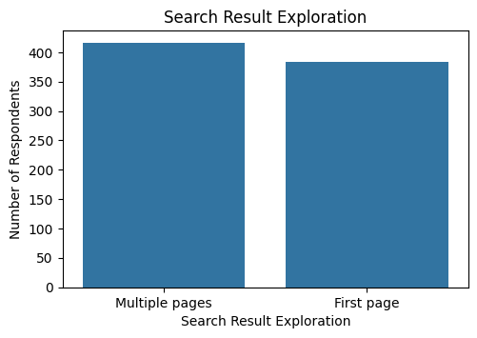
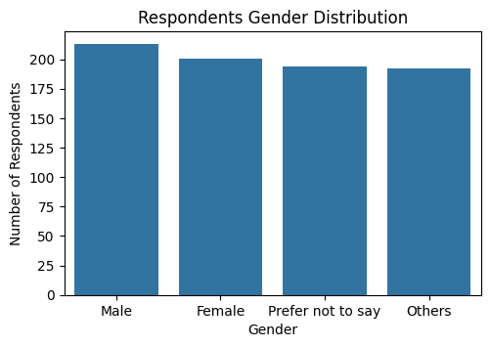
Market Basket Analysis with Python - Snapdeal
40.00 %
Low Satisfaction
40.88 %
High Frequency Behavior
52.00 %
Multiple Page Search
34.50 %
Add to Cart (Yes)
67.38 %
Recommendation not helpful/sometimes
27.38 %
(Better Price Elsewhere)
Top Cart Abandonment Reason
Purchase frequency is almost evenly distributed.
Clothing & Fashion are the most popular product categories followed by Beauty & Personal Care.
Browsing engagement is high. Number of customers browsing multiple times a day and few times a week are higher.
52% of the customers explore multiple search result pages.
Among the respondents, males are the highest in number followed by females.

Slide 2
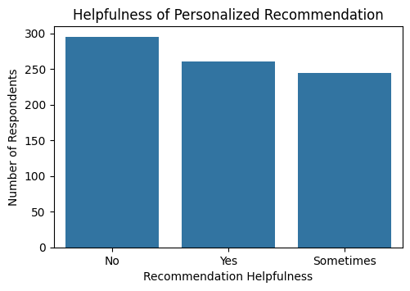
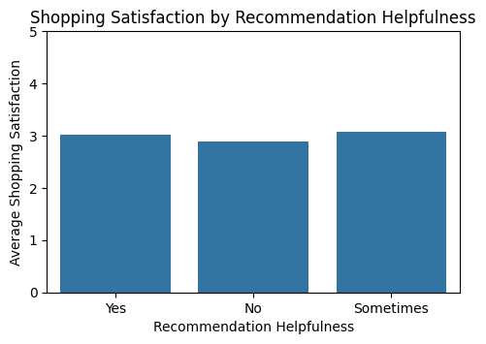
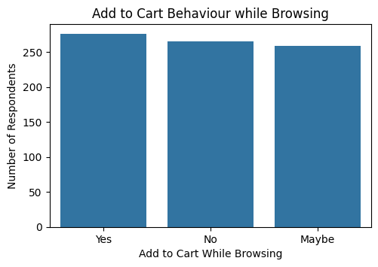
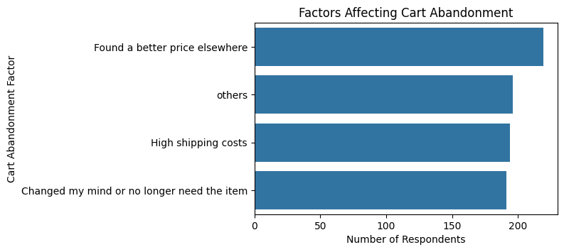
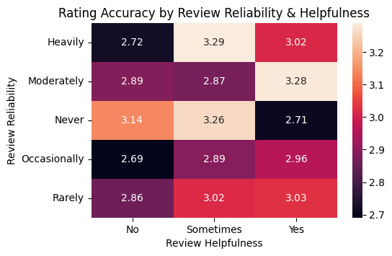
Market Basket Analysis with Python - Snapdeal
67.38% of the respondents either do not find the personalized recommendations helpful or only sometimes helpful.
Those who find personalized recommendations helpful or sometimes helpful do not have much difference in average shopping satisfaction than those who do not find them helpful.
Add to cart intent is not very different among those who say yes and those who say no or maybe.
Those who rely heavily on reviews not always find those reviews helpful while those who rely rarely on reviews might find them helpful. That means more helpful reviews do not always have high ratings.

Slide 3
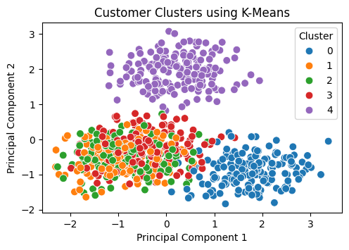
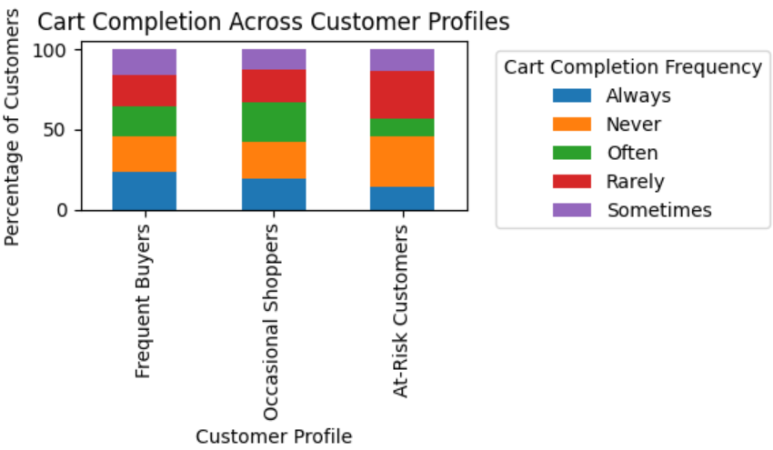
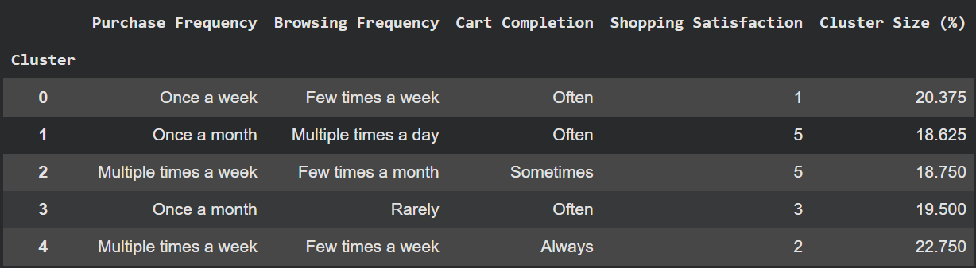
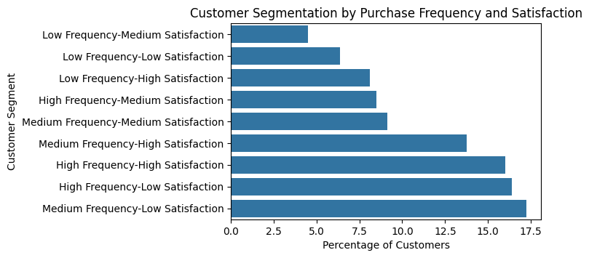
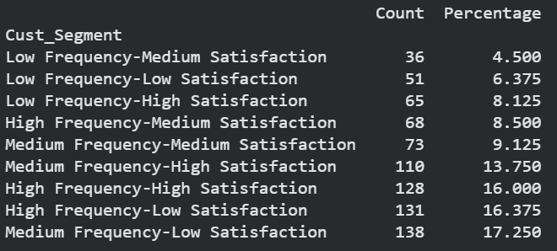
Market Basket Analysis with Python - Snapdeal
K-Means identified 5 different clusters indicating differences in purchasing, browsing, cart completion and shopping satisfaction patterns.
Medium frequency & low satisfaction customers form the largest segment (17.25%). This segment also needs retention efforts along with high frequency and low satisfaction segment (16.38%).
At risk customers have higher never/rarely cart completion frequency while frequent buyers have higher always/often cart completion frequency,
Customers who browse few times a week and purchase once or multiple times a week have lower shopping satisfaction and form the highest clusters. This group needs better shopping experience.

Slide 4
Market Basket Analysis with Python - Snapdeal
Insights:
Customers actively browse and 52% of them explore multiple search result pages but add to cart behavior is almost equal for customers who say yes/no/sometimes.
Finding a better price elsewhere is the highest occurring cart abandonment factor (27.38%) followed by high shipping costs (24.25%).
67.38% of the customers either do not find personalized recommendations helpful or find them helpful only sometimes.
The At-Risk customers have higher never/rarely cart completion, thereby giving a conversion and retention opportunity.
There exists distinct combinations of customers with different purchase frequency and satisfaction levels. Hence, different segments should be treated with different engagement strategies.
Customers who browse few times a week and purchase once or multiple times a week have lower shopping satisfaction and form the highest clusters.
Recommendations:
Use behavioral data of customers like browsing, purchasing, cart abandonment, cart completion etc. to personalize recommendations and ensure the customers find them helpful.
Monitoring of competitor pricing and using targeted discounts and lowering shipping costs are needed to reduce cart abandonment.
Improve product search exploration and filters so that customers find the required products faster and on the first page.
Target customers with low satisfaction, high cart abandonment and at-risk customers with low cart completion.
Improve the shopping experience of customers who browse few times a week and purchase once or multiple times a week (43.13% cluster size) while also encouraging customers who browse multiple times a day but purchase once a month (18.63% cluster size) to buy more.

