Slide 1

SPARK OS
Educational Mini Operating System — Review 3
Team: Tech Titans
Team Members:
Ananya (2510030251)
Uday Kiran (2510030081)
Sai Charan (2510030205)
Harsha (2510030061)

Slide 2
Project Overview
• Spark OS is an educational mini operating system that connects OS theory with practical implementation.
• Core concepts are implemented as independent modules for clarity and extensibility.
• Development and testing are performed in an Ubuntu environment.
• QEMU provides a controlled, reproducible environment for execution and demonstration.
• Interaction and observation are via a simple VGA text-mode shell and a small set of commands.
OS Theory
↓
Implementation
↓
QEMU
↓
Observation
↓
Learning

Slide 3
Existing Gap and Proposed Approach
Existing Gap
Spark OS Approach
OS concepts are frequently taught as isolated theory.
PCB and process states are difficult for students to visualise.
Scheduling often remains paper-based or simulated without integration.
Students rarely see these concepts inside a booting OS image.
Implement concepts as working, independent modules in C/assembly.
Expose functionality via an in-OS shell (help/about/ps/states/schedule).
Run and test inside QEMU using a GRUB-bootable ISO for reproducibility.
Observe internal structures (PCB, process table, scheduler state) directly.

Slide 4

Novelty of Developed Methodology
The novelty is not the Round Robin algorithm itself; rather it is the educational methodology that makes internal OS concepts concrete and observable for learners.
Concept-to-Implementation
Module Design
Translate textbook concepts into small, testable modules.
Separate PCB, process table, scheduler and shell for clarity.
In-VM Demonstration
Immediate Feedback
Use QEMU + shell commands to reveal runtime state.
Shell commands provide reproducible evidence for learning and assessment.

Slide 5
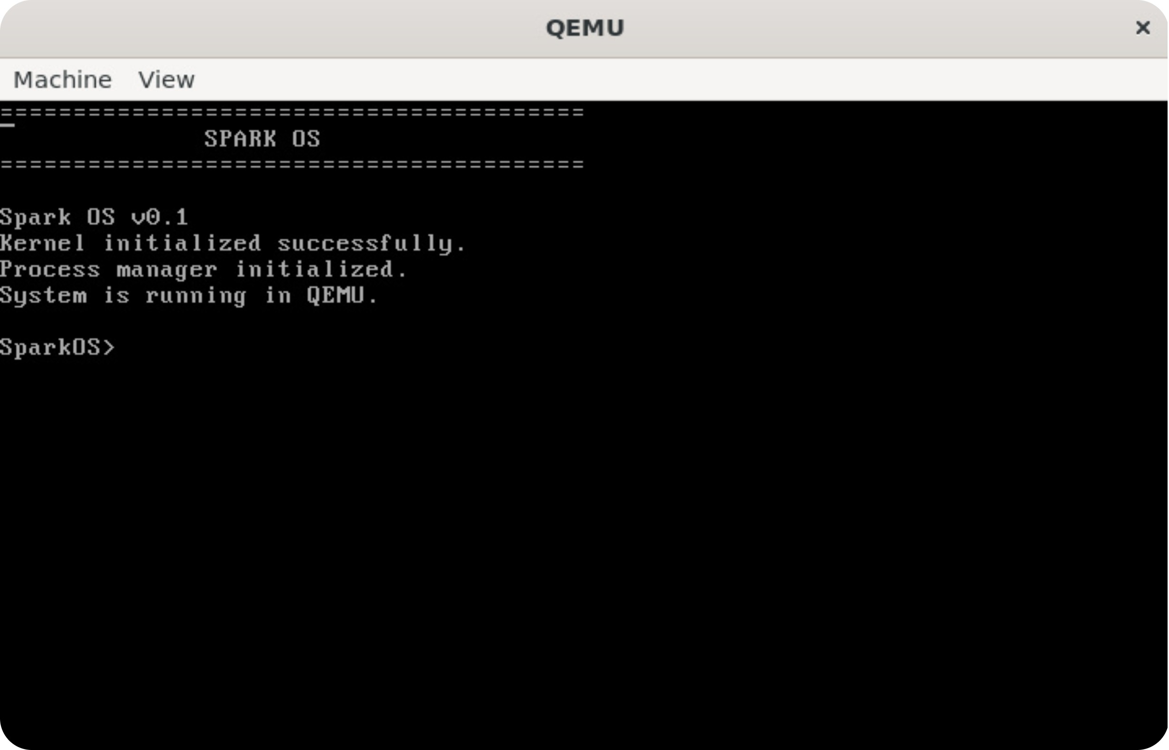
Pipeline:
OS CONCEPT
↓
MODULE DESIGN
↓
C IMPLEMENTATION
↓
QEMU EXECUTION
↓
SHELL-BASED DEMONSTRATION
↓
RESULT EVALUATION

Slide 6

Spark OS — System Architecture
Clean, modular architecture emphasising separation between user interface and core OS modules.
Boot Sequence
Bootloader → Kernel → Shell initialization.
User Interaction
User issues commands to the Shell.
Process Management
Shell → Process Manager updates PCB table.
Scheduling
Round-robin Scheduler selects next PCB.
Execution
Scheduler dispatches to QEMU/CPU for run.
Boot sequence: Bootloader (GRUB) → Kernel → Shell → OS Modules (Process Manager, Scheduler, PCB).

Slide 7
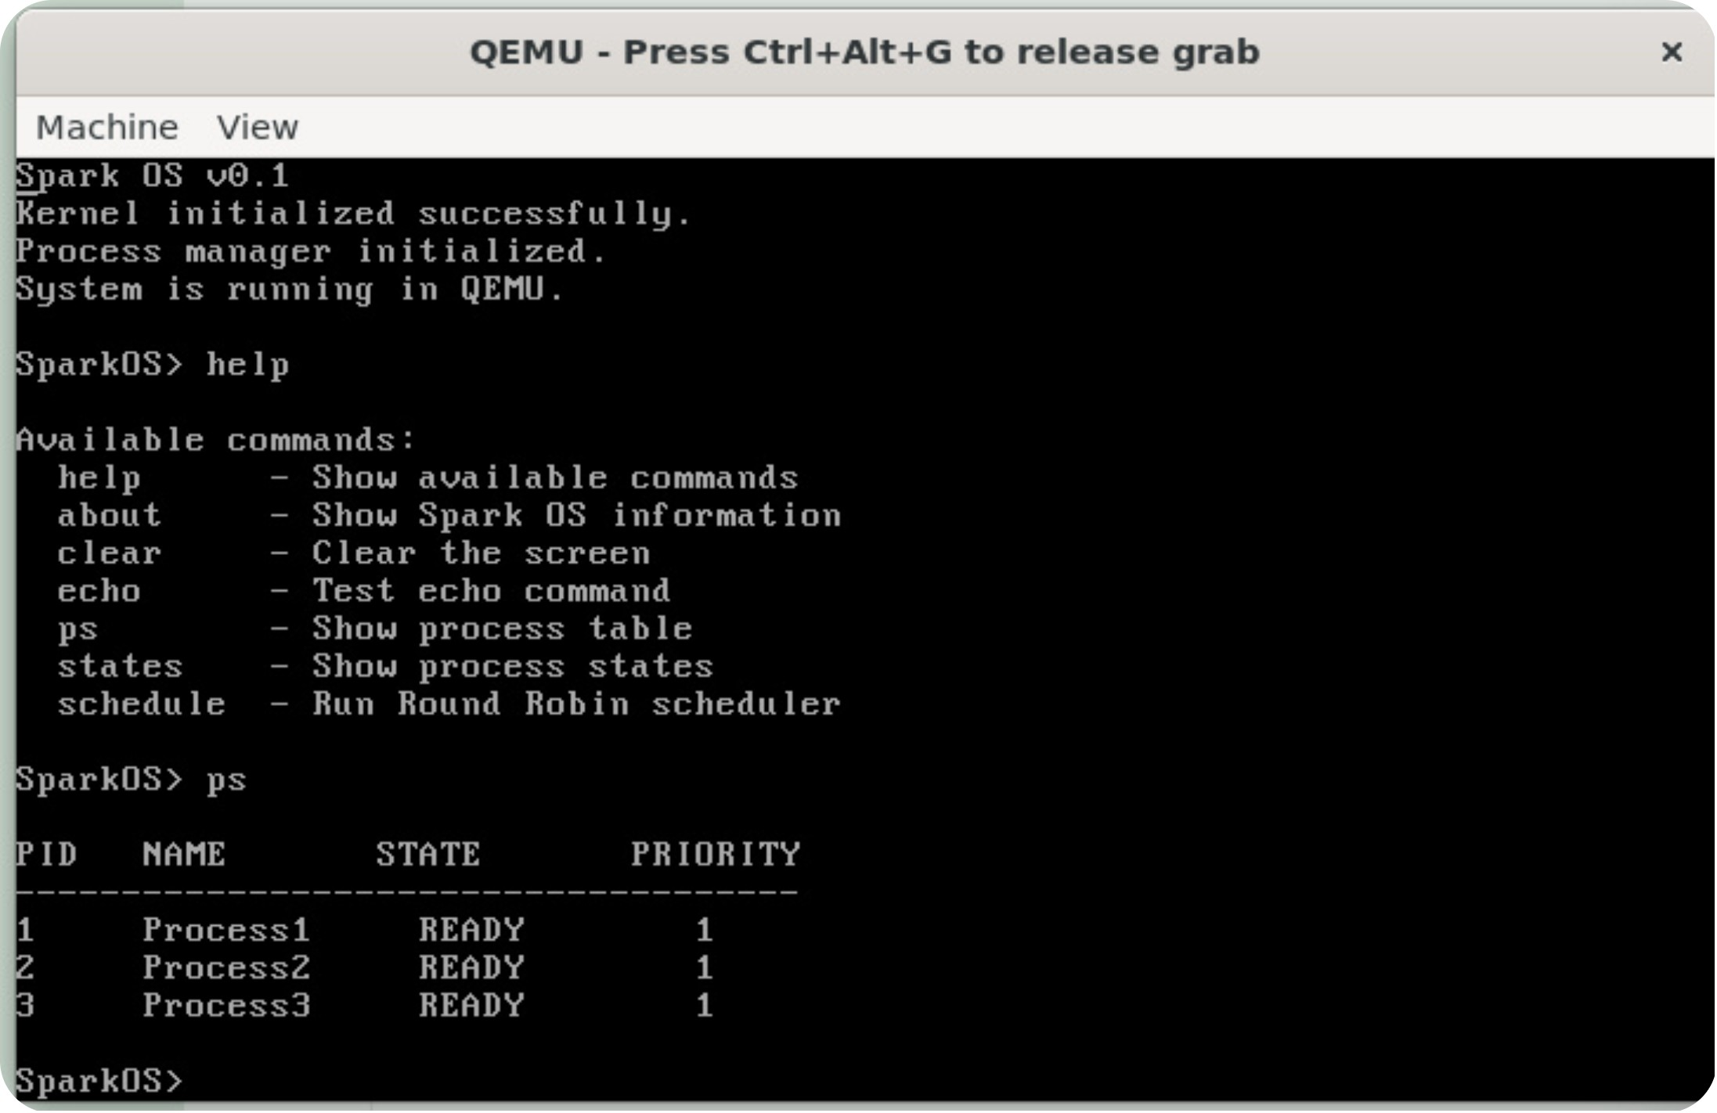
Process Management Implementation
PCB Fields
ps command: output showing PID, Name,
State, Priority
PID — unique process identifier
Process Name — short descriptor
Process State — NEW / READY / RUNNING / WAITING / TERMINATED
Priority — scheduling hint (integer)
Process Table (initial test data)
PID | Name | State | Priority
1 | Process1 | READY | 1
2 | Process2 | READY | 1
3 | Process3 | READY | 1

Slide 8
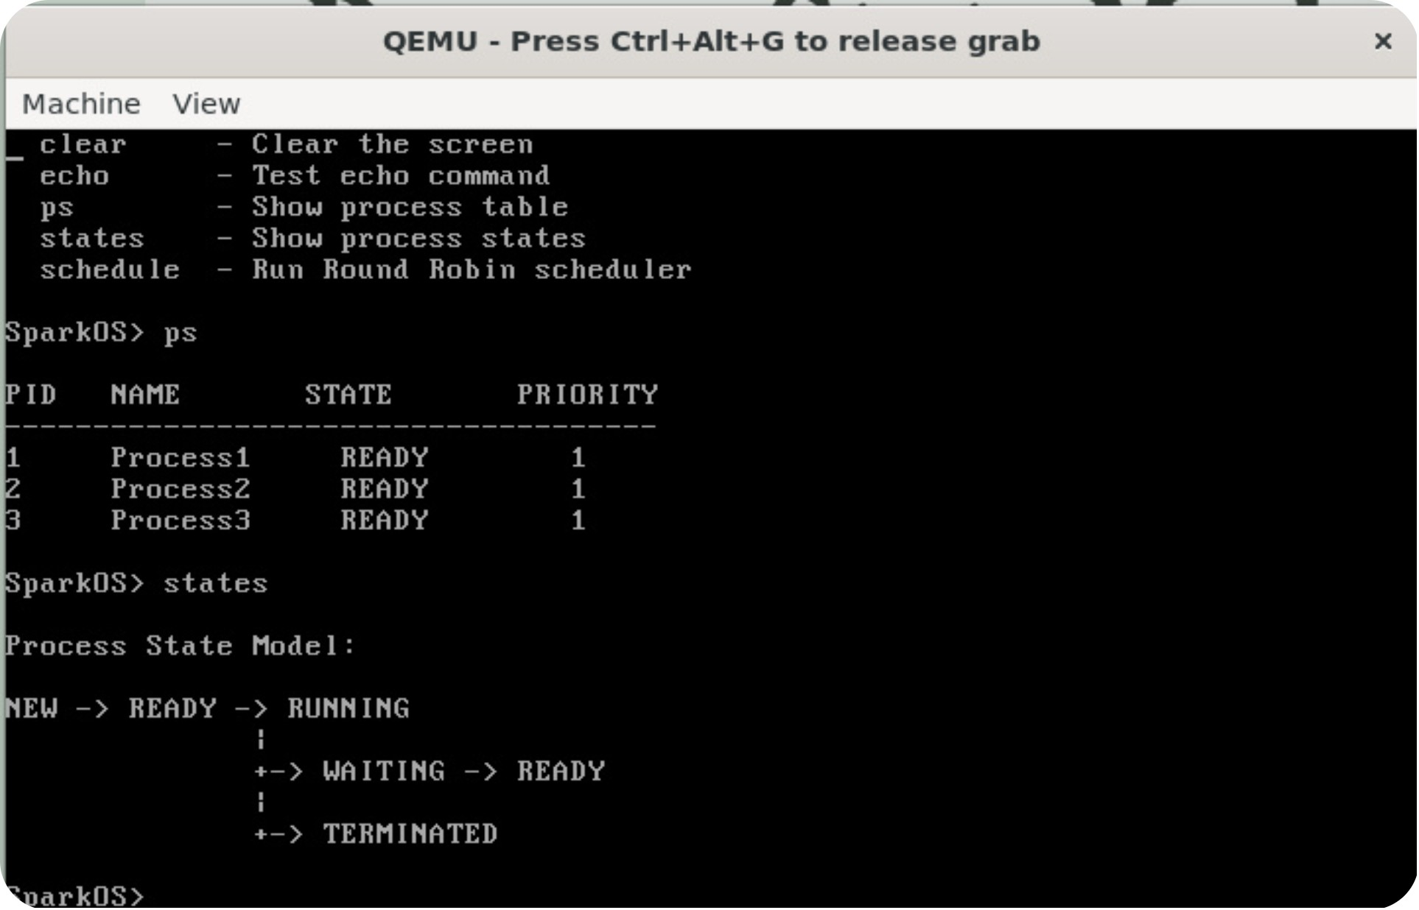
Process State Model
State Transition Diagram
states command: output —
Process State Model
NEW → READY → RUNNING → (WAITING → READY) → TERMINATED
Brief definitions:
NEW — process created but not admitted
READY — waiting for CPU
RUNNING — currently executing
WAITING — blocked for I/O or event
TERMINATED — execution finished

Slide 9
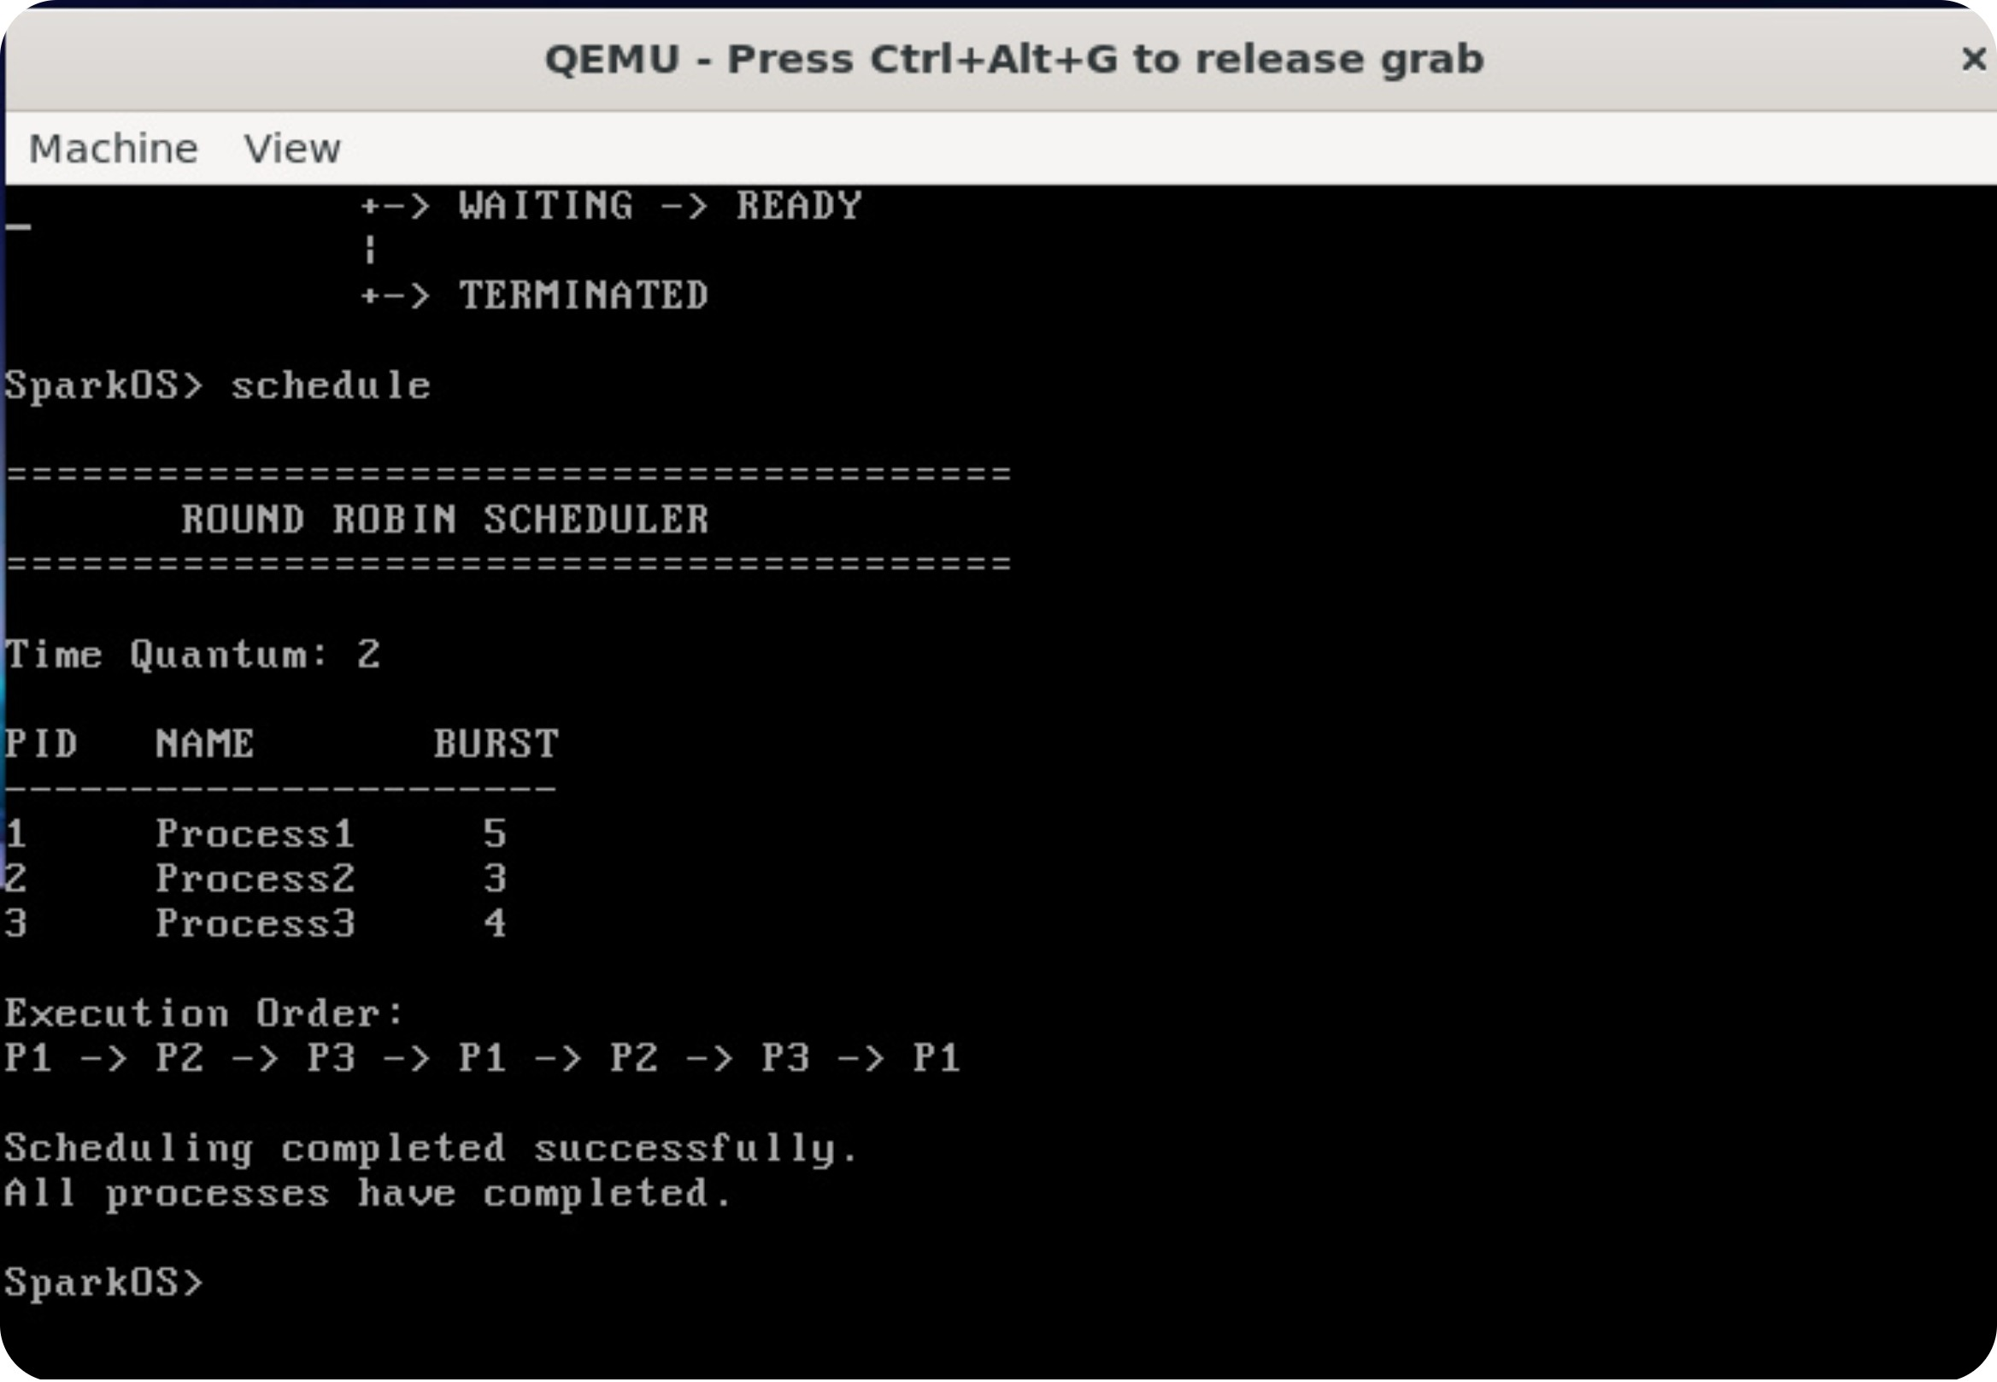
Round Robin Scheduling Implementation
Initial processes: P1 (5), P2 (3), P3 (4)
Behaviour: each READY process is given up to the time quantum; remaining burst returns to the ready queue. This is a scheduling simulation implemented in software — see Technical Honesty note.
Execution Sequence:
P1 → P2 → P3 → P1 → P2 → P3 → P1

Slide 10
Methodology Evaluation
Evaluation Table (summary)
Criterion | Result
Correctness | Expected process information and scheduling sequence displayed by shell commands.
Modularity | Process manager and scheduler implemented as separate modules; clear interfaces.
Testability | Features testable via shell commands (ps, states, schedule).
Demonstrability | OS concepts visible through QEMU output and shell evidence.
Understandability | Tables, simple commands and documented outputs support comprehension.
Reproducibility | Build instructions (Ubuntu, GCC, NASM, GNU LD, GRUB, QEMU) allow rebuild.

Slide 11
Adaptability & Accessibility
Adaptability
Modules can be replaced: scheduler → FCFS, priority scheduling, varied quantum.
Supports adding more processes and configurable quantum without redesign.
Future additions (timer interrupts, real context switching) planned as module extensions.
Dissemination & Accessibility
Uses common open-source tools (Ubuntu, GCC, NASM, GRUB, QEMU).
No specialised hardware required — reproducible in standard lab machines.
Source code modular structure eases onboarding for students.

Slide 12
THANK YOU!

