Slide 1
Audio Compression Using DFT,DWT and FFT

Slide 2
Introduction
The Essence of Audio Compression
Audio compression is essential for reducing file sizes and enabling efficient storage and transmission. Our focus lies on leveraging the Discrete Fourier Transform (DFT) and Fast Fourier Transform (FFT)—the mathematical catalysts that enable this process.
Project Purpose
We aim to explore and implement DFT and FFT from scratch, demonstrating their role in compressing audio files. By comparing these techniques, we'll assess their efficiency and impact on audio quality.

Slide 3
Paper Link | Paper Name | Method | Takeaway
https://www.ijsr.net/archive/v6i2/ART2017951.pdf https://web.cecs.pdx.edu/~mperkows/CLASS_573/Kumar_2007/01227607.pdf https://citeseerx.ist.psu.edu/document?repid=rep1&type=pdf&doi=ad4e81ef175882ead70f4511d351db11e6c58fe2 https://dl.acm.org/doi/pdf/10.1145/354756.354857 | Audio Compression Using Fourier Transform Perinati Tewari | using the Fourier Transform to differentiate between frequencies, using lossy compression by discarding inaudible frequencies and reducing the bit rate of less sensitive sound signals | The paper underscores the efficacy of audio compression by utilizing the psychoacoustic properties of human hearing, particularly through the application of Fourier Transform methods.

Slide 4
How our method compares to the referenced paper.
Our method utilizes custom-implemented Discrete and Fast Fourier Transforms to compress audio data. By analyzing frequency components, we selectively reduce file size while aiming to preserve audible quality. This aligns with techniques in the referenced paper, yet with an emphasis on algorithmic understanding and efficiency evaluation of DFT and FFT in practice.

Slide 5
Problem Statement
The task involves developing an audio compression algorithm leveraging the FFT to reduce the size of audio files. This algorithm should maintain a balance between compression ratio and audio quality, making it suitable for various applications ranging from archival purposes to real-time audio streaming. The challenge lies in designing the algorithm to be efficient, capable of handling audio files of different lengths and formats, and ensuring the output audio maintains intelligibility and fidelity to the original to an acceptable degree.

Slide 6
But where is DFT being used ?
the Discrete Fourier Transform (DFT) is implicitly used through the implementation of a custom Fast Fourier Transform (FFT) method for compressing the audio file. The FFT is an efficient algorithm for computing the DFT
he DFT (via FFT) is used to :
Transform audio data into the frequency domain, where compression is applied by selectively retaining significant frequency components.
Enable the manipulation of audio data in a way that reduces file size while attempting to preserve as much of the original audio quality as possible.
Provide a basis for both analyzing and modifying the audio content efficiently, which is crucial for effective compression.

Slide 7
What is DWT and where it is used?
DWT stands for Discrete Wavelet Transform. It's a mathematical transform used in signal processing and data compression.
How and where it is being used:
The DWT decomposes a signal into different frequency components called wavelets, which are then analyzed and processed independently.
It's widely used in various fields such as image and audio compression, denoising, feature extraction, and more.
The DWT has advantages over other transforms like the Fourier Transform in terms of its ability to capture both frequency and time-domain information simultaneously, making it particularly useful for analyzing non-stationary signals.

Slide 8
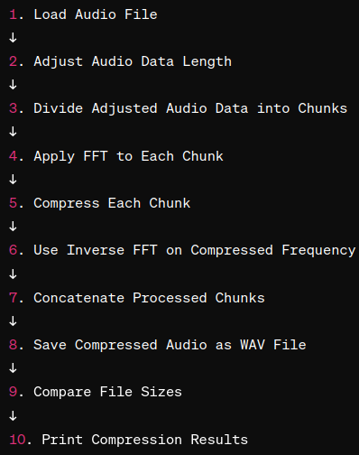
Flow of things { To be explained By group members }
{ MAIN SLIDE }

Slide 9
IMPLEMENTATION
https://colab.research.google.com/drive/1-vqms0vSny1cQM-R3N3dJnRFmiu0eOWC?usp=sharing

Slide 10
Conclusion
his exercise underscores the importance of algorithmic efficiency and the potential of FFT in multimedia applications. By custom implementing FFT and DFT, and through careful manipulation of frequency components, the code provides a basis for experimenting with different compression ratios and chunk sizes, offering insights into the trade-offs between compression efficiency and audio quality. Such exploration is crucial for advancing audio processing technologies, with implications ranging from streaming services and digital media storage to telecommunications and beyond.

Slide 11
Group Details
Ananya Rao - I008
Ahan Doshi - I006
Aditya Singh - I005

