Slide 1

AgriNurture A sustainable fertilizer usage optimizer for higher yield
Under the Supervision of
Prof. Renuka Singh
a
BY
Ananya Sinha (2102901540020)
Chirag Yadav (2102901540040)
Ayushree Mishra (2102901540020)

Slide 2
Problem Statement
Challenges
Excessive and improper use of fertilizers leads to soil degradation and reduced agricultural productivity.
Impact Heavy metal accumulation, air pollution, greenhouse effect and many such, negatively impacting farmers’ income.
Need Analysis of soil data that provides tailored fertilizer recommendations, promoting sustainable farming while enhancing crop yield and farmer income.

Slide 3
Objectives
Optimize Fertilizer Usage for Enhanced Soil Health Ensuring minimal environmental impact and preventing soil degradation
Increase Agricultural Productivity and Crop Yield Maximize crop yield while maintaining soil fertility and productivity over the long term.
Empower Farmers with Sustainable Agricultural Practices Guidance that enables them to adopt sustainable farming practices and improve their income

Slide 4
Abstract
This project focuses on optimizing fertilizer usage for sustainable agriculture. By integrating soil type, crop type, and various environmental factors, the system recommends the most suitable fertilizer to enhance yield while preserving soil health. Machine learning techniques will be employed to analyze historical data and predict the best fertilizer options. The project aims to balance high productivity with environmental sustainability, ensuring long-term agricultural success. Key outcomes include increased crop yield, reduced environmental impact, and improved soil management practices.

Slide 5
Introduction
Agricultural sustainability is a pressing issue of the modern world. The farm yield has to be maximized while keeping the soil health intact. However, the increased use of excessive and improper fertilizers has led to extensive soil deterioration, reduced agricultural output, and threatened the livelihoods of farmers. In this project, we present a data-driven approach that uses big data analytics and machine learning in order to optimize fertilizer utilization by generating personalized recommendations based on soil characteristics, types of crops being grown, and weather conditions.
We hope that our data driven solution will help in ensuring sustainable farming for maximizing crop yield as well as farmer’s income for livelihood generation.

Slide 6
Literature Review
S. no. | Year | Title | Author | Methodology | Insights
1. | 2024 | Optimizing Fertilizer Usage using Machine Learning Techniques | Nada Attar | Decision Trees, Random Forest, Multilinear Regression | RF achieved 93.68% accuracy, DT achieved 89%
2. | 2024 | Optimizing fertilizer use for sustainable food systems | Yinghui Yuan. | Meta-frontier production function, Two-Stage Residual Inclusion model | IWFS adoption increases fertilizer efficiency, higher yields, reduced labor inputs
3. | 2024 | Fertilization rate optimization model for potato crops | Freddy A. Diaz- | Fertilization rate optimization model | Emissions reduced by 7.5%, final benefit decreased by 0.35%
4. | 2024 | Sustainable Phosphorus Fertilizer Supply Chain Management | Mohammad Shokouhifar | Ensemble heuristic-metaheuristic algorithm (H-WOA-VNS) | 33% yield improvement, 27.8% P efficiency increase
5. | 2023 | Numerical Data Based Fertilizer Recommendation System for Farmer | H K VEERESH | Data-driven approaches, Advanced machine learning algorithms | Improved crop yields, precision fertilizer recommendations

Slide 7
Literature Review
S no. | Year | Title | Author | Methodology | Insights
6. | 2023 | Optimizing soil and fertilizer management strategy for wheat production | Peng Wu | No-tillage, straw mulching, green manure planting | 10-20% reduction in nitrogen inputs, increased wheat yield
7. | 2023 | Soil Analysis-Guided Expert: A Machine Learning Device for Optimized Fertilizer Selection | Robert G. de Luna | Random Forest, Decision Trees, SVM, XGBoost, Neural Networks, Optuna | Neural Network achieved 99% accuracy
8. | 2023 | Optimized fertilization using online soil nitrate data | Yonatan Yekutie | Manual adjustments based on soil nitrate data | 38% reduction in fertilizer application, maintained yield
9. | 2023 | Toward the sustainable use of mineral phosphorus fertilizers for crop production in China | Elstrow | Analysis of primary resource demand for phosphorus fertilizers | Identified challenges in sustainable phosphorus fertilizer use in China
10. | 2023 | Toward the sustainable use of mineral phosphorus fertilizers for crop production in China | Bin Song | Evaluation of final agricultural use of mineral phosphorus fertilizers | DAP and MAP fertilizers had higher yield, but also higher P loss

Slide 8
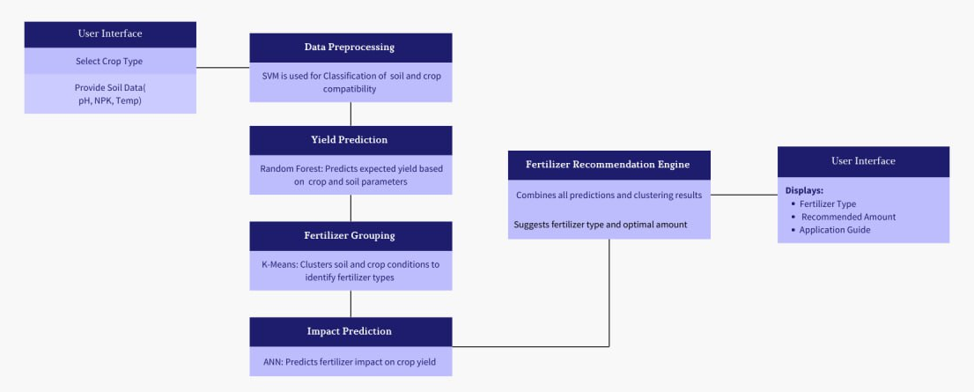
Data Flow Diagram

Slide 9
Methodology
Data Collection: Soil, weather, crop, and geospatial data.
Data Processing: Clean and prepare data for analysis.
Model Training: Machine learning algorithms predict optimal fertilizer use.
Recommendation Generation: Tailored fertilizer advice based on real-time data.
User Interface: Accessible insights via mobile/web apps and data visualization.
Feedback Loop: Farmer inputs improve system recommendations over time.
Sustainability Monitoring: Continuous tracking of environmental benefits.

Slide 10
Technology and Algorithms Used
Random Forest: Used to predict the best fertilizer by analyzing multiple features like soil type, pH, moisture content, and crop type.
Support Vector Machines (SVM): Applied for classification of soil types and fertilizer effectiveness.
K-Means Clustering: To group similar soil and crop types for more tailored recommendations.
Artificial Neural Networks (ANN): For complex relationships between multiple factors, predicting precise fertilizer quantities.
Data Collection: IoT-based soil sensors, satellite imagery for environmental data, and agricultural databases.
Data Processing: Python (Pandas, NumPy), cloud platforms for data storage and model deployment.
User Interface: Web or mobile app interface for farmers to input data and receive recommendations.
Deployment: Cloud-based deployment with real-time recommendation capability

Slide 11
Thank you

