Slide 1

Power BI Dashboard Report
Data-Driven Insights from Global Listings & Reviews
Ananyay Kaushik
ABADS B17

Slide 2
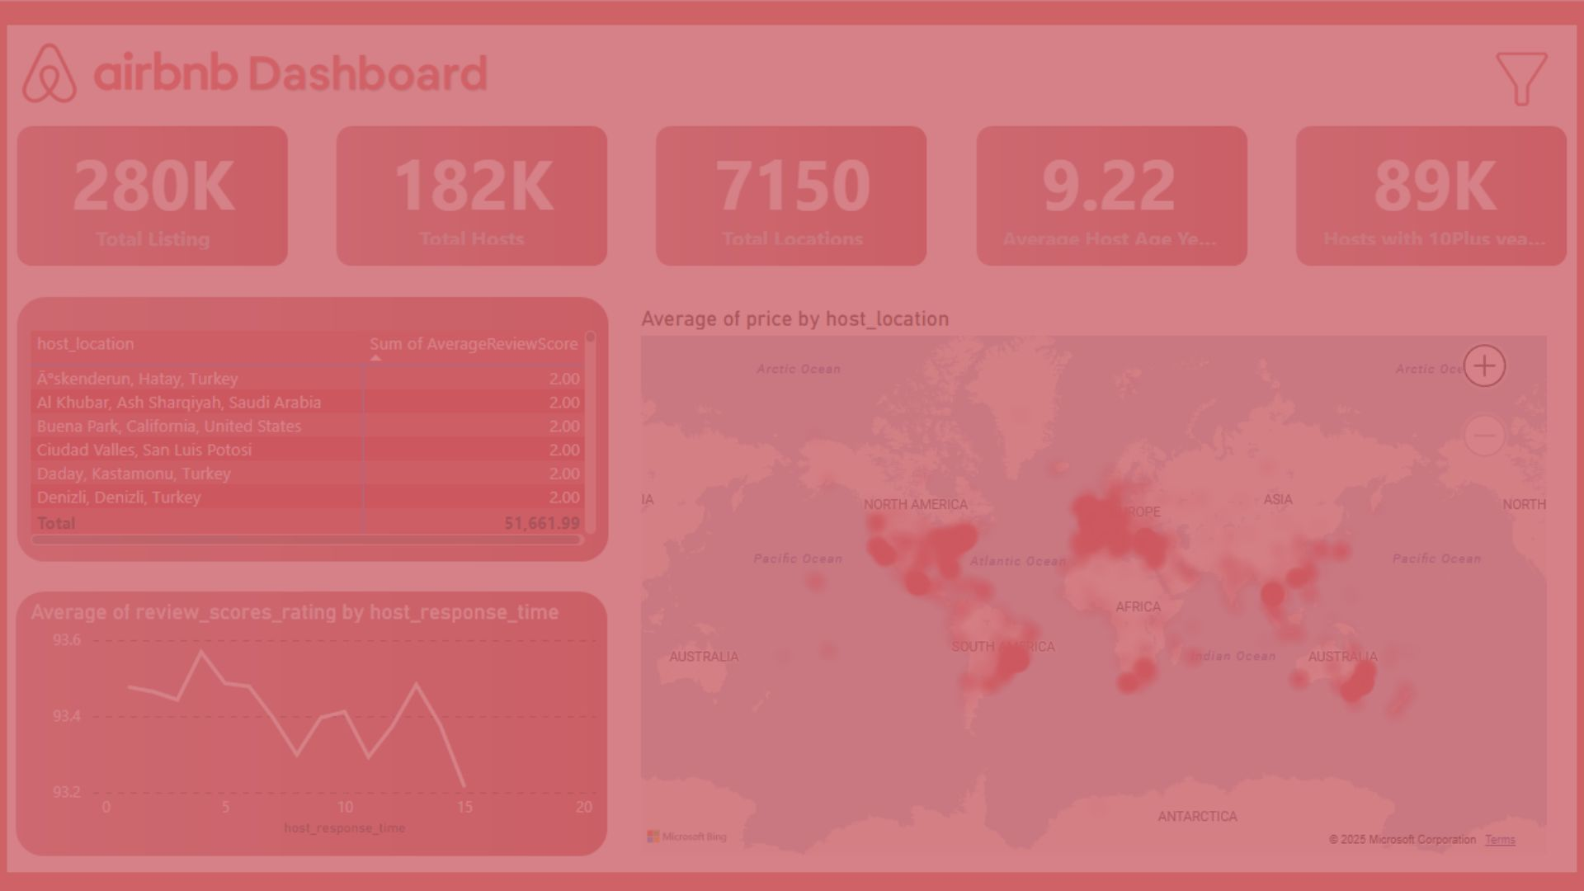
Project Overview
Objective:
Analyze Airbnb listings & reviews to uncover patterns in pricing, satisfaction, host behavior, and visitor trends.
Tools Used:
Power BI, DAX, CSV files (Listings.csv & Reviews.csv)
Datasets:
Listings (details, prices, locations)
Reviews (ratings, timestamps)

Slide 3
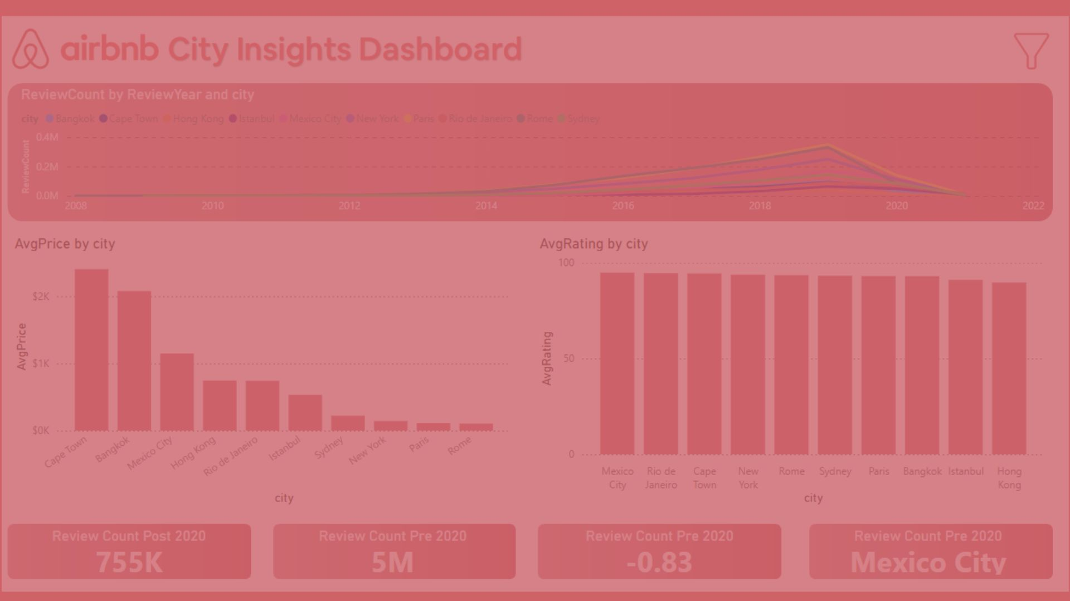
Business Questions Addressed
Which locations have the lowest review scores?
How does host response time impact ratings?
What property types command the highest prices?
How have visitor trends changed in 2020?
Which cities and hosts perform best?

Slide 4
Overview Dashboard

Slide 5





Key KPIs
280K+
Total Listings
182K+
Total Hosts
7.1K+
Locations
9.2 Years
Average Host Age
89K+
Hosts with 10+ Years of experience
50K+
Super Host

Slide 6
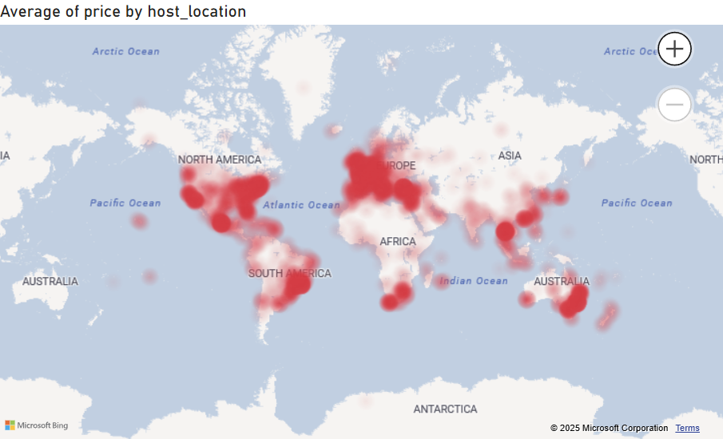

Slide 7




Outliers Skew the Average
A listing in Valencia shows an average price of 499,000, far above typical ranges.
Most Listings Are Budget
Friendly 75% of locations have average prices below 440, with a median of 144.
Wide Global Variation
High and low prices are found across both developed and developing regions.
Optimization Opportunity
A high standard deviation (6,209) shows room for better dynamic pricing strategies.

Slide 8
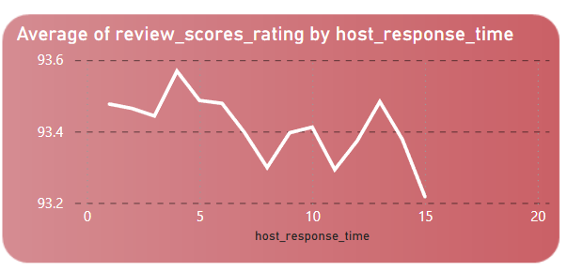

Faster Responses Get Better Ratings
Hosts with quicker response times (1–5) consistently have higher ratings (up to 93.57).
Ratings Drop with Slower Responses
As response time increases, ratings gradually decline, dropping to 93.22 at the slowest level.
Narrow Rating Range, Clear Pattern
Though ratings vary slightly (93.22–93.57), the trend shows a steady preference for responsive hosts.

Slide 9
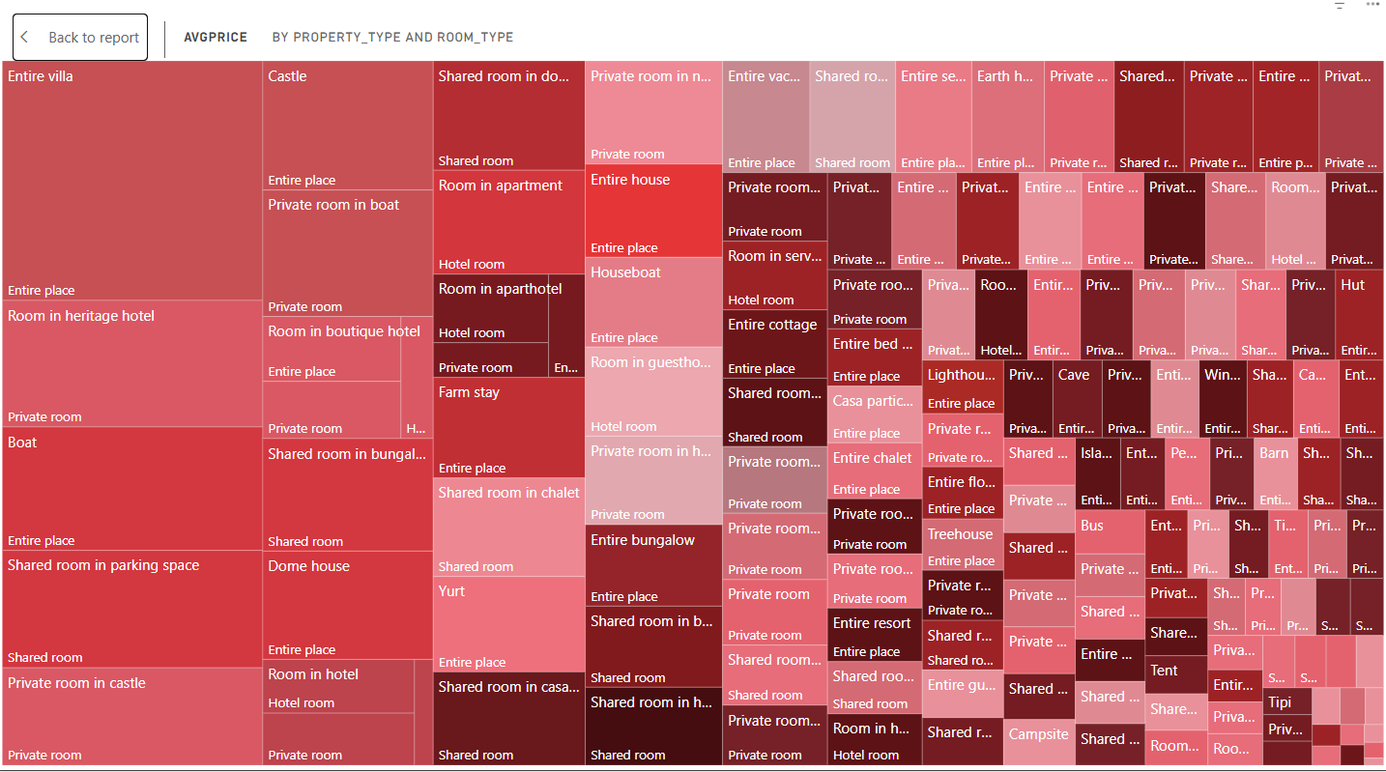

Slide 10

Entire places dominate Airbnb listings, with entire villas generating the highest revenue.
Surprisingly, heritage hotels follow closely — unexpected, as Airbnb is typically preferred for home-like stays over hotel experiences.
Boats, castles, and bungalows also rank high, highlighting a strong demand for unique or novelty stays.
Shared rooms and private rooms are the lowest earners, suggesting limited appeal for shared accommodations.
Overall, distinctive and experience-rich properties consistently command higher prices and guest interest.

Slide 11
Cuauhtémoc leads with the highest composite score (7.80), indicating top-tier host responsiveness and smooth check-ins.
Followed closely by Centro Storico and Buttes-Montmartre, both strong performers in guest experience.
Sydney and Copacabana round out the top five, suggesting that high hospitality standards extend across global regions.
These areas set a benchmark for guest satisfaction in operational touchpoints, especially check-in and communication.
Cape Town and Bangkok top the chart with average prices of 2405 and 2078, showing strong demand or high-value listings in these markets.
Mexico City also commands higher prices (1149), reinforcing its growing appeal as a travel destination.
Surprisingly, traditional hotspots like Paris, Rome, and New York have significantly lower averages (all under 150), possibly due to more compact listings or tighter market competition.
This contrast reveals how regional expectations, property types, and traveler behavior shape pricing — not just city popularity.

Slide 12
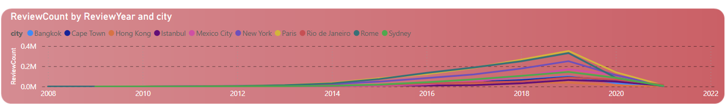
Paris and Rome consistently lead in total reviews across years, with peak activity in 2019 (over 350K reviews in Paris alone).
New York and Mexico City also saw significant engagement, showing strong and steady user interaction year over year.
2020–2021 show a steep decline, clearly reflecting the impact of the COVID-19 pandemic on travel and stays worldwide.
Cities like Bangkok, Cape Town, and Istanbul show gradual growth from 2011–2019, but with fewer total reviews compared to traditional tourist hotspots.
Long-term data since 2008–2009 shows the platform’s global expansion, especially in Europe and North America first, then spreading to Asia and South America.

Slide 13


Massive drop in engagement post-2020, with total reviews falling from 5M to just 755K, a sharp 83% decline.
This highlights the severe impact of the pandemic on global travel and Airbnb activity.
Despite the decline, Mexico City emerged as the top-performing city post-2020, showing strong local resilience and continued guest interest.

Slide 14
Dashboard

Slide 15
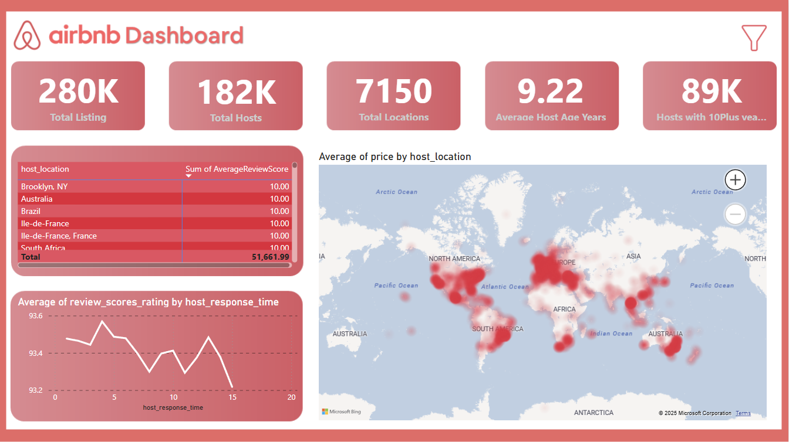

Slide 16
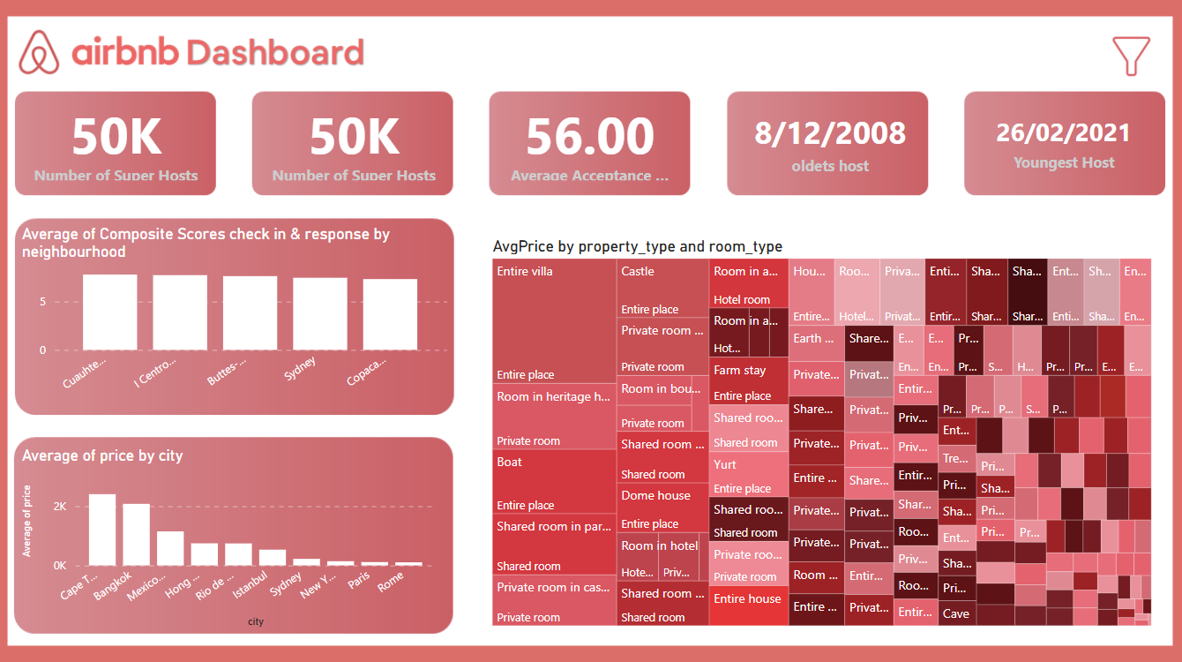

Slide 17
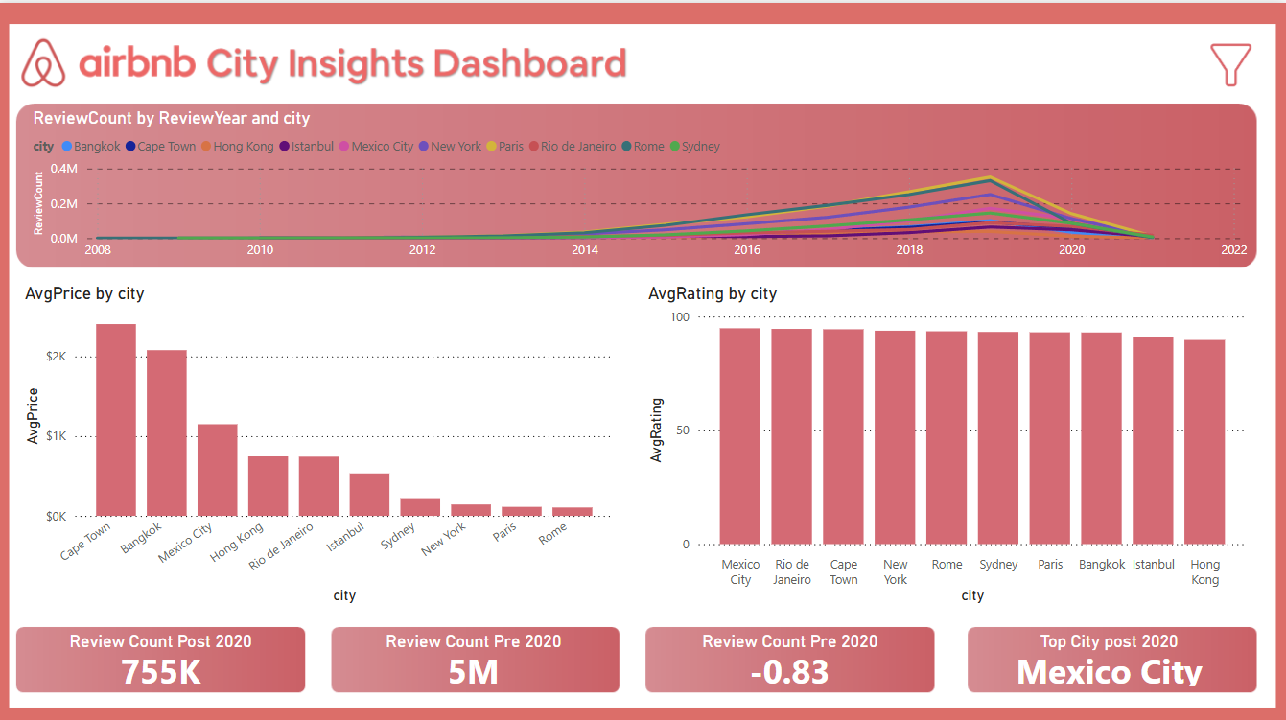

Slide 18
Major takeaways and action points

Slide 19

Entire places dominate listings and generate the highest earnings, especially unique options like villas, heritage homes, and boats.
Review activity dropped 83% post-2020, but cities like Mexico City remain strong performers.
Cape Town and Bangkok have high average prices, signaling premium market potential.
Faster host response times are linked to better guest ratings.
Check-in and communication scores are highest in neighborhoods like Cuauhtémoc and Centro Storico, suggesting strong local management.

Slide 20

For Hosts
Improve response times to boost review scores and visibility.
List entire properties, especially in cities with higher average prices (e.g., Cape Town, Bangkok, Mexico City).
Emphasize unique stays (villas, boats, castles) to tap into novelty-driven bookings.

Slide 21

For Airbnb
Promote top-performing cities post-COVID (e.g., Mexico City) to re-ignite demand.
Incentivize experienced hosts to stay active through loyalty rewards or reduced fees.
Highlight high-scoring neighborhoods for new hosts or guests seeking reliability.

Slide 22
Thankyou and for detailed review visit the dashboard.

