Slide 1

ME 415
Pressure
from PIV
Algorithms &
Project: 6
Comparison with Simulations
Term project · Autumn ’26
By Anany Bajpai (24B2135) & Arnav Oza (24B2217)
Instructor: Prof. Anjishnu Choudhury, MED-IITB
Introduction, problem & objectives
Governing equations & algorithms
Solution strategy & test cases
Results & discussion
CFD comparison & literature
Conclusions
Notes:
Title. Introduce the team and the project: we rebuild the pressure field from PIV-type velocity data, test three algorithms, and compare against exact solutions, a CFD simulation and published studies.

Slide 2
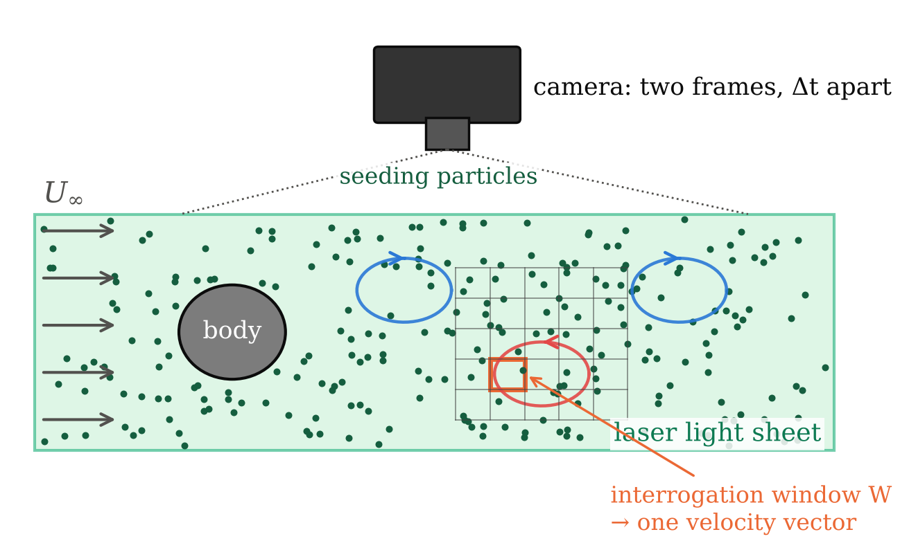
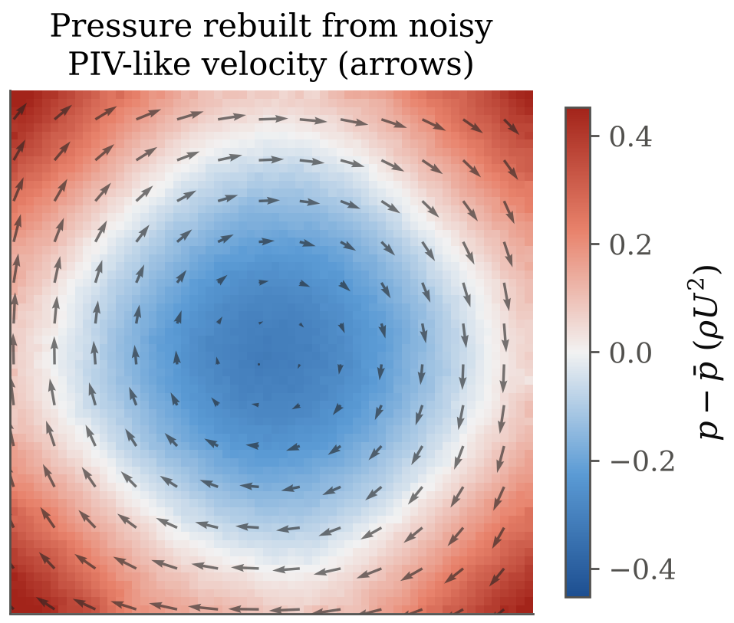
Introduction
What is pressure from PIV?
Fig. 1 Planar PIV (schematic)
Fig. 2 Our pressure reconstruction
Particle Image Velocimetry (PIV) photographs tracer particles in a laser sheet twice, Δt apart, and turns their displacement into a velocity field u(x, y). It does not measure pressure.
Pressure can be recovered from the momentum equation, because its gradient depends only on velocity and how velocity changes in time.
We wrote a Python code that rebuilds pressure from PIV-like velocity with three algorithms (direct, omni-directional, Poisson).
We tested it on exact Navier–Stokes solutions with a synthetic PIV error model, ran an OpenFOAM cylinder wake (Re = 100) as a realistic test, and checked our trends against published studies.
2 /25
Anany Bajpai & Arnav Oza
ME 415: CFD & HT
Autumn ’26
Term Project
Notes:
PIV gives velocity only. Pressure follows from Navier–Stokes. Our work: a code with three integration algorithms, verified on exact solutions with a realistic PIV error model, plus a CFD wake and a comparison with the literature.

Slide 3
Problem & Objectives
Why is pressure from PIV hard, and what did we set out to do?
PIV velocity u, v
(with noise σ)
Problem
Pressure sets forces, noise and cavitation, but taps give only wall values and probes disturb the flow. PIV measures the whole velocity field without touching the flow, but not pressure.
Pressure must be inferred: differentiate the measured velocity, then integrate. Differentiation amplifies measurement noise (Fig. 3).
Why it matters
Full-field pressure from one non-intrusive measurement: loads on wings, blades and bluff bodies, aeroacoustic sources, and flows where probes cannot go (e.g. heart valves).
Objectives
Implement three algorithms: direct, omni-directional and Poisson.
Verify them on exact Navier–Stokes solutions (order of accuracy).
Quantify the effect of spacing, noise, Δt, boundary conditions, window size and denoising.
Compare with a CFD cylinder wake (Re = 100) and published studies.
Expected output
Error trends and guidelines (method, boundary data, spacing, Δt) for planning PIV-pressure experiments.
Differentiate: ∂u/∂t, (u·∇)u, ∇²u
noise grows ~σ/Δt, σ/h, σ/h²
Pressure gradient
∇p = G
Integrate G
(path, rays or Poisson)
Pressure p
(up to a constant)
Fig. 3 Where the noise is amplified
3 /25
Anany Bajpai & Arnav Oza
ME 415: CFD & HT
Autumn ’26
Term Project
Notes:
The core difficulty: velocity has to be differentiated, which amplifies noise, before it can be integrated into pressure. All four objectives are met; the CFD comparison is in the results section.

Slide 4
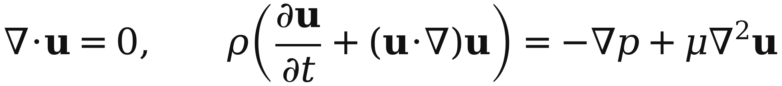
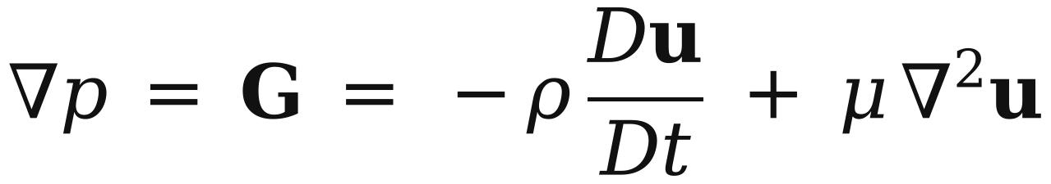
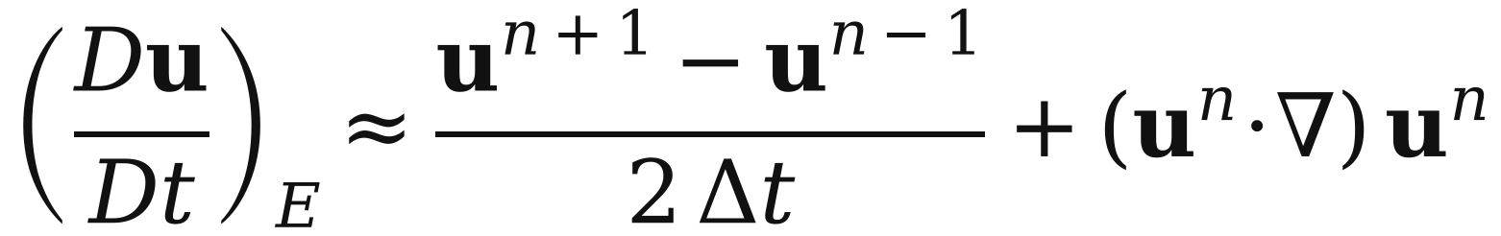
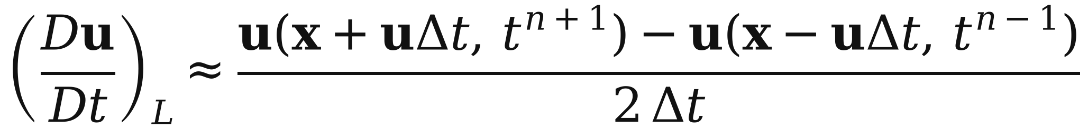
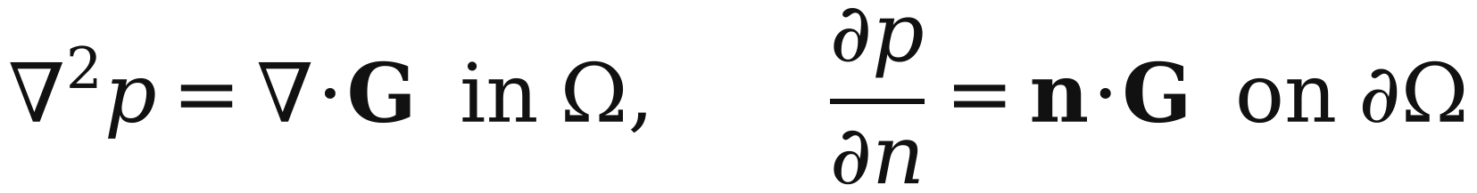
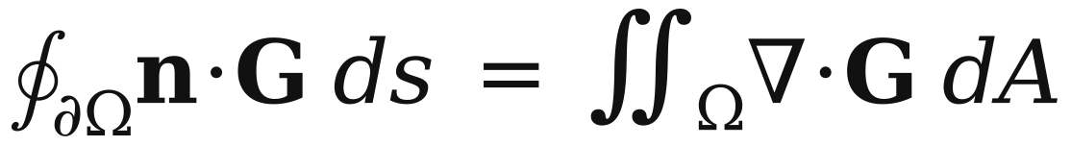
Governing Equations
From velocity to pressure
Eq. (1): Incompressible Navier–Stokes
Eq. (2): Pressure gradient from velocity
Eq. (3): Eulerian material derivative
Eq. (4): Lagrangian material derivative
Eq. (5): Pressure-Poisson problem
Eq. (6): Solvability (compatibility)
Every term in G (Eq. 2) is a derivative of measured velocity. Du/Dt comes from three snapshots, at a fixed point (Eq. 3) or along the particle path (Eq. 4).
∇· of Eq. 2 gives a Poisson problem with Neumann edges (Eq. 5): solvable only if Eq. 6 holds, and only up to a constant, so we compare p − p̄.
Assumptions
Incompressible Newtonian fluid, constant ρ and μ; 2-D planar flow (out-of-plane terms neglected); velocity on a uniform grid at instants n − 1, n, n + 1.
4 /25
Anany Bajpai & Arnav Oza
ME 415: CFD & HT
Autumn ’26
Term Project
Notes:
Eq. 2 is the key: pressure gradient from velocity. Eulerian vs Lagrangian matters when structures are convected. The Poisson problem with pure Neumann data is singular; we fix the constant with a zero-mean condition.

Slide 5
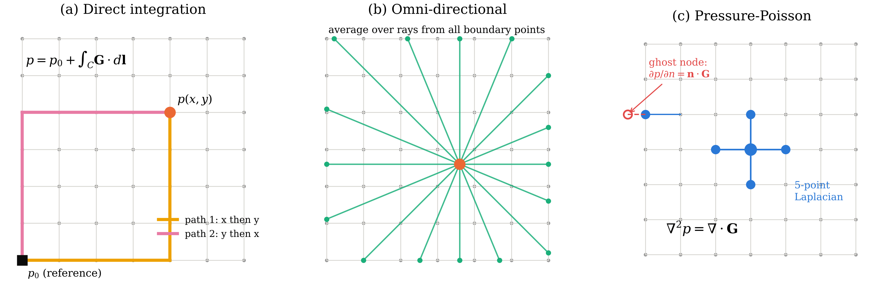
Algorithms
Three ways to integrate ∇p = G
Fig. 4 The three integration algorithms on the PIV grid
(a) Direct integration
March G·dl from a reference corner with the trapezoidal rule, x-then-y and y-then-x; average the two paths.
Fastest (0.3 ms at 64²), but every error on the path is carried to every later point.
(b) Omni-directional
Integrate along 32 ray directions into each node (Liu & Katz 2006). Edge values come from a consistent linear system; interior values are ray averages.
Averaging cancels path errors; slowest (≈0.4 s).
(c) Pressure-Poisson (main)
5-point Laplacian as a sparse matrix; Neumann edges by ghost-node elimination; singular system closed by a zero-mean constraint, solved directly.
15 ms; also Jacobi, GS, SOR and CG (backup).
5 /25
Anany Bajpai & Arnav Oza
ME 415: CFD & HT
Autumn ’26
Term Project
Notes:
Direct: simplest but path dependent. Omni: average over many paths, robust but expensive. Poisson: the standard method; elliptic, so errors are smoothed. All three use the same G.

Slide 6
Solution Strategy
Logic chart and pseudo-code
Velocity source: exact solutions (Taylor–Green, Kovasznay) or CFD wake
for case in [TaylorGreen, Kovasznay, CFD]:
truth = exact_or_cfd(case) # fine grid
for param in sweep(h, σ, Δt, BC, W, filter):
for seed in range(10):
F = degrade(truth, W, h, σ, seed)
F = denoise(F) # optional
a = DuDt(F, eulerian | lagrangian)
G = -ρ*a + μ*lap(u)
p = poisson(G) | direct(G) | omni(G)
ε = L2(p - p_ref) / L2(p_ref) # zero mean
save mean, std of ε -> CSV -> figures
Synthetic PIV: box filter W → subsample to h → noise σU
Optional denoising: Gaussian / Savitzky–Golay
Material derivative Du/Dt: Eulerian or Lagrangian
Main functions (Python, NumPy/SciPy)
fields/ exact solutions, CFD loader · piv/ degrade, denoise
core/ derivatives, material derivative, Poisson (sparse direct + iterative), direct and omni integration, reconstruct()
analysis/ metrics, plots · studies/ one script per sweep
tests/ 87 unit tests, all passing (manufactured solutions, order checks)
sweep h, σ, Δt, BC, W, filter;
10 noise seeds each
Pressure gradient G = −ρ Du/Dt + μ∇²u
Integrate: Direct | Omni | Poisson
Compare with exact p: ε_L2, error map, core pressure
Fig. 5 Logic chart of the code
6 /25
Anany Bajpai & Arnav Oza
ME 415: CFD & HT
Autumn ’26
Term Project
Notes:
One function, reconstruct(), runs the whole chain. Every study script loops over a parameter and 10 noise seeds and writes a CSV; the figures are generated from those CSVs.

Slide 7
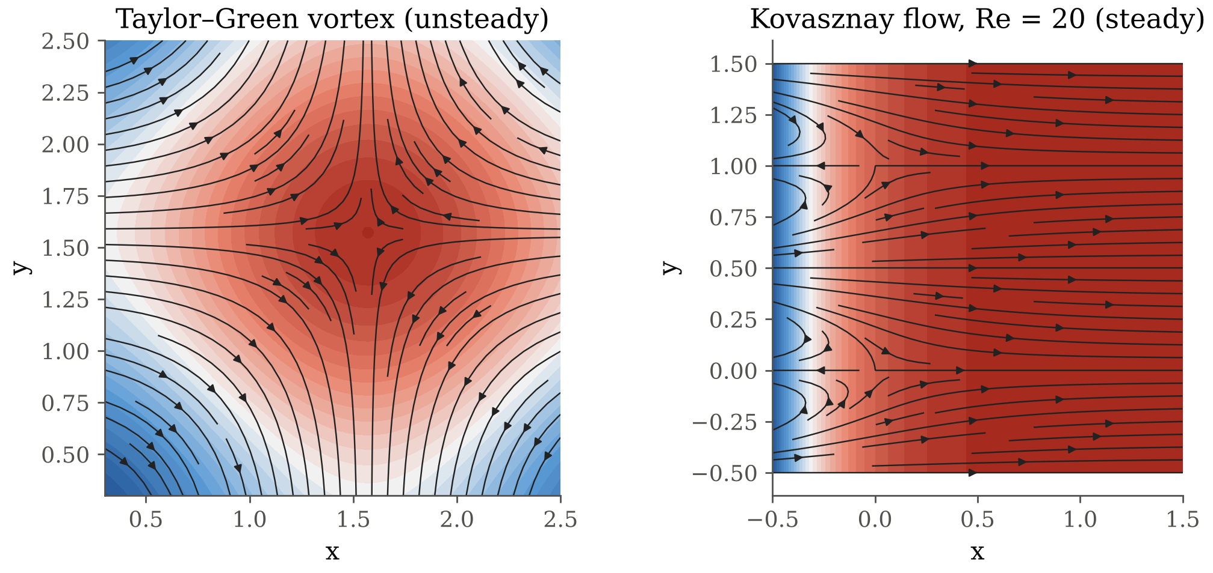
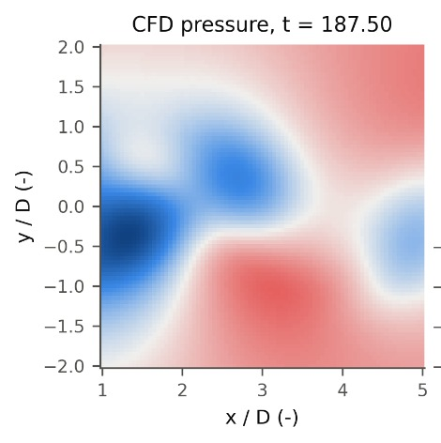
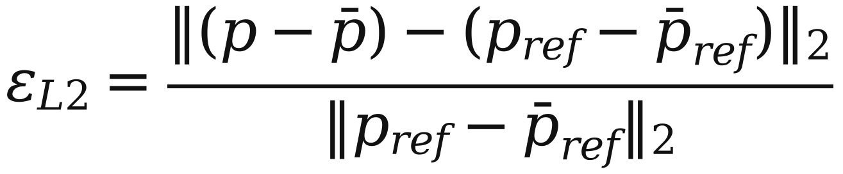
Test Cases
Exact flows, synthetic PIV and the error metric
Exact Navier–Stokes solutions (Fig. 6)
Taylor–Green vortex: unsteady and decaying; the viscous term cancels, so ∇p balances convection. A copy carried at U = 1 tests the time derivative.
Kovasznay flow (Re = 20, 40): steady flow behind a grid; here the viscous term μ∇²u matters.
CFD cylinder wake (Re = 100): OpenFOAM solution sampled on an 81 × 81 window behind the cylinder (Fig. 7).
Synthetic PIV model
Exact field on a 4× finer grid → box filter of width W (interrogation window) → keep every 4th point (spacing h) → add Gaussian noise σ·U to u and v.
Fig. 6 Test flows: pressure and streamlines
Error metric
Fig. 7 CFD wake window (x/D 1–5)
Baseline: 64 × 64 vectors, W = h, σ = 1 % of U, Δt = 0.05; mean ± std over 10 noise seeds.
7 /25
Anany Bajpai & Arnav Oza
ME 415: CFD & HT
Autumn ’26
Term Project
Notes:
Exact solutions give the true pressure everywhere, so the error is known exactly. The degradation model mimics PIV: spatial averaging over the window, finite spacing, random error.

Slide 8
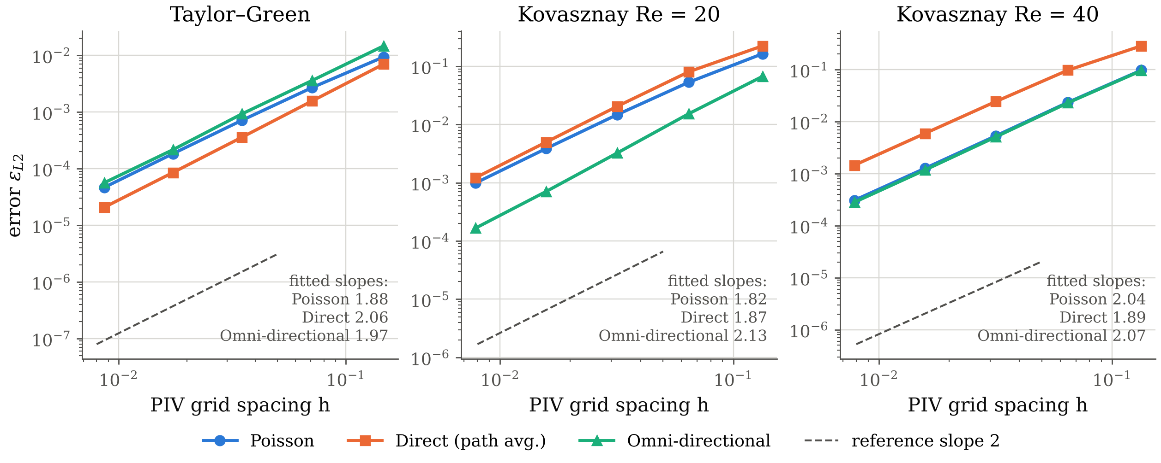
Verification
Grid convergence on clean (exact) data
Fig. 8 Error vs PIV spacing h, exact point samples (W = 0, σ = 0)
1. All three methods are second-order accurate
Fitted slopes 1.82–2.13: central differences and the trapezoidal rule are O(h²), and the Poisson solve adds no lower-order error.
2. Boundaries do not spoil the order
Second-order one-sided stencils and ghost-node Neumann conditions at the edges; a first-order version gives slope ≈ 1 (backup).
3. The viscous term matters at low Re
Without μ∇²u, Kovasznay stops converging (unit test). The code is verified before noise is added.
8 /25
Anany Bajpai & Arnav Oza
ME 415: CFD & HT
Autumn ’26
Term Project
Notes:
Before studying noise we check the code is correct. All methods converge at second order on all three flows.

Slide 9
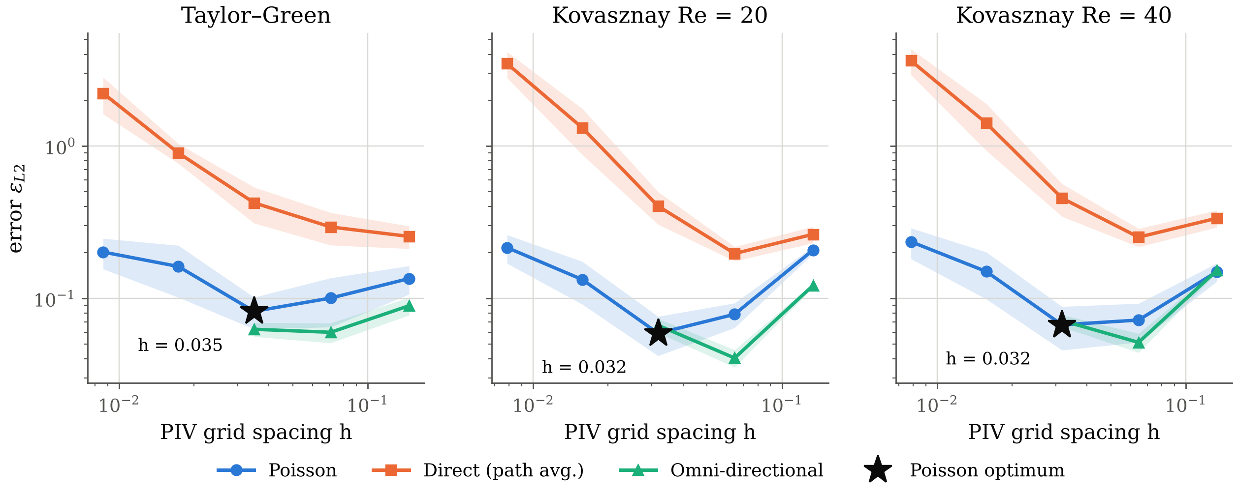
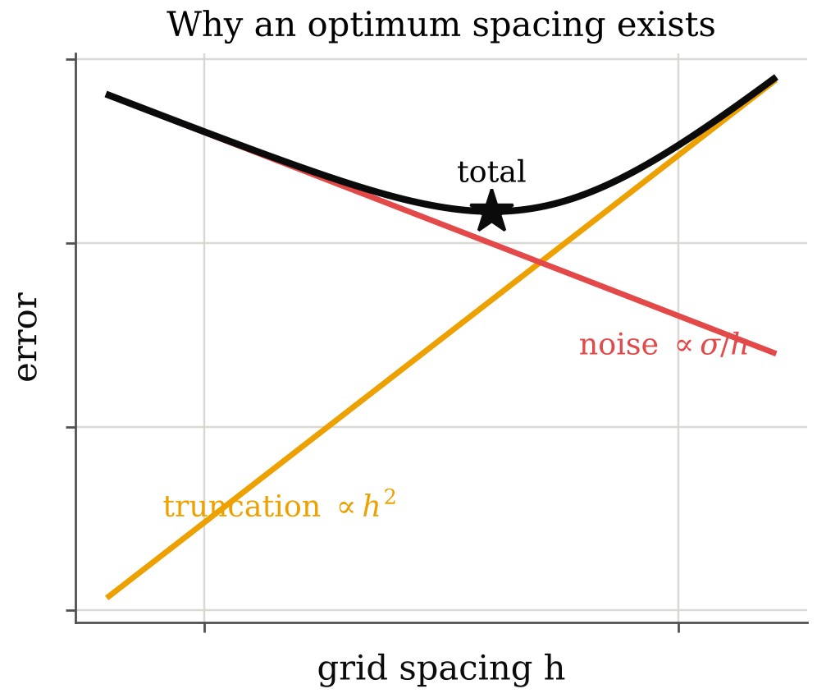
Noise vs. Resolution
Finer is not always better
Fig. 9 Error vs spacing with σ = 1 %, W = h (mean ± std, 10 seeds)
1. With 1 % noise, refining the grid stops helping
Poisson error is lowest at h ≈ 0.032–0.035 (n = 64) for all three flows and rises on finer grids: Taylor–Green 0.082 → 0.20 at h = 0.009.
2. Why: two competing errors
Truncation falls as h², but differentiation amplifies noise: σ/h in (u·∇)u and μσ/h² in the viscous term. The sum has a minimum.
3. Direct integration only gets worse
0.26 → 2.2 as h shrinks: a path crosses ~1/h noisy steps, so its error grows like a random walk.
Fig. 10 Error budget
9 /25
Anany Bajpai & Arnav Oza
ME 415: CFD & HT
Autumn ’26
Term Project
Notes:
Main practical result: there is an optimum vector spacing. Below it, noise amplification by the derivatives dominates truncation error.

Slide 10
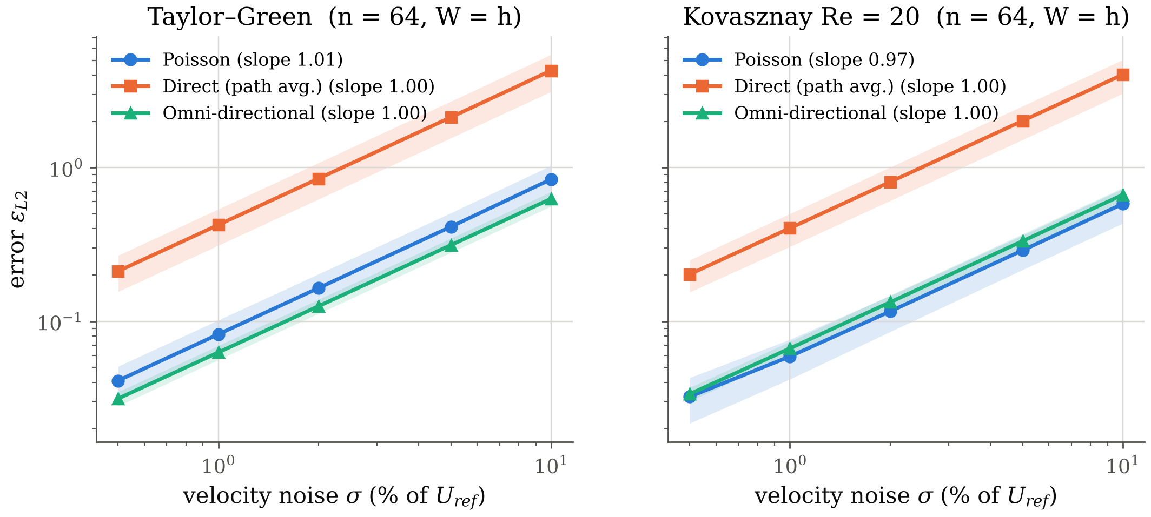
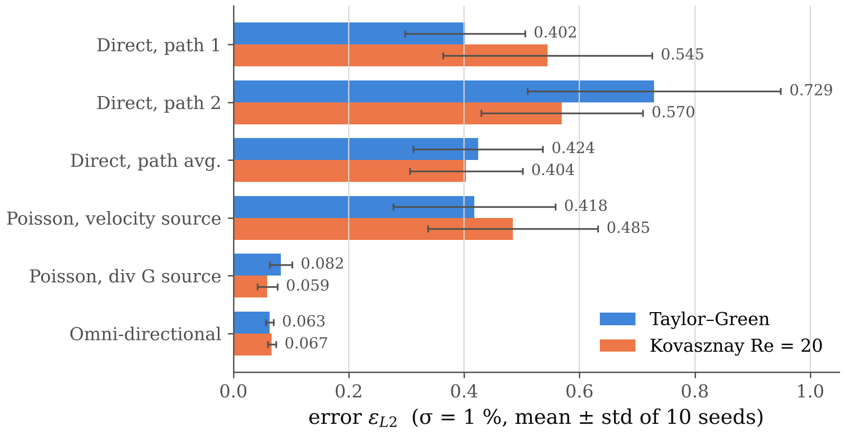
Noise & Method
How each algorithm handles measurement noise
Fig. 11 Error vs noise (n = 64, W = h)
Fig. 12 Methods at σ = 1 %
Error grows linearly with noise (log–log slopes 0.97–1.01): the reconstruction is a linear operation on the velocity error.
Direct integration is 5–7× worse: one path carries every error along it, while Poisson (elliptic) and omni average over many paths.
Omni ≈ Poisson in accuracy (0.063 vs 0.082 Taylor–Green; 0.067 vs 0.059 Kovasznay) but ≈27× slower (0.41 s vs 15 ms).
Velocity-source Poisson ∇²p = −ρ(u_x² + 2u_y v_x + v_y²) is 5–8× worse with noise: it multiplies noisy derivatives.
10 /25
Anany Bajpai & Arnav Oza
ME 415: CFD & HT
Autumn ’26
Term Project
Notes:
Linear growth with sigma is expected. The important comparison is between methods: averaging methods are far more robust than a single integration path.

Slide 11
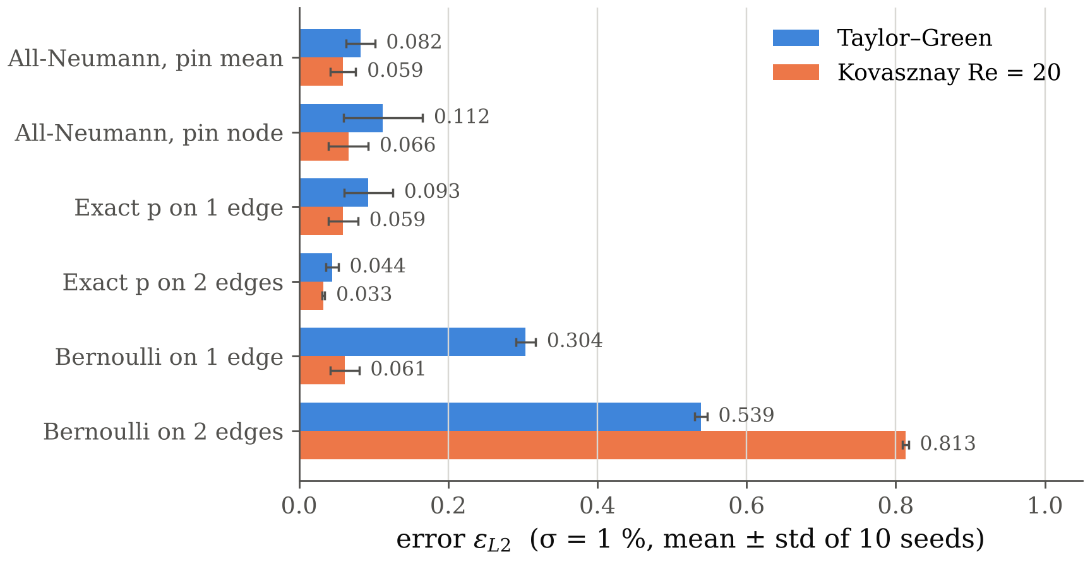
Boundary Conditions
What we impose on the edges matters
1. Known pressure on edges helps
Exact p on 2 opposite edges halves the error (Taylor–Green 0.082 → 0.044; Kovasznay 0.059 → 0.033); 1 edge gives little gain.
2. Pure Neumann: fixing the constant matters
Pinning one node puts that node’s error into the whole field (0.112 vs 0.082 with a zero-mean constraint).
Fig. 13 Poisson error, six boundary treatments
3. Bernoulli edges fail in rotational flow
p + ½ρ|u|² = const holds only in irrotational flow; both test flows are rotational, giving 0.30–0.81. Use it only at free-stream edges.
Why: Neumann data n·G are themselves noisy derivatives, while a Dirichlet edge anchors the solution.
11 /25
Anany Bajpai & Arnav Oza
ME 415: CFD & HT
Autumn ’26
Term Project
Notes:
Boundary data are the single most effective improvement. But Bernoulli is only valid where the flow is irrotational; inside a vortex it is simply wrong.

Slide 12
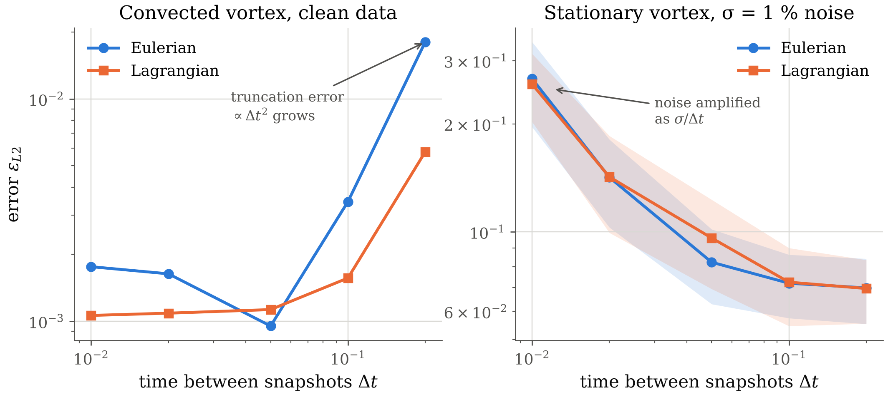
Time Step
Eulerian vs. Lagrangian material derivative
1. Convected vortex, clean data
Eulerian error rises 10× by Δt = 0.2 (1.8e-3 → 1.8e-2): at a fixed point the pattern sweeps past, so ∂u/∂t changes fast. Lagrangian follows the particle and stays 3× lower (5.8e-3).
Fig. 14 Error vs time between snapshots
2. Stationary vortex
Eulerian error does not depend on Δt; Lagrangian grows (4.2e-3 at Δt = 0.2) because curved paths are traced with a straight step.
3. Noisy data
Noise enters ∂u/∂t as σ/Δt, so both improve with larger Δt (0.27 → 0.07). The best Δt balances noise against truncation.
12 /25
Anany Bajpai & Arnav Oza
ME 415: CFD & HT
Autumn ’26
Term Project
Notes:
Lagrangian wins when structures are convected through the window, as in a wake. With noise, a longer time separation reduces the amplification of noise in the time derivative.

Slide 13
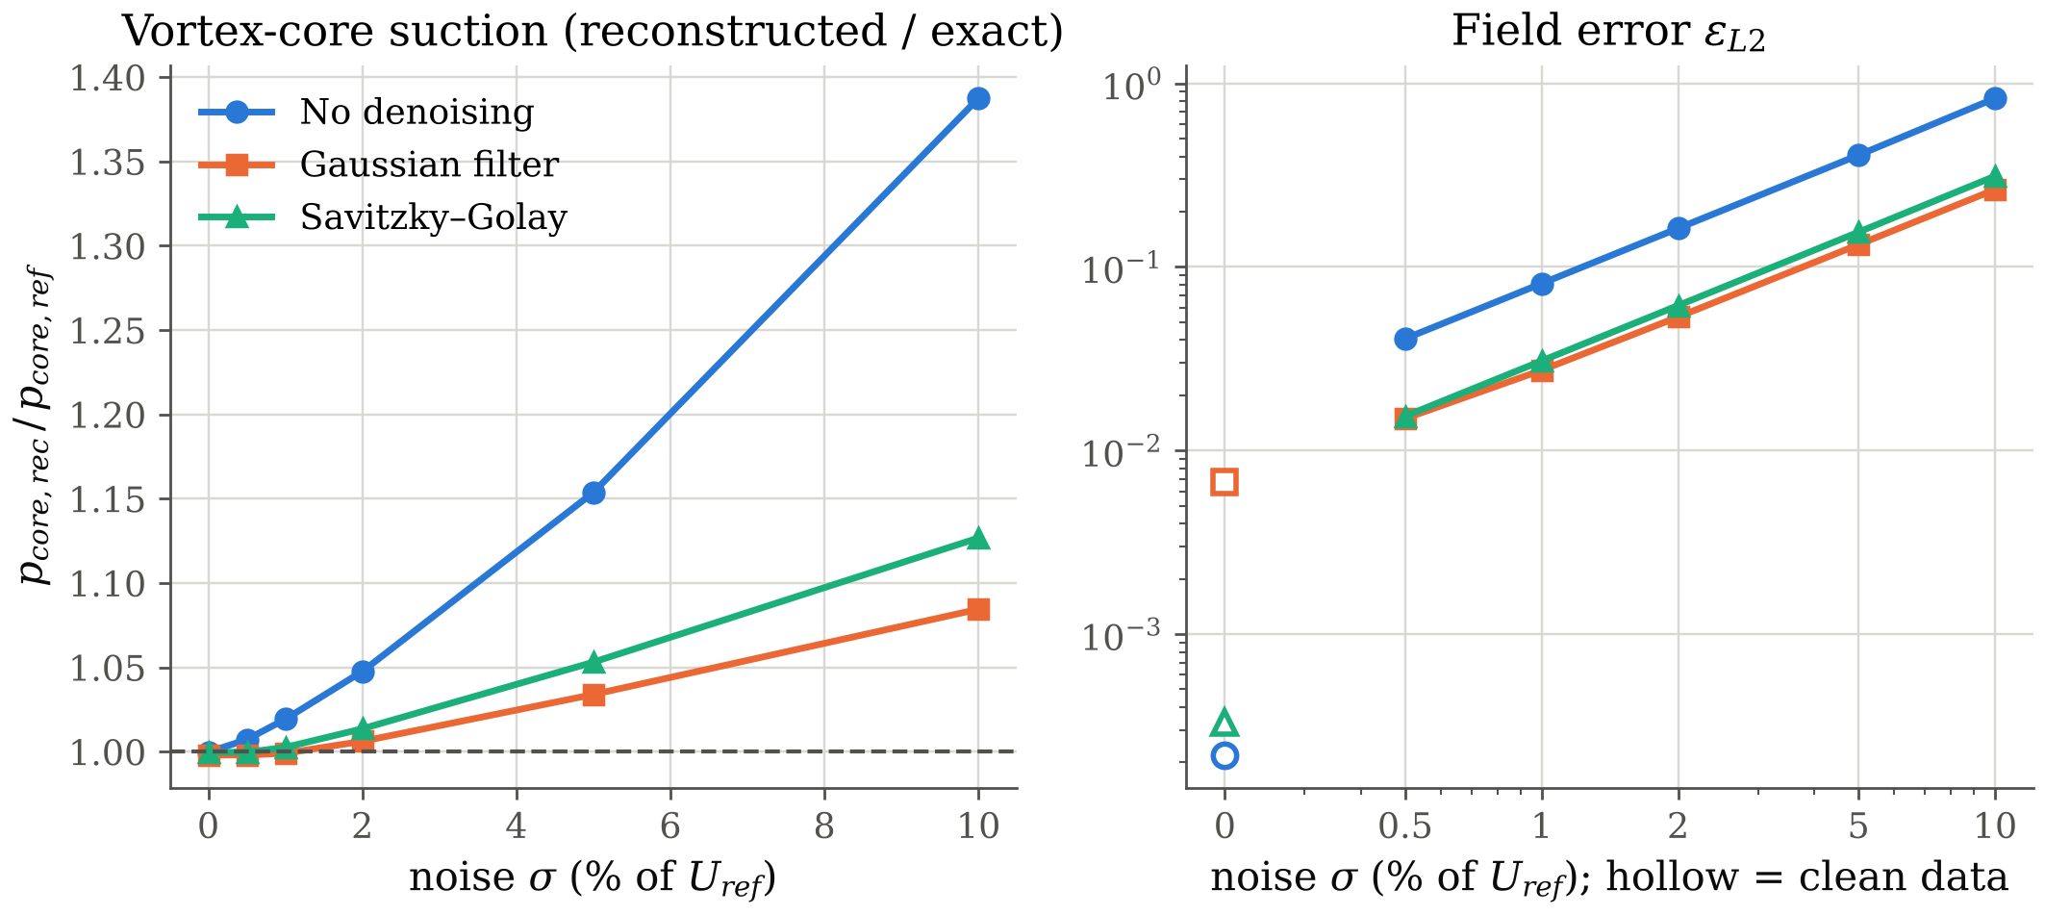
Window & Denoising
Smoothing trades noise for bias
1. Interrogation window W
Averaging over W smooths velocity. Taylor–Green core suction drops only 0.3 % at W = 4h (vortex ≫ window); Kovasznay ε rises 0.015 → 0.061 (sharper gradients).
Fig. 15 Core suction ratio and field error vs noise
2. Denoising cuts the noisy error about 3×
σ = 1 %: 0.081 → 0.027 (Gaussian), 0.031 (Savitzky–Golay); but on clean data the Gaussian filter adds bias (0.0002 → 0.007).
3. Noise biases the vortex core, not just scatters it
Without denoising the core suction is over-predicted (1.39× at σ = 10 %): (u·∇)u multiplies noisy terms, and products of noise do not average to zero.
13 /25
Anany Bajpai & Arnav Oza
ME 415: CFD & HT
Autumn ’26
Term Project
Notes:
Filtering is a trade-off: it removes random error but introduces systematic smoothing error. Worth it once noise is above about 0.5 %.

Slide 14
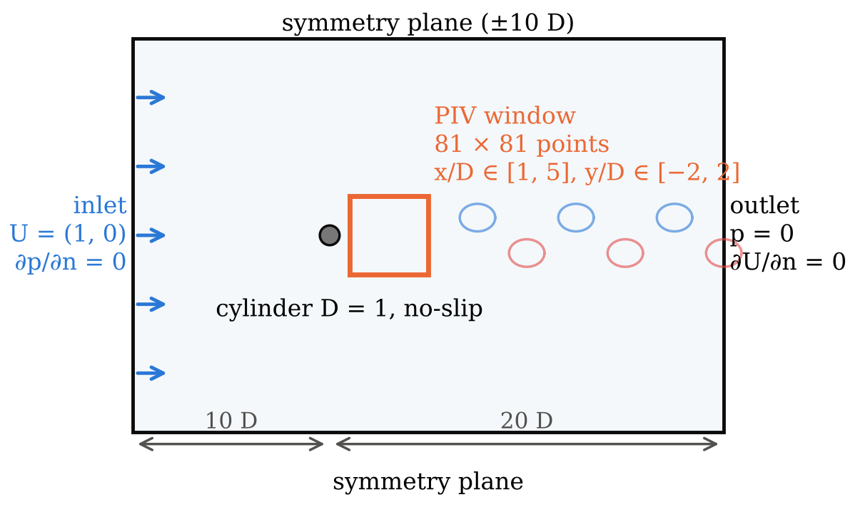
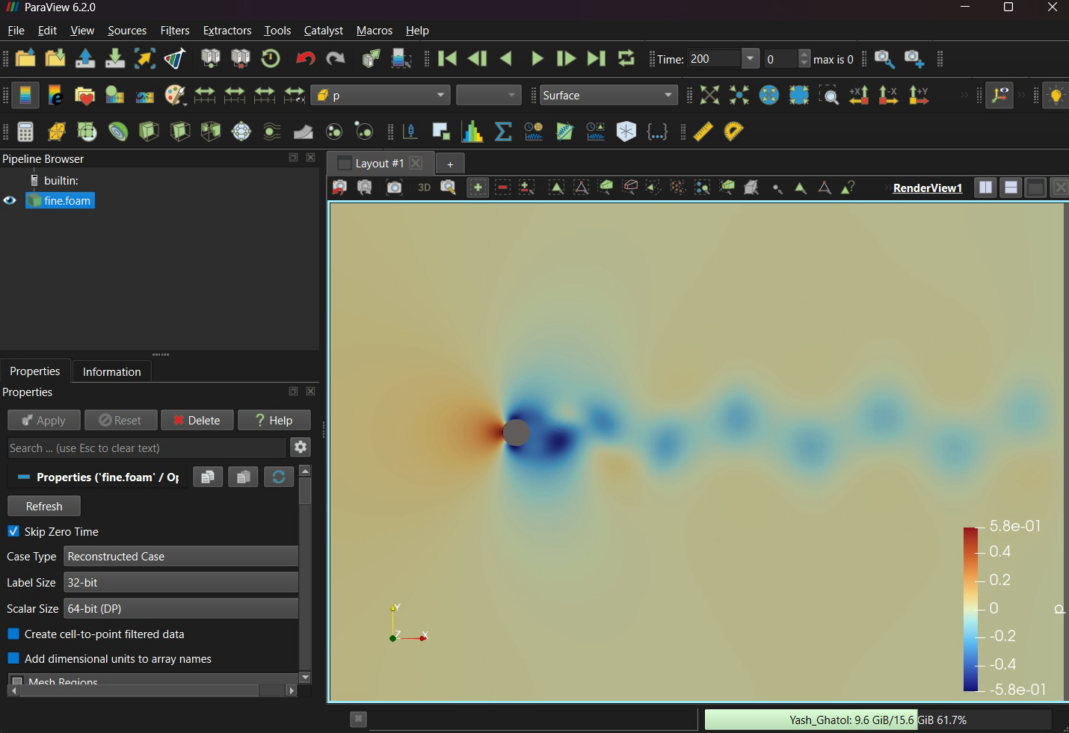
CFD Simulation
Cylinder wake at Re = 100 (OpenFOAM)
Item | Setting
Equations | Incompressible NS (Eq. 1), laminar
Solver | pimpleFoam (PISO mode)
Time / convection | backward (2nd order) / linearUpwind
Time step | max Courant 0.5, run to t = 200 D/U
Re = UD/ν | 100 (U = D = 1, ν = 0.01)
Output | Cd, Cl (forces); PIV window every 0.05 D/U
Fig. 16 Domain, BCs and PIV window
2-D laminar is valid: the wake stays 2-D below Re ≈ 190.
A small inlet kick (t < 6) starts shedding sooner; from t = 6 the inlet is exactly U = (1, 0).
Three meshes (6,690 / 26,760 / 107,040 cells) for grid independence.
Fig. 17 ParaView 6.2: fine-mesh pressure at t = 200
14 /25
Anany Bajpai & Arnav Oza
ME 415: CFD & HT
Autumn ’26
Term Project
Notes:
OpenFOAM set-up. The ParaView screenshot shows the actual fine-mesh solution at t = 200: high pressure at the stagnation point, low pressure on the sides and in the shed vortex cores, which alternate above and below the centreline.

Slide 15
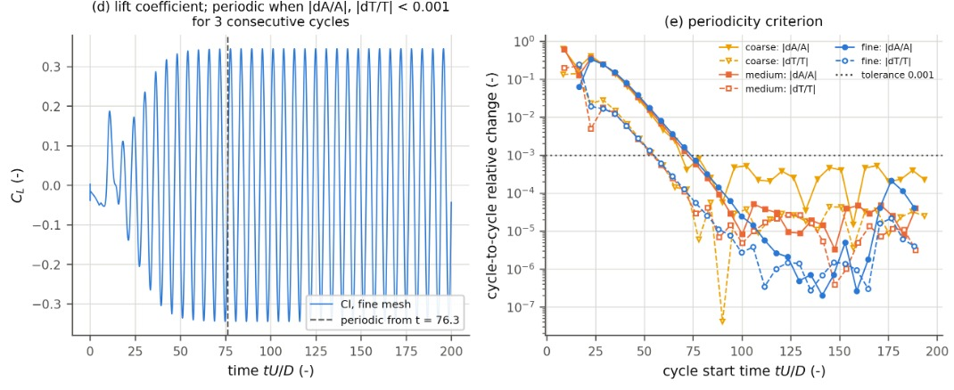
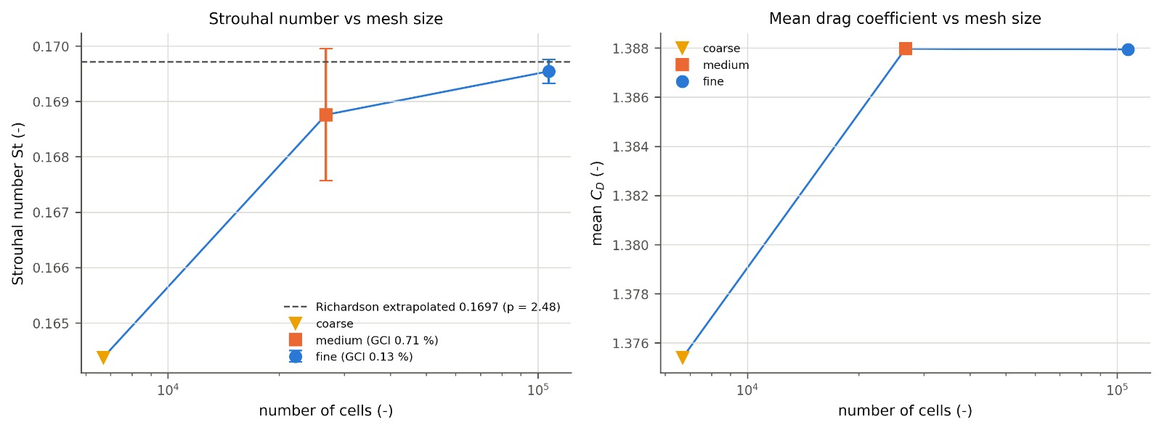
CFD Verification
Grid independence and periodic shedding
Mesh | Cells | St | C̄d | Cl amp.
Coarse | 6,690 | 0.1644 | 1.3754 | 0.3216
Medium | 26,760 | 0.1688 | 1.3880 | 0.3451
Fine | 107,040 | 0.1695 | 1.3879 | 0.3451
Richardson extrap. | – | 0.1697 | conv. | conv.
2-D simulations, Re = 100 | – | ≈0.164–0.165 | ≈1.33 | ≈0.33
Fig. 19 Lift and periodicity check
St converges: 0.1644 → 0.1688 → 0.1695 (changes 2.7 %, then 0.46 %). Observed order p = 2.48, extrapolated 0.1697, GCI fine 0.13 %; asymptotic ratio 1.005, so the meshes are in the asymptotic range.
C̄d and Cl amplitude are already converged on the medium mesh (changes 0.00 % and 0.01 %), so a Richardson order cannot be defined.
Periodic from t = 76.3: cycle-to-cycle changes of amplitude and period stay below 10⁻³; the PIV window (t = 175–200) is well inside. Residuals level off near 10⁻³: periodic, not steady.
vs literature: St and C̄d are 3–4 % higher, as expected from the 5 % blockage of the ±10 D symmetry sides.
Fig. 18 St and Cd vs mesh (bars: GCI)
Literature values approximate; check before quoting.
15 /25
Anany Bajpai & Arnav Oza
ME 415: CFD & HT
Autumn ’26
Term Project
Notes:
Grid independence: the Strouhal number converges with observed order about 2.5 and a fine-mesh GCI of 0.13 %. Drag and lift amplitude stop changing at the medium mesh. The flow is periodic after t = 76, so the sampling window from t = 175 is fully developed. Our values are a few per cent above the unbounded-domain literature because the side walls block 5 % of the flow.

Slide 16
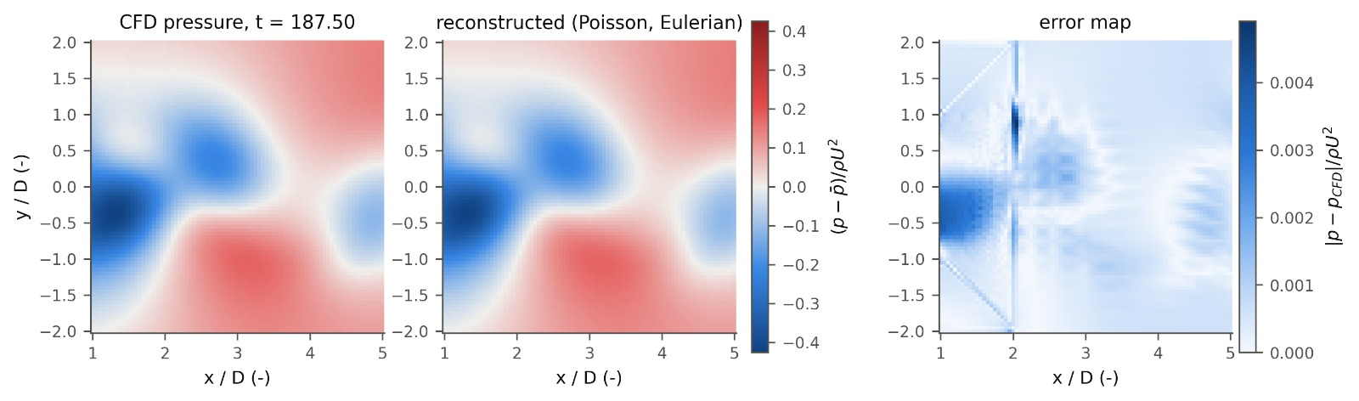
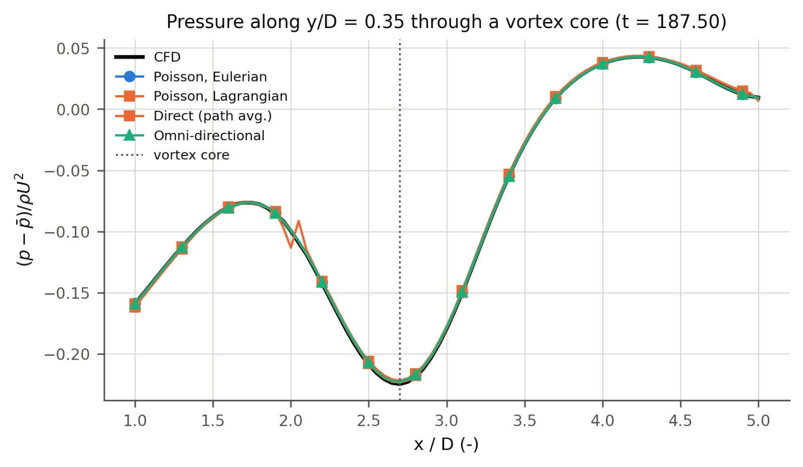
CFD Wake: Reconstruction
Pressure from PIV-like samples of the OpenFOAM velocity
Fig. 20 CFD pressure, reconstruction and error map (t = 187.5)
The wake pressure is recovered: from the 81 × 81 CFD velocity samples (h = 0.05 D, no noise) the Poisson error is ε = 0.5–0.75 % over a shedding period.
Vortex-core suction (−0.22 ρU² at x/D ≈ 2.7) is matched by every method within about 1 %.
Error sits on the CFD mesh's block edges (x/D = 2 and the diagonals to (2, ±2), the edges of the O-grid). The interpolated velocity has small slope jumps there, and differentiation amplifies them; direct integration shows a kink at x/D = 2. This is an error of the "measured" data, not of the method.
Fig. 21 Line through a vortex core
16 /25
Anany Bajpai & Arnav Oza
ME 415: CFD & HT
Autumn ’26
Term Project
Notes:
Reconstruction on the CFD wake. Without noise the error is below 1 %. Note where the error lives: on the block boundaries of the OpenFOAM mesh, where the sampled velocity has small kinks; differentiation turns kinks into steps. This is the same mechanism as noise amplification, applied to a systematic error.

Slide 17
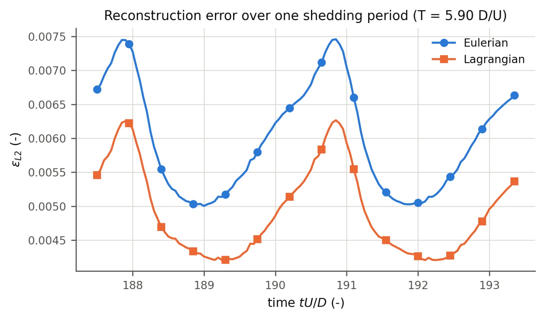
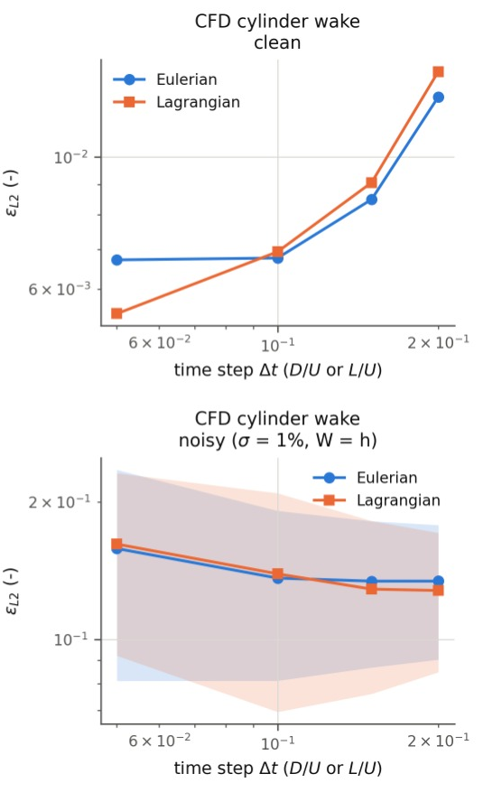
CFD Wake: Δt and Noise
Eulerian vs Lagrangian on a real wake
Fig. 22 Error over one shedding period (clean, Δt = 0.05)
Error pulses twice per period (T = 5.90, i.e. St = 0.1695): it peaks each time a vortex forms on one side.
At Δt = 0.05 Lagrangian is 15–18 % better throughout the period: the vortices are carried through the window.
At Δt ≥ 0.1 Eulerian is slightly better, unlike the convected Taylor–Green. Likely: in the near wake (x/D 1–5) vortices are still forming, move slower than U and spin fast (w ≈ c), so straight-line tracking of curved paths costs more; more tracked points also leave the window.
With 1 % noise ε ≈ 0.13–0.15 for both schemes, nearly flat in Δt. Higher than Taylor–Green (0.08) because wake pressure varies only about ±0.2 ρU², so the same velocity noise is larger relative to the signal.
Fig. 23 Error vs Δt on the wake
17 /25
Anany Bajpai & Arnav Oza
ME 415: CFD & HT
Autumn ’26
Term Project
Notes:
Time-resolved behaviour on the wake. The Lagrangian advantage seen on the convected Taylor–Green holds only at the smallest time step here; in the near wake the vortices are not yet simply convected, so the theory's assumption (w much smaller than c) does not hold. With noise, noise amplification dominates and the scheme matters little.

Slide 18
Literature
Do our trends match published studies?
Our result | Published finding | Match
Exact p on 2 edges: ε 0.044 vs 0.082 all-Neumann (≈2×) | Pan et al. [3]: Dirichlet edges give less error than Neumann (≈2× for large domains); avoid pure Neumann if possible | Agrees
Bernoulli edges: ε 0.30–0.81 in rotational flow | Pan et al. [3]: Bernoulli-based Dirichlet data are valid only in irrotational regions | Agrees
Error from 0.02 % (clean) to >100 % (direct, σ ≥ 2 %); depends on method, spacing and filtering | Charonko et al. [2]: errors from <1 % to >100 %; sensitive to all these factors; no single best method | Agrees
Lagrangian 3× better at large Δt in convected flow; noise ∝ 1/Δt | Violato et al. [6]: Eulerian limited to short Δt; short Δt amplifies precision error, long Δt adds truncation error | Agrees
Omni and Poisson recover the main features; direct integration is very noise-sensitive | van Gent et al. [4]: all methods tested recover the main features; noise lowers accuracy | Partly
CFD wake (fine mesh): St 0.1695, C̄d 1.388, Cl amplitude 0.345 | 2-D simulations at Re = 100 (e.g. Park et al. [7]): St ≈ 0.164–0.165, C̄d ≈ 1.33; experiments St ≈ 0.164 [8] | Agrees (+3–4 %, blockage)
Reference numbers refer to the References slide.
18 /25
Anany Bajpai & Arnav Oza
ME 415: CFD & HT
Autumn ’26
Term Project
Notes:
This is the research part of the project: our controlled synthetic experiments reproduce the main published conclusions, and the CFD wake matches published Strouhal and drag values within the few per cent expected from blockage. Partial: van Gent et al. found no method critically sensitive to noise, whereas our direct integration is; their noise levels and methods differ.

Slide 19
Conclusions
Key findings and takeaway
Key findings
All three algorithms are second-order accurate on exact data (slopes 1.8–2.1): the code is verified.
Noise, not discretisation, limits PIV pressure: error grows linearly with σ, and there is an optimum spacing (h ≈ 0.03 here).
Poisson and omni are 5–7× more robust than direct integration; Poisson is ≈27× faster than omni.
Known pressure on two edges halves the error; Bernoulli edges hold only in irrotational flow.
Lagrangian Du/Dt tolerates larger Δt in convected flow; with noise, larger Δt helps both.
Filtering trades noise for bias: it helps at σ ≥ 1 % and hurts on clean data.
On the OpenFOAM wake (St 0.1695, GCI 0.13 %) the clean reconstruction error is 0.5–0.75 %; mesh-block kinks in the data are amplified like noise.
Objectives
All four met: algorithms implemented, verified on exact flows, studied parametrically, and compared with a CFD wake and published studies.
Recommended practice
Poisson solver; Dirichlet edges only where p is known (free stream); Lagrangian Du/Dt with the largest Δt that keeps truncation small; spacing near the noise–truncation optimum; light denoising above σ ≈ 0.5 %.
Main takeaway
PIV pressure is limited by how velocity noise is amplified by differentiation. Method, boundary data, spacing and Δt decide whether that noise is averaged out or accumulated.
Way ahead: make noise depend on W (larger windows, less noise in real PIV); correlated noise; 3-D time-resolved data.
19 /25
Anany Bajpai & Arnav Oza
ME 415: CFD & HT
Autumn ’26
Term Project
Notes:
Summarise in one sentence: the accuracy of PIV pressure is set by how measurement noise propagates, and our study shows which choices control that.

Slide 20
References
Papers cited in this talk
[1] B. W. van Oudheusden, PIV-based pressure measurement, Meas. Sci. Technol. 24 (2013) 032001.
[2] J. J. Charonko, C. V. King, B. L. Smith, P. P. Vlachos, Assessment of pressure field calculations from particle image velocimetry measurements, Meas. Sci. Technol. 21 (2010) 105401.
[3] Z. Pan, J. Whitehead, S. Thomson, T. Truscott, Error propagation dynamics of PIV-based pressure field calculations: how well does the pressure Poisson solver perform inherently?, Meas. Sci. Technol. 27 (2016) 084012.
[4] P. L. van Gent et al., Comparative assessment of pressure field reconstructions from particle image velocimetry measurements and Lagrangian particle tracking, Exp. Fluids 58 (2017).
[5] X. Liu, J. Katz, Instantaneous pressure and material acceleration measurements using a four-exposure PIV system, Exp. Fluids 41 (2006) 227–240.
[6] V. Violato, P. Moore, F. Scarano, Lagrangian and Eulerian pressure field evaluation of rod-airfoil flow from time-resolved tomographic PIV, Exp. Fluids 50 (2011) 1057–1070.
[7] J. Park, K. Kwon, H. Choi, Numerical solutions of flow past a circular cylinder at Reynolds numbers up to 160, KSME Int. J. 12 (1998) 1200–1205.
[8] C. H. K. Williamson, Vortex dynamics in the cylinder wake, Annu. Rev. Fluid Mech. 28 (1996) 477–539.
[9] L. I. G. Kovasznay, Laminar flow behind a two-dimensional grid, Proc. Camb. Philos. Soc. 44 (1948) 58–62.
20 /25
Anany Bajpai & Arnav Oza
ME 415: CFD & HT
Autumn ’26
Term Project
Notes:
References. The cylinder values quoted from Park et al. are approximate; check them in the paper before quoting exact numbers.

Slide 21
Backup Slides
Supporting detail for questions
Iterative Poisson solvers: Jacobi, Gauss–Seidel, SOR, CG
First- vs second-order schemes
Kovasznay reconstruction and error map
CFD lift history, spectrum and solver residuals
21 /25
Anany Bajpai & Arnav Oza
ME 415: CFD & HT
Autumn ’26
Term Project

Slide 22
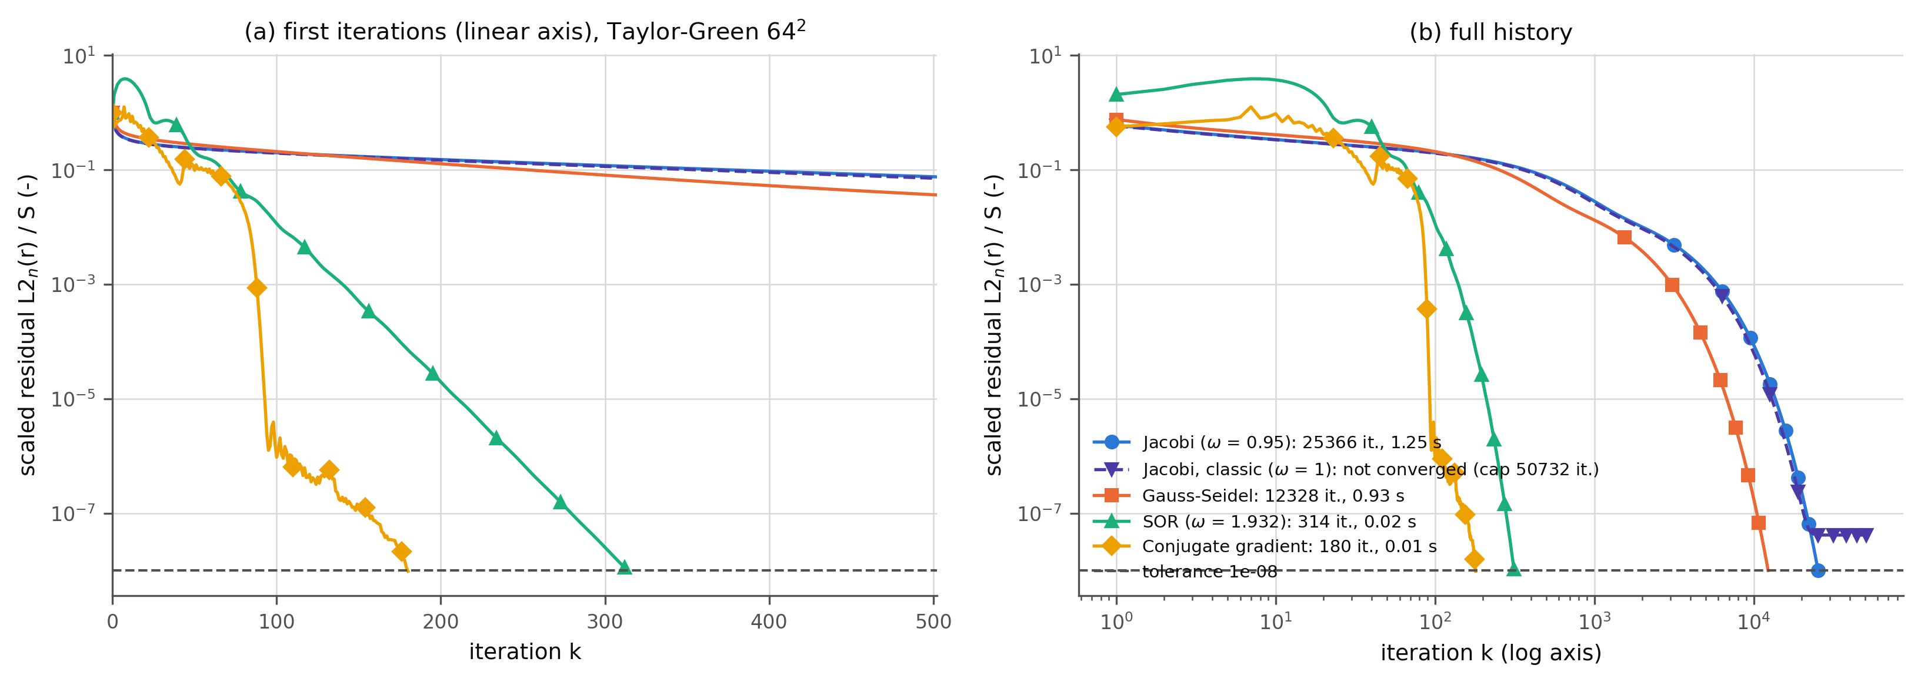
Iterative Solvers
Backup: same Poisson system, five solvers
Fig. 24 Scaled residual history, Taylor–Green 64²
Solver (64², tol 1e-8) | Iterations | Time
Jacobi (ω = 0.95) | 25,366 | 1.3 s
Gauss–Seidel | 12,328 | 0.93 s
SOR (ω = 1.932) | 314 | 0.024 s
Conjugate gradient | 180 | 0.013 s
Jacobi, classic (ω = 1) | stalls at 4.2e-8 | –
All solve the same matrix as the direct solve; SOR at ω_opt and CG need 80–140× fewer iterations than Jacobi.
Iterations grow as N^1.0 (Jacobi, GS), N^0.52 (SOR) and N^0.43 (CG).
Classic Jacobi stalls on the all-Neumann problem (checkerboard mode); ω = 0.95 fixes it. SOR does not converge at ω = 2 and diverges at 2.1.
22 /25
Anany Bajpai & Arnav Oza
ME 415: CFD & HT
Autumn ’26
Term Project

Slide 23
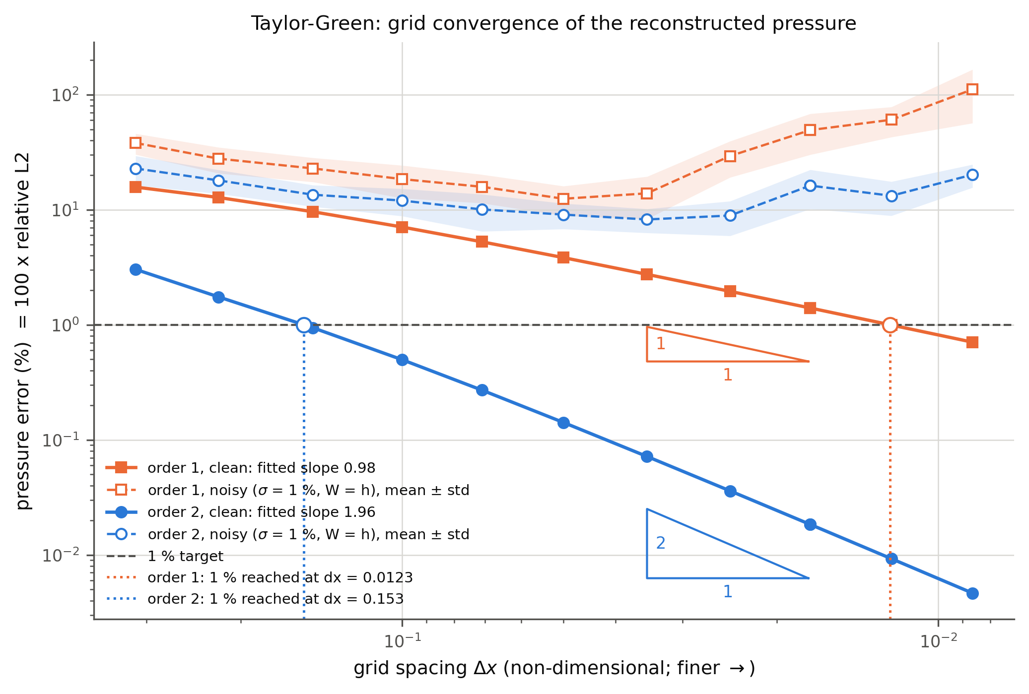
Scheme Order
Backup: first- vs second-order differences
Fig. 25 Grid convergence, Taylor–Green
Fitted slopes: 0.98 vs 1.96 (Taylor–Green), 1.00 vs 1.96 (Kovasznay Re = 20).
1 % error is reached at Δx ≈ 0.153 with second order but needs Δx ≈ 0.012 with first order: a 12× finer grid.
With 1 % noise both schemes level off and rise again on fine grids; the second-order scheme stays lower.
23 /25
Anany Bajpai & Arnav Oza
ME 415: CFD & HT
Autumn ’26
Term Project

Slide 24
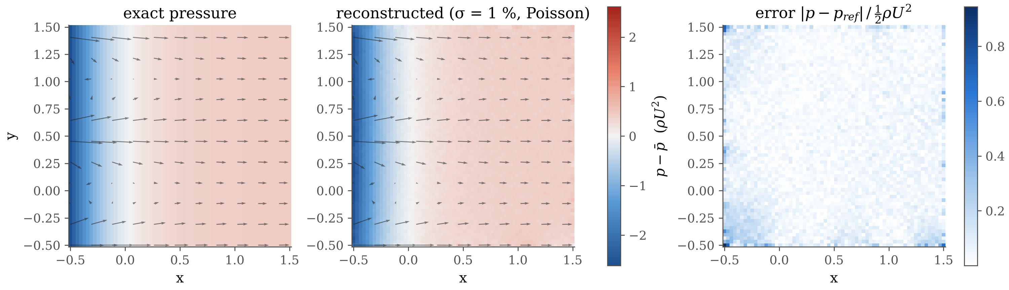
Kovasznay Flow
Backup: noisy reconstruction and error map
Fig. 26 Kovasznay Re = 20: exact, reconstructed (σ = 1 %) and error
ε_L2 = 0.056 for this seed. The error is mostly random scatter from the noise; the largest values sit at the edges and corners, where one-sided stencils and the noisy Neumann data n·G act.
24 /25
Anany Bajpai & Arnav Oza
ME 415: CFD & HT
Autumn ’26
Term Project

Slide 25
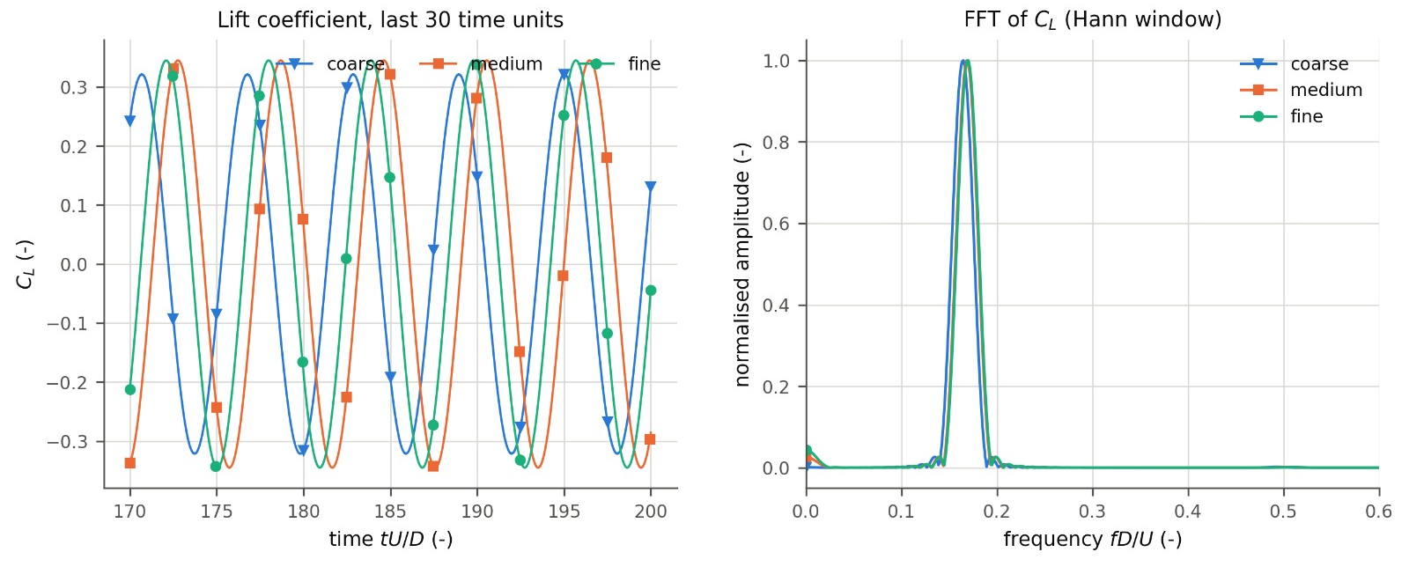
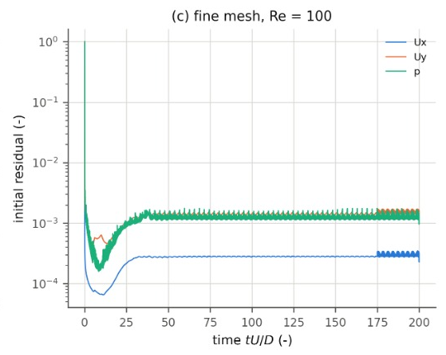
CFD Lift & Residuals
Backup: forces, spectrum and solver residuals
Fig. 27 Lift coefficient and its spectrum, three meshes
Cl from all three meshes over the last 30 time units; the FFT peak gives St (Hann window, uniform resampling).
Coarse mesh: lower Cl amplitude (0.322 vs 0.345) and lower St (0.1644): too little resolution at the cylinder.
Initial residuals fall from 1, then level off near 10⁻³ (p, Uy) and 3 × 10⁻⁴ (Ux): each time step starts from a changed, periodic flow, so they never reach zero.
Fig. 28 Fine-mesh residuals
25 /25
Anany Bajpai & Arnav Oza
ME 415: CFD & HT
Autumn ’26
Term Project

Slide 26
Fin.
Thank you. Questions?

