Slide 1

ME 415
Pressure
from PIV
Algorithms &
Project: 6
Comparison with Simulations
Term project · Autumn ’26
By Anany Bajpai (24B2135) & Arnav Oza (24B2217)
Instructor: Prof. Anjishnu Choudhury, MED-IITB
Problem & objectives
Governing equations & algorithms
Solution strategy & test cases
Results: grid, method, boundaries, time step
CFD cylinder wake (OpenFOAM)
Literature & conclusions
Notes:
[ANANY · 0:00–0:15 · 15 s]
Good morning. I'm Anany, and this is Arnav. Our project is pressure from PIV: we rebuild the pressure field from velocity measurements, compare three algorithms, and test them against exact solutions and a CFD simulation.

Slide 2
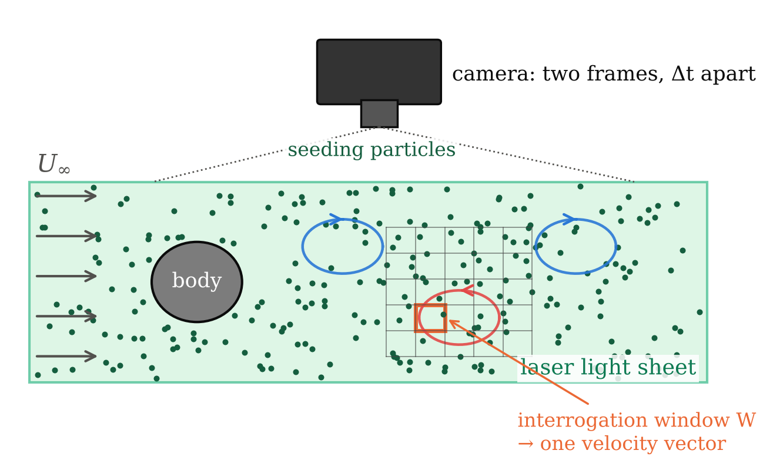
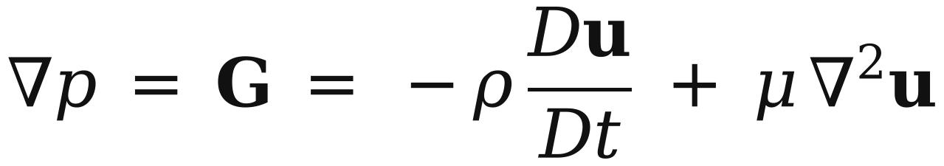
Problem & Objectives
PIV gives velocity, not pressure
PIV measures the whole velocity field without touching the flow, but not pressure.
Momentum gives the pressure gradient from velocity alone:
Differentiate, then integrate: differentiation amplifies measurement noise.
Fig. 1 Planar PIV: two frames Δt apart → velocity field
Objectives
Implement three integration algorithms: direct, omni-directional, Poisson.
Verify them on exact Navier–Stokes solutions.
Find what controls the error: spacing, noise, Δt, boundary conditions.
Compare with an OpenFOAM cylinder wake and published studies.
2 /25
Anany Bajpai & Arnav Oza
ME 415: CFD & HT
Autumn ’26
Term Project
Notes:
[ANANY · 0:15–1:05 · 50 s]
PIV photographs tracer particles in a laser sheet twice, a short time apart, and gives the velocity over a whole plane without touching the flow. But it does not measure pressure, which sets forces, noise and cavitation. So pressure has to be inferred: differentiate the measured velocity, then integrate, and differentiation amplifies measurement noise.
Our four objectives: implement three integration algorithms, verify them on exact Navier–Stokes solutions, find what controls the error, and compare with an OpenFOAM cylinder wake and published studies.

Slide 3
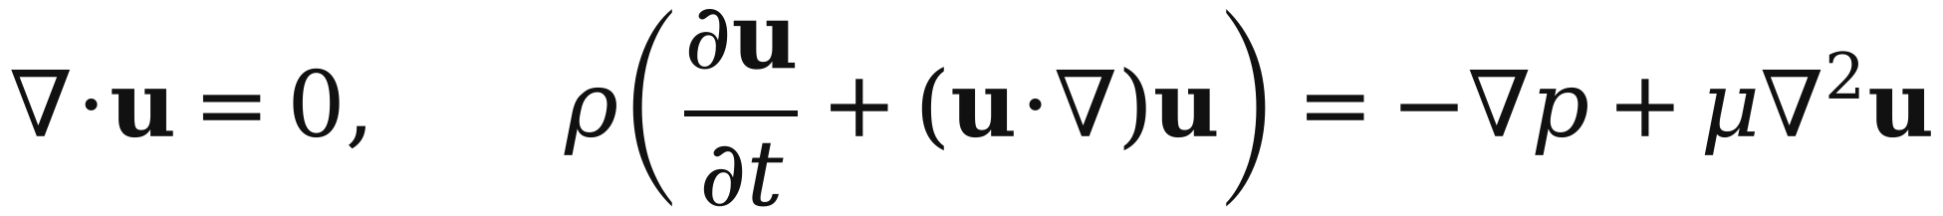
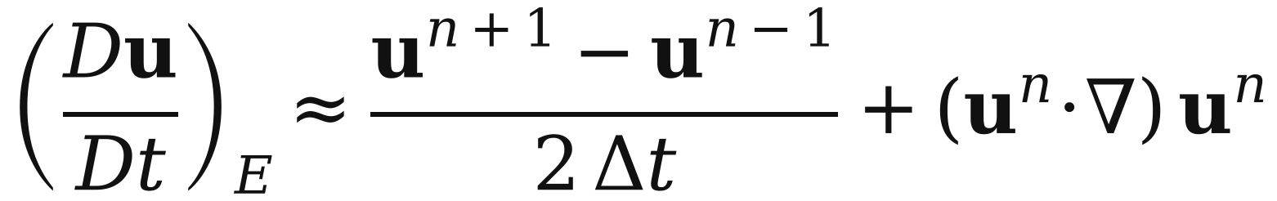
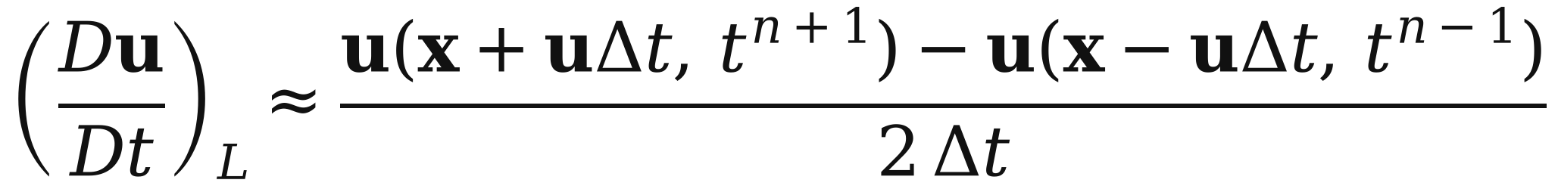
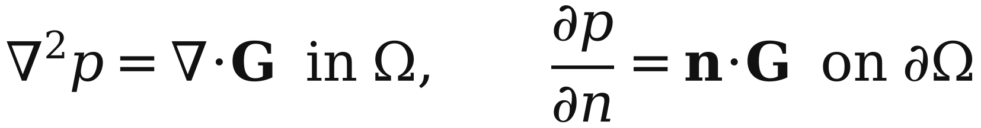
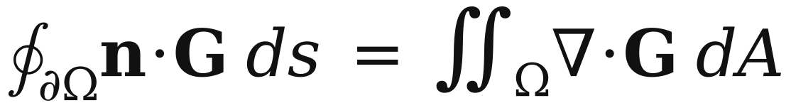
Governing Equations
From velocity to pressure
Eq. (1): Incompressible Navier–Stokes
Eq. (2): Pressure gradient from velocity
Eq. (3): Eulerian material derivative
Eq. (4): Lagrangian material derivative
Eq. (5): Pressure-Poisson problem
Eq. (6): Solvability (compatibility)
Every term in G (Eq. 2) is a derivative of measured velocity. Du/Dt comes from three snapshots, at a fixed point (Eq. 3) or along the particle path (Eq. 4).
∇· of Eq. 2 gives a Poisson problem with Neumann edges (Eq. 5): solvable only if Eq. 6 holds, and only up to a constant, so we compare p − p̄.
Assumptions
Incompressible Newtonian fluid, constant ρ and μ; 2-D planar flow (out-of-plane terms neglected); velocity on a uniform grid at instants n − 1, n, n + 1.
3 /25
Anany Bajpai & Arnav Oza
ME 415: CFD & HT
Autumn ’26
Term Project
Notes:
[ANANY · 1:05–2:00 · 55 s]
We start from incompressible Navier–Stokes, equation 1, and rearrange momentum for the pressure gradient, equation 2: G equals minus rho times the material acceleration plus the viscous term. Every term is a derivative of measured velocity.
The material derivative needs three snapshots: Eulerian, equation 3, at a fixed point, or Lagrangian, equation 4, following the particle.
Taking the divergence of G gives the pressure Poisson equation, 5, with Neumann boundary data. It is solvable only if the compatibility condition, 6, holds, and only up to a constant, so we fix the mean to zero. Physically it is a least-squares fit that keeps the gradient part of G and discards the curl, which is pure error. We assume incompressible, two-dimensional flow.

Slide 4
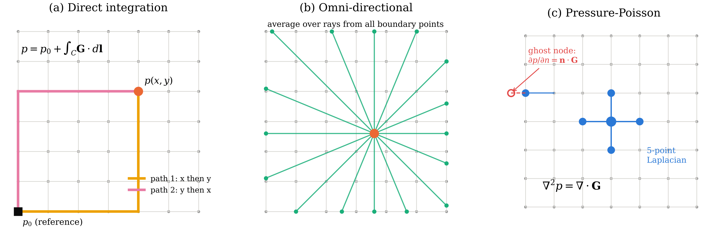
Algorithms
Three ways to integrate ∇p = G
Fig. 2 The three integration algorithms on the PIV grid
(a) Direct integration
March G·dl from a reference corner with the trapezoidal rule, x-then-y and y-then-x; average the two paths.
Fastest (0.3 ms at 64²), but every error on the path is carried to every later point.
(b) Omni-directional
Integrate along 32 ray directions into each node (Liu & Katz 2006). Edge values come from a consistent linear system; interior values are ray averages.
Averaging cancels path errors; slowest (≈0.4 s).
(c) Pressure-Poisson (main)
5-point Laplacian as a sparse matrix; Neumann edges by ghost-node elimination; singular system closed by a zero-mean constraint, solved directly.
15 ms; also Jacobi, GS, SOR and CG (backup).
4 /25
Anany Bajpai & Arnav Oza
ME 415: CFD & HT
Autumn ’26
Term Project
Notes:
[ANANY · 2:00–2:50 · 50 s]
Three ways to integrate G. Direct integration marches G along a path from a corner with the trapezoidal rule, x-then-y and y-then-x, and averages the two. It is the fastest, but every error is carried along the path.
Omni-directional integration, after Liu and Katz, averages line integrals from 32 directions into each node. It is robust but slow.
The Poisson solver is our main method: a sparse 5-point Laplacian, Neumann edges by ghost-point elimination, and a zero-mean constraint for the singular system, solved directly in about 15 milliseconds.

Slide 5
Solution Strategy
Logic chart and pseudo-code
Velocity source: exact solutions (Taylor–Green, Kovasznay) or CFD wake
for case in [TaylorGreen, Kovasznay, CFD]:
truth = exact_or_cfd(case) # fine grid
for param in sweep(h, σ, Δt, BC, W, filter):
for seed in range(10):
F = degrade(truth, W, h, σ, seed)
F = denoise(F) # optional
a = DuDt(F, eulerian | lagrangian)
G = -ρ*a + μ*lap(u)
p = poisson(G) | direct(G) | omni(G)
ε = L2(p - p_ref) / L2(p_ref) # zero mean
save mean, std of ε -> CSV -> figures
Synthetic PIV: box filter W → subsample to h → noise σU
Optional denoising: Gaussian / Savitzky–Golay
Material derivative Du/Dt: Eulerian or Lagrangian
Main functions (Python, NumPy/SciPy)
fields/ exact solutions, CFD loader · piv/ degrade, denoise
core/ derivatives, material derivative, Poisson (sparse direct + iterative), direct and omni integration, reconstruct()
analysis/ metrics, plots · studies/ one script per sweep
tests/ 87 unit tests, all passing (manufactured solutions, order checks)
sweep h, σ, Δt, BC, W, filter;
10 noise seeds each
Pressure gradient G = −ρ Du/Dt + μ∇²u
Integrate: Direct | Omni | Poisson
Compare with exact p: ε_L2, error map, core pressure
Fig. 3 Logic chart of the code
5 /25
Anany Bajpai & Arnav Oza
ME 415: CFD & HT
Autumn ’26
Term Project
Notes:
[ANANY · 2:50–3:30 · 40 s]
Our logic chart: take a velocity source, degrade it like a real PIV system, optionally denoise, compute the material derivative, form G, integrate, and compare with the exact pressure. Each study varies one parameter around a baseline, with ten noise seeds.
The code is Python, with 87 unit tests that check every stencil and solver against exact answers.

Slide 6
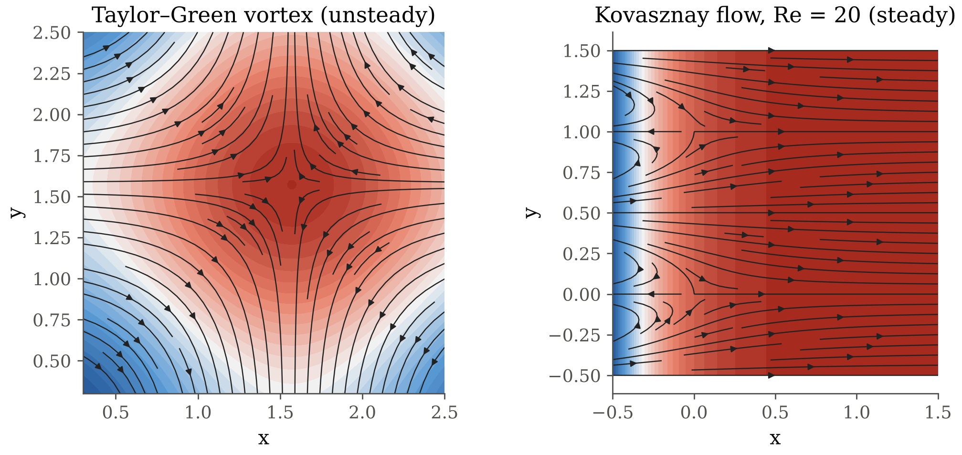
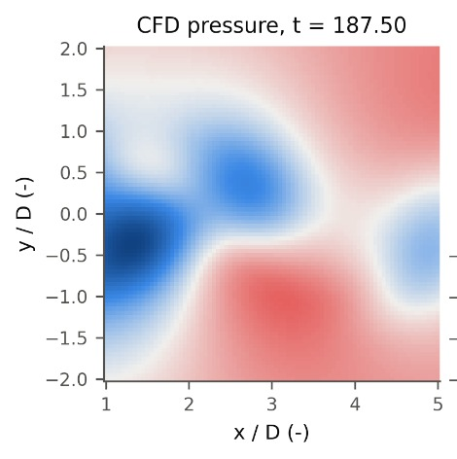
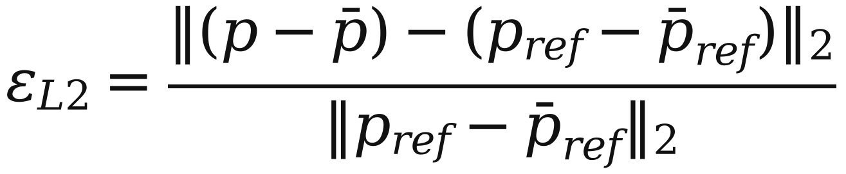
Test Cases
Exact flows, synthetic PIV and the error metric
Exact Navier–Stokes solutions (Fig. 4)
Taylor–Green vortex: unsteady and decaying; the viscous term cancels, so ∇p balances convection. A copy carried at U = 1 tests the time derivative.
Kovasznay flow (Re = 20, 40): steady flow behind a grid; here the viscous term μ∇²u matters.
CFD cylinder wake (Re = 100): OpenFOAM solution sampled on an 81 × 81 window behind the cylinder (Fig. 5).
Synthetic PIV model
Exact field on a 4× finer grid → box filter of width W (interrogation window) → keep every 4th point (spacing h) → add Gaussian noise σ·U to u and v.
Fig. 4 Test flows: pressure and streamlines
Error metric
Fig. 5 CFD wake window (x/D 1–5)
Baseline: 64 × 64 vectors, W = h, σ = 1 % of U, Δt = 0.05; mean ± std over 10 noise seeds.
6 /25
Anany Bajpai & Arnav Oza
ME 415: CFD & HT
Autumn ’26
Term Project
Notes:
[ANANY · 3:30–4:05 · 35 s]
We need flows whose pressure is known exactly. Taylor–Green is unsteady and its viscous term cancels, so it tests convection; a convected copy tests the time derivative. Kovasznay flow is steady with a strong viscous term. And the CFD wake.
The synthetic PIV model box-filters the exact field over the window, keeps every fourth point to get spacing h, and adds 1 percent noise. The error is the relative L2 norm of the demeaned pressure difference.

Slide 7
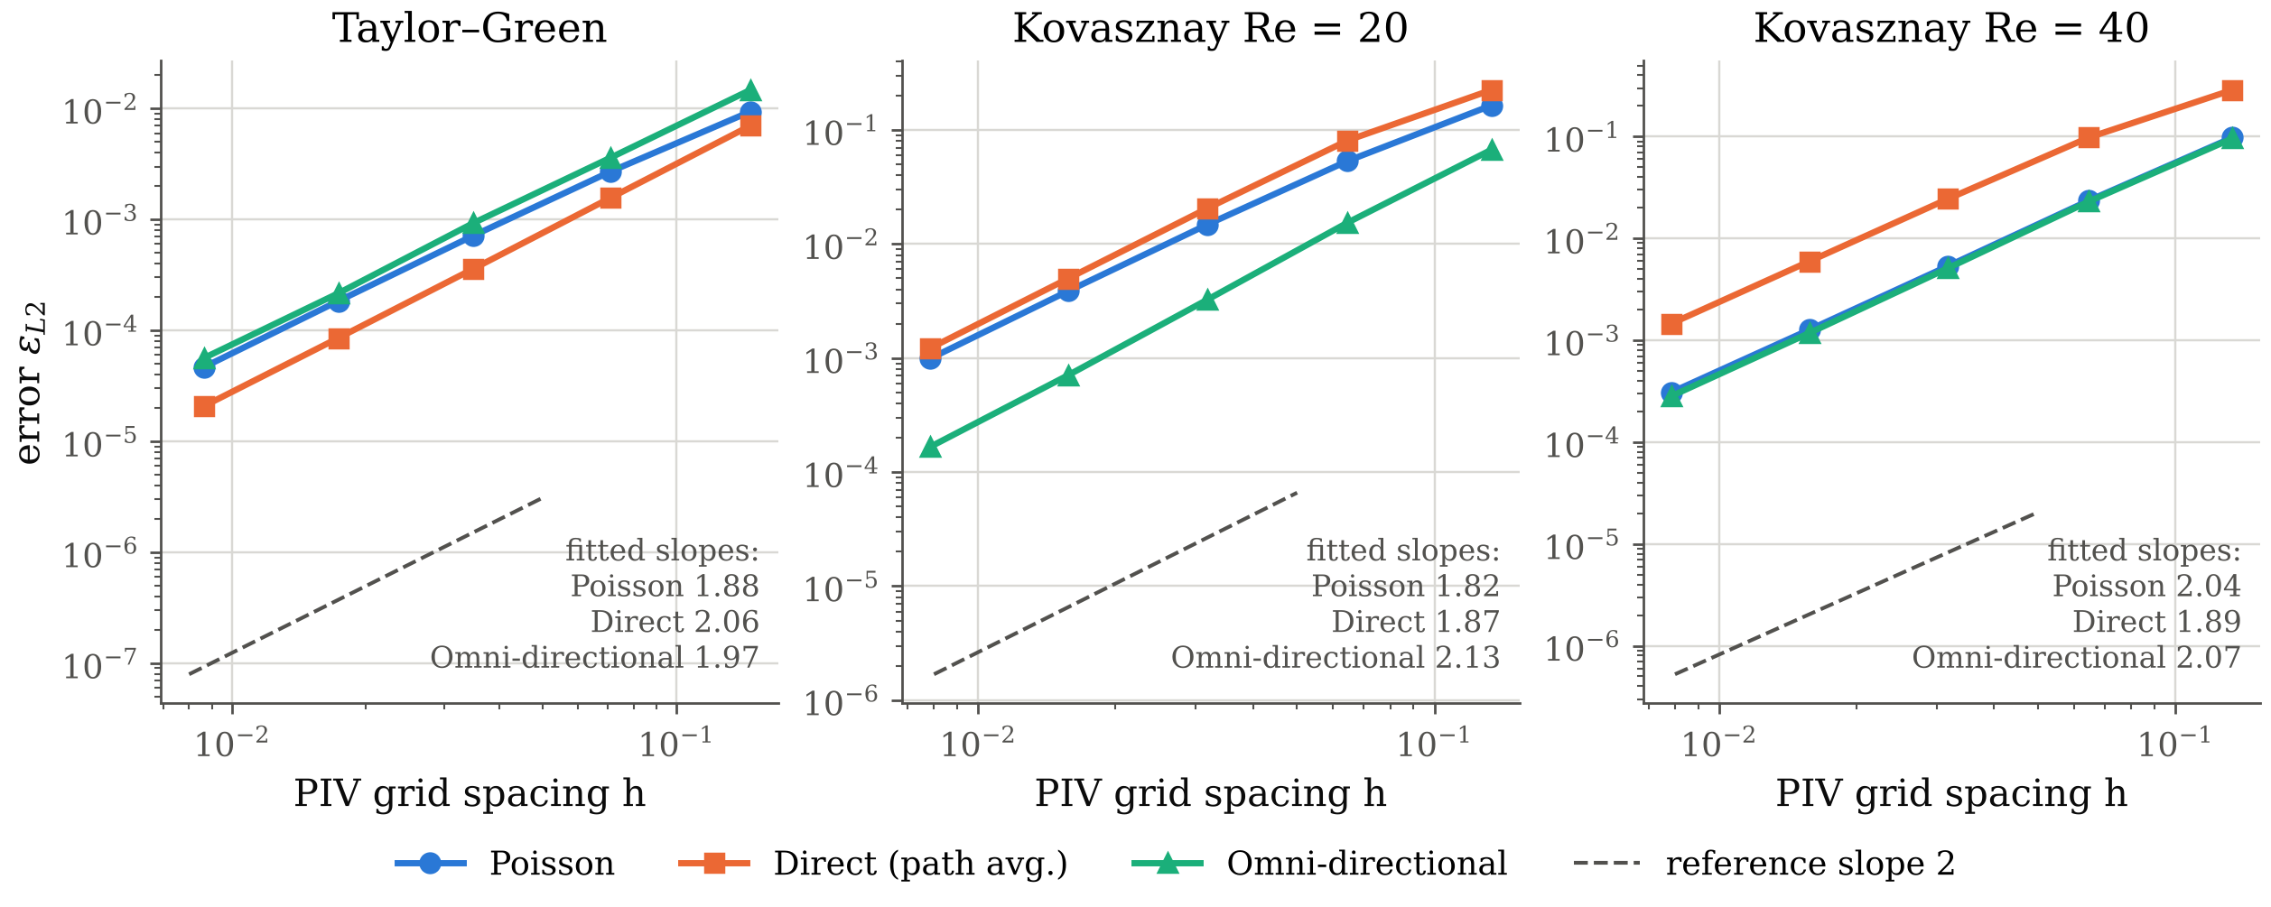
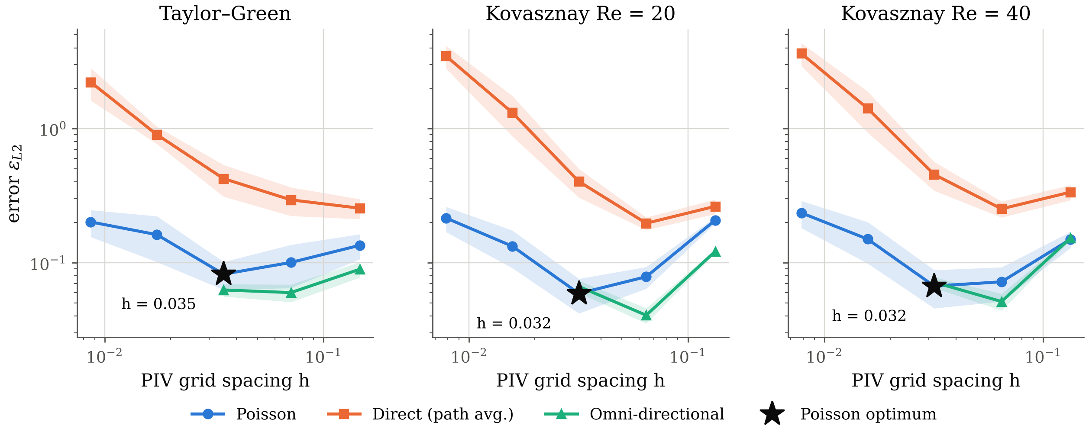
Accuracy vs Grid Spacing
Second order when clean; an optimum spacing when noisy
Verified: all methods, all flows converge at second order on clean data.
With noise the error rises again below h ≈ 0.03 (TG: 0.082 → 0.20).
Why: truncation ∝ h², but noise is amplified ∝ σ/h (convective) and μσ/h² (viscous).
Direct only gets worse: errors add like a random walk along the path.
Fig. 6 Clean data: slopes 1.8–2.1 (second order)
Fig. 7 σ = 1 % noise: Poisson optimum at h ≈ 0.03 (★)
7 /25
Anany Bajpai & Arnav Oza
ME 415: CFD & HT
Autumn ’26
Term Project
Notes:
[ANANY · 4:05–5:00 · 55 s]
On clean data, top, all three methods converge at second order on all three flows, with slopes 1.8 to 2.1, so the code is verified.
With 1 percent noise, bottom, the error stops falling: Poisson has a minimum near h = 0.03 and rises again on finer grids. Truncation error falls as h squared, but noise is amplified as one over h by the convective term and one over h squared by the viscous term. So noisy PIV has an optimum vector spacing, and the finest grid can make pressure worse.
Direct integration only gets worse: its errors add up like a random walk.

Slide 8
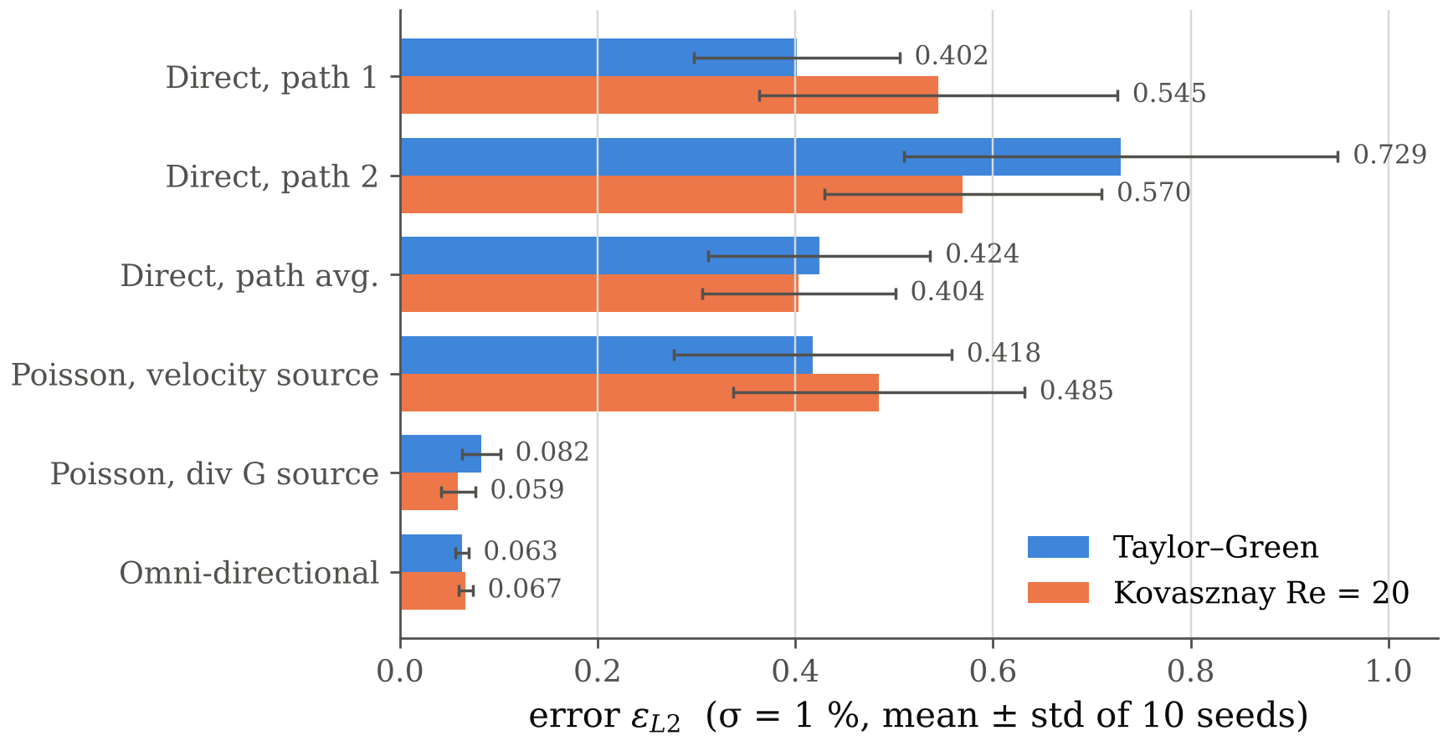
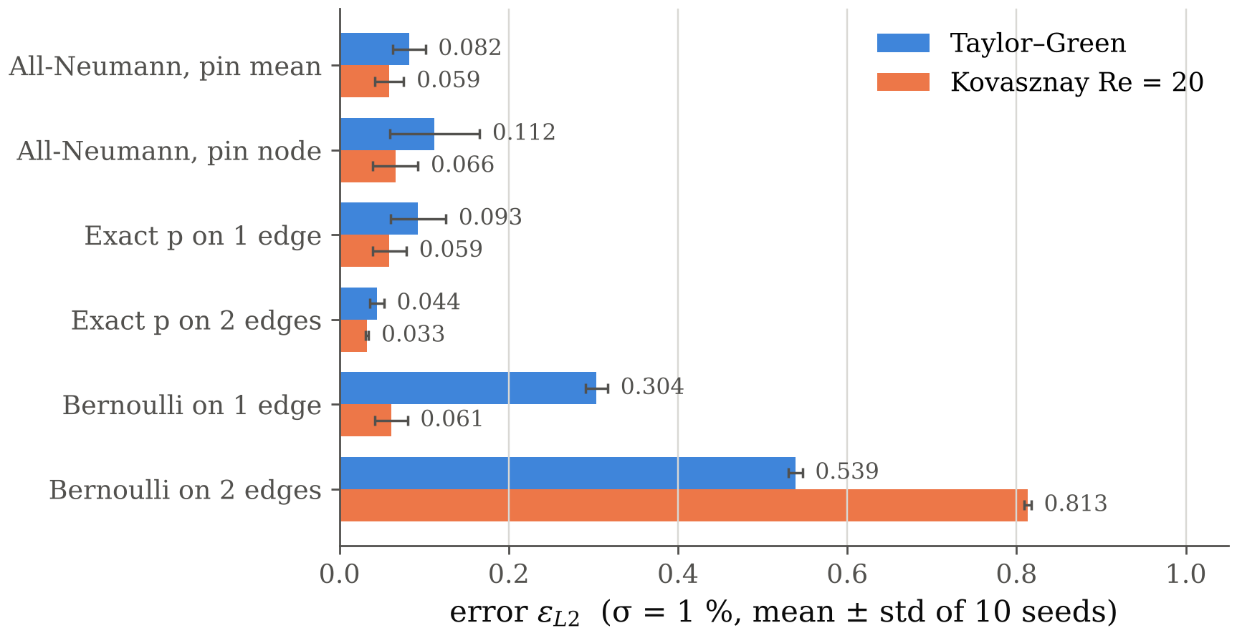
Method & Boundary Conditions
Errors at σ = 1 % noise, 10 seeds
Fig. 8 Integration methods
Fig. 9 Poisson boundary conditions
Direct is 5–7× worse: one path accumulates every error; Poisson and omni average over many paths.
Omni ≈ Poisson in accuracy, but ≈27× slower → Poisson is the practical choice.
Known p on 2 opposite edges halves the error (0.082 → 0.044): Neumann data are themselves noisy derivatives.
Bernoulli edges fail (up to 0.81): valid only in irrotational flow; both test flows carry vorticity.
8 /25
Anany Bajpai & Arnav Oza
ME 415: CFD & HT
Autumn ’26
Term Project
Notes:
[ANANY · 5:00–5:50 · 50 s]
At 1 percent noise, left, direct integration is five to seven times worse than Poisson or omni: one path accumulates every error, while Poisson and omni average over many paths. Omni and Poisson are equally accurate, but omni is about 27 times slower, so Poisson is the practical choice.
Right, boundary conditions: true pressure on two opposite edges halves the error, because Neumann data are themselves noisy derivatives. Bernoulli edges fail, up to 0.8, because Bernoulli needs irrotational flow and both test flows carry vorticity.
I'll hand over to Arnav.

Slide 9
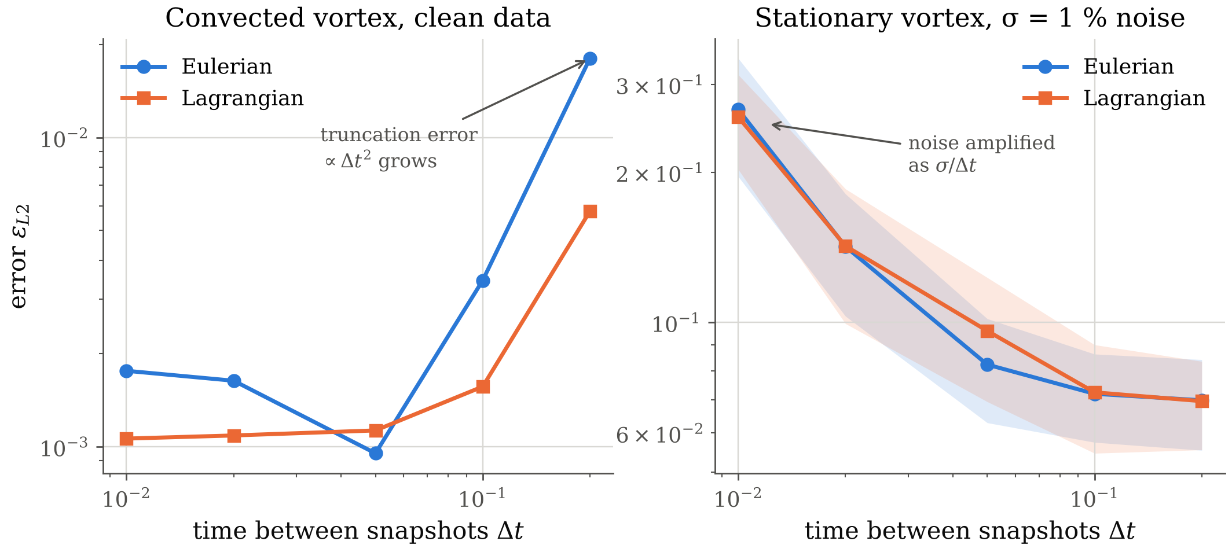
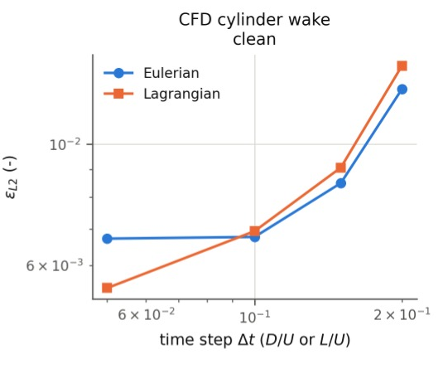
Time Step: Eulerian vs Lagrangian
Following the particle helps only when structures are convected
Fig. 11 CFD wake (clean)
Fig. 10 Convected vortex (clean) and stationary vortex (σ = 1 %)
Convected vortex: Lagrangian error 3× lower at Δt = 0.2: the vortex is carried faster than it spins.
With noise both improve with larger Δt: noise in ∂u/∂t scales as σ/Δt.
CFD wake: Lagrangian wins only at Δt = 0.05 (15–18 %). In the vortex-formation region vortices spin about as fast as they move, so the assumption breaks.
9 /25
Anany Bajpai & Arnav Oza
ME 415: CFD & HT
Autumn ’26
Term Project
Notes:
[ARNAV · 5:50–6:40 · 50 s]
Thanks. Theory says the Lagrangian derivative wins when structures are carried along faster than they spin. On the convected vortex, left, its error is three times lower at large time step. With noise, middle, both schemes improve as the time step grows, because noise in the time derivative scales as sigma over delta t.
On the CFD wake, right, Lagrangian wins only at the smallest step. Our window sits where vortices are still forming and spin about as fast as they move, so the assumption breaks.

Slide 10
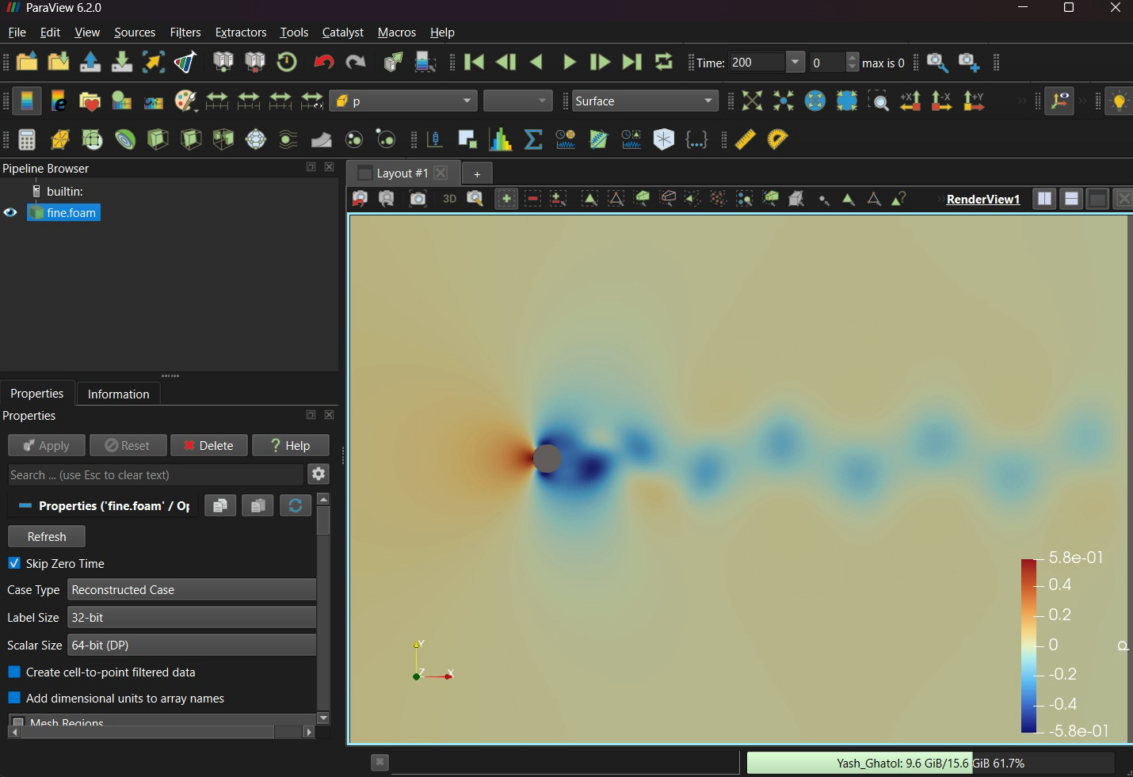
CFD: Cylinder Wake at Re = 100
OpenFOAM, three meshes, verified
Mesh | Cells | St | C̄d
Coarse | 6,690 | 0.1644 | 1.375
Medium | 26,760 | 0.1688 | 1.388
Fine | 107,040 | 0.1695 | 1.388
Richardson | – | 0.1697 | conv.
Literature | – | ≈0.165 | ≈1.33
pimpleFoam (PISO), 2nd-order schemes, Co ≤ 0.5, t = 200.
St: order p = 2.48, GCI 0.13 %; periodic from t = 76.
3–4 % above literature: 5 % side-wall blockage.
Fig. 12 ParaView 6.2: fine-mesh pressure, t = 200
Window for PIV: 81 × 81 points, x/D 1–5, y/D −2 to 2, every 0.05 D/U for t = 175–200 (about 4 shedding periods), from the fine mesh.
10 /25
Anany Bajpai & Arnav Oza
ME 415: CFD & HT
Autumn ’26
Term Project
Notes:
[ARNAV · 6:40–7:30 · 50 s]
We simulated the laminar cylinder wake at Reynolds number 100 in OpenFOAM, on three meshes up to 107,000 cells. This is the fine-mesh pressure in ParaView, with the Kármán vortex street.
The Strouhal number converges to 0.1695, with observed order 2.5 and a grid convergence index of 0.13 percent. Drag and lift converge on the medium mesh, and shedding is periodic from t = 76, well before our sampling window. Our values are 3 to 4 percent above the literature, plausibly from the 5 percent blockage of the side walls.

Slide 11
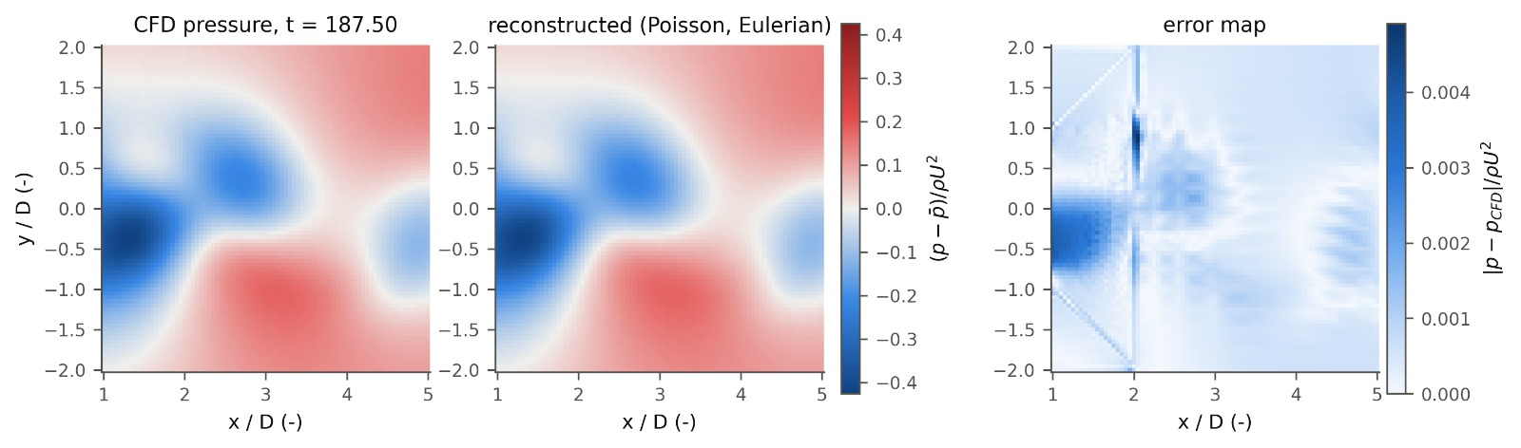
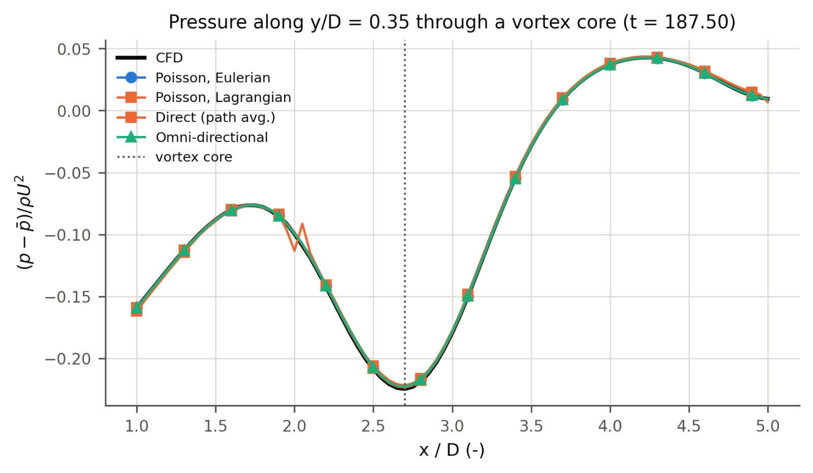
CFD Wake: Reconstruction
Pressure from PIV-like samples of the OpenFOAM velocity
Fig. 13 CFD pressure, reconstruction and error map (t = 187.5)
The wake pressure is recovered: from the 81 × 81 CFD velocity samples (h = 0.05 D, no noise) the Poisson error is ε = 0.5–0.75 % over a shedding period.
Vortex-core suction (−0.22 ρU² at x/D ≈ 2.7) is matched by every method within about 1 %.
Error sits on the CFD mesh's block edges (x/D = 2 and the diagonals to (2, ±2), the edges of the O-grid). The interpolated velocity has small slope jumps there, and differentiation amplifies them; direct integration shows a kink at x/D = 2. This is an error of the "measured" data, not of the method.
Fig. 14 Line through a vortex core
11 /25
Anany Bajpai & Arnav Oza
ME 415: CFD & HT
Autumn ’26
Term Project
Notes:
[ARNAV · 7:30–8:20 · 50 s]
From an 81 by 81 PIV-like sample of the CFD velocity, the pressure is recovered to within 0.5 to 0.75 percent, and every method matches the vortex-core suction within about 1 percent.
The remaining error sits on straight lines. These are the block edges of the CFD mesh, where the sampled velocity has small kinks that differentiation amplifies, just like noise. With 1 percent noise the wake error rises to about 14 percent, because the wake's pressure variations are small compared with the velocity noise.

Slide 12
Literature
Do our trends match published studies?
Our result | Published finding | Match
Exact p on 2 edges: ε 0.044 vs 0.082 all-Neumann (≈2×) | Pan et al. [3]: Dirichlet edges give less error than Neumann (≈2× for large domains); avoid pure Neumann if possible | Agrees
Bernoulli edges: ε 0.30–0.81 in rotational flow | Pan et al. [3]: Bernoulli-based Dirichlet data are valid only in irrotational regions | Agrees
Error from 0.02 % (clean) to >100 % (direct, σ ≥ 2 %); depends on method, spacing and filtering | Charonko et al. [2]: errors from <1 % to >100 %; sensitive to all these factors; no single best method | Agrees
Lagrangian 3× better at large Δt in convected flow; noise ∝ 1/Δt | Violato et al. [6]: Eulerian limited to short Δt; short Δt amplifies precision error, long Δt adds truncation error | Agrees
Omni and Poisson recover the main features; direct integration is very noise-sensitive | van Gent et al. [4]: all methods tested recover the main features; noise lowers accuracy | Partly
CFD wake (fine mesh): St 0.1695, C̄d 1.388, Cl amplitude 0.345 | 2-D simulations at Re = 100 (e.g. Park et al. [7]): St ≈ 0.164–0.165, C̄d ≈ 1.33; experiments St ≈ 0.164 [8] | Agrees (+3–4 %, blockage)
Reference numbers refer to the References slide.
12 /25
Anany Bajpai & Arnav Oza
ME 415: CFD & HT
Autumn ’26
Term Project
Notes:
[ARNAV · 8:20–8:55 · 35 s]
Our trends reproduce the literature: Pan and co-workers on Dirichlet versus Neumann boundaries and on Bernoulli edges, Charonko and co-workers on errors from below 1 to over 100 percent, and Violato and co-workers on the Eulerian time-step limit. The CFD wake matches published Strouhal and drag values within the blockage effect.

Slide 13
Conclusions
Key findings and takeaway
Key findings
All three algorithms are second-order accurate on exact data (slopes 1.8–2.1): the code is verified.
Noise, not discretisation, limits PIV pressure: error grows linearly with σ, and there is an optimum spacing (h ≈ 0.03 here).
Poisson and omni are 5–7× more robust than direct integration; Poisson is ≈27× faster than omni.
Known pressure on two edges halves the error; Bernoulli edges hold only in irrotational flow.
Lagrangian Du/Dt tolerates larger Δt in convected flow; with noise, larger Δt helps both.
Filtering trades noise for bias: it helps at σ ≥ 1 % and hurts on clean data.
On the OpenFOAM wake (St 0.1695, GCI 0.13 %) the clean reconstruction error is 0.5–0.75 %; mesh-block kinks in the data are amplified like noise.
Objectives
All four met: algorithms implemented, verified on exact flows, studied parametrically, and compared with a CFD wake and published studies.
Recommended practice
Poisson solver; Dirichlet edges only where p is known (free stream); Lagrangian Du/Dt with the largest Δt that keeps truncation small; spacing near the noise–truncation optimum; light denoising above σ ≈ 0.5 %.
Main takeaway
PIV pressure is limited by how velocity noise is amplified by differentiation. Method, boundary data, spacing and Δt decide whether that noise is averaged out or accumulated.
Way ahead: make noise depend on W (larger windows, less noise in real PIV); correlated noise; 3-D time-resolved data.
13 /25
Anany Bajpai & Arnav Oza
ME 415: CFD & HT
Autumn ’26
Term Project
Notes:
[ARNAV · 8:55–9:50 · 55 s]
To conclude. The code is verified at second order. Noise, not discretisation, limits PIV pressure: the error grows linearly with noise and there is an optimum vector spacing. Poisson integration is robust and fast, known pressure on two edges halves the error, and the Lagrangian derivative helps only where structures are simply convected. All four objectives are met.
The main takeaway: the accuracy of pressure from PIV is set by how velocity noise is amplified by differentiation, and the choice of method, boundary data, spacing and time step decides whether that noise is averaged out or accumulated. Thank you.

Slide 14
Fin.
Thank you. Questions?
Notes:
[BOTH · 9:50–10:00]
Thank you. We're happy to take questions. Backup slides cover the CFD set-up and grid study, noise and window effects, the solvers, scheme order and CFD residuals.

Slide 15
References
Papers cited in this talk
[1] B. W. van Oudheusden, PIV-based pressure measurement, Meas. Sci. Technol. 24 (2013) 032001.
[2] J. J. Charonko, C. V. King, B. L. Smith, P. P. Vlachos, Assessment of pressure field calculations from particle image velocimetry measurements, Meas. Sci. Technol. 21 (2010) 105401.
[3] Z. Pan, J. Whitehead, S. Thomson, T. Truscott, Error propagation dynamics of PIV-based pressure field calculations: how well does the pressure Poisson solver perform inherently?, Meas. Sci. Technol. 27 (2016) 084012.
[4] P. L. van Gent et al., Comparative assessment of pressure field reconstructions from particle image velocimetry measurements and Lagrangian particle tracking, Exp. Fluids 58 (2017).
[5] X. Liu, J. Katz, Instantaneous pressure and material acceleration measurements using a four-exposure PIV system, Exp. Fluids 41 (2006) 227–240.
[6] V. Violato, P. Moore, F. Scarano, Lagrangian and Eulerian pressure field evaluation of rod-airfoil flow from time-resolved tomographic PIV, Exp. Fluids 50 (2011) 1057–1070.
[7] J. Park, K. Kwon, H. Choi, Numerical solutions of flow past a circular cylinder at Reynolds numbers up to 160, KSME Int. J. 12 (1998) 1200–1205.
[8] C. H. K. Williamson, Vortex dynamics in the cylinder wake, Annu. Rev. Fluid Mech. 28 (1996) 477–539.
[9] L. I. G. Kovasznay, Laminar flow behind a two-dimensional grid, Proc. Camb. Philos. Soc. 44 (1948) 58–62.
15 /25
Anany Bajpai & Arnav Oza
ME 415: CFD & HT
Autumn ’26
Term Project
Notes:
References. The cylinder values quoted from Park et al. are approximate; check them in the paper before quoting exact numbers.

Slide 16
Backup Slides
Supporting detail for questions
CFD set-up, grid study, wake Δt and noise
Noise sensitivity, window and denoising
Iterative solvers and scheme order
Kovasznay reconstruction
CFD lift, spectrum and residuals
16 /25
Anany Bajpai & Arnav Oza
ME 415: CFD & HT
Autumn ’26
Term Project

Slide 17
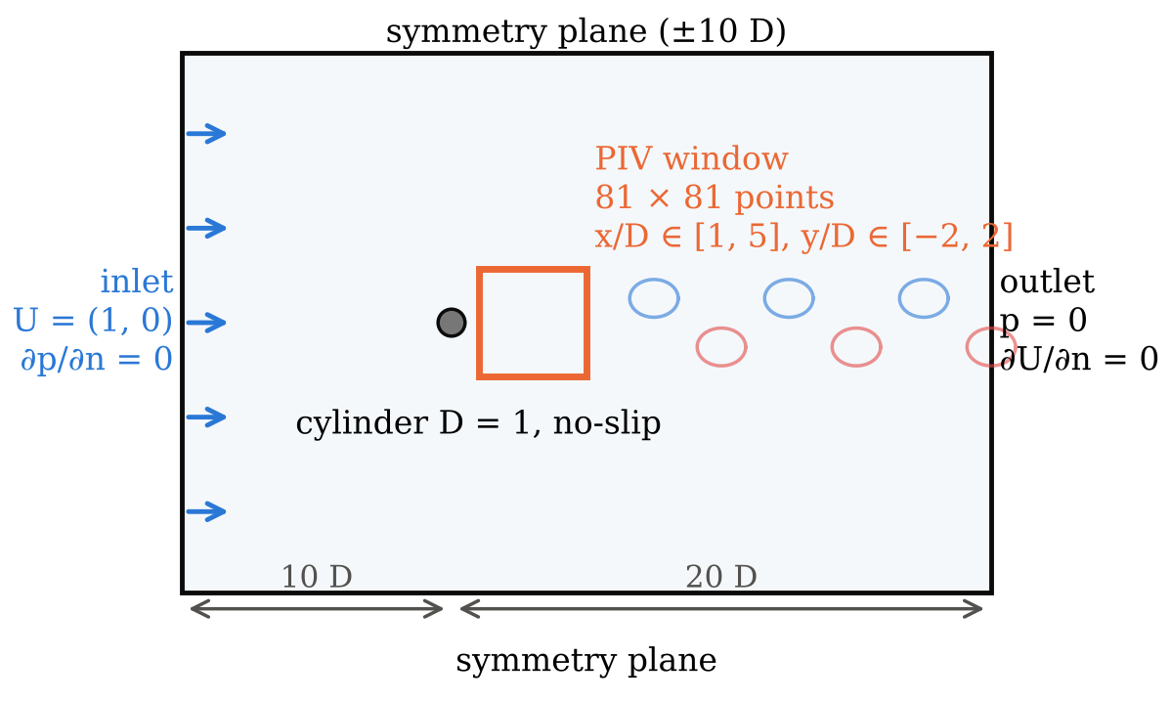
CFD Simulation
Cylinder wake at Re = 100 (OpenFOAM)
Item | Setting
Equations | Incompressible NS (Eq. 1), laminar
Solver | pimpleFoam (PISO mode)
Time / convection | backward (2nd order) / linearUpwind
Time step | max Courant 0.5, run to t = 200 D/U
Re = UD/ν | 100 (U = D = 1, ν = 0.01)
Output | Cd, Cl (forces); PIV window every 0.05 D/U
Fig. 15 Domain, BCs and PIV window
2-D laminar is valid: the wake stays 2-D below Re ≈ 190.
A small inlet kick (t < 6) starts shedding sooner; from t = 6 the inlet is exactly U = (1, 0).
Three meshes (6,690 / 26,760 / 107,040 cells) for grid independence.
Fig. 16 ParaView 6.2: fine-mesh pressure at t = 200
17 /25
Anany Bajpai & Arnav Oza
ME 415: CFD & HT
Autumn ’26
Term Project
Notes:
OpenFOAM set-up. The ParaView screenshot shows the actual fine-mesh solution at t = 200: high pressure at the stagnation point, low pressure on the sides and in the shed vortex cores, which alternate above and below the centreline.

Slide 18
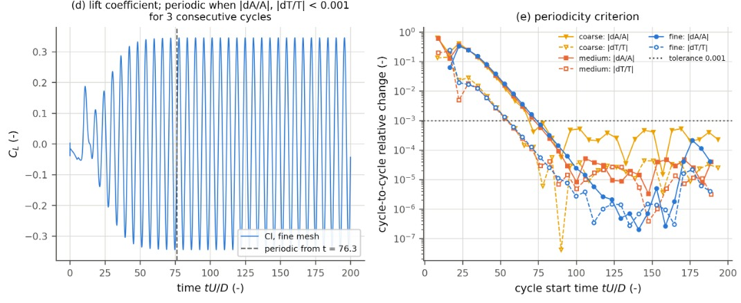
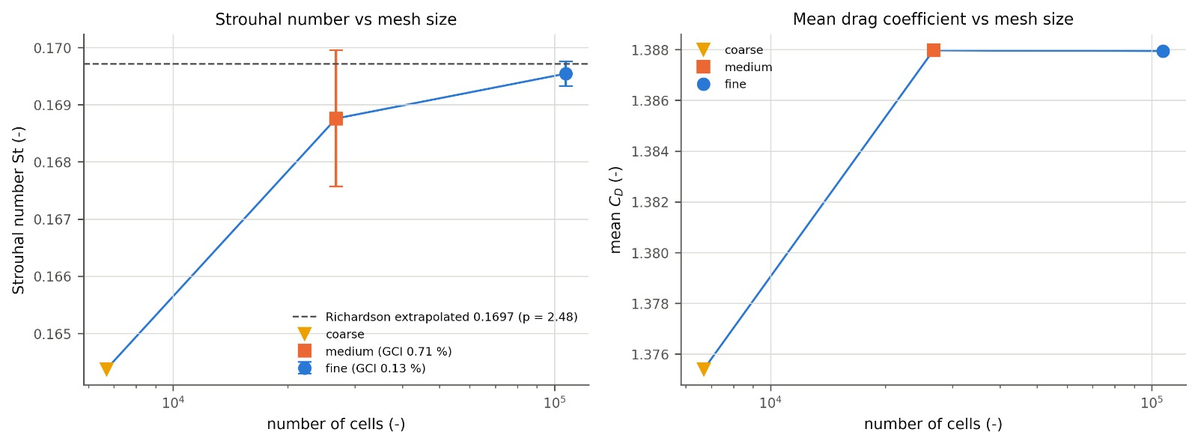
CFD Verification
Grid independence and periodic shedding
Mesh | Cells | St | C̄d | Cl amp.
Coarse | 6,690 | 0.1644 | 1.3754 | 0.3216
Medium | 26,760 | 0.1688 | 1.3880 | 0.3451
Fine | 107,040 | 0.1695 | 1.3879 | 0.3451
Richardson extrap. | – | 0.1697 | conv. | conv.
2-D simulations, Re = 100 | – | ≈0.164–0.165 | ≈1.33 | ≈0.33
Fig. 18 Lift and periodicity check
St converges: 0.1644 → 0.1688 → 0.1695 (changes 2.7 %, then 0.46 %). Observed order p = 2.48, extrapolated 0.1697, GCI fine 0.13 %; asymptotic ratio 1.005, so the meshes are in the asymptotic range.
C̄d and Cl amplitude are already converged on the medium mesh (changes 0.00 % and 0.01 %), so a Richardson order cannot be defined.
Periodic from t = 76.3: cycle-to-cycle changes of amplitude and period stay below 10⁻³; the PIV window (t = 175–200) is well inside. Residuals level off near 10⁻³: periodic, not steady.
vs literature: St and C̄d are 3–4 % higher, as expected from the 5 % blockage of the ±10 D symmetry sides.
Fig. 17 St and Cd vs mesh (bars: GCI)
Literature values approximate; check before quoting.
18 /25
Anany Bajpai & Arnav Oza
ME 415: CFD & HT
Autumn ’26
Term Project
Notes:
Grid independence: the Strouhal number converges with observed order about 2.5 and a fine-mesh GCI of 0.13 %. Drag and lift amplitude stop changing at the medium mesh. The flow is periodic after t = 76, so the sampling window from t = 175 is fully developed. Our values are a few per cent above the unbounded-domain literature because the side walls block 5 % of the flow.

Slide 19
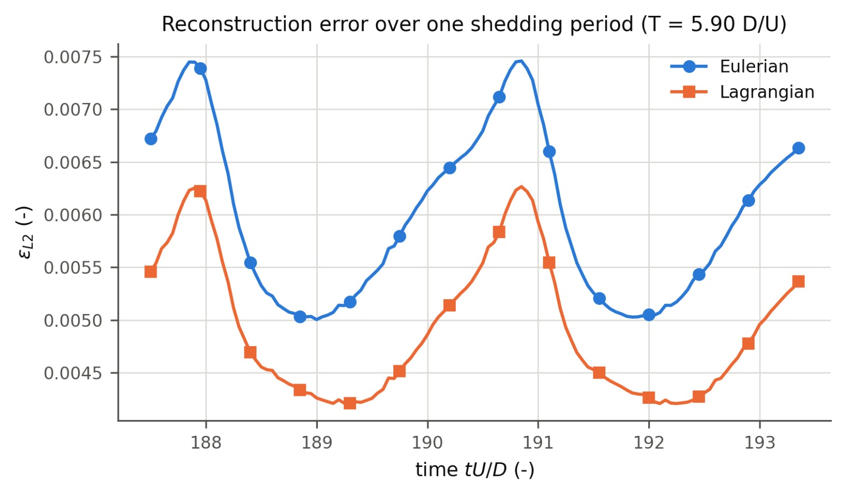
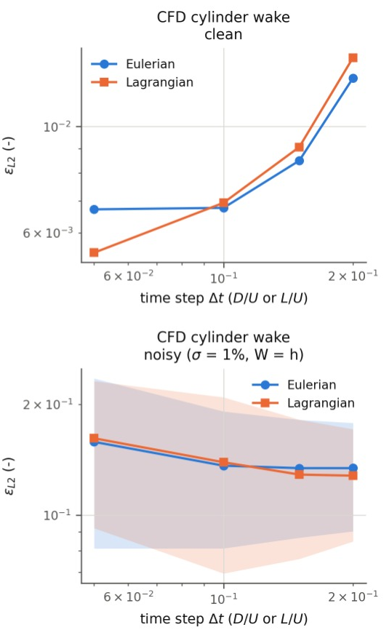
CFD Wake: Δt and Noise
Eulerian vs Lagrangian on a real wake
Fig. 19 Error over one shedding period (clean, Δt = 0.05)
Error pulses twice per period (T = 5.90, i.e. St = 0.1695): it peaks each time a vortex forms on one side.
At Δt = 0.05 Lagrangian is 15–18 % better throughout the period: the vortices are carried through the window.
At Δt ≥ 0.1 Eulerian is slightly better, unlike the convected Taylor–Green. Likely: in the near wake (x/D 1–5) vortices are still forming, move slower than U and spin fast (w ≈ c), so straight-line tracking of curved paths costs more; more tracked points also leave the window.
With 1 % noise ε ≈ 0.13–0.15 for both schemes, nearly flat in Δt. Higher than Taylor–Green (0.08) because wake pressure varies only about ±0.2 ρU², so the same velocity noise is larger relative to the signal.
Fig. 20 Error vs Δt on the wake
19 /25
Anany Bajpai & Arnav Oza
ME 415: CFD & HT
Autumn ’26
Term Project
Notes:
Time-resolved behaviour on the wake. The Lagrangian advantage seen on the convected Taylor–Green holds only at the smallest time step here; in the near wake the vortices are not yet simply convected, so the theory's assumption (w much smaller than c) does not hold. With noise, noise amplification dominates and the scheme matters little.

Slide 20
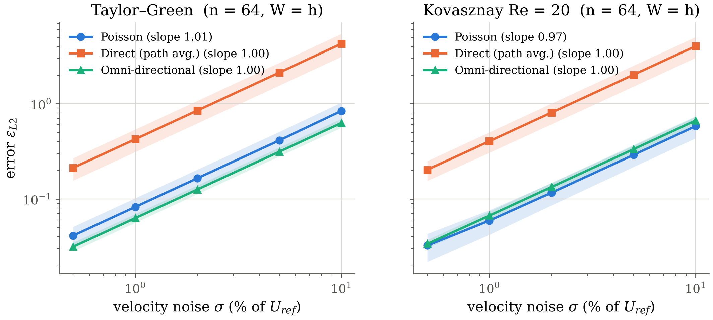
Noise & Method
How each algorithm handles measurement noise
Fig. 21 Error vs noise (n = 64, W = h)
Fig. 22 Methods at σ = 1 %
Error grows linearly with noise (log–log slopes 0.97–1.01): the reconstruction is a linear operation on the velocity error.
Direct integration is 5–7× worse: one path carries every error along it, while Poisson (elliptic) and omni average over many paths.
Omni ≈ Poisson in accuracy (0.063 vs 0.082 Taylor–Green; 0.067 vs 0.059 Kovasznay) but ≈27× slower (0.41 s vs 15 ms).
Velocity-source Poisson ∇²p = −ρ(u_x² + 2u_y v_x + v_y²) is 5–8× worse with noise: it multiplies noisy derivatives.
20 /25
Anany Bajpai & Arnav Oza
ME 415: CFD & HT
Autumn ’26
Term Project
Notes:
Linear growth with sigma is expected. The important comparison is between methods: averaging methods are far more robust than a single integration path.

Slide 21
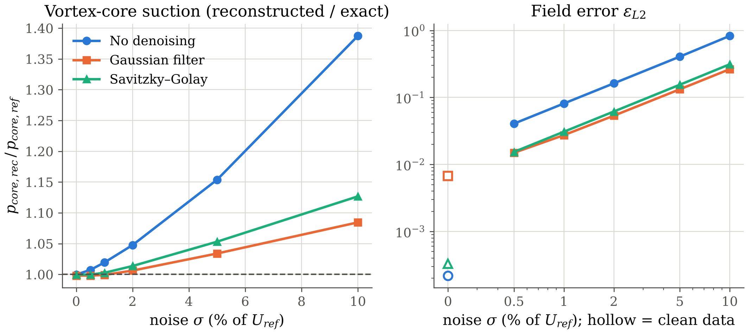
Window & Denoising
Smoothing trades noise for bias
1. Interrogation window W
Averaging over W smooths velocity. Taylor–Green core suction drops only 0.3 % at W = 4h (vortex ≫ window); Kovasznay ε rises 0.015 → 0.061 (sharper gradients).
Fig. 23 Core suction ratio and field error vs noise
2. Denoising cuts the noisy error about 3×
σ = 1 %: 0.081 → 0.027 (Gaussian), 0.031 (Savitzky–Golay); but on clean data the Gaussian filter adds bias (0.0002 → 0.007).
3. Noise biases the vortex core, not just scatters it
Without denoising the core suction is over-predicted (1.39× at σ = 10 %): (u·∇)u multiplies noisy terms, and products of noise do not average to zero.
21 /25
Anany Bajpai & Arnav Oza
ME 415: CFD & HT
Autumn ’26
Term Project
Notes:
Filtering is a trade-off: it removes random error but introduces systematic smoothing error. Worth it once noise is above about 0.5 %.

Slide 22
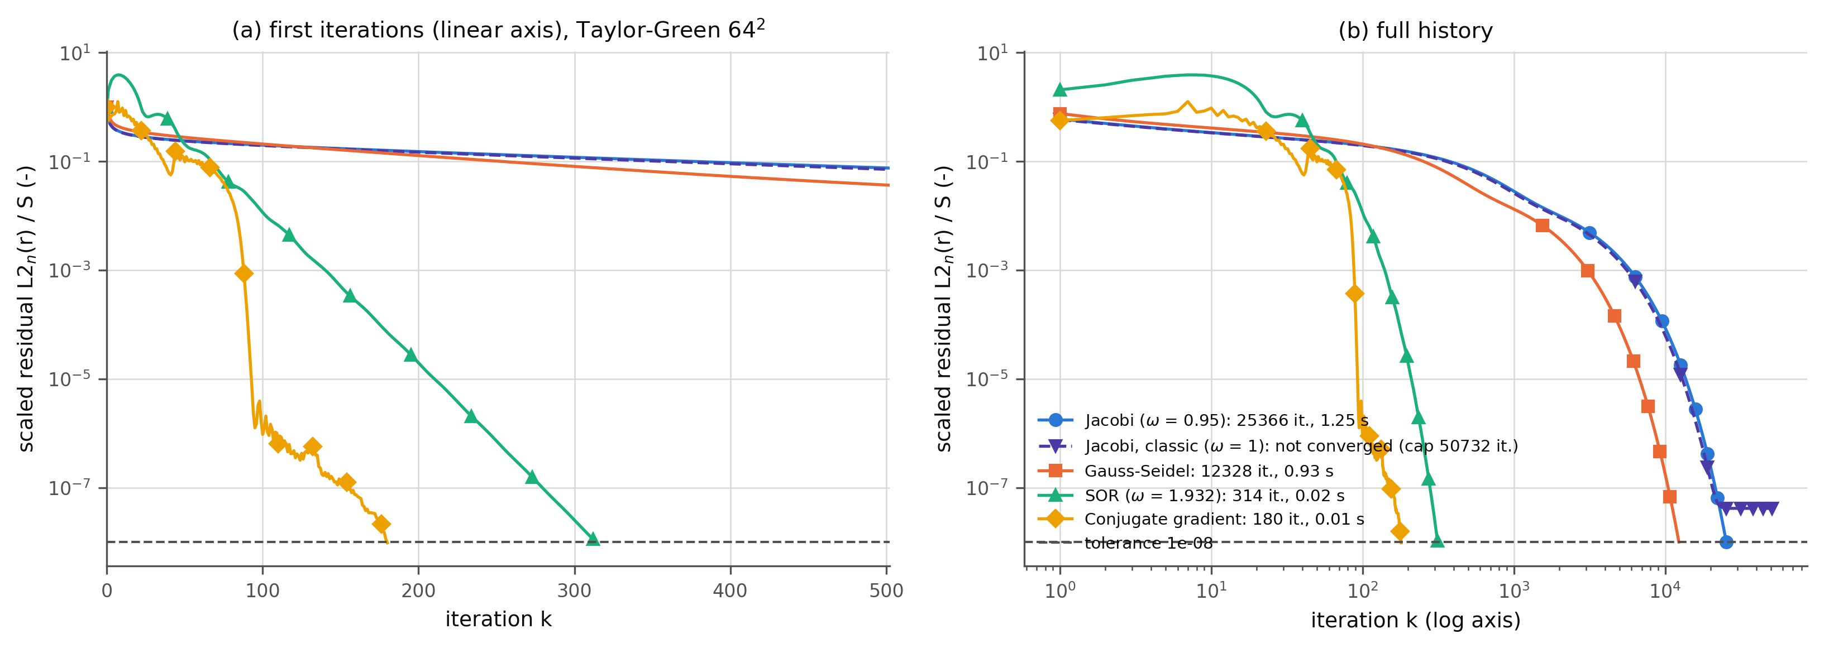
Iterative Solvers
Backup: same Poisson system, five solvers
Fig. 24 Scaled residual history, Taylor–Green 64²
Solver (64², tol 1e-8) | Iterations | Time
Jacobi (ω = 0.95) | 25,366 | 1.3 s
Gauss–Seidel | 12,328 | 0.93 s
SOR (ω = 1.932) | 314 | 0.024 s
Conjugate gradient | 180 | 0.013 s
Jacobi, classic (ω = 1) | stalls at 4.2e-8 | –
All solve the same matrix as the direct solve; SOR at ω_opt and CG need 80–140× fewer iterations than Jacobi.
Iterations grow as N^1.0 (Jacobi, GS), N^0.52 (SOR) and N^0.43 (CG).
Classic Jacobi stalls on the all-Neumann problem (checkerboard mode); ω = 0.95 fixes it. SOR does not converge at ω = 2 and diverges at 2.1.
22 /25
Anany Bajpai & Arnav Oza
ME 415: CFD & HT
Autumn ’26
Term Project

Slide 23
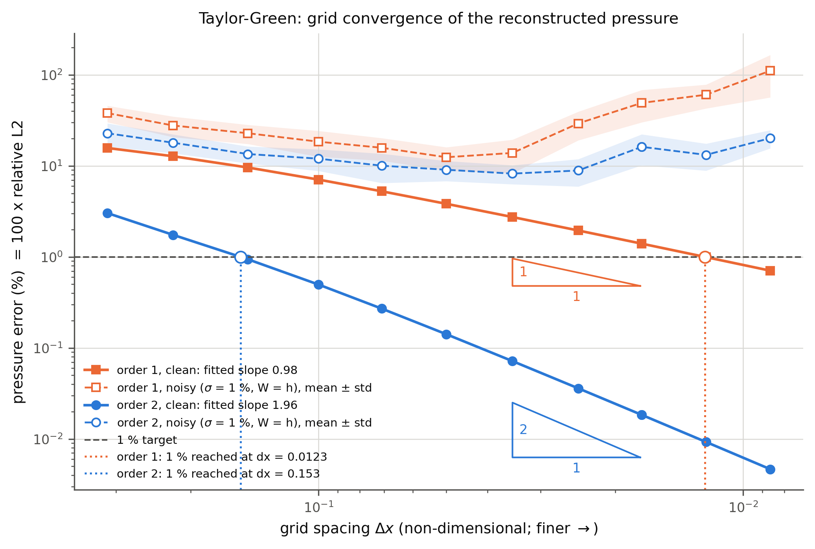
Scheme Order
Backup: first- vs second-order differences
Fig. 25 Grid convergence, Taylor–Green
Fitted slopes: 0.98 vs 1.96 (Taylor–Green), 1.00 vs 1.96 (Kovasznay Re = 20).
1 % error is reached at Δx ≈ 0.153 with second order but needs Δx ≈ 0.012 with first order: a 12× finer grid.
With 1 % noise both schemes level off and rise again on fine grids; the second-order scheme stays lower.
23 /25
Anany Bajpai & Arnav Oza
ME 415: CFD & HT
Autumn ’26
Term Project

Slide 24
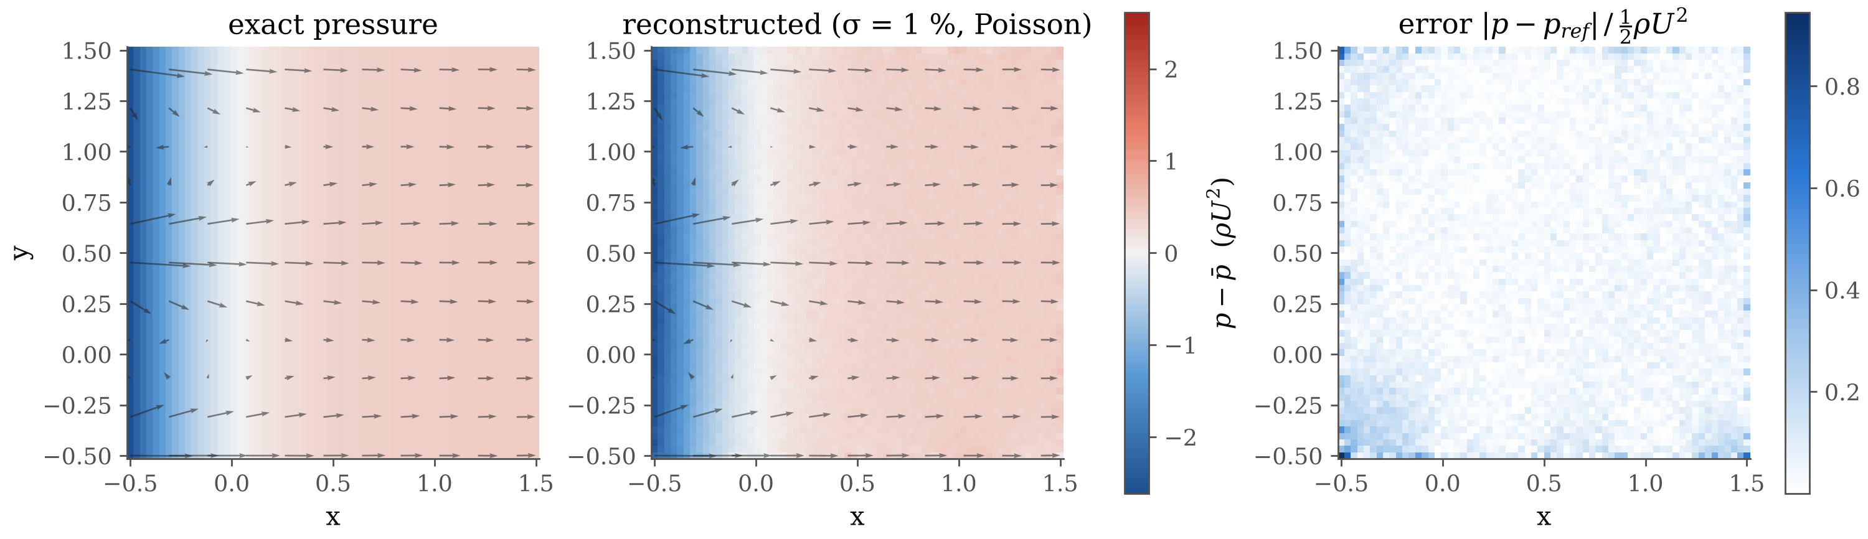
Kovasznay Flow
Backup: noisy reconstruction and error map
Fig. 26 Kovasznay Re = 20: exact, reconstructed (σ = 1 %) and error
ε_L2 = 0.056 for this seed. The error is mostly random scatter from the noise; the largest values sit at the edges and corners, where one-sided stencils and the noisy Neumann data n·G act.
24 /25
Anany Bajpai & Arnav Oza
ME 415: CFD & HT
Autumn ’26
Term Project

Slide 25
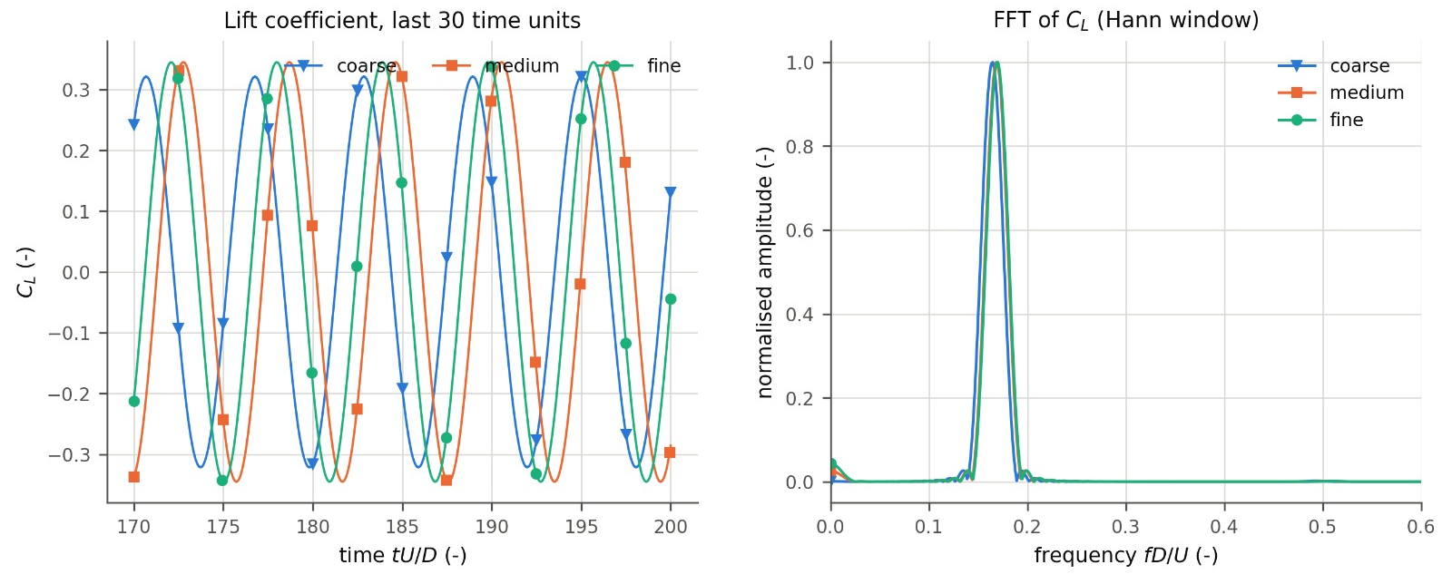
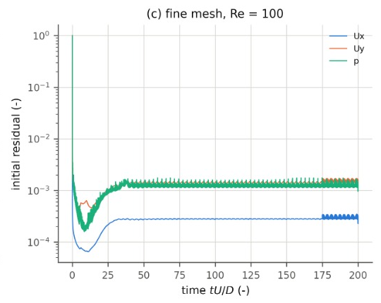
CFD Lift & Residuals
Backup: forces, spectrum and solver residuals
Fig. 27 Lift coefficient and its spectrum, three meshes
Cl from all three meshes over the last 30 time units; the FFT peak gives St (Hann window, uniform resampling).
Coarse mesh: lower Cl amplitude (0.322 vs 0.345) and lower St (0.1644): too little resolution at the cylinder.
Initial residuals fall from 1, then level off near 10⁻³ (p, Uy) and 3 × 10⁻⁴ (Ux): each time step starts from a changed, periodic flow, so they never reach zero.
Fig. 28 Fine-mesh residuals
25 /25
Anany Bajpai & Arnav Oza
ME 415: CFD & HT
Autumn ’26
Term Project

