Slide 1

BUG TRACKING SYSTEM

Slide 2
INTRODUCTION
A bug refers to any defect in the design, coding, and features of a product that can cause it
to malfunction or deliver incorrect results in a product. The process of identifying these
defects in a product is known as bug tracking.
A bug tracking software is an essential tool for managing the process of finding, tracking,
and fixing bugs. Not only does it ensure that you deliver a high-quality near-perfect
product, but it also enhances the productivity of the development team throughout the
product development process.
A bug tracking software keeps all issues relating to your bugs in the same place and
ensures that they are fixed appropriately. Not only does It provide visibility to all the
aspects of the project, but it also has tools for in-depth analysis and control. Having a single
platform from where everything is tracked is particularly valuable for companies running
large projects. A bug tracking tool provides a platform from which all of these multiple
moving parts involved in resolving bugs are seamlessly managed is critical to delivering a
bug-free product that will leave customers satisfied

Slide 3
Why we chose this project?
A bug free software is the main goal of any software developer. A bug tracking system helps you identify the bug and resolve it as soon as possible and reduce the risk of loss to the company. Customer satisfaction being the first priority to a company, producing a bug-free, best quality product in the specified timeline is also important. A bug if identified at an earlier stage can be a boon to a company else a bane. If a bug is identified at an earlier stage it reduces the risk of loss, risk of a tiny bug generating more bugs leading to a lot of loss w.r.t time and money. Bug tracking system plays an important role in tracking all the bugs of a software generated by various developers in a company, maintain it in a database and also for future reference. As per the research, nearly 45% of respondents plan to upsurge their expenditure on testing automation. Therefore, the rise in spending on software testing processes is driving the growth of the global bug tracking software market.

Slide 4
WORKING
The software includes three main roles- The admin, user and developer.
The user can upload their issues from any platform by logging in. A ticket number will be generated to each issue and the user can log in and view the status of the issue (open, assigned, resolved, closed) , comment and also close the issue.
The user can either upload his issue on the website or use the PHPEditor
The admin views all the issues reported by users and assigns it to a department.
Members of the department need to log in to view the issue assigned to them and only one member can resolve at a time. If that member fails to resolve the issue it will be passed on to another member.
State the problem you are solving in one or two sentences.
Make sure to explain why it is a real problem.

Slide 5
Tools and languages used
Github for Version Control
Lucid Chart as a design tool
XAMPP as Development and testing tool
Gantt chart
Breakdown chart
PHP
JavaScript
CSS
Bootstrap

Slide 6
SE principles applied
Agile method used
Software development lifecycle followed
Incremental model followed
Clear and unambiguous user requirements
Estimated time required
Updated versions of code using version control
Maintained a breakdown chart
Each module is validated

Slide 7
Why incremental model?
Requirements were clear and unambiguous
Had good plan and design w.r.t to the architecture, language and tools to be used
Divided each functionality into modules so that any bug in a particular module will not effect the entire functionality
Flexibility to change requirements whereas in waterfall model the requirements are frozen and not flexible
If we used V model we had to test each and every unit which would be difficult due to time and labour constraints.

Slide 8
How agile?
Focuses on simplicity and user friendly
Responding to change rather than following a plan
Understanding user requirements clearly as a user
Basic requirements prioritised first , additional requirements such as improvement on CSS done later

Slide 9
USER REQUIREMENTS-
FUNCTIONAL | NON-FUNCTIONAL
Security Restrict the bug from being resolved by multiple members Store the most common errors in a database for future reference Delete old records Update issue status Generating ticket number | Cross platform Robust and real time Manage accounts Store user and issue details Less response time High throughput

Slide 10
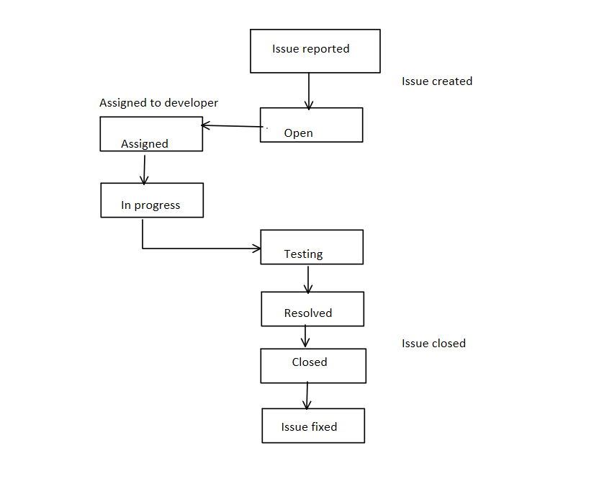
Architectural design

Slide 11
Code Snippets

Slide 12
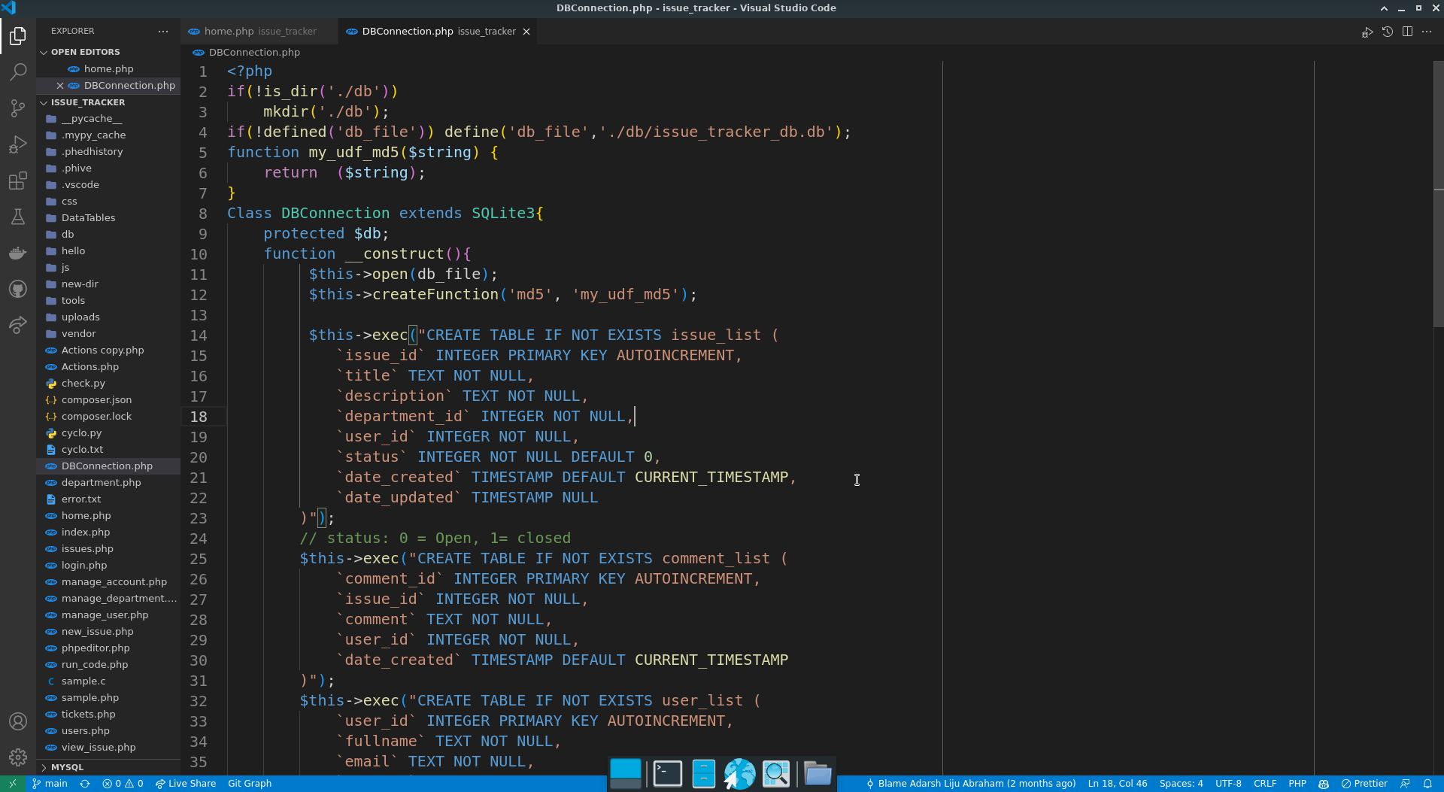
Database Code Snippet

Slide 13
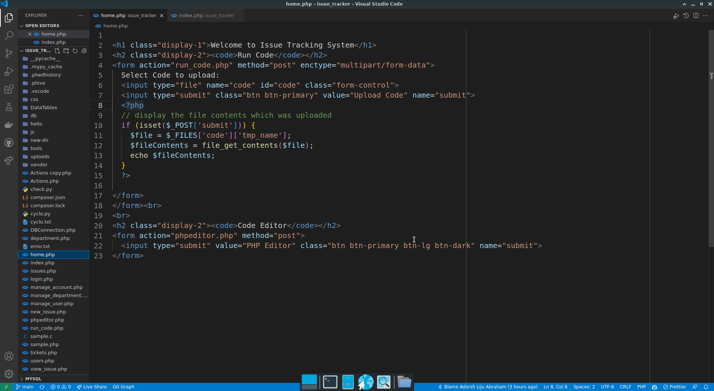
HomePage Code Snippet

Slide 14
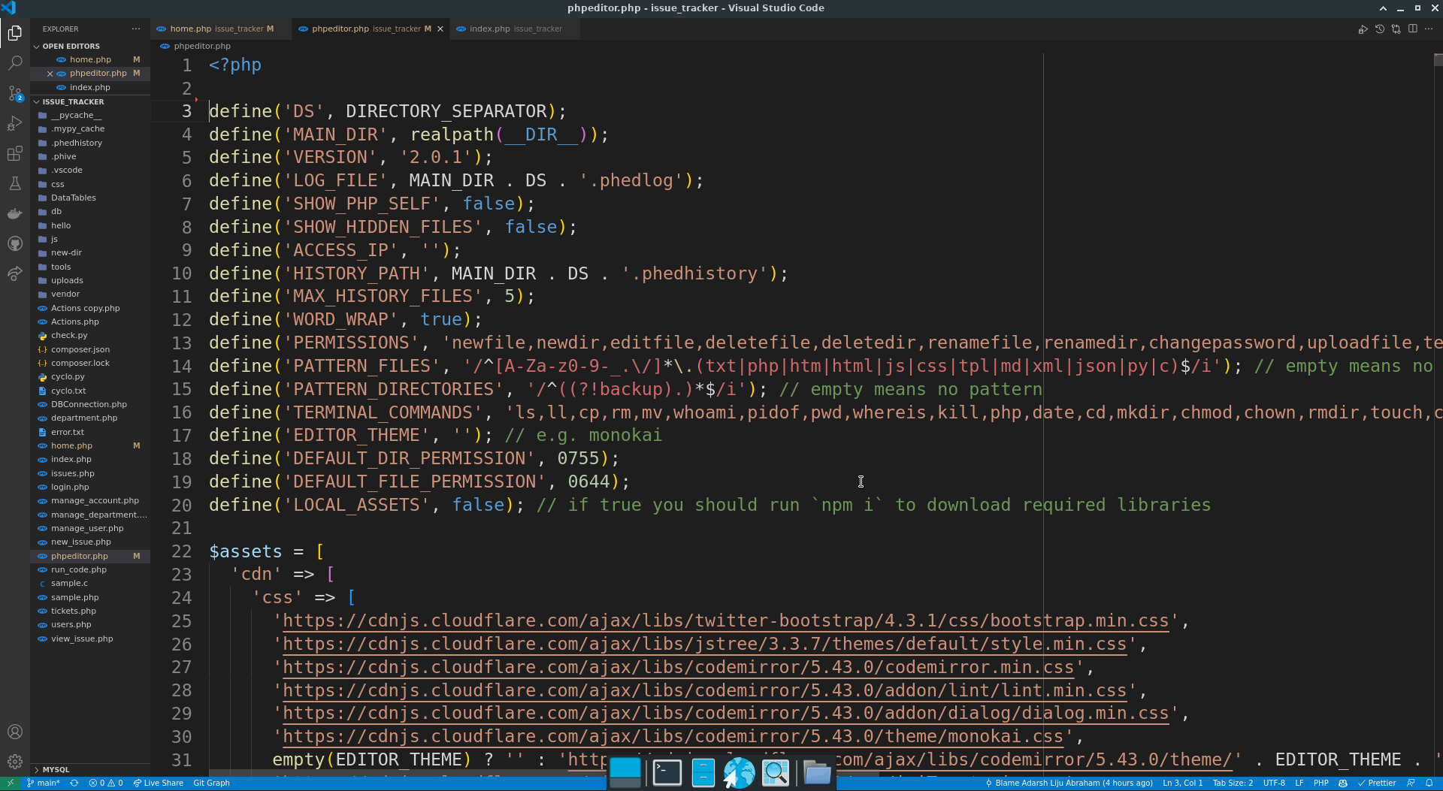
Text Editor Code Snippet

Slide 15
Performance metrics
Accuracy – 95%- as it resolves syntax error accurately but cannot fix logical errors
Performance- 97%
Availability- 98%- as the website can be accessed even without internet on any platform
Reliability- 95%- the website may undergo any cyber attacks

Slide 16
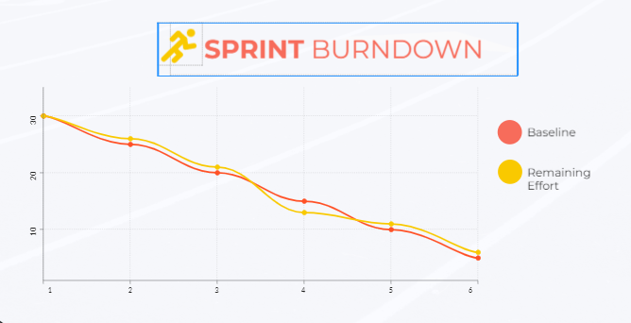
BURNDOWN CHART made after the basic requirements were developed

Slide 17
Features that were added later-
Test cases
Replicating vs code editor
Uploading code and running in C, C++ and Python

Slide 18
CONSTRAINTS
Knowledge constraints-about PHP
Documentation constraint- about SE principles
Design constraint- CSS and user can communicate only in english
Safety constraints- website maybe victim to DDOS attacks/ similar cyber attacks
Time constraint- could not add more features
System must be robust enough to handle multiple routes and queries.
System must be able to access data faster even when the database is fille

Slide 19
Future work
Automatically add issue when error occurs
More debugging features
Implementing Open AI code completion feature
Generating code as solution to a bug
A member reviews the solution given by a member
In-app chat
Email notifications to users about issue update

Slide 20


