Slide 1
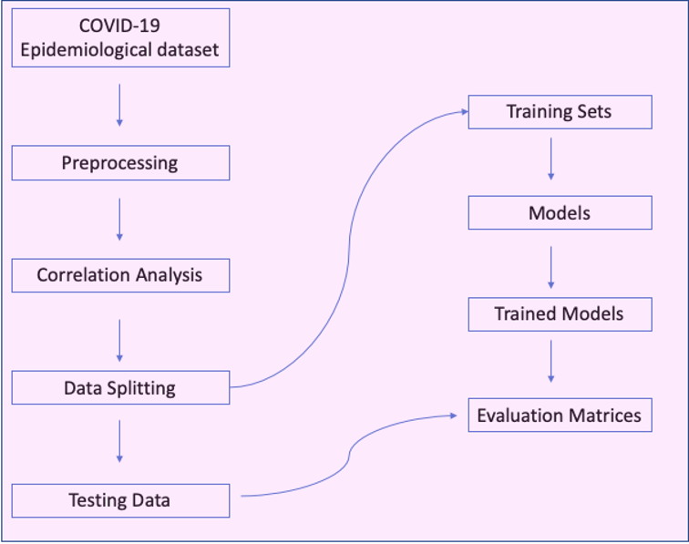
Workflow:-

Slide 2
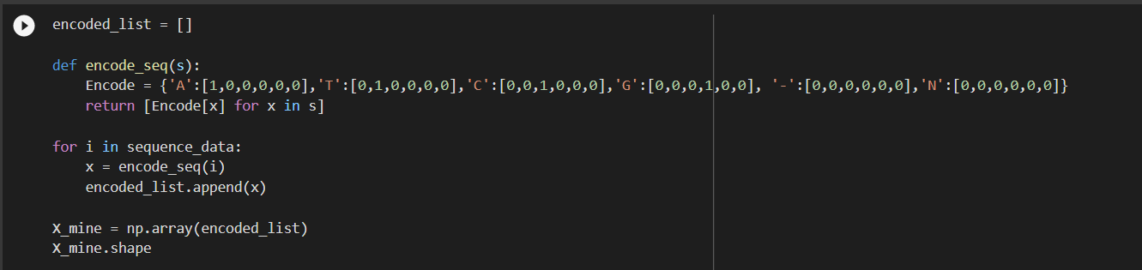
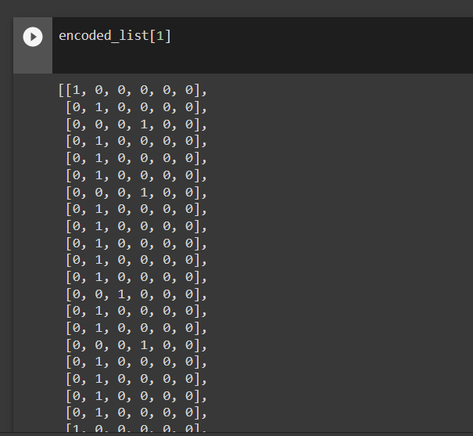
Pseudo Code :-
ENCODING OF DATASET TAKEN
OUTPUT OF ABOVE ENCODING

Slide 3
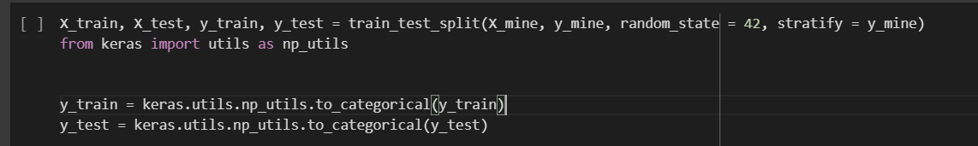
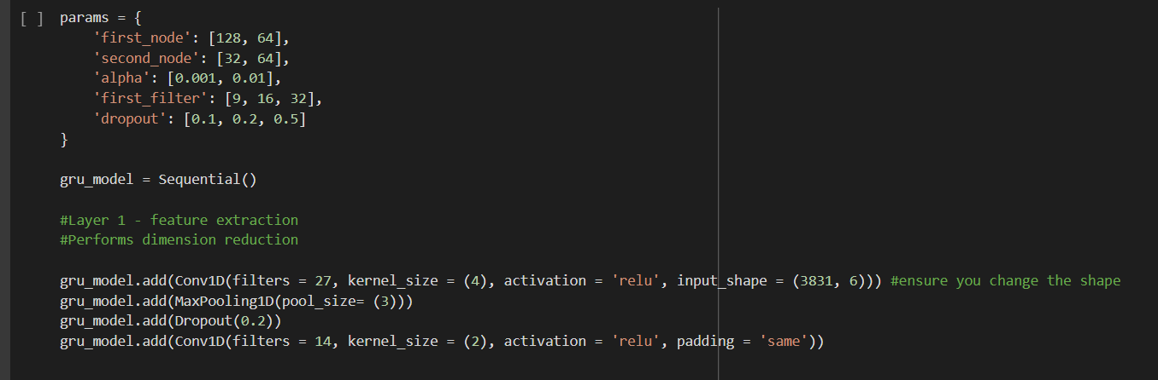
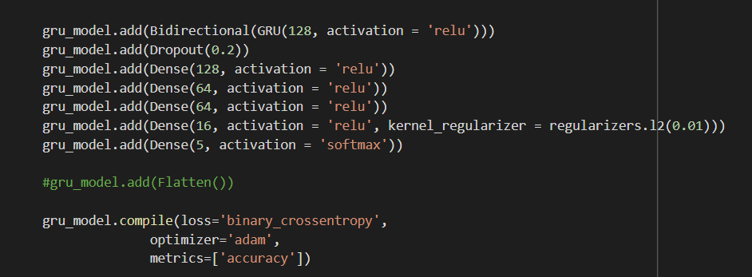
TESTING AND TRAINING OF DATA
FEATURE EXTRACTION

Slide 4
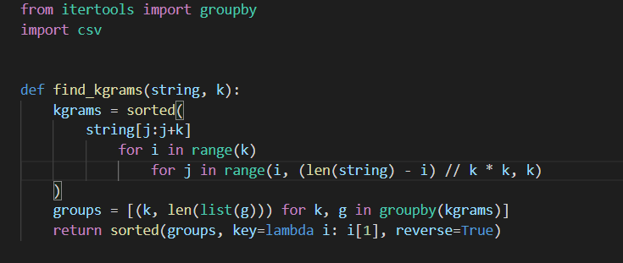
CODON ANALYSIS
OUTPUT

Slide 5
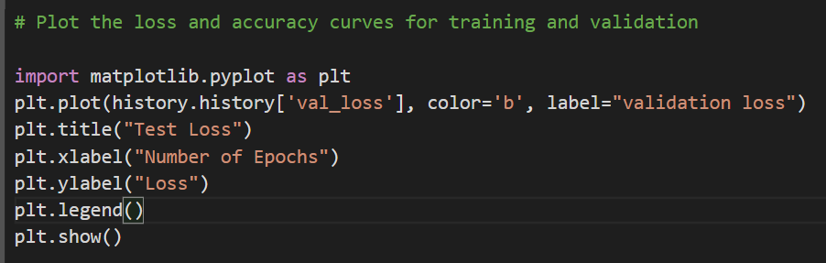
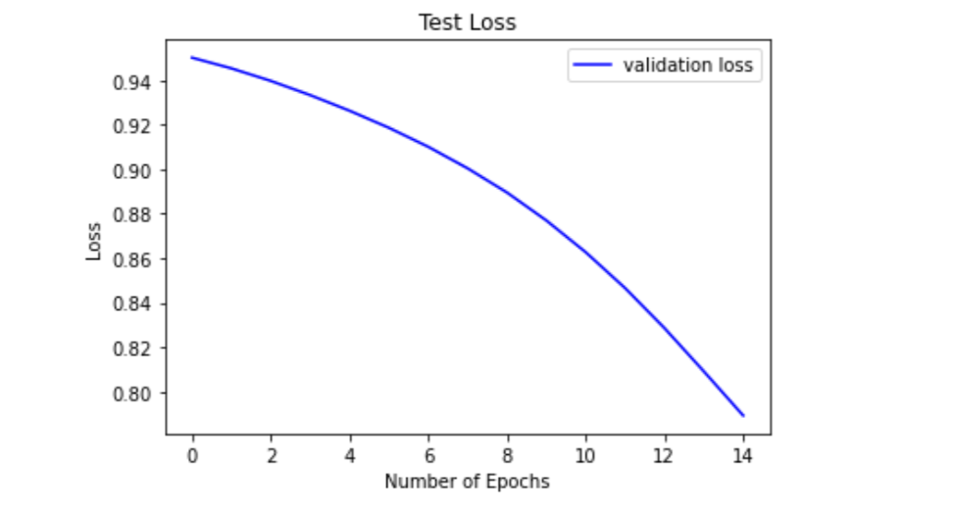

Slide 6
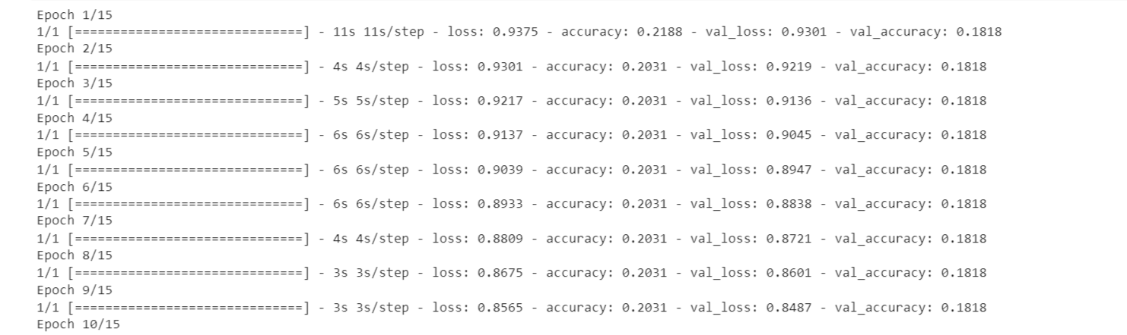
history = gru_model.fit(X_train, y_train, batch_size = 128, validation_data=(X_test, y_test), epochs=15)

Slide 7
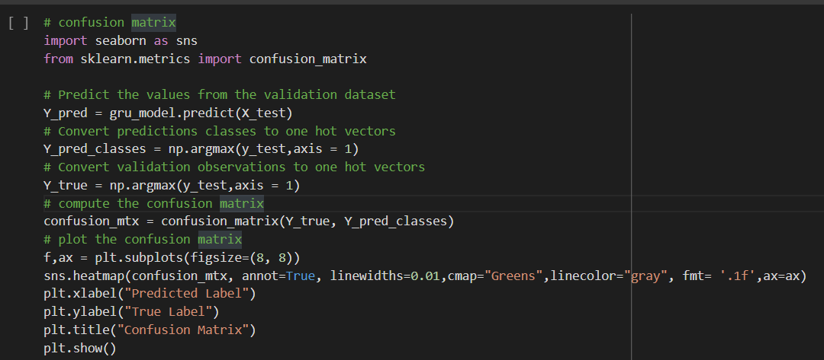
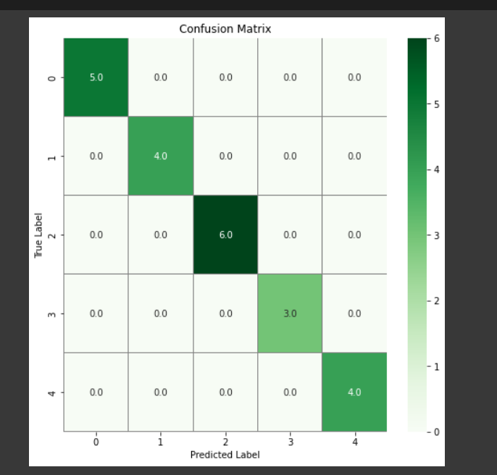
CONFUSION MATRIX

Slide 8
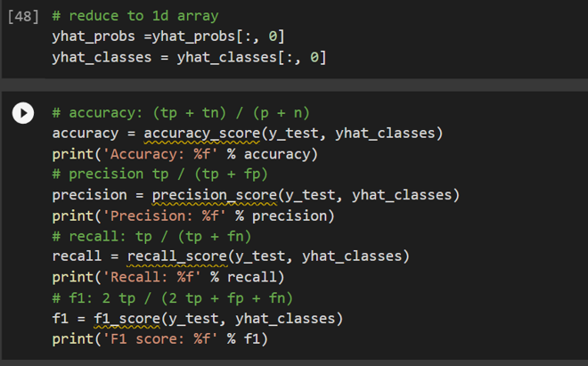
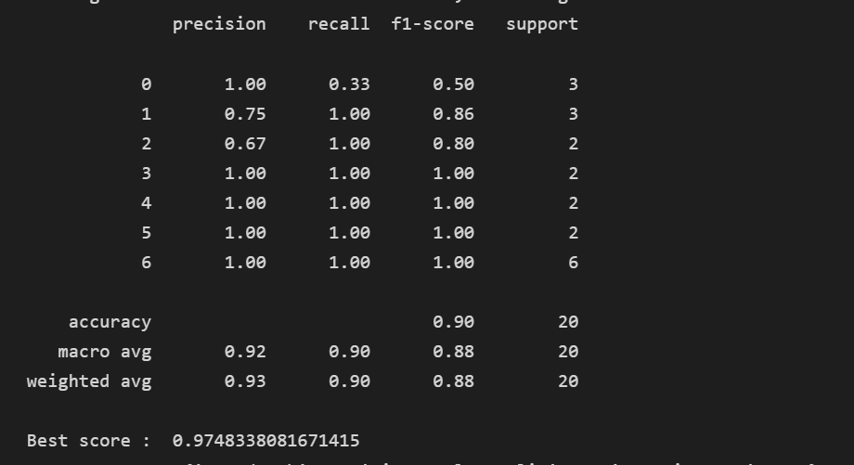
Accuracy output

