Slide 1
Data Cleaning Project
Prepared by: Anastasia Parks Altamirano
Date: 2025-05-03

Slide 2
Objectives
1. Load the data from 'data/FAKE-datasetPII.xlsx'
2. Rename columns for easier handling
3. Extract ZIP from ADDRESS before dropping
4. Remove PII columns
5. Scrub the data for PII
6. Save the cleaned data to output folder

Slide 3
Original Dataset Overview
The original dataset contains various columns,
including PII such as:
- Full Name
- SSN
- Credit Card Number
- Address
- Date of Birth
- Phone Number
The goal is to protect user privacy while
preserving useful information.

Slide 4
Data Cleaning Steps
1. Load the data from 'data/FAKE-datasetPII.xlsx'
2. Rename columns for easier handling
3. Extract ZIP from ADDRESS before dropping
4. Remove PII columns
5. Scrub the data for PII
6. Save the cleaned data to 'output/cleaned_data.csv'

Slide 5
Tools Used
1. Python
2. Pandas
3. Scrubadub
4. Python-pptx
These tools were used to load, clean, and present
the process.

Slide 6
Cleaned Data Preview
The cleaned data preview:
CARD TYPE EXPIRE DATE ZIP
VISA 2023-03-31 32801
MASTERCARD 2023-04-15 32801
DISCOVER 2023-05-31 32801
AMEX 2023-03-31 32801
VISA 2023-04-15 32801
The cleaned data has been saved to 'output/cleaned_data.csv'.

Slide 7
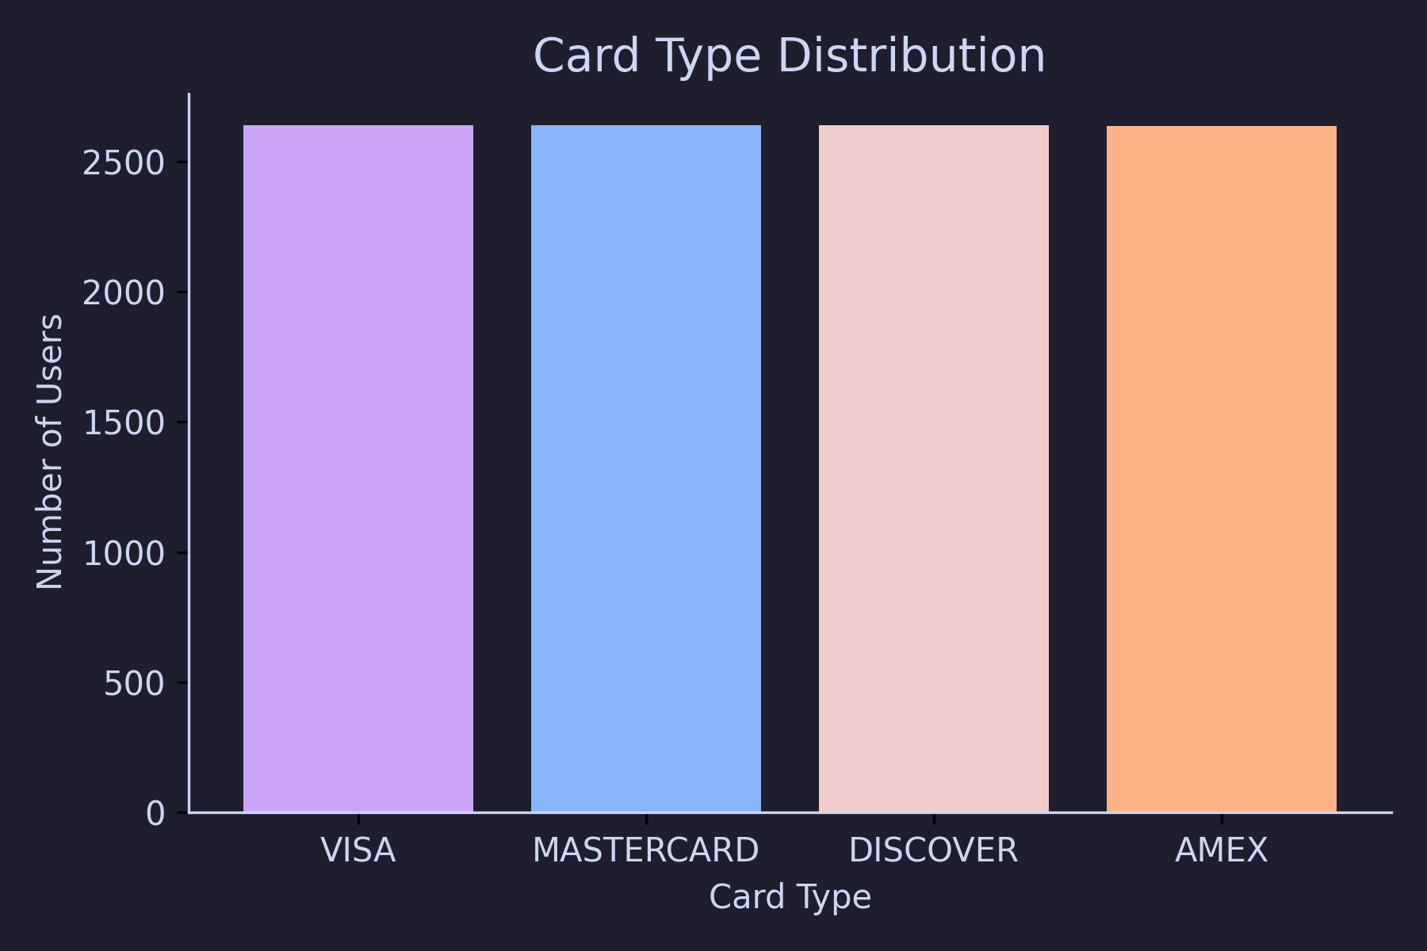
Card Type Distribution
The chart below shows the distribution of card types
in the dataset:

