Slide 1


SPI Simulyzer implementation
More Lives Saved
More Life Lived
Dragos Tutui
SWV

Slide 2
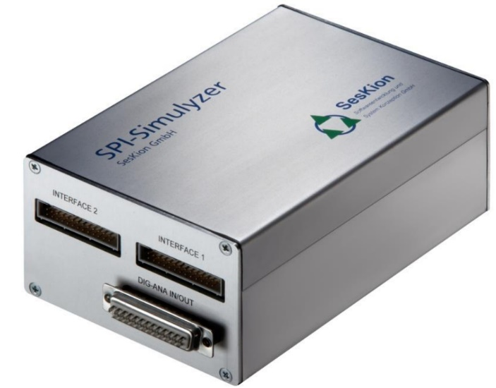
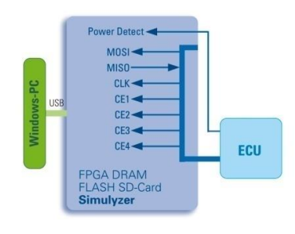
Device overview
The SPI Simulyzer is a standalone device containing both HW and SW capabilities necessary for simulation and data acquisition of a specific SPI communication. It’s main use is as a virtual automotive sensor data generator when communicating with other ECU’s.
Within our project, the Simulyzer is used as :
Sensor mode (The SPI-Simulyzer simulates one sensors by generating according data. The data communication between the ECU (SPI master) and simulated sensors are displayed and recorded)
Simulyzer Box
Sensor mode config

Slide 3
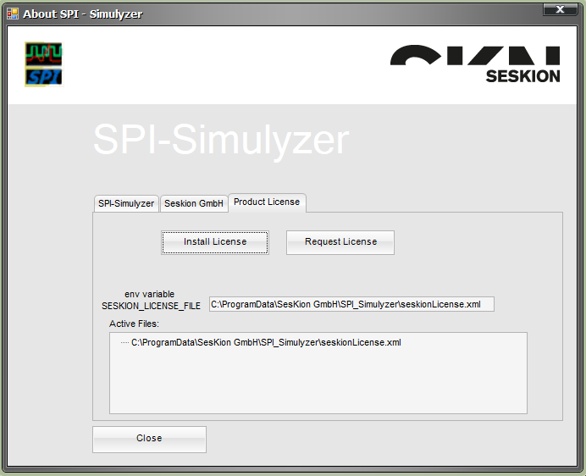
Device setup preconditions
Installing Simulyzer GUI:
Run SPI-SimulyzerSetup_V1_21_1_preRelease_V2 from the installation folder.
After installation is finished, the corresponding application license must be installed.
Proceed by Opening SPI-Simulyzer GUI → Help → About → Product License → Install License → Path to seskionLicense.xml file from Installation folder → Open

Slide 4
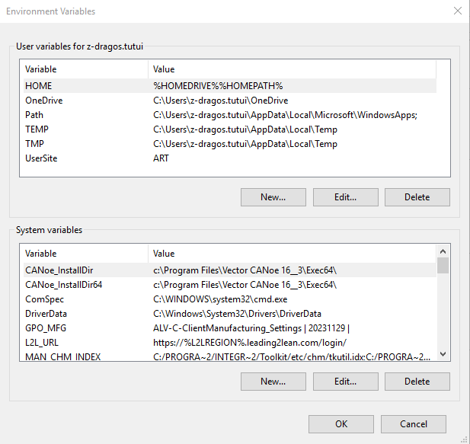
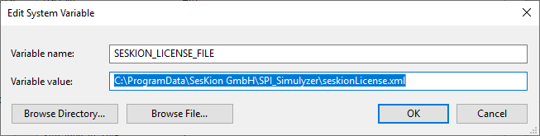
Device setup preconditions
Setup Windows Environment Variable for Simulyzer GUI:
Navigate to Windows Control Panel → System and Security → System → Advanced System Settings → Advanced → Environment Variables → System variables → New → Fill in the details as shown below with Variable name and Variable value (C:\ProgramData\SesKion GmbH\SPI_Simulyzer\seskionLicense.xml)

Slide 5
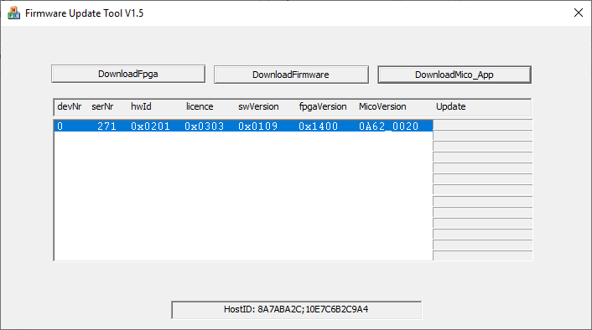
Device setup preconditions
Flash Simulyzer box with FPGA image:
Navigate to Simulyzer GUI installation folder (C:\Program Files (x86)\SesKion GmbH\SPI-Simulyzer) → Close all Simulyzer GUI instances or open windows → Open FirmwareUpdate.exe → Select devNr 0 → DownloadFpga → Select SPI-Simulyzer_Slave_0201_xxxx.fpga from the installation folder → Open

Slide 6
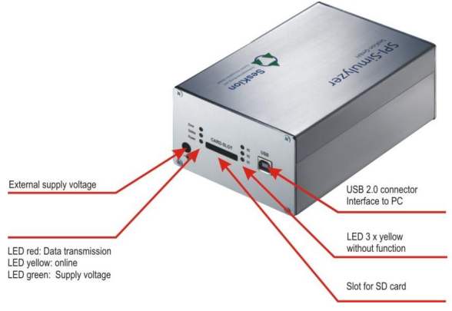
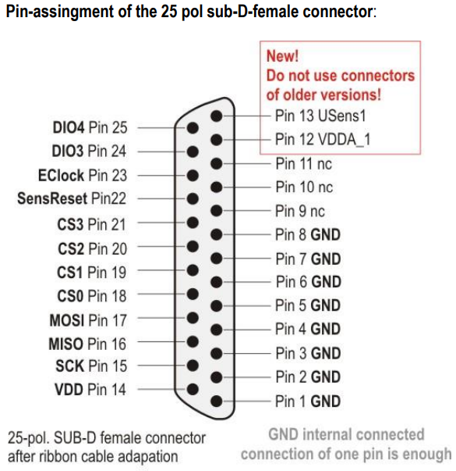
Device setup preconditions
External connections:
In addition to the USB and power connection, the Simulyzer must be connected through SPI pins to the target ECU.
The following sequence must always be observed when connecting the Simulyzer to any PC
Connect power jack, wait for yellow LED to turn ON
Connect USB cable
Connect ribbon cable to INTERFACE 1
Connect SPI harness/ DB25 connector to target SPI ECU pins (SPI harness length must be as short as possible)
Connect Digital- Analog PIN 12 to ALARMB pin on target SPI ECU pins (Check Simulyzer data sheet to pin assignment)

Slide 7
CANoe and Python files/ commands
Use cases
The Simulyer & CANoe setup is meant to be used as following:
CANoe script is used to launch Pyton script execution with function sysExec(“Location of Python executable”, “Python script name”, “Python script location”). EX:
sysExec("C:\\Program Files\\Python39\\python.exe", "Simulyzer_Initialization.py", "C:\\MKS\\AUDI_MCC\\Phase_01\\View_Test\\Tools\\CANoe\\Config\\ECS_AUDI_VERIF\\Includes\\HW_Modules\\SPI_Simulyzer")
The python script contains Simulyzer setup start/ end sequence and proposed test sequence according to user needs or test requirements

Slide 8
Functional Test
Test sequence example:
Below the Simulyzer box generates data showing that the ECU has been tilted 25 degrees from horizontal on X axis for a total of 5s and then returning back to horizontal position. This is done by writing different hex values in the Simulyzer’s registry’s. For registry identification and what values to write inside, both the safety manual and the Accelerometer datasheet must be consulted.
sekRetVal = mydll.SPI_WriteSimulationSensorRegister(devhnd, 0, 0x6, 0x1F00) #SPI-Simulyzer, sensor 0, write in registry 6 (which contains accel_z_data), value 0x1F00 or dec 7946
sekRetVal = mydll.SPI_WriteSimulationSensorRegister(devhnd, 0, 0x5, 0x0) #SPI-Simulyzer, sensor 0, write in registry 5 (which contains accel_y_data), value 0x0
sekRetVal = mydll.SPI_WriteSimulationSensorRegister(devhnd, 0, 0x4, 0x0CAC) # SPI-Simulyzer, sensor 0, write in registry 4 (which contains accel_x_data), value 0x0CAC or dec 3244
time.sleep(5.0)
sekRetVal = mydll.SPI_WriteSimulationSensorRegister(devhnd, 0, 0x6, 0x1F00) #reg Z axis written to ~0.9g/ simulating horizontal position
sekRetVal = mydll.SPI_WriteSimulationSensorRegister(devhnd, 0, 0x5, 0x0) #reg Y axis written to 0g
sekRetVal = mydll.SPI_WriteSimulationSensorRegister(devhnd, 0, 0x4, 0x0) #reg X axis written to 0g

Slide 9
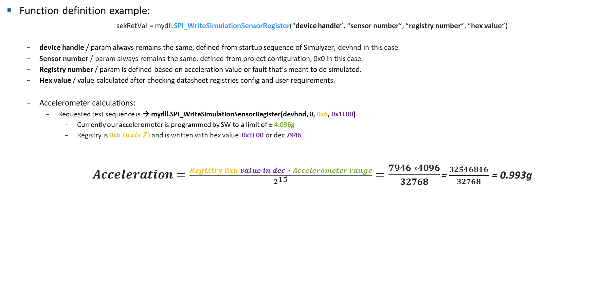
Functional Test
Function definition example:
sekRetVal = mydll.SPI_WriteSimulationSensorRegister(“device handle”, “sensor number”, “registry number”, “hex value”)
device handle / param always remains the same, defined from startup sequence of Simulyzer, devhnd in this case.
Sensor number / param always remains the same, defined from project configuration, 0x0 in this case.
Registry number / param is defined based on acceleration value or fault that’s meant to de simulated.
Hex value / value calculated after checking datasheet registries config and user requirements.
Accelerometer calculations:
Requested test sequence is → mydll.SPI_WriteSimulationSensorRegister(devhnd, 0, 0x6, 0x1F00)
Currently our accelerometer is programmed by SW to a limit of ± 4.096g
Registry is 0x6 $\left(axis Z\right)$ and is written with hex value 0x1F00 or dec 7946
$Acceleration=\frac{Registry 0x6 value in dec ∗ Accelerometer range}{2^{15}}=\frac{7946 ∗4096}{32768}$ = $\frac{32546816}{32768}$ = 0.993g

Slide 10
Functional Test
Test sequence example:
Always start ECU from power OFF
Start Python script with desired acceleration/ fault configuration
Power ON ECU
Observe ECU behavior
Once launched, python script and Simulyzer runs independently from CANoe environment, so test timing and execution coordination is important.
testcase SPI_Simulyzer_Launch ()
{
long iResult;
int iFlagNotPresent = 0;
int iFlagPresent = 1;
ActivateMeasurementFrame(1,1);
Wait(1000);
testStep("STEP", "3 fault flags are expected to be absent: vrefshieldz_alarm, vrefshieldxy_alarm, accel_cp_alarm");
EvalManStepEqual("Check current values for ACC_vrefshieldz_alarm", getsignal(ACC_vrefshieldz_alarm), iFlagNotPresent);
EvalManStepEqual("Check current values for ACC_vrefshieldxy_alarm", getsignal(ACC_vrefshieldxy_alarm), iFlagNotPresent);
EvalManStepEqual("Check current values for ACC_accel_cp_alarm", getsignal(ACC_accel_cp_alarm), iFlagNotPresent);
PowerOff();
iResult = sysExec("C:\\Program Files\\Python39\\python.exe", "Simulyzer_Initialization.py", "C:\\MKS\\AUDI_MCC\\Phase_01\\View_Test\\Tools\\CANoe\\Config\\ECS_AUDI_VERIF\\Includes\\HW_Modules\\SPI_Simulyzer");
EvalManStepEqual("Script execution: ", iResult, 1);
PowerOn();
Wait(10000);
testStep("STEP", "3 fault flags are expected to be present: vrefshieldz_alarm, vrefshieldxy_alarm, accel_cp_alarm");
EvalManStepEqual("Check current values for ACC_vrefshieldz_alarm", getsignal(ACC_vrefshieldz_alarm), iFlagPresent);
EvalManStepEqual("Check current values for ACC_vrefshieldxy_alarm", getsignal(ACC_vrefshieldxy_alarm), iFlagPresent);
EvalManStepEqual("Check current values for ACC_accel_cp_alarm", getsignal(ACC_accel_cp_alarm), iFlagPresent);
}

Slide 11

Saving More Lives

