Slide 1
What is agile
Agile software development methodology is an process for developing software (like other software development methodologies – Waterfall model, V-Model, Iterative model etc.)
However, Agile methodology differs significantly from other methodologies. In English, Agile means ‘ability to move quickly and easily’ and responding swiftly to change – this is a key aspect of Agile software development as well.

Slide 2
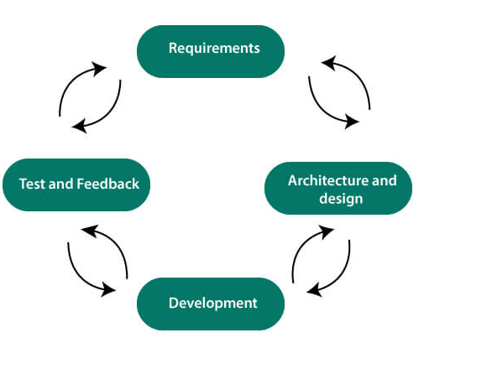
Agile Life cycle

Slide 3
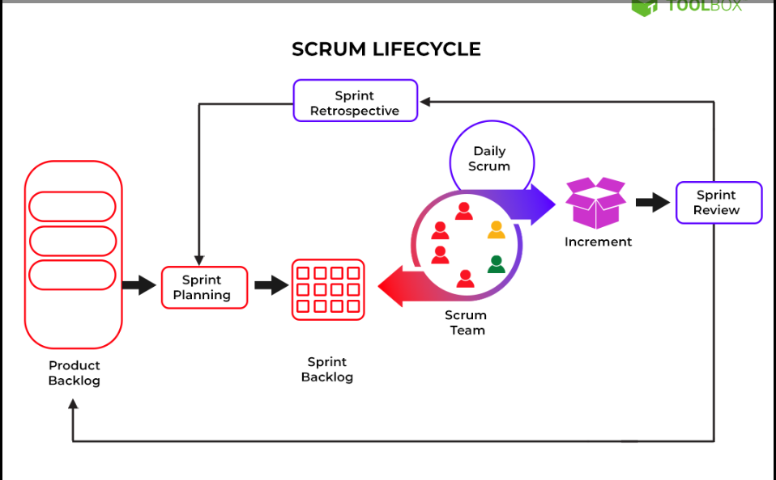

Slide 4
