Slide 1
Optimizing Heat 3D Algorithm using DOACROSS parallelism in OpenMP and other parallelism methods
CSC-201 Project

Slide 2
Introduction
The Heat3D equation is a mathematical representation used to compute the numerical solution of the three-dimensional heat equation, a partial differential equation that describes the distribution of temperature in a given region over time. This equation often arises in physics, engineering, and numerical simulations. Using finite difference methods, the continuous domain is discretized into a 3D grid of points, and the partial derivatives are approximated using difference formulas.
Solving the 3D heat equation presents several challenges, particularly in computational and practical contexts. These challenges arise from the equation's complexity, the need for numerical stability, and the high computational demands of 3D simulations.

Slide 3
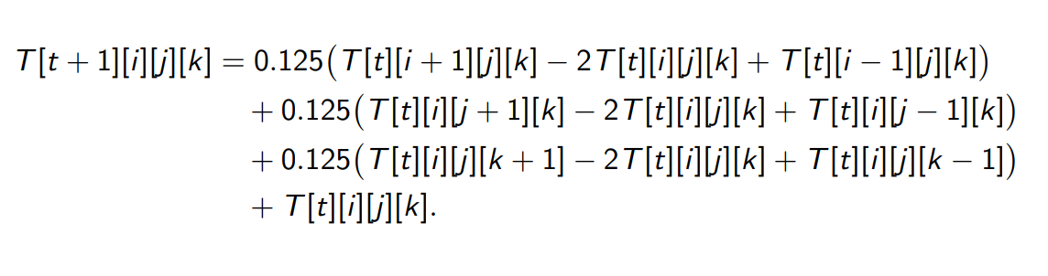
Heat 3D Equation
The heat 3D equation is:
where T[t][i][j][k] is the temperature at grid point (i, j, k) at time step t.
The goal of this project is to exploit various parallelism strategies to solve the equation much faster. Parallelizing the solution of the heat 3D equation is essential to handle the high computational demands, especially for large grids.

Slide 4
What is OpenMP
OpenMP (Open Multi-Processing) is an open standard for parallel programming in shared-memory environments. It provides a simple and flexible interface for developing parallel applications in C, C++, and Fortran. OpenMP allows developers to take advantage of multi-core and multi-threaded processors by enabling the parallelization of code sections.
Key features of OpenMP:
Shared-Memory Parallelism: OpenMP uses the shared-memory programming model, where all threads have access to the same memory space.
Directives-Based: Parallelism is specified using compiler directives (pragmas) embedded in the code, making it easier to add or remove parallelism.
Portable and Scalable: OpenMP programs can run on various architectures, and scalability depends on the number of available processor cores.
Thread Management: OpenMP handles thread creation, management, and synchronization, simplifying the programming model.

Slide 5
DOACROSS Parallelism in OpenMP
DOACROSS parallelism is a parallel programming technique used in computational systems, particularly in the context of loop parallelization. It allows loops with inter-iteration dependencies (i.e., when iterations depend on the results of previous iterations) to execute in parallel by carefully managing these dependencies.
DOACROSS can handle dependencies by synchronizing between iterations when needed allowing partial parallelism while maintaining correctness. Synchronization points (e.g., barriers, flags, or condition variables) are introduced to ensure that an iteration waits for the completion of the specific iterations it depends on. This makes DOACROSS more versatile as it balances parallelism and data management efficiently.

Slide 6
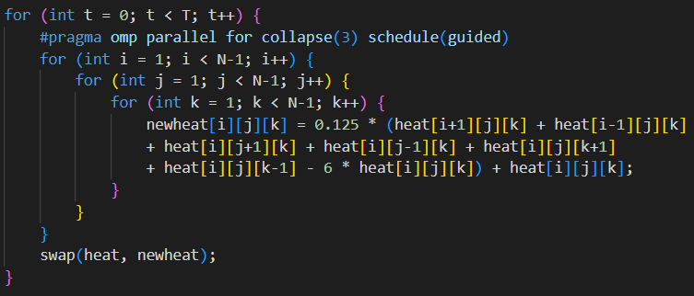
Implementation

Slide 7
Explanation
The directive
#pragma omp parallel for collapse(3) schedule(guided)
will parallelize nested loops in OpenMP.
Parallel for: construct is used to distribute iterations of a loop among multiple threads, enabling parallel execution.
Collapse(3): combines the three nested loops into a single large loop, enabling efficient parallelization of all iterations.
Guided Scheduling: Schedule controls how iterations are divided among threads. Dynamic schedule assigns iterations to threads, starting with large chunks and reducing the chunk size as execution progresses.

Slide 8
Wavefront Parallelism
Wavefront parallelism is a computational technique used to parallelize algorithms or workloads where data dependencies form a wave-like progression across a multidimensional grid.
Key characteristics:
Dependency structure: Wavefront parallelism is used when computations at a grid point depend on values from earlier grid points. Typically, dependencies flow diagonally, creating a "wavefront" of independent tasks that can be processed in parallel.
Execution Pattern: The wavefront starts at one corner of the grid (e.g., the top-left for a 2D grid) and progresses diagonally to the opposite corner (e.g., bottom-right). At each step, computations on the current wavefront are independent and can be executed in parallel.
Synchronization: Synchronization is needed between wavefront steps to ensure that dependencies are resolved before starting the next wavefront.

Slide 9
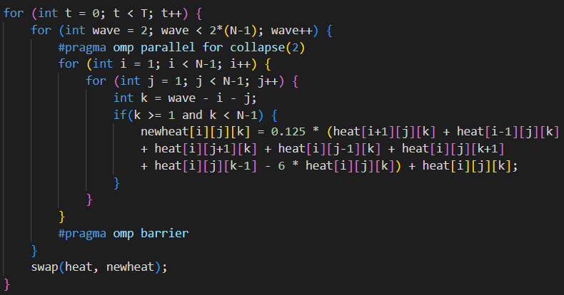
Implementation

Slide 10
Explanation
Here we consider a plane wave propagating along the body diagonal of the grid in one time step. Diagonal planar slices of the cubic grid become the wavefront. So we process the grid in the following way: first we compute for all points (i, j, k) such that i + j + k = 0, then compute for i + j + k = 1, then for i + j + k = 2 and so on.
Each diagonal slice (wavefront) can be computed independently in parallel. We also used OpenMP to parallelize the iterations among wavefronts.

Slide 11
SIMD parallelism
SIMD (Single Instruction Multiple Data) instructions allows multiple data elements to be processed simultaneously with a single instruction, improving parallelism and performance. SIMD instructions are typically used to enhance the performance of data-parallel tasks such as array processing, graphics rendering, or scientific computations.
It uses vector registers like AVX2, which can process multiple data elements simultaneously. For eg. with AVX2, a 256-bit vector register can hold 8 single-precision floats or 4 double-precision floats. Instead of performing operations one element at a time, SIMD performs them across all elements in the vector.
In C++, SIMD can be utilized through compiler intrinsic functions. Compiler intrinsics provide direct access to SIMD operations, and they are specific to the architecture you're targeting (e.g., SSE, AVX for Intel/AMD processors).

Slide 12
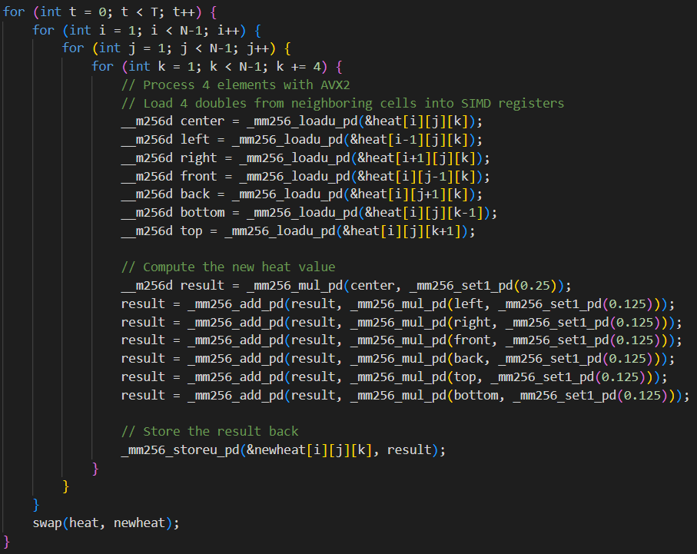
Implementation

Slide 13
Explanation
Some key data types and operations:
__m256d is a data type for 256-bit AVX registers (which can hold four double values).
_mm256_loadu_pd loads data into registers.
_mm256_add_pd is used to add the elements in the two AVX registers, element-wise.
_mm256_mul_pd is used to multiply the elements in the two AVX registers, element-wise.
_mm256_storeu_pd stores the results back to a normal array.

Slide 14
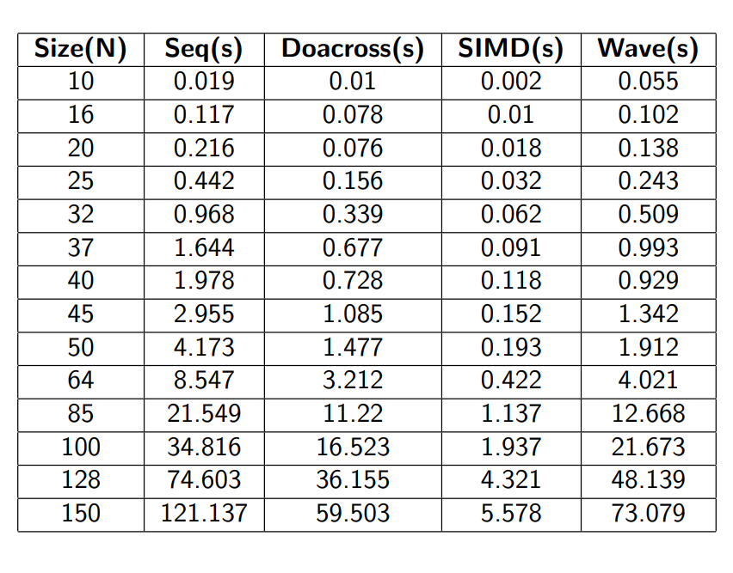
Time duration Table

Slide 15
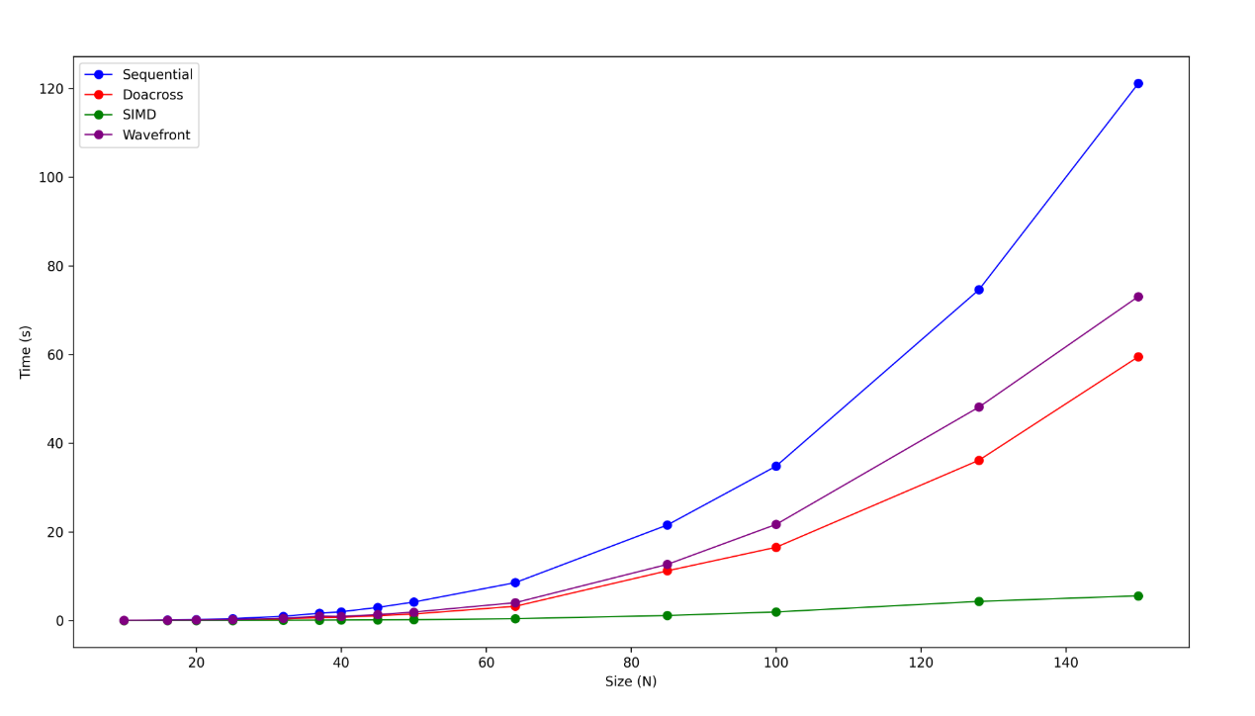
Time duration Plot

Slide 16
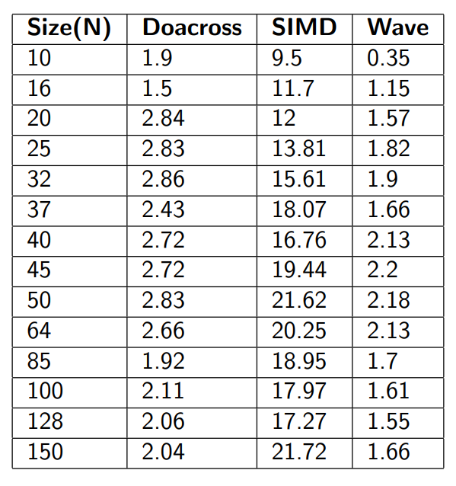
Speedup Table
Here speedup is wrt. sequential approach.

Slide 17
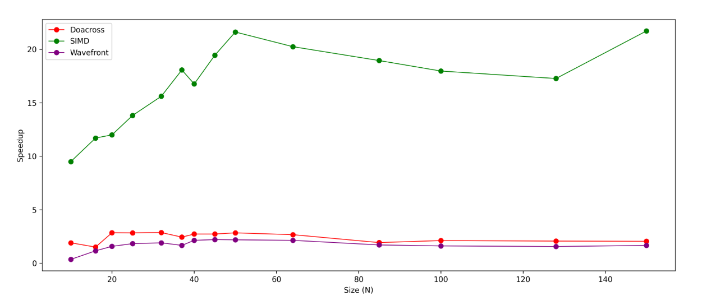
Speedup Plot

Slide 18
Heat Conduction Visualization in 2D

