Slide 1
Optimizing Heat Diffusion Simulations: Implementing DOACROSS Parallelism in 3D Heat Algorithm with OpenMP"

Slide 2
Problem Statement
Objective: Implement the Heat 3D algorithm using DOACROSS parallelism in OpenMP and compare its performance with a sequential approach.
Deliverables:
Bash File to run the C++ program.
Performance Report comparing execution time of parallel vs sequential implementations.
System Specifications for the test environment.
Test Cases: Evaluate for grid sizes N = 10,100,1000,10000 over T = 1000 iterations to measure and compare the performance of DOACROSS parallelism vs sequential approach.

Slide 3
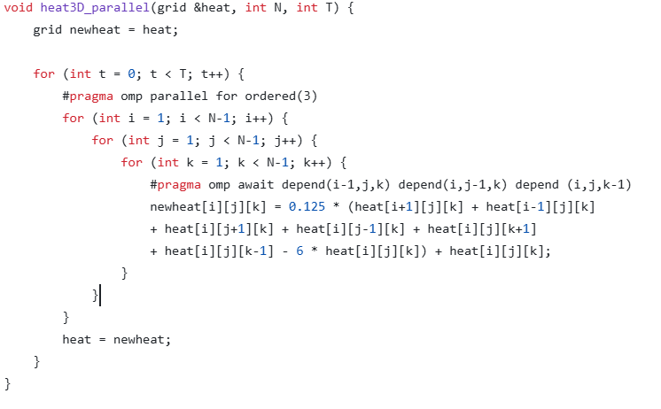
Components of the code
Grid Structure
DOACROSS Parallelism

Slide 4
Grid Structure:
The algorithm operates on a 3D grid heat, where heat[i][j][k] represents the heat value at the grid point (i, j, k).
DOACROSS Parallelism:
Parallelization:
The outer loop (for t = 0; t < T; t++) runs for T iterations (time steps).
The 3D grid is processed in parallel using #pragma omp parallel for, and the iteration is split among available threads.
DOACROSS Parallelism: #pragma omp await depend() ensures synchronization by specifying dependencies between adjacent grid points during the updates.

Slide 5
Data Dependencies:
Input dependencies: The depend(in) clauses ensure that the current grid values are available before updating neighboring grid points.
Output dependencies: The depend(out) clause ensures that the new heat values are written back to the grid only after all dependencies have been resolved.

Slide 6
Report
N | Sequential(ms) | Parallel(ms) | Speedup
10 | 25 | 28 | 0.89
30 | 1107 | 589 | 1.88
50 | 4067 | 1900 | 2.14
75 | 18933 | 7627 | 2.48
100 | 37513 | 16548 | 2.27
150 | 150126 | 80035 | 1.88
200 | 316396 | 163083 | 1.94

Slide 7
