Slide 1
ICT3113 Assignment 1 · Performance Requirements & Testing
Complaint Triage on CPU-Only Hardware
Which local model to deploy, and what service quality can be promised
Group P1-9
Rebuild & run
cp .env.example .env
docker compose up -d --build
Step 5 playbook: step5/README.md
Results: step5/RESULTS.md
Chew E Jae Justin [2400851]
Eugene Kee Zong Lin [2402575]
Tan Ye Kai [2403052]
Tok You Xiong [2401871]
Yap Hong Xiang, Alfred [2401438]
Repository: github.com/anarchygene/ICT3113_Assignment_1
Supporting Documents: https://drive.google.com/drive/folders/10I7v22nkXLYZGCKVxepytw7TX5KMS4pF?usp=sharing
Notes:
Group P1-9. Members and student IDs to be filled in. The repository contains the service, docker compose file, golden set, frozen prediction record (STEP4.md, freeze commit 3567f80), all JMeter .jtl files and service logs.

Slide 2
Architecture: one synchronous model call per ticket
Service PC · Docker Compose
Endpoints
Load-generator PC
Apache JMeter 5.6.3, open-loop Open Model Thread Groups
POST /tickets
Classifies one narrative and stores the result. Returns HTTP 201 and the category. Invalid output returns HTTP 502.
GET /search?q=
Case-insensitive substring search of stored narratives.
GET /stats
Returns ticket counts for all seven categories.
Triage service (FastAPI)
Validates, calls Ollama, stores, logs every request (id, path, status, duration)
HTTP :8000, home LAN
Ollama 0.12.3 · CPU only
One model loaded
NUM_PARALLEL = 1, so tickets are classified one at a time
PostgreSQL 16
The service starts empty, filled only through POST /tickets
Synchronous Baseline
POST /tickets waits for the model result. The service has no cache, application queue, retries, or batching.
Notes:
Prompt: fixed system prompt listing the seven exact category names, JSON output mode, temperature 0, num_ctx 4096 (app/classifier.py). JMeter runs on a separate PC; logs are kept in evidence/step5/logs.

Slide 3
Workload: 81 tickets/h at peak, 105/h with growth headroom
189,070
81 / h
complaints/year: Barclays Bank UK, H1 2026 × 2 [S: R1]
present-day peak hour [E]
105 / h
316 / h
Tickets
requirement load: peak + 30% growth [S: R5]
agent searches at 105/h (6 per agent-hour) [E]
Peak calculation: 189,070 / 365 × 1.25 / 12 × 1.5 = 81 tickets/h.
Sources: Annual volume and daily factor [R1, R3]. Estimates: 12-hour arrival
window and 1.5 hourly factor [R6, R7].
Level | POST/h | Search/h | Tested
Off-peak (Sunday) | 18 | 55 | –
Average | 43 | 130 | 3 runs
Peak | 81 | 243 | 3 runs
Peak + 30% (R1–R4) | 105 | 316 | 3 runs
Burst / surge | 130 / 243 | 316 | stress ramp
Words per ticket
Ticket length: median 140, p95 305, p99 352, maximum 369 words. The
extract limits narratives to 200–2,000 characters.
Longer client tickets can increase latency.
[S] sourced · [E] estimate · [M] measured. Sources on slide 12; full derivation in workload/WORKLOAD.md.
Notes:
Sources: R1 Barclays UK complaints Jan–Jun 2026 (94,535 opened); R3 CFPB daily counts (busiest day 1.25× weekly mean); R5 FIDReC +32% claims against banks; R6 Call Centre Helper (40% of an hour's calls in the first 15 min → 1.6× burst, 130/h); R7 Taylor 2012 (busiest half-hour ~2× median, upper bound for the 1.5× hour factor). Estimates: 12-hour arrival window, 1.5× busiest hour, 30 min agent time per complaint, 6 searches per agent-hour, 3× incident surge (243/h).

Slide 4
Requirements: testable, identical for every candidate
R1–R4 condition: open-loop mixed load, 105 POST/h + 316 search/h, 20-min steady window after a 2-min warm-up, 3 runs. R5–R7: the frozen 160-ticket golden set.
Req | Testable statement | Why this number
R1 Throughput | ≥ 105 successful classifications/h; backlog not growing | Peak 81/h + 30% one-year growth (FIDReC +32%)
R2 POST latency | p95 ≤ 30 s, p99 ≤ 60 s | Automated intake can wait. The p95 target is below the 34-second mean arrival interval. This alone does not prove queue stability.
R3 Search latency | p95 ≤ 2 s, p99 ≤ 5 s | Agents search interactively while handling a case
R4 Reliability | ≤ 1.0% errors per endpoint; /stats delta = successful POSTs | A failed classification is an unrouted ticket
R5 Accuracy | ≥ 85.0% overall (≥ 136/160) | ≥ 5 of 6 routed correctly, else manual correction cost dominates
R6 Per category | every category ≥ 70.0% | Stops a small team (Credit card, n = 11) being sacrificed for the average
R7 Conformance | ≥ 99.0% valid JSON with an exact category name | Non-exact output cannot be routed
R8 Deployment | CPU-only local Ollama; 0 restarts or OOM kills | Inference must stay on client-controlled CPU hardware.
Notes:
Full statements and justifications in STEP4.md section 4 (frozen at commit 3567f80). Thresholds are the same for all three candidates and were not changed after results.

Slide 5
Candidate models and exact weight digests
Gemma 3 1B
Qwen3 4B Instruct
Llama 3.1 8B Instruct
Small · 1.0B
gemma3:1b-it-q4_K_M
ID 8648f39daa8f · weights sha256:7cd4618c1faf…
https://ollama.com/library/gemma3:1b-it-q4_K_M
815 MB · Gemma Terms of Use
Fast, low-resource floor of the trade-off
Medium · 4.0B
qwen3:4b-instruct-2507-q4_K_M
ID 0edcdef34593 · weights sha256:85e4a5b7b8ef…
https://ollama.com/library/qwen3:4b-instruct-2507-q4_K_M
2.5 GB · Apache 2.0
Predicted balance; non-thinking variant, no reasoning tokens
Large · 8.0B
llama3.1:8b-instruct-q4_K_M
ID 46e0c10c039e · weights sha256:667b0c1932bc…
https://ollama.com/library/llama3.1:8b-instruct-q4_K_M
4.9 GB · Llama 3.1 Community License
Accuracy ceiling a CPU server can plausibly run
Why this set: parameters roughly double at each step, so the speed-versus-accuracy trade-off is visible across what a CPU server can run. Phi-4 Mini 3.8B was dropped before benchmarking because it duplicated the 4B class. Held constant: Q4_K_M weights, Ollama 0.12.3, same prompt, JSON mode, temperature 0, num_ctx 4096. IDs recorded locally after pulling (evidence/step4/ollama-list.txt).
Notes:
Full weights digests: gemma 7cd4618c1faf8b7233c6c906dac1694b6a47684b37b8895d470ac688520b9c01; qwen 85e4a5b7b8ef0e48af0e8658f5aaab9c2324c76c1641493f4d1e25fce54b18b9; llama 667b0c1932bc6ffc593ed1d03f895bf2dc8dc6df21db3042284a6f4416b06a29. Local IDs match the ollama.com registry IDs.

Slide 6
Golden set: 160 tickets, κ = 0.896, frozen before testing
160
κ 0.896
14
34 / 160
tickets, rows 9840–9999
Cohen's kappa (146/160 agree)
disagreements, all resolved and recorded
33 / 160 changed at first check (20.6%); 34 after resolution
Labelling protocol (labelling_protocol.txt)
Resolved disagreements
Decide by the customer's problem and the resolution they want (added in revision 2, 7 Oct)
Several fits → the most-mentioned theme; ties → the order of the category list
Mortgage outranks loan or debt; Money transfer is the lowest priority
Credit card excludes credit-card debt; Debt collection includes collector activity after settlement
Row 9928: loan from Western Finance, then collection pressure
Labeller: Consumer loan · Reviewer: Debt collection → Debt collection (collection activity dominates the complaint)
Row 9880: Cash App card activation, account and money taken
Labeller: Bank account · Reviewer: Money transfer → Money transfer (payment-app service, not a bank)
Process: Two people labelled every ticket independently, without
conferring. They then discussed all 14 disagreements and recorded the
final labels.
… and 12 more, listed in evidence/step1/agreement.txt
Notes:
Golden distribution: Credit reporting 33, Bank account 30, Money transfer 28, Debt collection 24, Mortgage 18, Consumer loan 16, Credit card 11. Disagreements: labeller won 8, reviewer won 6. kappa from scripts/agreement.py → evidence/step1/agreement.txt. Raw consumer label vs final golden: kappa 0.751. Golden set committed before any model saw it (commit 0013266; freeze 3567f80).

Slide 7
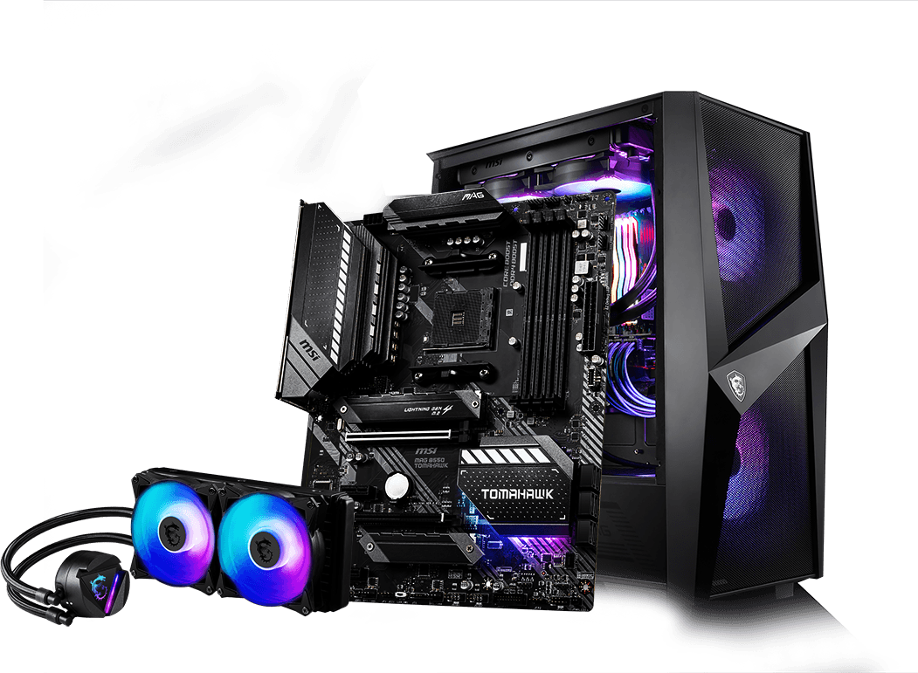

Test environment: service and load generator kept apart
Service Laptop: API + PostgreSQL + Ollama
Load-generator PC: JMeter only
Lenovo 83JT laptop, Intel Core Ultra 7 256V: 4 performance + 4 low-power cores, 8 threads
16 GB RAM; Docker VM limited to 8 CPUs / 7.5 GiB
Windows 11 Home 10.0.26200; Docker 29.5.3, Compose v5.1.4
Ollama 0.12.3: library=cpu, '100% CPU', NUM_PARALLEL 1
Wi-Fi 7 adapter; on mains power, sleep disabled
MSI MS-7C91 desktop, AMD Ryzen 5 3600, 6 cores / 12 threads
32 GB RAM; Windows 10 Pro 22H2
Apache JMeter 5.6.3 on Temurin OpenJDK 17.0.20.1, no plugins
Wired Ethernet 1 Gbps to the same router
✓ Never co-hosted with the service
How results scale to the client
Limitations
One Ollama inference stream limits classification throughput. A simple
capacity estimate is 3,600 divided by mean service time in seconds. Faster CPUs or separate model instances can increase capacity. Client-server measurements must verify the increase.
Laptop thermals and hybrid cores; WSL2 VM overhead
Home Wi-Fi, not isolated: JMeter time exceeds server time by a median of 34 ms (p95 112 ms)
About 35 POSTs per 20-min window, so p99 ≈ maximum
Extract clipped to 200–2,000 characters
Notes:
Evidence: evidence/step4/service-hardware.txt, load-generator-hardware.txt, jmeter-version.txt, ollama-server-config.txt; evidence/step5/deploy-*.txt (ollama ps shows 100% CPU, context 4096). The Intel Arc iGPU is unused: Ollama runs in a Linux container without GPU passthrough. The 34 ms network overhead was measured over 2,956 successful load-test requests by matching JMeter samples to API log lines.

Slide 8
Playbook: freeze, deploy, measure, reconcile
1 Freeze
Golden set + predictions committed (3567f80) before any model run
2 Deploy
switch_model.ps1: save logs, set tag, 2 synthetic warm-ups, TRUNCATE, check /stats = 0
3 Accuracy
160 golden tickets, one at a time, via POST /tickets; non-201 = wrong + non-conformant
4 Load
Redeploy (empty DB); 3 levels × 3 runs from the load-generator PC
5 Stress
Qwen3 4B: POST ramp 60 → 1,200/h over 40 min; search fixed at 316/h
6 Reconcile
save_logs.ps1 → analyse_jtl.py: every JMeter sample ↔ log line by request ID; /stats delta
Open-loop JMeter configuration (step5/jmeter/ticket_triage.jmx)
• Use two Open Model Thread Groups for POST and search traffic. Arrivals do not wait for responses.
• Schedule: rate(R/hour) random_arrivals(22 min) pause(1 min). Exclude the first 2 minutes. Measure the next 20 minutes.
• Use arrival seeds 1, 2, and 3. Wait 60 seconds between runs. Connection timeout: 10 seconds. Response timeout: 310 seconds.
• Data: team rows 9000–9839 and 20 search terms. Save X-Request-ID in the JTL file and service log.
Notes:
Metric definitions (analyse_jtl.py): window = [t0 + warm-up, t0 + warm-up + 20 min) by request start time; p50/p95/p99 = nearest-rank over all samples in the window, failures included; achieved/h = successful requests completing inside the window; error % = JMeter success=false. Each run reuses the same ticket order, so content is controlled and only arrival timing varies between runs.

Slide 9
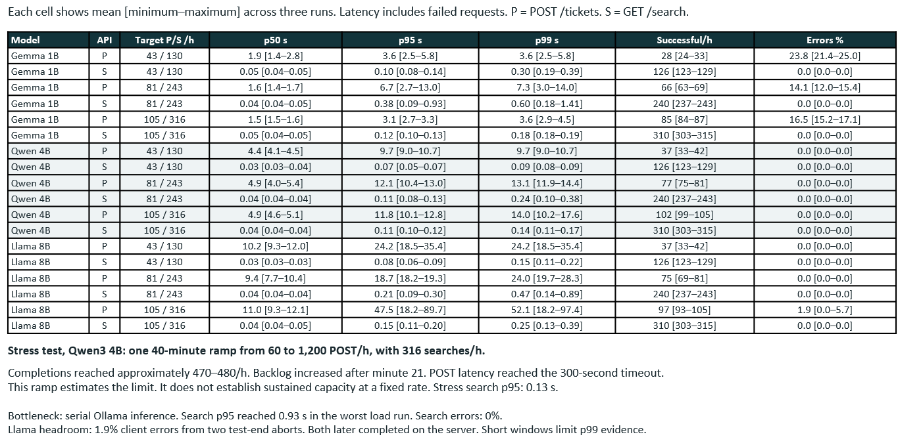
Load and stress: Ollama inference is the bottleneck
Notes:
Source: step5/results/levels.csv, runs.csv, summary.md and the stress timeline.csv. Llama headroom per run: p95 18.2 s / 34.7 s / 89.7 s; run 3 had 5 arrivals within ~1.2 min. Reconciliation: 3,640 JMeter samples across 28 runs, every one matched to a service-log line; 73 status mismatches, all JMeter test-end aborts (71 in the stress run, 2 in Llama headroom run 3), where the server log shows the real outcome.

Slide 10
Accuracy: no candidate reaches 85%; Llama best at 75.6%
30.0%
Gemma 3 1B
48/160 · valid output 81.9%
68.8%
Qwen3 4B
110/160 · valid output 98.1%
75.6%
Llama 3.1 8B
121/160 · valid output 99.4%
Where each model goes wrong
Gemma: 26 of 29 invalid answers are capitalisation ('Consumer Loan'); 18/30 Bank → Credit reporting; Money transfer 0/28
Qwen: 9/33 Credit reporting → Credit card; 3 lowercase answers (R7 98.1%)
Llama: errors spread out; 16 tickets wrongly sent to Credit card; Bank account 66.7%
Notes:
Confusion matrices: step5/results/<model>/accuracy/summary.md and confusion_matrix.csv. Sequential single-request latency (p50): Gemma 2.4 s, Qwen 7.9 s, Llama 13.2 s. Categories ≥ 70%: Gemma 0/7, Qwen 4/7 (fails Credit reporting 51.5%, Debt collection 62.5%, Bank 66.7%), Llama 4/7 (fails Credit reporting 69.7%, Bank 66.7%, Consumer loan 68.8%).

Slide 11
Recommendation: Qwen3 4B, for assisted routing only
Req | Gemma | Qwen | Llama
R1 Throughput | FAIL | PASS† | FAIL
R2 POST latency | PASS | PASS | FAIL
R3 Search | PASS | PASS | PASS
R4 Errors | FAIL | PASS | PASS*
R5 Accuracy | FAIL | FAIL | FAIL
R6 Per category | FAIL | FAIL | FAIL
R7 Conformance | FAIL | FAIL | PASS
R8 CPU-only | PASS | PASS | PASS
Deploy Qwen3 4B (0edcdef34593) to suggest a category that an agent confirms
The only candidate meeting every service requirement (R1–R4, R8) at peak + 30%: p95 11.8 s against 30 s, 0% errors, and capacity ~470/h (4.5× the 105/h need), which absorbs bursts and surges.
Llama is 6.8 points more accurate and the only model passing R7, but on this CPU it fails R1 and R2 (p95 up to 90 s). We do not trade peak capacity for accuracy that still misses R5.
Gemma is ruled out: 16.5% of tickets rejected, 30% accurate.
Qwen R1: 102/h <105/h. Not demonstrated.
*Llama R4: 1.9% client errors. Server completions do not erase them.
Not met by any candidate: R5 (85% overall) and R6 (70% per category). Qwen also misses R7 (98.1%). Fully automatic routing cannot be promised on this hardware.
Prediction | Predicted | Measured
Bottleneck | Ollama CPU; 502 at 300 s | Confirmed | ✓
Accuracy G/Q/L | 52 / 74 / 71% | 30 / 69 / 76% | ✗
Latency G/Q/L | 1.5 / 5 / 10 s | 2.4 / 7.9 / 13.2 s | ✗
Qwen limit | ~700/h | ~470/h | ✗
Hardest category | Money transfer | Gemma only | ✗
Llama R1, R2 | pass | fail | ✗
Why our predictions were wrong: we modelled 8 equal cores, but the 256V has 4 low-power cores and runs inference inside WSL2, the likely reason every model ran 1.3–1.6× slower (not measured separately). We reasoned from mean utilisation and ignored Poisson bursts (Llama R2). The prompt lacks our protocol's rules, which caps accuracy. Assignment 2: case-insensitive parsing, protocol rules in the prompt, more cores per Ollama instance.
Notes:
Full verdict reasoning in step5/RESULTS.md sections 5–7. Predictions frozen in STEP4.md at commit 3567f80. Hardest-category outcome: Gemma Money transfer 0% (as predicted); Qwen's hardest was Credit reporting 51.5% (9 to Credit card, and only 4 of those 9 mention a card, so the cause is not yet diagnosed); Llama's hardest was Bank account 66.7%. Assisted routing: at 68.8% accuracy, about 2 in 3 tickets need only a confirmation; a misroute costs one agent correction.

Slide 12
References and acknowledgements
Data and workload sources
Software, model licences, acknowledgements
Consumer Financial Protection Bureau. Consumer Complaint Database. consumerfinance.gov/data-research/consumer-complaints (course extract, team rows 9000–9999)
[R1] Barclays (2026). UK complaints data, January to June 2026. home.barclays/who-we-are/reporting/uk-complaints-data
[R2] CFPB (2024, 2025). Consumer Response Annual Reports 2023, 2024. files.consumerfinance.gov
[R3] CFPB Consumer Complaint Database API, daily counts (retrieved 1 Oct 2026)
[R4] Financial Conduct Authority (2026). Aggregate complaints data 2025 H2. fca.org.uk/data/complaints-data
[R5] FIDReC (2025). FIDReC received a record 4,355 claims this fiscal year. fidrec.com.sg
[R6] Call Centre Helper. 10 Things You Need to Know About Call Centres. callcentrehelper.com
[R7] Taylor, J. W. (2012). Density forecasting of intraday call center arrivals. Management Science 58, 534–549
Ollama 0.12.3, MIT License. github.com/ollama/ollama
Gemma 3 (Google DeepMind), Gemma Terms of Use. ai.google.dev/gemma/terms
Qwen3-4B-Instruct-2507 (Alibaba Qwen), Apache License 2.0. huggingface.co/Qwen/Qwen3-4B-Instruct-2507
Llama 3.1 8B Instruct (Meta), Llama 3.1 Community License. Built with Llama. huggingface.co/meta-llama/Llama-3.1-8B-Instruct
Apache JMeter 5.6.3, Apache License 2.0 · PostgreSQL 16, PostgreSQL License · FastAPI, MIT
AI assistance: Claude Code (Anthropic) helped build the service and test tooling, as permitted by the brief. Labelling, test runs and judgements are the team's.
Notes:
Full URLs: workload/WORKLOAD.md references section and STEP4.md section 2 (licence links). The Llama 3.1 Community License requires displaying 'Built with Llama'.

