Slide 1

Business Analysis
Reviews Clothing, Shoes, and Jewelry

Slide 2
Points of analysis
Relation between reviews and helpfulness
Relation between price and reviews
Relation between sales rank and helpfulness
Relation between date and reviews
Reviews among categories
What products and brands are trending

Slide 3
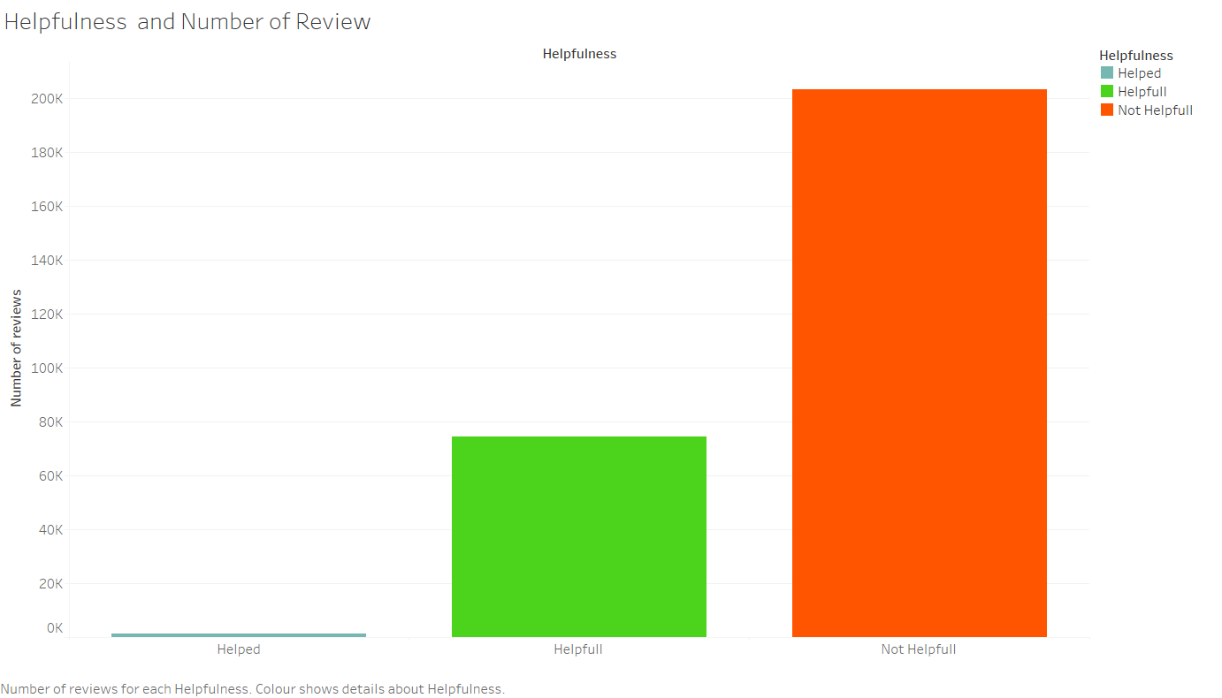
73% of reviews are considered not helpful and only 27% falls in helpful and helped.
Reviews Clothing, Shoes, and Jewelry
Helped | 0.46%
Helpful | 26.64 %
Not helpful | 72.90%

Slide 4
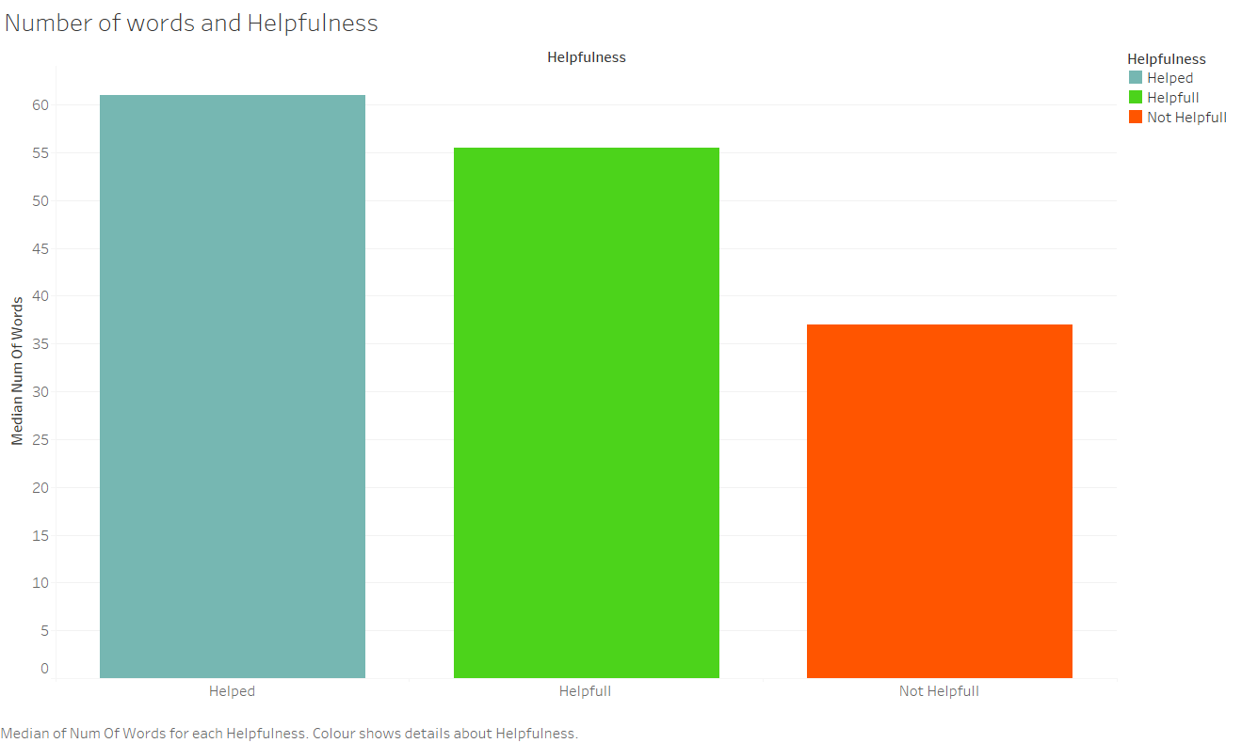
Reviews considered not helpful have an average of 52 words while reviews considered helpful and helped have an average over 80 words.
Reviews Clothing, Shoes, and Jewelry
< 500
Helped | 1%
Helpful | 26%
Not Helpful | 73%
> 500
Helped | 1%
Helpful | 79%
Not Helpful | 19%

Slide 5
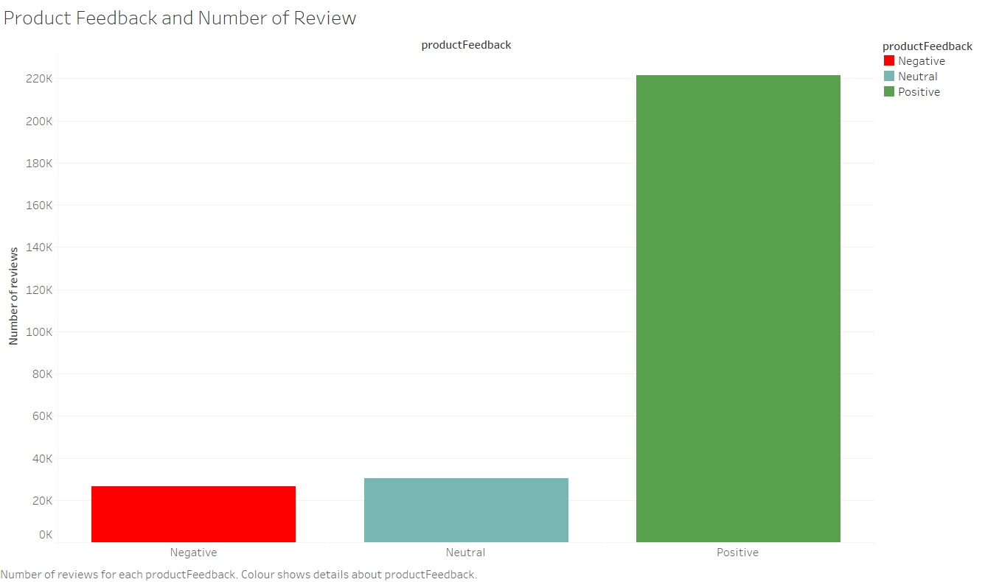
Percentage of reviews of products with a positive rating is 80% and products with neutral and negative is 20%
Reviews Clothing, Shoes, and Jewelry
Negative | 9%
Neutral | 11%
Positive | 80%

Slide 6
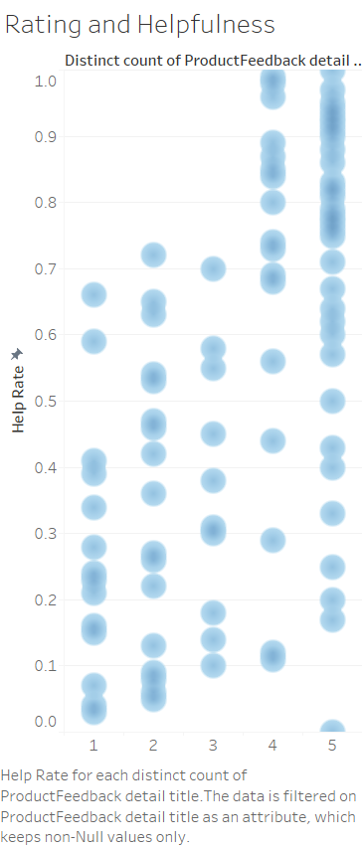
Reviews Clothing, Shoes, and Jewelry
Product reviews with a
higher positive rating.

Slide 7
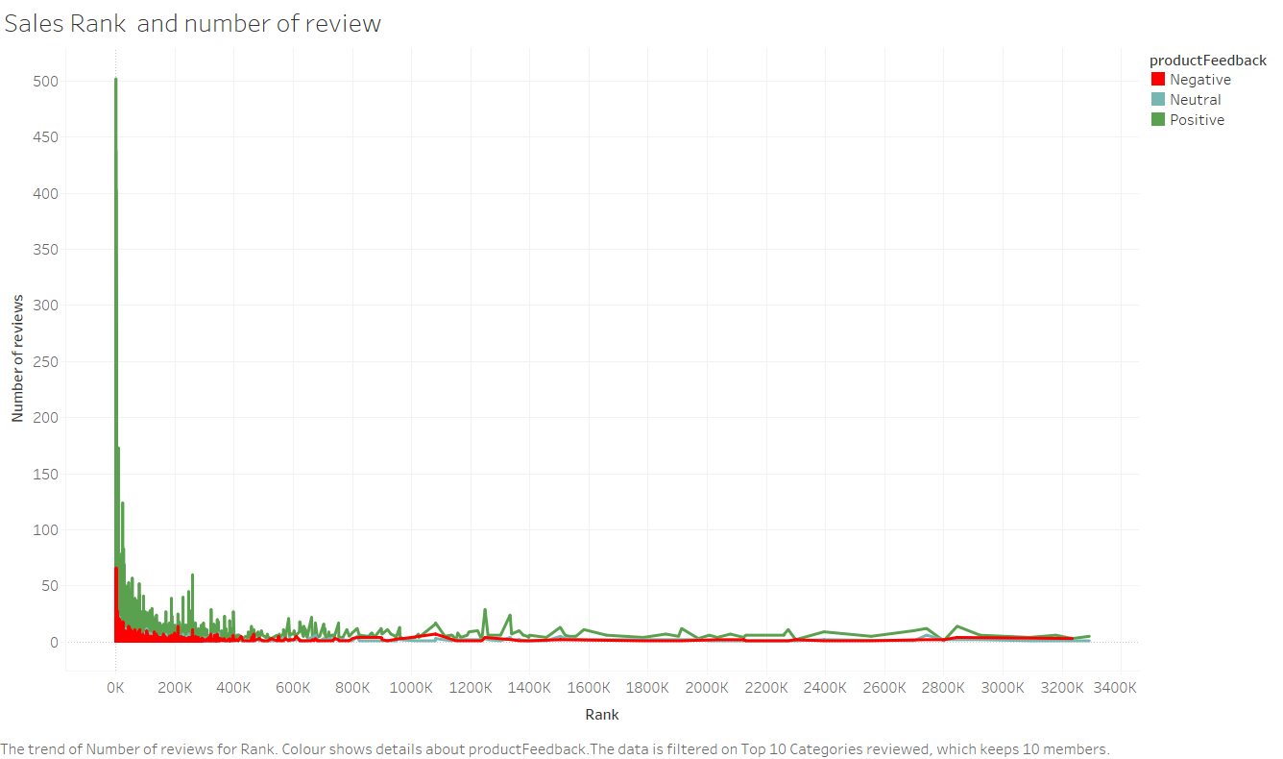
Products with positive rating are in the top #100 of Sales Rank.
Reviews Clothing, Shoes, and Jewelry
Negative | 8%
Neutral | 9%
Positive | 83%

Slide 8
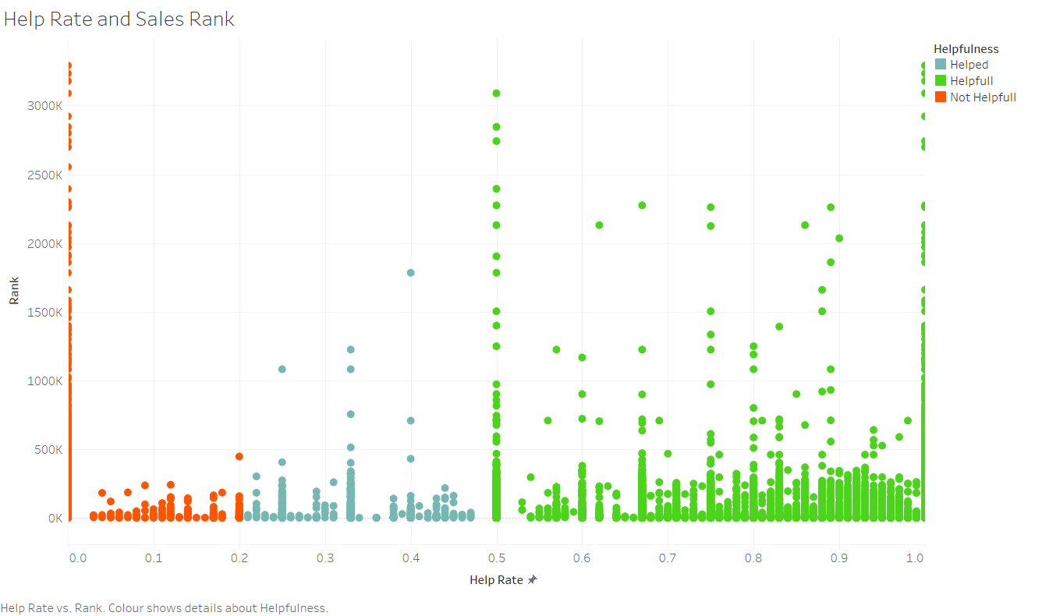
Products with helpful review classifies better in the sales rank.
Reviews Clothing, Shoes, and Jewelry

Slide 9
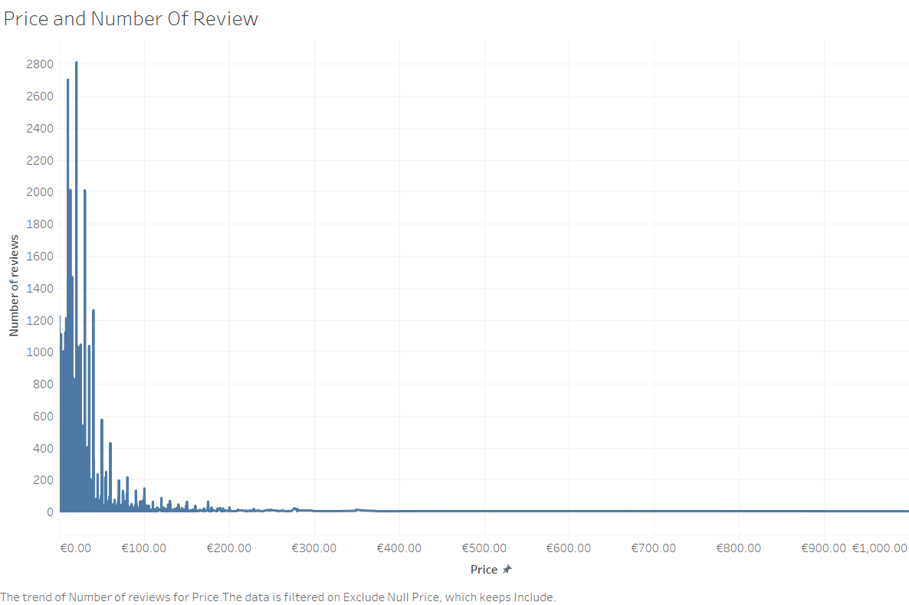
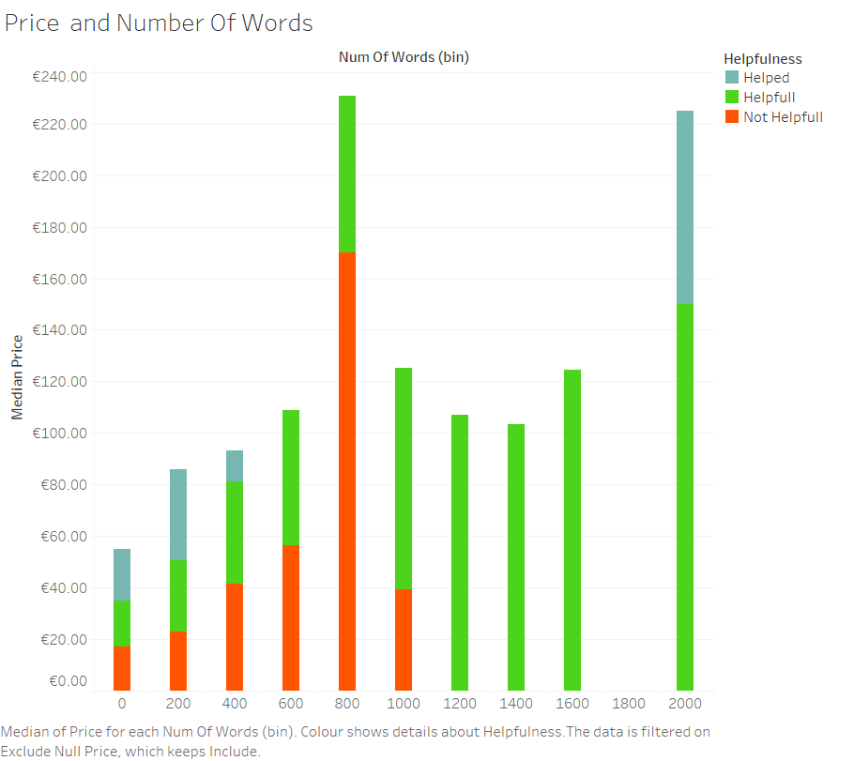
Almost 90% of the reviews are of products that cost up to €50
Reviews Clothing, Shoes, and Jewelry

Slide 10
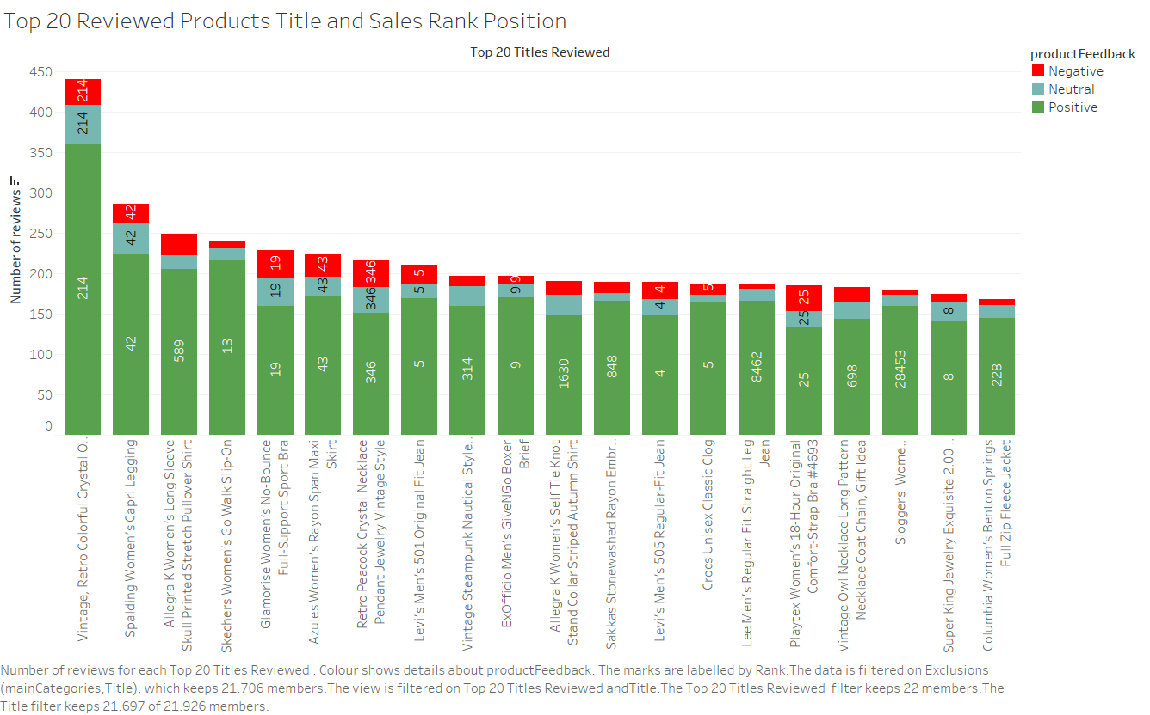
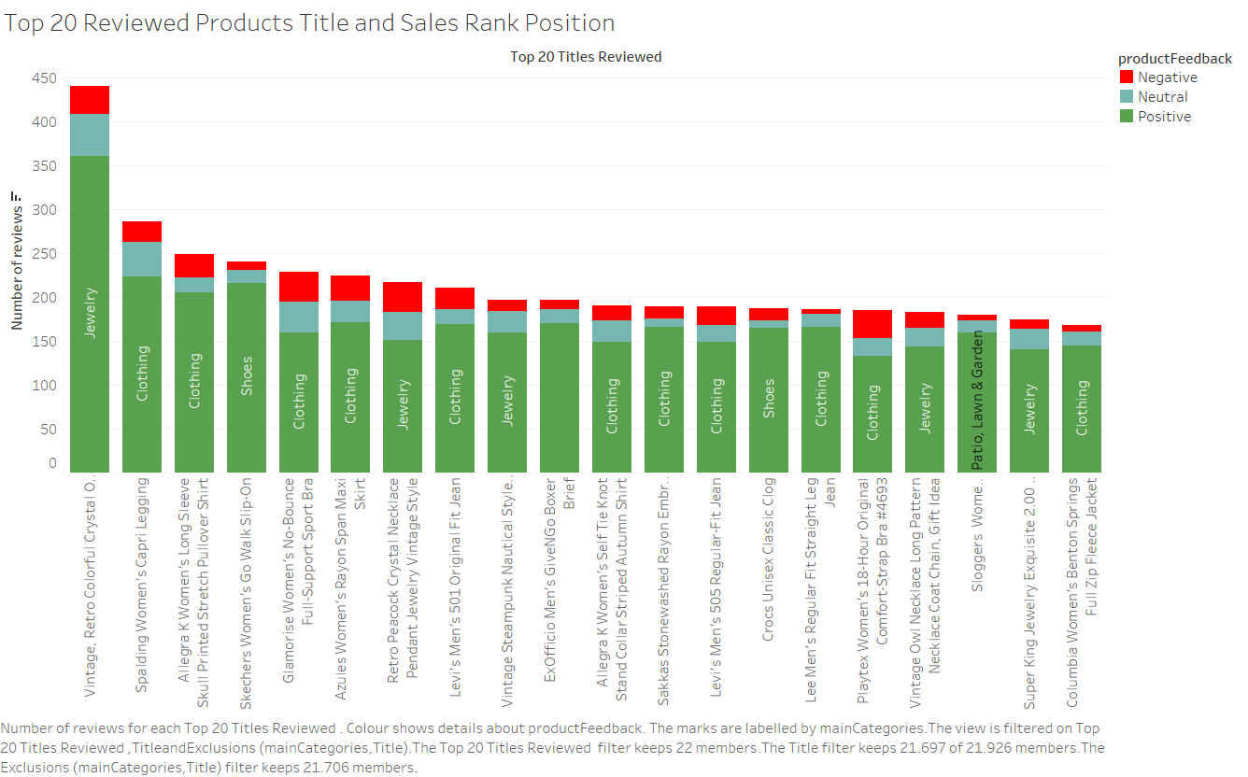
This graph shows Top 20 titles per number of review showing the categories their position in sale rank of that category.
Reviews Clothing, Shoes, and Jewelry

Slide 11
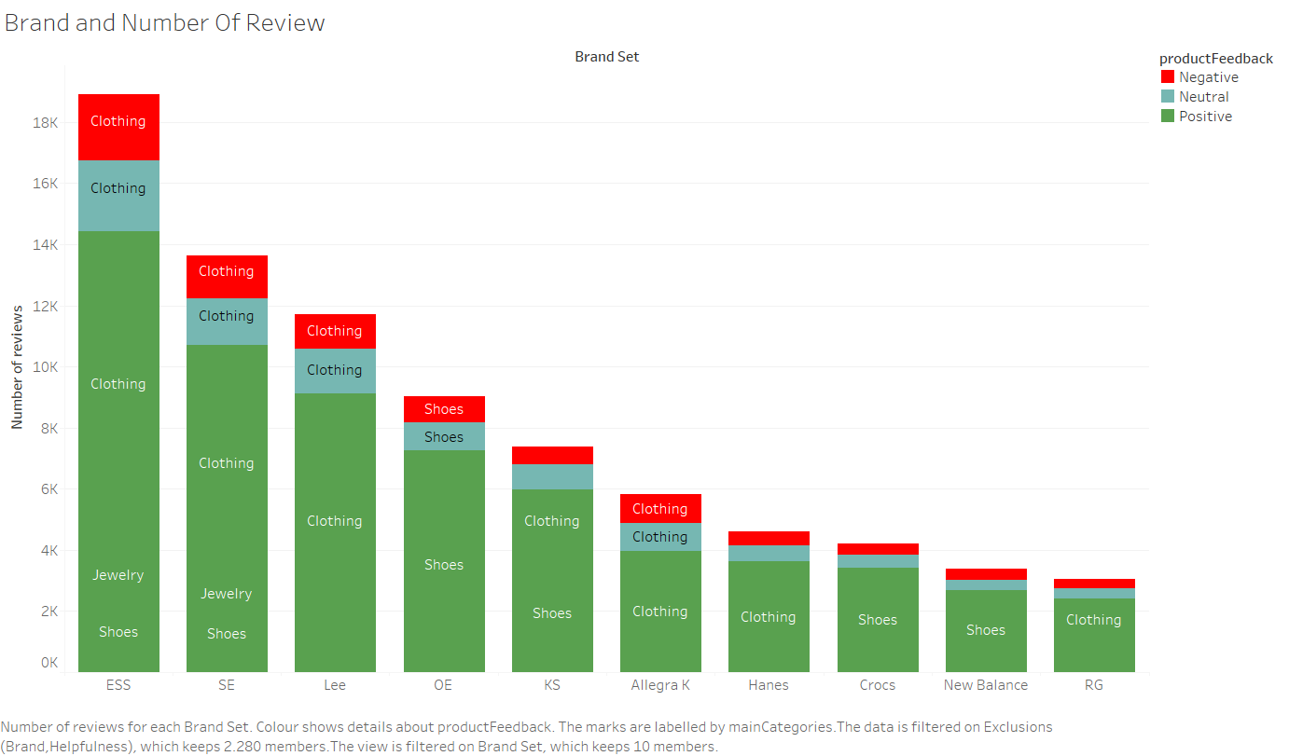
This graph shows the Top 10 brands reviewed and the product feedback which we can see is proportional among them.
Reviews Clothing, Shoes, and Jewelry

Slide 12
Actionable insights
Reviews with the highest Help Rate are those with a higher number of words. Most reviews over 500 words are considered helpful.
Products highly rated have high helpful rate.
The products that Rank higher in sales are the ones with the most positive reviews.
Products with prices up to €50 are highly reviewed.
Products with higher prices have a greater number of words in the review.
11 out of 20 titles most reviewed are in a significantly position in rank sales and falls in clothing category.

