Slide 1
Job Search Assistant
AI chatbot
H Anarghya
Lalitashree R Hegde
Pannaga Sharma ML
Prateeka C Bhat

Slide 2
What is a chatbot?
A chatbot is an artificial intelligence (AI) software that can simulate a conversation (or a chat) with a user in natural language through messaging applications, websites, or mobile apps.

Slide 3

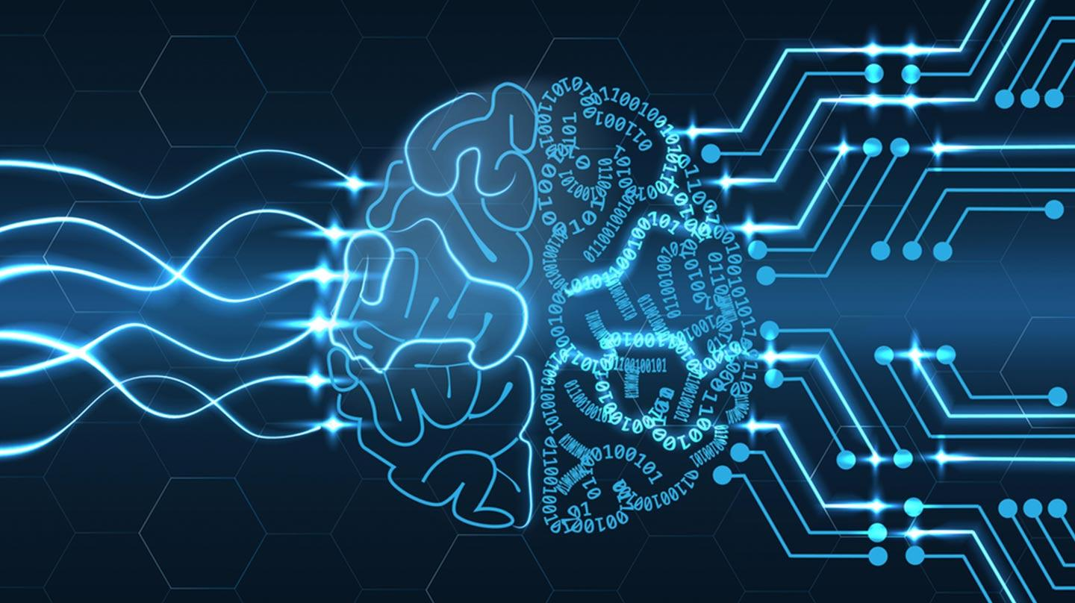


How does it work?
User makes a request
Request analyzed by AI
Real time response

Slide 4
Functionalities:
Percept- The agent takes user input such as qualification, tier level of the company, skill set, experience etc.
Action- Using the deep learning model ,the agent processes the requests.
Goal- To recommend suitable job role in a company located at Bangalore.
Environment- Virtual environment involving data set for training and user input.

Slide 5
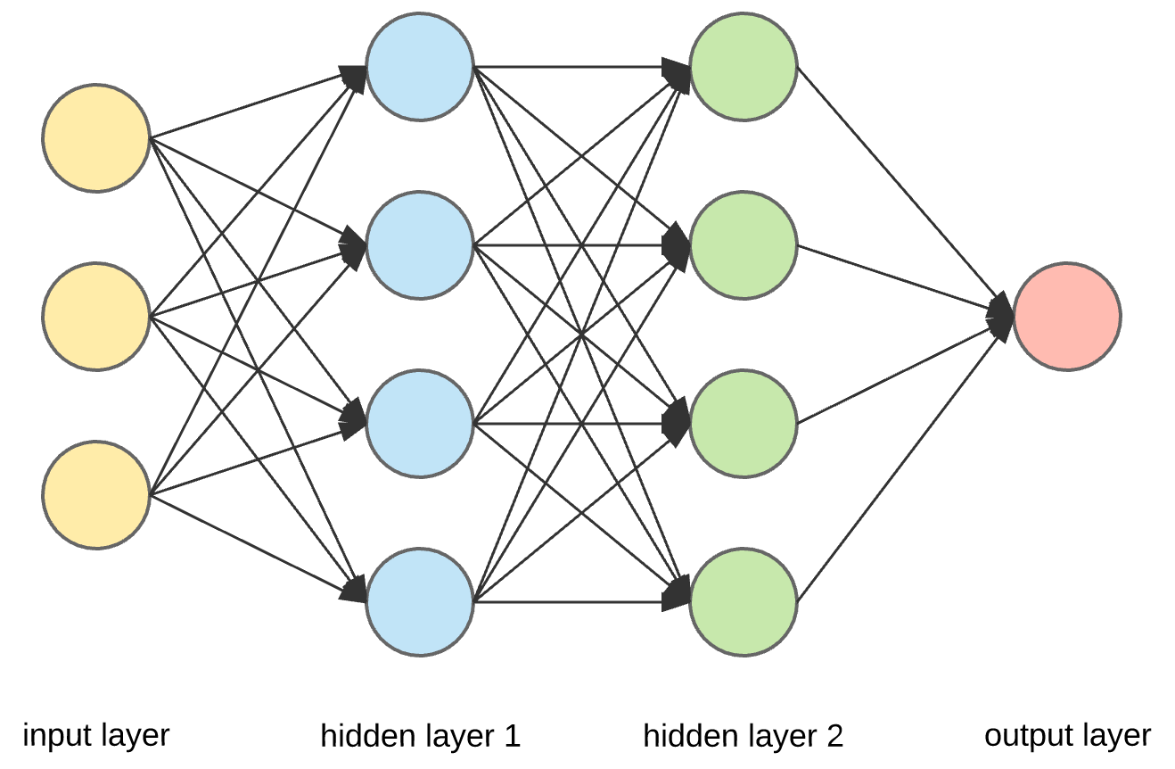
Technology
Neural networks- Basic components of the neural networks are input layers,hidden layers, output layer, weights and activation function. Input layer,hidden layer and output layer are called dense layers.

Slide 6


Deep learning with keras- Keras is a high-level neural networks API, capable of running on top of Tensorflow, Theano, and CNTK. It enables fast experimentation through a high level, user-friendly, modular and extensible API. Keras can also be run on both CPU and GPU.
Flask -is a popular web framework written in Python. It provides tools, libraries and technologies that allows us to build a web application.

Slide 7
Algorithm
Webpage(input)
Input layer
Keras API
Hidden Layers
Activation Function
Artificial Neural Network
Keras API
Output layer
Job Recommendation

Slide 8
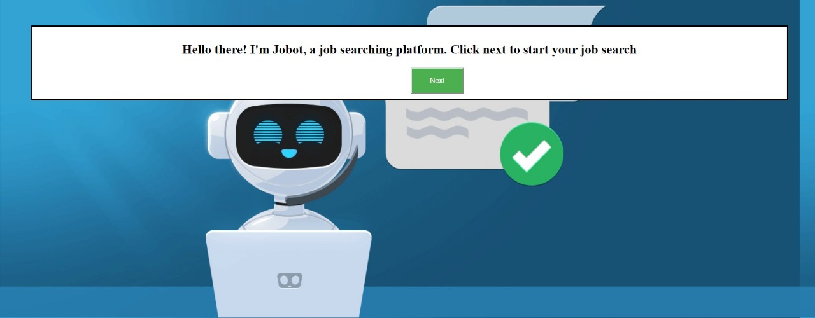
Screenshots

Slide 9
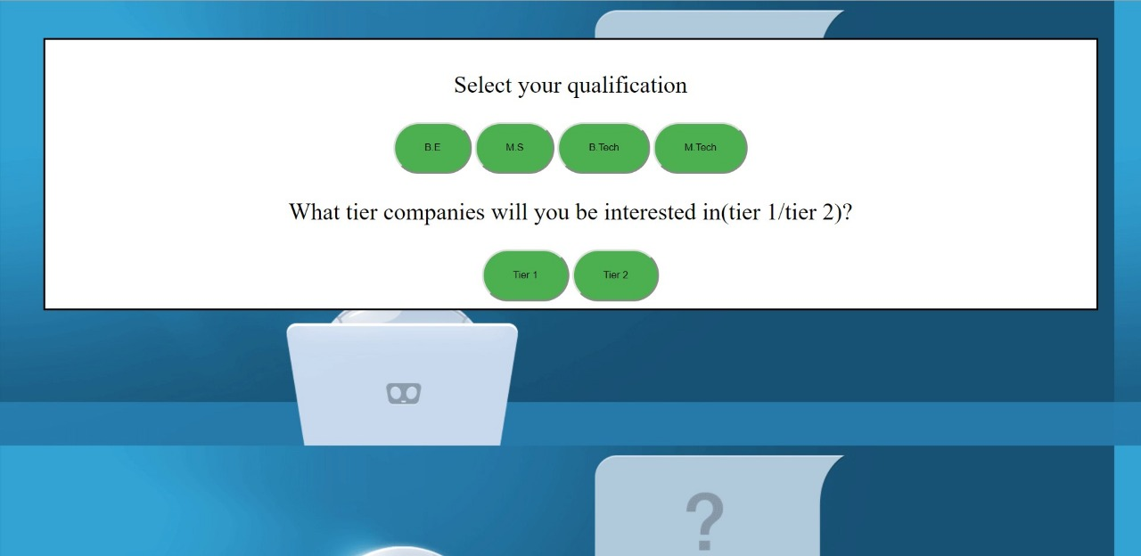

Slide 10
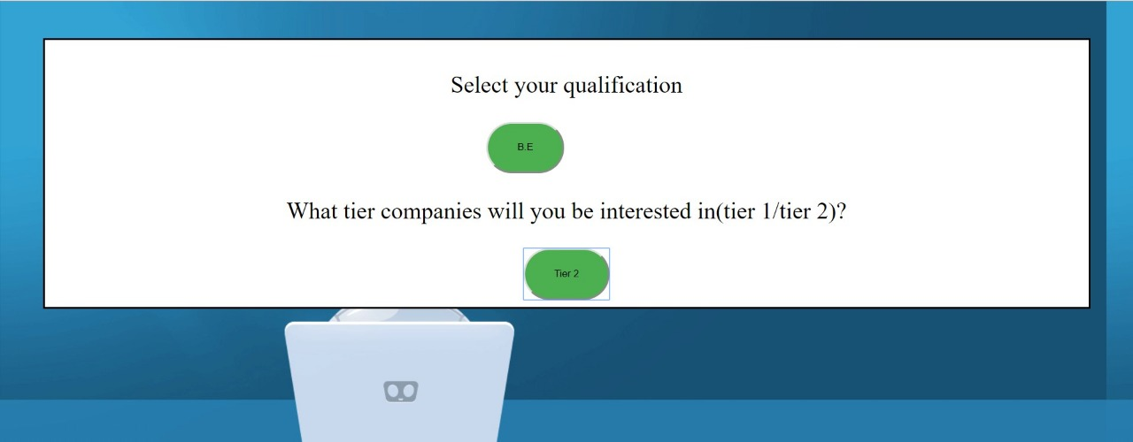

Slide 11
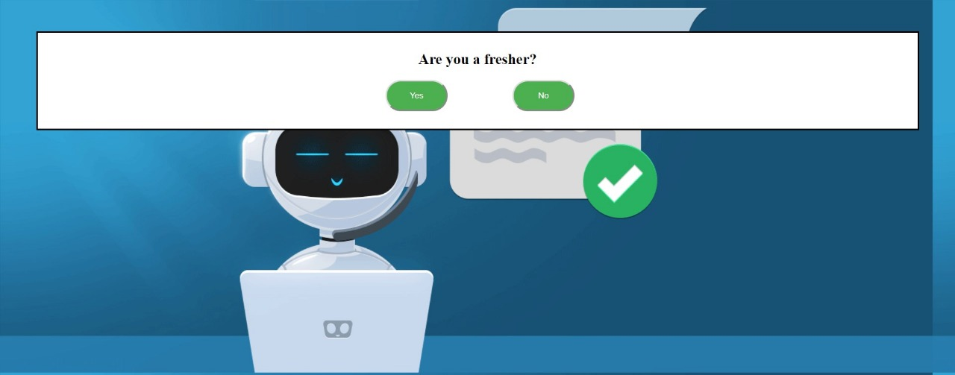

Slide 12
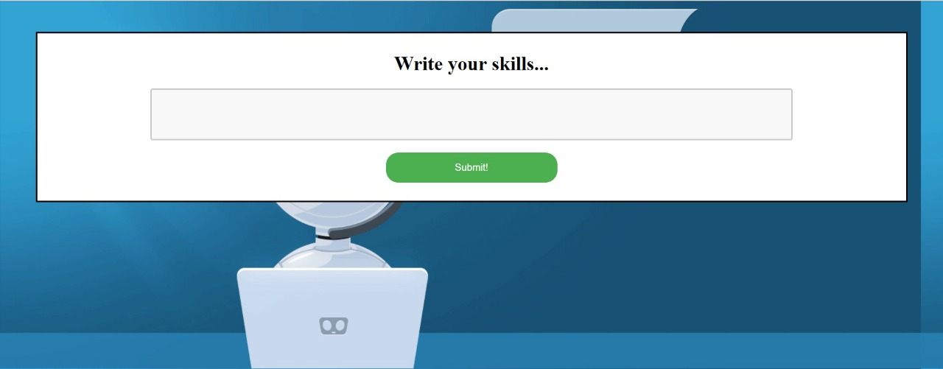

Slide 13
Benefits
Jobot recommends relevant IT jobs for aspirants who are looking for better job opportunities in Bangalore.

Slide 14

Thank You!

