Slide 1

ONLINE COURSES
Edx: Harvard and mit: 2012 – 2016
(KAGGLE)
Ana Recio de Mur

Slide 2
IS ATTENDANCE RELATED TO COURSE DURATION?
DO PEOPLE FINISH THE COURSES THEY START?
WHY?

Slide 3
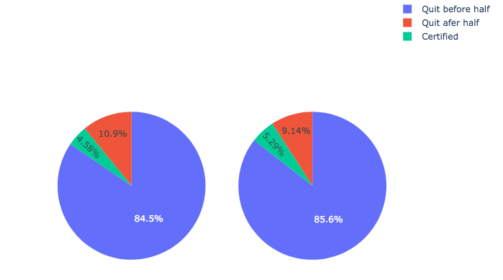
Do people finish the courses they start?
Harvard
MIT

Slide 4
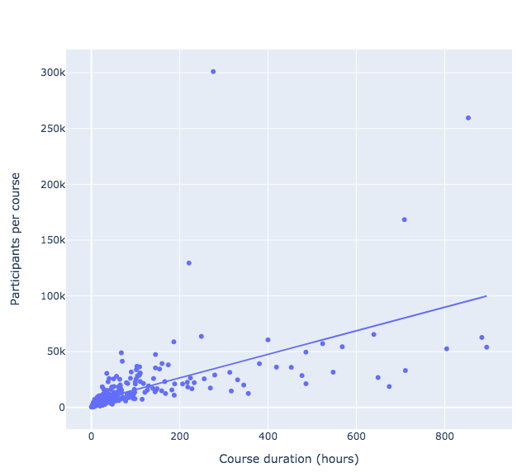
Participants vs. Course Duration
Introduction to computer science and programming
Majority of courses low duration
Introduction to computer science
As course duration increases, more participants per course
The Analytics Edge
People tend to choose longer courses
CORR = 0.59

Slide 5
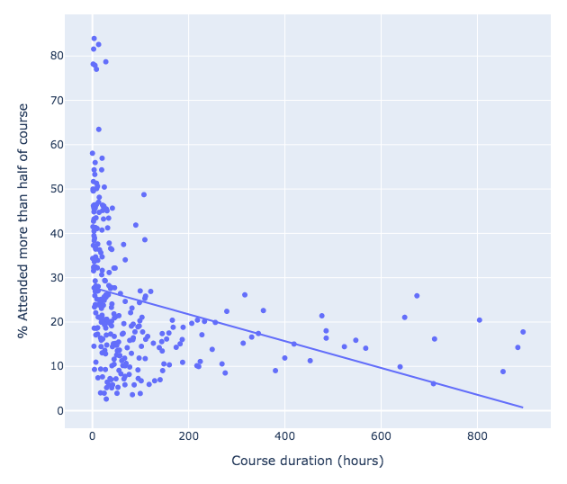
Attendance vs. Course Duration
Higher attendance in shorter courses
CORR = -0.3

Slide 6
CONCLUSION
People tend to choose courses which are longer
Completion and attendance rate are very low
Higher attendance in shorter courses
Recommendation for user:
Better to enroll in shorter courses and achieve a certification
Recommendation for edX:
Incentives for people to do longer courses
Offer more shorter courses

Slide 7
THANK YOU!

