Slide 1

ONLINE COURSES
Edx: Harvard and mit: 2012 – 2016 (KAGGLE )

Slide 2
IS COURSE DURATION RELATED TO ATTENDANCE?
DO PEOPLE FINISH THE COURSES THEY START?
WHY?

Slide 3
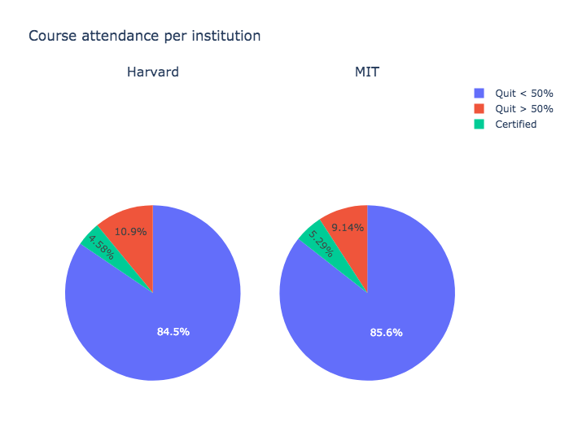

Slide 4
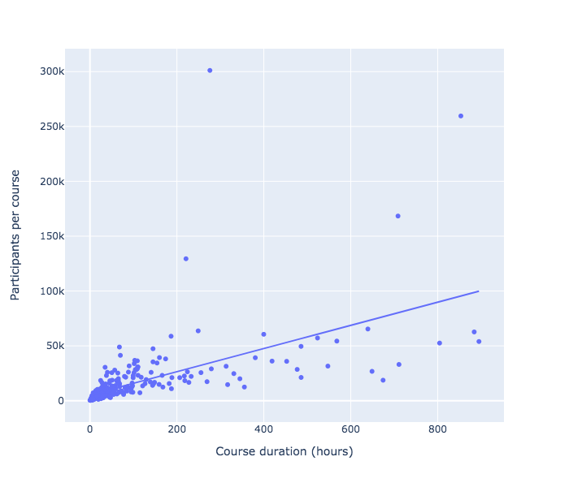
Majority of courses low duration
As duration increases, more participants per course
People tend to choose longer courses
TOTAL COURSES: 290

Slide 5
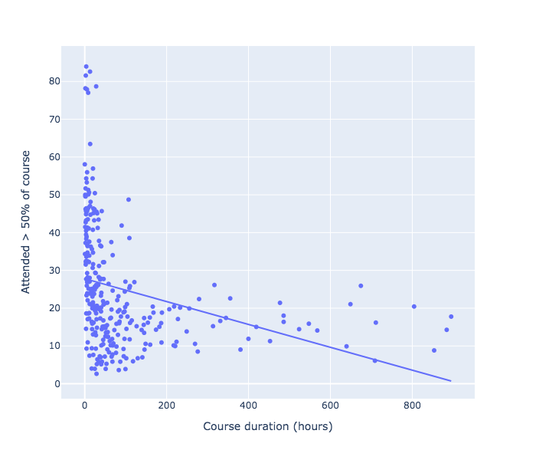
Higher attendance in shorter courses

Slide 6
CONCLUSION
People tend to choose courses which are longer
Completion and attendance rate are very low
Higher attendance in shorter courses
Seems better to enroll in shorter courses and achieve a certification

Slide 7
THANK YOU!

