Slide 1
Air Quality Prediction.
Forecasting Air Pollution Trends
Prepared by:
Anas Ebrahim Shabalah

Slide 2
Table of contents
01
04
02
03
Methodology
Introduction
Overview of the project topic.
Outlines the approach used to forecast the air pollution trend.
Project
Objective
05
Result and Visualization
Displaying the model performance, findings through graphs.
Provides insight of what the prediction entails.
Dataset Description
06
Conclusion
Summary of the entire analysis.
Include air quality data with relevant environmental factors for forecasting.

Slide 3
Introduction
Air pollution remains a major environmental concern, impacting both public health and climate conditions. This project focuses on predicting Carbon Monoxide (CO) concentration based on environmental sensor data using Python and various machine learning models..
This project aims to predict Carbon Monoxide (CO) concentration using historical air quality data from the UCI Air Quality dataset. By applying various machine learning models, we analyze environmental sensor data to forecast CO levels and evaluate model performance..

Slide 4
Project Objectives

Slide 5

OBJECTIVES
Analyze key environmental sensor data to identify patterns related to CO concentration.
Develop predictive models to estimate Carbon Monoxide (CO) levels accurately.
Apply Python-based machine learning techniques such as Linear Regression, Decision Trees, Random Forest, and Gradient Boosting.
Provide insights into how environmental conditions affect CO levels in urban areas.
Visualize data distributions, missing values, outliers, and model performance.

Slide 6
Datasets Description
Source: UCI Machine Learning Repository
Data: 9358 hourly records collected between March 2004 and February 2005.
Location: Highly polluted area in Italy.
Data includes ground truth concentrations of CO, benzene, NOx, NO₂, and non-methane hydrocarbons, recorded using 5 metal oxide chemical sensors. Missing values are represented by -200, and sensor drifts and cross-sensitivities may affect measurement accuracy. The dataset is intended for research purposes only.

Slide 7
Datasets Description – cont’d
The dataset contains air pollution data with the following features (important features only):
Relative Humidity (RH) (%): Percentage of moisture in the air.
CO(GT) (mg/m³): True concentration of Carbon Monoxide in
the air (measured by chemical analysis).
NO₂(GT) (µg/m³): Ground truth concentration of
Nitrogen Dioxide.
C6H6(GT) (µg/m³): Benzene concentration, indicating
air pollution levels.
Temperature (T) (°C): Ambient air temperature measured
at the monitoring station.
PT08.S1(CO): Sensor 1 response to Carbon Monoxide.

Slide 8
Steps Involved in this Project
Data Collection
Data Exploration
01
02
Data Cleansing & Preparation
04
Model Building in
Python
03
05
Analyzing the Model outcome
06
Results
Notes:
1 In the first step, the source of the data will be identified
2 In this step data cleansing such as duplicate checks, null handling, and feature selections are done. The datasets are also merged.
3 The Model results along with the chosen metrics will be analyzed and the best model will be chosen.
4The data is then explored to identify the patterns and relationships between the variables.
5 In this step, the dataset will be split into train and test sets and the models will be trained using R and Python.
6 The final results will then be published.

Slide 9
Data Processing
0.1 Importing Required Libraries
Manipulation & Visualization:
pandas: Used for data manipulation and analysis.
numpy: Provides tools for numerical operations and array handling.
matplotlib: Used for creating basic plots and visualizations.
matplotlib.dates: Helps with formatting and handling date values in plots.
seaborn: Used for creating advanced and attractive data visualizations
ort pandas as pd
MachineLearningModels:
ExtraTreesRegressor: For feature importance and regression modeling.
Train_Test_Split: Use for spling data to train and test
LinearRegression: Used for building linear regression models.
DecisionTreeRegressor: For regression modeling using decision trees.
RandomForestRegressor: For regression modeling using random forests.
GradientBoostingRegressor: For regression modeling using boosting techniques.
Performance Evaluation:
mean_squared_error, r2_score: Used for evaluating model performance by measuring error and prediction accuracy.

Slide 10
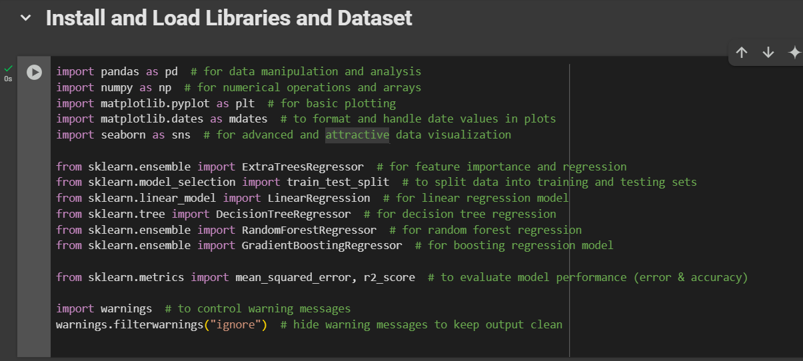
Data Processing

Slide 11
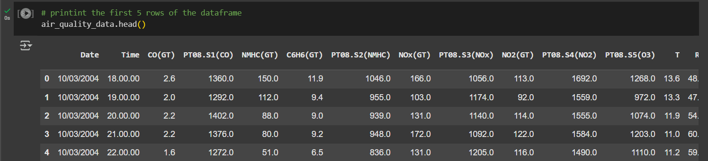
Data Processing
0.2 Loading the Dataset and Print the first rows:

Slide 12
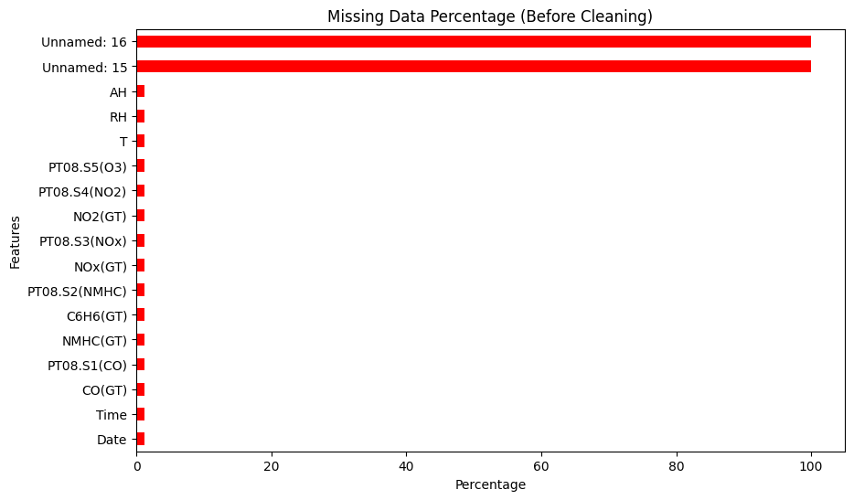
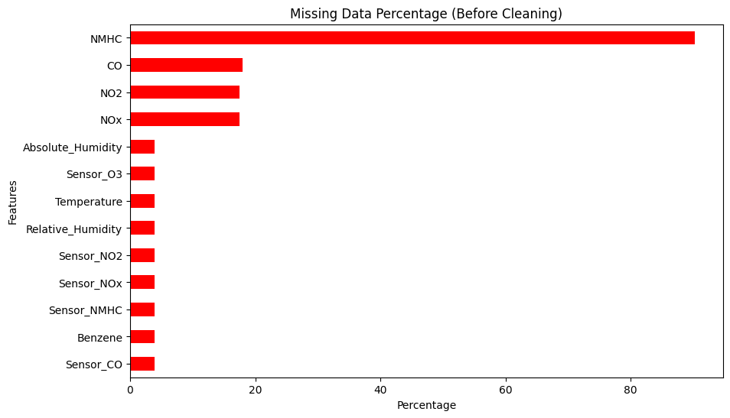
Data Processing
Visualizing Missing Datang
the percentage of missing values for each feature in the dataset. If missing values exist, it visualizes them using a horizontal bar chart; otherwise, it displays a message indicating that there are no missing values.
Notes:
We did a lot of eda (info,describe,insull ) then we visualizing.

Slide 13
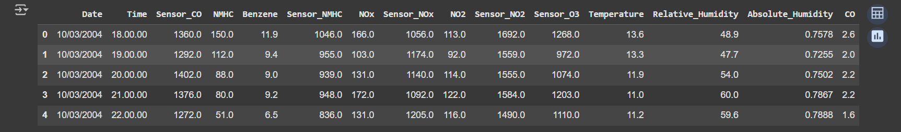
Data Processing
0.3 Cleaning the Data
Renamed columns for better readability and understanding:
Reorder columns to make 'CO' the last column
Removing Unnamed columns

Slide 14
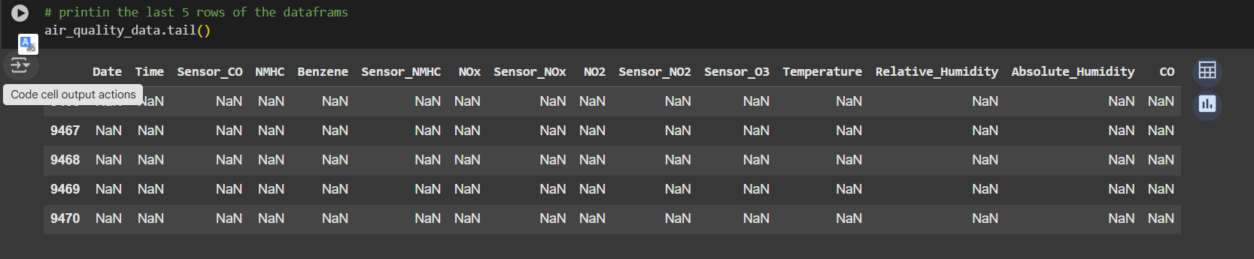
Data Processing
0.3 Cleaning the Data
During the initial inspection of the dataset, it was found that several rows at the end of the CSV file contained only null values (NaN) and no actual data. These empty rows were likely introduced unintentionally during the data export process. The 9356th row was identified as the last valid data point

Slide 15
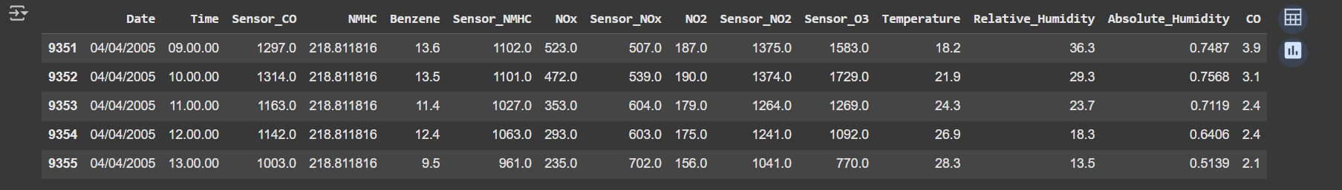
Data Processing
0.3 Cleaning the Data
According to the dataset information provided on the source website, missing values are represented by -200 instead of standard null markers. Therefore, all instances of -200 were treated as missing values during data cleaning to ensure accurate analysis
Handling the missing values first convert all -200 to NaN then replace all NaN values with mean of that sepcific column
If missing values exist, it visualizes them using a horizontal bar chart; otherwise, it displays a message indicating that there are no missing values.

Slide 16
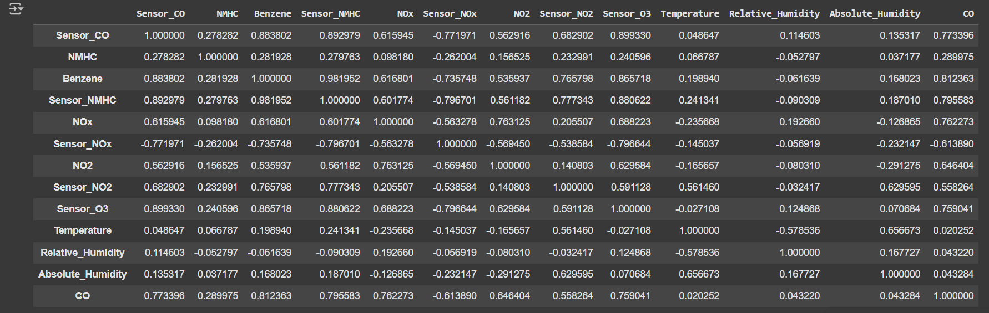
Final EDA (After Cleaning)
Check the correlation of all features with Multivariant
Correlation analysis showed that CO levels are strongly linked to several features, especially Benzene, Sensor_CO, Sensor_NMHC, and Sensor_O3, indicating common sources like traffic pollution. Moderate positive correlations were also found with NOx, NO2, and Sensor_NO2. A negative correlation with Sensor_NOx suggests possible sensor issues. Temperature and humidity had only weak correlations with CO, indicating limited environmental impact

Slide 17
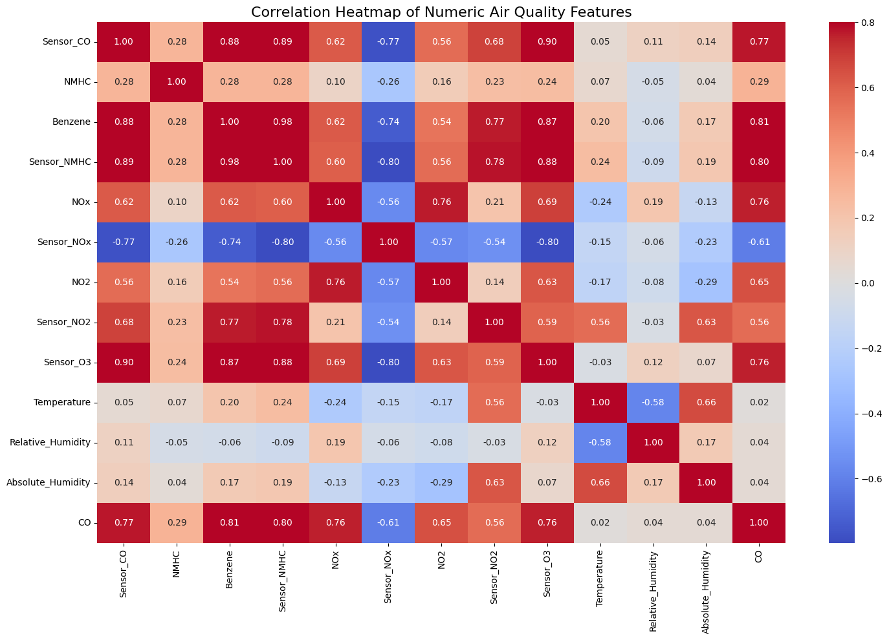
plot Heatmap of correlated features

Slide 18
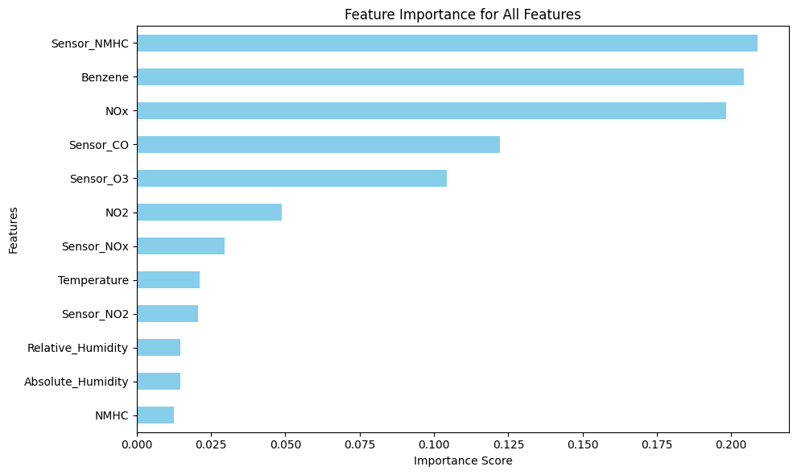
Feature Importances
ExtraTreesRegressor
To identify which features most influence the prediction of CO, we trained an ExtraTreesRegressor:
Visualizing
A horizontal bar chart was plotted showing the features sorted by importance

Slide 19
Model Building & Forecasting
Data Splitting
The dataset was split into training and test sets:
75% for training
25% for testing
The regression model was evaluated using the coefficient of determination (R²) on both the training and testing datasets. The results are as follows:
R² on the training set: 0.8095
R² on the testing set: 0.7908
Overall, the model shows strong predictive capability and is well-suited for forecasting the target variable based on the provided features.

Slide 20
Model Building & Forecasting
Multiple Regression models were built in Python using algorithms such as
Linear Regression
Decision Tree Regression
Random Forest Regression
Gradient Boost Regression
Evaluation Metrics:
Mean Squared Error (MSE): Measures the average squared difference between the actual and predicted values. Lower values are better.
R² (Coefficient of Determination): Measures how well the model explains the variance in the target variable. A value closer to 1 means a better fit.

Slide 21
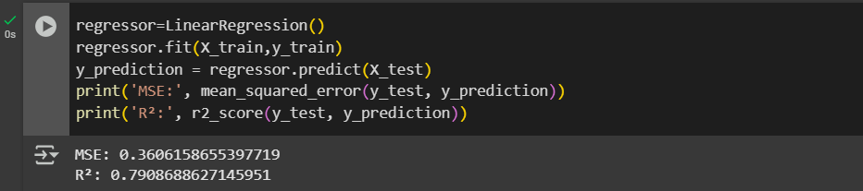
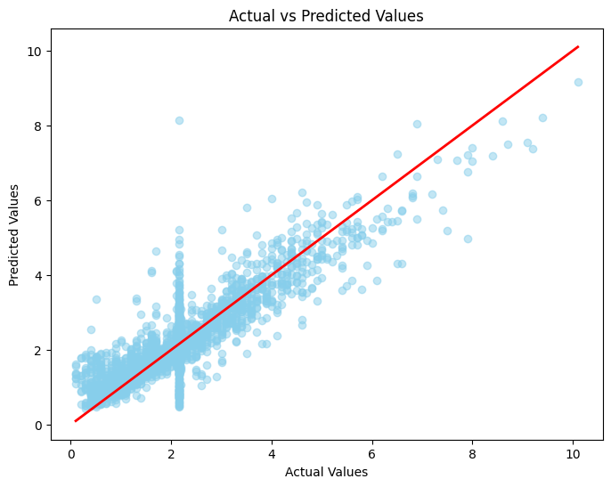
Model Building & Forecasting
Linear Regression
Visualizing Linear Regression Results

Slide 22
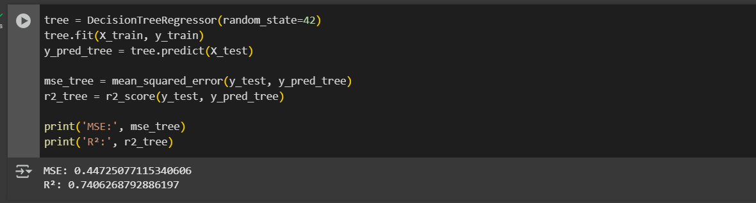
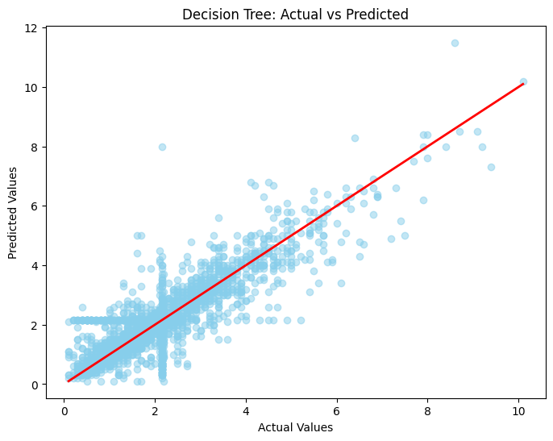
Model Building & Forecasting
Decision Tree
Visualizing Decision Tree Results

Slide 23
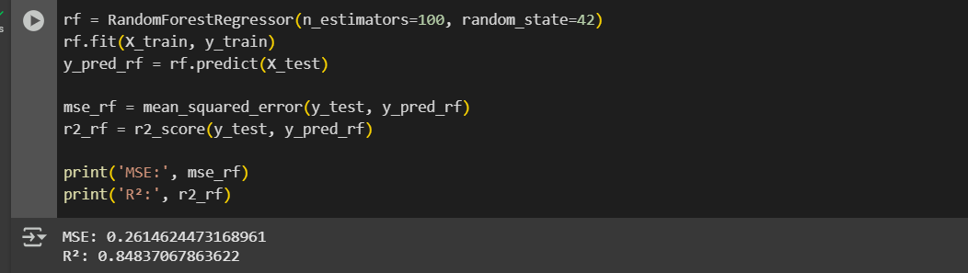
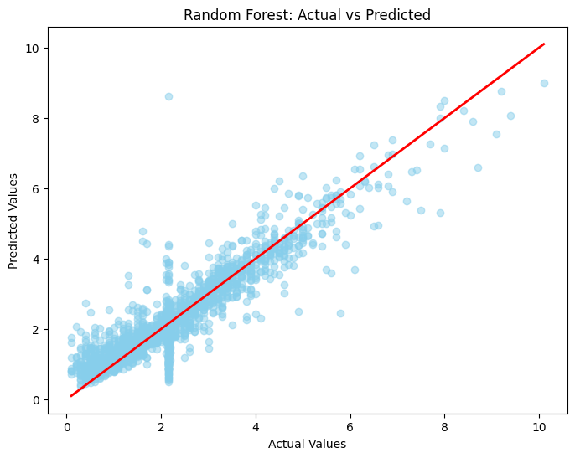
Model Building & Forecasting
Random Forest
Visualizing Random Forest Results

Slide 24
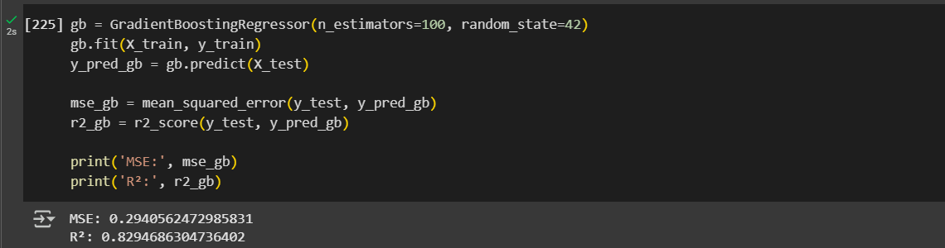

Model Building & Forecasting
Gradient Boosting
Visualizing Gradient Boosting Results

Slide 25
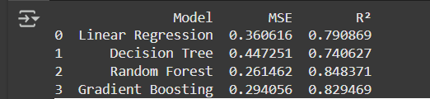
Performance Comparison
To evaluate the effectiveness of different regression models in predicting CO concentration, we compared four popular algorithms using the same training and testing datasets. The performance was assessed using two key metrics:
MSE (Mean Squared Error): Lower values indicate better performance.
R² (Coefficient of Determination): Higher values (closer to 1) indicate better fit.

Slide 26
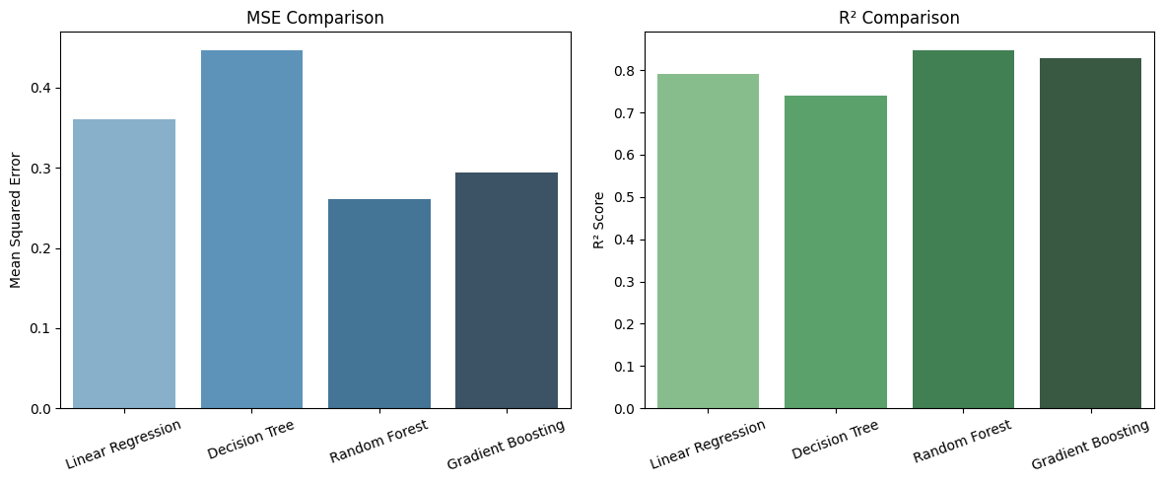
Performance Comparison Visualization

Slide 27
Performance Comparison(Key Insights)
Random Forest outperformed all other models with the lowest MSE (0.2615) and the highest R² (0.8484). It captured complex patterns in the data more effectively, making it the best model for this task.
Gradient Boosting also showed strong performance, closely following Random Forest.

Slide 28
Conclusions
Summarize
key concepts
Real-world applications
Preview
next steps
The model can be enhanced by incorporating real-time sensor data from IoT devices to provide continuous updates and send alerts when pollution exceeds safe level.
Deploying the model in a web application for public and governmental use.
project predicts Carbon Monoxide (CO) concentration using machine learning models.
Future work could involve LSTM networks and additional environmental features to improve accuracy.

Slide 29
Thank
You!

