Slide 1
Machine Learning
Our Team:
Shaik Nayeem
Amina Mahnoor
Khizar Mohammed Farooq
Syed Anas Naseer
Mohammed Shahalam Ahmed

Slide 2
Overview
Data Collection
Data Processing
Data Analysis
Data Visualization
Data Pre-processing
Machine Learning Model (XGBoost Regressor)
Evaluation

Slide 3
Problem Statement
To build a predictive model and find the sales of each product at BigMart. Bigmart will try to understand the types of products and stores which play the main in increasing sales.

Slide 4
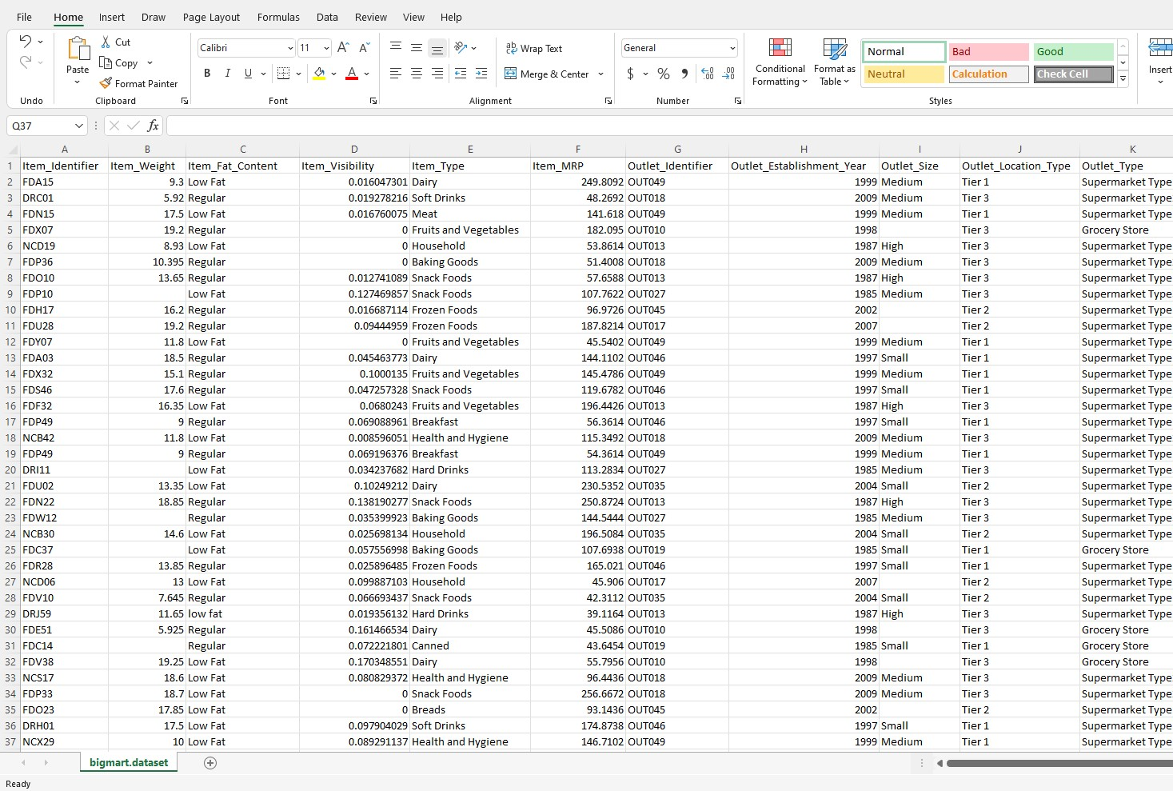
Dataset
We were given a csv file of a shopping mart
Categorical Features:
Item_Identifier
Item_Fat_Content
List item
Outlet_Identifier
Outlet_Size
Outlet_Location_Type
Outlet_Type

Slide 5
Exploratory Data Analysis
Observe
the null values (if any)
Check values in the different columns
How are the values affecting Sales

Slide 6
Data Pre processing
We handled the null values by taking the mean of its values.
We had 2 options:
Ignore and delete the null data
Work with the null data smartly

Slide 7
Data Visualization
Types of plot we had in availability:
Line charts to view continuous data
Bar charts to view categorical data
Box plots to view the outliers
Histogram to view the frequency of the variables
Scatter plot to view how one variable depends on the other
Bubble plot to view how a third variable affects relation between two variables

Slide 8
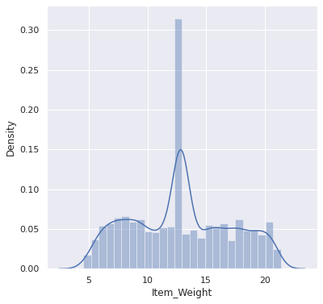
Data Visualization
This is a Graph for weight distribution of items in the shop
We can observe that most of the items are of range 12 kilos to 14 kilos
We can also observe that the range starts from around 5 kilos and goes till 20 kilos

Slide 9
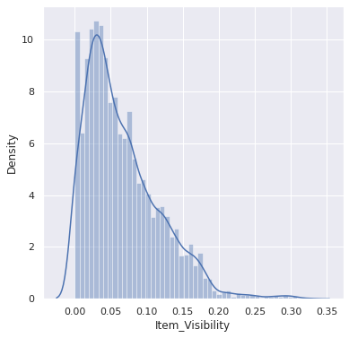
Data Visualization
This is a Graph for item visibility in the shop
We can observe that on a peak the items are of highest available at 0.05
We can also observe that there are some items that also has availability of 0.30

Slide 10
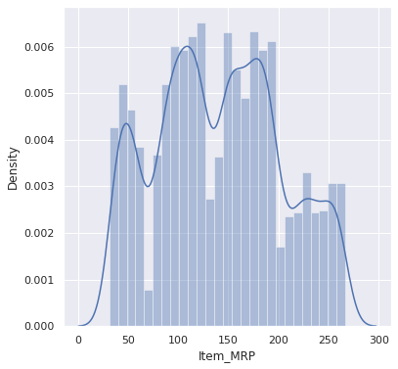
Data Visualization
This is a Graph for Item MRP of the items in the shop
We can observe that the graph varies a lot.
We can also observe that there are 3 peaks on the graph
This means most of the items are around their price areas i.e Rs50, Rs100, Rs175.

Slide 11
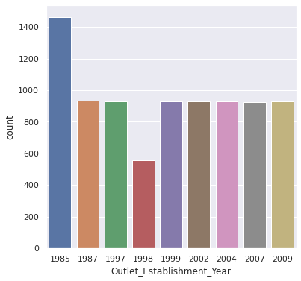
Data Visualization
This is a Graph for Outlet establishment year of the item in the shop
We can observe that most of the items are found in the outlet which was established in year 1985
We can also observe that the outlet that was established in year 1998 has the least count of items

Slide 12
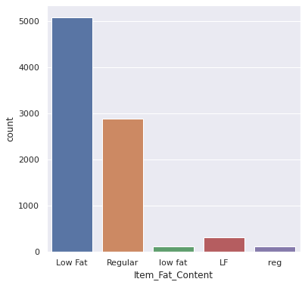
Data Visualization
This is a Graph for the fat content of the items in the shop
We can observe that most of the items has a low-fat content

Slide 13
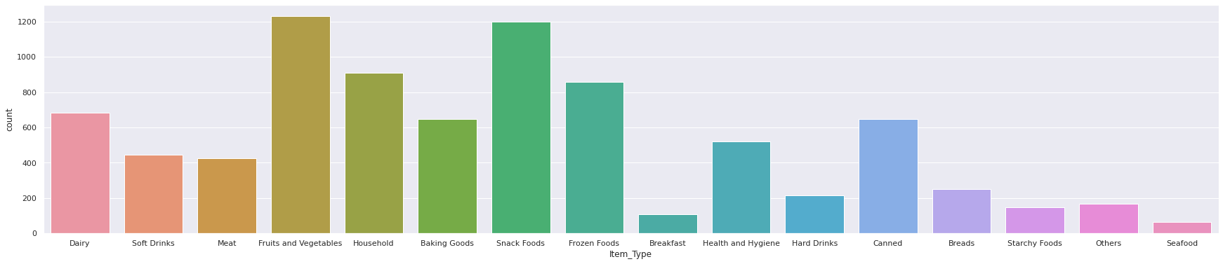
Data Visualization
This is a Graph for item type in the shop
We can observe that most of the items are Fruits and Vegetables and Snack food
We can also observe that the least type of food is Seafood and Breakfast.

Slide 14
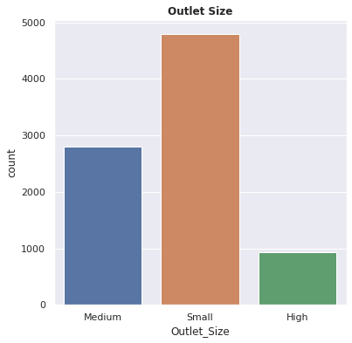
Data Visualization
This is a Bar Graph to visualize the Outlet Size of the shop chain
We can observe that the there exist a greater number of small outlets, followed by Medium outlets and then Large Outlets.

Slide 15
Conclusion
We have concluded that the sales data is affected the following factors:
1. Type of Item:
We can observe that people buy more Fruits and vegetables, and Snack type of goods.
2. Fat Content of Item:
3. Year of establishment:
We can observe that people buy more from outlets which were the oldest
Outlet sales is highly affected with type of outlet and mrp of the product. When these are removed the accuracy of outlet sales comes down.
We can observe that people buy more Low-Fat content goods

Slide 16
Thank You

