Slide 1
CV802
Assignment 2: Surface Extraction
Anas Khan

Slide 2
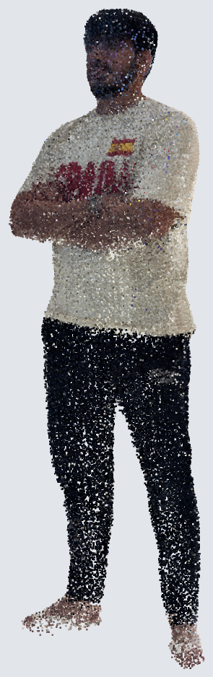
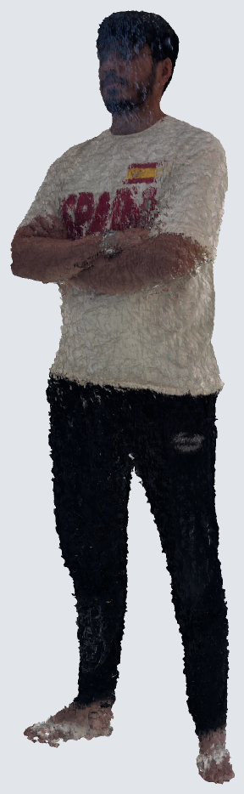
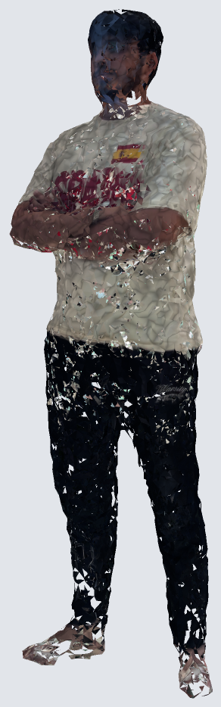
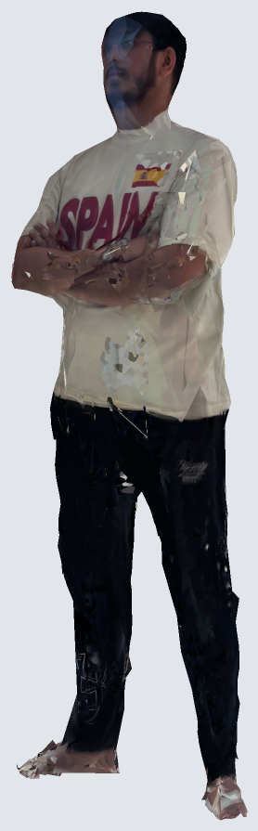

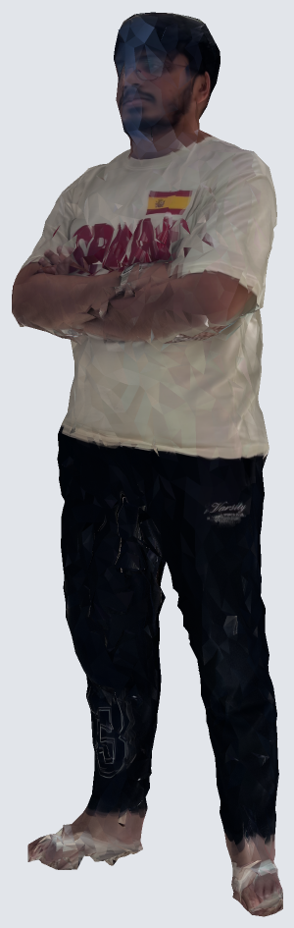
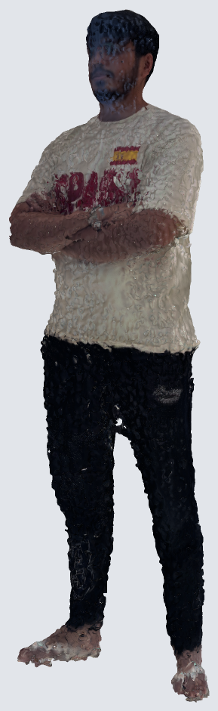

Problem Statement:
points
Poisson
IER
Point2Mesh
MeshAnything
DHSP
NKSR
SAP
VGGSfM points from Assignment 1 → textured meshes (.obj)
2

Slide 3
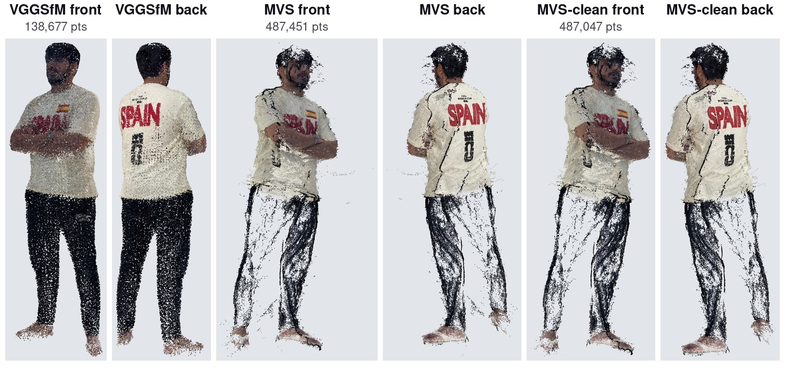
Inputs
3

Slide 4
Methods
Method | Venue | Year
Screened Poisson (our implementation) | SGP / ACM TOG | 2006 / 2013
IER meshing | ECCV | 2020
Point2Mesh | SIGGRAPH | 2020
MeshAnything V2 | arXiv | 2024
Deep Hybrid Self-Prior (DHSP) | ICCV | 2021
NKSR* | CVPR | 2023
Shape As Points (SAP)* | NeurIPS | 2021
2D Gaussian Splatting (2DGS)* | SIGGRAPH | 2024
* beyond the course list
4

Slide 5
Experiments
61 reconstructions in total
5

Slide 6
GPU time
One RTX 5000 Ada (32 GB). Others: SAP, MeshAnything, Poisson, IER, NKSR. DHSP includes its 3D and 2D stages. Not counted: failed attempts, e.g. a 15 h flattening run that never finished.
6

Slide 7
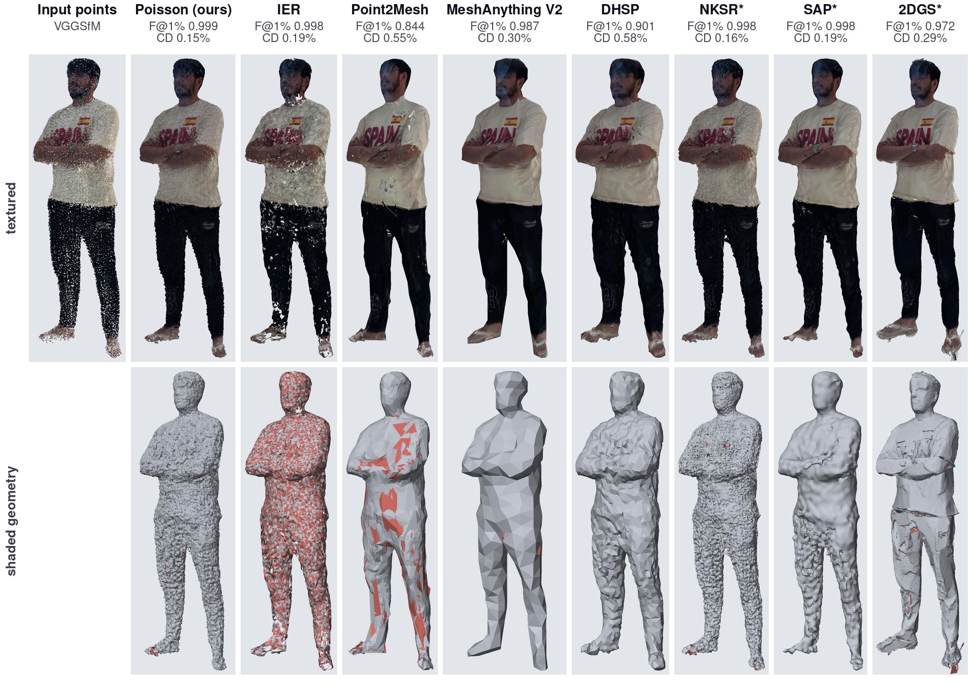
Results (VGGSfM)
7

Slide 8
Comparison (½)
best
second best
Course list
Method | Faces | Chamfer % ↓ | F@1% ↑ | F@0.5% ↑ | NC ↑ | Watertight | Time ↓
Poisson (ours) | 1.02M | 0.149 | 0.999 | 0.988 | 0.75 | no | 39 s
IER | 17k | 0.187 | 0.998 | 0.975 | 0.82 | no | 29 s
Point2Mesh | 10k | 0.553 | 0.844 | 0.530 | 0.80 | yes | 42 min
MeshAnything V2 | 1.4k | 0.295 | 0.987 | 0.858 | 0.82 | no | 77 s
DHSP | 6.0k | 0.583 | 0.901 | 0.407 | 0.89 | yes | 2.2 h
Beyond the course list
Method | Faces | Chamfer % ↓ | F@1% ↑ | F@0.5% ↑ | NC ↑ | Watertight | Time ↓
NKSR* | 2.09M | 0.156 | 0.998 | 0.973 | 0.75 | no | 7 s
SAP* | 64k | 0.195 | 0.998 | 0.961 | 0.81 | yes | 8 min
2DGS* | 657k | 0.289 | 0.972 | 0.864 | 0.75 | no | 47 min
VGGSfM input (138,677 points), best run per method.
8

Slide 9
Comparison (2/2)
best
second best
Course list
Method | MVS (487,451 points) |  |  | MVS-clean (487,047 points)
 | F@1% ↑ | Chamfer % ↓ | Time ↓ | F@1% ↑ | Chamfer % ↓ | Time ↓
Poisson (ours) | 0.999 | 0.127 | 41 s | 0.999 | 0.127 | 40 s
IER | 1.000 | 0.120 | 42 s | 1.000 | 0.123 | 50 s
Point2Mesh | 0.133 | 3.977 | 40 min | 0.387 | 1.298 | 39 min
MeshAnything V2 | 0.873 | 0.518 | 2 min | 0.908 | 0.438 | 41 s
DHSP | 0.900 | 0.636 | 4.0 h | 0.916 | 0.627 | 5.9 h
Beyond the course list
Method | MVS (487,451 points) |  |  | MVS-clean (487,047 points)
 | F@1% ↑ | Chamfer % ↓ | Time ↓ | F@1% ↑ | Chamfer % ↓ | Time ↓
NKSR* | 1.000 | 0.080 | 12 s | 1.000 | 0.080 | 18 s
SAP* | 0.963 | 0.197 | 9 min | 0.948 | 0.239 | 5 min
2DGS* | 0.938 | 0.308 | 30 min | 0.928 | 0.336 | 16 min
9

Slide 10
Quality vs time and size
VGGSfM input, best run per method. Higher is better; further left is faster (left chart) or lighter (right chart).
10

Slide 11
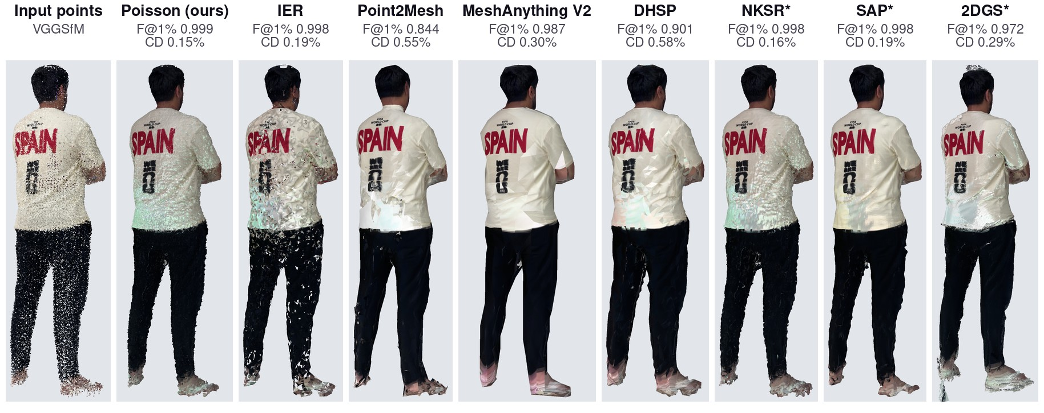
Back view (VGGSfM)
11

Slide 12
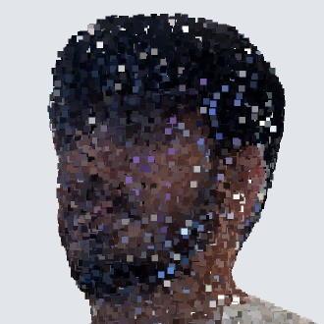
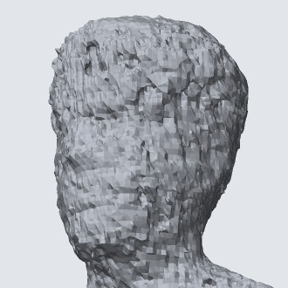
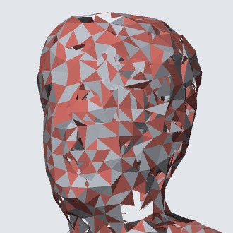
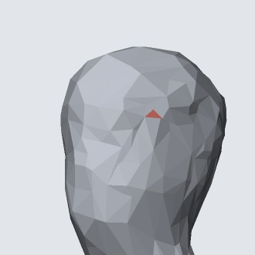
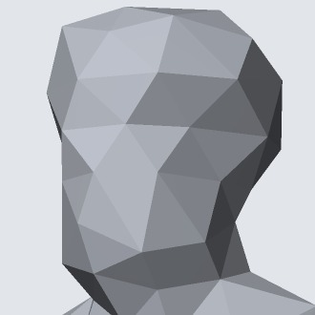
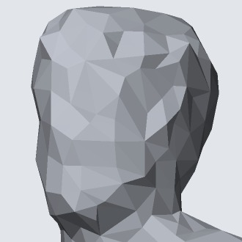
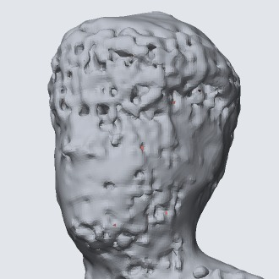
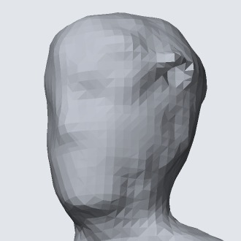
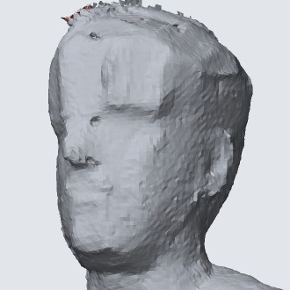
Close-up: face
Input points
Poisson (ours)
IER
Point2Mesh
MeshAnything V2
DHSP
NKSR*
SAP*
2DGS*
Shaded geometry of the best VGGSfM run per method, same crop for all. Red: triangles seen from the back.
12

Slide 13
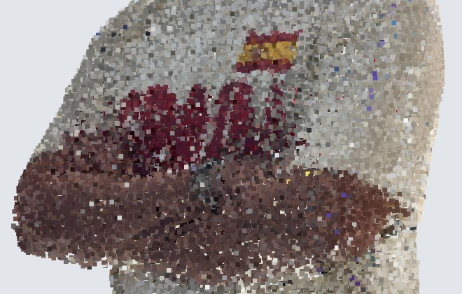
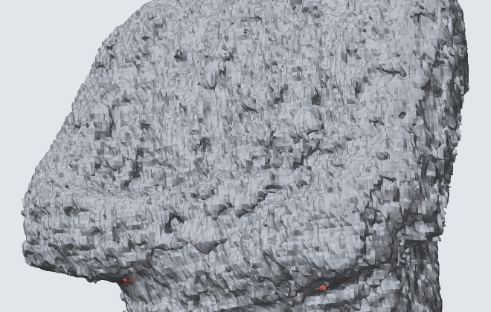
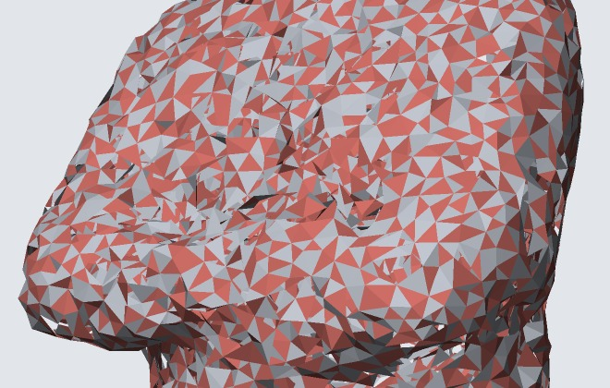
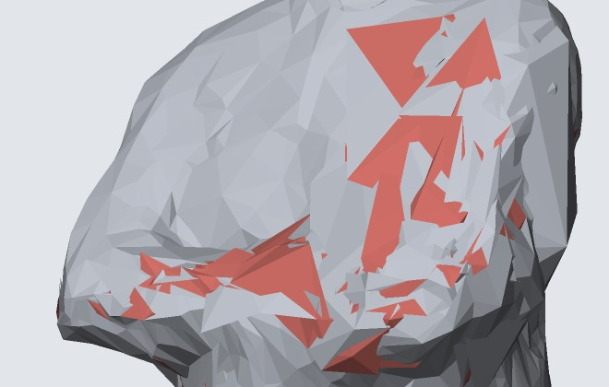
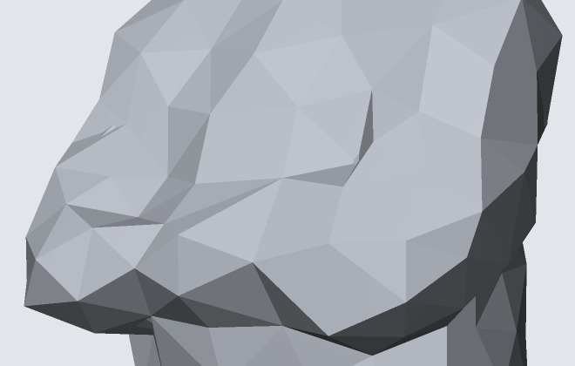
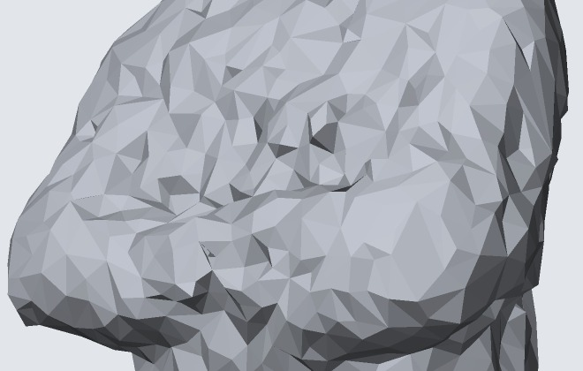
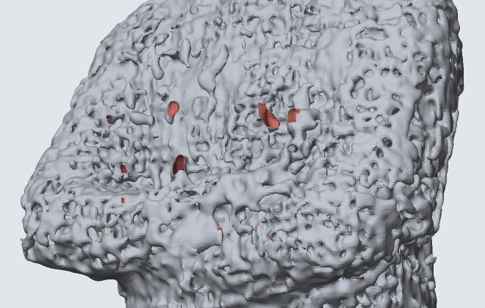
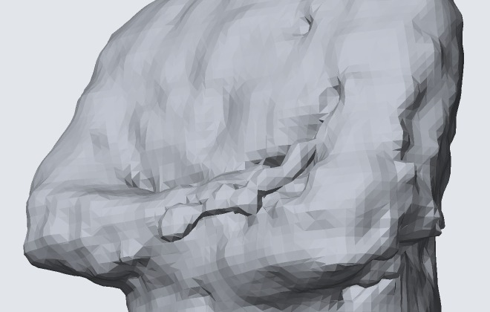
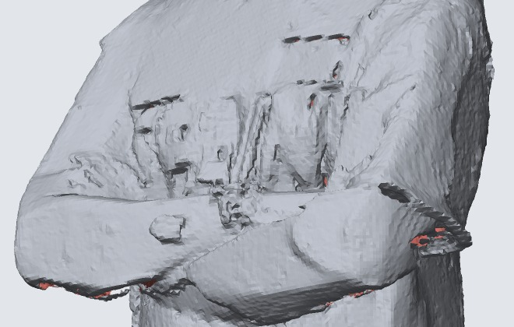
Close-up: crossed arms
Input points
Poisson (ours)
IER
Point2Mesh
MeshAnything V2
DHSP
NKSR*
SAP*
2DGS*
Shaded geometry of the best VGGSfM run per method, same crop for all. Red: triangles seen from the back.
13

Slide 14
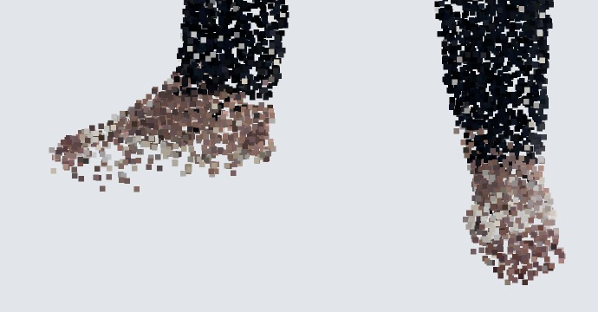
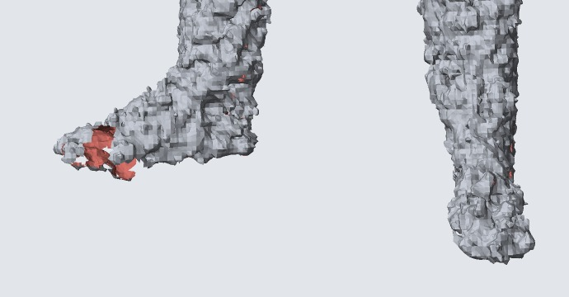
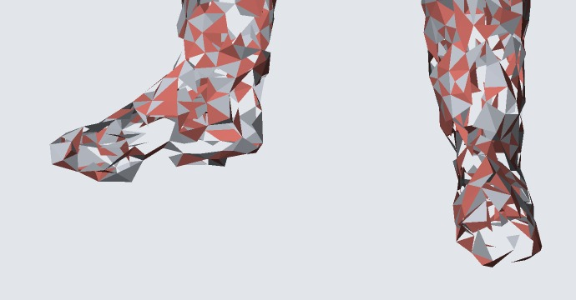
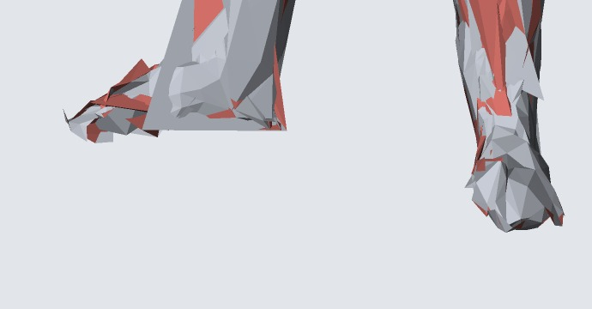
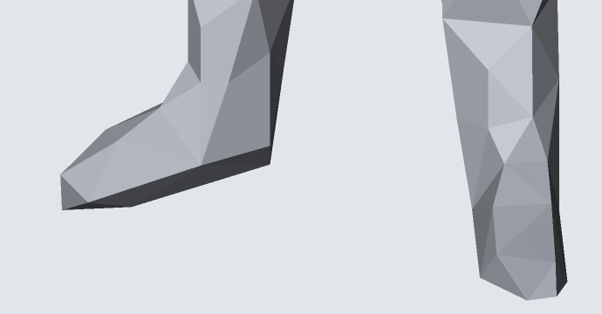
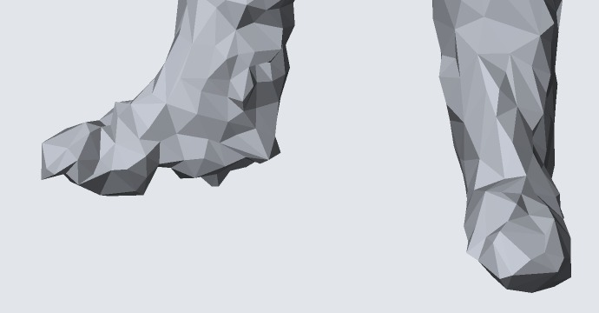
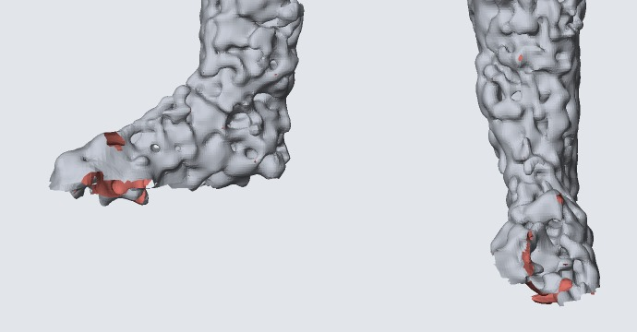
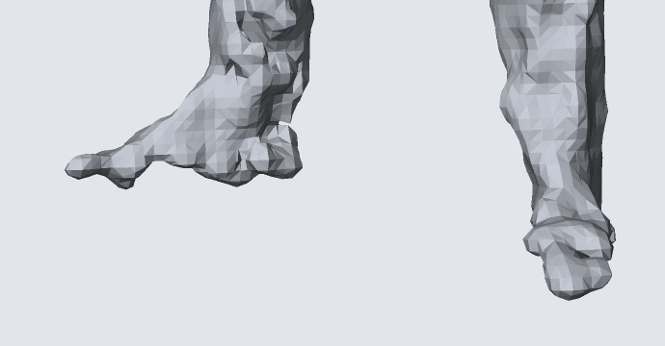
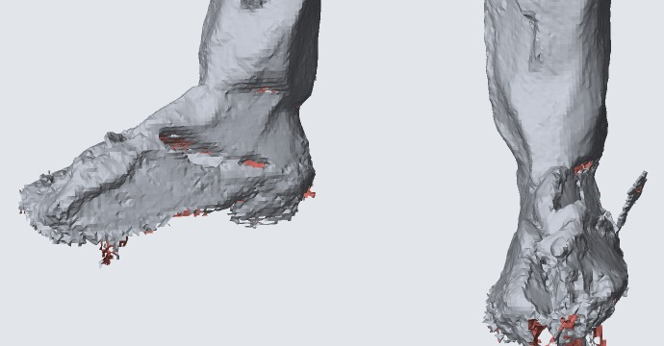
Close-up: feet
Input points
Poisson (ours)
IER
Point2Mesh
MeshAnything V2
DHSP
NKSR*
SAP*
2DGS*
Shaded geometry of the best VGGSfM run per method, same crop for all. Red: triangles seen from the back.
14

Slide 15
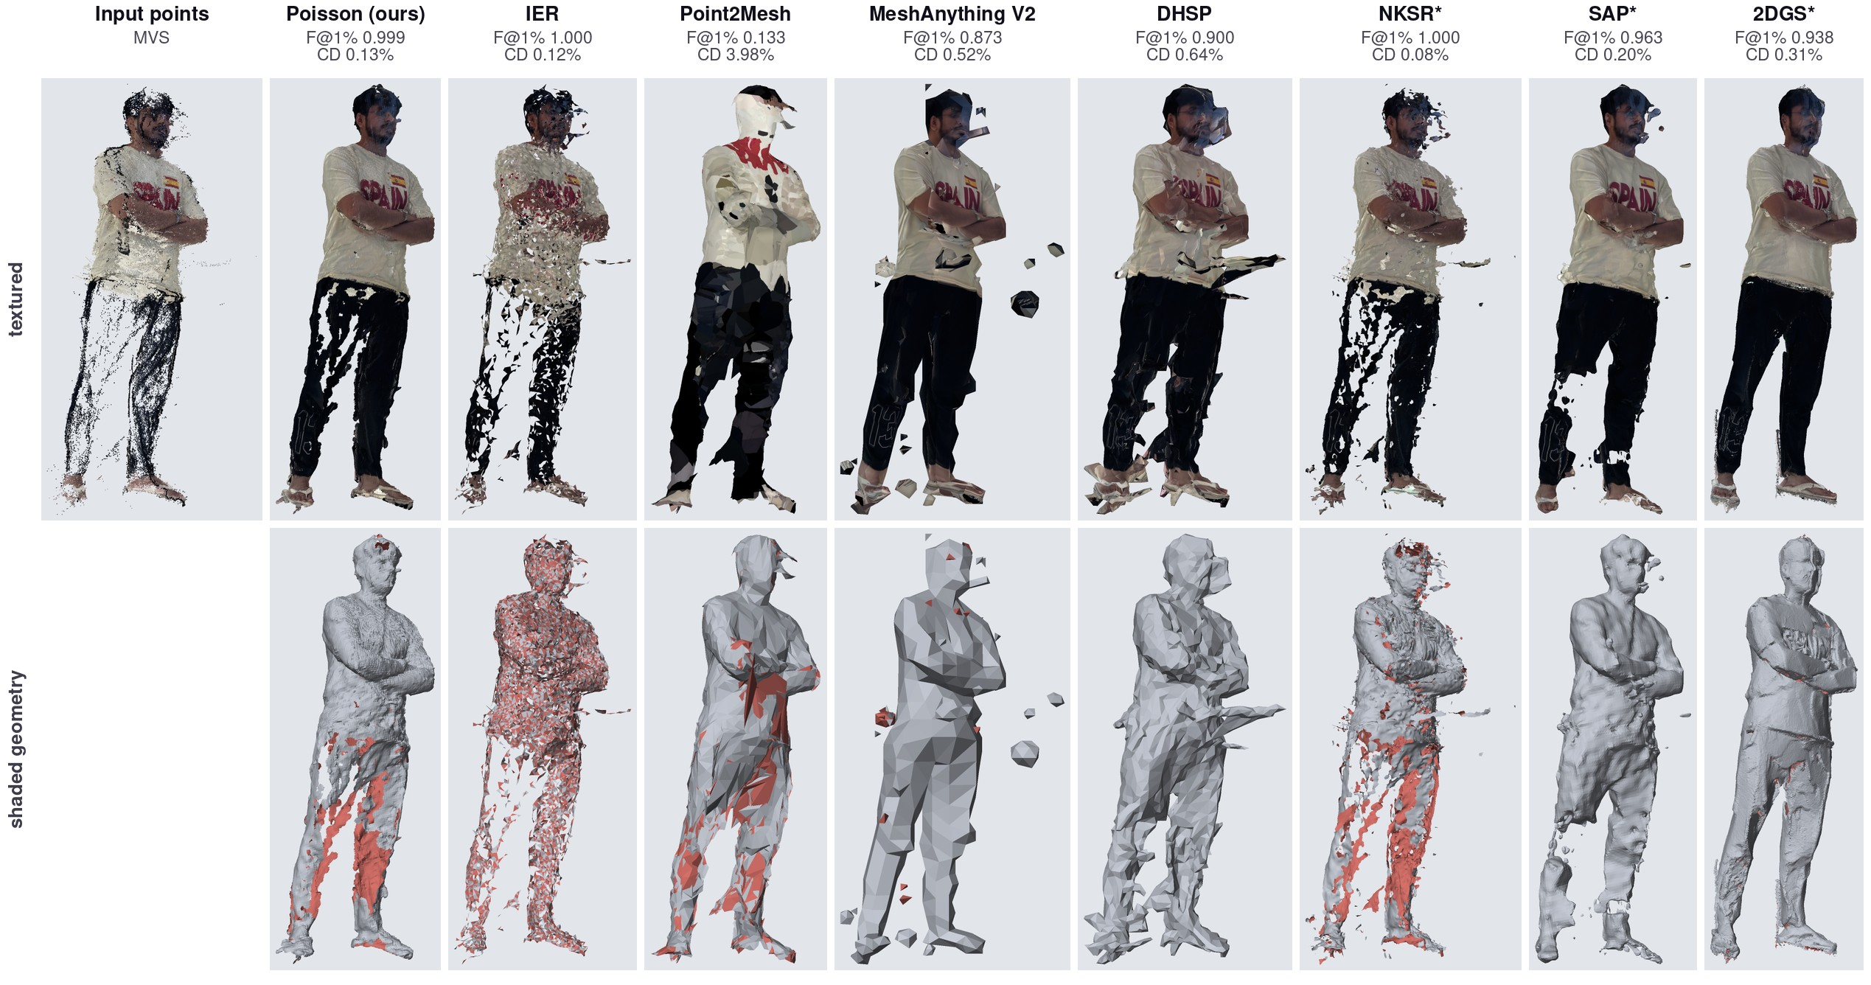
Results (MVS)
15

Slide 16
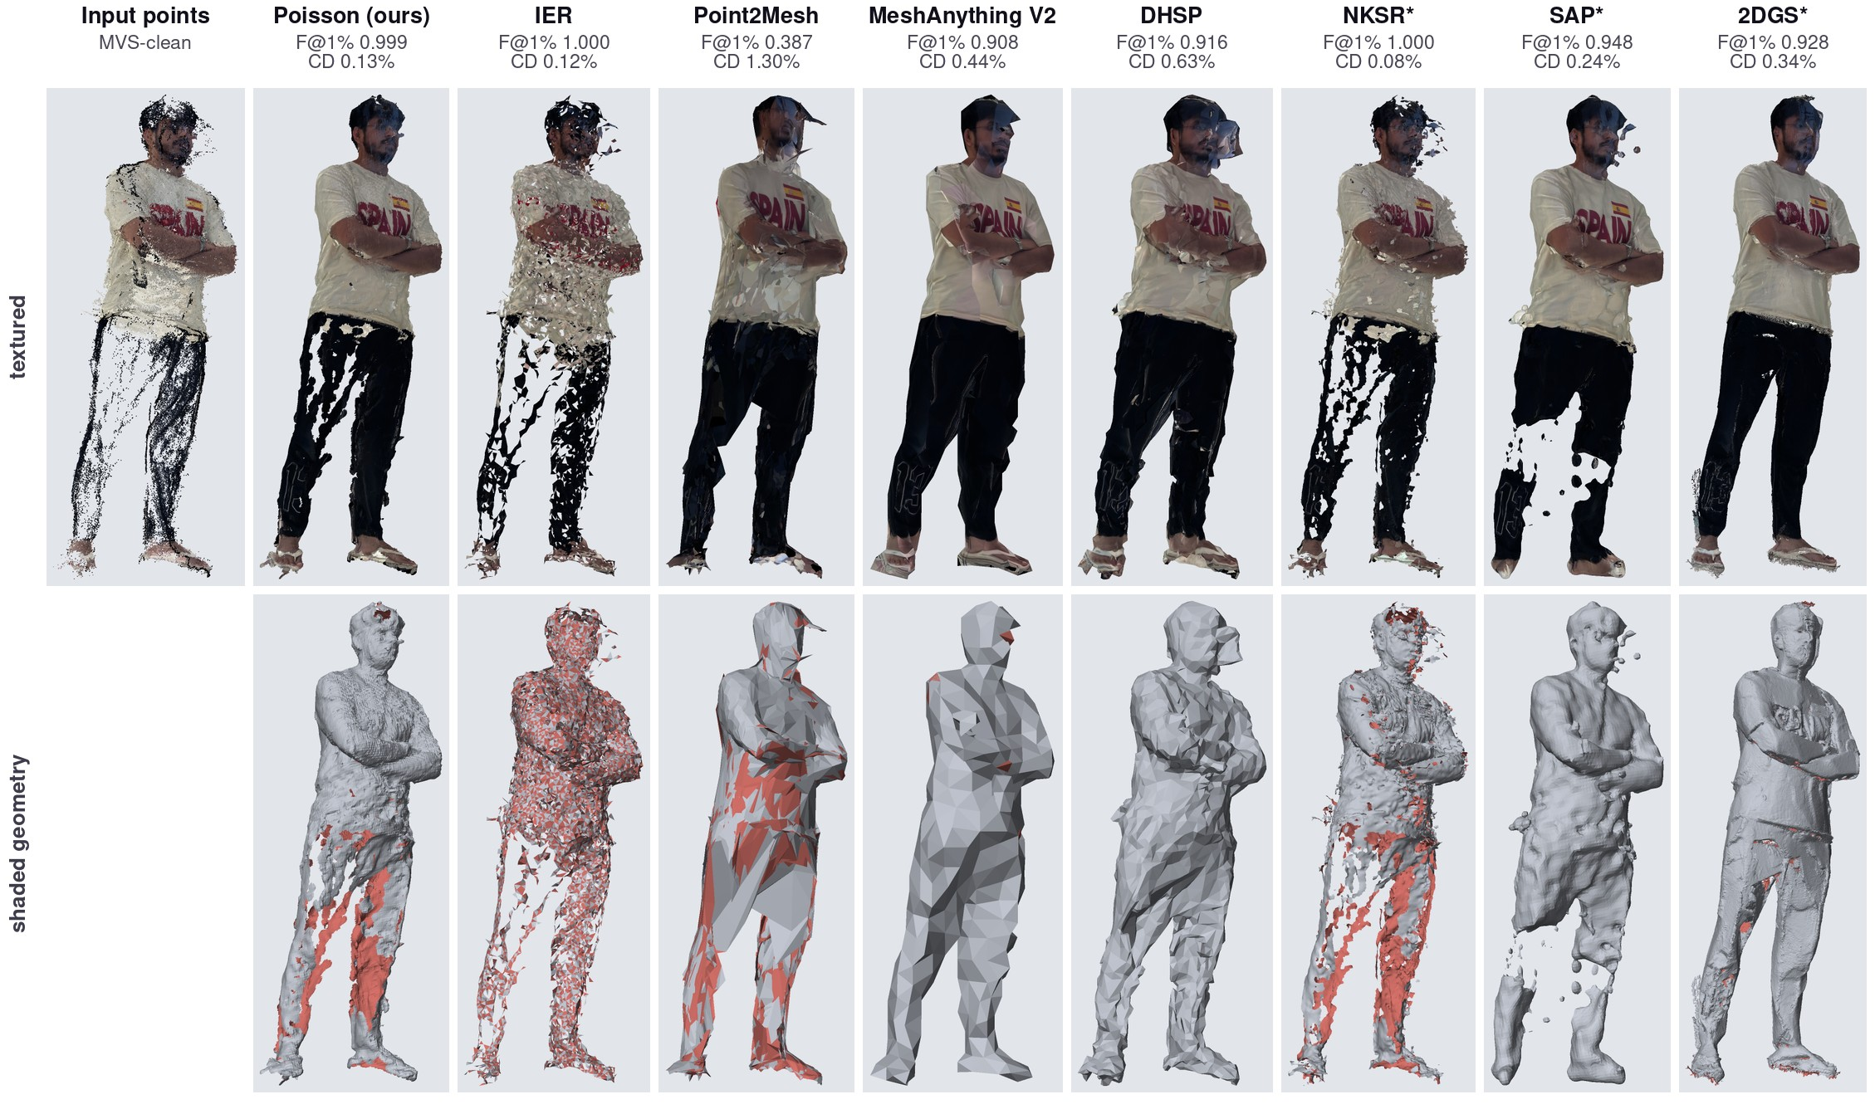
Results (MVS-clean)
16

Slide 17
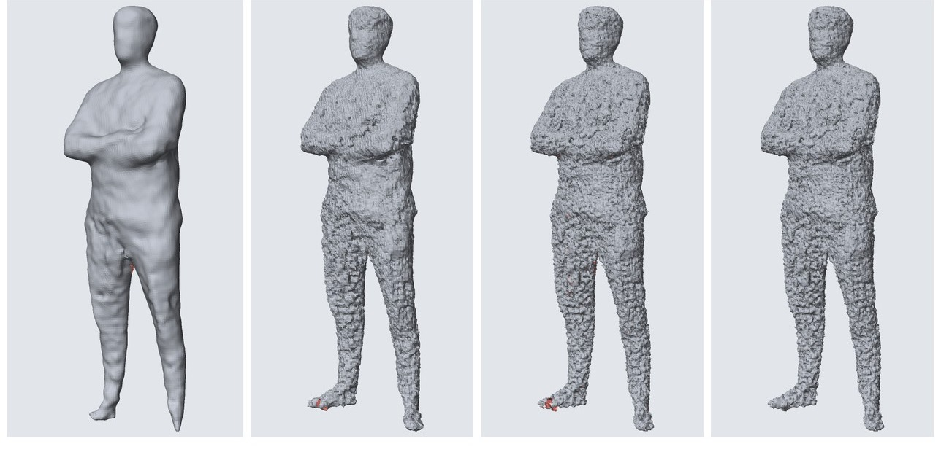
Poisson experiments
best
second best
256³, no screening
256³, screened
384³, screened
384³, not trimmed
Run | Faces | F@1% | Time
256³, no screening | 265k | 0.990 | 14 s
256³, screened | 358k | 0.998 | 17 s
384³, screened | 1.02M | 0.999 | 39 s
384³, not trimmed | 1.05M | 0.998 | 25 s
Chamfer 0.230%
Chamfer 0.179%
Chamfer 0.149%
Chamfer 0.154%
Screened: surface pulled onto the points
No screening: follows point directions only
Trimmed: parts far from points are cut off
17

Slide 18
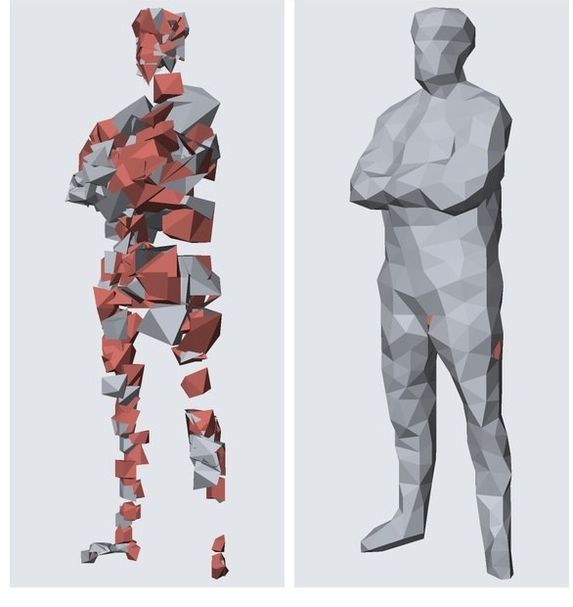
MeshAnything experiments
best
second best
raw points
Poisson mesh as input
F@1% 0.508 · 1,802 faces
F@1% 0.987 · 1,435 faces
Input | Model | Decoding | Faces | F@1% | Time
raw points | V2 | greedy | 624 | 0.113 | 92 s
raw points | V2 | sampling | 1,802 | 0.508 | 77 s
raw points | V1 | greedy | 795 | 0.442 | 59 s
Poisson mesh | V1 | greedy | 471 | 0.929 | 51 s
Poisson mesh | V2 | sampling | 2,058 | 0.965 | 95 s
Poisson mesh | V2 | greedy | 1,435 | 0.987 | 77 s
18

Slide 19
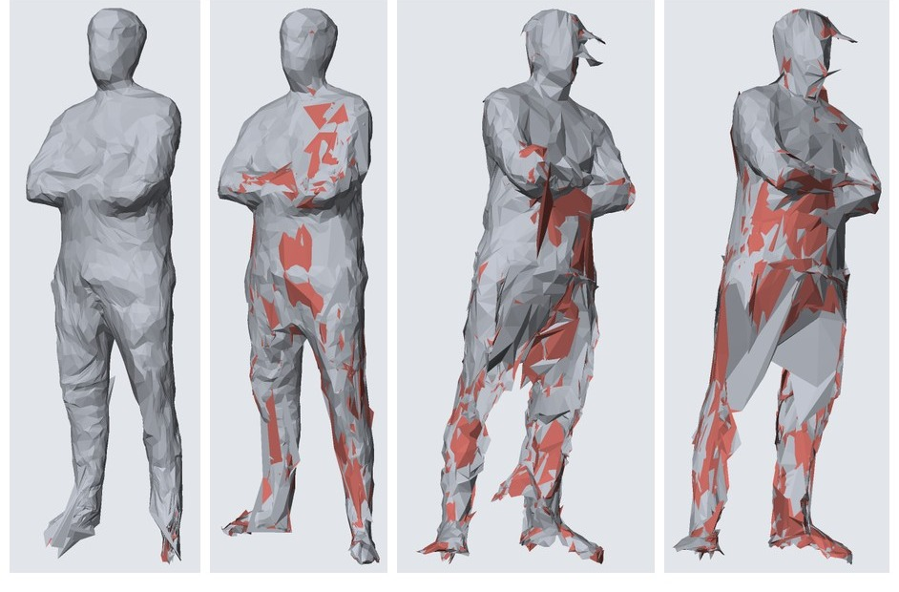
Point2Mesh experiments
best
second best
paper defaults
unoriented
MVS input
MVS-clean
Run | Faces | F@1% | Time
first try | 16k | 0.602 | 21 min
paper defaults | 10k | 0.646 | 44 min
+ unoriented | 10k | 0.844 | 42 min
+ unoriented, 20k | 20k | 0.655 | 3.4 h
MVS | 10k | 0.133 | 40 min
MVS-clean | 10k | 0.387 | 39 min
F@1% 0.646
F@1% 0.844
F@1% 0.133
F@1% 0.387
19

Slide 20
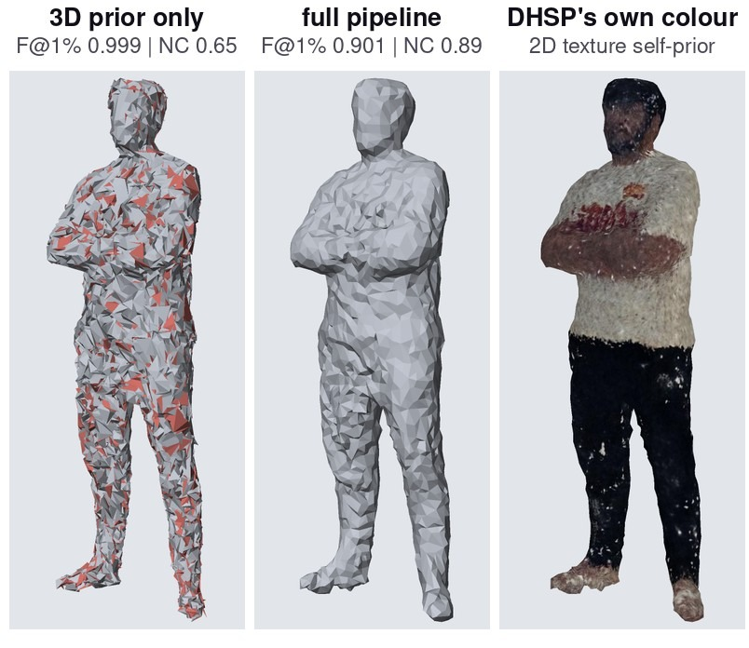
DHSP experiments
best
second best
Run | Faces | F@1% | NC | Time
3D prior only | 16k | 0.999 | 0.65 | 1.8 h
full pipeline | 6k | 0.874 | 0.89 | 4.1 h
full, extra smoothing | 6k | 0.901 | 0.89 | 2.2 h
MVS, full | 6k | 0.900 | 0.69 | 4.0 h
MVS-clean, full | 6k | 0.916 | 0.72 | 5.9 h
Full pipeline time = 3D stage + 2D stage.
20

Slide 21
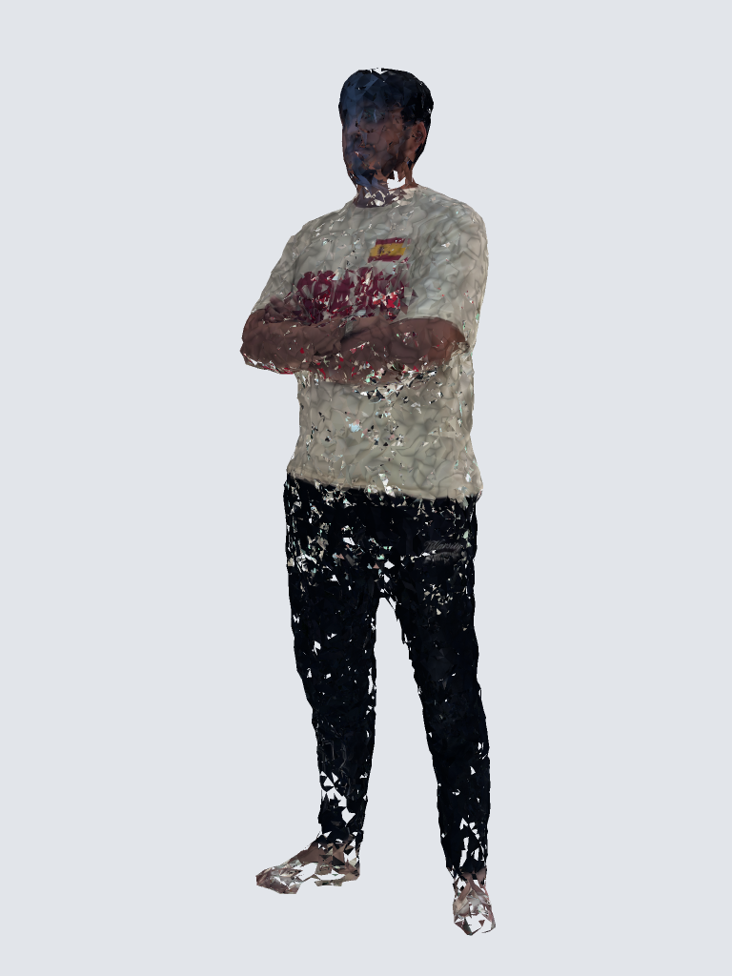
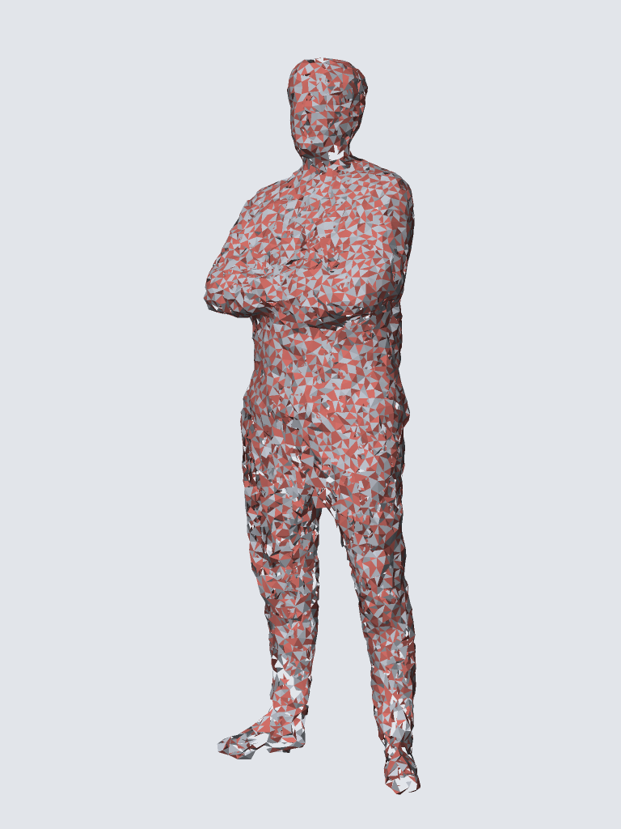
IER experiments
best
second best
Input | Faces | F@1% | Time
VGGSfM | 17.5k | 0.998 | 29 s
MVS | 16.4k | 1.000 | 42 s
MVS-clean | 16.7k | 1.000 | 50 s
21

Slide 22
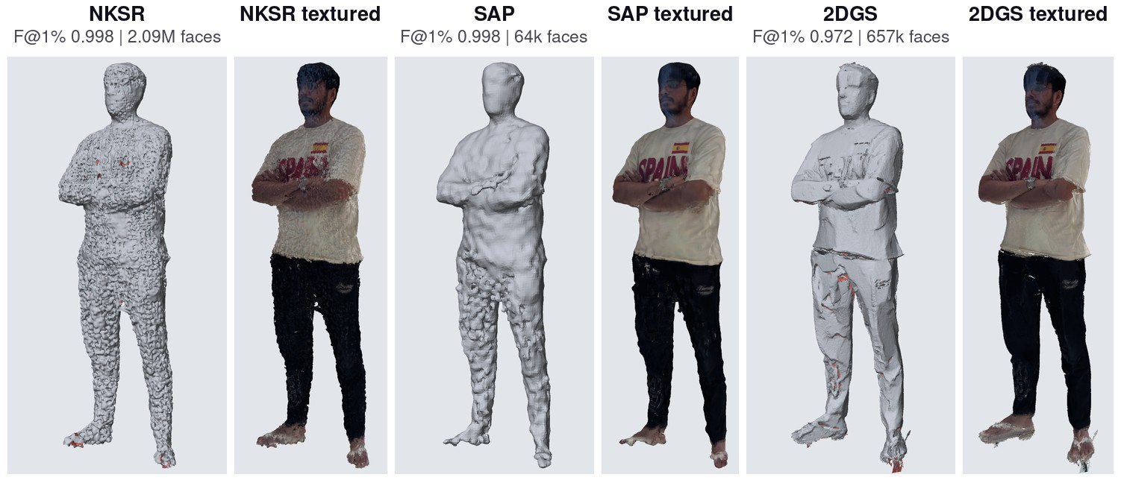
NKSR, SAP and 2DGS
NKSR: 2.09M faces in 7 s SAP: 64k faces in 8 min 2DGS: 657k faces in 47 min
22

Slide 23
Findings
1. Our own Poisson ties the best learned methods on VGGSfM (F@1% 0.999).
2. NKSR is best on the dense MVS clouds (Chamfer 0.08%).
3. A high score can hide a crumpled surface (DHSP 3D prior: F@1% 0.999, NC 0.65).
4. The input matters: MeshAnything 0.51 → 0.987 with a mesh input;
Point2Mesh 0.13 → 0.39 after removing MVS floaters.
5. Four methods give closed (watertight) meshes.
23

Slide 24
Let’s go through the videos!

Slide 25
Disclaimer
The next seven videos took a lot of effort to make.
Every scene was planned, animated and checked against our own runs, so every number in them is a real result.
They explain each method step by step, which is why the slides before them skip formulas and methodology.
25

Slide 26
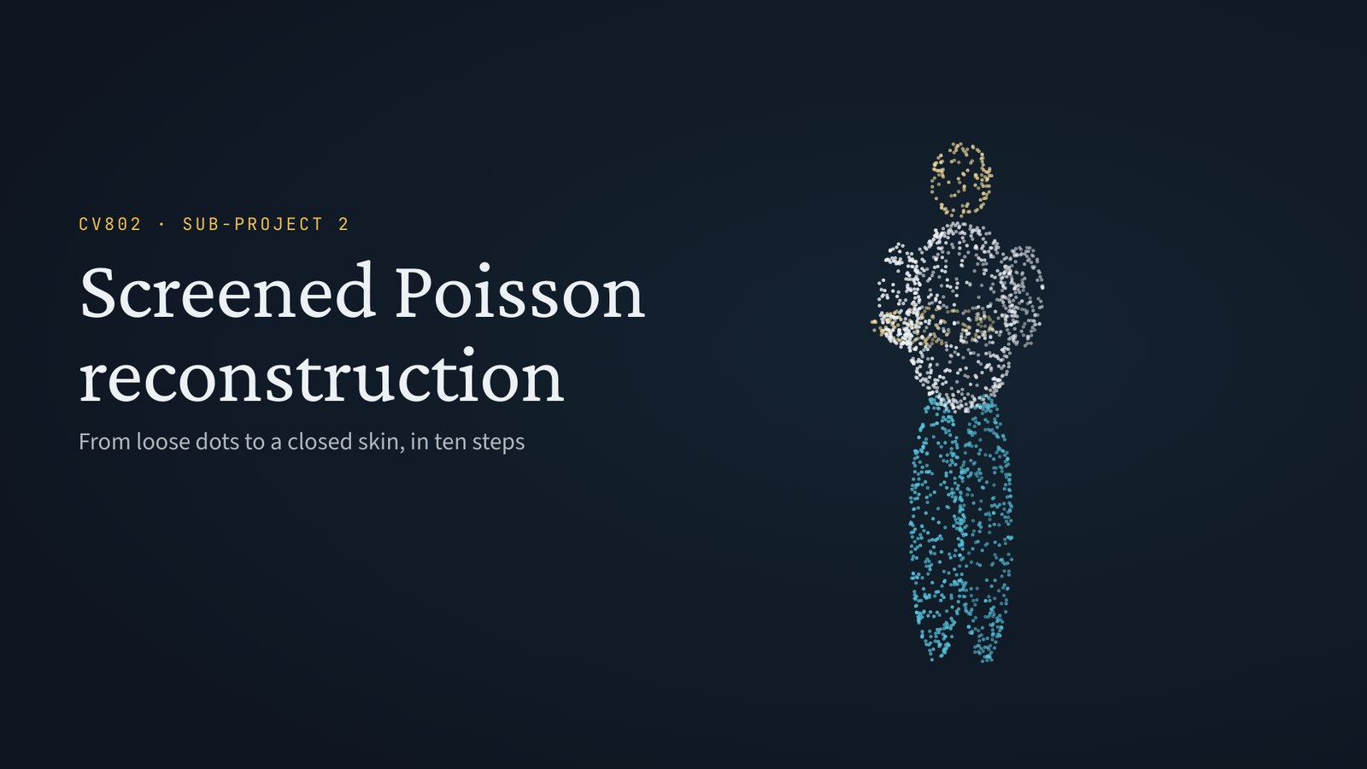
Video 1: Screened Poisson
3 min 9 s · 12 scenes
26

Slide 27
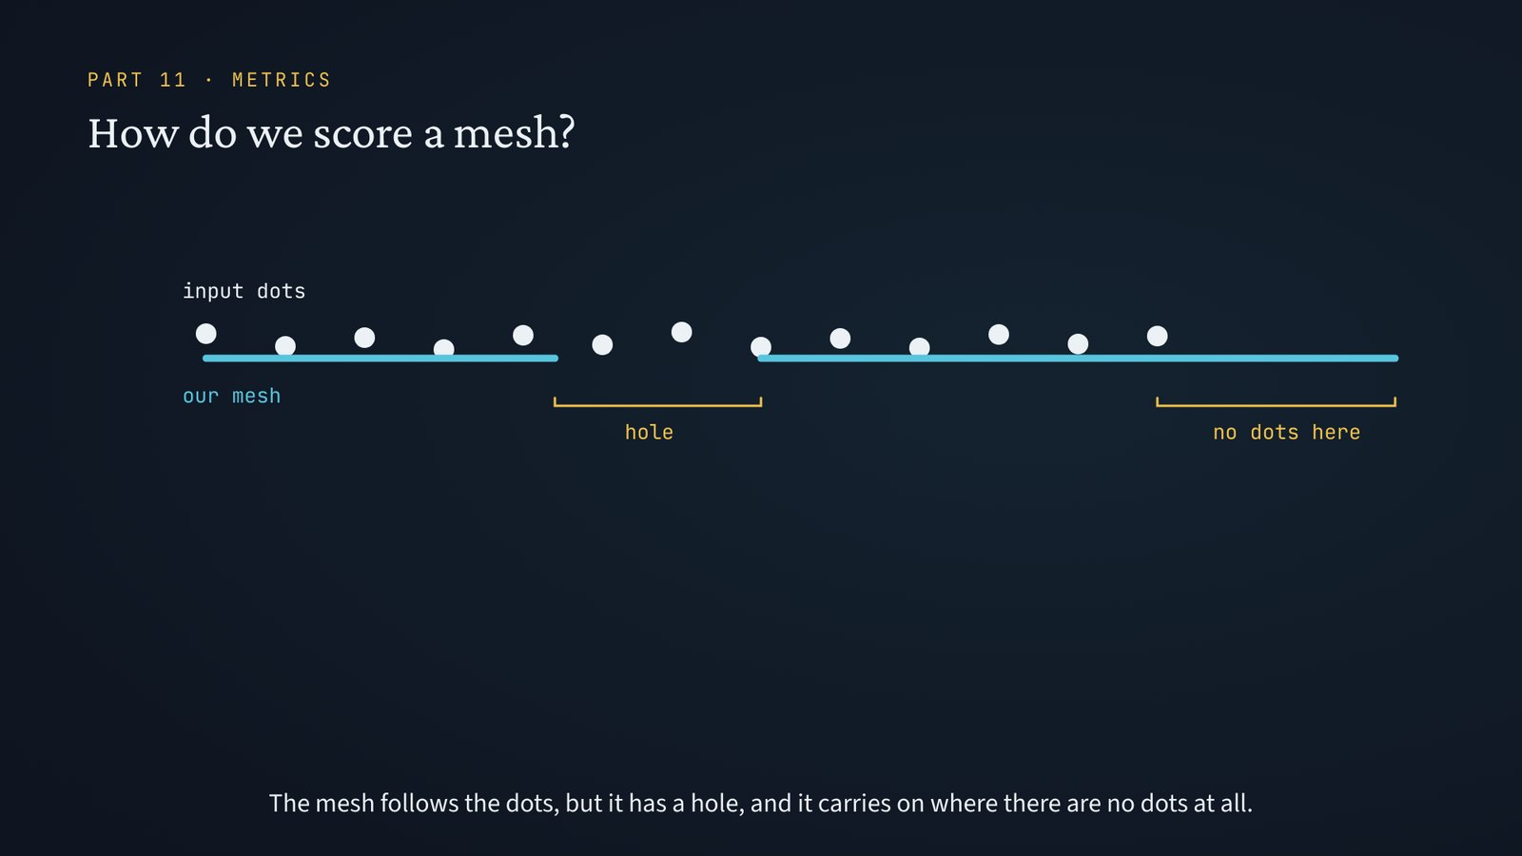
Video 2: The metrics
3 min 48 s · 14 scenes
27

Slide 28
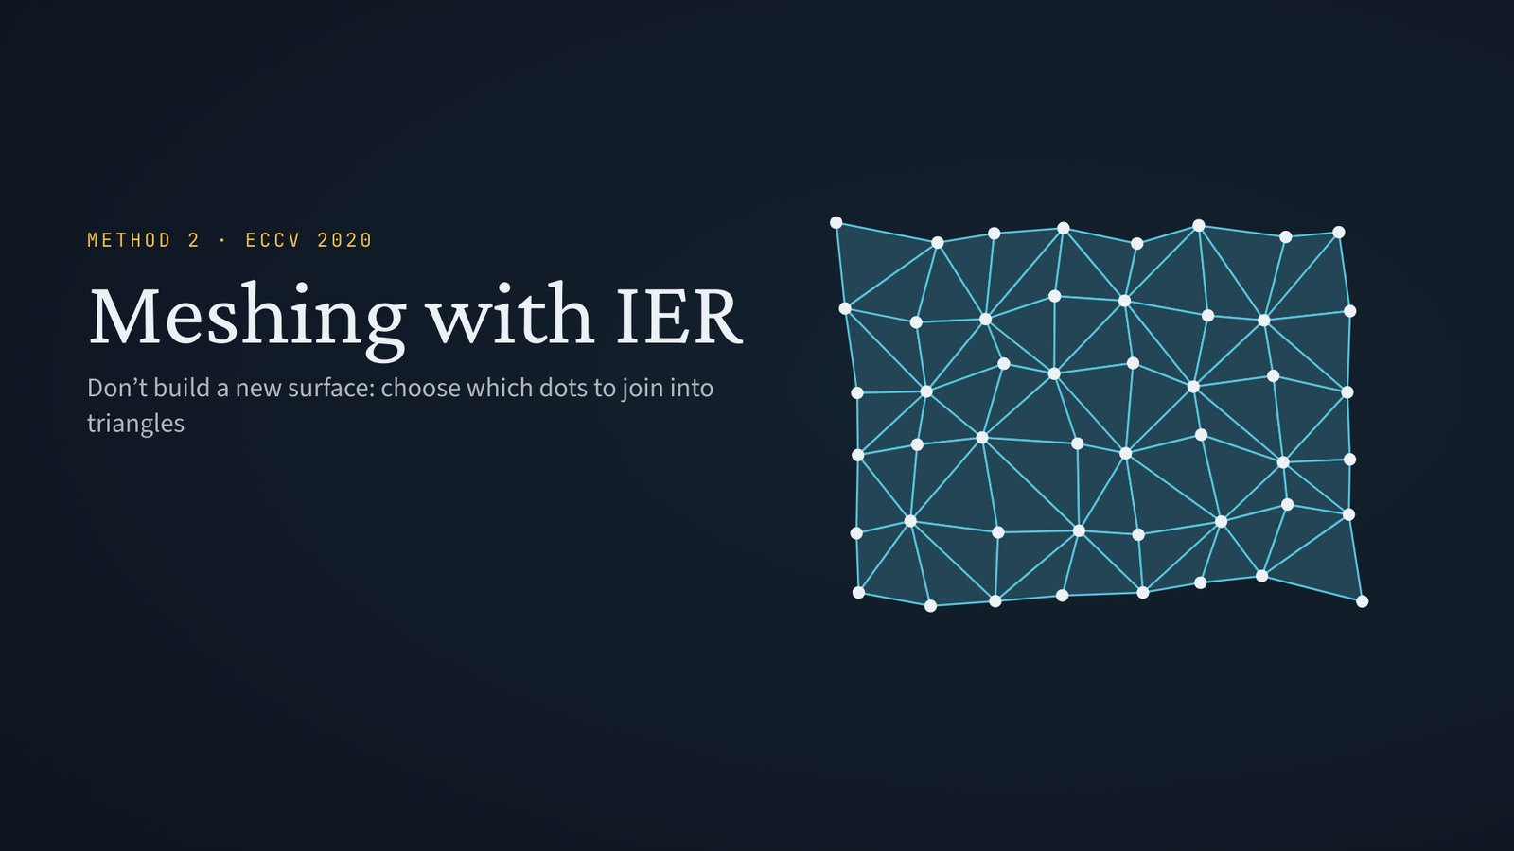
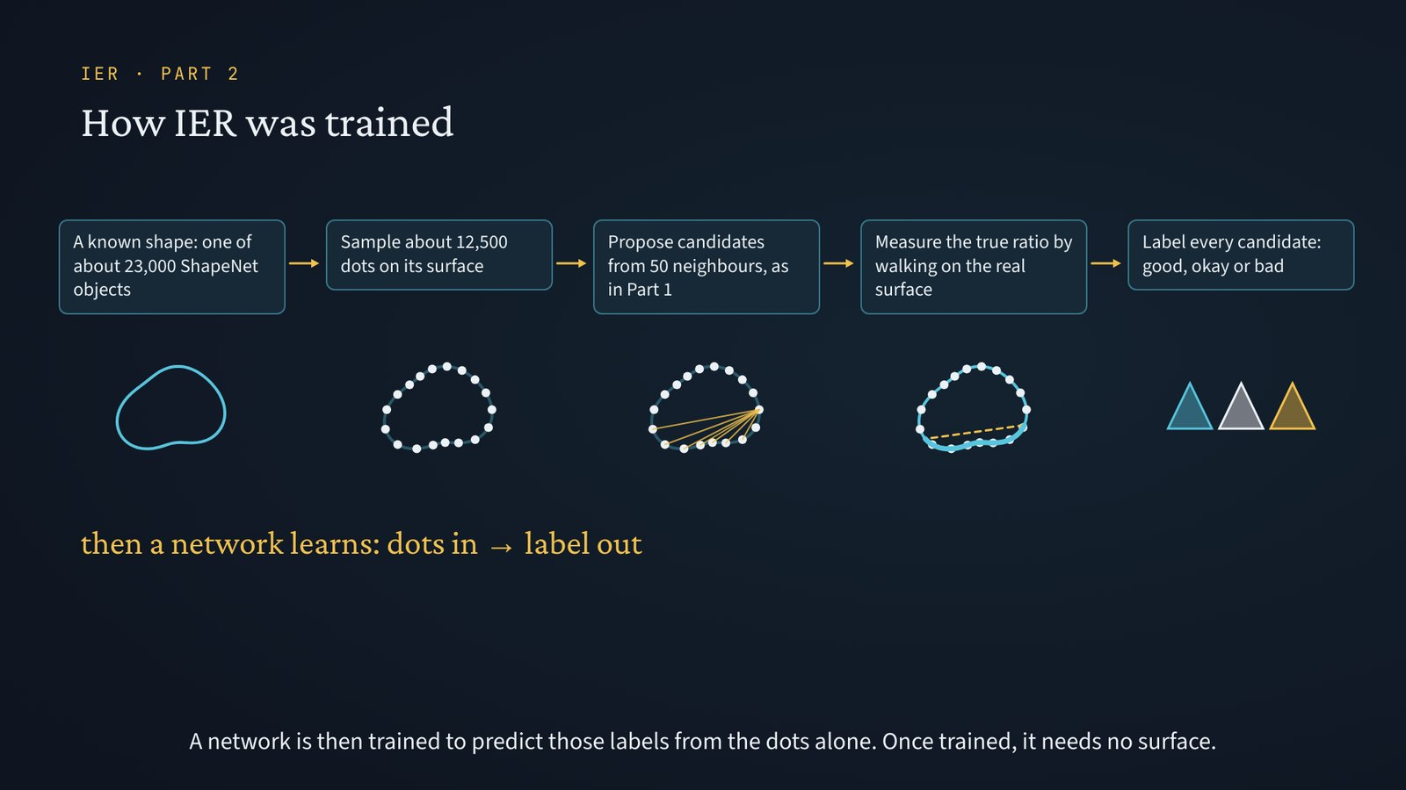
Video 3: IER meshing
Part 1 · 2 min 23 s · 8 scenes
Part 2 · 2 min 28 s · 7 scenes
4 min 51 s in total
28

Slide 29
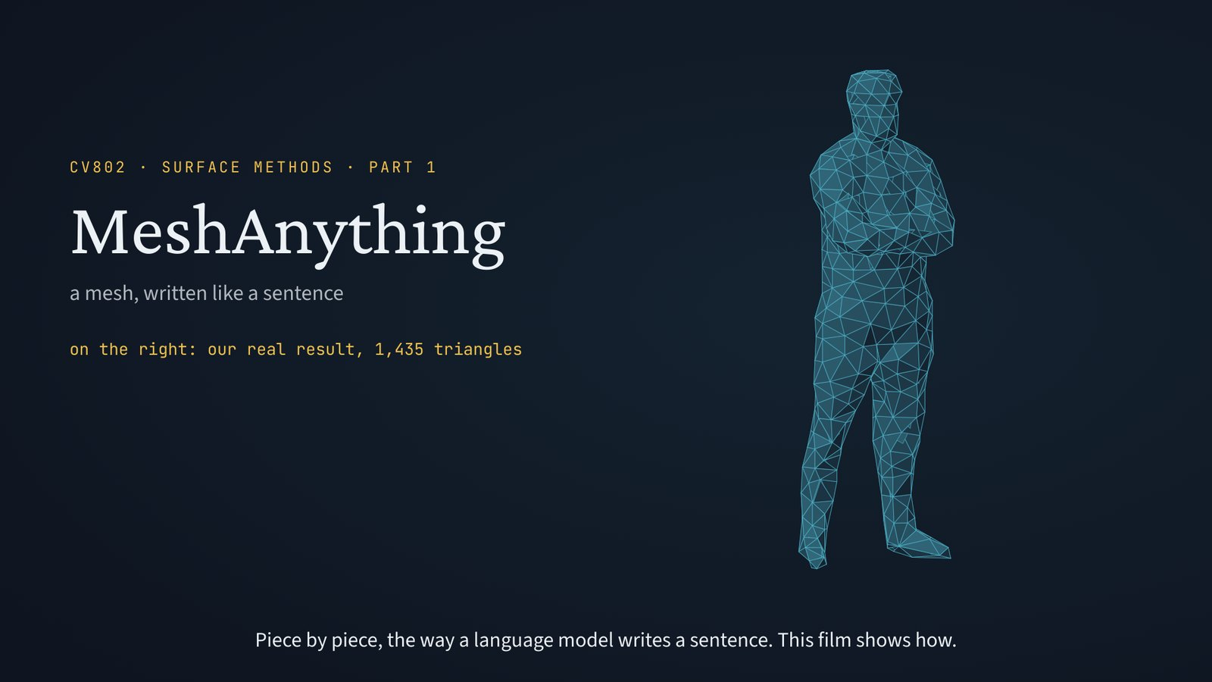

Video 4: MeshAnything
Part 1 · 3 min 22 s · 10 scenes
Part 2 · 3 min 2 s · 8 scenes
6 min 24 s in total
29

Slide 30


Video 5: Point2Mesh
Part 1 · 3 min 8 s · 9 scenes
Part 2 · 2 min 26 s · 7 scenes
5 min 34 s in total
30

Slide 31


Video 6: Deep Hybrid Self-Prior (DHSP)
Part 1 · 2 min 52 s · 8 scenes
Part 2 · 2 min 54 s · 8 scenes
5 min 46 s in total
31

Slide 32

Video 7: NKSR
4 min 6 s · 12 scenes
32

Slide 33
Extras: stills from the videos
One still per scene, in order, from the seven videos.
33

Slide 35


Slide 36


Slide 37


Slide 38


Slide 39


Slide 40


Slide 41


Slide 42


Slide 43


Slide 44


Slide 45


Slide 47


Slide 48


Slide 49


Slide 50


Slide 51


Slide 52


Slide 53


Slide 54


Slide 55


Slide 56


Slide 57


Slide 58


Slide 60


Slide 61


Slide 62


Slide 63


Slide 64


Slide 65


Slide 66


Slide 68


Slide 69


Slide 70


Slide 71


Slide 73


Slide 74


Slide 75


Slide 76


Slide 77


Slide 78


Slide 79


Slide 80


Slide 81


Slide 83


Slide 84


Slide 85


Slide 86


Slide 87


Slide 88


Slide 90


Slide 91


Slide 92


Slide 93


Slide 94


Slide 95


Slide 96


Slide 97


Slide 99


Slide 100


Slide 101


Slide 102


Slide 103


Slide 104


Slide 106


Slide 107


Slide 108


Slide 109


Slide 110


Slide 111


Slide 112


Slide 114


Slide 115


Slide 116


Slide 117


Slide 118


Slide 119


Slide 121


Slide 122


Slide 123


Slide 124


Slide 125


Slide 126


Slide 127


Slide 128


Slide 129


Slide 130


