Slide 1
CV802
Assignment 3: Novel-view Synthesis
Anas Khan

Slide 2
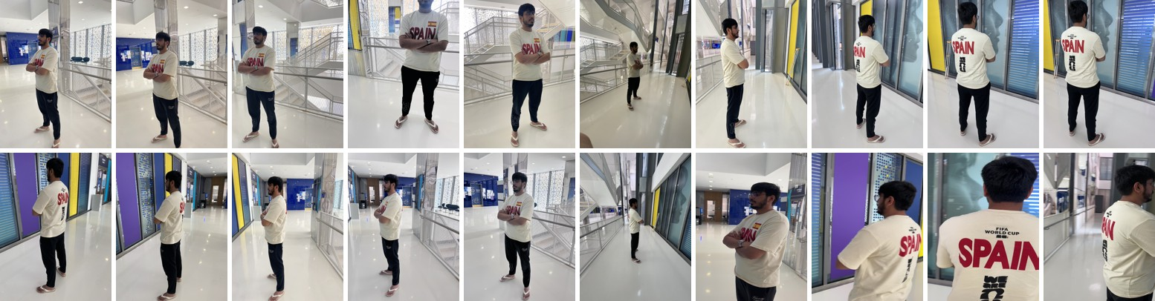
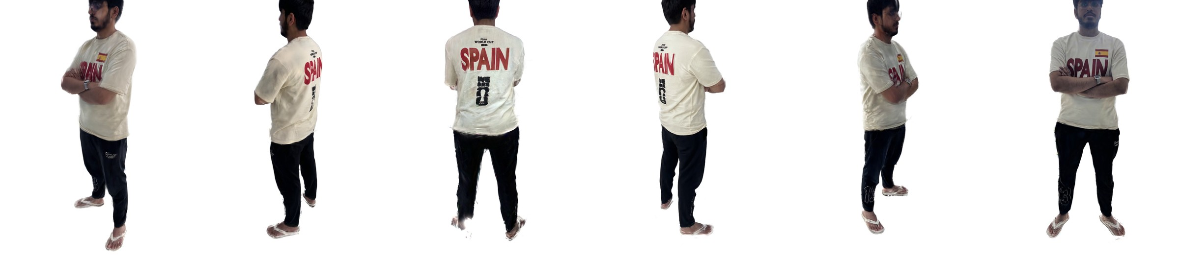
Problem Statement:
125 photos + their cameras (Assignment 1)
pictures from new viewpoints
Output: a video along a preset camera path (.mp4) and drag-to-view inside the starter GUI
2

Slide 3
Inputs
• The same 125 photos as Assignments 1 and 2 (4 iPhone lenses + video frames)
• Cameras from Assignment 1 (VGGSfM), undistorted to pinhole
• Person masks → person on a white background; resized to 1000 px
• 109 photos for training, 16 held out for scoring (every 8th, the 3DGS rule)
3

Slide 4
Methods
Method | Venue | Year | Scene stored as
NeRF | ECCV | 2020 | one neural network (not run in time)
TensoRF | ECCV | 2022 | a grid split into planes and lines
3D Gaussian Splatting (3DGS) | ACM TOG / SIGGRAPH | 2023 | ~200k coloured 3D blobs
Mip-Splatting | CVPR | 2024 | 3DGS + two anti-aliasing filters
All three trained with the authors' official code, same photos, same cameras, same 30,000 steps.
4

Slide 5
TensoRF: how it works
• Space is a 3D grid of features: density (how solid) and colour
• A full 300×300×300 grid is huge, so it is stored as planes × lines:
  – feature(x, y, z) = Σ plane_XY(x, y) · line_Z(z) + plane_XZ · line_Y + plane_YZ · line_X
• A pixel = shoot a ray, sample points along it, add up their colours:
  – C = Σ Tᵢ · (1 − e^(−σᵢ δᵢ)) · cᵢ , Tᵢ = how much light still gets through
• Small network turns the feature + viewing direction into a colour
5

Slide 6
3D Gaussian Splatting: how it works
• The scene is ~200k 3D Gaussians (soft ellipsoids): position, size, rotation, opacity, colour
• Start from our point cloud (Assignment 1); add, split and delete blobs while training
• To draw: project each blob to the screen (a 2D ellipse), sort front to back, blend:
  – Σ′ = J W Σ Wᵀ Jᵀ (3D shape → 2D shape on screen)
  – C = Σ cᵢ αᵢ Πⱼ₍ⱼ<ᵢ₎ (1 − αⱼ)
• No ray marching → real time (hundreds of frames per second)
6

Slide 7
Mip-Splatting: how it works
• 3DGS, plus two filters so a blob is never sharper than the camera can see
• 3D filter: each blob gets a minimum size, set by the closest training photo
  – Σ ← Σ + s²·I (no blobs thinner than one pixel of any photo)
• 2D filter: on screen, each blob is blurred to at least one pixel
• Why it matters: zoom out and 3DGS blobs become too thin → flicker and jagged edges
• Same quality at the training size; better when the camera moves closer or further
7

Slide 8
Experiments
• 4 trainings: TensoRF, 3DGS, Mip-Splatting (person), 3DGS full room (extra)
• Scores on the 16 held-out photos: PSNR, SSIM, LPIPS
• Zoom test: render 3DGS and Mip-Splatting at ¼ size and 1.6× size
• Result video: same 8 s orbit for every method
• Check: our GUI renderer vs the official renderer (same pixels?)
One RTX 5000 Ada (32 GB), trainings run side by side.
8

Slide 9
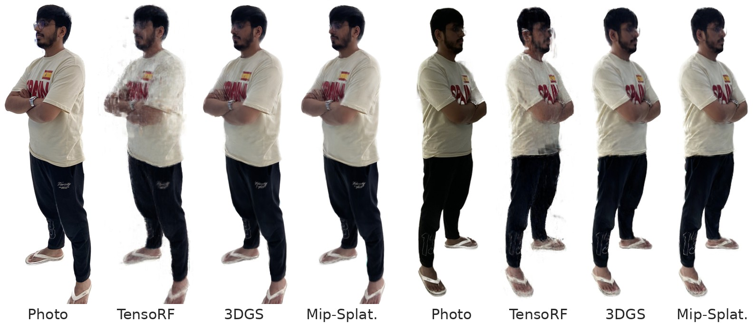
Results on held-out photos
9

Slide 10
Comparison
best
second best
Method | PSNR ↑ | SSIM ↑ | LPIPS ↓ | Training ↓ | FPS ↑ | Primitives | Size (MB)
TensoRF | 26.35 | 0.938 | 0.130 | 42 min | 1.0 | 17.4M | 67
3DGS | 27.53 | 0.956 | 0.064 | 7 min | 366 | 195k | 46
Mip-Splatting | 27.53 | 0.957 | 0.064 | 10 min | 594 | 217k | 52
16 held-out photos, 750×1000. PSNR in dB. FPS = images per second on the GPU. Primitives: Gaussians (3DGS, Mip) or numbers in the grid (TensoRF).
10

Slide 11
Quality vs time and speed
Higher is better; left chart: further left is faster to train, right chart: further right draws faster.
11

Slide 12
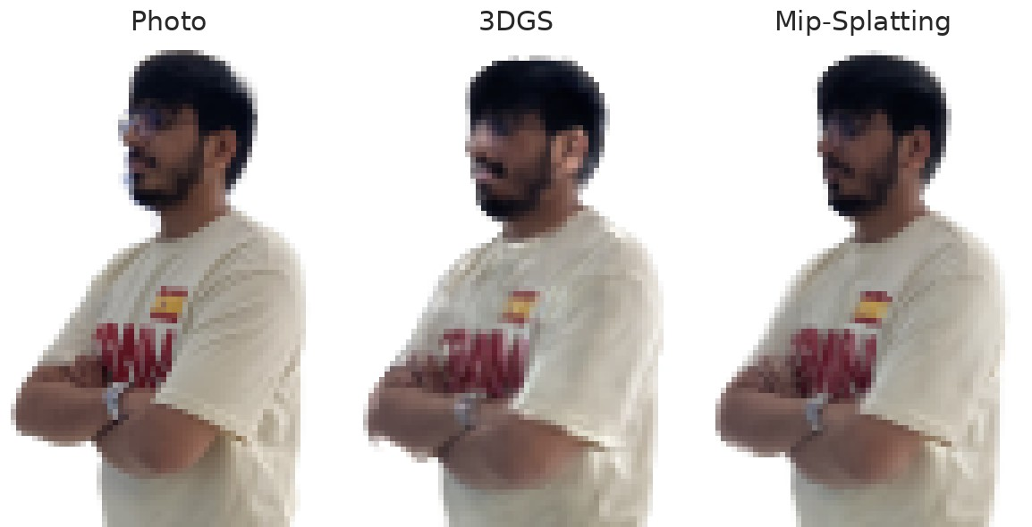
Zoom test: 3DGS vs Mip-Splatting
Rendered at | 3DGS | Mip
¼ size | 24.25 | 28.63
1× (training) | 27.53 | 27.53
1.6× | 27.15 | 27.29
Left: rendered at ¼ size, enlarged ×6 (pixels kept square). Table: PSNR (dB), 16 held-out photos; ¼ = photo averaged down, 1.6× = original 1600 px photos.
Zoomed out, 3DGS blobs get thinner than a pixel and the image breaks up; Mip-Splatting stays clean.
12

Slide 13
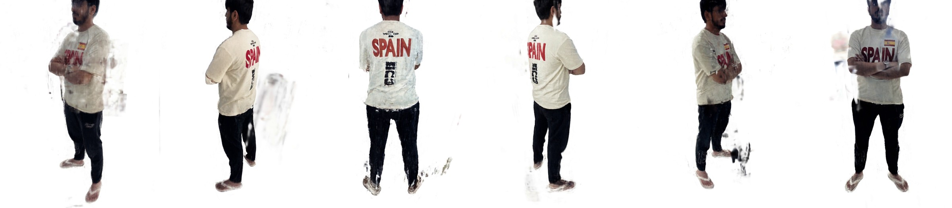

Result videos (preset 8 s orbit)
TensoRF
3DGS
Mip-Splatting
Frames 0, 40, 80, 120, 160, 200 of 240. The full videos are in results/videos/.
13

Slide 14
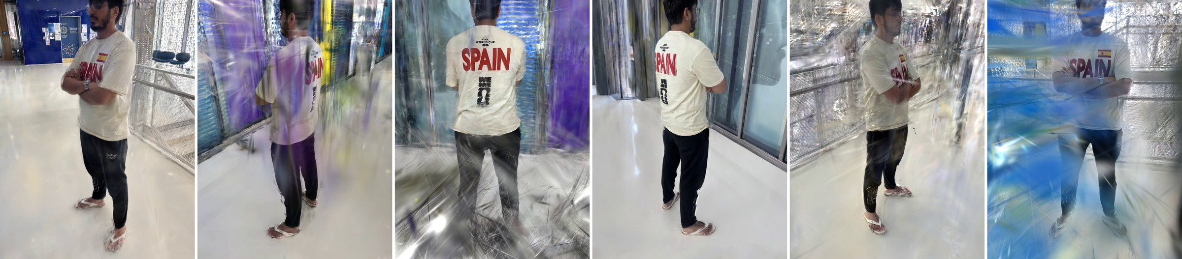
Extra: 3DGS with the room
• Same photos without the person masks: 19.71 dB PSNR on the held-out photos
• 1.78M Gaussians (person alone: ~200k), trained in 33 min
• The room is only seen from where the photos were taken, so views far from them break up
14

Slide 15
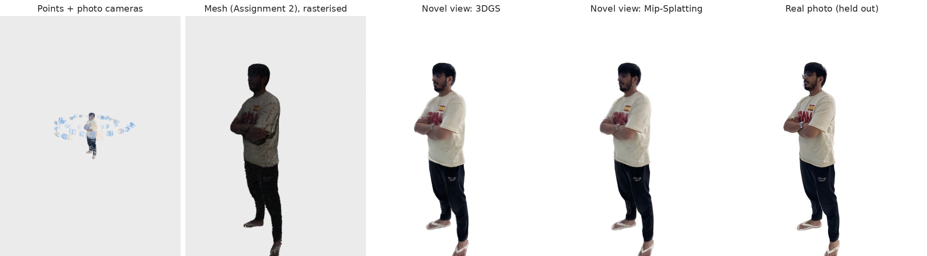
GUI: inside the course starter code
What the GUI's 3D view draws, from one held-out photo's camera (offscreen render of the same code)
• Same Open3D app as Assignment 1, new panels
• File > Open novel-view results; method menu
• Drag / pan / zoom → the novel view follows
• Held-out photo vs render, one click
• Keyframes or preset orbit → Export MP4
• Assignment 2 meshes rasterised in the same view
• Runs on a laptop: our PyTorch renderers
  – (CUDA, Apple GPU or CPU)
15

Slide 16
GUI renderer = official renderer
Model | Same pixels? (PSNR vs official) | Official FPS | Ours FPS (CUDA)
3DGS | 106 dB | 366 | 4.3
Mip-Splatting | 104 dB | 594 | 5.8
• Above ~50 dB two images look identical; >100 dB = differences of rounding only
• Ours follows the CUDA code step by step, in plain PyTorch, so it also runs without CUDA
• Slower than CUDA, so the GUI draws a small preview while dragging, full size when the mouse stops
16

Slide 17
Findings
• Best quality on held-out photos: Mip-Splatting (27.53 dB)
• Fastest to train: 3DGS (7 min); Gaussians draw in real time
• At the training size 3DGS ≈ Mip-Splatting; zoomed out Mip-Splatting is clearly better (+4.4 dB)
• Clean masks matter: the white background makes the person easy to learn
• Not done in time: NeRF (same idea as TensoRF, but one big network → much slower)
17

Slide 18
References
[1] B. Mildenhall et al. NeRF: Representing Scenes as Neural Radiance Fields for View Synthesis. ECCV 2020.
[2] A. Chen, Z. Xu, A. Geiger, J. Yu, H. Su. TensoRF: Tensorial Radiance Fields. ECCV 2022.
[3] B. Kerbl, G. Kopanas, T. Leimkühler, G. Drettakis. 3D Gaussian Splatting for Real-Time Radiance Field Rendering. ACM TOG 42(4), 2023.
[4] Z. Yu, A. Chen, B. Huang, T. Sattler, A. Geiger. Mip-Splatting: Alias-free 3D Gaussian Splatting. CVPR 2024.
[5] M. Zwicker, H. Pfister, J. van Baar, M. Gross. EWA Volume Splatting. IEEE Visualization 2001.
[6] J. Wang, N. Karaev, C. Rupprecht, D. Novotny. VGGSfM: Visual Geometry Grounded Deep Structure from Motion. CVPR 2024.
[7] Z. Wang, A. C. Bovik, H. R. Sheikh, E. P. Simoncelli. Image Quality Assessment: From Error Visibility to Structural Similarity. IEEE TIP 13(4), 2004.
[8] R. Zhang, P. Isola, A. A. Efros, E. Shechtman, O. Wang. The Unreasonable Effectiveness of Deep Features as a Perceptual Metric. CVPR 2018.
[9] Q.-Y. Zhou, J. Park, V. Koltun. Open3D: A Modern Library for 3D Data Processing. arXiv:1801.09847, 2018.
[10] M. Tancik et al. Nerfstudio: A Modular Framework for Neural Radiance Field Development. SIGGRAPH 2023.
18

