Slide 1
Flappy Bird

Slide 2
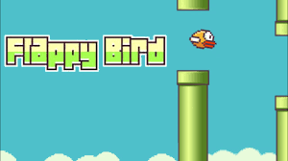
Brief Description of Idea
Idea: Train an RL agent to play Flappy Bird, a 2D game where a bird navigates through moving pipes by flapping its wings.
Objective: Enable the agent to maximize its score by learning to avoid pipes through trial and error.
Approach: Use Reinforcement Learning (likely Q-Learning or DQN) to develop a policy that maps game states to actions.
Scope: Implement in Python (e.g., using Pygame), focusing on a simple yet challenging game environment.

Slide 3
Environment:
Flappy Bird game, including the bird, moving pipes, ground, and sky. The environment updates based on the bird’s position and pipe locations.
Action:
Flap (jump): Bird gains upward velocity.
Do Nothing: Bird falls due to gravity.
State:
Horizontal distance to the nearest pipe.
Vertical distance to the pipe’s gap.
Bird’s vertical velocity.
Example: [x_distance, y_distance, velocity].
Reward:
+1 per frame the bird stays alive.
+10 for passing through a pipe (optional, based on design).
Penalty:
-1000 for colliding with a pipe, ground, or ceiling (game over).
Agent: RL algorithm (QL, DQN) that learns to select actions based on states to maximize cumulative rewards.

Slide 4
Without Implementation:
Early Behavior: The agent flaps randomly, crashing into the first pipe quickly.
Learning Progression: After many tries, it flaps to avoid nearby pipes, passing one or two but often misjudging gaps.
Long-Term Potential: With extensive training, it balances flapping and falling, passing multiple pipes but may fail suddenly due to small errors.
Failure Modes: The agent might over-flap (hitting upper pipes) or under-flap (falling into lower pipes), or repeat bad flap timings.
Challenges:
State Sensitivity: Small changes in state (e.g., bird velocity) require precise flap timing, leading to unstable learning.
Overfitting to Early Pipes: The agent may optimize for the first few pipes but struggle with varying pipe patterns later.

Slide 5
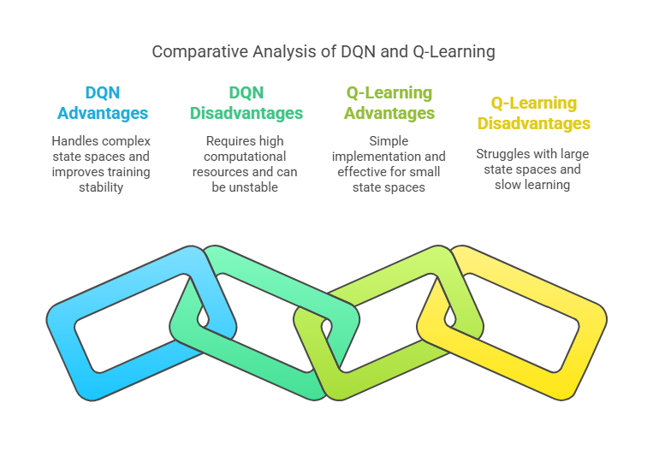

Slide 6
Thank you!

