Slide 1
Slide 1

Slide 2
Slide 2

Slide 3
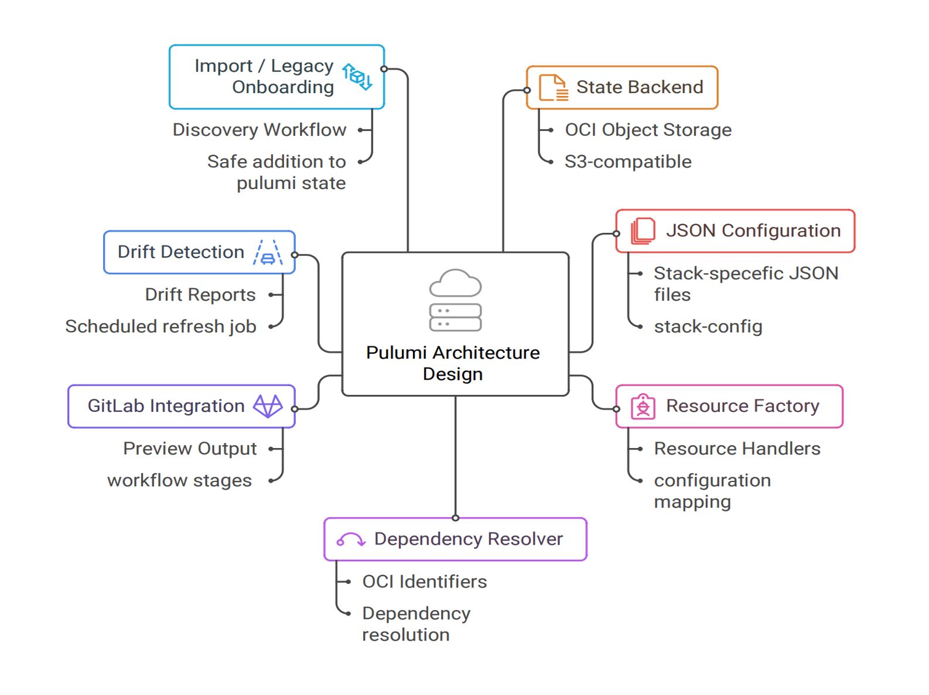
Oracle Corporation
• ● 1977: Founded as Software Development Laboratories (SDL)
• ● 2010: Acquired Sun Microsystems (Java, Solaris)
• ● Today: Global leader in cloud-based IT infrastructure and enterprise software

Slide 4
Oracle Labs
• ◆ Focuses on creating technologies to keep Oracle at the IT industry forefront
• ◆ Pursues innovative methodologies and approaches
• ◆ Takes on challenges difficult for product development organizations
• ✓ Java Programming Language - Revolutionary platform
• ✓ Chip Multithreading - Hardware innovation
• ✓ Real-world Applications - Focus on societal impact

Slide 5

GraalVM RISQ Team

Slide 6
Slide 6

Slide 7
Current State: Manual Infrastructure Management

Slide 8
Requirements

Slide 9
Technology Comparison: Terraform vs Pulumi

Slide 10
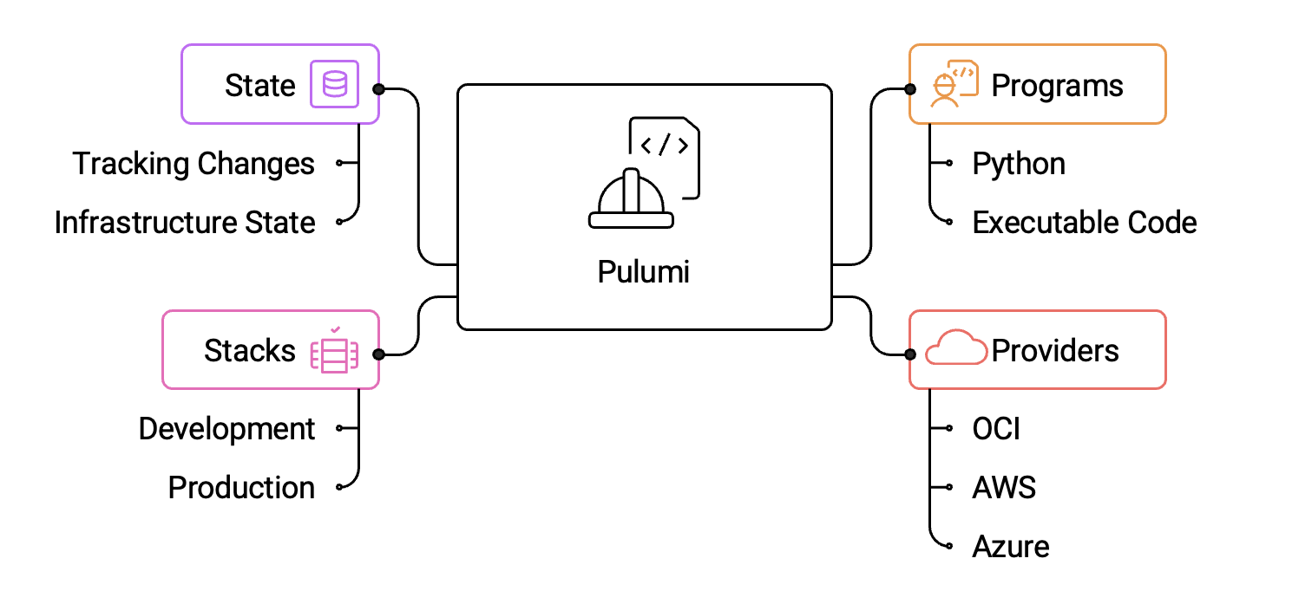
What is Pulumi?
• Programs: Infrastructure defined as executable code in Python
• Providers: Plugins interfacing with cloud APIs (OCI, AWS, Azure)
• Stacks: Isolated deployments for different environments
• State: Backend storage tracking infrastructure state and changes
• ✓ Use familiar programming languages (Python, TypeScript, Go)
• ✓ Leverage existing tools and testing frameworks
• ✓ Share and reuse components across projects
• ✓ Strong typing and IDE support

Slide 11
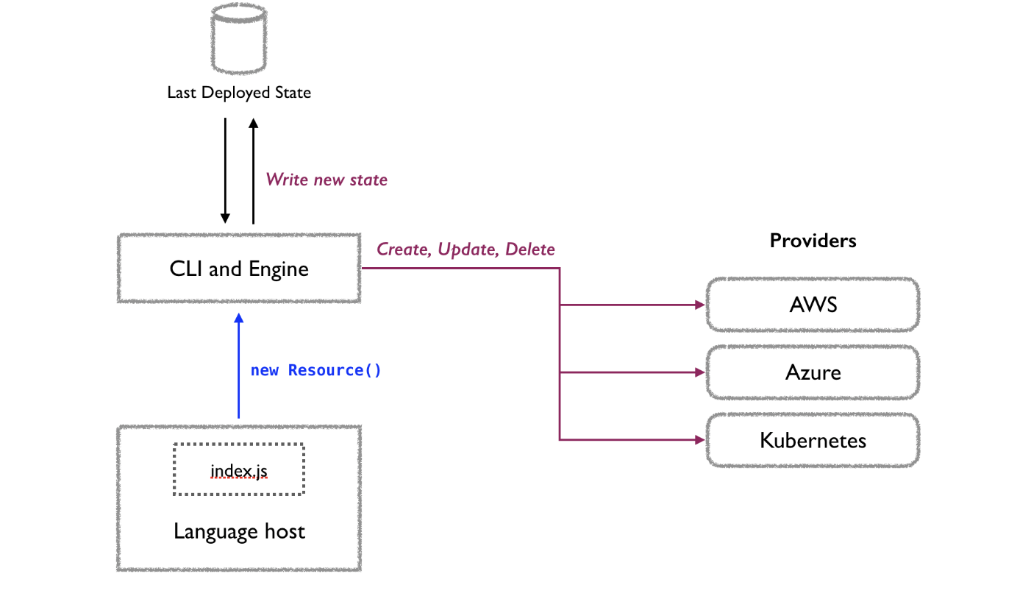
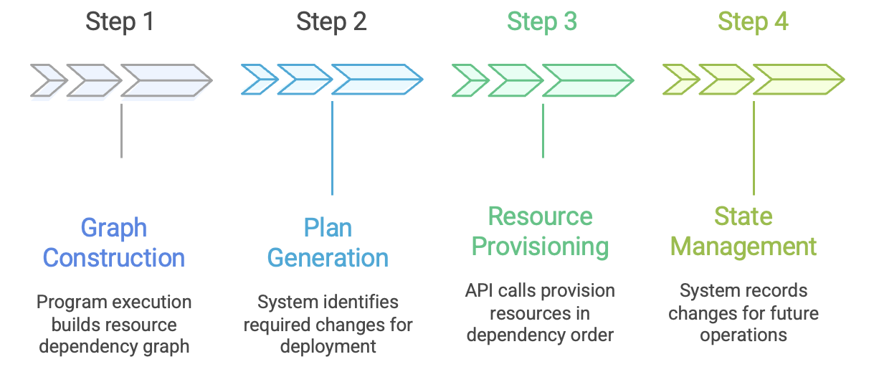
Pulumi Operational Model

Slide 12
Proposed Solution: JSON-Driven IaC Framework

Slide 13
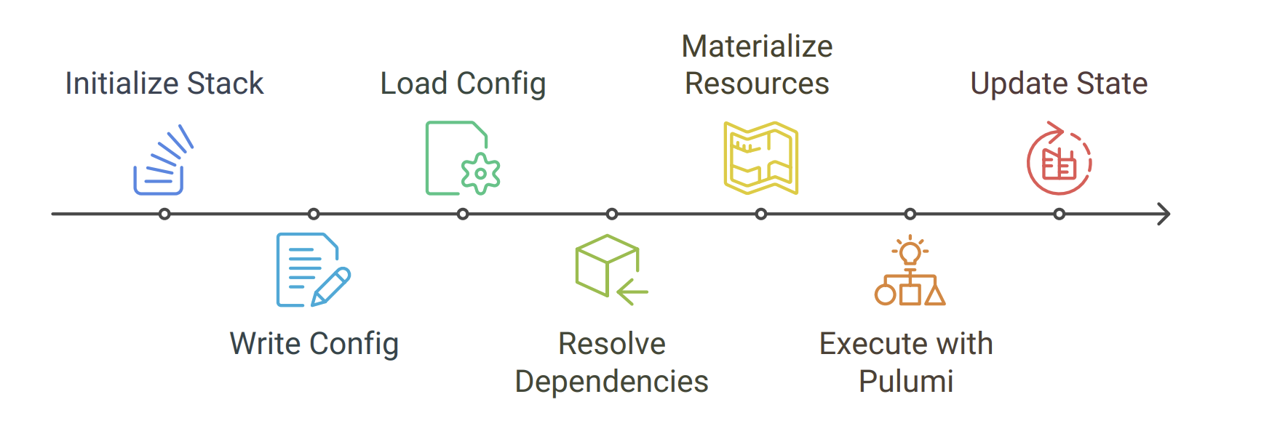
Architecture Design Overview

Slide 14
Slide 14

Slide 15
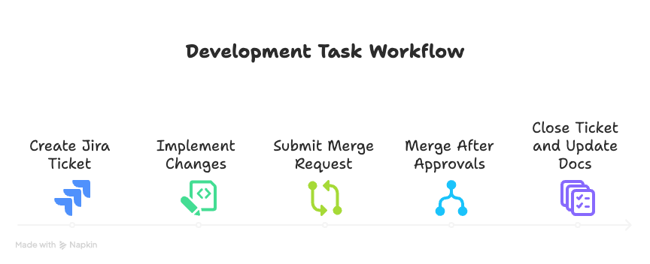
Management Approach

Slide 16



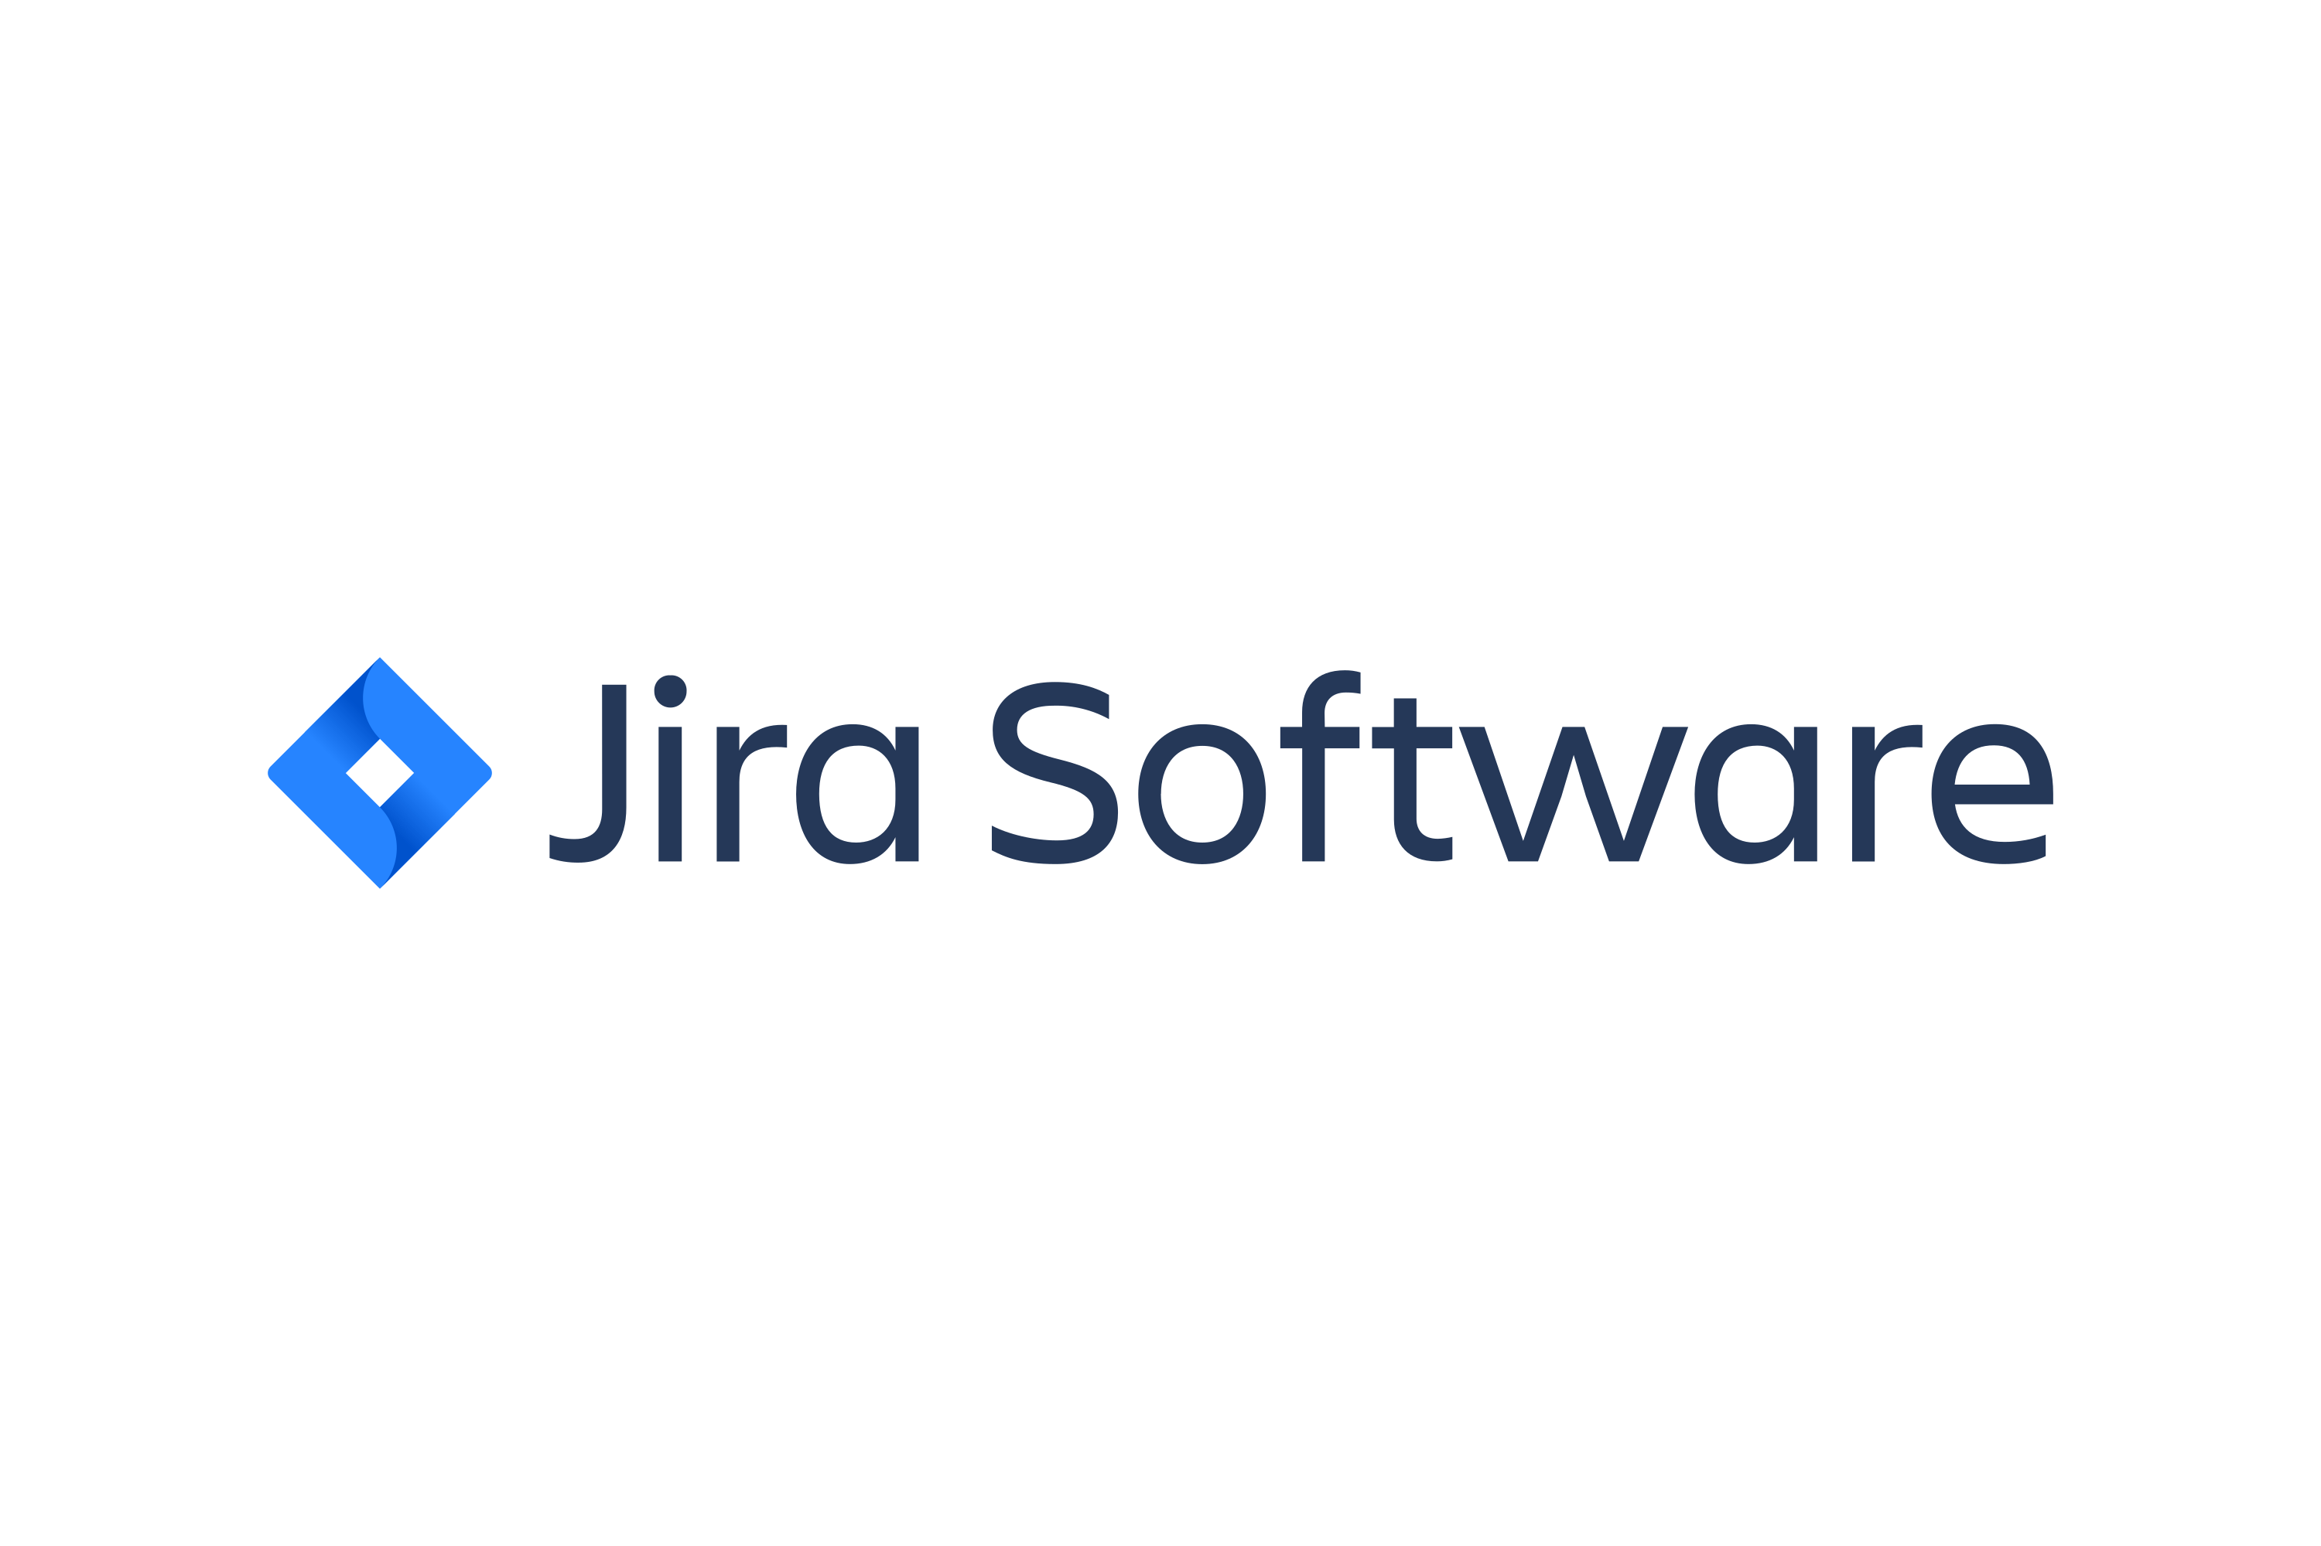
Communication & Collaboration Tools

Slide 17
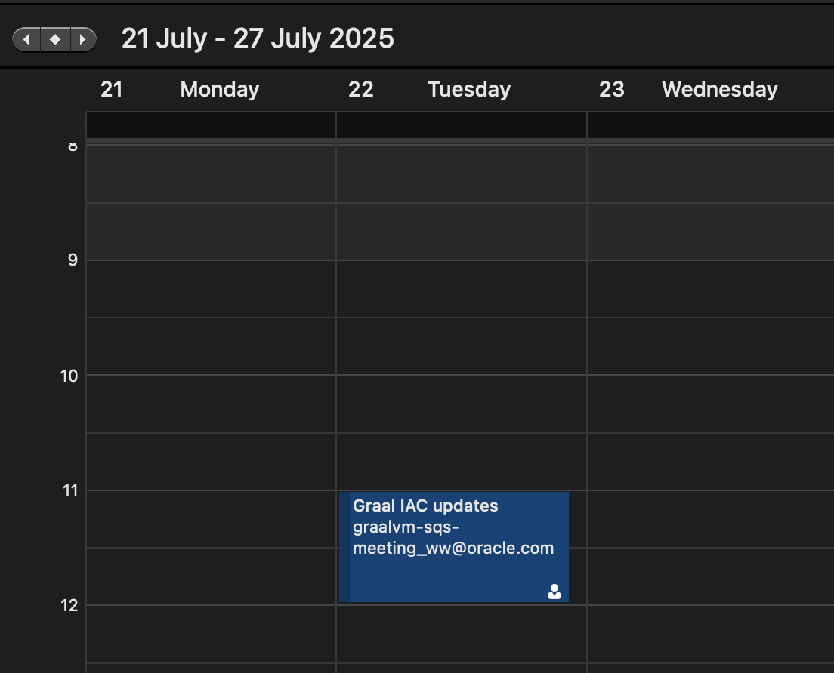
Mentor Check-Ins & Team Meetings
• ● Task Review: Evaluating progress on completed tasks
• ● Current Focus: Aligning on ongoing work and objectives
• ● Planning Ahead: Setting priorities for upcoming work
• ● Issue Resolution: Collaboratively developing solutions
• ● Progress Updates: Sharing recent activities and developments
• ● Planning & Prioritization: Refining timelines and priorities
• ● Collaborative Problem Solving: Team-wide brainstorming

Slide 18
Development Workflow

Slide 19
Slide 19

Slide 20
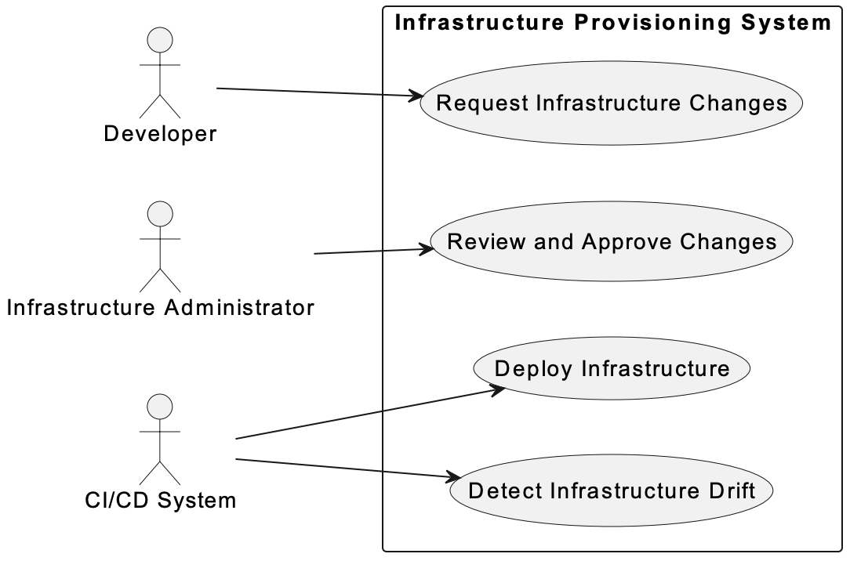
Use Case Analysis

Slide 21
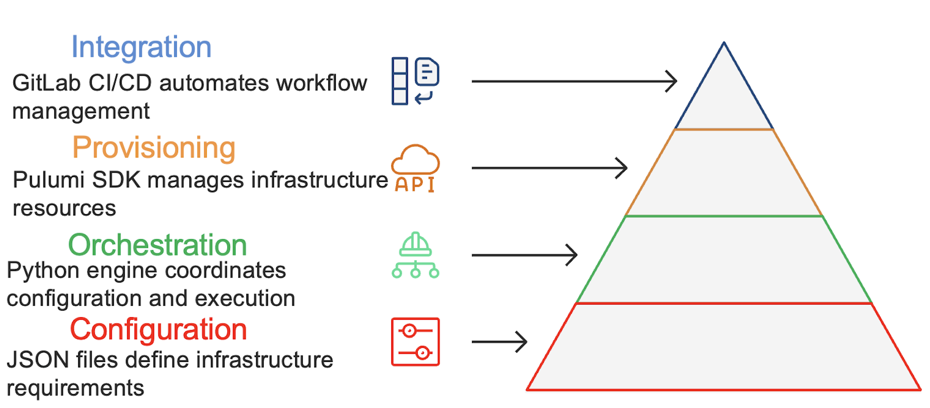
High-Level System Architecture

Slide 22
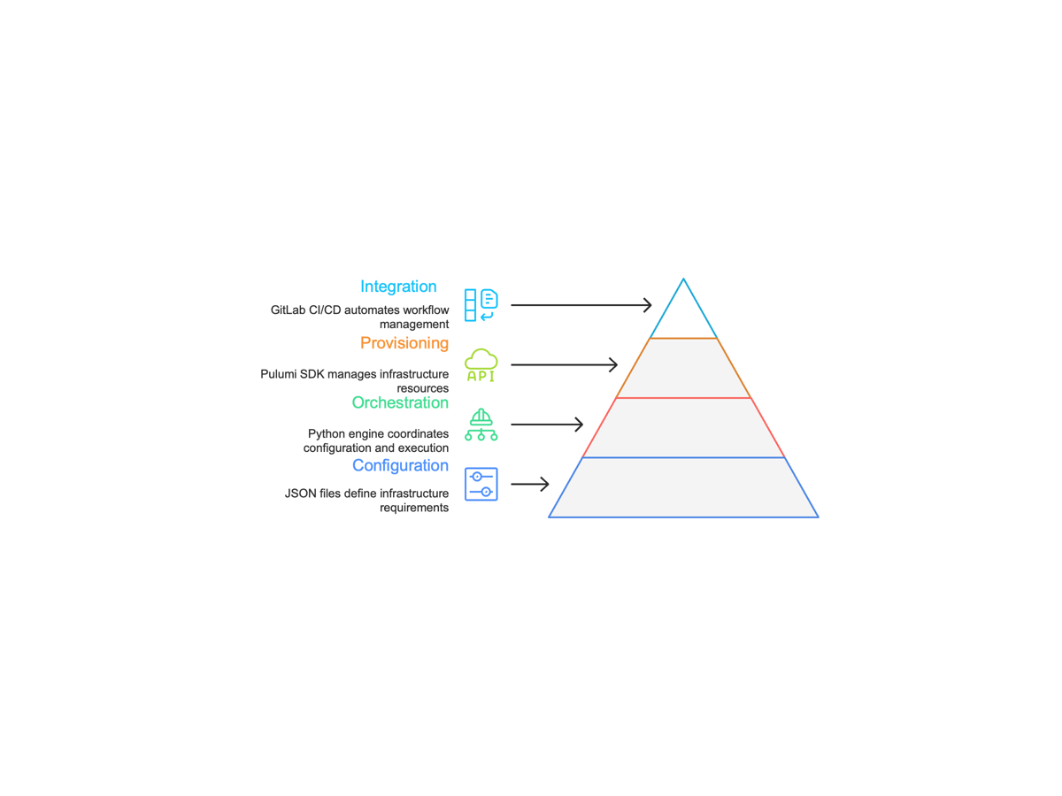
Layered Architecture Design

Slide 23
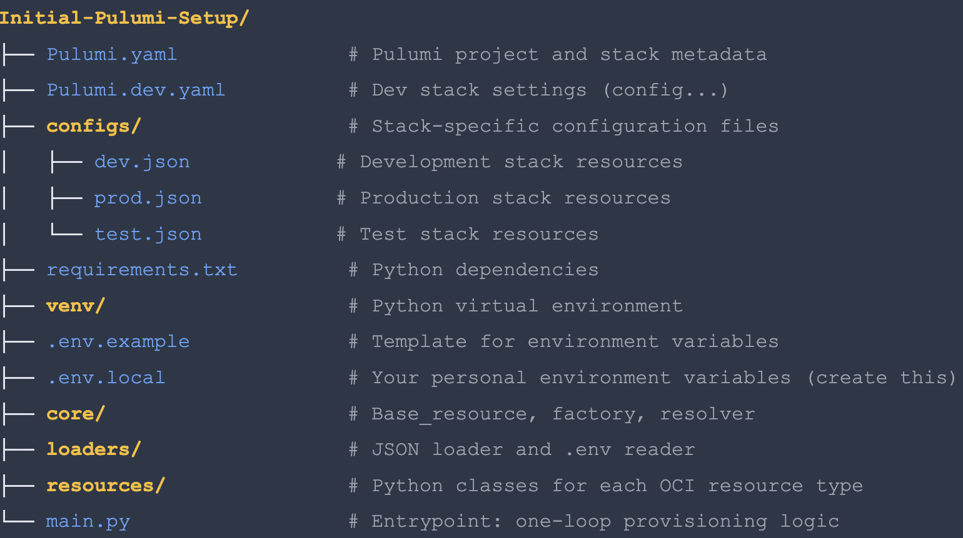
Component Architecture
• • Loads stack-specific JSON files
• • Performs initial validation
• • Maps stack names to config paths
• • Dynamic registry: JSON → Python classes
• • Automatic registration during import
• • Consistent creation interface
• • Converts logical names to OCIDs
• • Handles internal and external references
• • Ensures correct creation order
• • Orchestrates resource creation

Slide 24
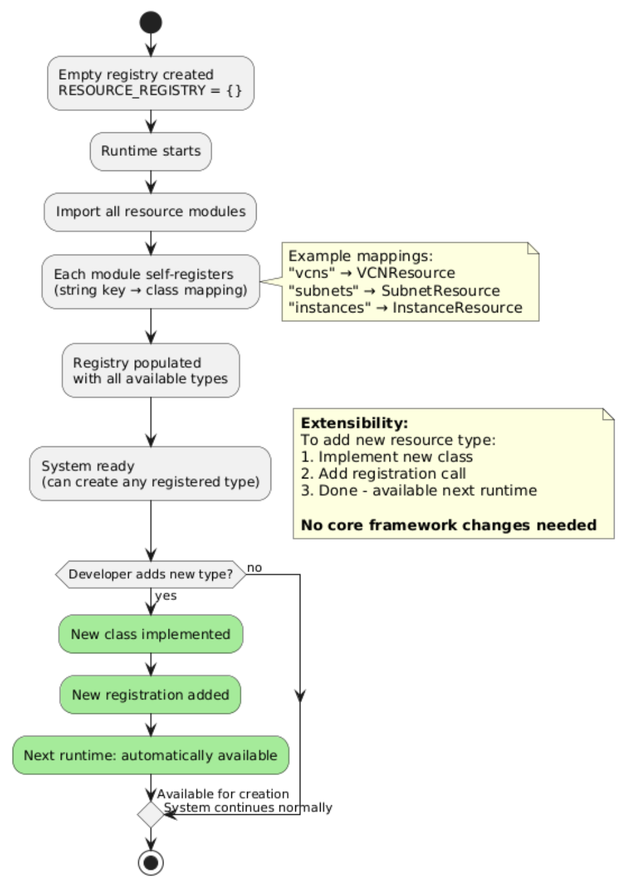
Factory Pattern Implementation

Slide 25
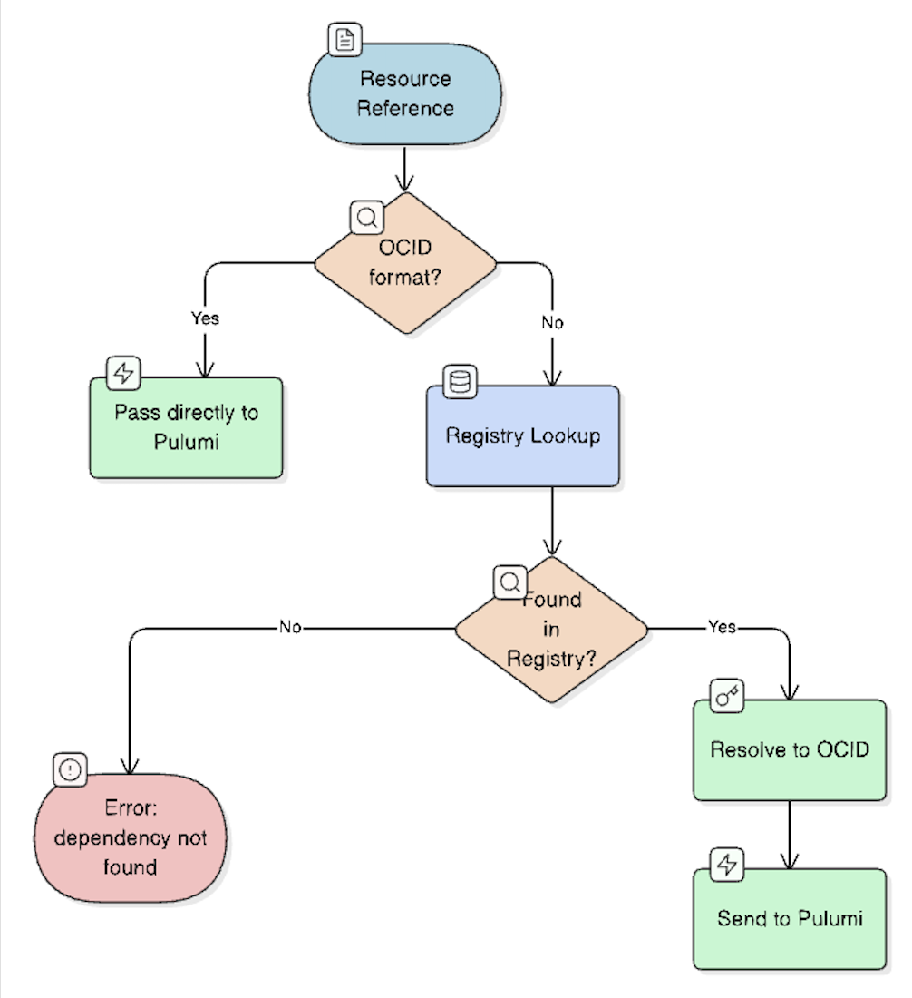
Dependency Resolution Strategy
• 1. Logical names in JSON (e.g., "production-vcn") are resolved to actual OCIDs at runtime
• 2. OCIDs starting with "ocid1." pass through directly for external resources
• 3. Internal resource registry maintained during execution
• 4. Missing dependencies trigger clear error messages with specific resource identification

Slide 26
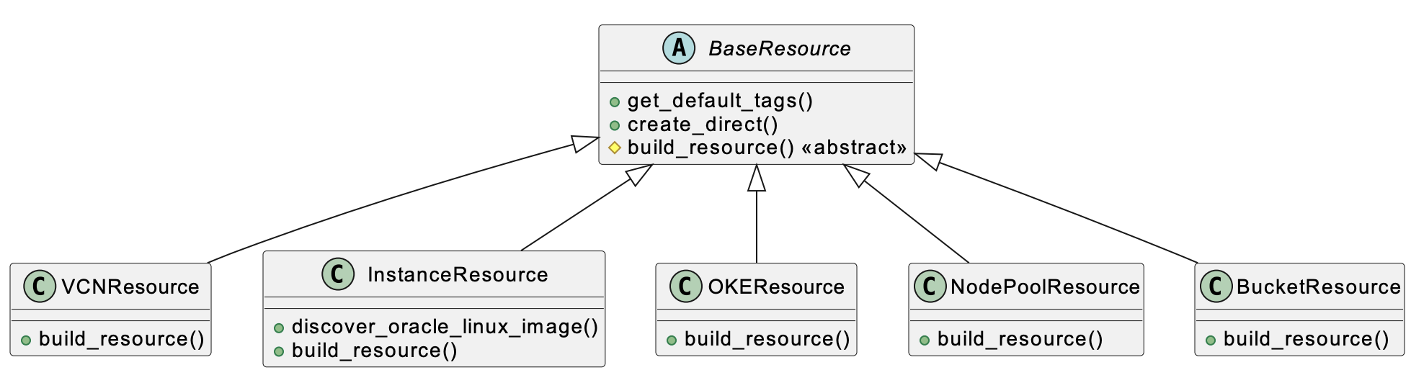
Class Hierarchy & Inheritance Structure

Slide 27
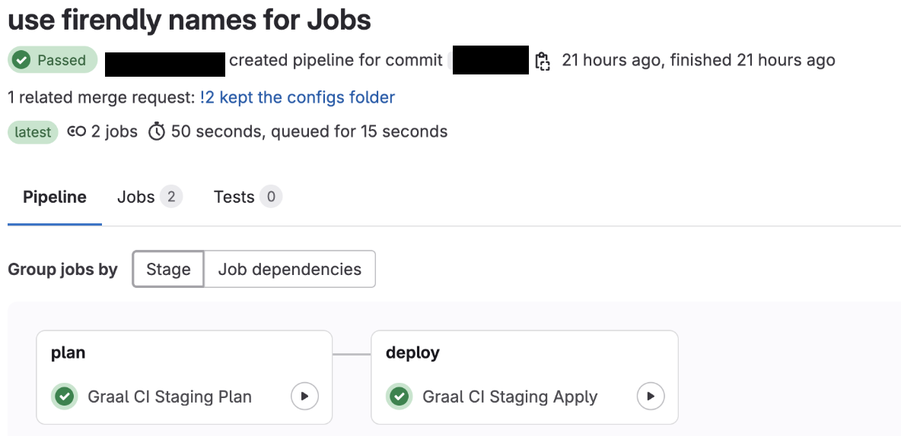
GitLab CI/CD Pipeline Integration
• ✓ Automatically triggered on pull request
• ✓ Stack selection based on branch naming
• ✓ Validates configuration
• ✓ Generates preview artifacts
• ✓ No infrastructure changes made
• ✓ Requires manual approval for protected stacks
• ✓ Performs stack verification
• ✓ Executes Pulumi provisioning
• ✓ Comprehensive logging
• ✓ Updates remote state in OCI Object Storage

Slide 28
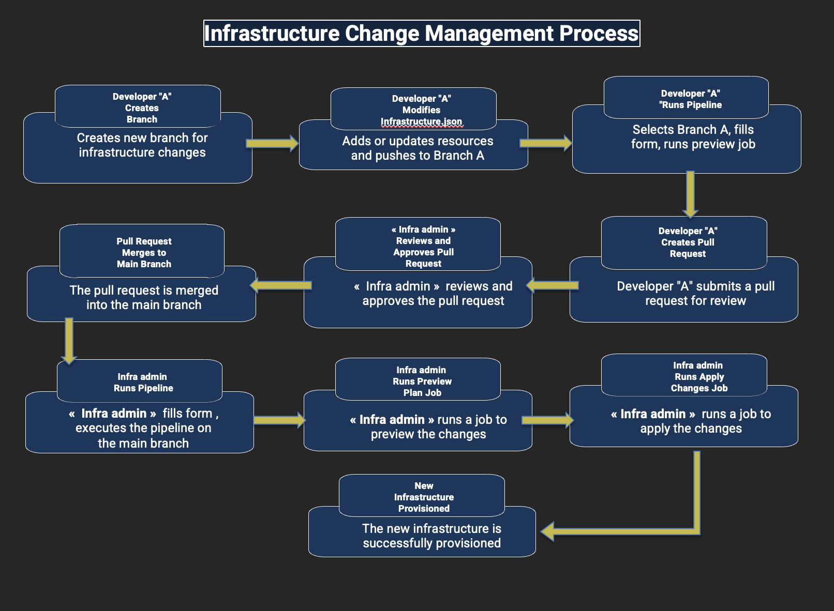
End-to-End Infrastructure Workflow

Slide 29

JSON Configuration Structure

Slide 30
Slide 30

Slide 31
Delivered Features

Slide 32
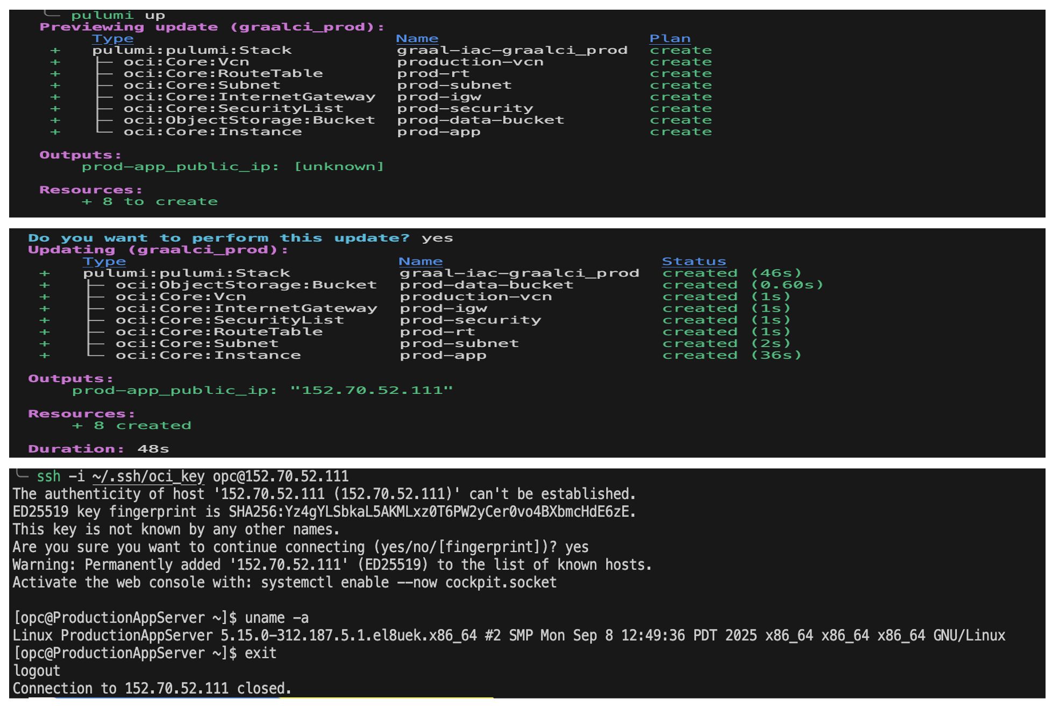
Testing & Validation Results

Slide 33
Performance Improvements

Slide 34
Project Impact Assessment

Slide 35
Slide 35

Slide 36
Current Limitations & Future Work

Slide 37
Conclusion
• • Factory Pattern implementation
• • Custom dependency resolution
• • CI/CD-first approach
• • Environment isolation
• • 70% faster delivery
• • Improved collaboration
• • Knowledge sharing
• • Operational excellence
• • IaC best practices
• • Pulumi & OCI development

Slide 38
Slide 38

