Slide 1
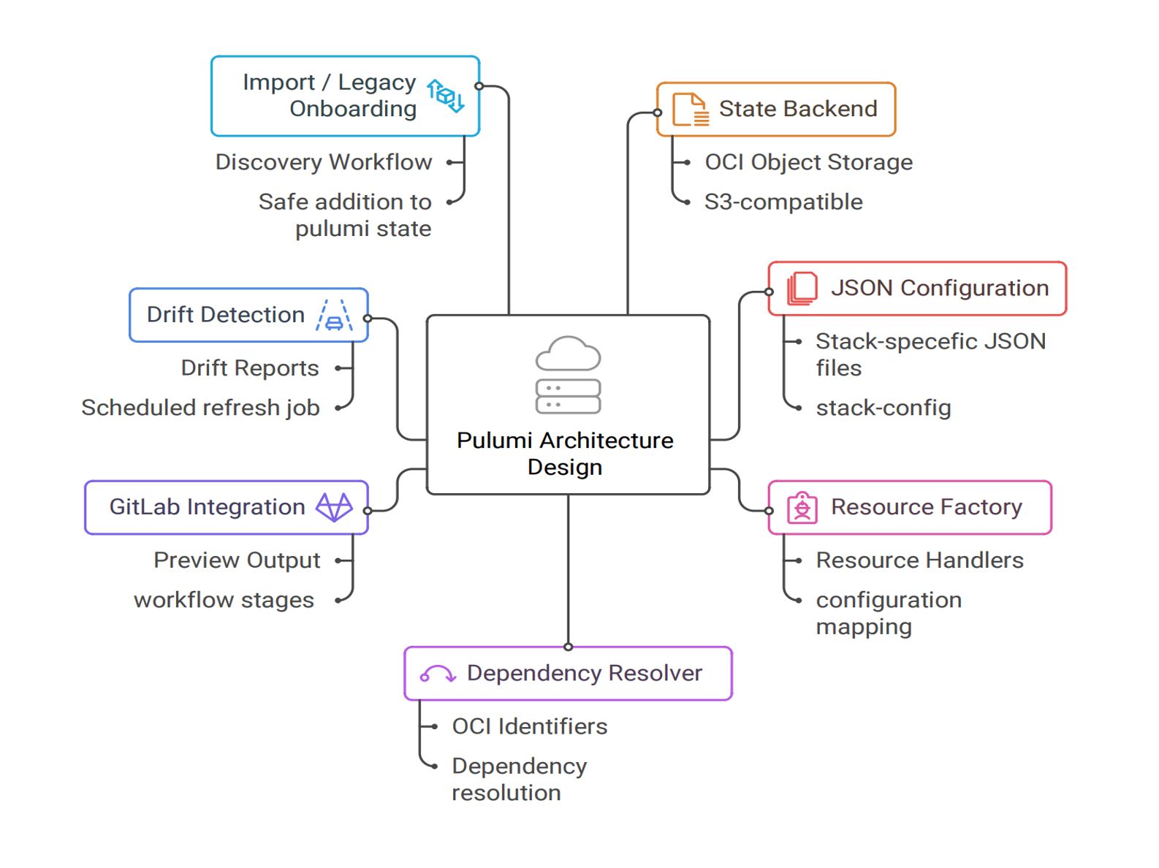

Presentation

Slide 2
Company & TeamContext

Slide 3
Oracle Corporation
1977
Founded
47 Years
Enterprise
#3
Global Ranking
1977: Founded as Software Development Laboratories (SDL)
2010: Acquired Sun Microsystems (Java, Solaris)
Today: Global leader in cloud-based IT infrastructure and enterprise software

Slide 4
Oracle Labs
◆ Focuses on creating technologies to keep Oracle at the IT industry forefront
◆ Pursues innovative methodologies and approaches
◆ Takes on challenges difficult for product development organizations
✓ Java Programming Language - Revolutionary platform
✓ Chip Multithreading - Hardware innovation
✓ Real-world Applications - Focus on societal impact

Slide 5
GraalVM RISQ Team

Slide 6
Problem & SolutionOverview

Slide 7
Current State: Manual Infrastructure Management
Slow Provisioning: Environment provisioning required hours with significant manual effort
Configuration Drift: Dev, staging, and production environments diverge over time
No Version Control: Infrastructure changes not tracked, difficult to rollback
Concentrated Expertise: Only few team members had deep OCI knowledge
Security Gaps: Manual steps easy to overlook access control and network rules
Error-Prone: Manual configuration introduces errors and inconsistencies

Slide 8
Requirements

Slide 9
Technology Comparison: Terraform vs Pulumi
Terraform
Pulumi ✓ SELECTED

Slide 10
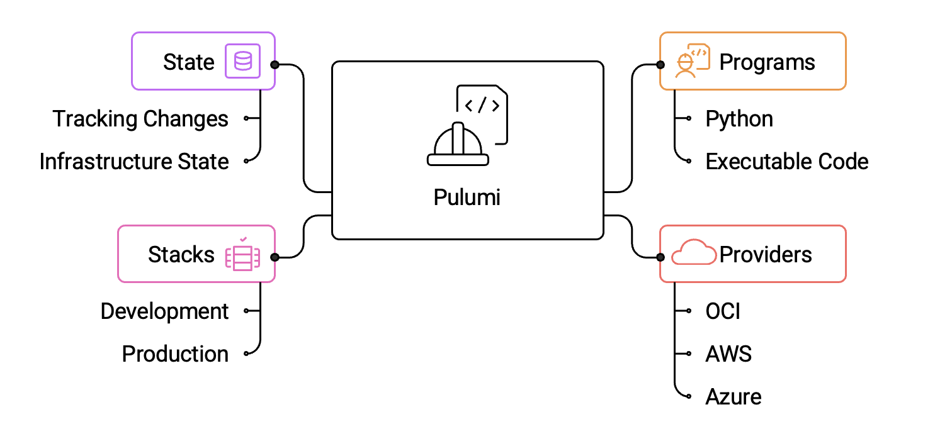
What is Pulumi?

Slide 11
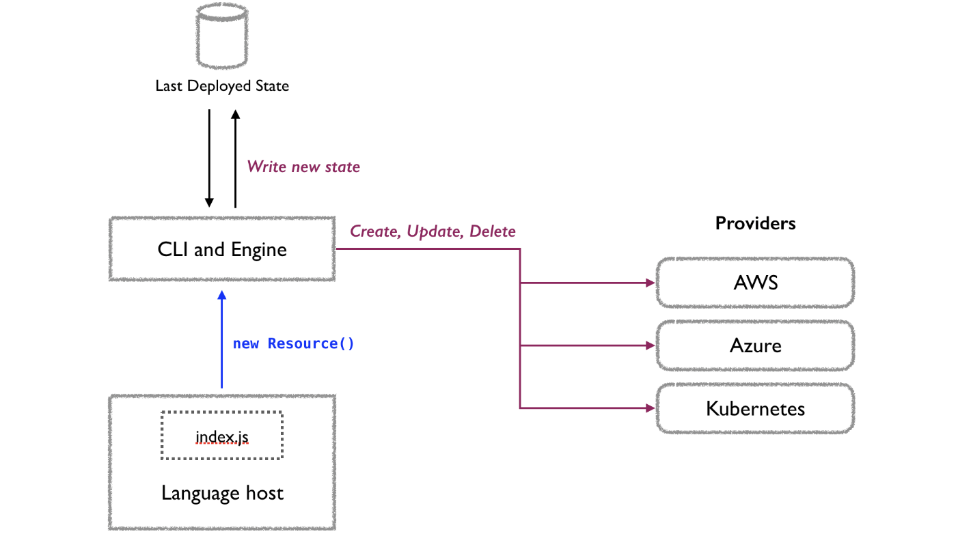
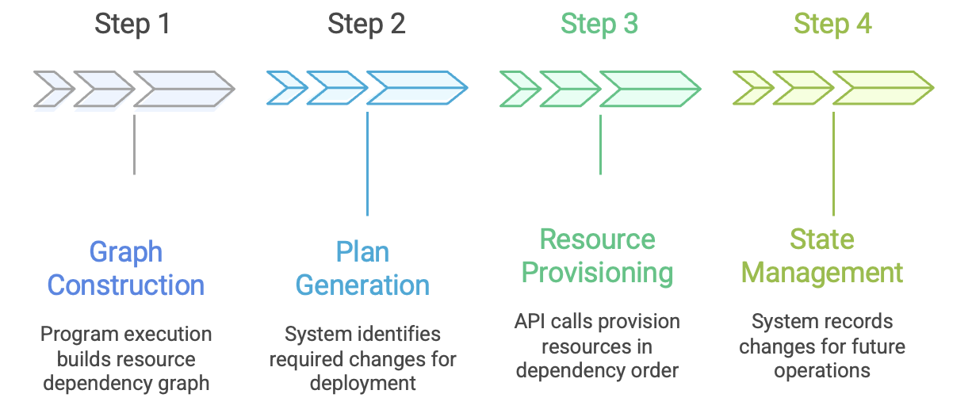
Pulumi Operational Model

Slide 12
Proposed Solution: JSON-Driven IaC Framework

Slide 13
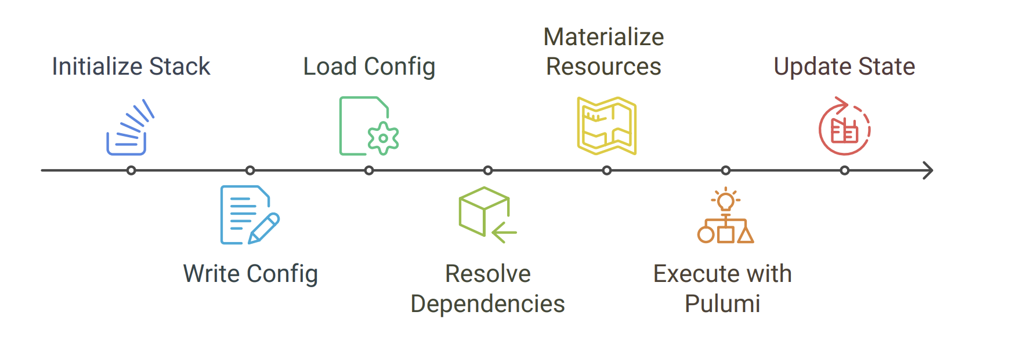
Architecture Design Overview

Slide 14
ProjectManagement

Slide 15
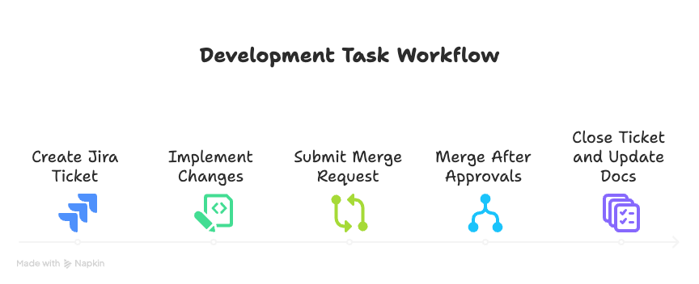
Management Approach

Slide 16



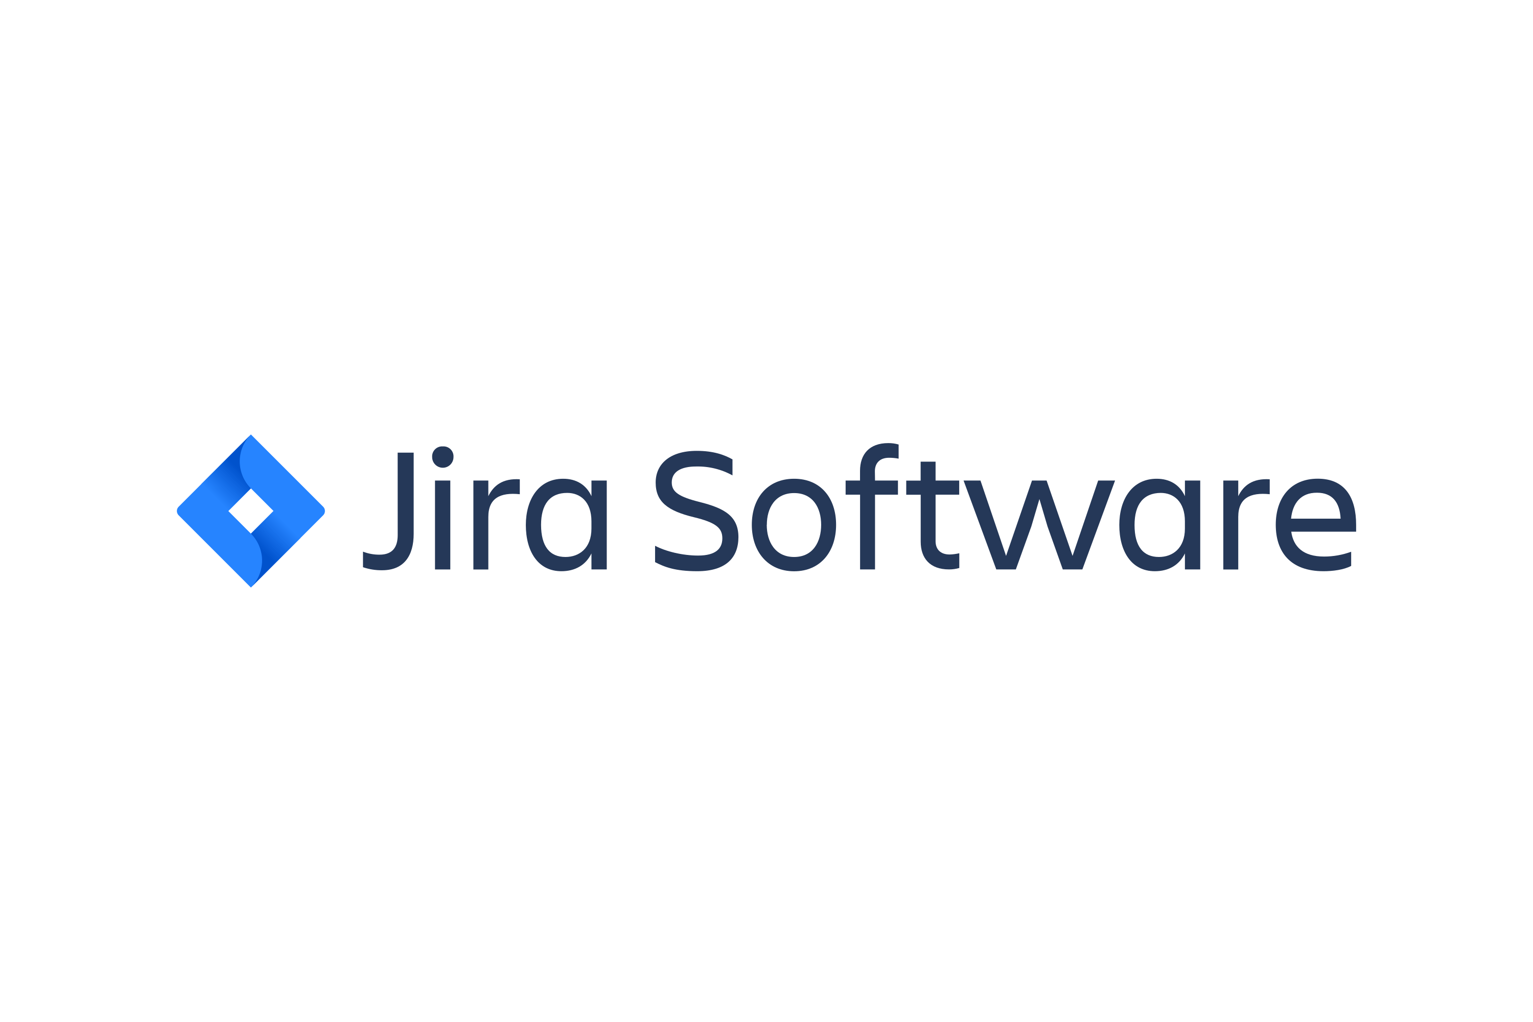
Communication & Collaboration Tools

Slide 17
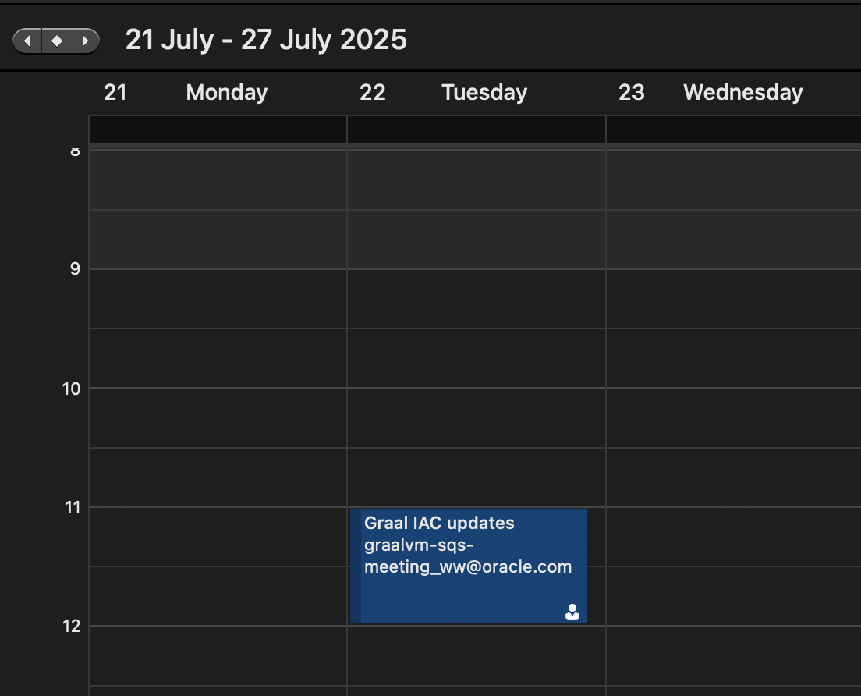
Mentor Check-Ins & Team Meetings

Slide 18
Development Workflow

Slide 19
TechnicalImplementation

Slide 20
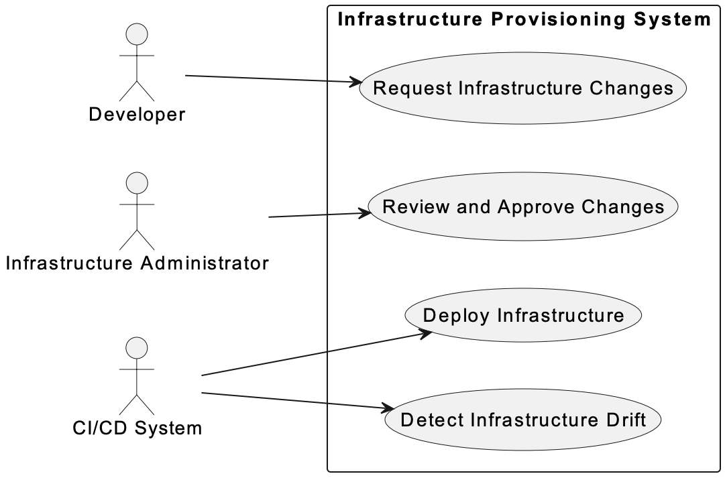
Use Case Analysis

Slide 21
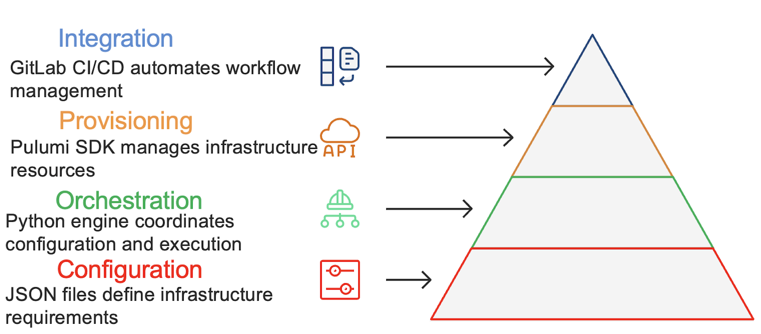
High-Level System Architecture

Slide 22
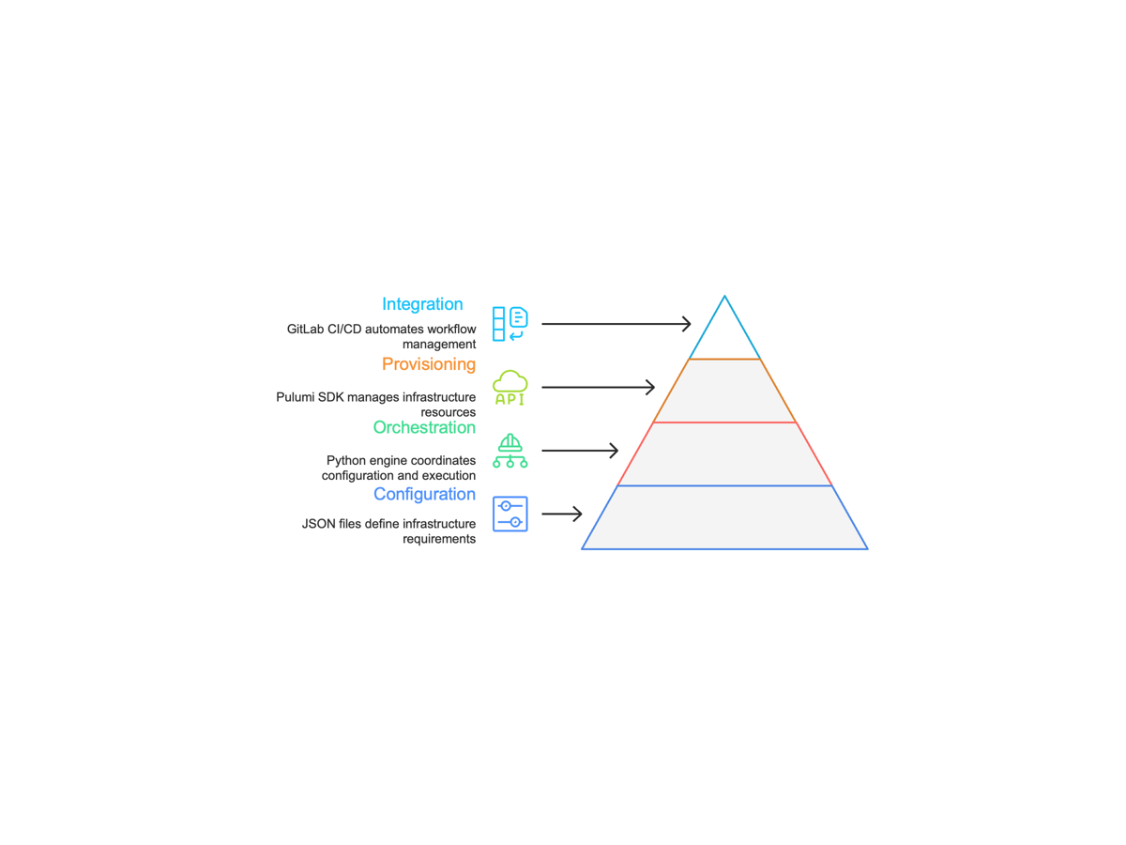
Layered Architecture Design

Slide 23
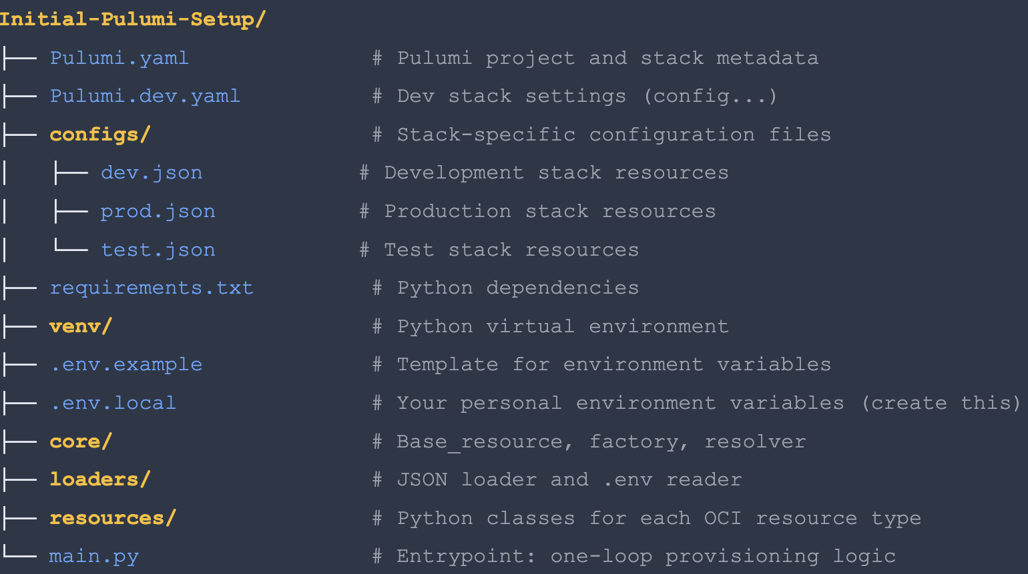
Component Architecture

Slide 24
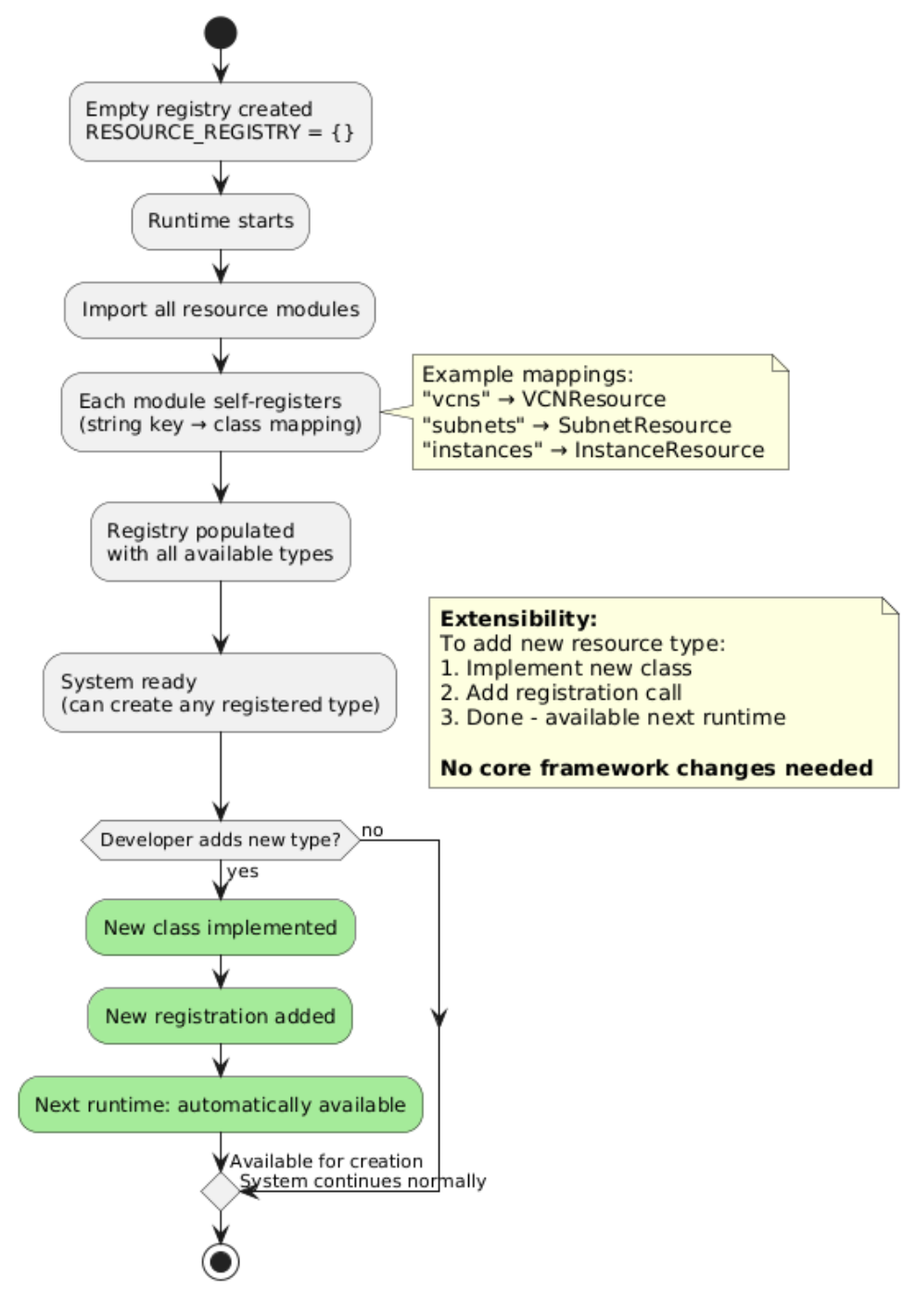
Factory Pattern Implementation

Slide 25
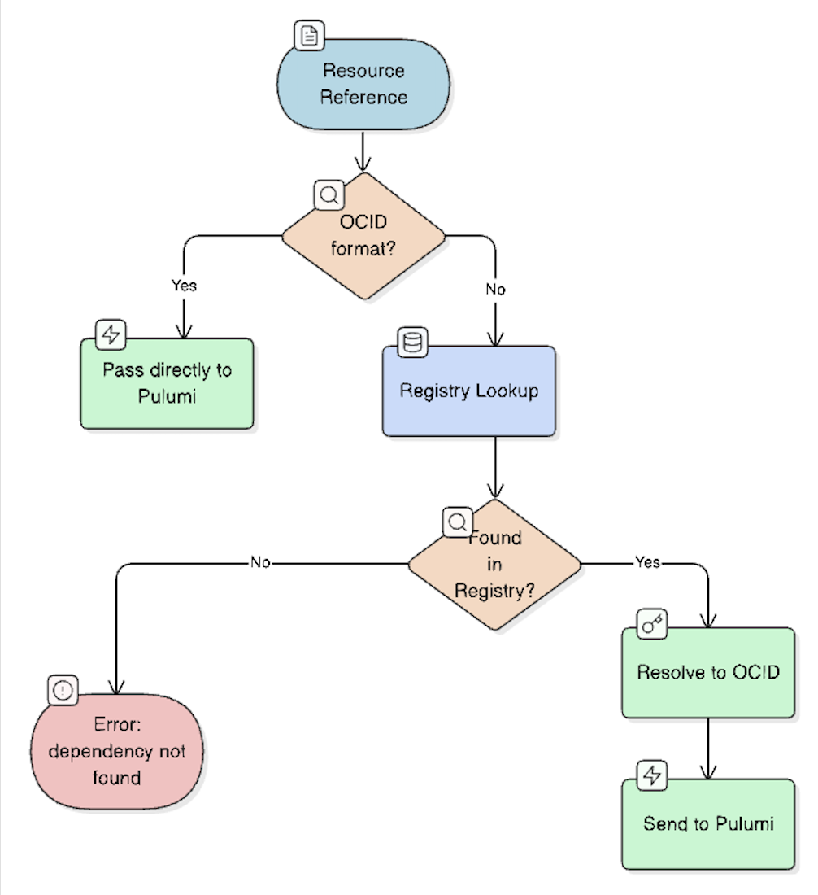
Dependency Resolution Strategy

Slide 26
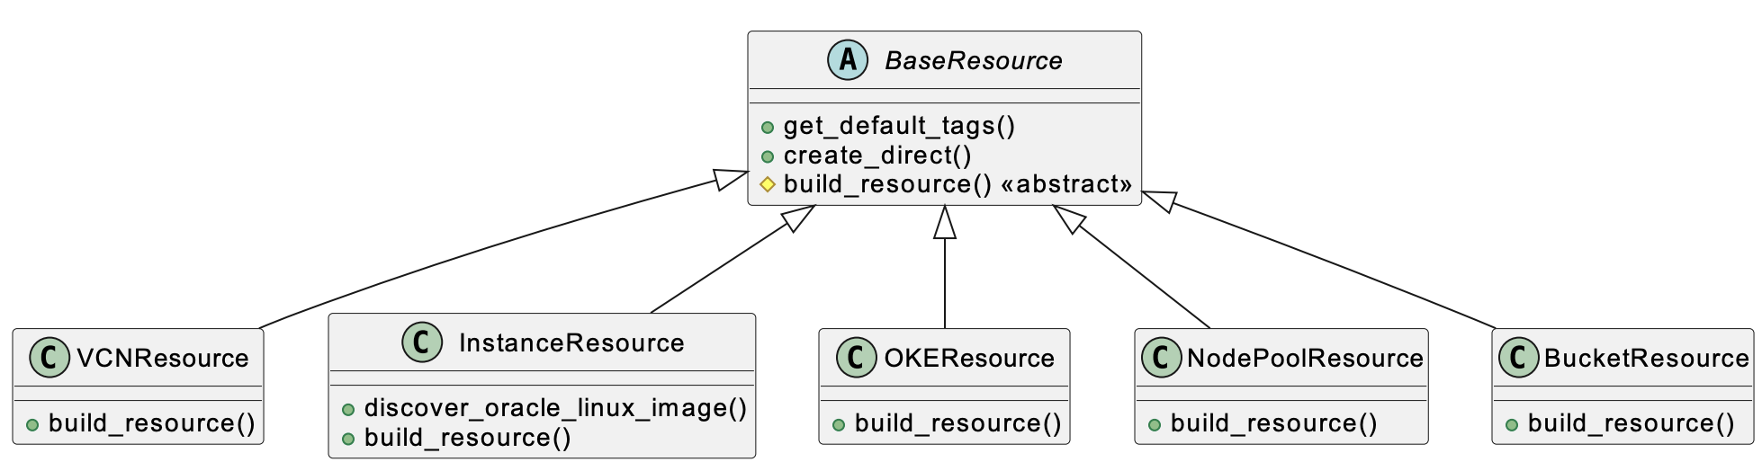
Class Hierarchy & Inheritance Structure

Slide 27
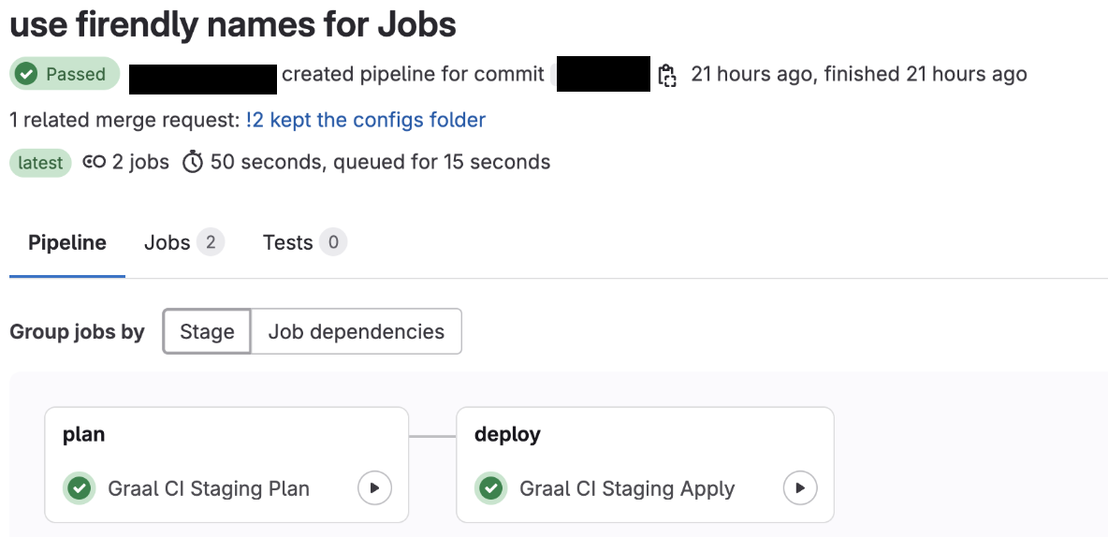
GitLab CI/CD Pipeline Integration

Slide 28
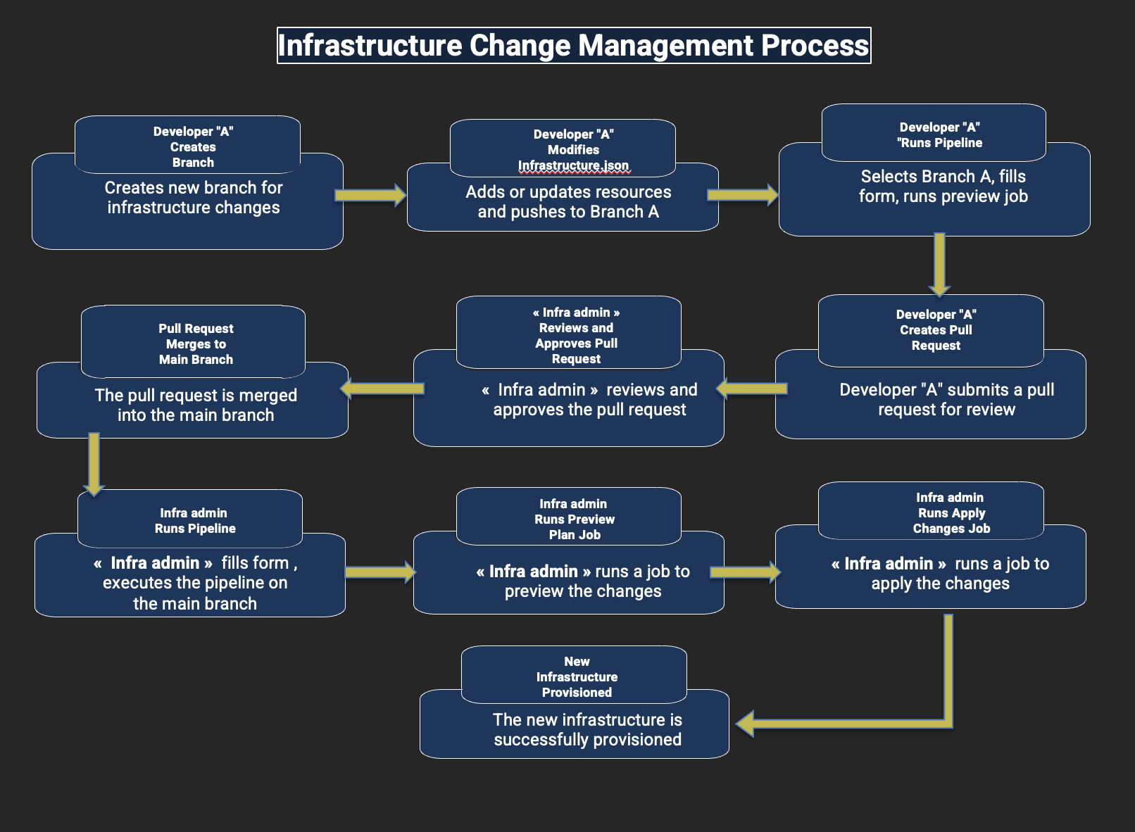
End-to-End Infrastructure Workflow

Slide 29

JSON Configuration Structure

Slide 30
Results &Validations

Slide 31
Delivered Features
JSON-Driven Automation: Infrastructure fully declarative via per-stack JSON files
Dynamic Factory Pattern: Add resource types without modifying core logic
Full CI/CD Integration: Provisioning, preview, drift detection in GitLab
Multi-Environment: Isolated dev, staging, and production stacks
Resource Coverage: VCNs, subnets, compute, gateways, buckets, OKE
Remote State: Pulumi state in OCI Object Storage

Slide 32
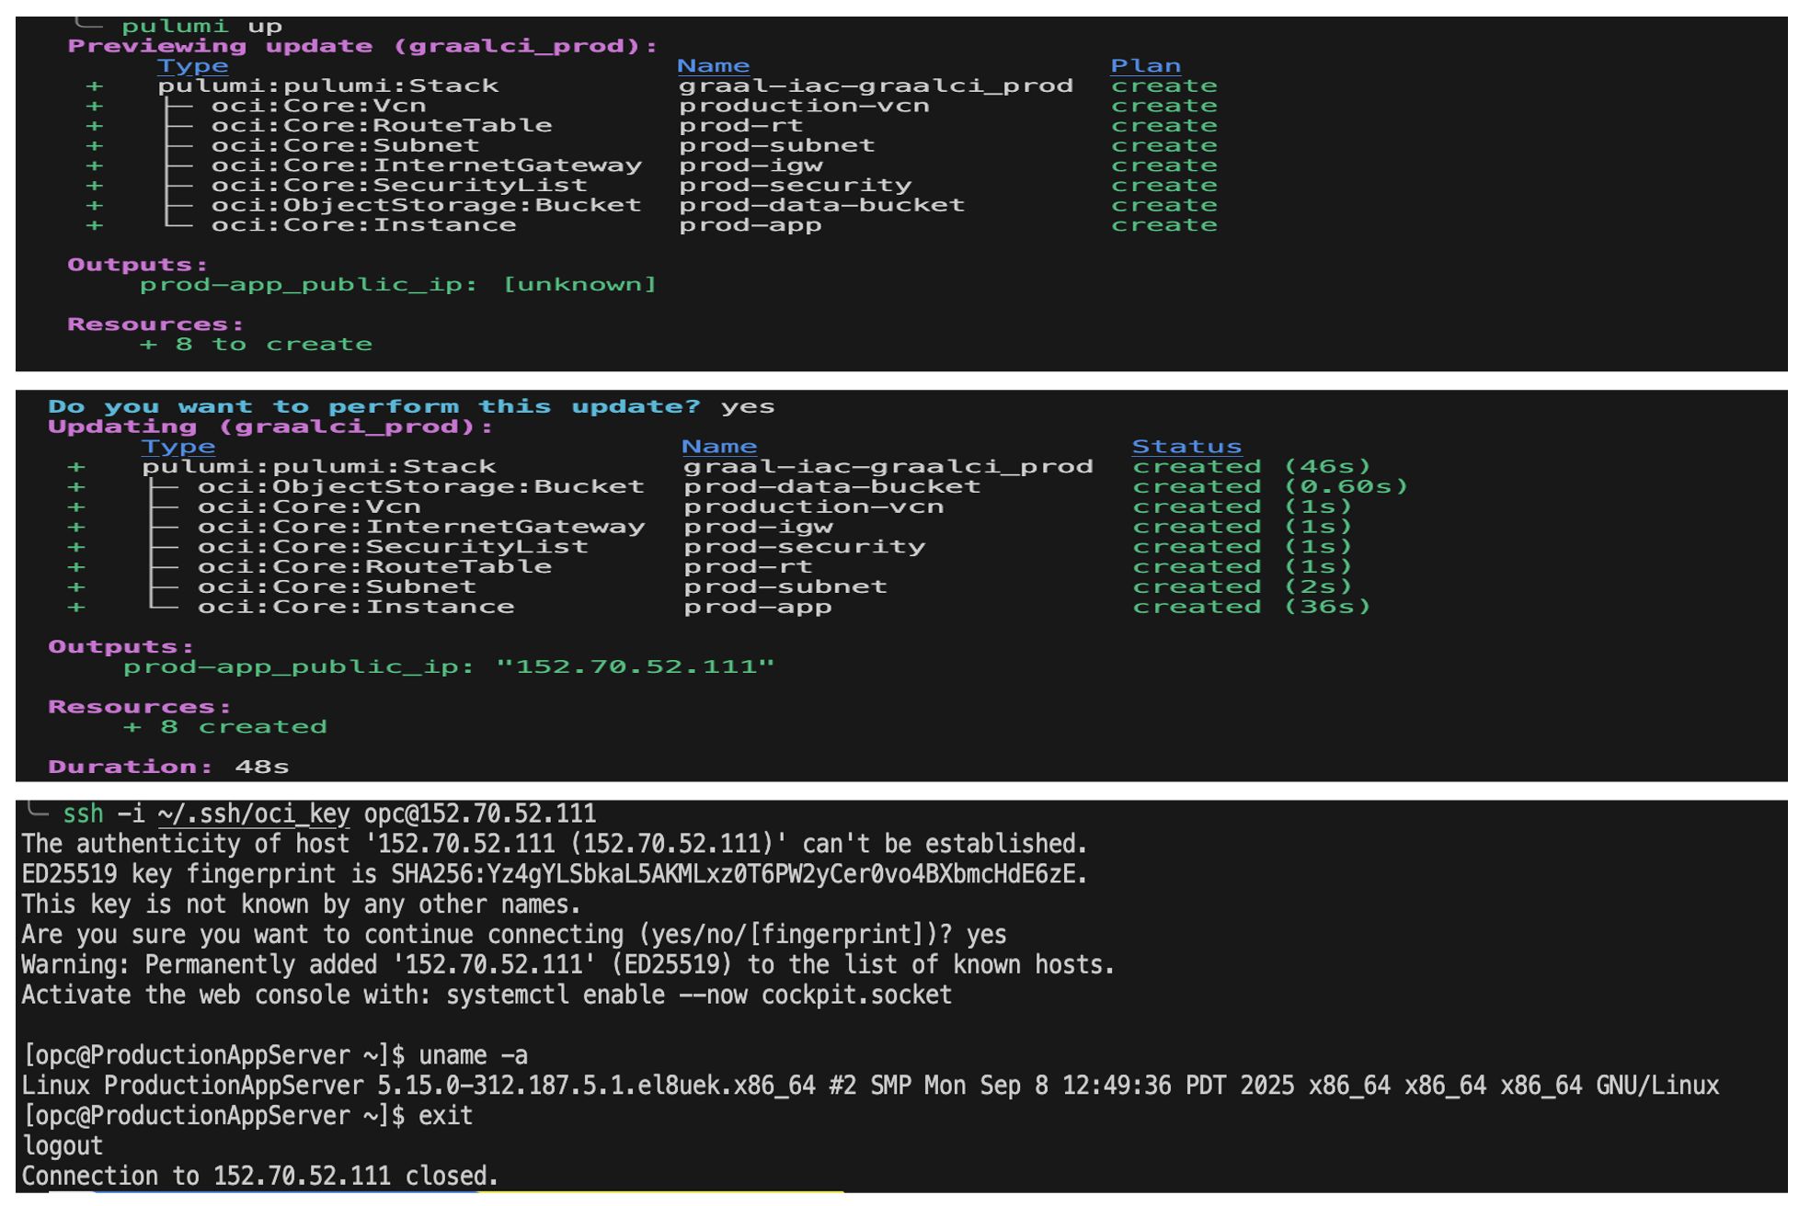
Testing & Validation Results

Slide 33
Performance Improvements

Slide 34
Project Impact Assessment

Slide 35
FutureEnhancements

Slide 36
Current Limitations & Future Work

Slide 37
Conclusion
• Factory Pattern implementation
• Custom dependency resolution
• CI/CD-first approach
• Environment isolation
• 70% faster delivery
• Improved collaboration
• Knowledge sharing
• Operational excellence
• IaC best practices
• Pulumi & OCI development

Slide 38
Thank You

