Slide 1


Infrastructure as Code Support
in Graal CI
JSON-Driven IaC Framework with Pulumi & GitLab CI/CD
Yassine DBAICHI
École Hassania des Travaux Publics
Oracle Labs - GraalVM RISQ Team
Academic Year 2024-2025

Slide 2
Agenda
1. Company & Team Context
2. Problem & Solution Overview
Oracle, Oracle Labs, GraalVM RISQ Team mission and focus
Current challenges, requirements, and proposed JSON-driven IaC solution
3. Project Management
4. Technical Implementation
Agile methodology, communication tools, and development workflow
Architecture, design patterns, CI/CD integration, and deployment
5. Results & Validations
6. Future Enhancements
Implementation results, testing outcomes, and performance metrics
Current limitations, future work, and conclusion

Slide 3
Company & Team Context

Slide 4
Oracle Corporation
Global Technology Leader: Multinational computer technology corporation specializing in database software and cloud solutions
Founded: 1977 by Larry Ellison, Bob Miner, and Ed Oates
Headquarters: Austin, Texas, USA (Oracle Headquarters)
Market Position: One of the largest enterprise software companies worldwide
Core Products: Oracle Database, Oracle Cloud Infrastructure (OCI), Enterprise Applications
Revenue: $50+ billion annually with 430,000+ employees globally

Slide 5
Oracle Labs - Research & Innovation
Mission: Conduct research to advance the state of the art in computer science and systems
Research Excellence
Oracle Labs bridges cutting-edge academic research with real-world enterprise applications
Output: Open-source projects, academic publications, and production-ready technologies
Focus Areas: Programming languages, Virtual machines, Database systems, Cloud infrastructure
Key Projects: GraalVM, Truffle Framework, SubstrateVM
Collaboration
Strong partnerships with universities and research institutions worldwide

Slide 6
GraalVM - High-Performance Polyglot Runtime
What is GraalVM? A universal virtual machine for running applications written in JavaScript, Python, Ruby, R, JVM languages, and more
Key Features: Polyglot capabilities, Native Image compilation, Superior performance optimization, Reduced memory footprint
Use Cases: Microservices, serverless computing, containerized applications

Slide 7
GraalVM RISQ Team
Team Name: RISQ (Release Infrastructure, Systems & Quality)
Mission: Ensure reliability, scalability, and quality of GraalVM infrastructure and development workflows
Responsibilities: CI/CD pipeline management, Infrastructure automation, Testing infrastructure, Developer tooling improvements
Tech Stack: GitLab CI/CD, Oracle Cloud Infrastructure, Python, Bash scripting
The RISQ team acts as the backbone supporting GraalVM development, ensuring smooth operations for hundreds of developers

Slide 8
Project Context & Internship Focus
Team Challenge
Manual Bottleneck
GraalVM requires frequent infrastructure provisioning for testing, CI/CD, and development environments across multiple cloud regions
Infrastructure management was manual, error-prone, and time-consuming - limiting team agility
Project Goal
My Role
Design and implement an automated Infrastructure as Code (IaC) solution integrated with Graal CI pipeline
Lead developer responsible for architecture design, implementation, and GitLab CI/CD integration

Slide 9
Problem & Solution Overview

Slide 10
Current Infrastructure Management Challenges
Manual Console Operations: Team members had to manually create resources through OCI web console - time-consuming and repetitive
Lack of Version Control: No tracking of infrastructure changes, making rollbacks and audits difficult
Configuration Drift: Resources created manually often diverged from documented standards
Scalability Issues: Provisioning multiple similar environments was labor-intensive
Knowledge Silos: Infrastructure knowledge concentrated in few team members
No CI/CD Integration: Infrastructure provisioning was separate from development workflow
Result: Slow deployment cycles, increased error rates, and reduced team productivity

Slide 11
Functional Requirements
FR1 - Declarative Configuration: Users define infrastructure in human-readable format (JSON) without writing Python/Terraform code
FR2 - Resource Support: Support for essential OCI resources (VCN, Subnets, Compute Instances, Storage Buckets, Security Lists, Routing)
FR3 - Dependency Management: Automatic resolution of resource dependencies (e.g., subnet requires VCN, instance requires subnet)
FR4 - CI/CD Integration: Seamless integration with GitLab CI/CD pipeline (plan, preview, apply stages)
FR5 - State Management: Track infrastructure state to enable updates and deletions
FR6 - Multi-Environment: Support for development, staging, and production configurations

Slide 12
Non-Functional Requirements
Performance
Security
• Provision infrastructure in <5 minutes
• Support concurrent deployments
• Minimal API calls to OCI
• Credentials stored securely (GitLab secrets)
• No hardcoded sensitive data
• Audit trail via Git commits
Extensibility
• Plugin architecture for new resources
• Support for future cloud providers
• Custom validation rules

Slide 13
IaC Technology Selection: Terraform vs Pulumi
Terraform
Pulumi ✓ (Selected)
Pros:
• Industry standard with mature ecosystem
• HCL declarative language
• Large provider ecosystem
• Strong community support
Cons:
• Custom DSL (HCL) requires learning
• Limited programming logic & abstraction
• State management complexity
• Hard to build dynamic configurations
Pros:
• Use real programming languages (Python)
• Full programmatic control & abstraction
• Built-in state management
• Excellent OCI support
• Enables framework development on top
• Team Python expertise leverage
Why chosen: Perfect fit for building JSON-driven abstraction layer. Pulumi's programmatic approach allows us to create a framework that hides IaC complexity from users.

Slide 14
How does Pulumi work?
1. Write Code
2. Preview
Define infrastructure using Python - loops, functions, conditionals available
Run 'pulumi preview' to see what will change before applying
3. Deploy
4. State Management
Pulumi SDK translates Python to OCI API calls and provisions resources
Pulumi tracks all resources in state file (OCI Object Storage)
Python-First: Leverage existing team Python expertise
OCI Provider: First-class Oracle Cloud Infrastructure support
Framework Foundation: Enables building JSON-driven abstraction layer on top

Slide 15
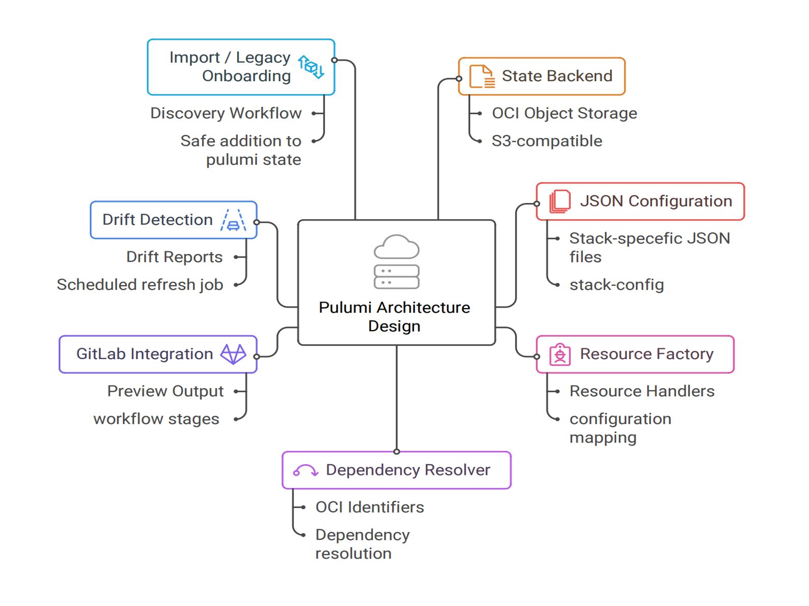

Slide 16
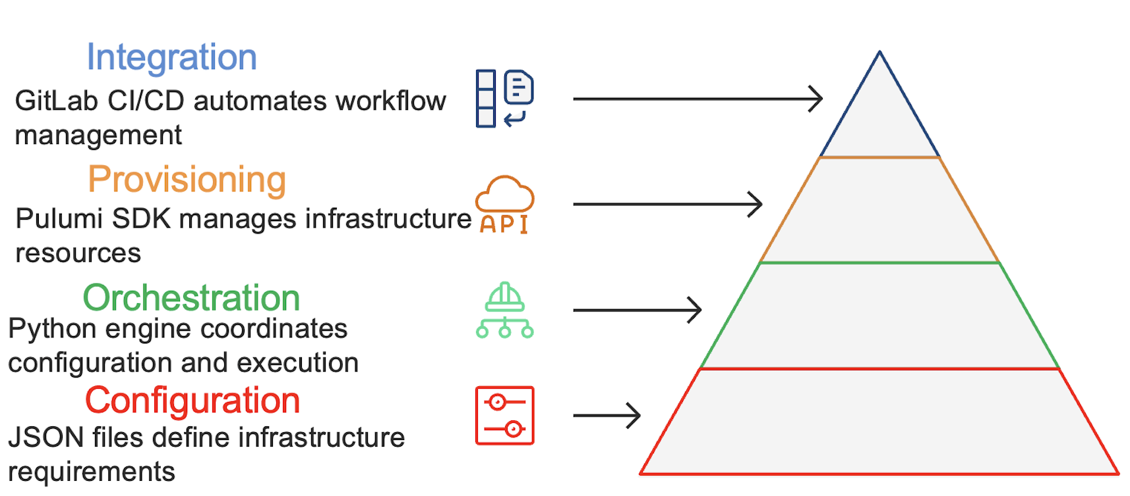

Slide 17
Project Management

Slide 18
Project Management Approach
Methodology: Kanban Agile - visual workflow management with continuous delivery
Project Tracker: Task board for tracking work items (To Do, In Progress, Done)
Regular Meetings: Weekly sync meetings with mentor to review progress and blockers
Continuous Flow: Work items pulled as capacity allows, no fixed sprint boundaries
Focus on Delivery: Prioritize completing tasks over starting new ones

Slide 19
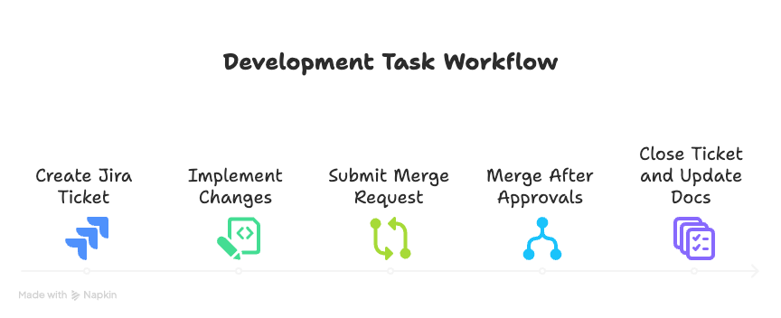

Slide 20





Communication & Collaboration Tools
Slack
Zoom
Jira
Outlook
Daily communication, quick questions
Weekly sync meetings, discussions
Task tracking, sprint planning
Meeting scheduling, formal comms
Confluence
GitLab
Documentation, knowledge base
Code repository, CI/CD, MRs

Slide 21
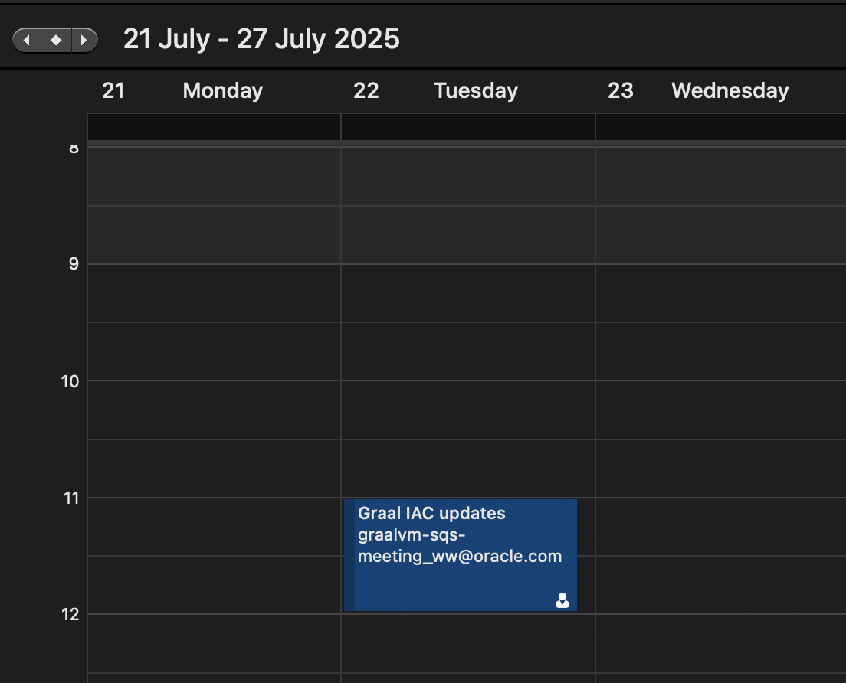
Mentor Check-ins & Team Meetings
Weekly Sync Meetings
• Frequency: Every Tuesday 11:00 AM
• Duration: 45-60 minutes
• Agenda: Progress review, blockers discussion, next steps planning
• Participants: Intern + mentor (Hamza Ghaissi)
Ad-hoc Sessions
• Technical architecture discussions
• Code reviews and pair programming
• Debugging complex issues
• Design decision consultations
Communication Style: Open-door policy via Slack - quick responses and collaborative problem-solving

Slide 22
Project Timeline & Key Milestones
Phase 1: Research (2 weeks)
Phase 2: Prototype (2 weeks)
Phase 3: Development (4 weeks)
• OCI API exploration
• Pulumi SDK study
• Requirements gathering
• Architecture design
• Core framework skeleton
• VCN + Instance resources
• Factory pattern POC
• Basic dependency resolver
• All 7 resource types
• JSON configuration loader
• Dependency resolution logic
• Error handling
Phase 4: CI/CD Integration (2 weeks)
Phase 5: Testing (2 weeks)
Phase 6: Documentation (1 week)
• GitLab pipeline config
• Plan & deploy stages
• Manual approval gates
• Pipeline testing
• Integration testing
• Edge case validation
• Performance testing
• Bug fixes
• User guide creation
• Code documentation
• Architecture diagrams
• Final presentation

Slide 23
Technical Implementation

Slide 24
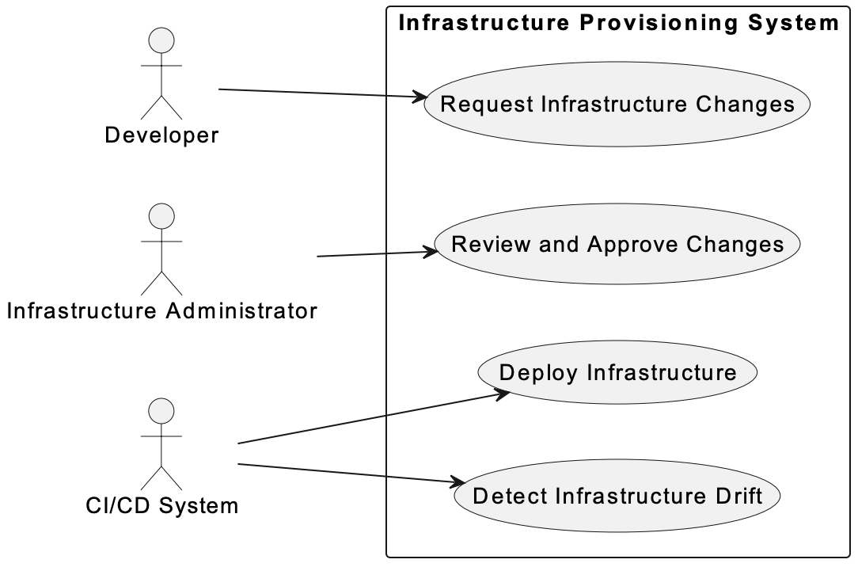

Slide 25
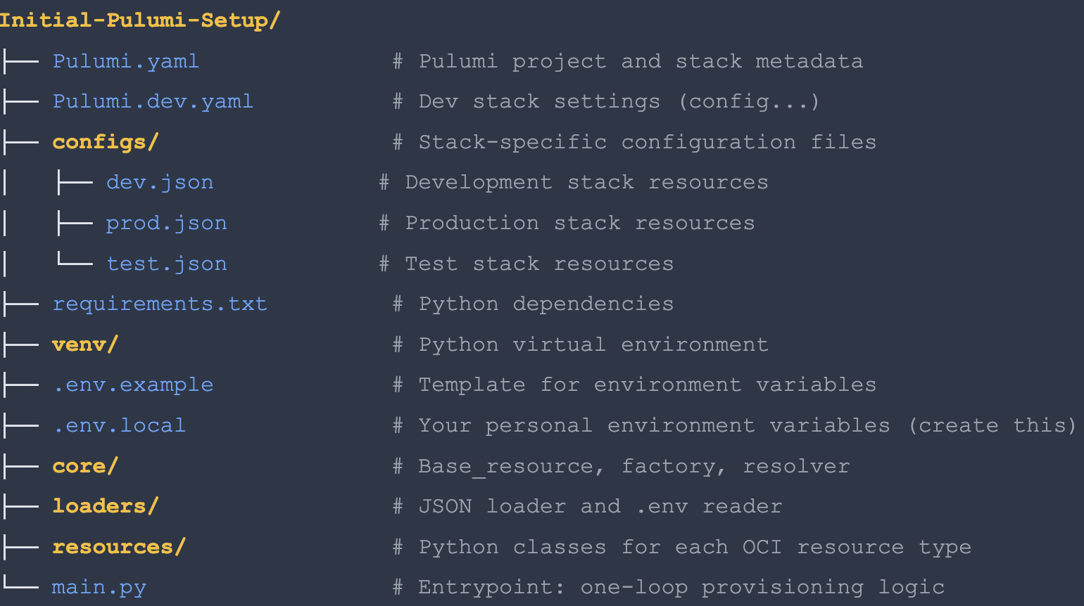

Slide 26
JSON Configuration Example
infrastructure.json
{
"name": "production-vcn",
"cidrBlock": "10.0.0.0/16",
"internetGateways": [...],
"securityLists": [...],
"routeTables": [...],
"subnets": [...]
}
Name-Based References: Resources reference each other by human-readable names
Automatic Resolution: Framework resolves names to OCIDs automatically

Slide 27
Core Framework Components
BaseResource (Abstract)
ResourceFactory
File: core/base_resource.py (21 lines)
Purpose: Abstract base class defining resource interface
Methods: create() - Factory method, build() - Abstract (must implement)
File: core/resource_factory.py (38 lines)
Purpose: Factory pattern for dynamic instantiation
Registry: Maps type strings → Python classes
7 resource types registered
DependencyResolver
ConfigLoader
File: core/dependency_resolver.py (14 lines)
Purpose: Resource reference manager
Methods: register_resource(name, resource), get_resource_id(name)
File: config/config_loader.py (25 lines)
Purpose: Parse infrastructure.json
Methods: get_vcns_config(), get_instances_config(), get_image_config()

Slide 28
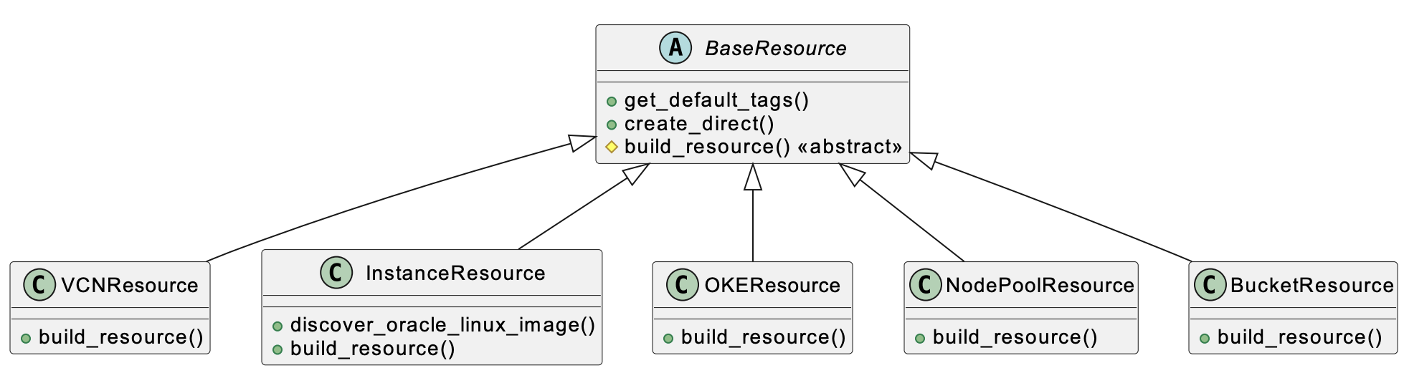

Slide 29
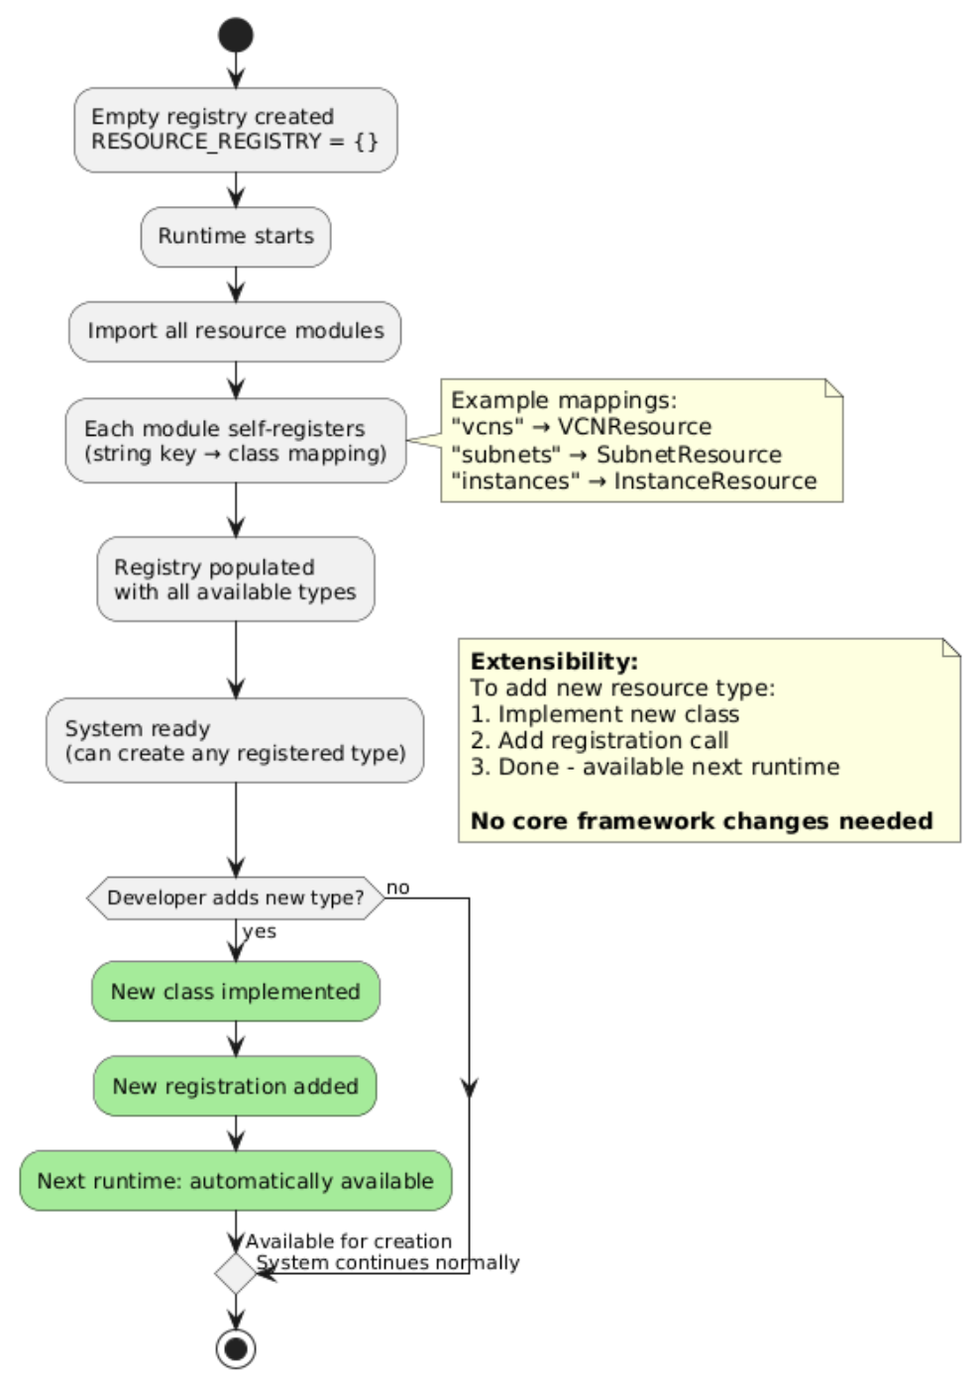

Slide 30
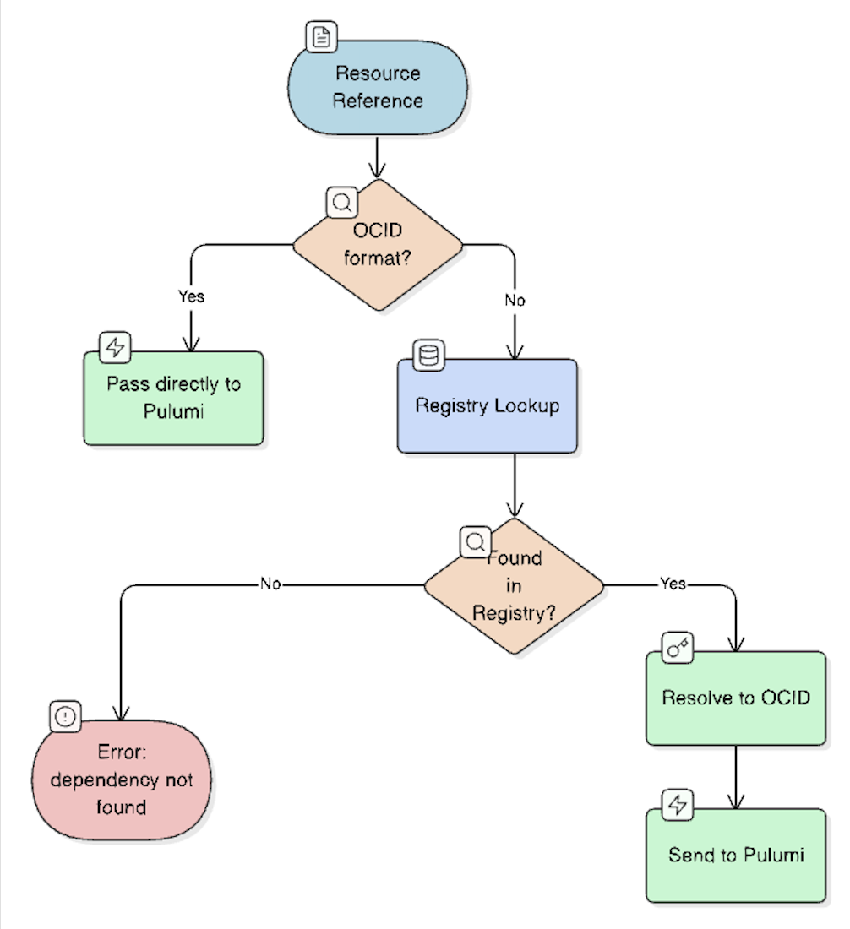

Slide 31
Implemented Resource Types
1. VCN (Virtual Cloud Network)
2. Internet Gateway
Purpose: Foundation network container
Purpose: Enable internet connectivity
3. Security List
4. Route Table
Purpose: Firewall rules (ingress/egress)
Purpose: Network routing configuration
5. Subnet
6. Compute Instance
Purpose: Network segment within VCN
Purpose: Virtual machine
7. Object Storage Bucket
Purpose: S3-compatible object storage

Slide 32
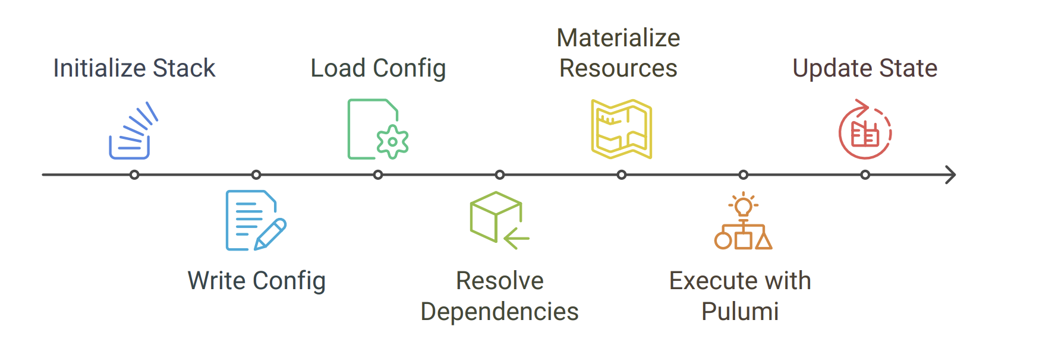

Slide 33
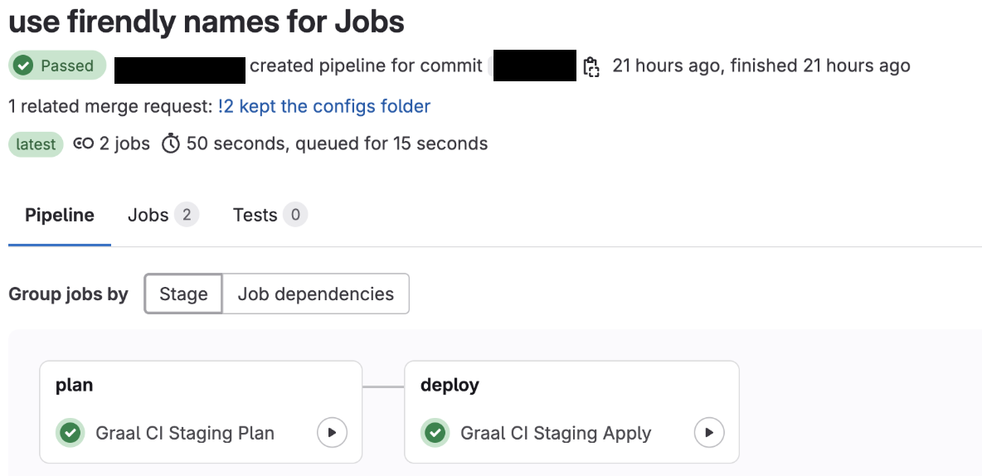

Slide 34
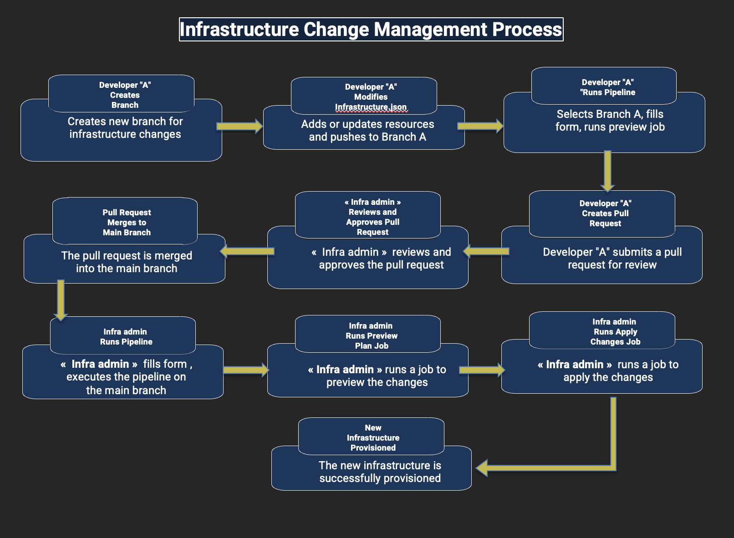

Slide 35
Results & Validations

Slide 36
Implementation Results
✓ Deliverables Completed
✓ Requirements Met
• Python framework (800 LOC)
• 7 OCI resource types
• JSON configuration system
• GitLab CI/CD pipeline
• Documentation & diagrams
• Declarative JSON config
• Dependency resolution
• CI/CD integration
• Multi-environment support
• State management
✓ Production Ready
• Error handling implemented
• Tested on dev & staging
• Documentation complete
• Team training delivered
• Now in active use by RISQ team

Slide 37
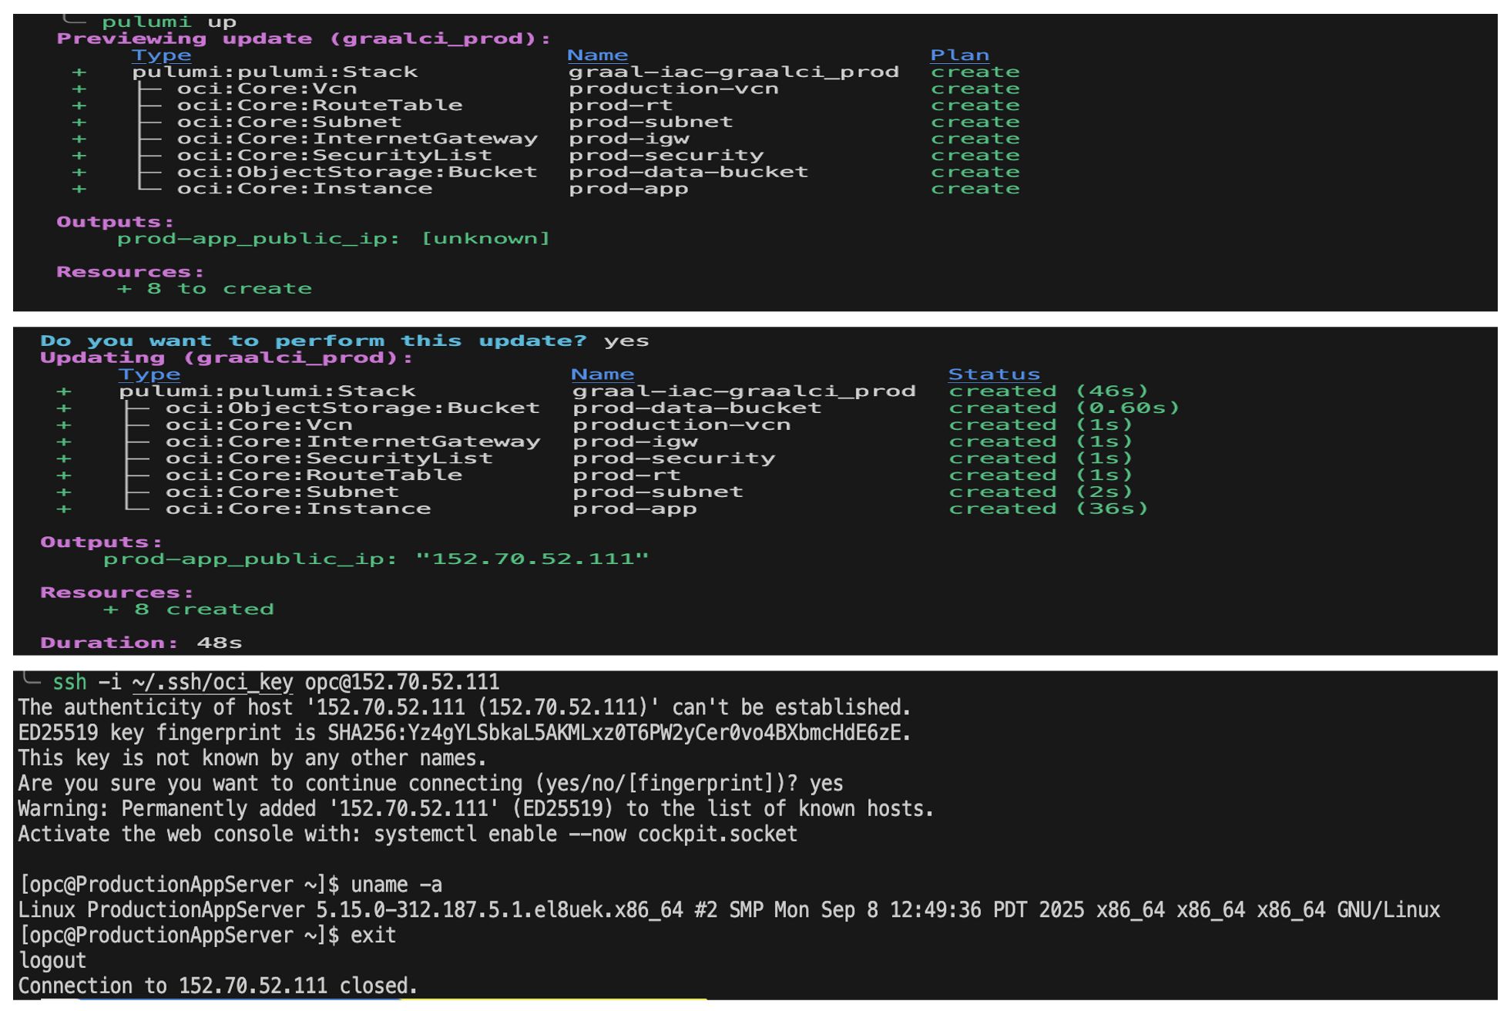

Slide 38
Testing & Validation Results
Unit Testing
CI/CD Pipeline Testing
Scope: Individual resource classes
• Factory pattern registration
• Dependency resolver lookup
• Config loader parsing
✓ All components working correctly
Validated:
• Plan stage (preview changes)
• Deploy stage (apply changes)
• Manual approval gate
• State persistence
✓ Pipeline stable over 20+ runs
Integration Testing
Edge Cases Tested
Test Cases:
• Single VCN + 1 instance
• 2 VCNs + 2 instances
• Complex network (IGW + RT + SL)
• Bucket creation
✓ End-to-end provisioning successful
• Missing dependency (error caught)
• Invalid CIDR block (validation)
• Duplicate resource names (detected)
• Image not compatible with shape

Slide 39
Performance Metrics & Improvements
95%
100%
85%
Time Reduction
Consistency
Error Reduction
From 2-3 hours manual setup
To <5 minutes automated
Zero configuration drift
All envs from same templates
Automated validation
Dependency checking
Before (Manual)
After (Automated)
• Average setup: 2.5 hours
• Error rate: ~15%
• Documentation: Often outdated
• Reproducibility: Low
• Average setup: 4 minutes
• Error rate: <2%
• Documentation: Self-documenting JSON
• Reproducibility: 100%

Slide 40
Business Impact & Team Benefits
Developer Productivity: Team members can now focus on GraalVM development instead of infrastructure management - estimated 10+ hours saved per week across the team
Faster Testing Cycles: Spin up test environments in minutes instead of hours - enables rapid experimentation and bug fixes
Onboarding Acceleration: New team members can provision infrastructure on day one without specialized training - reduces onboarding time from days to hours
Cost Optimization: All infrastructure tracked in Git - easier to identify and delete unused resources, preventing budget overruns

Slide 41
Future Enhancements

Slide 42
Future Improvements
More Resource Coverage
Schema Validation
Expand framework to support additional OCI resources like Load Balancers, Databases, and File Storage
Implement JSON schema validation to catch configuration errors before deployment
Role Identification
Define clear roles within the team on how to use the framework and establish best practices

Slide 43
Conclusion
Successfully delivered a production-ready IaC framework that transforms infrastructure management for the GraalVM RISQ team

Slide 44
Thank You
Questions & Discussion
Yassine DBAICHI
Infrastructure as Code Support in Graal CI
Oracle Labs - GraalVM RISQ Team
Academic Year 2024-2025

