Slide 1


Infrastructure as Code Support
in Graal CI
JSON-Driven IaC Framework with Pulumi & GitLab CI/CD
Yassine DBAICHI
École Hassania des Travaux Publics
Oracle Labs - GraalVM RISQ Team
Academic Year 2024-2025

Slide 2
Agenda
1. Company & Team Context
2. Problem & Solution Overview
Oracle, Oracle Labs, GraalVM RISQ Team mission and focus
Current challenges, requirements, and proposed JSON-driven IaC solution
3. Project Management
4. Technical Implementation
Agile methodology, communication tools, and development workflow
Architecture, design patterns, CI/CD integration, and deployment
5. Results & Validations
6. Future Enhancements
Implementation results, testing outcomes, and performance metrics
Current limitations, future work, and conclusion

Slide 3
Company & Team Context

Slide 4
Oracle Corporation
Global Technology Leader: Multinational computer technology corporation specializing in database software and cloud solutions
Founded: 1977 by Larry Ellison, Bob Miner, and Ed Oates
Headquarters: Austin, Texas, USA (Oracle Headquarters)
Market Position: One of the largest enterprise software companies worldwide
Core Products: Oracle Database, Oracle Cloud Infrastructure (OCI), Enterprise Applications
Revenue: $50+ billion annually with 430,000+ employees globally

Slide 5
Oracle Labs - Research & Innovation
Mission: Conduct research to advance the state of the art in computer science and systems
Focus Areas: Programming languages & compilers Virtual machines & runtime systems Database systems & optimization Cloud infrastructure & security
Key Projects: GraalVM, Truffle Framework, SubstrateVM

Slide 6
GraalVM - High-Performance Polyglot Runtime
What is GraalVM? A universal virtual machine for running applications written in JavaScript, Python, Ruby, R, JVM languages, and more
Key Features: Polyglot capabilities (multiple languages) Native Image compilation Superior performance optimization Reduced memory footprint
Use Cases: Microservices, serverless computing, containerized applications

Slide 7
GraalVM RISQ Team
Team Name: RISQ (Release Infrastructure, Systems & Quality)
Mission: Ensure reliability, scalability, and quality of GraalVM infrastructure and development workflows
Responsibilities: CI/CD pipeline management and optimization Infrastructure automation and provisioning Testing infrastructure maintenance Developer tooling and experience improvements
Tech Stack: GitLab CI/CD, Oracle Cloud Infrastructure, Python, Bash scripting

Slide 8
Project Context & Internship Focus
Team Challenge
Manual Bottleneck
GraalVM requires frequent infrastructure provisioning for testing, CI/CD, and development environments across multiple cloud regions
Infrastructure management was manual, error-prone, and time-consuming - limiting team agility
Project Goal
My Role
Design and implement an automated Infrastructure as Code (IaC) solution integrated with Graal CI pipeline
Lead developer responsible for architecture design, implementation, and GitLab CI/CD integration

Slide 9
Problem & Solution Overview

Slide 10
Current Infrastructure Management Challenges
Manual Console Operations: Team members had to manually create resources through OCI web console - time-consuming and repetitive
Lack of Version Control: No tracking of infrastructure changes, making rollbacks and audits difficult
Configuration Drift: Resources created manually often diverged from documented standards
Scalability Issues: Provisioning multiple similar environments was labor-intensive
Knowledge Silos: Infrastructure knowledge concentrated in few team members
No CI/CD Integration: Infrastructure provisioning was separate from development workflow

Slide 11
Functional Requirements
FR1 - Declarative Configuration: Users define infrastructure in human-readable format (JSON) without writing Python/Terraform code
FR2 - Resource Support: Support for essential OCI resources (VCN, Subnets, Compute Instances, Storage Buckets, Security Lists, Routing)
FR3 - Dependency Management: Automatic resolution of resource dependencies (e.g., subnet requires VCN, instance requires subnet)
FR4 - CI/CD Integration: Seamless integration with GitLab CI/CD pipeline (plan, preview, apply stages)
FR5 - State Management: Track infrastructure state to enable updates and deletions
FR6 - Multi-Environment: Support for development, staging, and production configurations

Slide 12
Non-Functional Requirements
Performance
Security
Provision infrastructure in <5 minutes
Support concurrent deployments
Minimal API calls to OCI
Credentials stored securely (GitLab secrets)
No hardcoded sensitive data
Audit trail via Git commits
Extensibility
Plugin architecture for new resources
Support for future cloud providers
Custom validation rules

Slide 13
IaC Technology Selection: Terraform vs Pulumi

Slide 14
How does Pulumi work?
Python-First: Leverage existing team Python expertise
OCI Provider: First-class Oracle Cloud Infrastructure support
Framework Foundation: Enables building JSON-driven abstraction layer on top

Slide 15
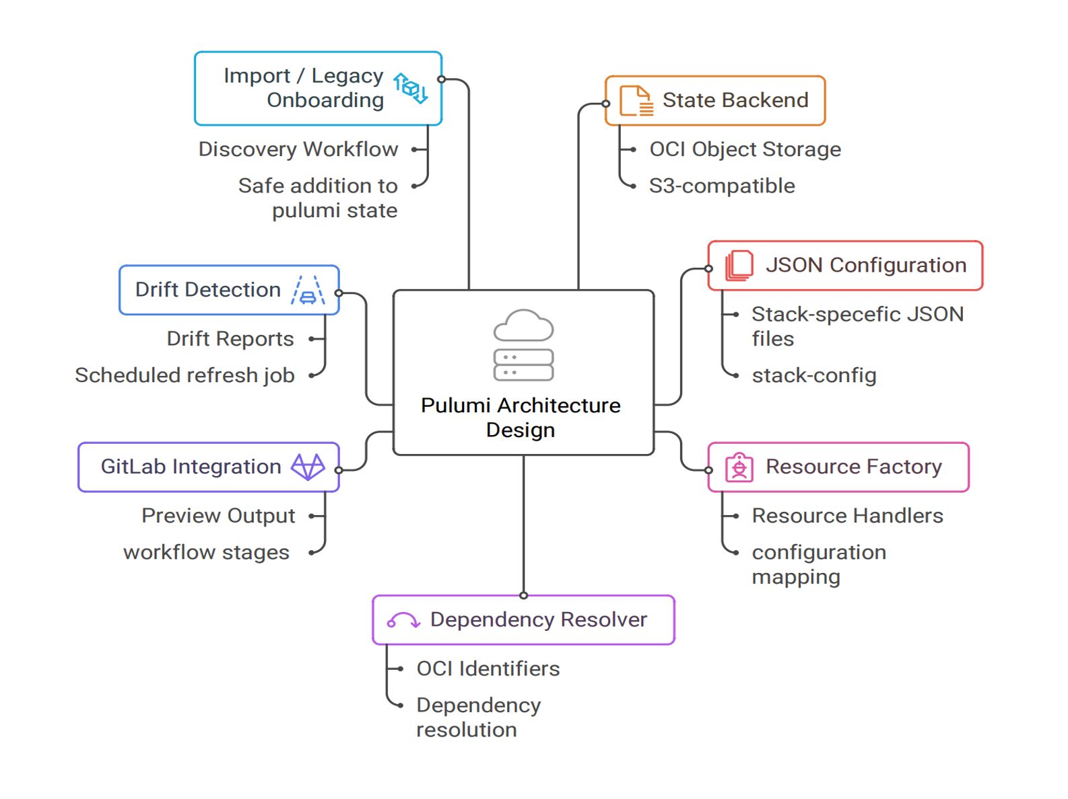

Slide 16
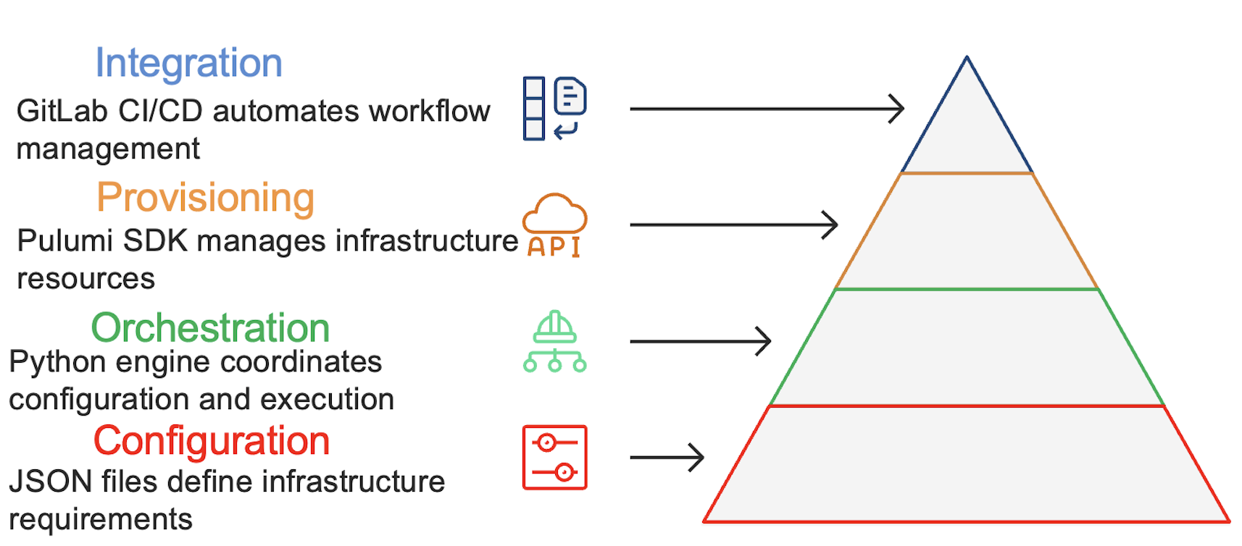

Slide 17
Project Management

Slide 18
Project Management Approach
Methodology: Kanban Agile - visual workflow management with continuous delivery
Project Tracker: Task board for tracking work items (To Do, In Progress, Done)
Regular Meetings: Weekly sync meetings with mentor to review progress and blockers
Continuous Flow: Work items pulled as capacity allows, no fixed sprint boundaries
Focus on Delivery: Prioritize completing tasks over starting new ones

Slide 19
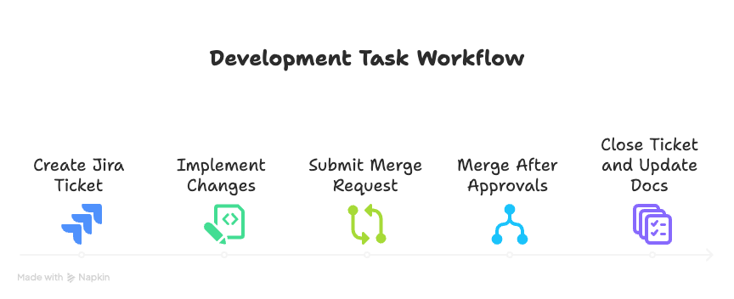

Slide 20





Communication & Collaboration Tools
Slack
Zoom
Jira
Outlook
Confluence
GitLab

Slide 21
Mentor Check-ins & Team Meetings

Slide 22
Project Timeline & Key Milestones

Slide 23
Technical Implementation

Slide 24
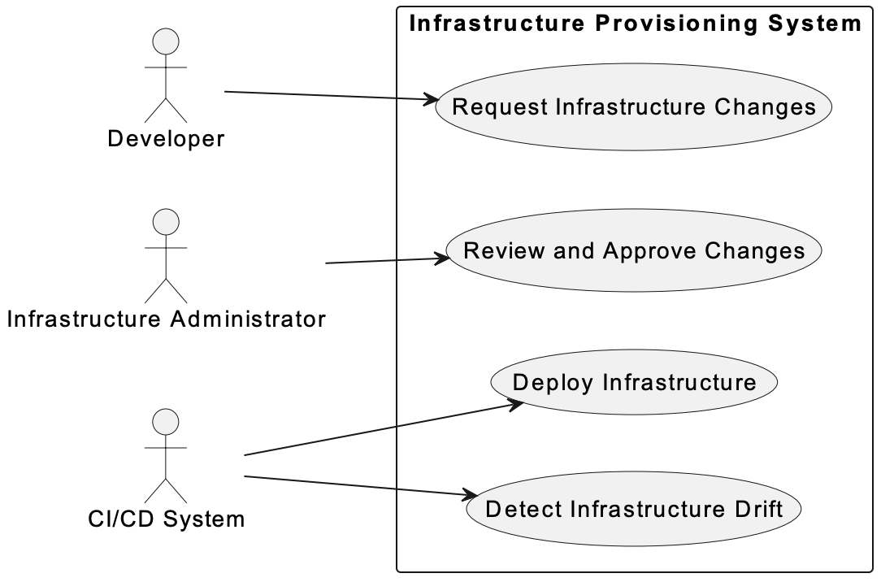

Slide 25
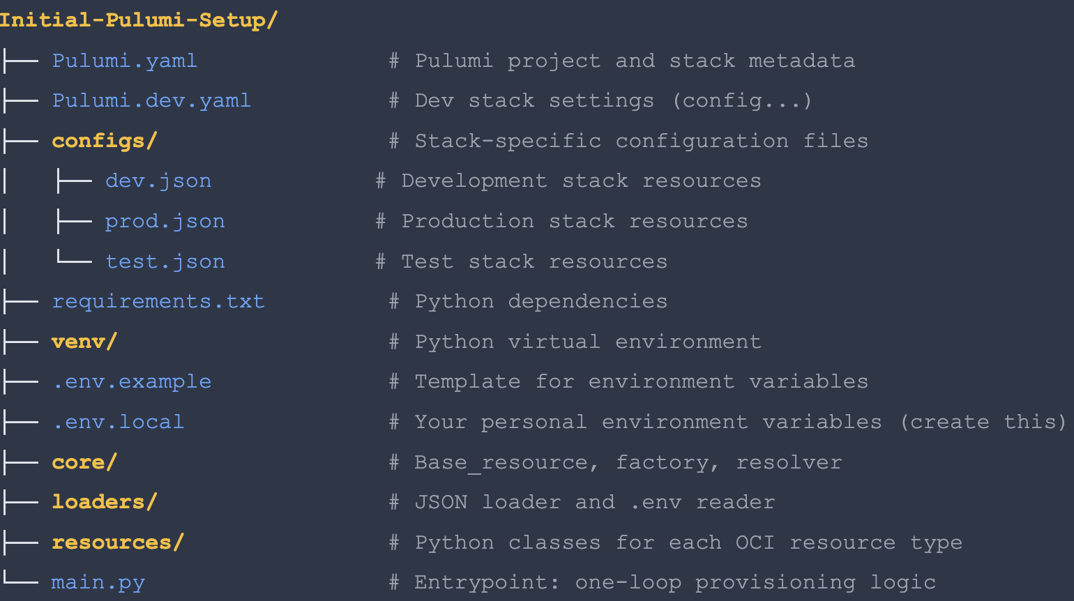

Slide 26
JSON Configuration Example
Name-Based References: Resources reference each other by human-readable names
Automatic Resolution: Framework resolves names to OCIDs automatically

Slide 27
Core Framework Components
BaseResource (Abstract)
ResourceFactory
File: core/base_resource.py (21 lines)
Purpose: Abstract base class defining resource interface
Methods:
create() - Factory method
build() - Abstract (must implement)
File: core/resource_factory.py (38 lines)
Purpose: Factory pattern for dynamic instantiation
Registry: Maps type strings → Python classes
7 resource types registered
DependencyResolver
ConfigLoader
File: core/dependency_resolver.py (14 lines)
Purpose: Resource reference manager
Methods:
register_resource(name, resource)
get_resource_id(name)
File: config/config_loader.py (25 lines)
Purpose: Parse infrastructure.json
Methods:
get_vcns_config()
get_instances_config()
get_image_config()

Slide 28
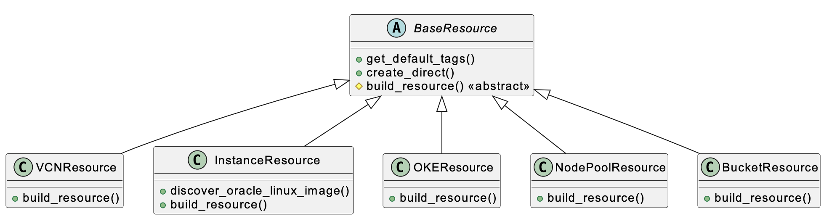

Slide 29
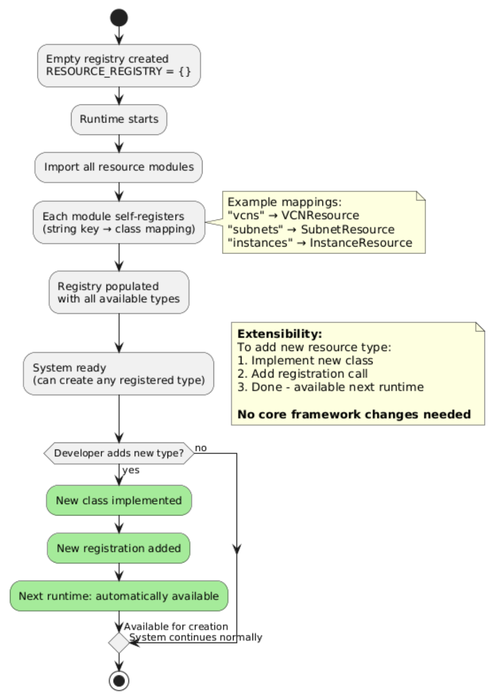

Slide 30
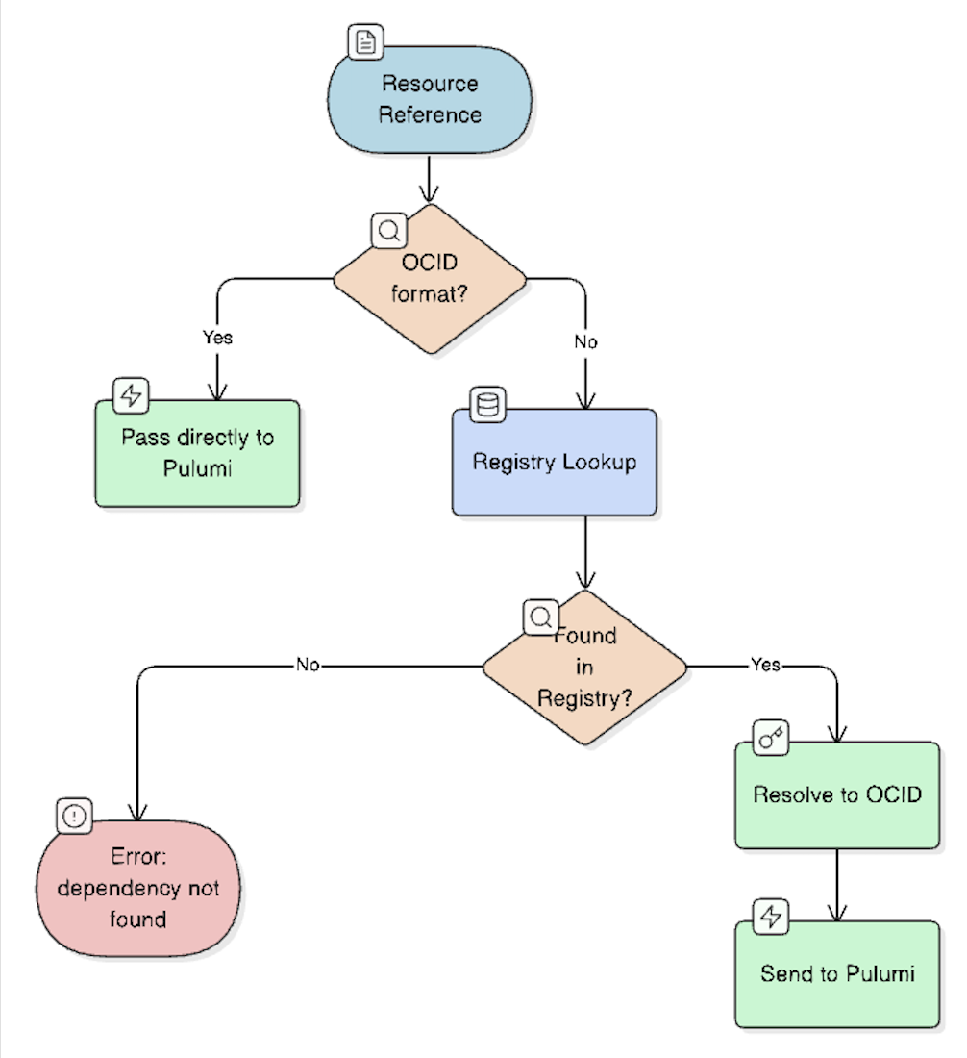

Slide 31
Implemented Resource Types

Slide 32
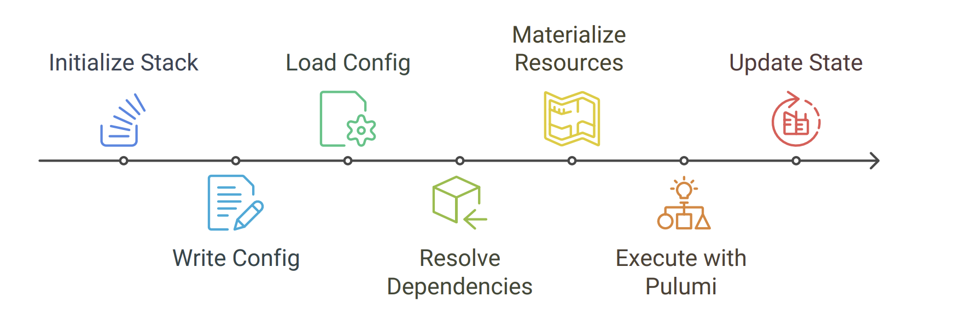

Slide 33
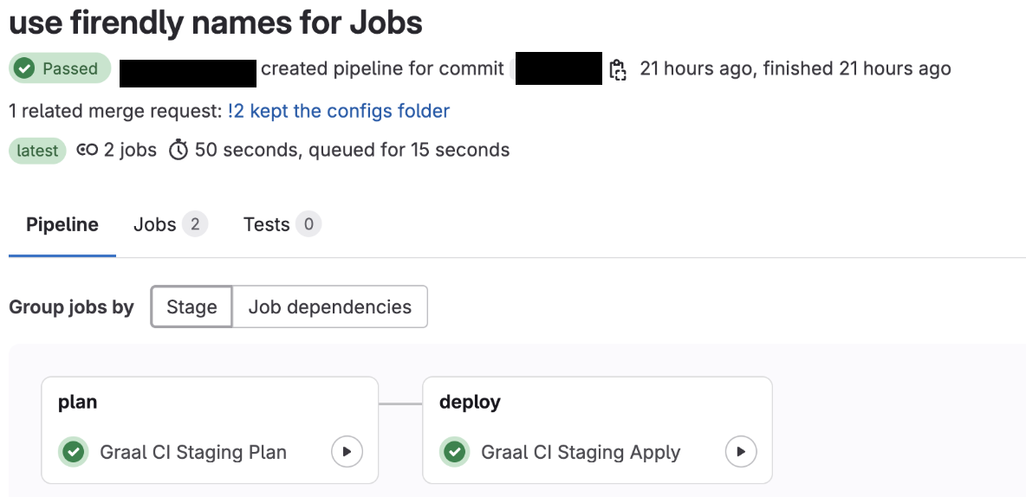

Slide 34
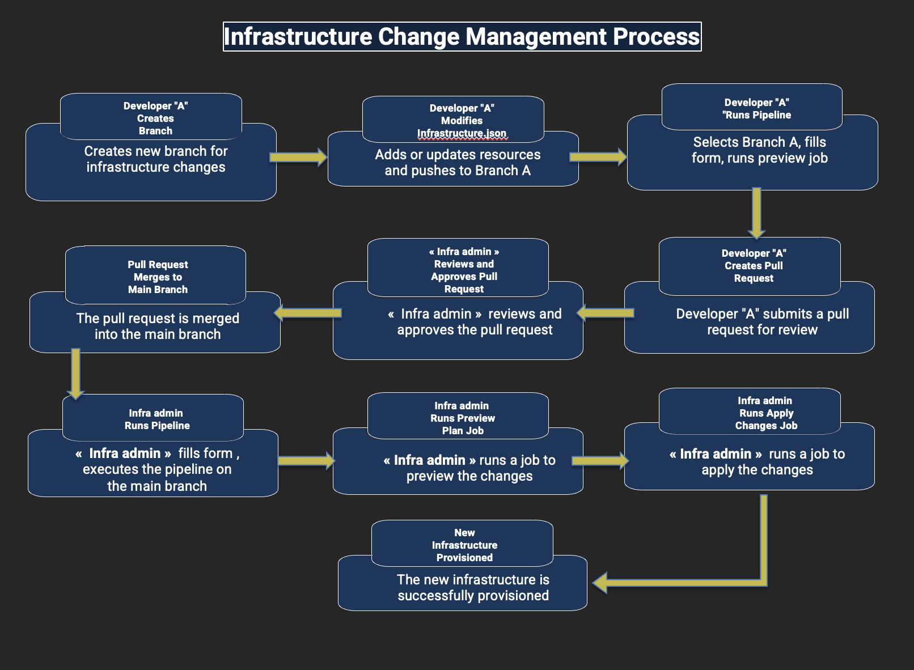

Slide 35
Results & Validations

Slide 36
Implementation Results
✅ Deliverables Completed
🎯 Requirements Met
Python framework (800 LOC)
7 OCI resource types
JSON configuration system
GitLab CI/CD pipeline
Documentation & diagrams
✓ Declarative JSON config
✓ Dependency resolution
✓ CI/CD integration
✓ Multi-environment support
✓ State management
🚀 Production Ready
Error handling implemented
Tested on dev & staging
Documentation complete
Team training delivered
Now in active use by RISQ team

Slide 37
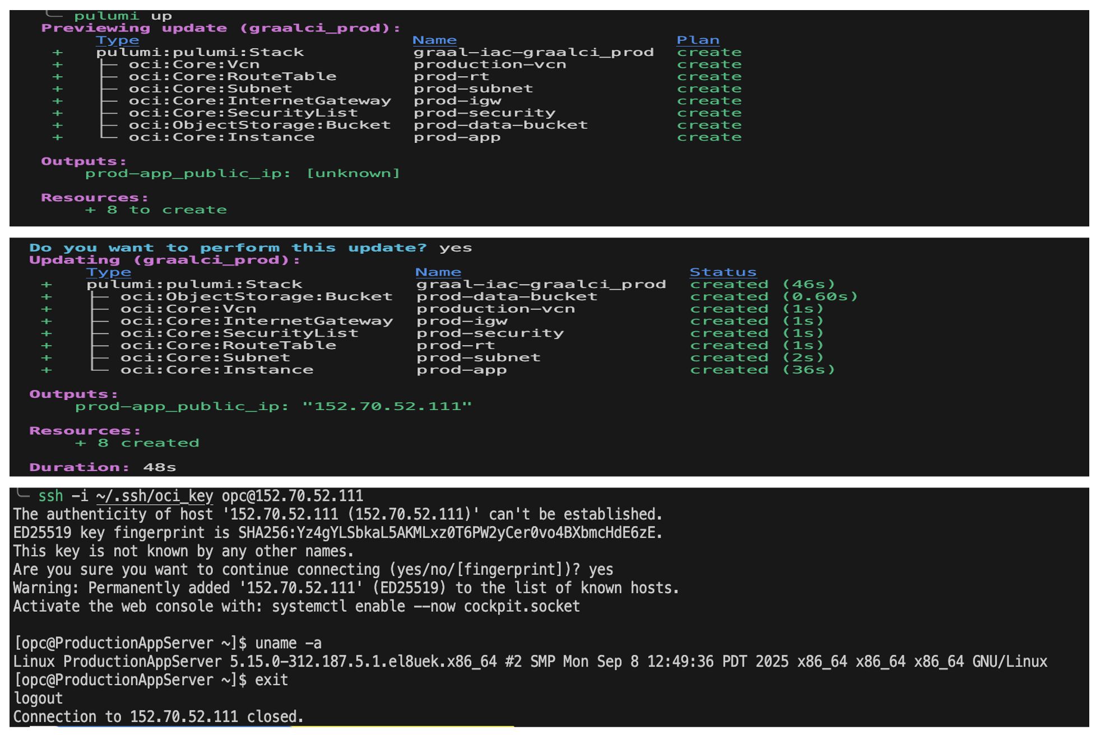

Slide 38
Testing & Validation Results

Slide 39
Performance Metrics & Improvements
Before (Manual)
After (Automated)
Average setup: 2.5 hours
Error rate: ~15%
Documentation: Often outdated
Reproducibility: Low
Average setup: 4 minutes
Error rate: <2%
Documentation: Self-documenting JSON
Reproducibility: 100%

Slide 40
Business Impact & Team Benefits
Developer Productivity: Team members can now focus on GraalVM development instead of infrastructure management - estimated 10+ hours saved per week across the team
Faster Testing Cycles: Spin up test environments in minutes instead of hours - enables rapid experimentation and bug fixes
Onboarding Acceleration: New team members can provision infrastructure on day one without specialized training - reduces onboarding time from days to hours
Cost Optimization: All infrastructure tracked in Git - easier to identify and delete unused resources, preventing budget overruns

Slide 41
Future Enhancements

Slide 42
Future Improvements
More Resource Coverage
Schema Validation
Expand framework to support additional OCI resources like Load Balancers, Databases, and File Storage
Implement JSON schema validation to catch configuration errors before deployment
Role Identification
Define clear roles within the team on how to use the framework and establish best practices

Slide 43
Conclusion

Slide 44
Thank You
Questions & Discussion
Yassine DBAICHI
Infrastructure as Code Support in Graal CI
Oracle Labs - GraalVM RISQ Team
Academic Year 2024-2025

