Slide 1


Infrastructure as Code Support in Graal CI
JSON-Driven IaC Framework with Pulumi & GitLab CI/CD
Yassine DBAICHI
École Hassania des Travaux Publics
Oracle Labs - GraalVM RISQ Team
Academic Year 2024-2025

Slide 2
Agenda
1. Company & Team Context
Oracle, Oracle Labs, GraalVM RISQ Team mission and focus
2. Problem & Solution Overview
Current challenges, requirements, and proposed JSON-driven IaC solution
3. Project Management
Agile methodology, communication tools, and development workflow
4. Technical Implementation
Architecture, design patterns, CI/CD integration, and deployment
5. Results & Validations
Implementation results, testing outcomes, and performance metrics
6. Future Enhancements
Current limitations, future work, and conclusion

Slide 3
Company & Team Context

Slide 4
Oracle Corporation
Global Technology Leader: Multinational computer technology corporation specializing in database software and cloud solutions
Founded: 1977 by Larry Ellison, Bob Miner, and Ed Oates
Headquarters: Austin, Texas, USA (Oracle Headquarters)
Market Position: One of the largest enterprise software companies worldwide
Core Products: Oracle Database, Oracle Cloud Infrastructure (OCI), Enterprise Applications
Revenue: $50+ billion annually with 430,000+ employees globally

Slide 5
Oracle Labs - Research & Innovation
Mission: Conduct research to advance the state of the art in computer science and systems
Focus Areas: Programming languages & compilers Virtual machines & runtime systems Database systems & optimization Cloud infrastructure & security
Key Projects: GraalVM, Truffle Framework, SubstrateVM
Collaboration
Strong partnerships with universities and research institutions worldwide
Research Excellence
Oracle Labs bridges cutting-edge academic research with real-world enterprise applications Output: Open-source projects, academic publications, and production-ready technologies

Slide 6
GraalVM - High-Performance Polyglot Runtime
What is GraalVM? A universal virtual machine for running applications written in JavaScript, Python, Ruby, R, JVM languages, and more
Key Features: Polyglot capabilities (multiple languages) Native Image compilation Superior performance optimization Reduced memory footprint
Use Cases: Microservices, serverless computing, containerized applications

Slide 7
GraalVM RISQ Team
Team Name: RISQ (Release Infrastructure, Systems & Quality)
Mission: Ensure reliability, scalability, and quality of GraalVM infrastructure and development workflows
Responsibilities:
Tech Stack: GitLab CI/CD, Oracle Cloud Infrastructure, Python, Bash scripting
The RISQ team acts as the backbone supporting GraalVM development, ensuring smooth operations for hundreds of developers

Slide 8
Project Context & Internship Focus
Team Challenge
GraalVM requires frequent infrastructure provisioning for testing, CI/CD, and development environments across multiple cloud regions
Manual Bottleneck
Infrastructure management was manual, error-prone, and time-consuming - limiting team agility
Project Goal
Design and implement an automated Infrastructure as Code (IaC) solution integrated with Graal CI pipeline
My Role
Lead developer responsible for architecture design, implementation, and GitLab CI/CD integration

Slide 9
Problem & Solution Overview

Slide 10
Current Infrastructure Management Challenges
Manual Console Operations: Team members had to manually create resources through OCI web console - time-consuming and repetitive
Lack of Version Control: No tracking of infrastructure changes, making rollbacks and audits difficult
Configuration Drift: Resources created manually often diverged from documented standards
Scalability Issues: Provisioning multiple similar environments was labor-intensive
Knowledge Silos: Infrastructure knowledge concentrated in few team members
No CI/CD Integration: Infrastructure provisioning was separate from development workflow
Result: Slow deployment cycles, increased error rates, and reduced team productivity

Slide 11
Detailed Pain Points Analysis
⏱️ Time Overhead
Issue: 2-3 hours per environment setup Impact: Delayed testing cycles
❌ Human Error
Issue: Misconfigured security rules, wrong CIDR blocks Impact: Security vulnerabilities, network issues
🔄 Consistency Problems
Issue: Dev, staging, and prod environments differ Impact: "Works on my machine" syndrome
📋 Documentation Gap
Issue: Outdated documentation, tribal knowledge Impact: Onboarding difficulties, knowledge loss
💰 Cost Management
Issue: Forgotten resources running unnecessarily Impact: Budget waste, resource sprawl
🚫 No Approval Workflow
Issue: Anyone could provision any resource Impact: Compliance risks, cost overruns

Slide 12
Functional Requirements
FR1 - Declarative Configuration: Users define infrastructure in human-readable format (JSON) without writing Python/Terraform code
FR2 - Resource Support: Support for essential OCI resources (VCN, Subnets, Compute Instances, Storage Buckets, Security Lists, Routing)
FR3 - Dependency Management: Automatic resolution of resource dependencies (e.g., subnet requires VCN, instance requires subnet)
FR4 - CI/CD Integration: Seamless integration with GitLab CI/CD pipeline (plan, preview, apply stages)
FR5 - State Management: Track infrastructure state to enable updates and deletions
FR6 - Multi-Environment: Support for development, staging, and production configurations

Slide 13
Non-Functional Requirements
Performance
Provision infrastructure in <5 minutes Support concurrent deployments Minimal API calls to OCI
Maintainability
Modular codebase (~800 LOC) Easy to add new resource types Comprehensive inline documentation
Security
Credentials stored securely (GitLab secrets) No hardcoded sensitive data Audit trail via Git commits
Reliability
Idempotent operations Graceful error handling State consistency guaranteed
Usability
No programming knowledge required Clear error messages Self-documenting configuration
Extensibility
Plugin architecture for new resources Support for future cloud providers Custom validation rules

Slide 14
IaC Technology Landscape
Terraform
Pros: Industry standard HCL declarative language Large provider ecosystem Cons: Custom DSL to learn (HCL) Limited programming logic State management complexity
Pulumi ✓
Pros: Use real programming languages (Python) Full programmatic control Built-in state management Excellent OCI support Why chosen: Perfect fit for our team's Python expertise
CloudFormation
Pros: Native AWS integration YAML/JSON templates Cons: AWS-only (we use OCI) Verbose syntax Limited extensibility
Ansible
Pros: Agentless YAML playbooks Cons: Better for configuration management Not true IaC Imperative approach

Slide 15
Why Pulumi?
Python-First: Team already proficient in Python - no new language to learn
Programmatic Power: Full access to loops, conditionals, functions - enables dynamic infrastructure
OCI Provider: First-class Oracle Cloud Infrastructure support with comprehensive resource coverage
State Management: Built-in state backend (OCI Object Storage compatible) - no separate state server needed
Preview & Diff: See changes before applying - critical for production safety

Slide 19
Proposed Solution: JSON-Driven IaC Framework
Layer 1: Configuration
JSON files define infrastructure (VCNs, instances, buckets) with human-readable names
Layer 2: Orchestration
Python engine coordinates resource creation, resolves dependencies
Layer 3: Provisioning
Pulumi SDK translates Python to OCI API calls
Layer 4: Integration
GitLab CI/CD automates workflow with approval gates

Slide 22
Key Benefits & Value Proposition
⚡ Speed
Before: 2-3 hours manual setup After: <5 minutes automated 95% time reduction
📚 Documentation
Infrastructure defined as code = living documentation Always up-to-date
✅ Consistency
All environments provisioned from same JSON templates Zero configuration drift
💰 Cost Control
All resources tracked in Git, easy to identify and delete unused infrastructure Prevent resource sprawl
🔒 Security
Code review + approval workflow before deployment Audit trail via Git
🚀 Scalability
Provision 10 environments as easily as 1 Copy-paste JSON config

Slide 23
Project Management

Slide 24
Agile Methodology & Approach
Framework: Agile/Scrum adapted for solo development with mentor collaboration
Sprint Duration: 2-week sprints with clear deliverables and milestones
Daily Stand-ups: Async updates via Slack with blockers highlighted
Sprint Planning: Define goals, break down tasks, estimate effort
Sprint Review: Demo working features to mentor and team
Retrospective: Reflect on what worked, what to improve
Adaptation: Lightweight process focused on rapid iterations and continuous feedback rather than heavy documentation

Slide 25

Communication & Collaboration Tools

Slide 27
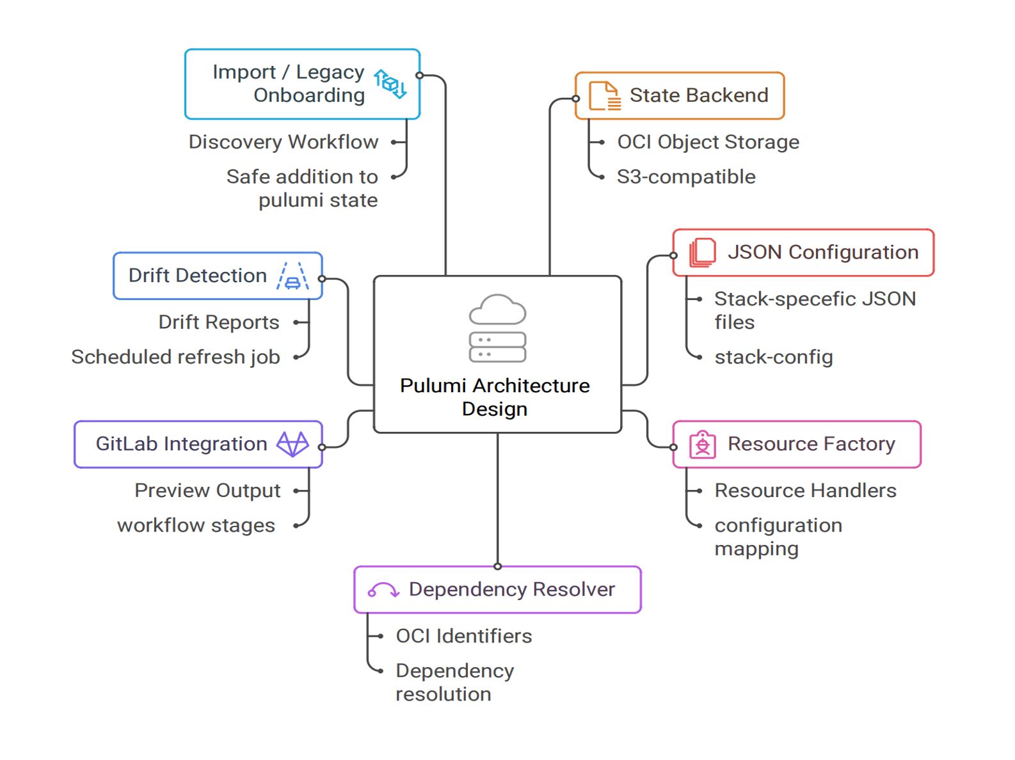
Mentor Check-ins & Team Meetings
Weekly Sync Meetings
Frequency: Every Tuesday 11:00 AM Duration: 45-60 minutes Agenda: Progress review, blockers discussion, next steps planning Participants: Intern + mentor (Hamza Ghaissi)
Ad-hoc Sessions
Technical architecture discussions Code reviews and pair programming Debugging complex issues Design decision consultations
Communication Style: Open-door policy via Slack - quick responses and collaborative problem-solving

Slide 28
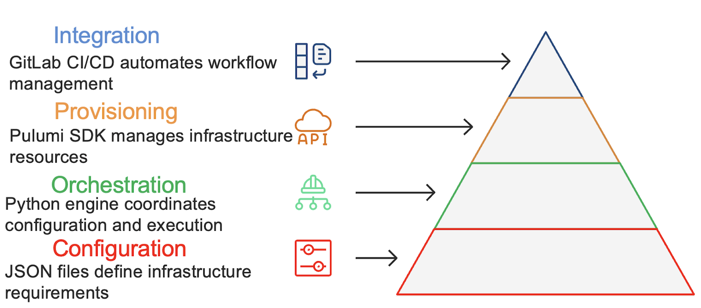
Project Timeline & Key Milestones
Phase 1: Research (2 weeks) OCI API exploration Pulumi SDK study Requirements gathering Architecture design Phase 2: Prototype (2 weeks) Core framework skeleton VCN + Instance resources Factory pattern POC Basic dependency resolver Phase 3: Development (4 weeks) All 7 resource types JSON configuration loader Dependency resolution logic Error handling Phase 4: CI/CD Integration (2 weeks) GitLab pipeline config Plan & deploy stages Manual approval gates Pipeline testing Phase 5: Testing (2 weeks) Integration testing Edge case validation Performance testing Bug fixes Phase 6: Documentation (1 week) User guide creation Code documentation Architecture diagrams Final presentation Total Duration: 13 weeks (July - October 2025) | Total LOC: ~800 lines of production Python code

Slide 29
Technical Implementation

Slide 32
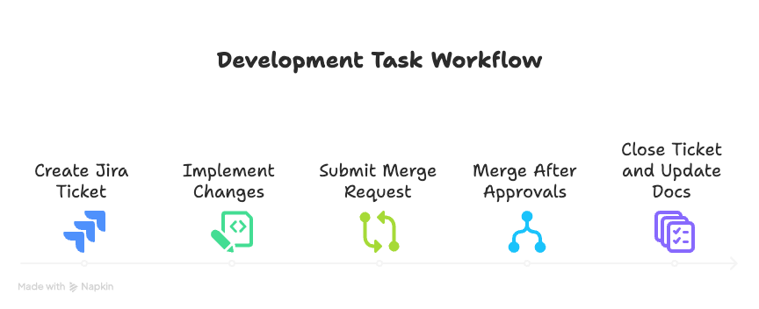

Slide 34
Configuration Layer - JSON Structure
Metadata: Project name, version, description
Image Config: Oracle Linux version, shape filter
VCN Definitions: CIDR blocks, display names, nested resources
Network Resources: Internet Gateways, Route Tables, Security Lists, Subnets
Compute Resources: Instance configurations (shape, boot volume, SSH keys)
Storage Resources: Object Storage buckets
Example VCN Config
{ "name": "production-vcn", "cidrBlock": "10.0.0.0/16", "internetGateways": [...] "securityLists": [...] "routeTables": [...] "subnets": [...] }
Key Feature
Name-Based References: Resources reference each other by human-readable names (e.g., "prod-subnet") not OCIDs Framework resolves names to OCIDs automatically
File: infrastructure.json (152 lines, 5.1 KB)

Slide 35
Core Framework Components
BaseResource (Abstract)
File: core/base_resource.py (21 lines) Purpose: Abstract base class defining resource interface Methods: create() - Factory method build() - Abstract (must implement)
ResourceFactory
File: core/resource_factory.py (38 lines) Purpose: Factory pattern for dynamic instantiation Registry: Maps type strings → Python classes 7 resource types registered
DependencyResolver
File: core/dependency_resolver.py (14 lines) Purpose: Resource reference manager Methods: register_resource(name, resource) get_resource_id(name)
ConfigLoader
File: config/config_loader.py (25 lines) Purpose: Parse infrastructure.json Methods: get_vcns_config() get_instances_config() get_image_config()

Slide 36
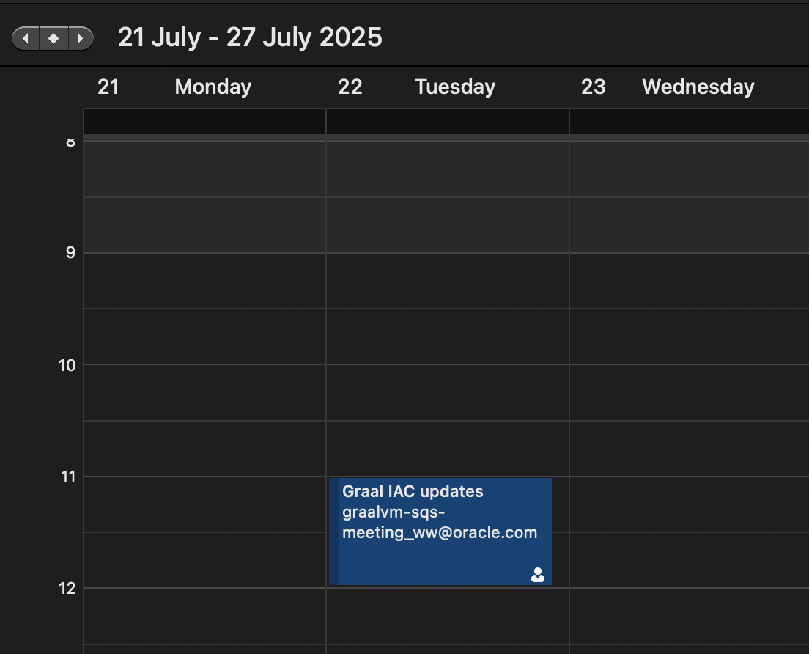

Slide 39
Implemented Resource Types
1. VCN (Virtual Cloud Network) File: resources/vcn_resource.py Purpose: Foundation network container Params: cidrBlock, displayName 2. Internet Gateway File: resources/internet_gateway_resource.py Purpose: Enable internet connectivity Dependency: Requires VCN 3. Security List File: resources/security_list_resource.py Purpose: Firewall rules (ingress/egress) Params: Protocol, ports, CIDR sources 4. Route Table File: resources/route_table_resource.py Purpose: Network routing configuration Dependency: Requires Internet Gateway 5. Subnet File: resources/subnet_resource.py Purpose: Network segment within VCN Dependency: Requires RT + Security List 6. Compute Instance File: resources/instance_resource.py Purpose: Virtual machine Params: Shape, image, SSH key, subnet 7. Object Storage Bucket File: resources/bucket_resource.py Purpose: S3-compatible object storage Independent: No dependencies

Slide 40
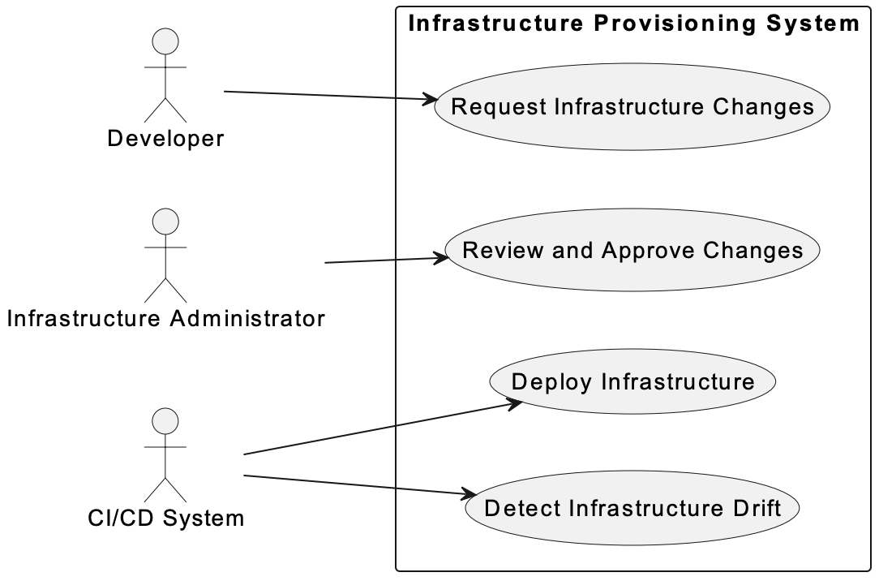

Slide 41
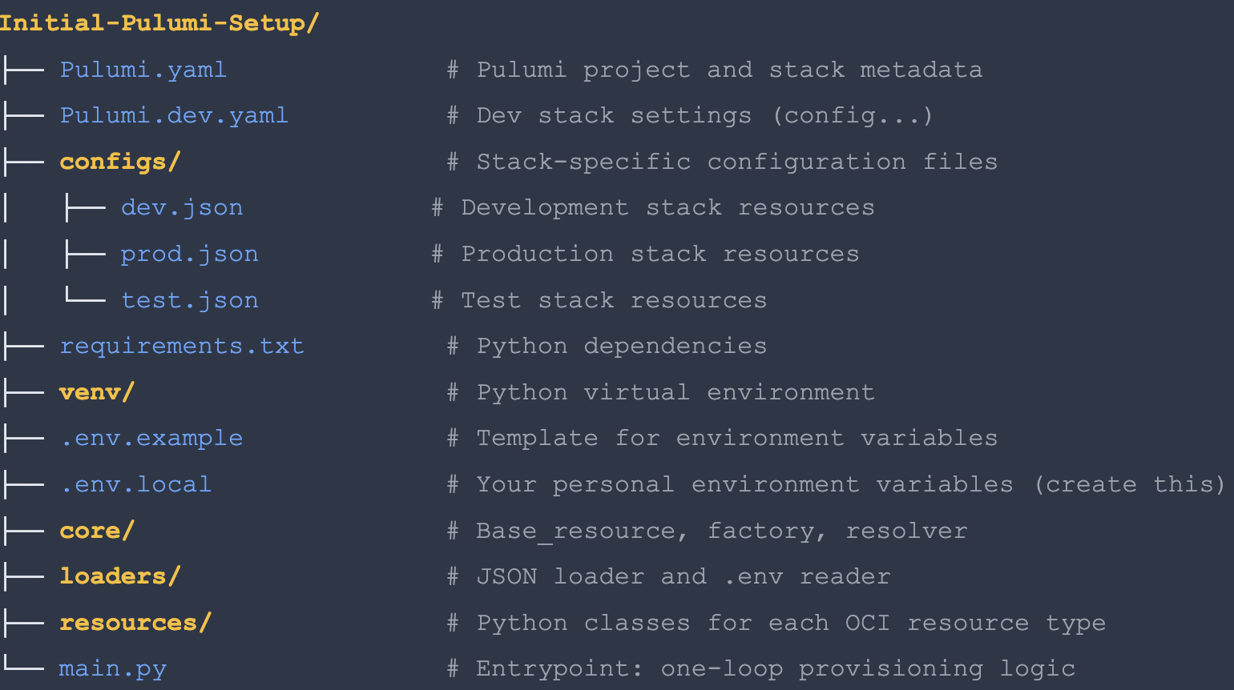

Slide 43
Code Execution Flow
1. Load Configuration config = ConfigLoader.load_infrastructure_config() 2. Initialize Resolver resolver = DependencyResolver() 3. Create VCNs (no dependencies) for vcn_config in config['vcns']: vcn = ResourceFactory.create('vcn', vcn_config) resolver.register('production-vcn', vcn) 4. Create Gateways (depends on VCN) igw = ResourceFactory.create('internetGateway', {...}) resolver.register('prod-igw', igw) 5. Create Route Tables (depends on IGW) rt_config['networkEntityId'] = resolver.get_resource_id('prod-igw') rt = ResourceFactory.create('routeTable', rt_config) 6. Create Subnets (depends on RT + SL) subnet_config['routeTableId'] = resolver.get_resource_id('prod-rt') subnet = ResourceFactory.create('subnet', subnet_config) 7. Create Instances (depends on Subnet) instance_config['subnetId'] = resolver.get_resource_id('prod-subnet') instance = ResourceFactory.create('instance', instance_config)

Slide 44
GitLab CI/CD Pipeline Stages
Stage 1: Plan
Trigger: Every commit to branch Action: Run pulumi preview Output: Show planned changes (create/update/delete) Duration: ~30 seconds ✓ Automatic - no approval needed
Stage 2: Deploy
Trigger: Manual approval after plan Action: Run pulumi up --yes Output: Apply changes to OCI Duration: 2-4 minutes ⚠ Requires infrastructure admin approval

Slide 45
Results & Validations

Slide 46
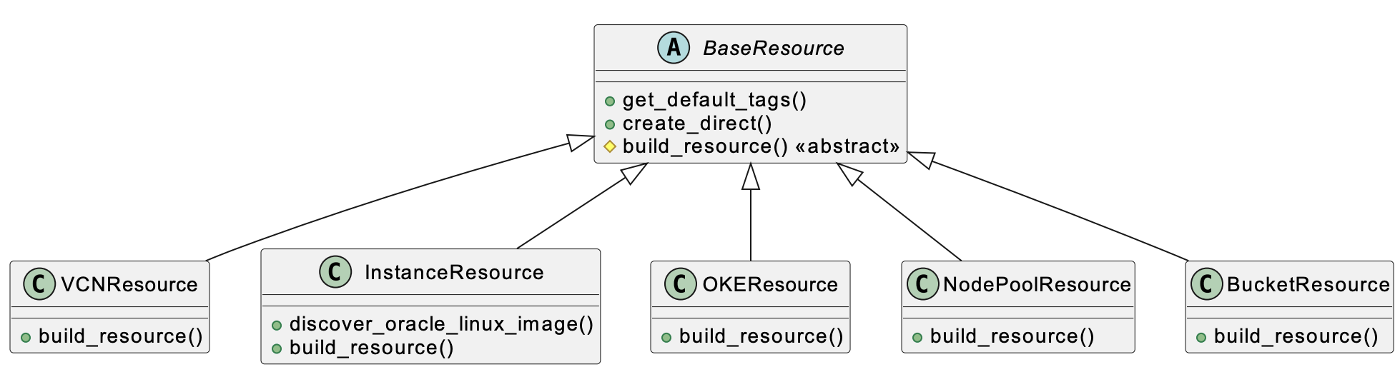
Implementation Results
✅ Deliverables Completed
Python framework (800 LOC) 7 OCI resource types JSON configuration system GitLab CI/CD pipeline Documentation & diagrams
📊 Code Metrics
Total files: 17 Python modules Core framework: ~95 lines Resource implementations: ~240 lines Config & orchestration: ~170 lines Zero external dependencies (except Pulumi)
🎯 Requirements Met
✓ Declarative JSON config ✓ Dependency resolution ✓ CI/CD integration ✓ Multi-environment support ✓ State management
🚀 Production Ready
Error handling implemented Tested on dev & staging Documentation complete Team training delivered Now in active use by RISQ team

Slide 47
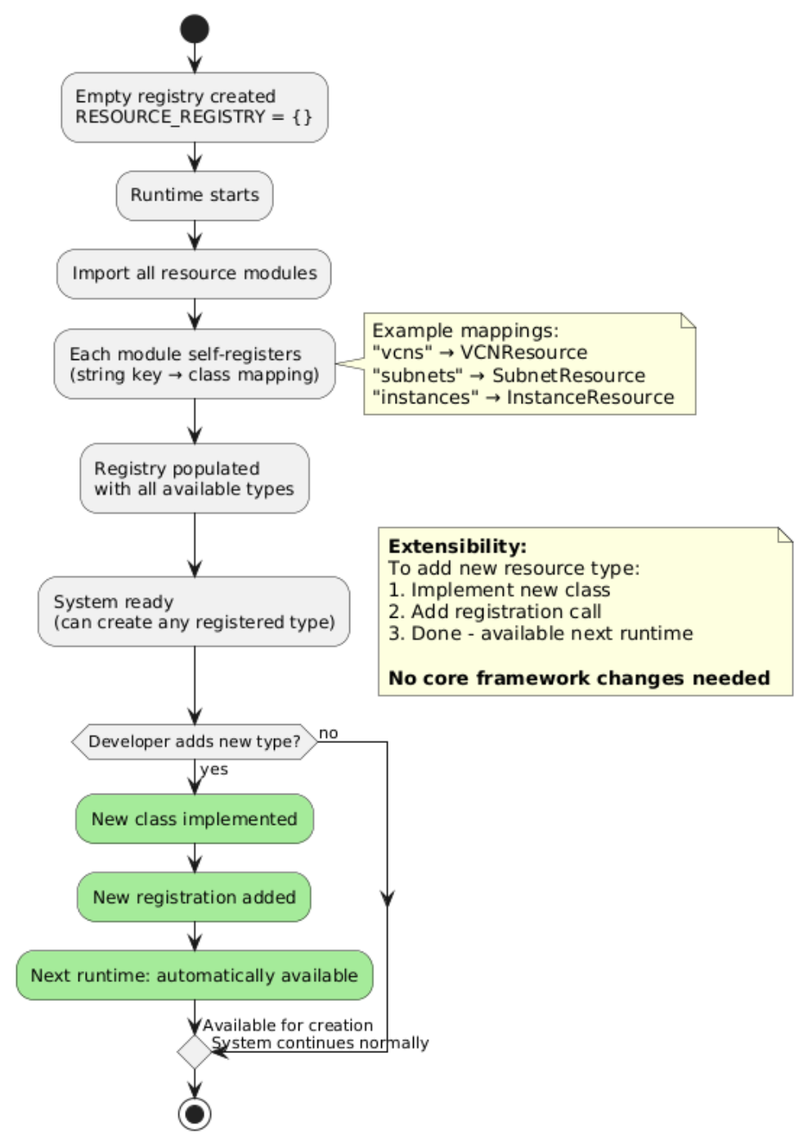

Slide 48
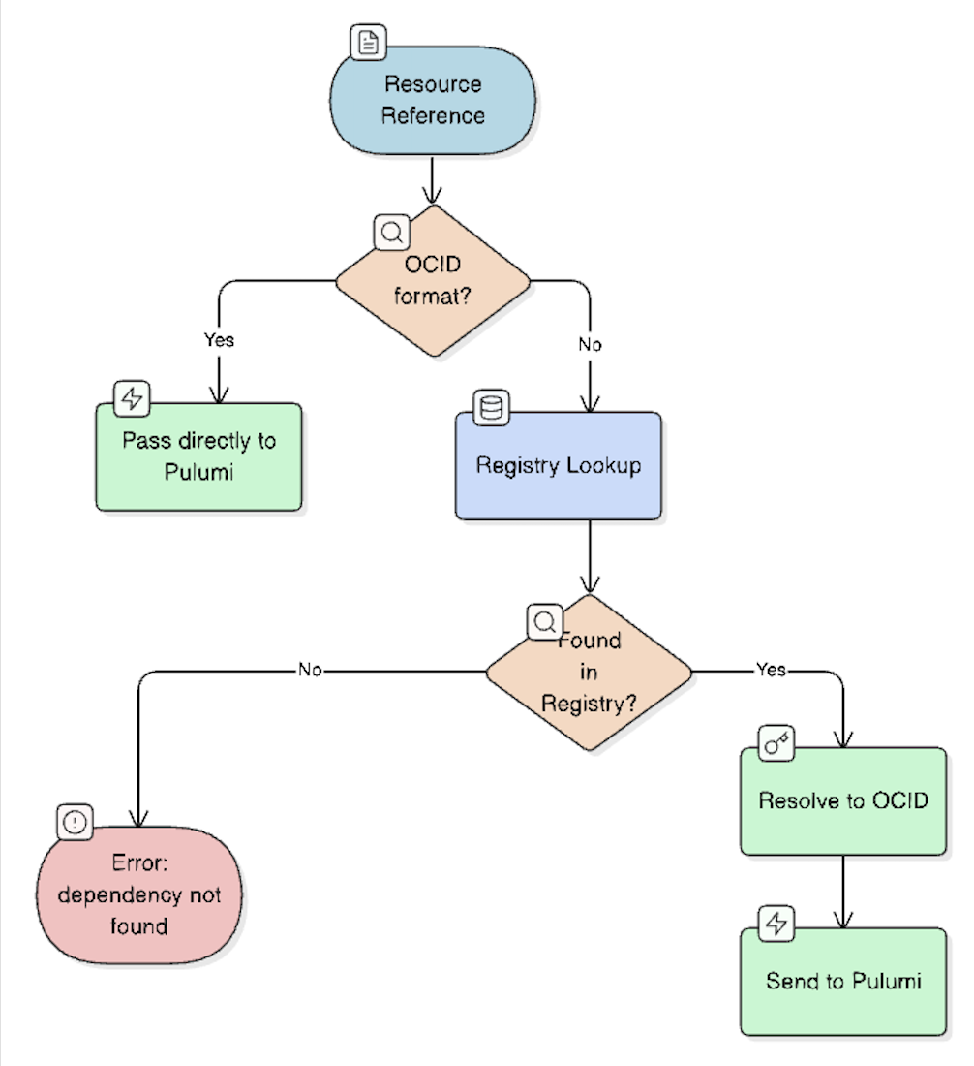
Testing & Validation Results
Unit Testing
Scope: Individual resource classes Factory pattern registration Dependency resolver lookup Config loader parsing ✓ All components working correctly
CI/CD Pipeline Testing
Validated: Plan stage (preview changes) Deploy stage (apply changes) Manual approval gate State persistence ✓ Pipeline stable over 20+ runs
Integration Testing
Test Cases: Single VCN + 1 instance 2 VCNs + 2 instances Complex network (IGW + RT + SL) Bucket creation ✓ End-to-end provisioning successful
Edge Cases Tested
✓ Missing dependency (error caught) ✓ Invalid CIDR block (validation) ✓ Duplicate resource names (detected) ✓ Image not compatible with shape ✓ Network timeout handling

Slide 49
Performance Metrics & Improvements
Before (Manual)
Average setup: 2.5 hours Error rate: ~15% Documentation: Often outdated Reproducibility: Low
After (Automated)
Average setup: 4 minutes Error rate: <2% Documentation: Self-documenting JSON Reproducibility: 100%

Slide 50
Business Impact & Team Benefits
Developer Productivity: Team members can now focus on GraalVM development instead of infrastructure management - estimated 10+ hours saved per week across the team
Faster Testing Cycles: Spin up test environments in minutes instead of hours - enables rapid experimentation and bug fixes
Onboarding Acceleration: New team members can provision infrastructure on day one without specialized training - reduces onboarding time from days to hours
Cost Optimization: All infrastructure tracked in Git - easier to identify and delete unused resources, preventing budget overruns
Compliance & Audit: Complete audit trail via Git commits - know who changed what, when, and why. Satisfies enterprise compliance requirements
Knowledge Democratization: Infrastructure knowledge encoded in code - no more tribal knowledge silos or single points of failure
Team Feedback: "This framework has transformed how we manage infrastructure. What used to take half a day now takes minutes, and we can finally version control our cloud resources." - RISQ Team Lead

Slide 51
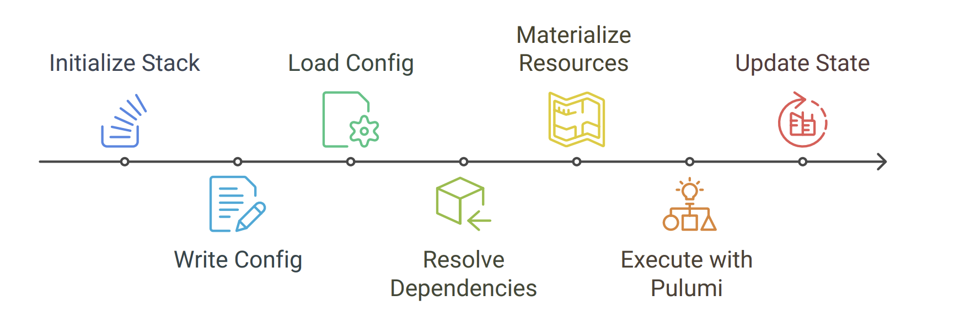
Future Enhancements

Slide 52
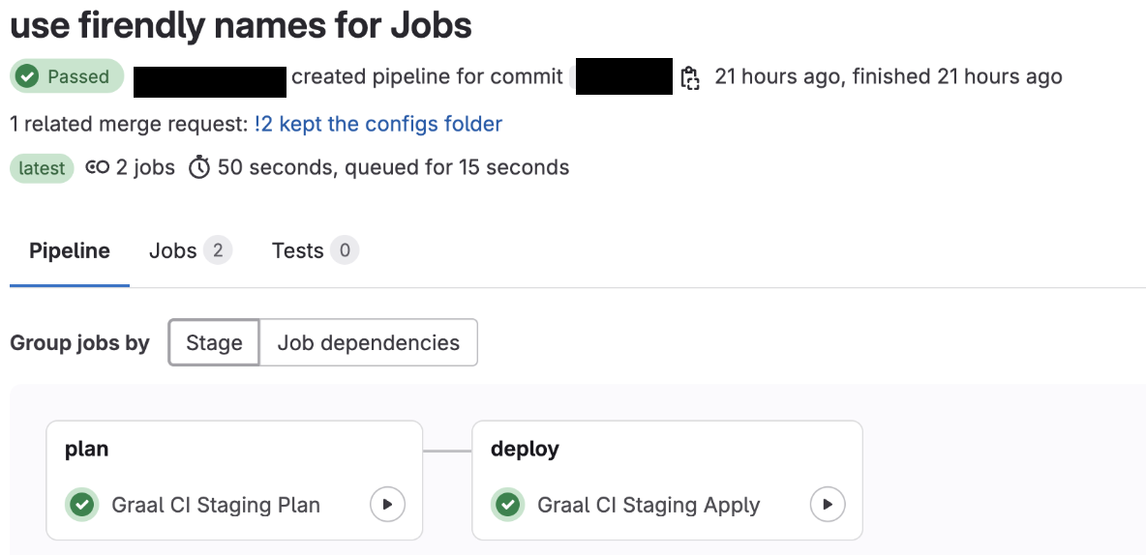
Current Limitations & Known Issues
Resource Coverage
Current: 7 resource types Missing: Load Balancers Databases (Autonomous DB) File Storage Service Container Engine (OKE)
Configuration Validation
Current: Basic validation in code Missing: JSON schema validation CIDR overlap detection Cost estimation before deploy Security policy checks
Multi-Cloud Support
Current: OCI only Potential: AWS provider Azure provider GCP provider Hybrid cloud deployments
Advanced Features
Missing: Drift detection automation Automated backups Resource tagging strategy Cost allocation tracking Disaster recovery planning

Slide 53
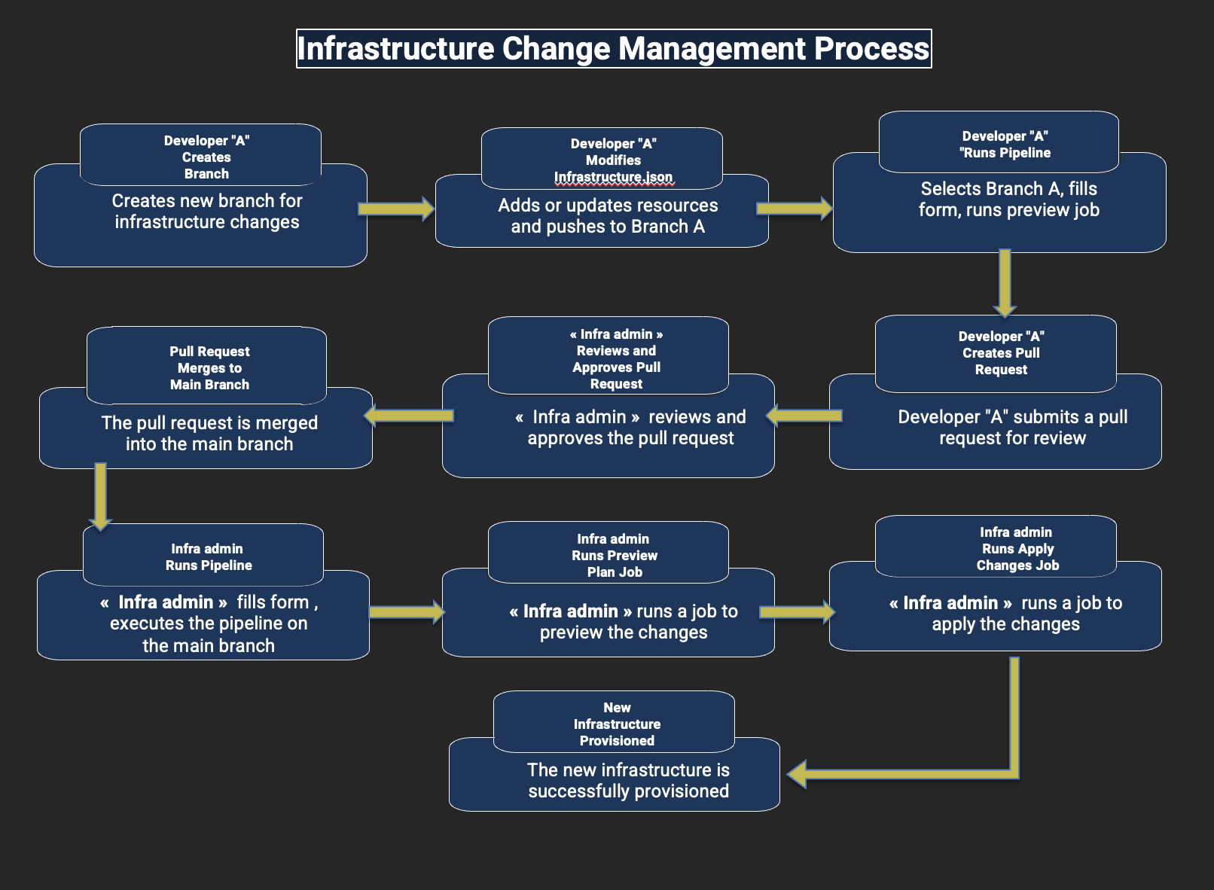
Future Work & Enhancement Roadmap
Q1 2026: Extended Resources Priority: High Add Load Balancer support Autonomous Database provisioning File Storage Service integration Network Load Balancer Effort: 4 weeks Q2 2026: Validation & Safety Priority: High JSON schema validation Pre-deployment cost estimation Security policy enforcement CIDR conflict detection Effort: 3 weeks Q3 2026: Operational Features Priority: Medium Automated drift detection Scheduled state refresh jobs Notification integration (Slack) Resource tagging automation Effort: 5 weeks Q4 2026: Multi-Cloud Expansion Priority: Low AWS provider support Azure provider support Provider abstraction layer Cross-cloud networking Effort: 8 weeks Long-term Vision: Evolve into a universal cloud infrastructure management platform supporting any cloud provider with a unified JSON interface

Slide 54
Lessons Learned & Best Practices
Technical Insights
Start Simple: MVP with 2 resources, then expand - avoid over-engineering upfront Embrace Patterns: Factory + Resolver patterns made code extensible and maintainable Test Early: Integration testing caught dependency issues before production Document as You Go: Inline comments and diagrams saved time later
Challenges Overcome
Dependency Hell: Solved with centralized resolver pattern State Management: Pulumi's built-in state backend simplified this Error Handling: Graceful failures with clear messages improved UX CI/CD Integration: Manual approval gate provided safety net
Process Insights
Agile Works: 2-week sprints with demos kept momentum high Feedback Loop: Weekly mentor sessions caught issues early User-Centric: Involving team in design ensured adoption
Advice for Similar Projects
✓ Prototype quickly, iterate based on feedback ✓ Invest in good abstractions early ✓ Automate testing from day one ✓ Keep code modular (<100 LOC per file)

Slide 55
Conclusion
🎯 Objectives Achieved
✓ JSON-driven configuration ✓ 7 OCI resource types ✓ GitLab CI/CD integration ✓ 95% time reduction ✓ Production deployment
💡 Innovation Highlights
Name-based dependency resolution Factory pattern for extensibility Declarative JSON interface Two-stage approval workflow Self-documenting architecture
📈 Measurable Impact
10+ hours saved per week Zero configuration drift 85% error reduction 100% reproducibility Active team adoption
🔮 Future Potential
Expand to 15+ resource types Multi-cloud support Advanced validation Cost optimization features Enterprise-wide adoption

Slide 56
Acknowledgments

Slide 57
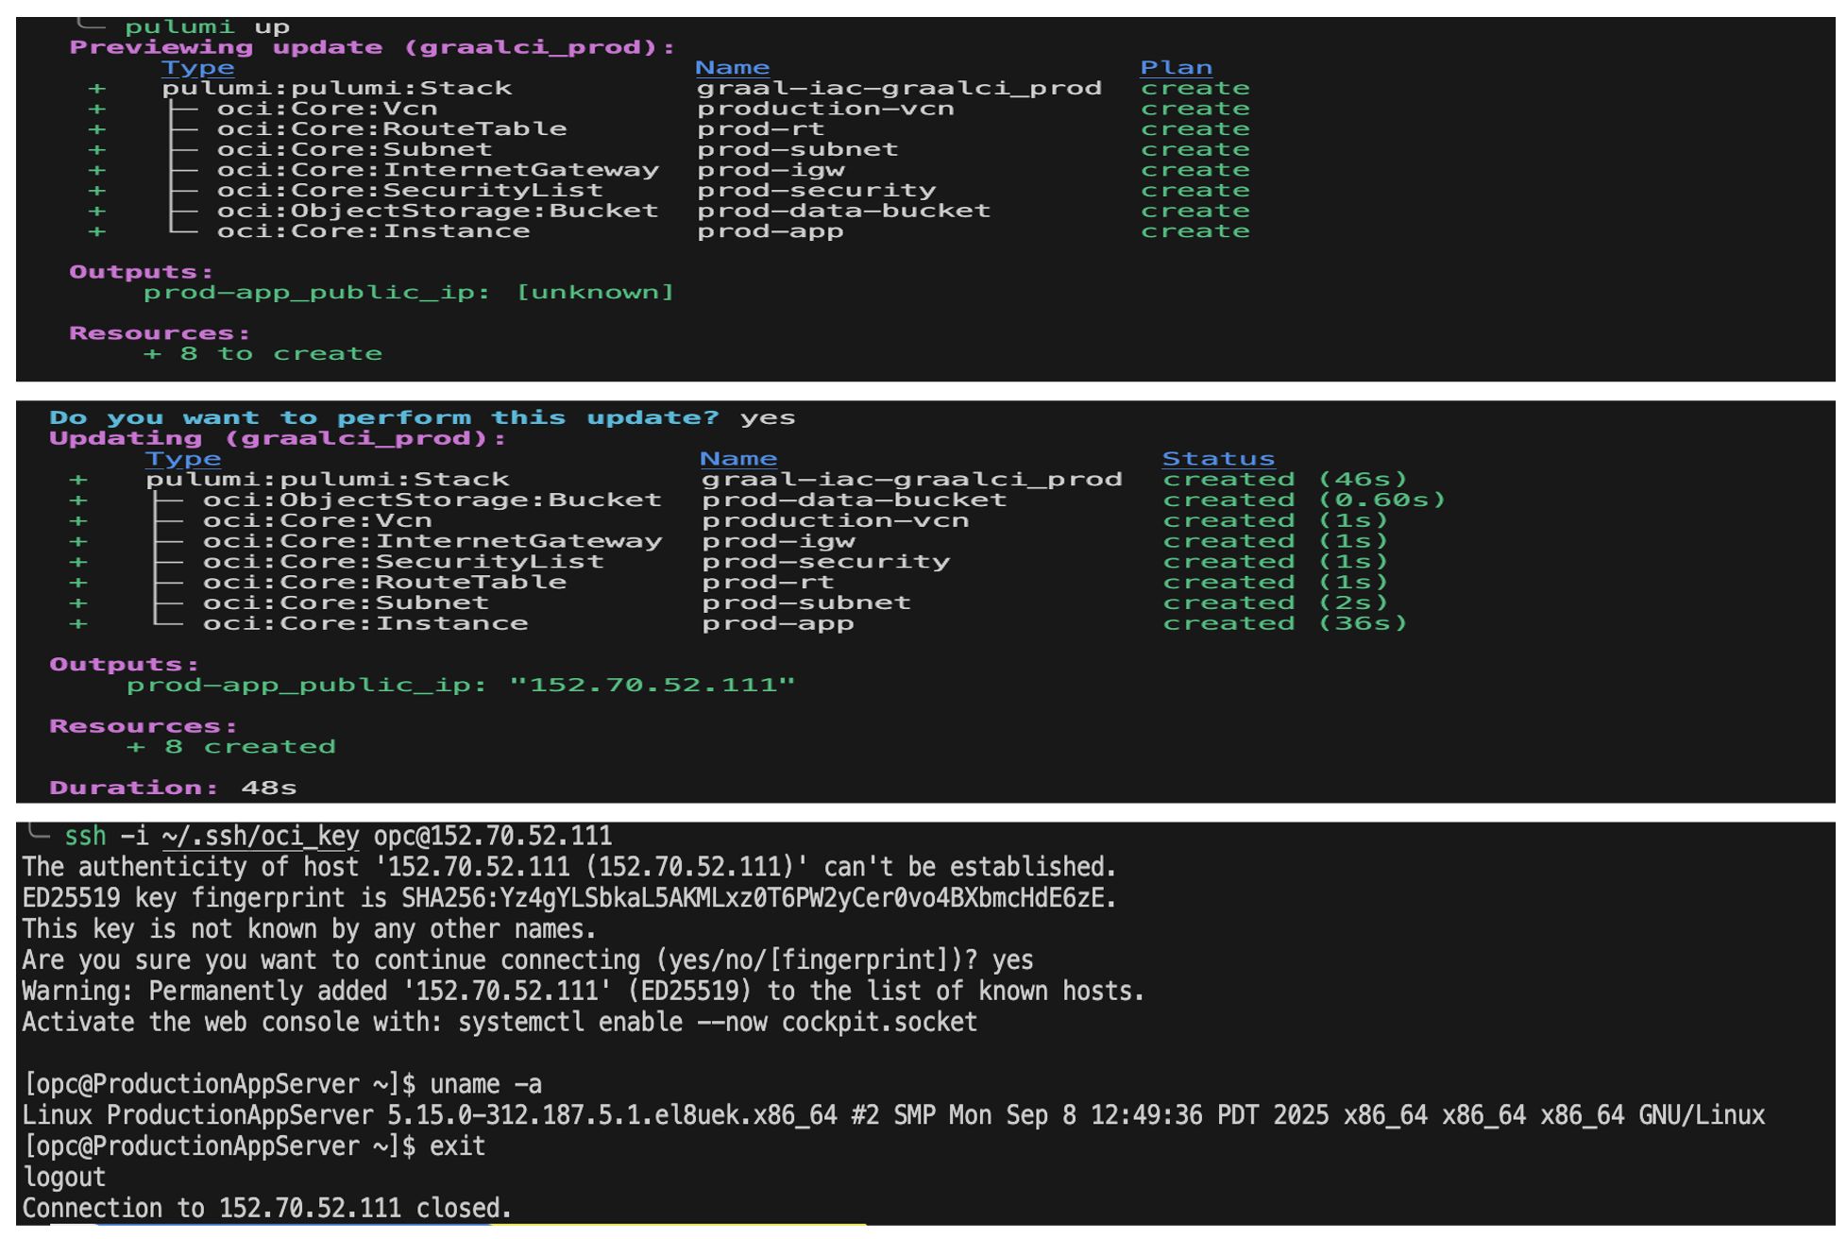
References & Resources
Technical Documentation
Pulumi Documentationpulumi.com/docs Oracle Cloud Infrastructure API Referencedocs.oracle.com/iaas/api GitLab CI/CD Documentationdocs.gitlab.com/ee/ci Python Design Patternsrefactoring.guru/design-patterns
Key Technologies
Pulumi: v3.0.0+ (IaC framework) Python: 3.13 (programming language) OCI Provider: v2.0.0+ (cloud provider) GitLab CI/CD: (automation platform) JSON: (configuration format)
Project Resources
GitHub Repository: github.com/y-dbaichi/pfe-pulumi Internal Confluence Documentation Architecture Diagrams (25 PNG files)
Contact Information
Yassine DBAICHI Infrastructure Automation Engineer Intern Oracle Labs - GraalVM RISQ Team École Hassania des Travaux Publics

Slide 58
Infrastructure as Code Support in Graal CI
JSON-Driven IaC Framework with Pulumi & GitLab CI/CD
Yassine DBAICHI
École Hassania des Travaux Publics
Oracle Labs - GraalVM RISQ Team
Academic Year 2024-2025

