Slide 1
Network Science
Bipartite graphs and Two-mode networks
“I think the next [21st] century will be the century of complexity” – Stephen Hawking

Slide 2
Introduction to Two-mode networks
In complex networks literature, most of the complex networks are based on uni-partite (one-mode) structure where all the nodes are homogeneous like routers network (Yan et al., 2006), air transportation network (Gautreau et al., 2009) and social friendship network (Lieberman, 2014) etc.
However, there are many complex networks which are based on bipartite (two-mode) structure and can only be modeled as two-mode networks
In these type of networks, there are two diﬀerent sets of nodes and the links are between one set to an other set of nodes (Latapy et al., 2008)
.

Slide 3
Introduction to Two-mode networks
The examples include scientiﬁc collaboration network (Newman, 2001a), movie-actor network (Newman et al., 2001), co-occurrence network of language (i Cancho and Sol´e, 2001), human diseases network (Goh et al., 2007), pollination and seed dispersal networks (Padr´on et al., 2011) and ﬂavor compound network (Ahn et al., 2011) among many others
These networks are also known as collaboration or aﬃliation networks in social science literature
The two-mode network can be defined as a triple G = (⊤, ⊥ , E) where ⊤ and ⊥ are two disjoint sets of nodes, the top and bottom nodes respectively(Guillaume and Latapy, 2006)
For the names of the symbols please refer wikipedia.org/wiki/list_of_logic_symbols
.

Slide 4
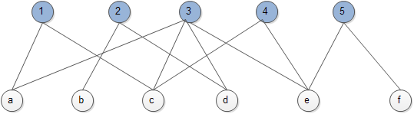
Introduction to Two-mode networks (Cont..)
The main diﬀerence as compared to one-mode network is the existence of links between top and bottom nodes
A simple Two-mode network
The two-mode network consists two different sets of nodes, and links exists between one set of nodes to other
.

Slide 5
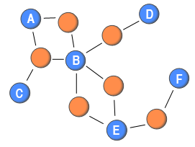
Introduction to Two-mode networks (Cont..)
An other example of two-mode network representation
A simple Two-mode network
The two-mode network consists two different sets of nodes, and links exists between one set of nodes to other
.

Slide 6
Introduction to Two-mode networks
In other words, there is no link in between nodes from the same set
Here, the T (Top) nodes are represented as M and ⊥ (Bottom) nodes as N
The two-mode network can be represented by using adjacency matrix C = (c_{iβ} )_{M ×N} , where the entries of the matrix are c_{iβ} = 1 if there is link between top set node i and bottom set node β, and 0 otherwise
A distinction is often made between the two node sets based on which set is considered more responsible for tie creation (primary or top node set) than the other (secondary or bottom node set)
.

Slide 7
Introduction to Two-mode networks
One of the first two-mode datasets to be analysed was the Davis’ Southern Women dataset (Davis et al., 1941)
which recorded the attendance of a group of women (primary node set) to a series of events (secondary node set)
A woman would be linked to an event if she attended it
Another category of two-mode networks that has become popular in recent years is scientific collaboration networks (Newman, 2001)
The two sets of nodes are scientists and papers, and a scientist is linked to a paper if she or he is listed as an author

Slide 8
Introduction to Two-mode networks
As scientists generally decide whether or not they would like to work on a paper, they are often assumed to be the primary nodes
However, it is not always obvious which node set is the primary one, and in these cases, the research question guides the choice
Two-mode networks are rarely analysed without transforming them
In network analysis, the two-mode networks are mostly not analyzed in their native form
The main reason of this is the lack of methods or network descriptor available for two-mode network analysis (Tutoky and Paraliˇc, 2011)
.

Slide 9
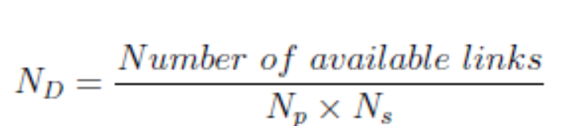
Two-mode network analysis metrics
Density of Two-mode networks
Where N_{D} represents the network density, and Np and Ns are primary and secondary nodes in the network
Two-Mode Degree
Degree is the number of ties a node has or the number other nodes that a node is connected to
In two-mode networks, this concept can be directly applied
In two-mode networks, “the number of other nodes that a node is connected to” is ambiguous
.

Slide 10
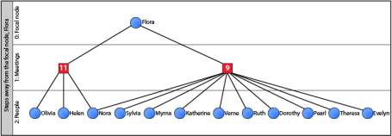
Two-mode network analysis metrics
Two-Mode Degree
It could either be the number of secondary nodes a primary node is connected to (and vice versa), or the number of primary nodes a primary node is connected to
To clarify the difference between these two numbers, we referred to them as nodes’ two-mode and one-mode degree, respectively
.

Slide 11
Two-mode network analysis metrics
Two-Mode Degree
As can be seen from this diagram, Flora’s two-mode degree is 2 and the one-mode degree is 12
If the network is projected to a one-mode network, the standard degree measure would be 12
.

Slide 12
Network Projection
In network analysis, the two-mode networks are mostly not analyzed in their native form
The main reason of this is the lack of methods or network descriptor available for two-mode network analysis (Tutoky and Paraliˇc, 2011)
Therefore, for network analysis they are first converted into the one-mode network where we can analyze only one set of nodes as primary or secondary depending on the requirement of analysis
This is accomplished by choosing any one set of nodes and connecting two nodes from the same set if they were connected to the same node (of the other kind)
.

Slide 13
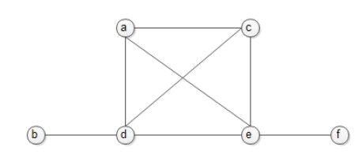
Network Projection
Transforming a two-mode network into a one-mode network is often referred to as projection
The Figure shown below is the ⊥ projection of above network as an example
.

Slide 14
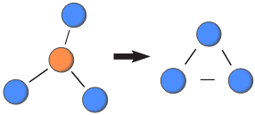
Network Projection
It is possible to maintain some of the richness contained within the two-mode structure by carefully considering multiple ways of projecting two-mode networks onto weighted one-mode networks
It is worth mentioning here that after network projection, the resulted networks, most often comprises large fully-connected groups
As the links are made among all nodes in the one-mode network that were connected to a single other node in the two-mode structure (Guillaume and Latapy, 2006)
.

Slide 15
Network Projection
In case of binary links, only presence or absence of link is considered in the network
Whereas links can have weight which shows different behavior in terms of strength (links) and they can be different from each other
Therefore, the selection of proper projection method from all the available methods is very important step in better understanding the behavior of network in analysis
.

