Slide 1
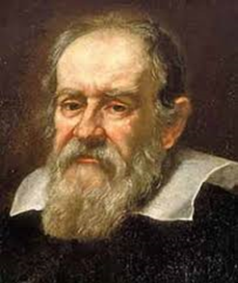
Network Science
Network analysis metrics
“Measure what is measurable, and make measurable what is not so”
Galileo Galilei

Slide 2
Network Analysis Metrics
Shortest paths in social networks
The shortest routes or paths in unweighted network depends only on the number of intermediate nodes from source node to destination node
The length of the paths is defined as the minimum number of links connecting the two nodes in the network either directly or indirectly
The shortest or geodesic route between nodes i and j can be defined formally as given in equation
where d(i, j) is the distance between nodes i and j, and h are the nodes that come in between route of nodes i and j
.

Slide 3
Network Analysis Metrics
Shortest paths in social networks
When links are weighted then simple or binary routes are not important because links
can be differentiated and links with high valued weight would be preferred as compared to low valued weights
For example, flow of data from one router to another router can be sent via high bandwidth links as compared to low bandwidth links more efficiently and faster
Therefore, if the links weight represent the strength then the paths which are based on strong links becomes shorter as compared to weak links
For example, the network as shown in Figure on next slide has three routes between nodes D and E and all these routes have different weights and intermediate nodes
.

Slide 4
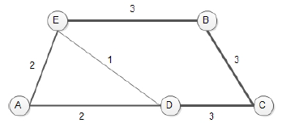
Network Analysis Metrics
Shortest paths in social networks
Figure: A weighted network with multiple paths between E and D
When the links in network represent the diffusion of resources, information, diseases, etc., then the paths and speed clearly affected by the weight of links.
Many attempts have been made to find shortest paths in case of weighted networks as given in (Freeman et al.) (Wasserman and Faust) (Newman)
.

Slide 5
Network Analysis Metrics
Shortest paths in social networks
Dijkstra long ago proposed the algorithm which remained very popular for finding all shortest paths in the network.
Therefore, in weighted networks links weight need to be inverted before applying the Dijkstra's algorithm for the identification of shortest routes as proposed by (Brandes and Newman)
In this way, the resulted links weight can be considered as costs and hence weak links have greater values and strong (or cheap) links have low values
Therefore, links with higher weight become stronger, and it takes less cost to transmit information through that link
.

Slide 6


Network Analysis Metrics
Shortest paths in social networks
The Newman and Brandes proposed implementation of Dijkstra's algorithm can be formally defined as given in equation
The (Opsahl et al., 2010) generalization used the tuning parameter α to transform the inverted weights, before using Dijkstra’s algorithm to find the least costly path as given in equation
Therefore, links with higher weight become stronger, and it takes less cost to transmit information through that link
.

Slide 7

Network Analysis Metrics
Betweenness and closeness centralities in weighted social networks (Global measures)
The betweenness centrality is geodesic-based measure that depends on the finding of shortest paths from node to node in the network (Barthelemy, 2004)
Therefore, it is a measure to quantify the importance of a node in the network on the basis of focal position on the shortest paths in between the remaining other pairs of nodes
Where represents the betweenness centrality of node i, gjk is the total number of shortest paths or routes in between two nodes, and gjk(i) is the number of those routes that passes through node i
.

Slide 8

Network Analysis Metrics
Betweenness and closeness centralities in weighted social networks (Global measures)
Whereas (Opsahl et al., 2010) generalizations of betweenness centrality depend on their generalization of shortest routes
The betweenness centrality is formalized according to (Opsahl et al., 2010) as given in equation
.

Slide 9
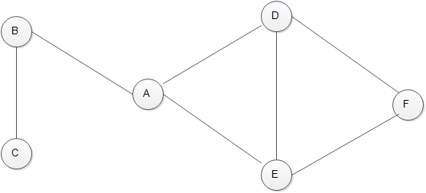
Network Analysis Metrics
For each pair, consider two questions:
How many shortest paths are there between the pair of people
How many of these shortest paths contain A
For A
C to B: 0/1 =0 B to D: 1/1= 1 B to E: 1/1=1
B to F: B to A to D to F
B to F : B to A to E to F = 2/2 =1
.

Slide 10
Network Analysis Metrics
For A
C to D:
C to B to A to D = 1/1 =1 C to B to A to E = 1/1 =1 C to B to A to D to F=
C to B to A to D = 1/1 = 2/2= 1
D to E = 0/1 =0
D to F = 0/1 = 0
E to F = 0/1 = 0 Betweenness of A = 0+1+1+1+1+1+1+0+0+0 = 6
.

Slide 11


Network Analysis Metrics
Betweenness and closeness centrality in weighted complex networks
Closeness is defined as, the inverse of the sum of all shortest paths from a main node to all the other nodes in the network.
Freeman formalized closeness as given in equation
where represent closeness centrality of node i in the network and d(i, j) is the distance between nodes i and j
(Opsahl et al., 2010) generalizations of closeness centrality rely on the generalization of shortest path. Closeness centrality has been formalized according to (Opsahl et al., 2010) as given in equation
.

Slide 12
Network Analysis Metrics
For A
A to C: ( A,B,C): 2
A to B: ( A,B): 1
A to D: ( A,D):1
A to E: (A,E) :1
A to F: (A,D,F)
: (A,E,F) = 2 Avg= (2+1+1+1+2)/5 =7/5= 1.4 = Closeness of A 1/1.4 = 0.714
.

Slide 13
Network Analysis Metrics
Transitivity and clustering coefficients:
It has been noticed and shown (Ghoshal, 2009) that many real-world networks shows high degree of transitivity.
This basic measure has received long ago the attention of researchers from theoretical and empirical research perspective of networks (Holland and Leinhardt, 1971; Friedkin, 1984; Louch, 2000; Snijders, 2001; Snijders et al., 2006).
For example, if node A is connected with node B and C, then there are chances that node B and node C are also connected with each other.
From the networks topological point of view, it measures the presence of triangles in the network.
.

Slide 14
Network Analysis Metrics
Transitivity and clustering coefficients:
Clustering coefficient can be used to quantify this behavior of nodes in the networks.
There are two versions of clustering coefficients to test this behavior.
The global version is introduced to assess overall clustering behavior of network.
The local clustering coefficient gives the indication of single nodes participation in the network.
.

Slide 15

Network Analysis Metrics
Transitivity and clustering coefficients:
The global clustering coefficient is defined as the ratio of the number of closed triplets or triangles (three nodes all connected) over the number of total connected triplets both closed and open (three nodes with at least two links) as given in equation
where Gc represents the global clustering coefficient. τ is the number of 2- paths, and τ∆ is the number of these 2-paths that are closed by triangle.
.

Slide 16
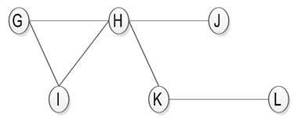
Network Analysis Metrics
Transitivity and clustering coefficients:
For the network shown in figure the binary global clustering coefficient (without considering link weights) value is 3/9 = 0.33.
In this network, the closed triplets are H → G ← I ; G → H ← I; G → I ← H; and on the other hand, the open triplets are G → H ← J ; G → H ← K; I → H ← J ; I → H ← K; J → H ← K; H → K ← L .
.

Slide 17
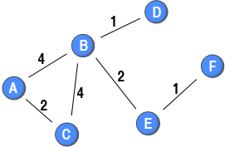
Network Analysis Metrics
Weighted clustering coefficients:
What about the social networks with weighted links?
The weighted global clustering coeﬃcient was proposed by (Opsahl and Panzarasa, 2009)
.

Slide 18
Network Analysis Metrics
Weighted clustering coefficients:
They deﬁned the triplet values based on four methods namely the geometric mean, minimum, maximum and arithmetic mean
The closed triplets values then be divided with these triplet values
In case of arithmetic mean, the average of links weight is considered
The limitation of this method is the insensitivity towards the diﬀerence of two extreme values as the highest value can impact on triplet value
.

Slide 19
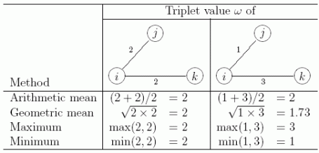
Network Analysis Metrics
Weighted clustering coefficients:
The limitation of this method is the insensitivity towards the diﬀerence of two extreme values as the highest value can impact on triplet value
.

Slide 20
Network Analysis Metrics
Weighted clustering coefficients:
Similarly, geometric mean is the simple geometric mean of links weight
This method some how decrease the sensitivity issue of arithmetic mean
For example, a triplet made up by a link with a low value and a link with a high value will have a lower value as compared to arithmetic mean method
.

Slide 21
Network Analysis Metrics
Weighted clustering coefficients:
In addition, it is possible to use two extreme methods to deal with differences in tie weights
The maximum method takes the highest value of the two weights, and will make a triplet with a strong tie and a weak tie equal to a triplet with two strong ties
Conversely, the minimum method takes the lowest value of the two weights, and make triplets with a strong tie and a weak tie equal to triplets with two weak ties
.

Slide 22
Network Analysis Metrics
Weighted clustering coefficients:
The values of global clustering coeﬃcient for weighted network of Figure based on these 4 methods will be A.M = 0.41, G.M = 0.43, Max:= 0.37 and Min: = 0.5.
.

Slide 23
Network Analysis Metrics
Weighted clustering coefficients:
The values of global clustering coeﬃcient for weighted network of Figure based on these 4 methods will be A.M = 0.41, G.M = 0.43, Max:= 0.37 and Min: = 0.5.
Therefore, it is very important to choose appropriate method based on the dataset for deﬁning the values of triplets
BCA wij=4, wjk=2 AM= 3 GM=2.83 Ma:= 4 Mi:= 2
CAB wij=2, wjk=4 AM= 3 GM=2.83 Ma:= 4 Mi:= 2
ABC wij=4, wjk=4 AM= 4 GM=4 Ma:= 4 Mi:= 4
DBA wij=1, wjk=4 AM= 2.5 GM=2 Ma:= 4 Mi:= 1
DBC wij=4, wjk=1 AM= 2.5 GM=2 Ma:= 4 Mi:= 1
EBA wij=2, wjk=4 AM= 3 GM=2.83 Ma:= 4 Mi:= 2
.

Slide 24
Network Analysis Metrics
Weighted clustering coefficients:
EBC wij=2, wjk=4 AM= 3 GM=2.83 Ma:= 4 Mi:= 2
EBD wij=2, wjk=1 AM= 1.5 GM=1.41 Ma:= 2 Mi:= 1
FEB wij=1, wjk=2 AM=1.5 GM=1.41 Ma:= 2 Mi:= 1
AM = (3+3+4) / (3+3+4) +2.5+2.5+3+3+1.5+1.5 = 10/ 24 = 0.41
GM = (2.83+2.83+4) / (2.83+2.83+4) +2 +2 +2.83 +2.83 +1.41 +1.41 = 9.66 / 22.14 =0.43
Max: = (4+4+4 ) / (4+4+4) + (4+4+4+2+2) = 12 /32 = 0.37
.

Slide 25
As it is possible to see from the networks have a weighted clustering coefficient that is higher than the traditional clustering coefficient
 | Network | Number of nodes | Number of links | Cc=unweighted | Weighted
1 | US airport network | 500 | 2980 | 0.351 | 0.476
2 | Newman’s Scientific collaboration network | 16730 | 47594 | 0.359 | 0.317
3 | Movie actor network | 306 | 2345 | 0.181 | 0.236

Slide 26
Network Analysis Metrics
Local clustering coefficients:
The local clustering coeﬃcient can be deﬁned as the ratio between the number of present links divided by the total numbers of possible links between the nodes contacts (Watts and Strogatz, 1998) as given in equation
where C(i) represents the local clustering coefficient of node i. Whereas, τ_{i} is the number of 2-paths centred on node i, and τi,∆ is the number of these that are closed by being part of a triangle
The value of this coefficient remains in the range of 0 and 1, because if no link is present between neighbors then its value will be 0 and becomes 1 if all possible links exists
.

Slide 27
Network Analysis Metrics
Local clustering coefficients:
For example, in figure the local clustering coefficient of node G and I is 1, because all the possible links between their neighbors are present
The clustering coefficient of the node J and L is undefined because they have less than 2 neighbors
The value of clustering for the node K is 0 as no any neighbor of it is connected
Finally, for node H one out of six possible links are present, therefore its coefficient would be 1/6
.

Slide 28
Network Analysis Metrics
Local clustering coefficients:
The main advantage of this version of the clustering coefficient is that a score is assigned to each node (local measure)
However, this version of the clustering coefficient suffers from three major limitations (see Opsahl and Panzarasa, 2009, for a longer discussion)
First, its outcome does not take into consideration the weight of the ties in the network
Second, the local clustering coefficient cannot be calculated on directed networks
Third, a negative correlation with degree is often found in real-world networks
This is due to the fact that it is “easier” for a node with two neighbours to get a score of 1 (only one tie is need) than for a node with 10 neighbours (45 ties must be present)
.

Slide 29
Network Analysis Metrics
Local clustering coefficients:
The metric defined in equation 2.15 extended to weighted networks by (Barrat et al., 2004a)
They generalized this metric to weighted networks by explicitly including the weight of links in computation
”They used a triplet value for each triplet on the basis of arithmetic mean. After that, for each node they summed the value of the closed triplets that were centred on the node and divided it by the total value of all triplets centered on the node”
As in case of global clustering coefficient of weighted networks, the triplet values can be found by using geometric mean, minimum and maximum methods as well (Opsahl and Panzarasa, 2009)
.

Slide 30
Network Analysis Metrics
Local clustering coefficients:
For example, in the network shown in Figure the scores of weighted local clustering coefficients for nodes is: Node A and C get the value 1 as their all neighbors are connected
Node D and F values are undefined as they have less than two neighbors
Node E get 0 value as no any neighbor of it is connected
.

Slide 31
Network Analysis Metrics
Local clustering coefficients:
As for as node B is concerned, it would get different values because B has more than 2 neighbors, and is the center of both open and closed triplets
The values of node B for different methods are given as Minimum=0.36, Maximum=0.18, arithmetic mean=0.24 and geometric mean=0.27, respectively
.

