Slide 1
Network Science
Network models

Slide 2


Barabasi Albert Scale-free model

Slide 3

Barabasi Albert Scale-free model (Cont…)

Slide 4

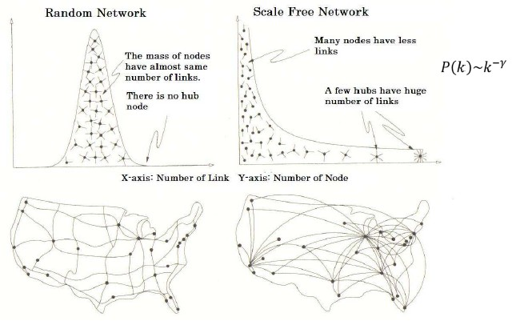
Barabasi Albert Scale-free model (Cont….)

Slide 5

Barabasi Albert Scale-free model (Cont…)

Slide 6
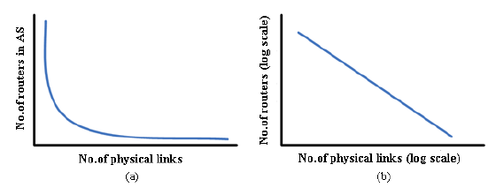
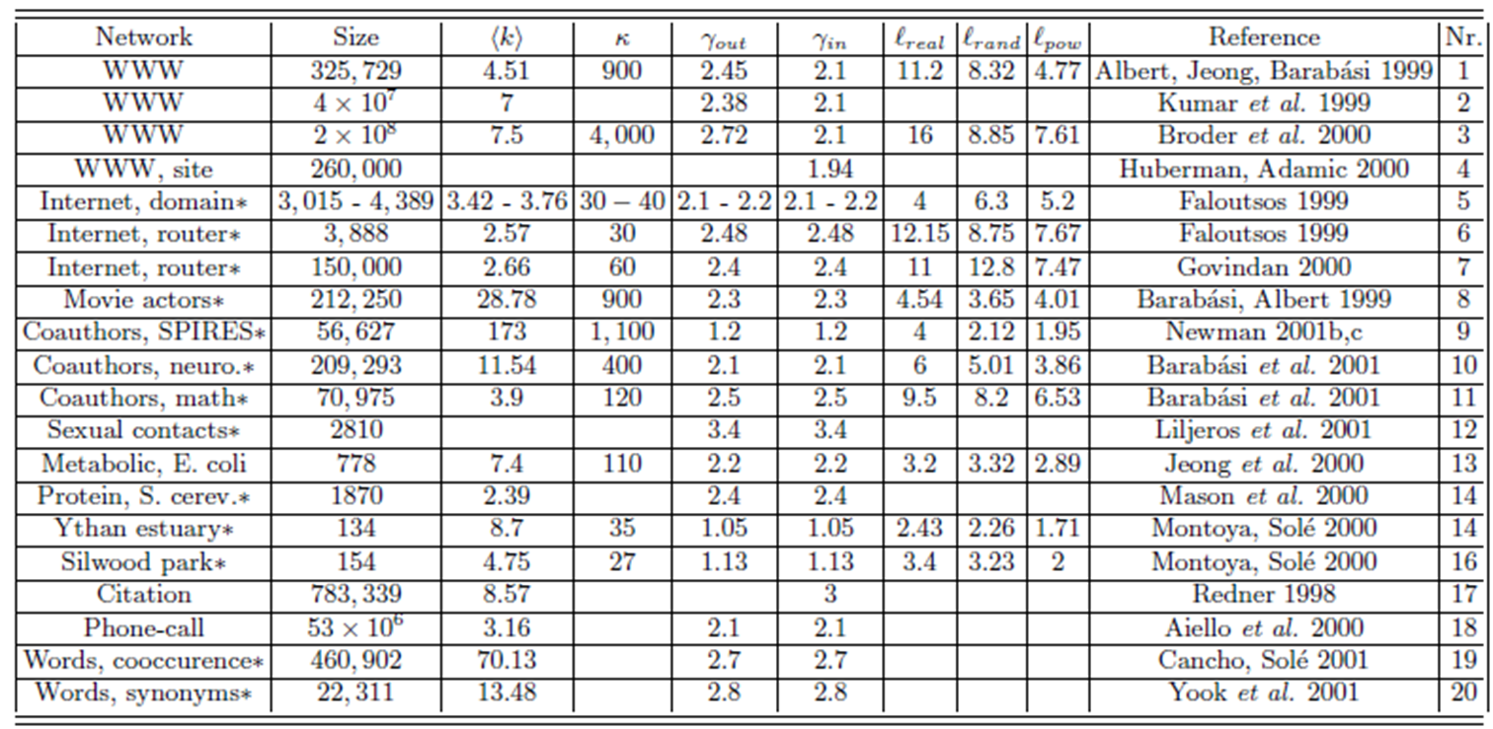
Scale-free Network model (Cont…)
The scaling exponents characterizing the degree distribution of several scale-free networks, for which P(k) follows a power-law

Slide 7
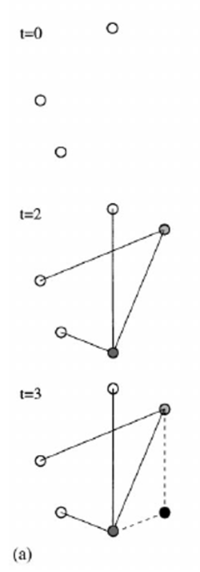
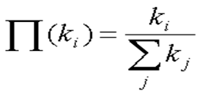
Scale-Free network model:
Scale-free network model by Barabasi and Albert (BA) in 1999
One of the most basic and widely-accepted model of complex networks
According to this model there are two ingredients for modeling of dynamic networks
1. Growth:
The network expand continuously
2. Preferential Link attachment:
Links are not made randomly but preferentially
Growth
Start with mo nodes, and then add a node with m edges at every
time step
m≦m0
Preferential Attachment
After t time steps, there are N = t+m0 nodes and mt edges.
Where N=Nodes m0=initial nodes and t=time

Slide 8
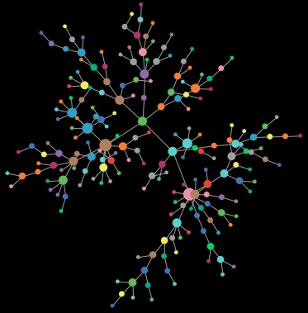
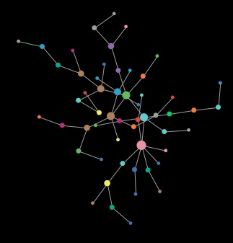
Ingredients in generating power-law networks
nodes appear over time (growth)

Slide 9
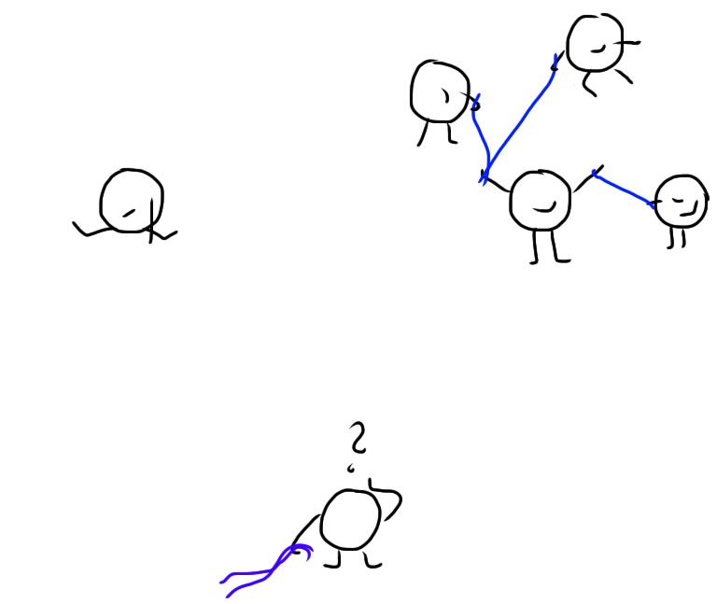
Ingredients in generating power-law networks
nodes prefer to attach to nodes with many connections (preferential attachment, cumulative advantage)

Slide 10

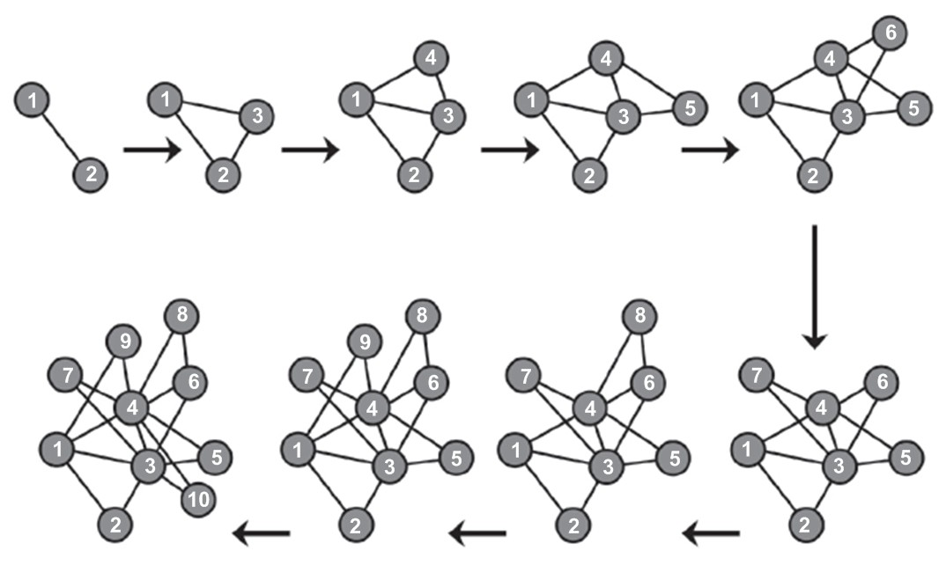
Barabasi Albert Scale-free model

Slide 11
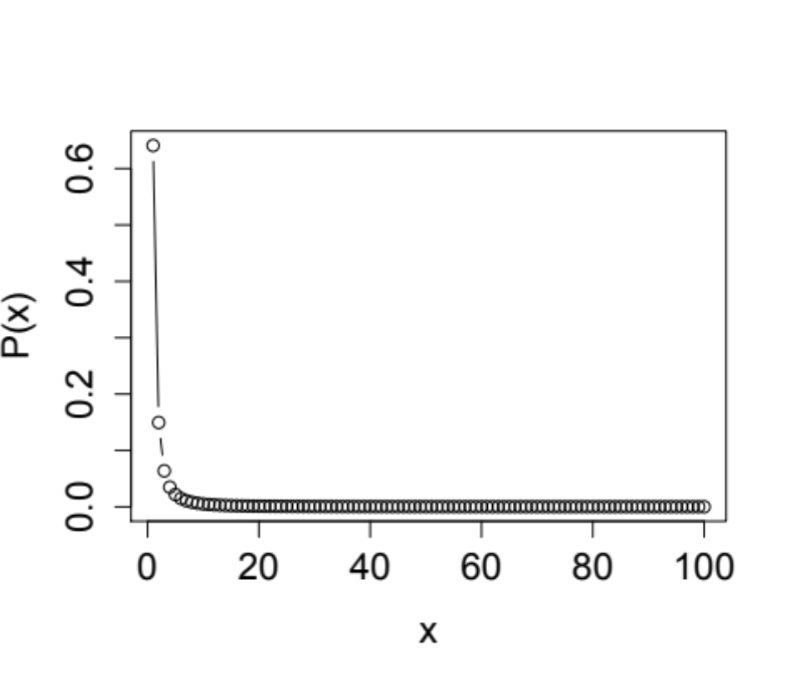
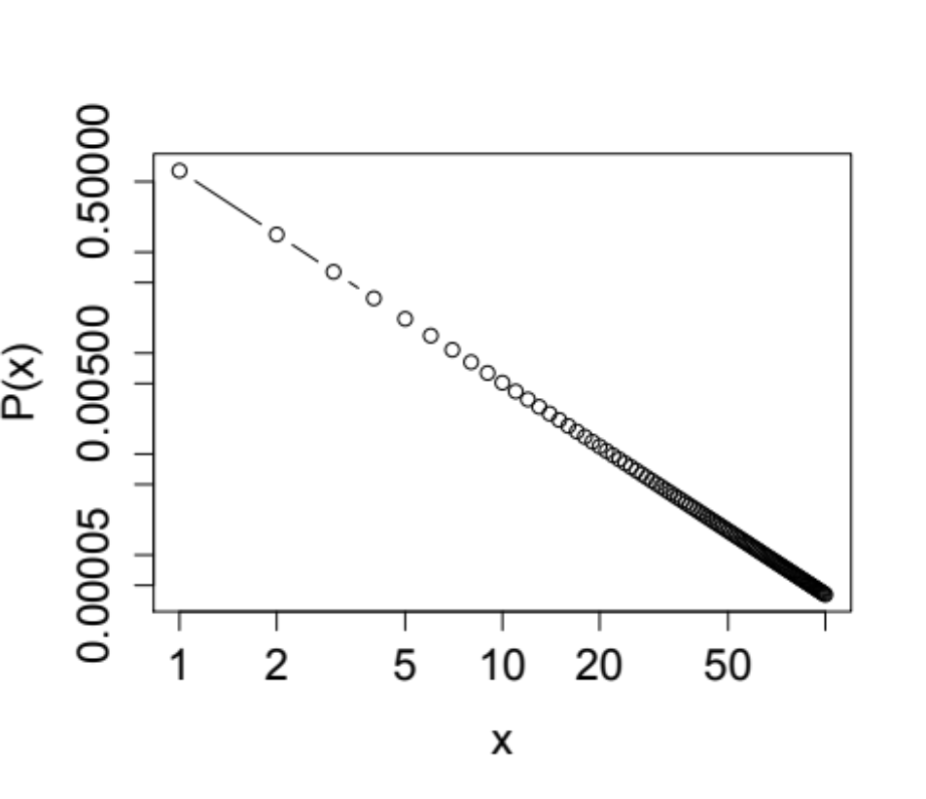
Power-law distribution
linear scale
log-log scale
high skew (asymmetry)
straight line on a log-log plot

Slide 12
Uneven participation
0
  ‘answer people’ may reply to thousands of others
  ‘question people’ are also uneven in the number of repliers to their posts, but to a lesser extent
10
α
= 1.87 fit, R
2
= 0.9730
10
-1
number of people one replied to
-2
cumulative probability
10
number of people one received replies from
10
-3
10
-4
10
0
10
1
10
2
10
3
degree (k)

Slide 13
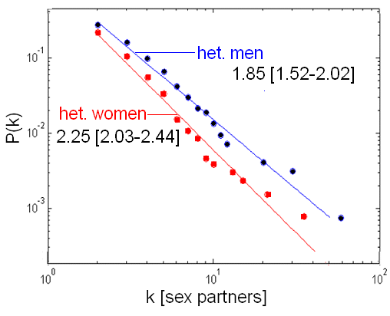
Real-world degree distributions
Sexual networks
Great variation in contact numbers

Slide 14
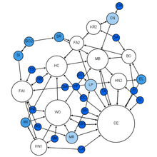
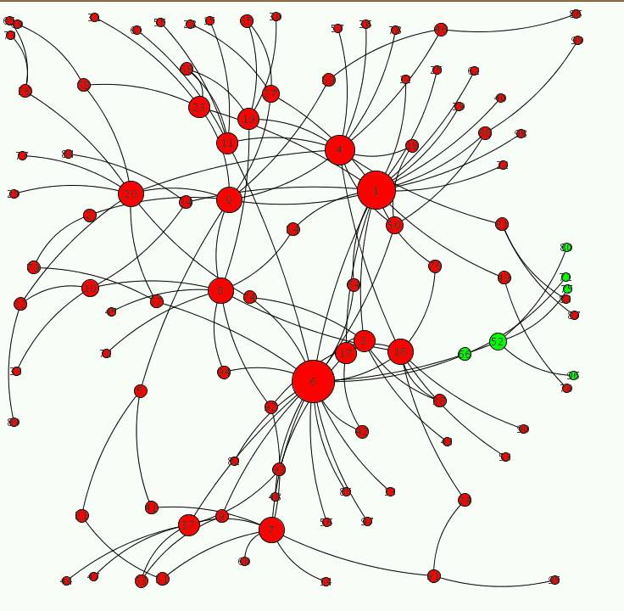
Emergence of scaling due to power-law

Slide 15
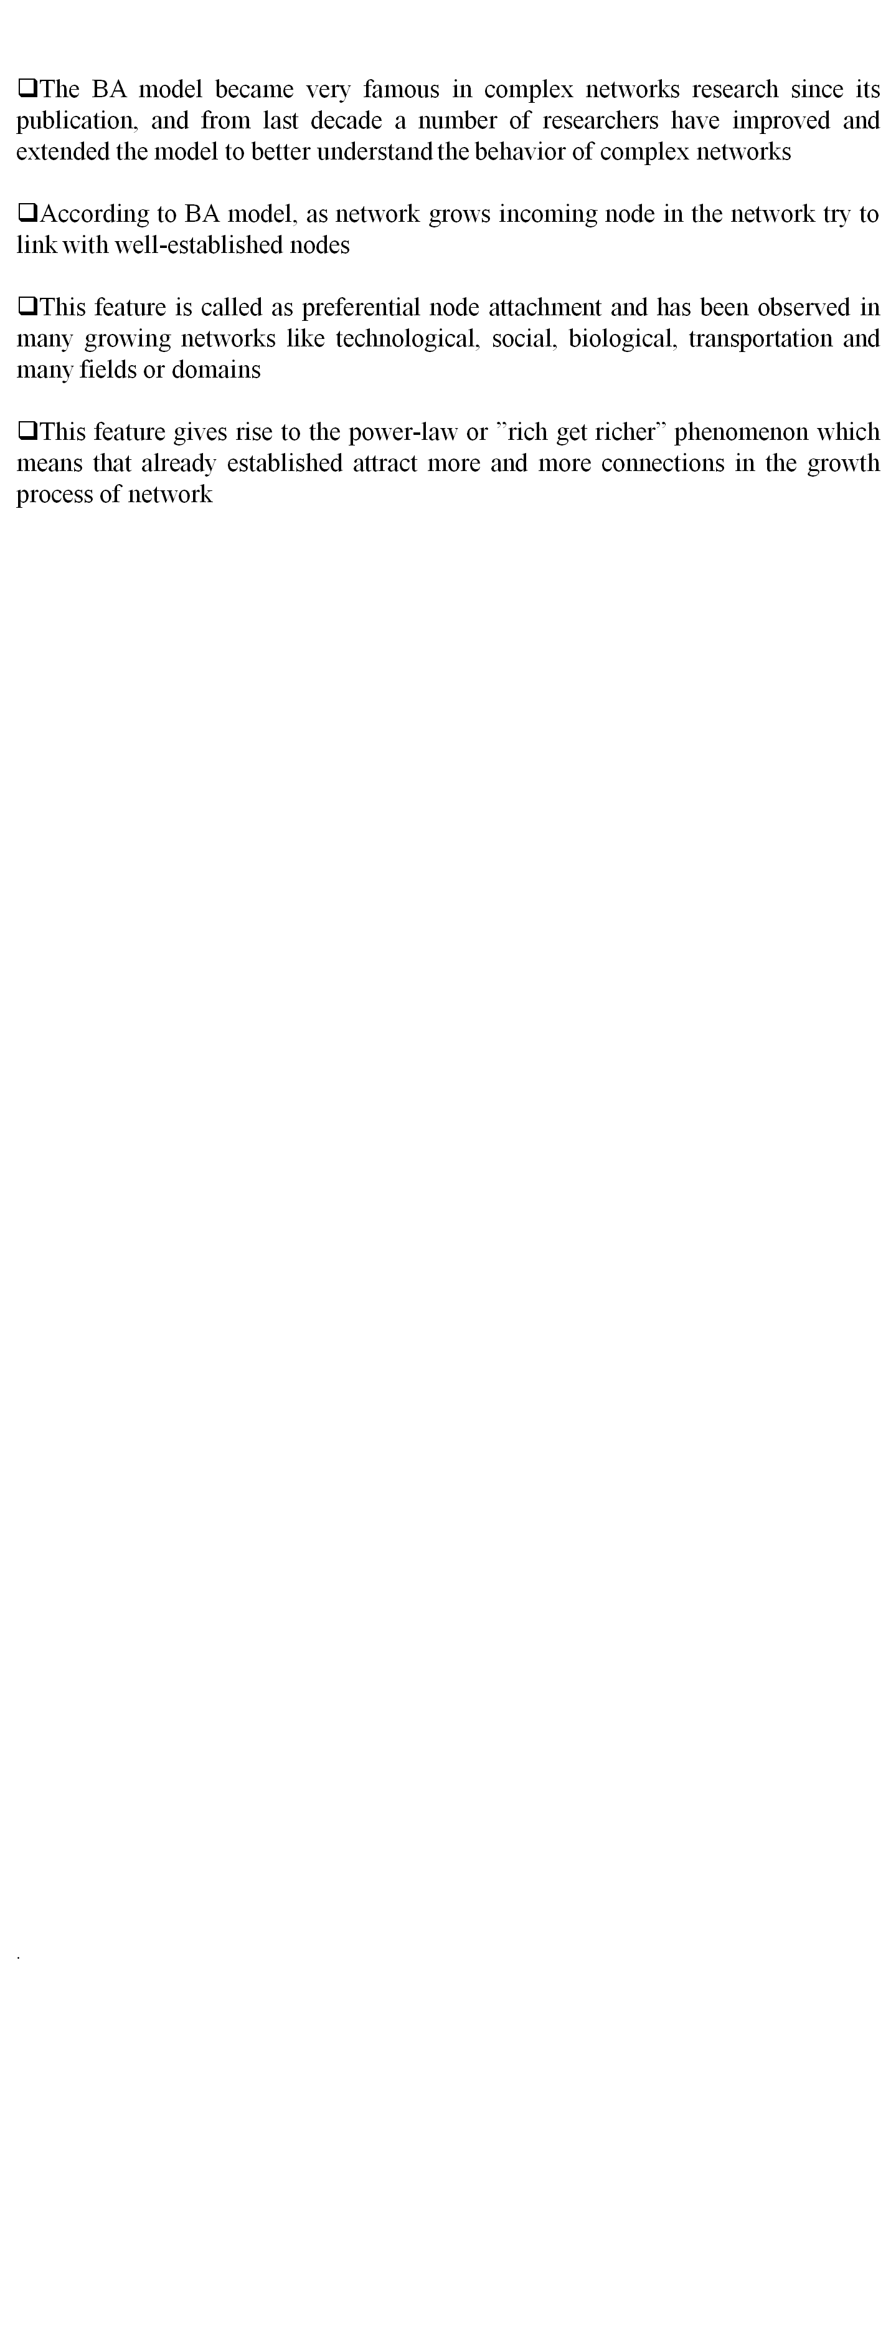
Barabasi Albert Scale-free model (Cont…)

Slide 16
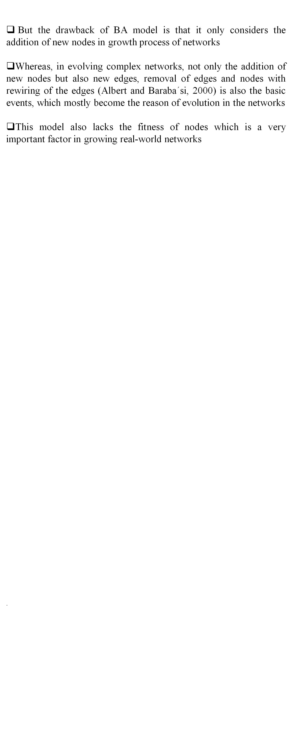
Barabasi Albert Scale-free model

Slide 17
Fitness based scale-free network model
To include the concept of fitness of nodes in growth process of the networks, Bianconi and Barabasi proposed fitness based scale-free network model
In this model, a fitness parameter ηi is assigned to each node which remain same throughout the changes of time
In this way, at each time step ”a new node j with a fitness ηj is added to the system, where ηj is chosen from the distribution ρ(η)”

Slide 18

Fitness based scale-free network model
The fitness parameter depends on the domain of a network and it reflects the different abilities for each node to compete in the networks for gaining new links
In this way, each new node connects one of its m links to the nodes already present in the network, and the probability to connect to a node i is proportional to both the degree and the fitness of node i, mathematically, this is represented in equation

Slide 19

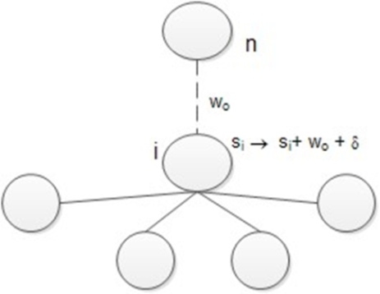
Network Models:
Barrat, Barthmeley and Vespignani (BBV) model
To address the issue of the variation of links weight with various intensities and growth of nodes, introduced a (BBV) model
Growth: Starting from initial nodes connected by links with assigned weight wo a new node n is added at each time step. This new node is connected to m previously existing nodes, choosing preferentially node with large strength (i.e., a node i is chosen) according to the probability distribution as given in equation
Weight dynamics:
The weight of each new link (n, i) is initially set to a given value wo. The creation of this link will introduce variations of the traffic across the network as shown in Figure

Slide 20


Network Models:
Barrat, Barthmeley and Vespignani (BBV) model
If we limit the case for simplicity where the introduction of a new link on node i will trigger only local rearrangements of weights on the existing neighbors, j ∈ V (i), according to the rule as given in equation
where in general ∆wij depends on local dynamics and can be a function of different parameters such as weight wij , the connectivity or the strength of i, etc.
In the following, we focus on the case where the addition of a new link with wo induces a total increase δi of the total outgoing traffic and where this perturbation is proportionally distributed among the edges according to their weights as given in equation

Slide 21
Network Models:
Barrat, Barthmeley and Vespignani (BBV) model
This rule yields a total strength increase for node i of (δi + wo), implying that si → si + δi + wo.
After the weights have been updated, the growth process is iterated by introducing a new node, i.e., going back to step 1 until the desired size of the network is reached.
In this model, in contrast to the connectivity preferential attachment of the rich get richer type, the mechanism here relies on the importance of the traffic and could be more adequately described as ”busy get busier”

Slide 22
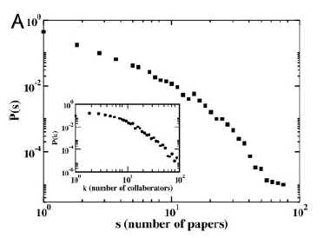
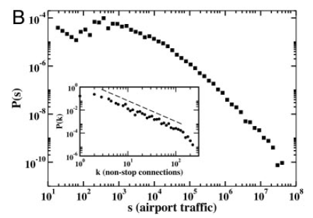
Network Models:
Barrat, Barthmeley and Vespignani (BBV) model
According to (Barrat et al.) the obtained network shows heavy-tailed distribution of weight of links and strength of nodes
The analysis and studies of many complex weighted networks have revealed that in addition to a complex topological structure, real-world networks display large heterogeneity in the capacity and intensity of the connections

Slide 23
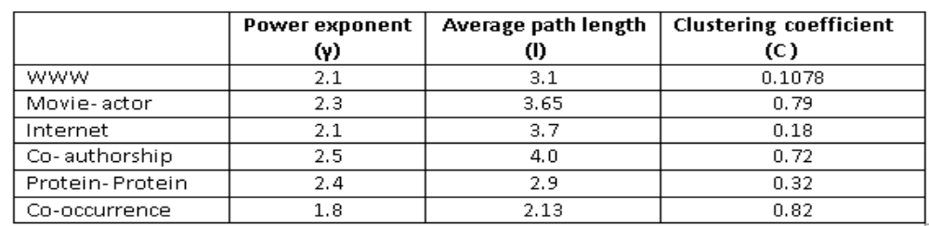
Due to scale-free topology these networks become highly clustered and the average path-length between nodes grows very slowly as the nodes increase in the networks
Further, scale-free networks become very robust and resilient under random attack
On the other hands, these networks become vulnerable under targeted attack due to presence of few hubs and links in the networks
The table given below shows the values of power exponent, average path-length and global clustering coefficient of few real-world networks

