Slide 1

Network Science
“As a net is made up of a series of ties, so everything in this world is connected by a series of ties. If anyone thinks that the mesh of a net is an independent, isolated thing, he is mistaken. It is called a net because it is made up of a series of interconnected meshes, and each mesh has its place and responsibility in relation to other meshes”.
Buddha

Slide 2
What are networks?
Networks are sets of nodes connected by edges.
“Network” ≡ “Graph”
node
edge
points | lines
vertices | edges, arcs | math
nodes | links | computer science
sites | bonds | physics
actors | ties, relations | sociology

Slide 3
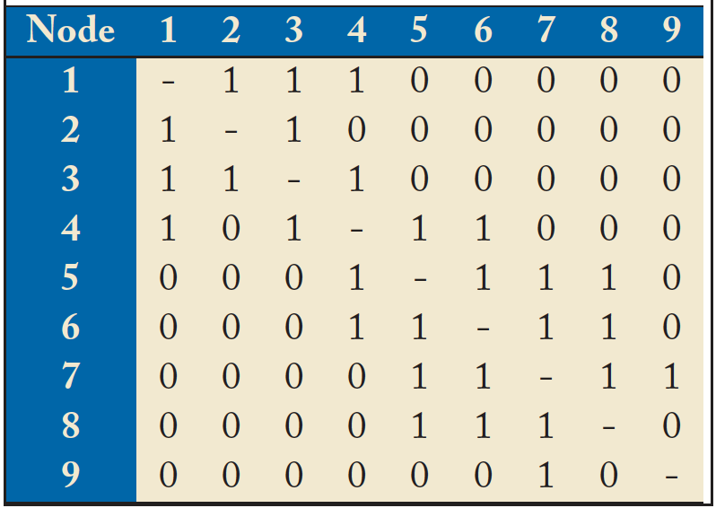
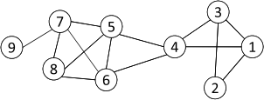
Networks and Representation
Social Network: A social structure made of nodes (individuals or organizations) and edges that connect nodes in various relationships like friendship, kinship etc.
Graph Representation
Matrix Representation

Slide 4
Adjacency matrix
2
0 | 0 | 0 | 0 | 0
0 | 0 | 1 | 1 | 0
0 | 1 | 0 | 1 | 0
0 | 0 | 0 | 0 | 1
1 | 1 | 0 | 0 | 0
3
1
A =
5
4

Slide 5
Network elements: edges
Directed (also called arcs, links)
  A -> B
    A likes B, A gave a gift to B, A is B’s child
Undirected
  A <-> B or A – B
    A and B like each other
    A and B are siblings
    A and B are co-authors

Slide 6
Edge attributes
Examples
  weight (e.g. frequency of communication)
  ranking (best friend, second best friend…)
  type (friend, relative, co-worker)
  properties depending on the structure of the rest of the graph: e.g. betweenness

Slide 7
Directed networks
girls’ school dormitory dining-table partners, 1st and 2nd choices (Moreno, The sociometry (the study of relationships within a group of people) reader, 1960)
2
2
Louise
2
Ada
1
Lena
1
1
1
Adele
Marion
2
2
1
2
2
1
Jane
1
2
2
Cora
2
1
Frances
2
1
2
Eva
1
Maxine
Mary
1
2
1
1
2
1
Anna
1
1
Edna
Ruth
Robin
Martha
2
1
Betty
2
2
1
2
1
2
2
Jean
1
2
1
2
1
2
1
Laura
Alice
1
Hazel
2
Helen
Hilda
2
1
Ellen
1
2
Ella
Irene

Slide 8
Data representation
adjacency matrix
edgelist
adjacency list

Slide 9


Adjacency matrices
Representing edges (who is adjacent to whom) as a matrix
  A_{ij} = 1 if node i has an edge to node j
  = 0 if node i does not have an edge to j
  A_{ii} = 0 unless the network has self-loops
  A_{ij} = A_{ji} if the network is undirected,
  or if i and j share a reciprocated edge

Slide 10
Edge list
Edge list
  2, 3
  2, 4
  3, 2
  3, 4
  4, 5
  5, 2
  5, 1
2
3
1
5
4

Slide 11
Nodes
Node network properties
  from immediate connections
    indegree
    how many directed edges (arcs) are incident on a node
    outdegree
    how many directed edges (arcs) originate at a node
    degree (in or out)
    number of edges incident on a node
  from the entire graph
    centrality (betweenness, closeness)
indegree=3
outdegree=2
degree=5

Slide 12
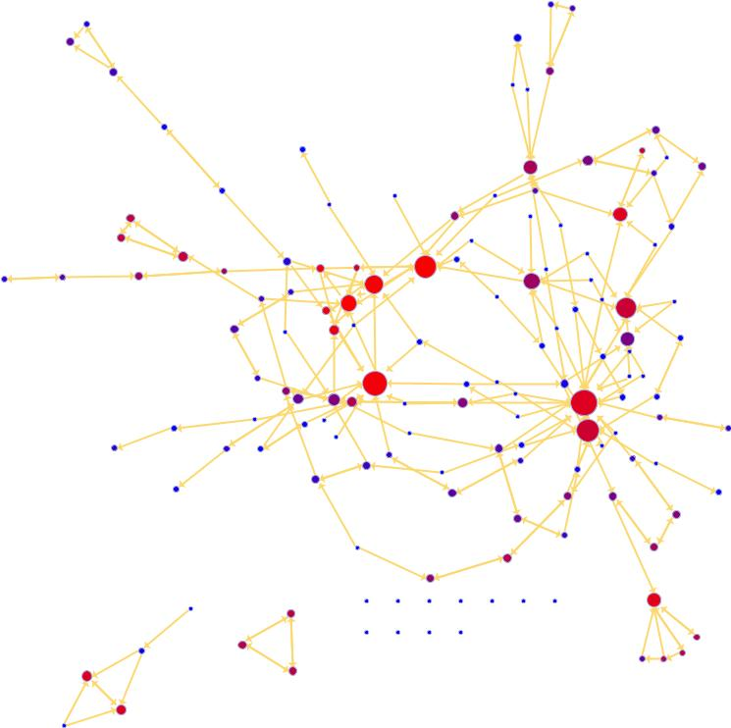
Degree: which node has the most edges?
?
?
?

Slide 13
Computing metrics
degree & degree distribution
connected components

Slide 14
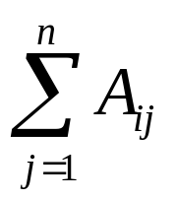
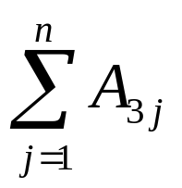
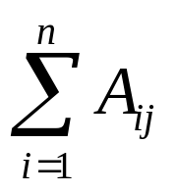
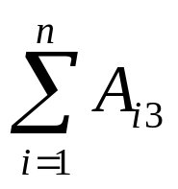
Node degree from matrix values
2
3
1
4
0 | 0 | 0 | 0 | 0
0 | 0 | 1 | 1 | 0
0 | 1 | 0 | 1 | 0
0 | 0 | 0 | 0 | 1
1 | 1 | 0 | 0 | 0
5
Outdegree =
A =
example: outdegree for node 3 is 2, which we obtain by summing the number of non-zero entries in the 3rd row
0 | 0 | 0 | 0 | 0
0 | 0 | 1 | 1 | 0
0 | 1 | 0 | 1 | 0
0 | 0 | 0 | 0 | 1
1 | 1 | 0 | 0 | 0
Indegree =
A =
example: the indegree for node 3 is 1, which we obtain by summing the number of non-zero entries in the 3rd column

Slide 15
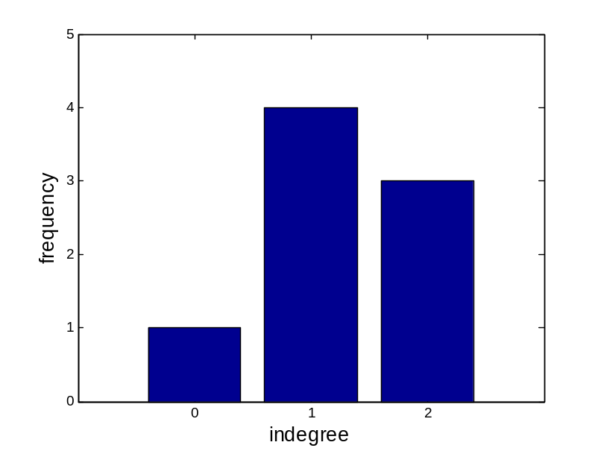
Network metrics: degree sequence and degree distribution
Degree sequence: An ordered list of the (in,out) degree of each node
  In-degree sequence:
    [2, 2, 2, 1, 1, 1, 1, 0]
  Out-degree sequence:
    [2, 2, 2, 2, 1, 1, 1, 0]
  (undirected) degree sequence:
    [3, 3, 3, 2, 2, 1, 1, 1]
Degree distribution: A frequency count of the occurrence of each degree
  In-degree distribution:
    [(2,3) (1,4) (0,1)]
  Out-degree distribution:
    [(2,4) (1,3) (0,1)]
  (undirected) distribution:
    [(3,3) (2,2) (1,3)]

Slide 16
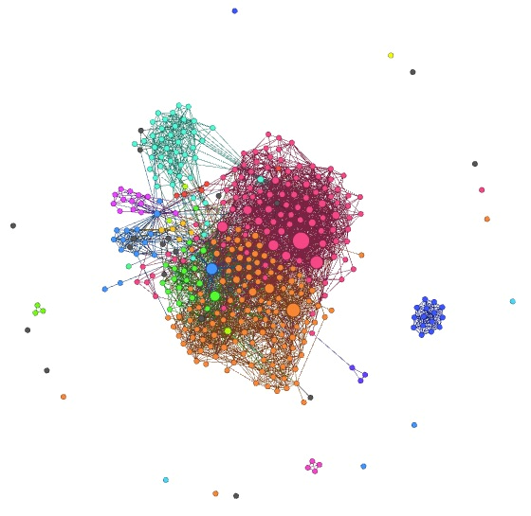
Is everything connected?

Slide 17
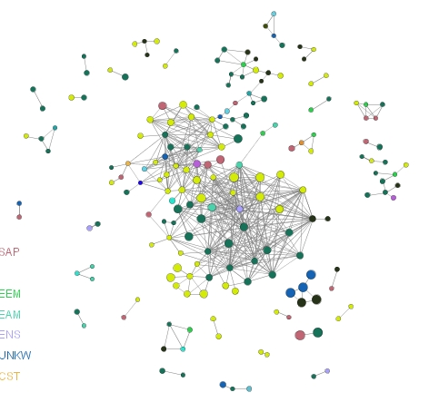
Giant component
If the largest component encompasses a significant fraction of the graph, it is called the giant component

Slide 18
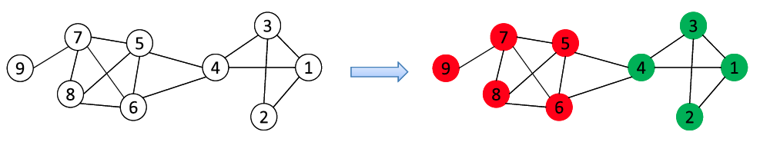
Research directions (Community Detection)
A community is a set of nodes between which the interactions are (relatively) frequent
  A.k.a., group, cluster, cohesive subgroups, modules
Applications: Recommendation based communities, Visualization of a huge network
New lines of research in social media
  Community Detection in Heterogeneous Networks
  Community Evolution in Dynamic Networks
  Scalable Community Detection in Large-Scale Networks

Slide 19
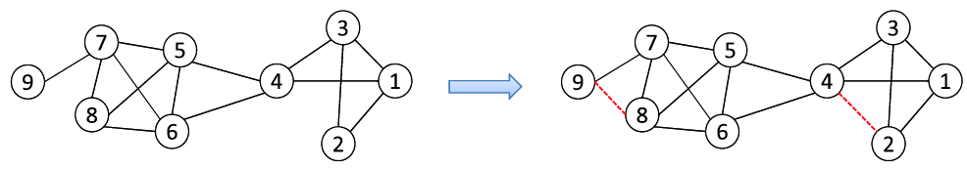
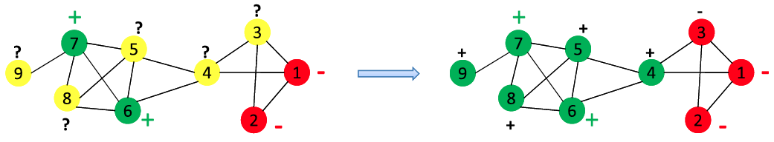
Classification and Recommendation
Common in social media applications
  Tag suggestion, Product/Friend/Group Recommendation
Link prediction
Network-Based Classification

Slide 20
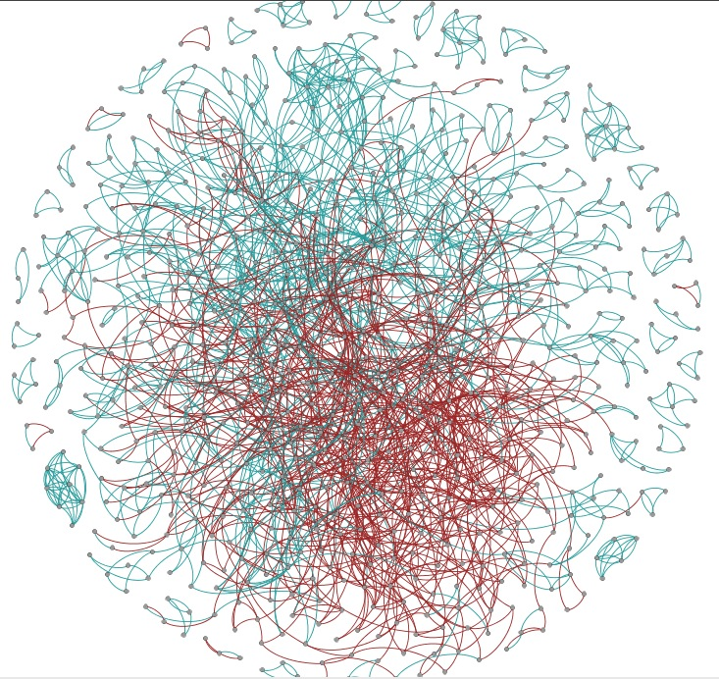
Positive and negative weights
e.g. one person trusting/distrusting another
  Research challenge: How does one ‘propagate’ negative feelings in a social network? Is my enemy’s enemy my friend?
This is a who-trust-whom online social network of a a general consumer review site Epinions.com
sample of positive & negative ratings from Epinions network

Slide 21
Centrality Analysis and Influence Modeling
Centrality Analysis:
  Identify the most important actors or edges
    E.g. PageRank in Google (PageRank is an algorithm used by Google Search to rank websites in their search engine results. PageRank was named after Larry Page, one of the founders of Google. PageRank is a way of measuring the importance of website pages)
  Various other criteria
Influence modeling:
  How is information diffused?
  How does one influence each other?
Related Problems
  Viral marketing: word-of-mouth effect

Slide 22
Major Goals of this study are:

Slide 23
Goal: characterize network structure
Are nodes connected through the network?
How far apart are they?
Are some nodes more important due to their
position in the network?
Is the network composed of communities?

Slide 24
Goal: model network formation
Randomly generated networks
Preferential attachment
Small-world networks

Slide 25
Goal: understand how network structure affects processes
information diffusion
opinion formation
coordination/cooperation
resilience to attack

