Slide 1
“What attracts people most is other people”
- William Whyte
Network Science
Clustering in Two-mode networks

Slide 2
Introduction to Clustering in Two-mode networks
Clustering is very important phenomenon in real-world networks which characterizes the deviation of these networks from ER (Erdos Renyi) random network model
There are many examples of real-world networks where the nodes in the network cluster into tightly connected cliques or groups especially in social networks (Holland and Leinhardt, 1970; Opsahl, 2009)
To test this phenomenon, many measures have been introduced
Especially, the local clustering coefficient measures single node’s direct connectivity with its neighbor’s, i.e., node and its connections whereas the global clustering coefficient measures the overall tendency of clustering in the whole network
.

Slide 3
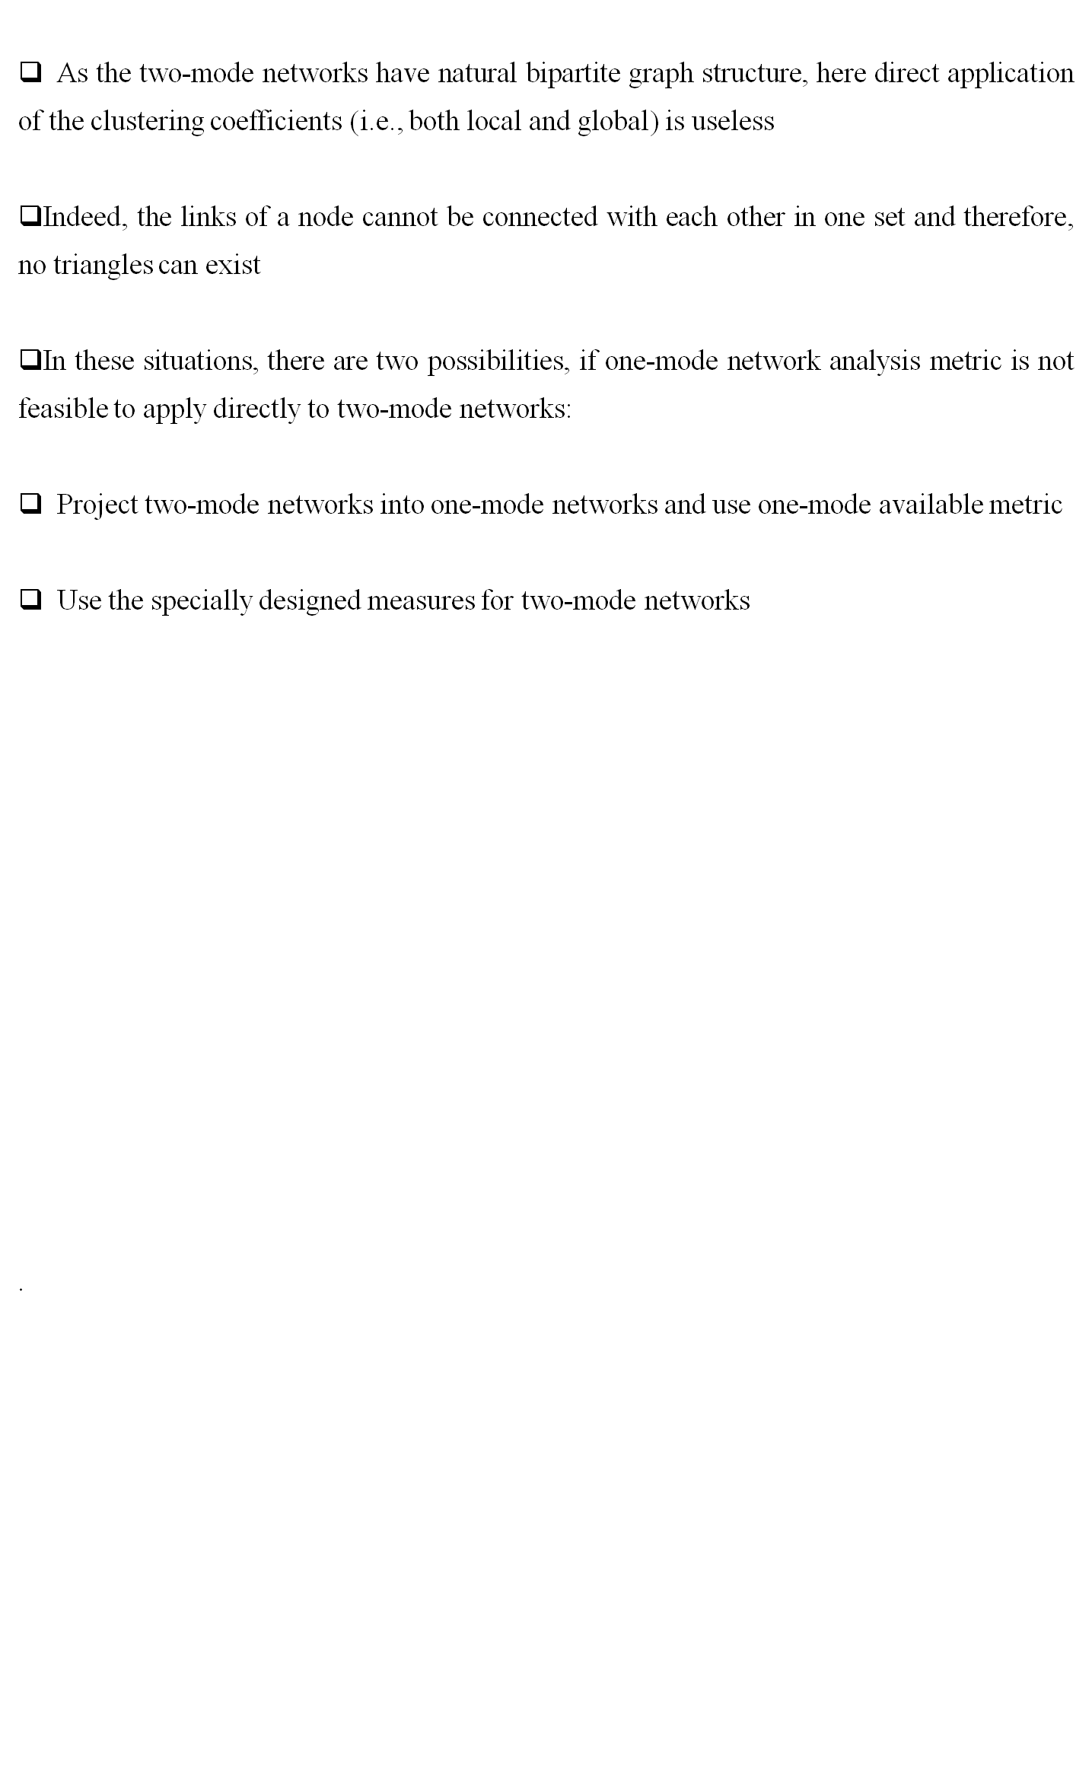
Clustering in Two-mode networks (Cont..)

Slide 4
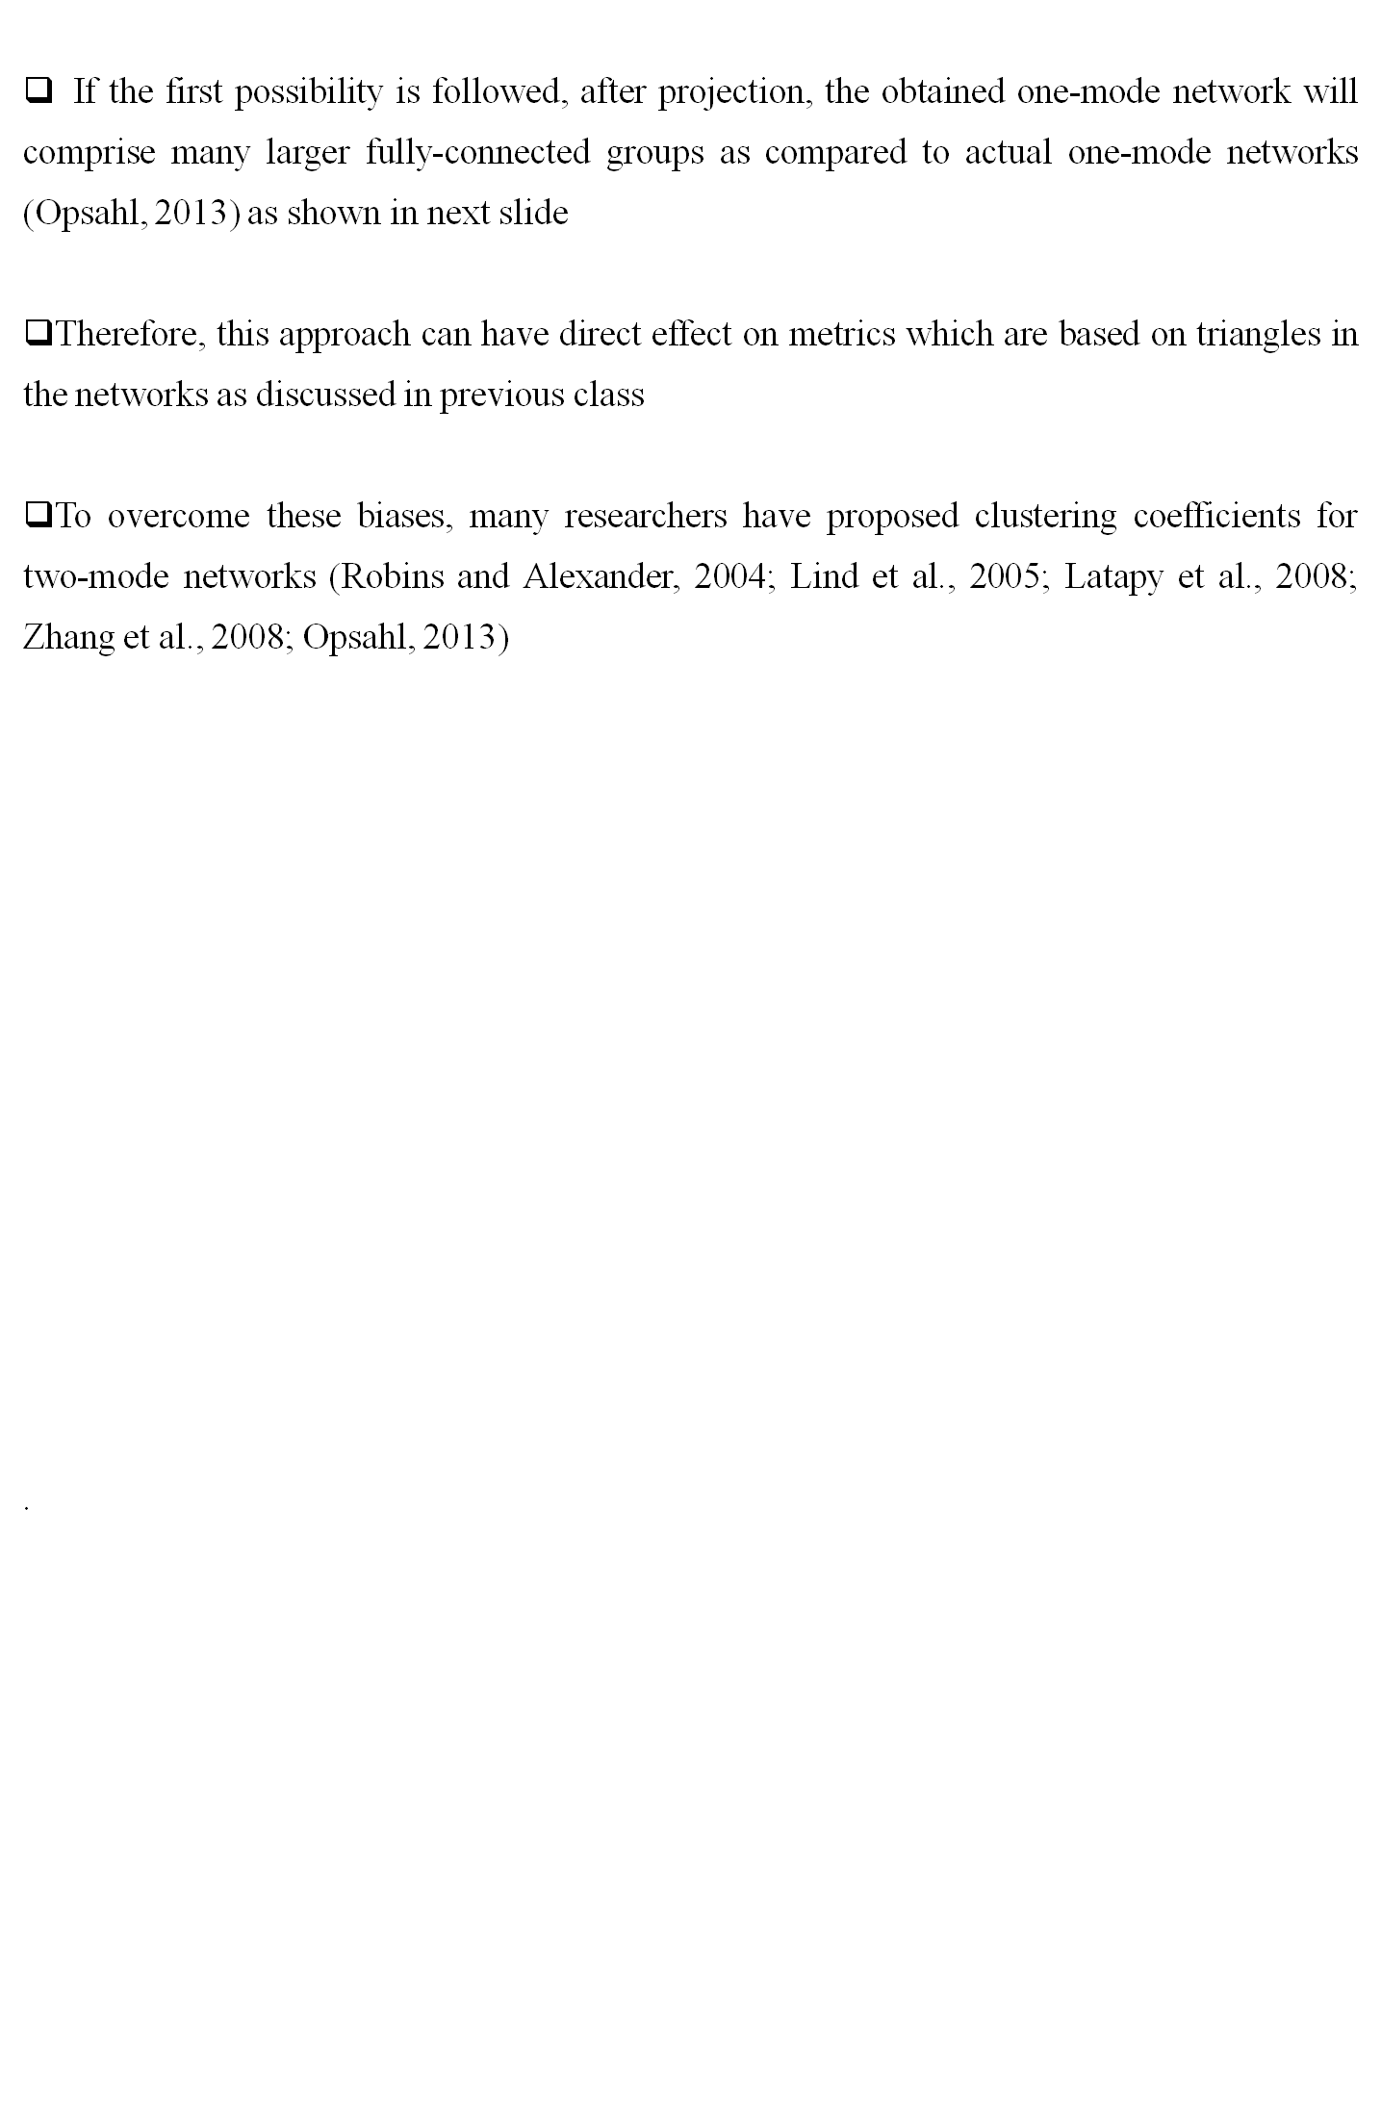
Clustering in Two-mode networks (Cont..)

Slide 5
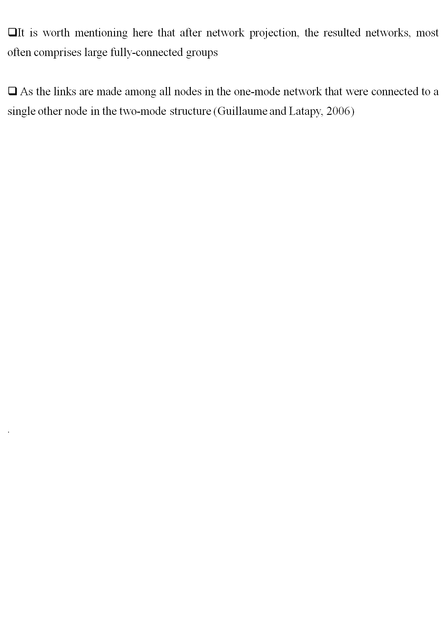
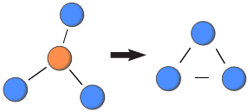
Clustering in Two-mode networks (Cont..)

Slide 6
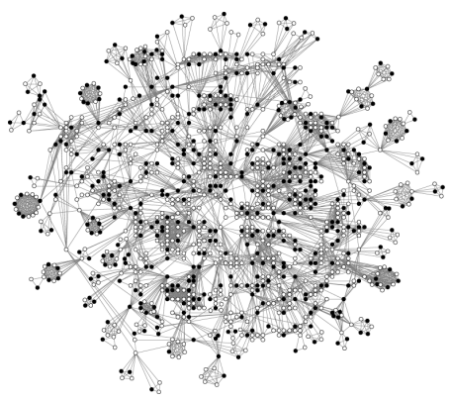
Clustering in Two-mode networks (Cont..)
Figure: The network structure among directors (circles) who form part of the largest group of interconnected directors. Two directors are connected if they are members of the same board. The solid circles refer to women, whereas the hollow circles refer to men
.

Slide 7
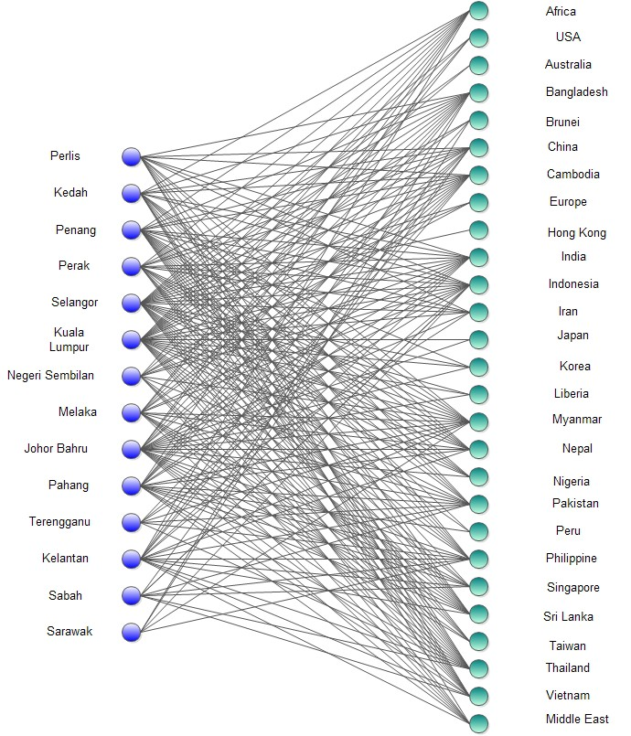
Clustering in Two-mode networks (Cont..)
.

Slide 8
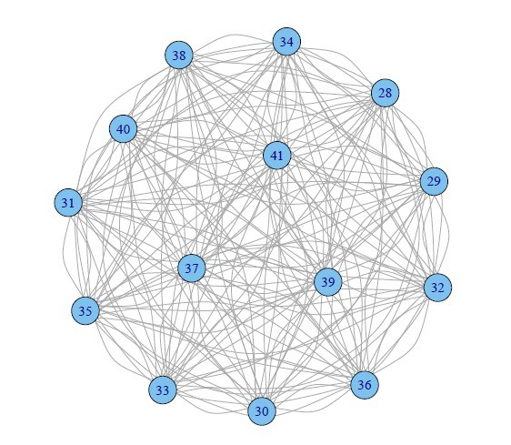
Clustering in Two-mode networks (Cont..)
.

Slide 9
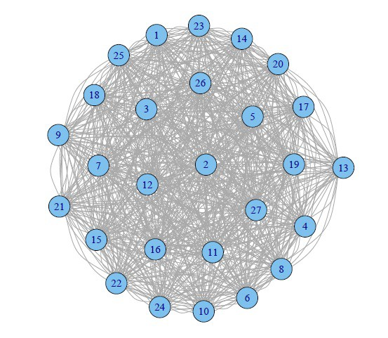
Clustering in Two-mode networks (Cont..)
.

Slide 10
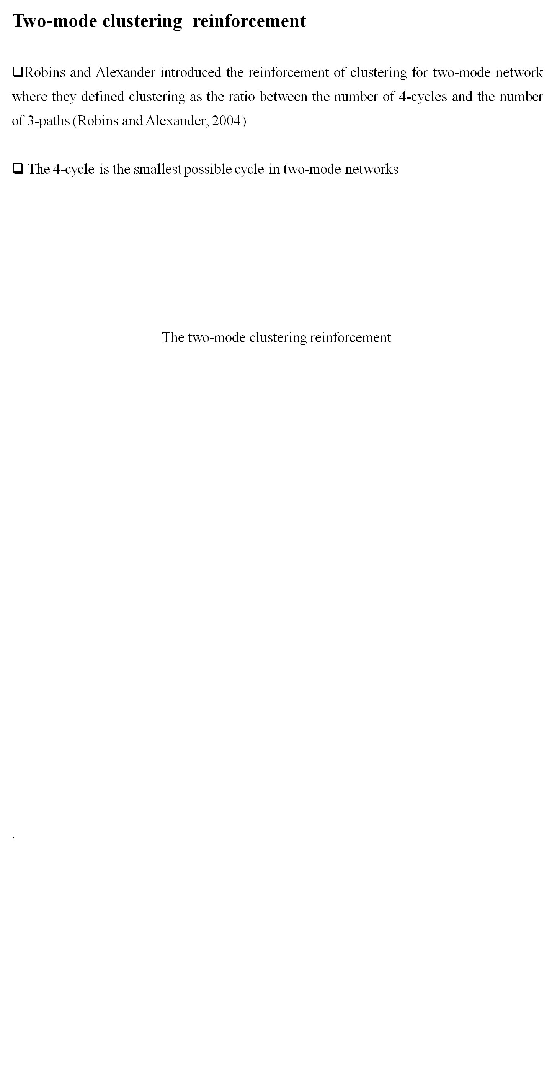
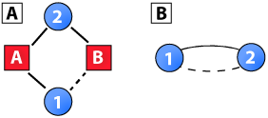
Clustering in Two-mode networks (Cont..)

Slide 11
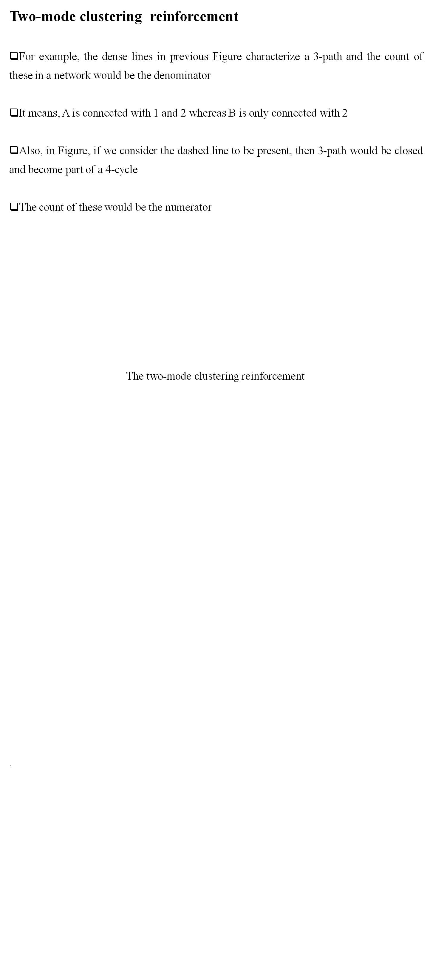
Clustering in Two-mode networks (Cont..)

Slide 12
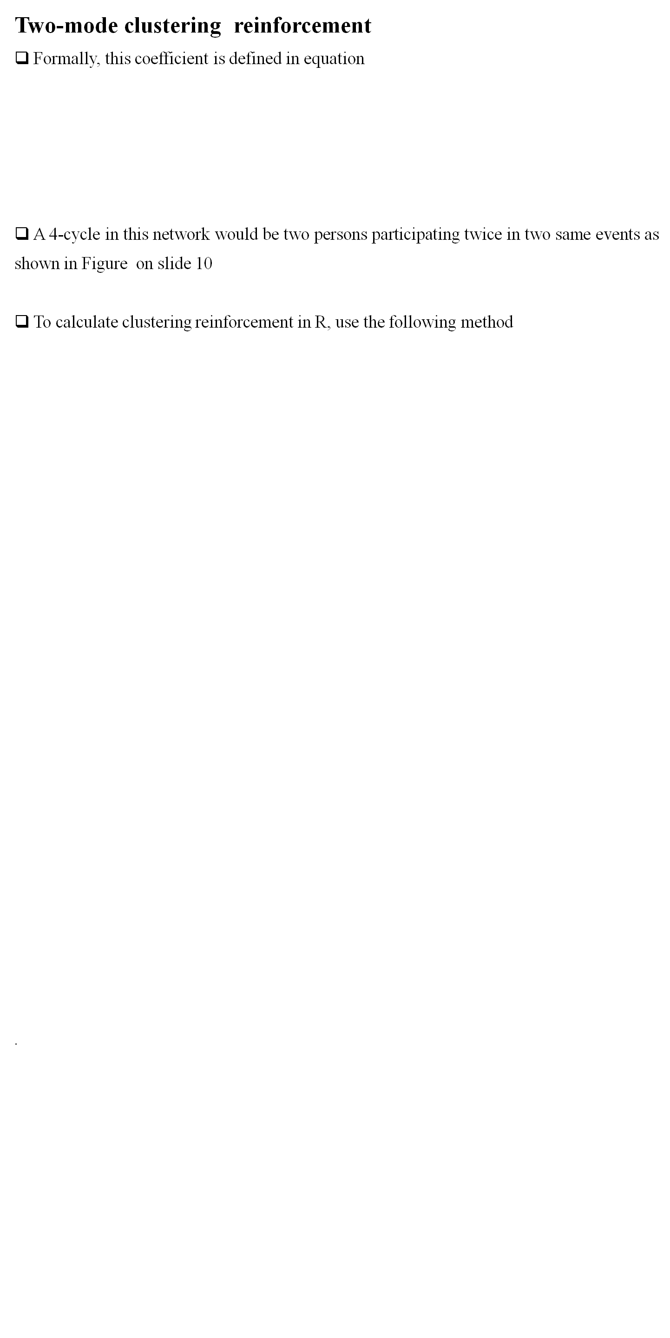

Clustering in Two-mode networks (Cont..)

Slide 13
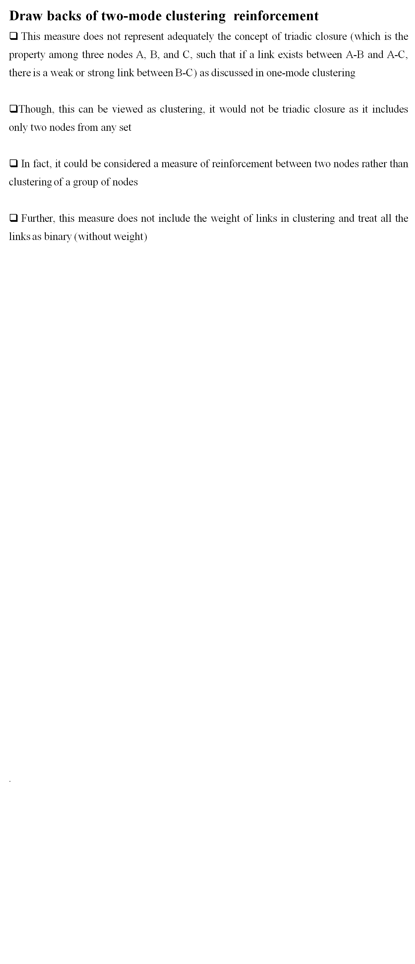
Clustering in Two-mode networks (Cont..)

Slide 14
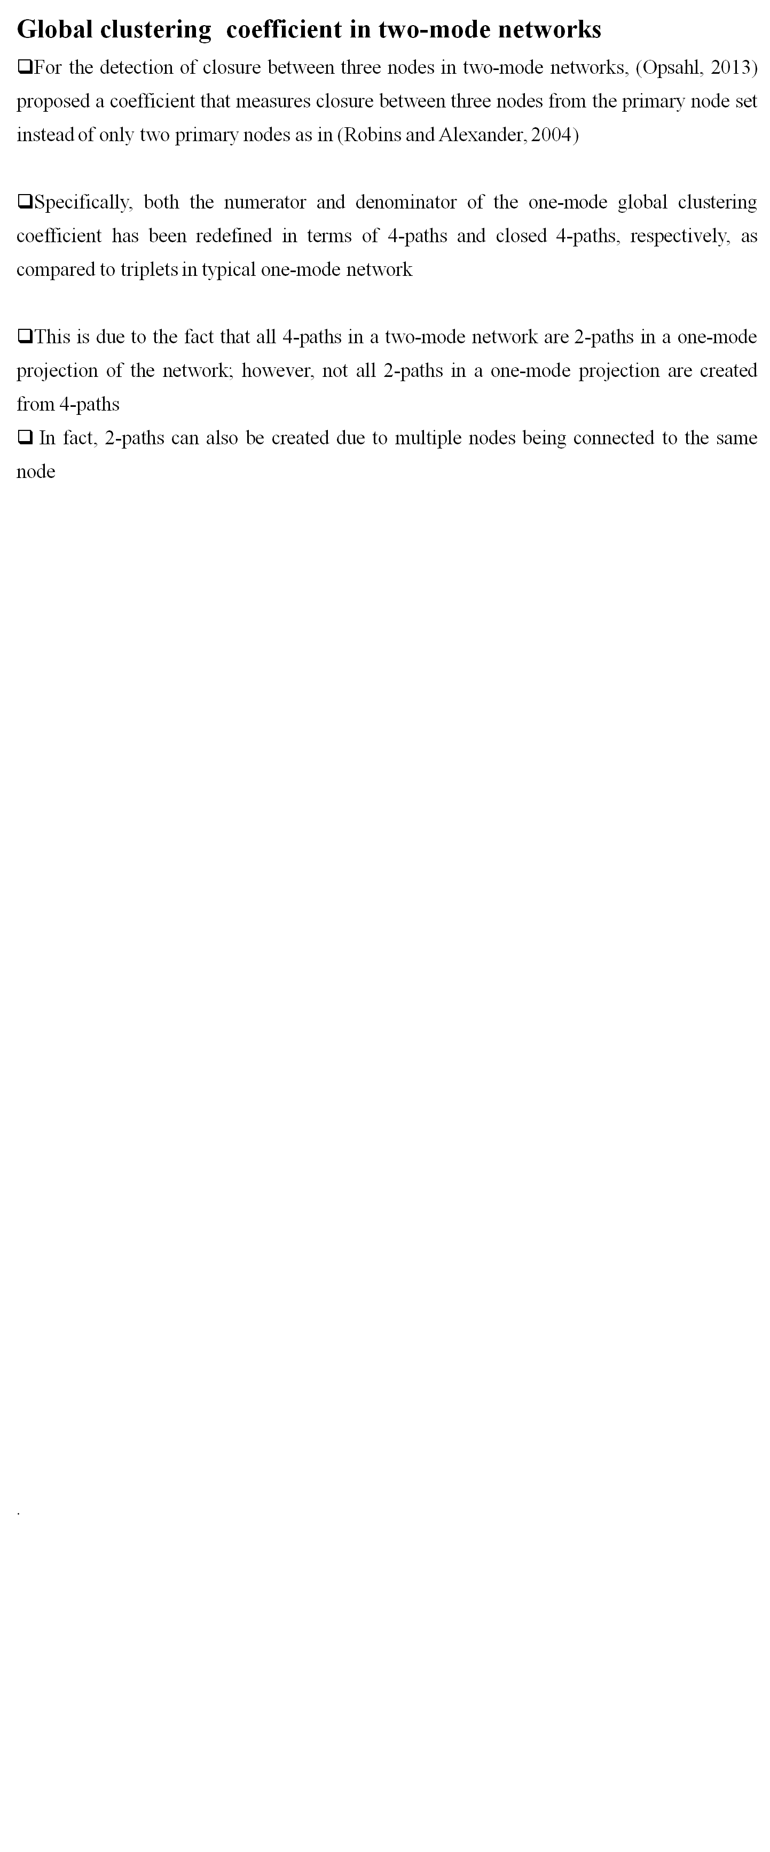
Clustering in Two-mode networks (Cont..)

Slide 15
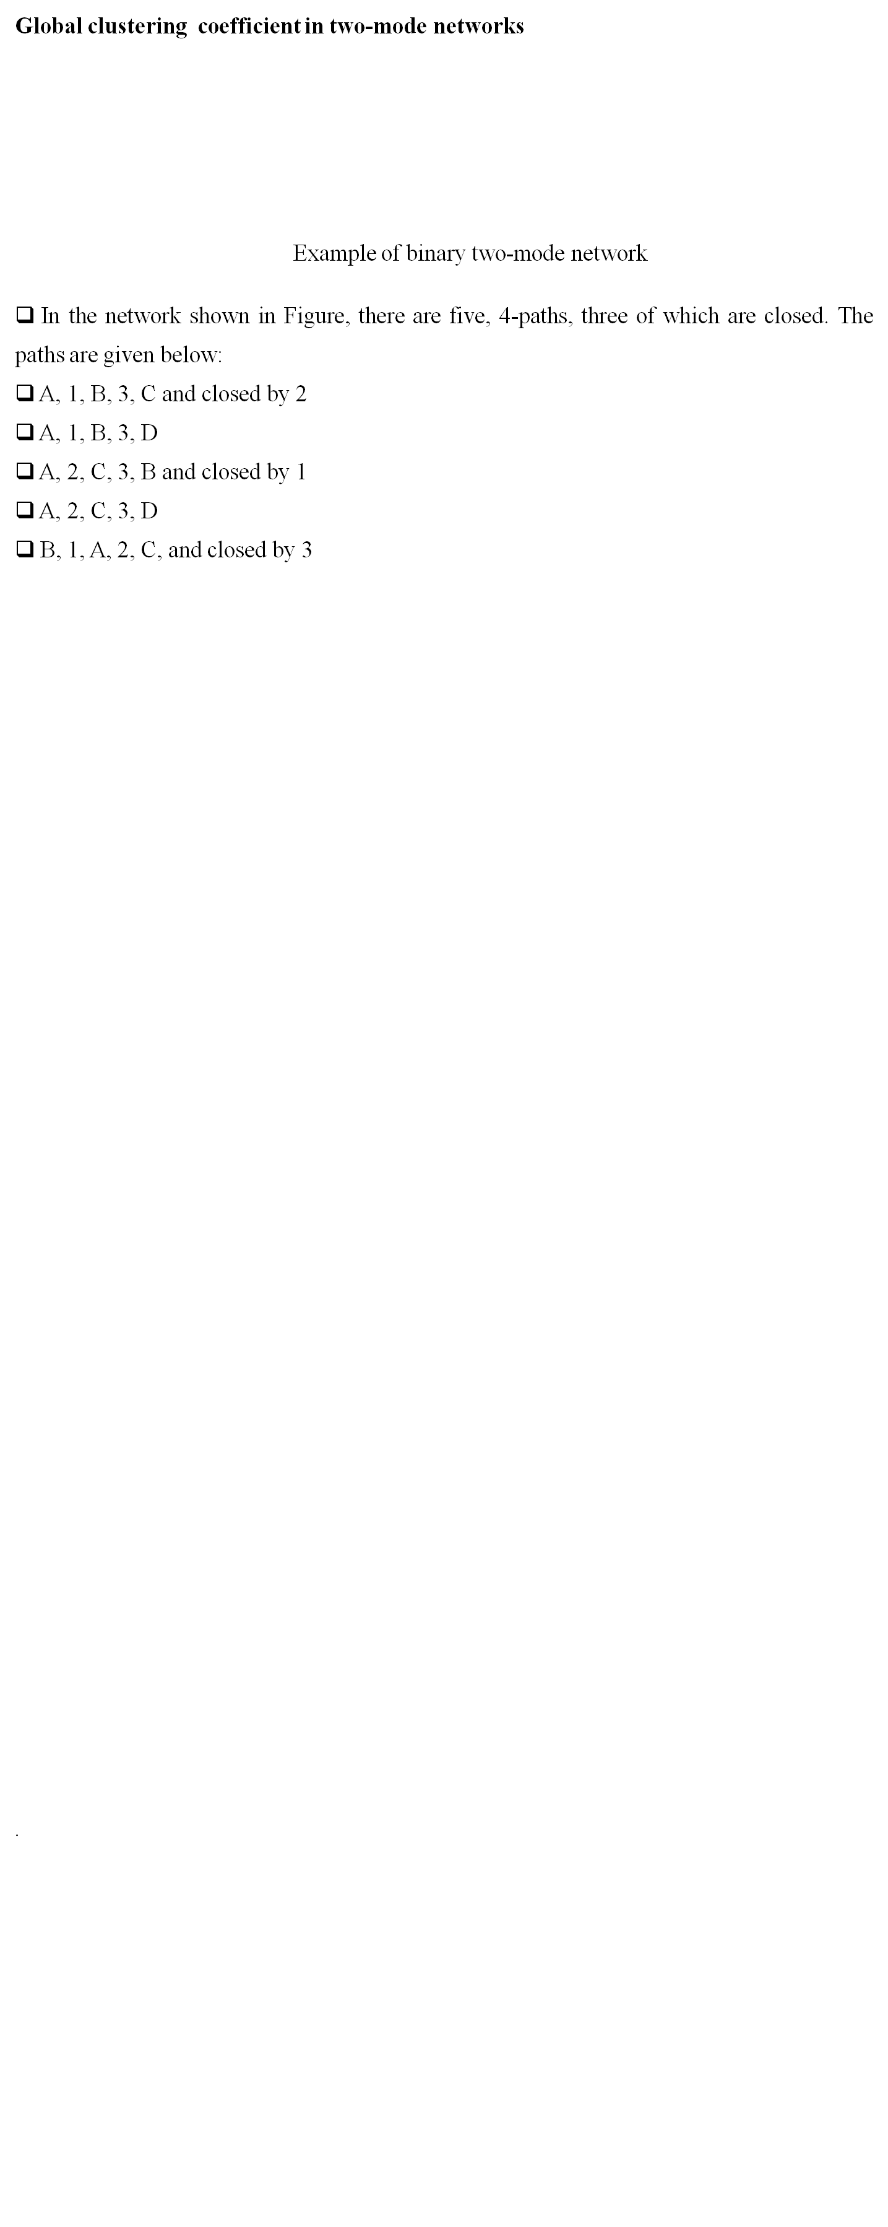
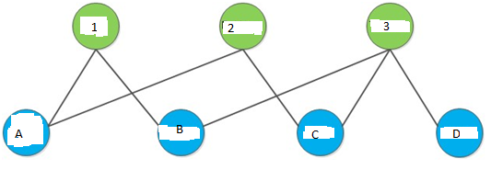
Clustering in Two-mode networks (Cont..)

Slide 16
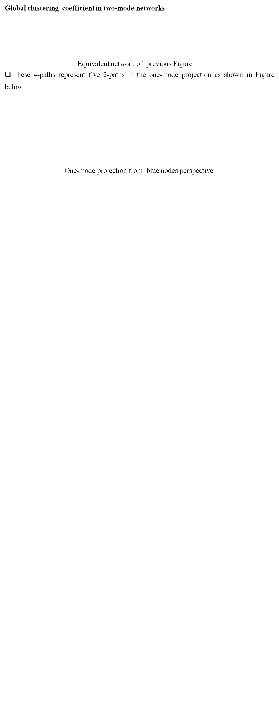
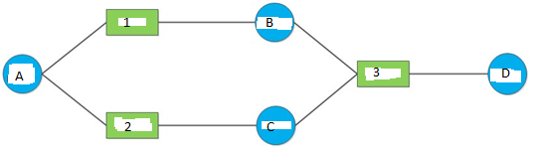
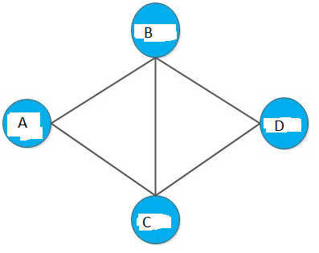
Clustering in Two-mode networks (Cont..)

Slide 17
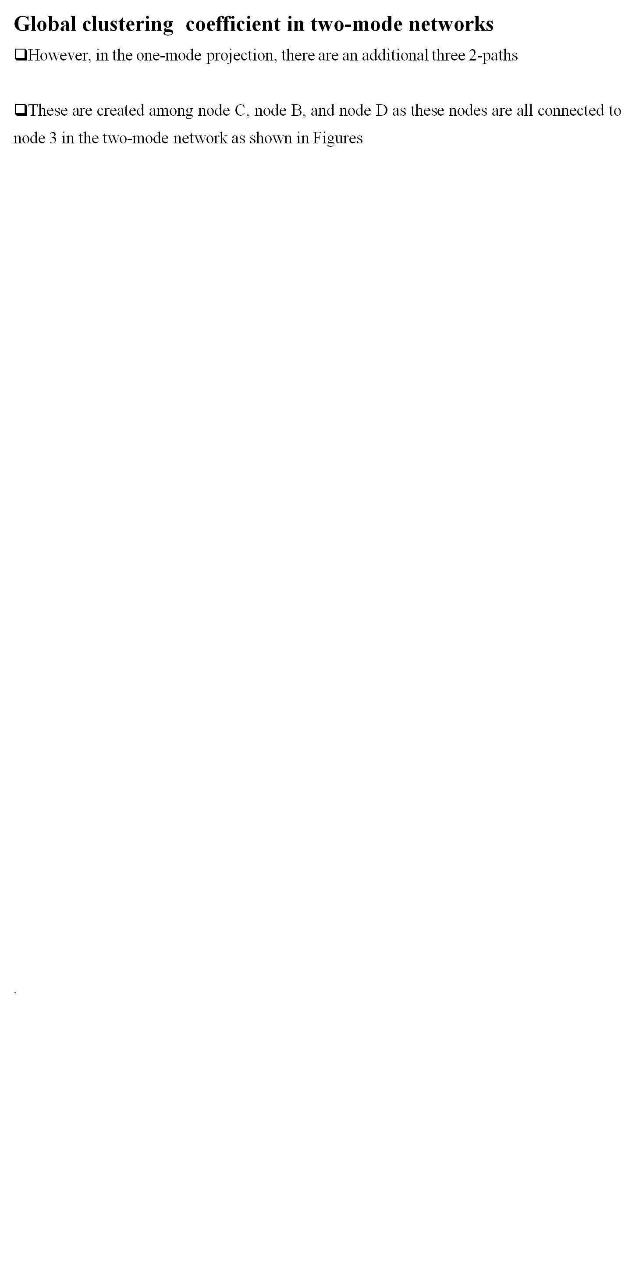
Clustering in Two-mode networks (Cont..)

Slide 18
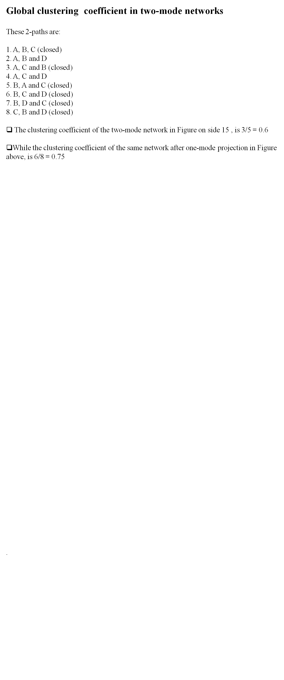
Clustering in Two-mode networks (Cont..)

Slide 19
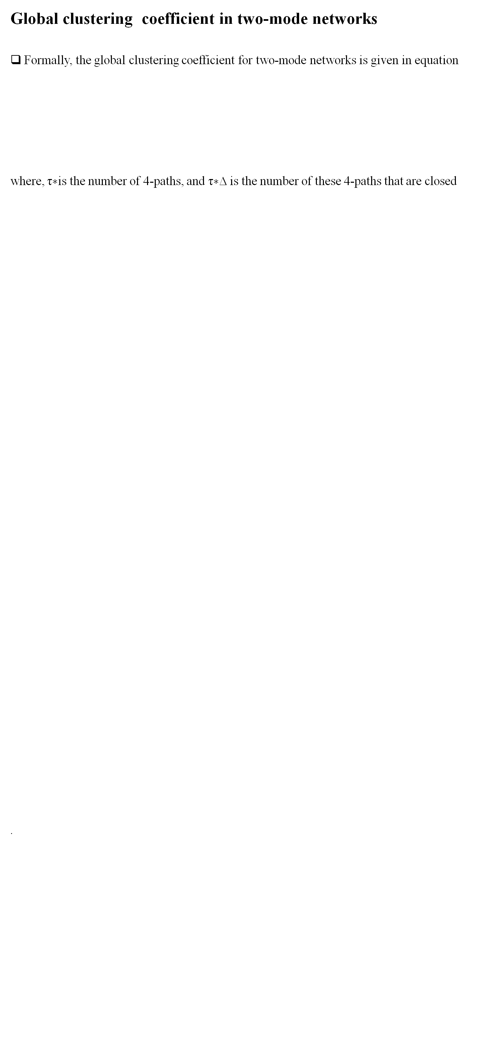

Clustering in Two-mode networks (Cont..)

Slide 20
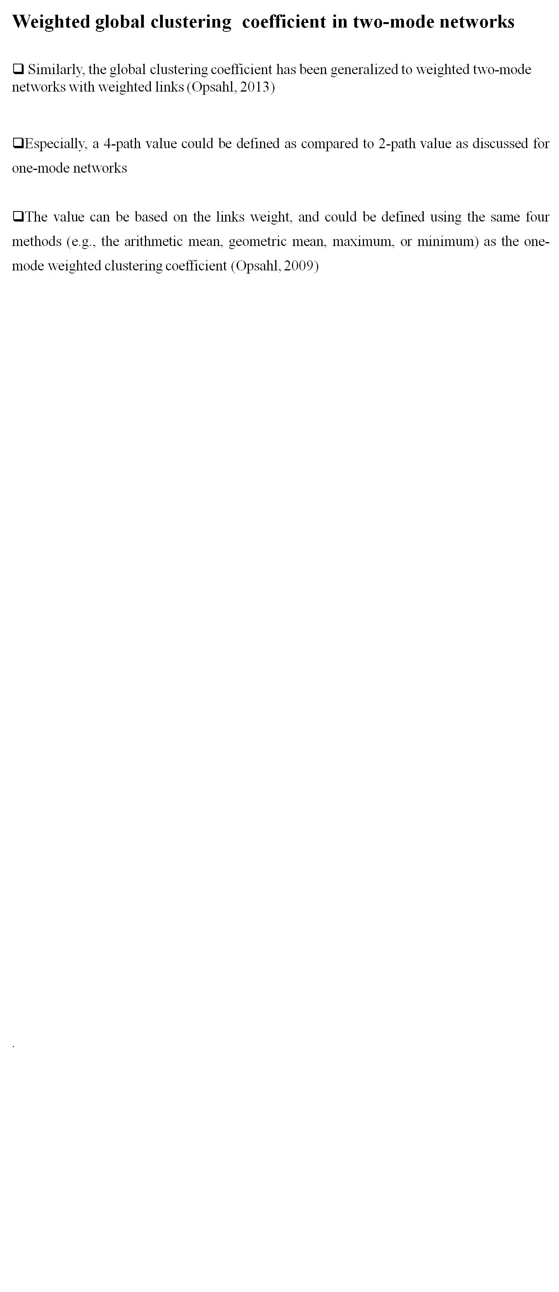
Clustering in Two-mode networks (Cont..)

Slide 21
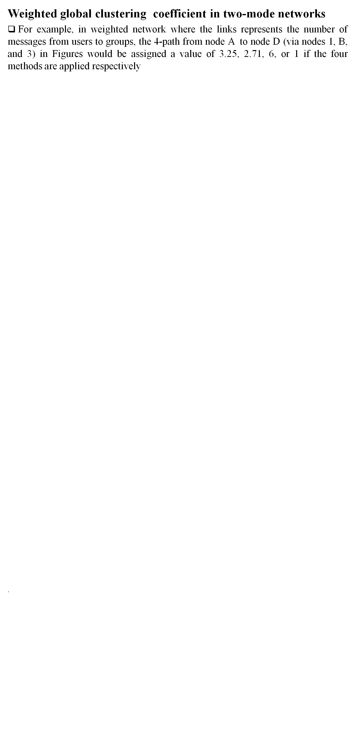
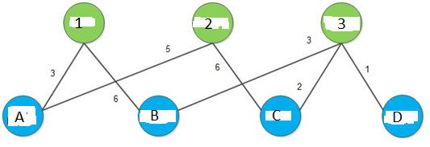
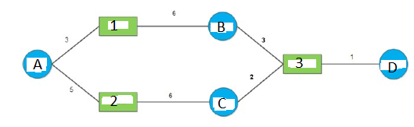
Clustering in Two-mode networks (Cont..)

Slide 22
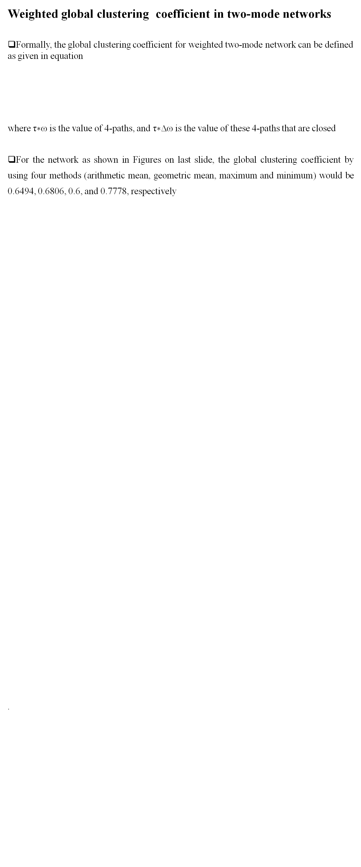

Clustering in Two-mode networks (Cont..)

Slide 23
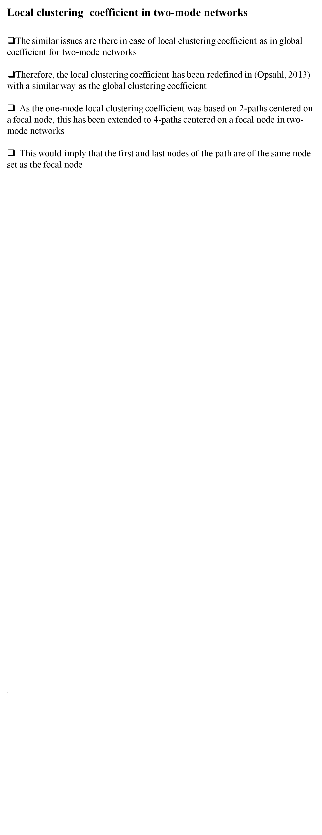
Clustering in Two-mode networks (Cont..)

Slide 24
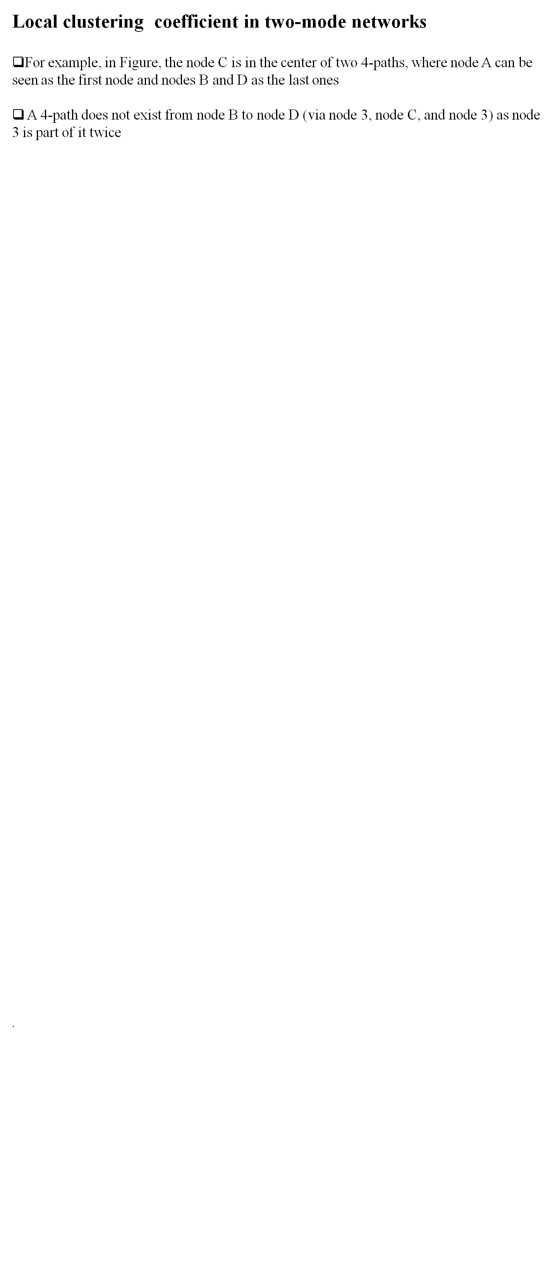
Clustering in Two-mode networks (Cont..)

Slide 25
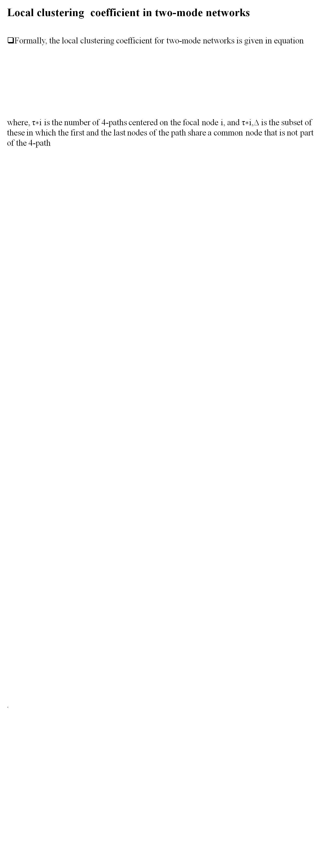

Clustering in Two-mode networks (Cont..)

Slide 26
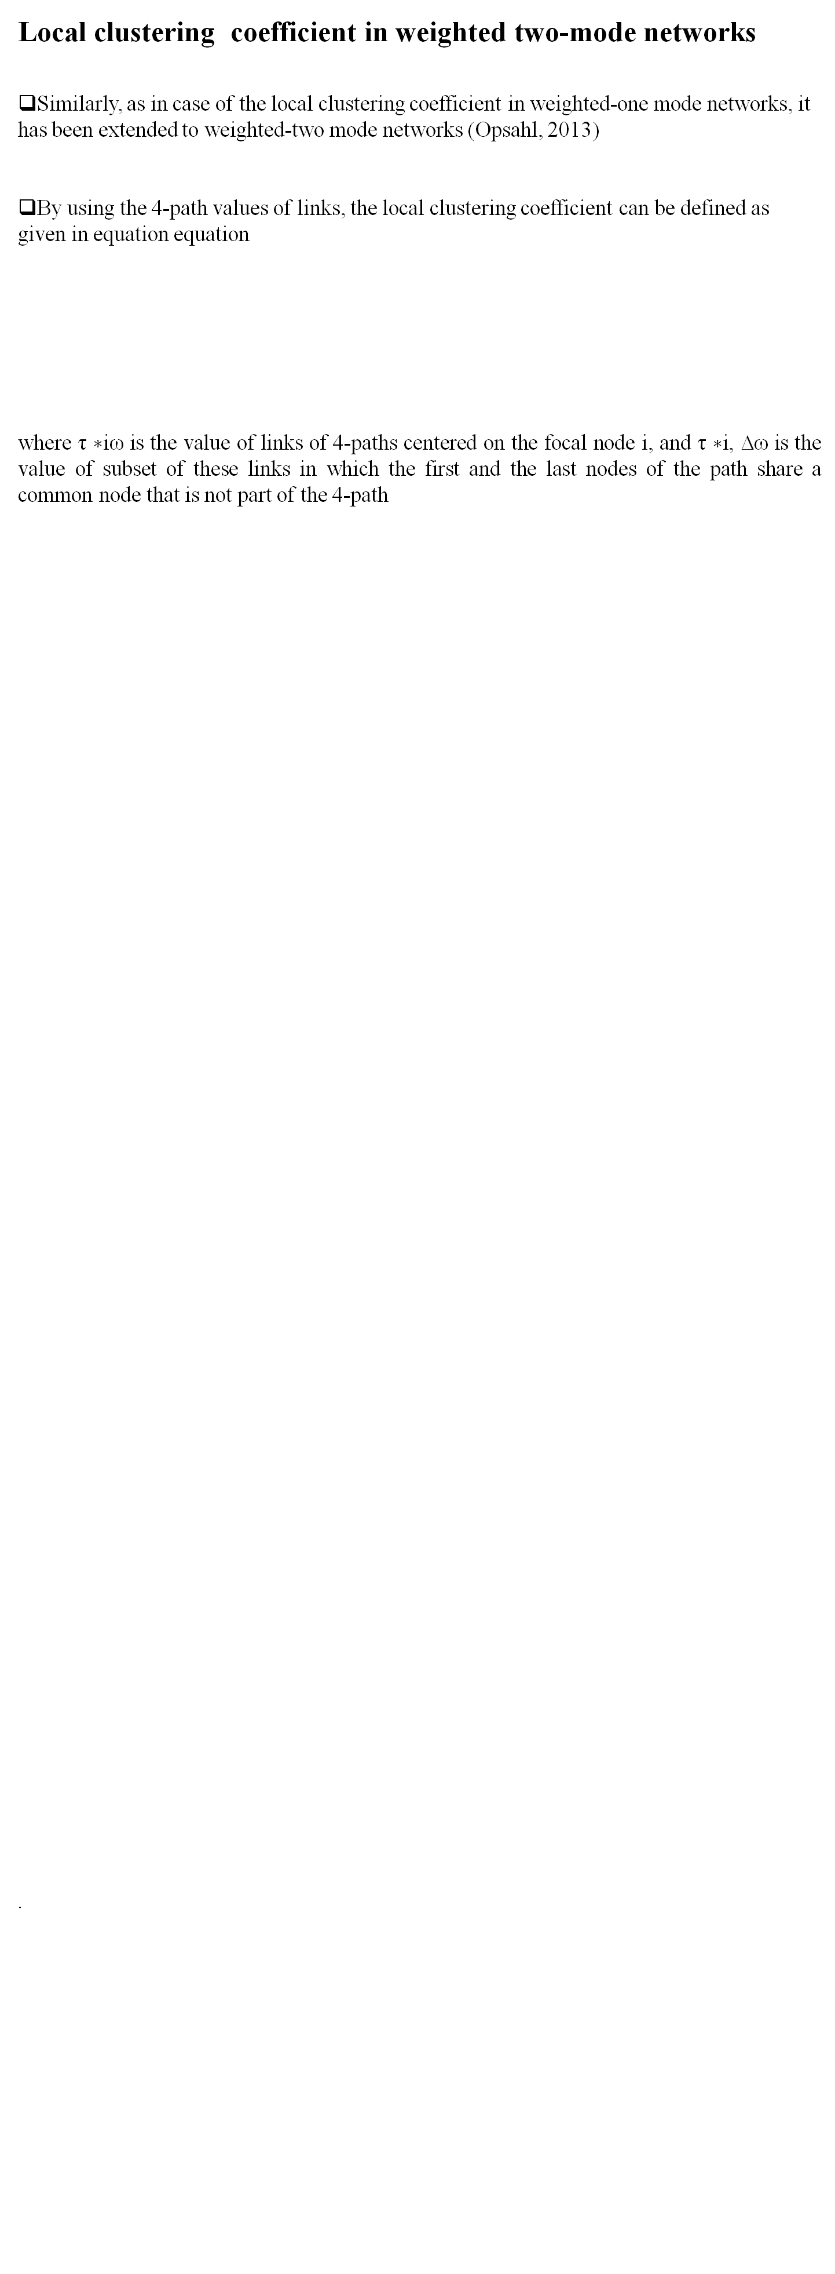

Clustering in Two-mode networks (Cont..)

Slide 27
Local and global clustering in two-mode networks (Commands in R)
# Load tnet
library(tnet)
# Calculate two-mode degree
out<- degree_tm(net, measure="degree")
# Calculate the reinforcement coefficient (Robins and Alexander, 2004)
reinforcement_tm(net)
# Calculate the global coefficient (Opsahl, 2012)
clustering_tm(net)
# Calculate the local coefficient (Opsahl, 2012)
clustering_local_tm(net)
.

