Slide 1
Network Science
Robustness and vulnerability of Complex networks

Slide 2
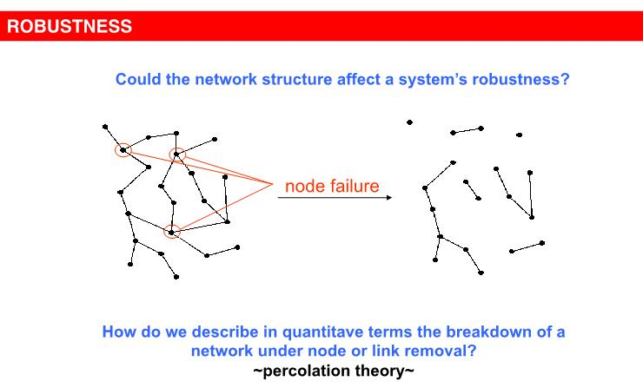
Introduction to Robustness and Vulnerability
Complex systems maintain their basic functions even under error and failure.
At any moment hundred of routers on the internet are broken, yet, the internet
as a whole does not loose its functionality.
Where does robustness comes from?
Can the network structure affect a systems robustness?
.

Slide 3
Introduction to Robustness and Vulnerability
It has been observed that many real-world complex networks show very robust behavior under random attacks (Albert and Baraba´si, 2002).
For example, communication networks like router networks show very robust behavior even when many nodes and links go down regularly.
However, it does not effect on the global information flowing capability of these networks.
.

Slide 4
Introduction to Robustness and Vulnerability
Similarly, terrorist networks (Ilachinski, 2012; Mahesar et al., 2015), Internet from router and AS (Autonomous systems) perspectives (Pu et al., 2012; Chen et al., 2005), cellular and metabolic networks (Jeong et al., 2000) have been proven to be very robust networks under random nodes and links failure.
Also, strong correlation has been observed between network topology and robustness of real-world networks (Albert et al., 2000; Kaufmann and Zweig, 2009).
If we compare the nodes removal versus the links removal from the network, then nodes removal has high impact on robustness.
.

Slide 5
Introduction to Robustness and Vulnerability
As removal of node also disconnects the links directly connected with that node.
Therefore, node removal affects more on topology of the network as compared to links removal.
Indeed, due to heterogeneous degree distribution of nodes and links weight, scale-free topology of these networks shows robust behavior under random attack.
It implies that, the robustness and vulnerability of network mainly depend on the topological structure of network under analysis.
.

Slide 6
Introduction to Robustness and Vulnerability
In case of random networks, where almost all nodes have the same degree with same importance for the connectedness of network, saves these networks in the case of targeted attacks.
On the other hands, scale-free networks will lose a high percentage of its links very quickly if the nodes with high degree are removed.
Similarly, in case of the removal of highly weighted links can quickly decrease the flow of traffic in networks.
This is the reason; scale-free networks become very vulnerable to this (targeted) attack
.

Slide 7
Introduction to Robustness and Vulnerability
Many real-world datasets of complex systems when modelled and analyzed as complex networks have shown that they are very robust under random attacks and on the other hand they become vulnerable under targeted attacks [Xu, J. and Chen, H. (2008)][X.Huang, J.Gao, S.V.Buldyrev, S.Havlin, H.E.Stanley(2011)][Pu, C.-L., Zhou, S.-Y., Wang, K., Zhang, Y.-F., and Pei, W.-J.(2012)].
.

Slide 8
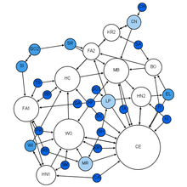
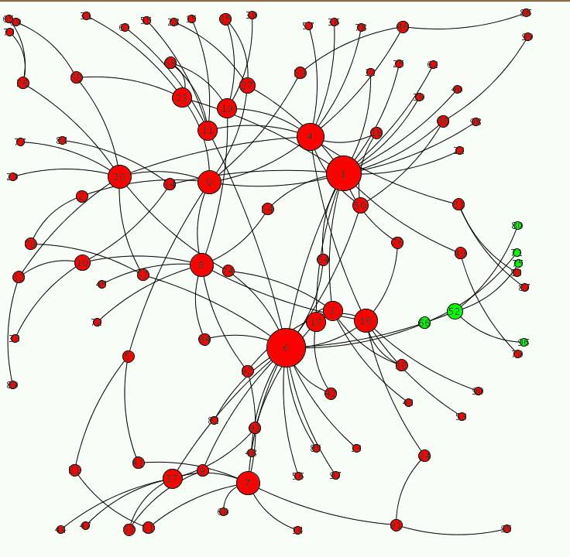
Reason of robustness and vulnerability

Slide 9
How to measure robustness of network?
To find the robustness aspect of complex network, we can use random links removal approach when we have many links with varying weights and less number of nodes in network.
The random links removal experiment can be performed (varying) times with (varying ) percentage of links.
For example, twenty times with 10% and 20% links removal from the network.
Different metrics can be used i.e., degree, strength, betweenness etc.
.

Slide 10
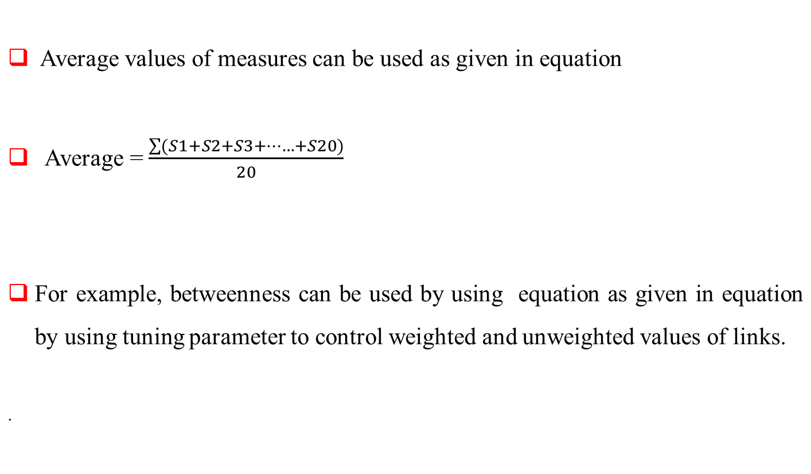
How to measure robustness of network?

Slide 11
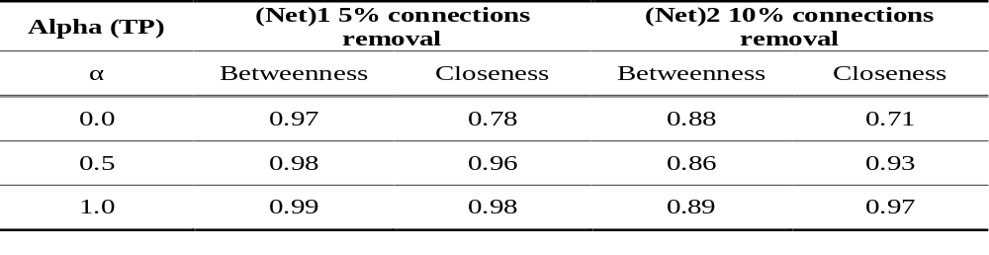
How to measure robustness of network?
Further, for finding the ranks of the nodes in both true and observed networks Spearman’s rank correlation can be used.
The effect of random links removal from the original network on betweenness and closeness centralities using Spearman’s rank correlation as compared to true network.

Slide 12
Link Prediction
Link prediction has several applications including predicting relations among nodes such as routers in technological network sharing data with other, and predicting their future behavior such as communications between them and so on.

Slide 13
Link Prediction in Complex Networks
One of the fundamental problems in network science is link prediction.
The prediction of future links is very significant problem in the area of network science.
Link prediction is used to predict future possible links in the network e.g., Dark Networks.
It can be used to predict missing links due to incomplete data.
Due to the complex relationship between nodes in network it needs an efficient method of link prediction.
.

Slide 14
Methods of link prediction
The link prediction problem for social networks was formally introduced by (Liben and Nowell) and Kleinberg.
They discussed link prediction problem as a basic computational problem to understand the mechanism underlying social network evolution purely based on endogenous properties of the given network i.e., properties derivable from its existing link.
.

Slide 15
Methods of link prediction
Many link prediction methods have been introduced based on different structural and topological properties of various networks.
Typical choices of structural similarity measures include
Local Indices based on
1) Common Neighbors(CN)
2) Jaccard index
3) Adamic-Adar index
Global Indices based on the ensemble of all paths,
1) Katz index
.

Slide 16
Common Neighbors(CN)
This method is used as a baseline to judge the performance of other methods.
This method is based on the assumption that two nodes with many common neighbors will be connected in the future.
The more common neighbors two users have, the higher the probability that a relationship between them will emerge.
The number of their common neighbors can be regarded as a measurement of their similarity.

Slide 17

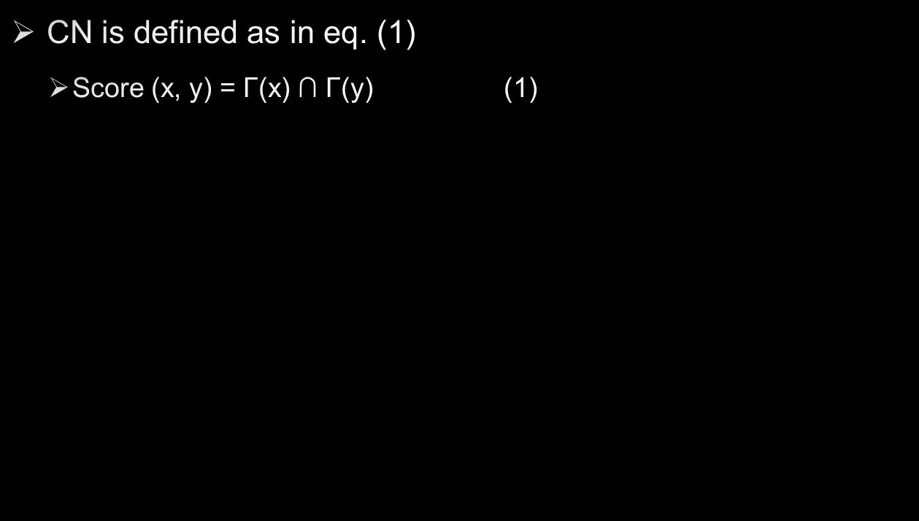

C
D
Neighbors of X
  Γ(A) ∩ Γ(D)
  Γ(A) ∩ Γ(E)
A
B , C
B , C
B , C
B
B
E
S = 2
S = 1

Slide 18

Jaccard Index
This method is based on common neighbor concept which has been extensively used in information retrieval.
This coefﬁcient measures higher chances for any two nodes x and y which share a higher ratio of common neighbors comparative to total number of neighbors.
For high number of common neighbors, the score would be higher
It can be formally defined as in eq. (2)
  Score (x, y) = │ Γ(x) ∩ Γ(y) │
  │ Γ(x) Ս Γ(y) │ (2)

Slide 19

Adamic-Adar Index (AA)
It was initially designed to measure the relation between personal home pages.
This metric was used for comparison between two web pages in World Wide Web network if they are very close to each other
In this method the counting of rare features are used in weighting more heavily as compared to many.
For evaluating Adamic-Adar of two people we find common neighbor of two people and count all the neighbors of that common neighbor. Then by the equation we can find Adamic- Adar of that two people.

Slide 20

Adamic-Adar Index (AA)
The more friends common neighbor of node x and node y has, the lower score it will be assigned to. Thus, the common neighbor of a pair of nodes with few neighbors contributes more to the Adamic/Adar score (AA) value.
The weighting scheme used is the inverse log frequency of their occurrence.
For example, if only two people mention an item, then the weight of that item is 1/log(2) or 1.4.
If five people mention the item, then its weight drops down to 1/log (5) 0r 0.62.

Slide 21
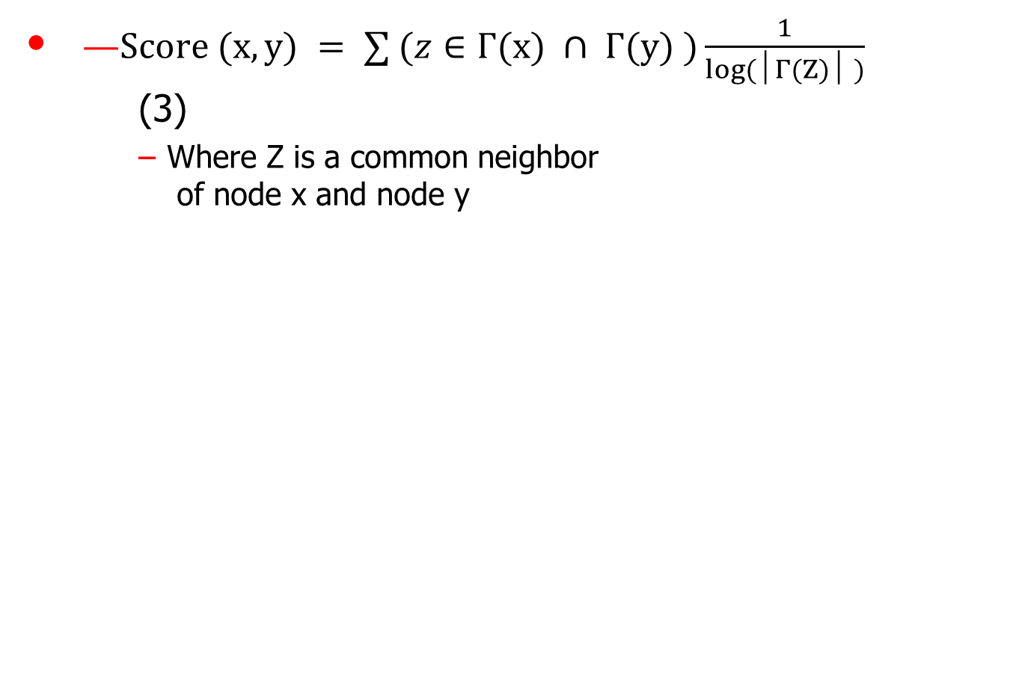
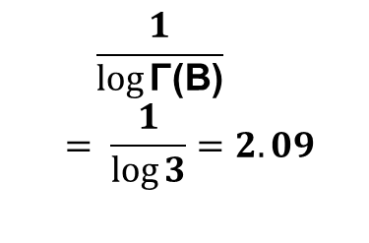
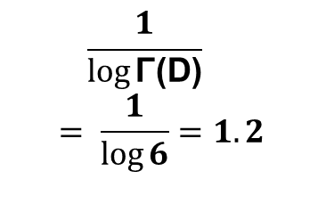
Adamic-Adar Index (AA)
  Γ(A) ∩ Γ(C) = B
  Γ(A) ∩ Γ(E) = D
B
  Γ(B) = 3
  Γ(D) = 6
D
F
A
C
E

Slide 22
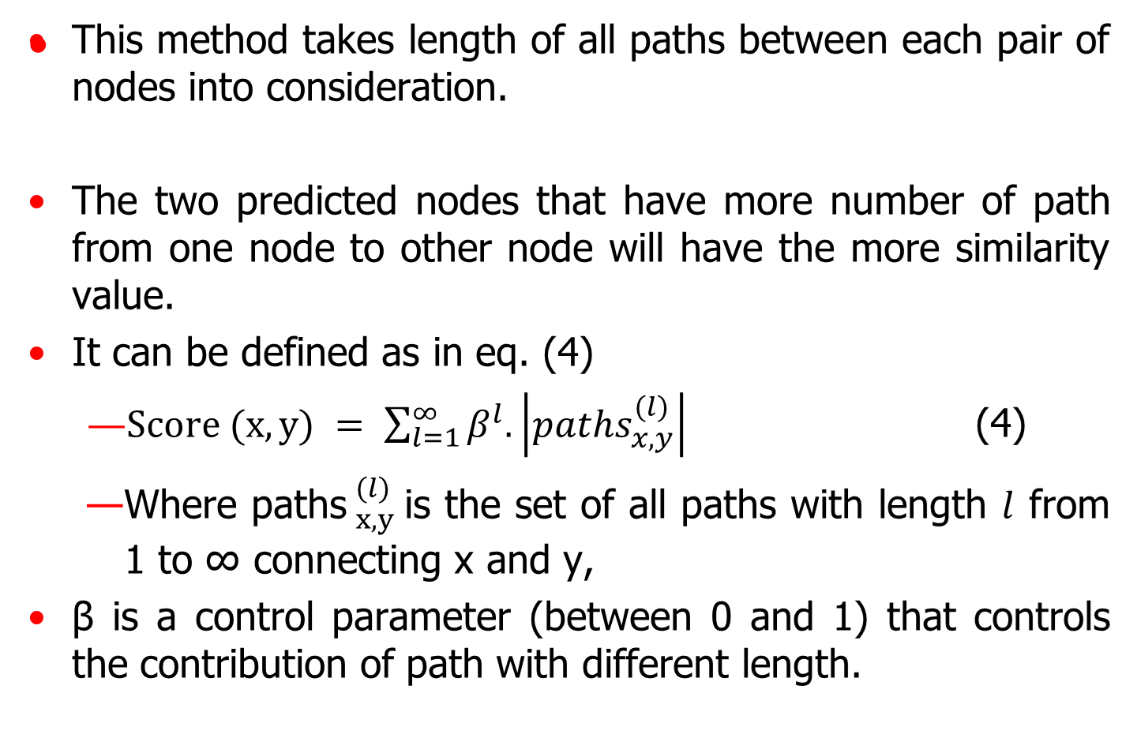
Katz Index

