Slide 1

Week 2 ENTREPRENEURSHIP
Lecture by Dr. Arifa Bhutto

Slide 2
Outline
Global Entrepreneurship Monitor (GEM)
Entrepreneurial Revolution
Causes of the Entrepreneurial Revolution
The Entrepreneurial Process
role of team
Barriers to Entrepreneurship
The Entrepreneurial and Intrapreneurial Mind
Starting A Business
Before Starting an Enterprise
Six Steps for Successful Business
How Entrepreneurs Make Money
What is pitching a startup?
Entrepreneurs and the Economy
How Entrepreneurship Helps Economies
Entrepreneurs and their impact on jobs & economic growth

Slide 3


Entrepreneurial Process
1

Slide 4
Global Entrepreneurship Monitor (GEM)
Global Entrepreneurship Monitor (GEM) is a consortium of national
country teams, primarily associated with top academic institutions,
that carries out survey-based research on entrepreneurship around
the world. GEM is the only global research source that collects data
on entrepreneurship directly from individual entrepreneurs! GEM’s
Adult Population Survey (APS) provides analysis on the
characteristics, motivations and ambitions of individuals starting
businesses, as well as social attitudes towards entrepreneurship. The
National Expert Survey (NES) looks at the national context in which
individuals start businesses.

Slide 5
In numbers, GEM is:
20+ years of data
50,000+ interviews a year
100+ economies
500+ specialists in entrepreneurship
300+ academic and research institutions
200+ funding institutions

Slide 6

Entrepreneurial Revolution
Entrepreneur Revolution means taking the
initiative to do something that you love, something that you're good at, and something that will make you money.
People were losing jobs, and it was perceived as a bad time to be in business. However, people some people impacted by this collapse used resources to pick up the pieces and created jobs for themselves. This is often cited as one of the causes of the entrepreneurial revolution. that entrepreneurs are job creators

Slide 7
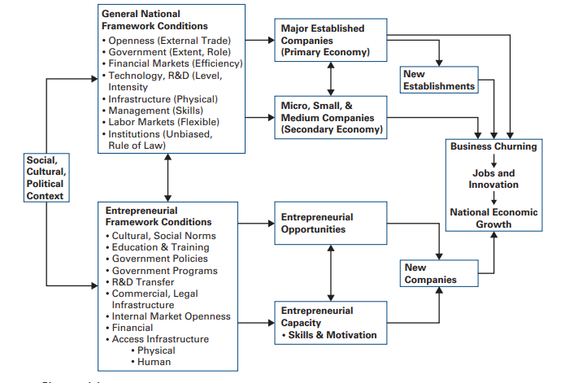
Causes of the Entrepreneurial Revolution
GEM model of economic growth

Slide 8
What is Entrepreneurial Process?
The Entrepreneur is a change agent that acts as an industrialist and undertakes the risk associated with forming the business for commercial use.
An entrepreneur has an unusual foresight to identify the potential demand for the goods and services.
The entrepreneurship is a continuous process that needs to be followed by an entrepreneur to plan and launch the new ventures more efficiently.

Slide 9
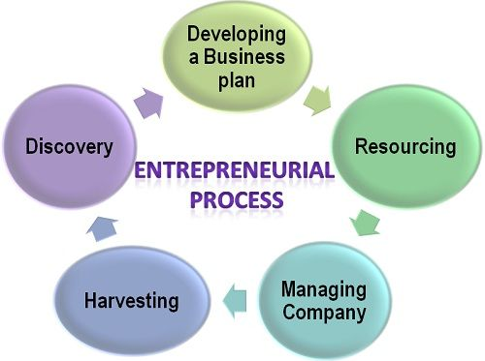
Entrepreneurial Process

Slide 10
Entrepreneurial Process
Discovery:
The identification and the evaluation of opportunities is a difficult task; an entrepreneur seeks inputs from all the persons including employees, consumers, channel partners, technical people, etc. to reach to an optimum business opportunity. Once the opportunity has been decided upon, the next step is to evaluate it.
Developing a Business Plan: Once the opportunity is identified, an entrepreneur needs to create a comprehensive business plan. A business plan is critical to the success of any new venture since it acts as a benchmark and the evaluation criteria to see if the organization is moving towards its set goals.

Slide 11
Entrepreneurial Process
Resourcing: The third step in the entrepreneurial process is resourcing, wherein the entrepreneur identifies the sources from where the finance and the human resource can be arranged.
Managing the company: Once the funds are raised and the employees are hired, the next step is to initiate the business operations to achieve the set goals.
Harvesting: The final step in the entrepreneurial process is harvesting wherein, an entrepreneur decides on the future prospects of the business, i.e. its growth and development.

Slide 12

Entrepreneurial Team
An entrepreneurial team consists of two or more persons who have an interest, both financial and otherwise, in and commitment to the venture's future and success; whose work is interdependent in the pursuit of common goals and venture success; who are accountable to the entrepreneurial team and for the venture

Slide 13

Importance of Entrepreneurial Team
The entrepreneurial team needs to be able to communicate a future that is desirable and tangible for every current and potential employee.
Employees must be so heavily engaged in the business that they'd be willing to invest their own capital or take a significant pay cut in exchange for equity

Slide 14
Barriers to Entrepreneurship
Take it very easy to do ….
Need only great idea!!!!
Lack of viable concept
Lack of market knowledge
Lack of technical skills
Lack of capital
Lack of business know how
Time presences and distractions
Legal constraints and regulations

Slide 15
What Are the 7 Characteristics of Entrepreneurs?
Versatile
Resilient
Flexible
Money-savvy
Business smart
Focused
Communicators.

Slide 16
Intrapreneurship?
An Intrapreneurship is the system wherein the principles of entrepreneurship are practiced within the boundaries of the firm. An intrapreneur is a person who takes on the responsibility to innovate new ideas, products and processes or any new invention within the organization.

Slide 17
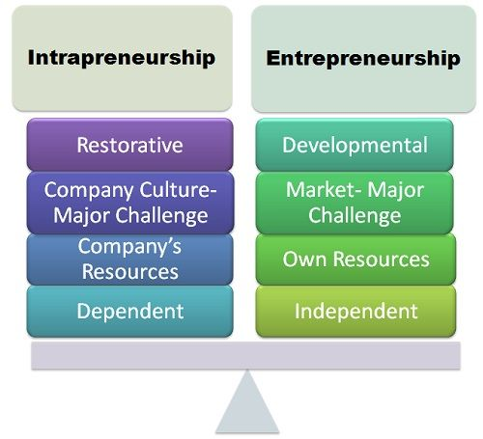

Slide 18
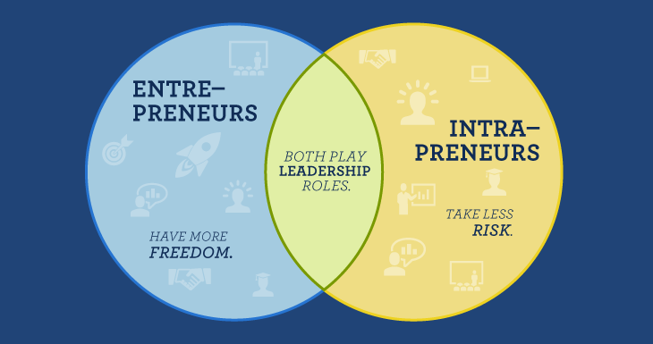
Both Play Leadership Roles

Slide 19

Starting a Business
Being an entrepreneur is not an easy task. It is a very big decision and one has to make efforts, has to be patient, and should work hard. Before starting an enterprise, some factors should be considered and reviewed in order to increase the probability of profitability.

Slide 20
How Entrepreneurs Make Money
Entrepreneurs make money like any business: they seek to generate revenues that are greater than costs. Increasing revenues is the goal and that can be achieved through marketing, word-of-mouth, and networking.
Keeping costs low is also critical as it results in higher profit margins.
This can be achieved through efficient operations and eventually economies of scale.
Here is an illustrative graph indicating possible cash flows and their timing during the different phases of an entrepreneurial venture:

Slide 21
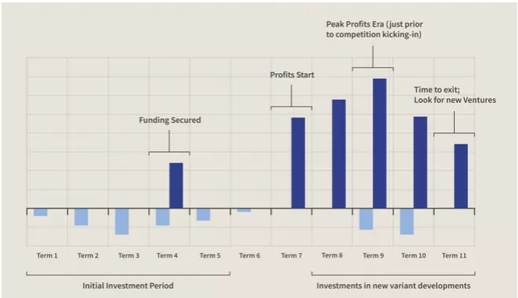
Graph

Slide 22

How Entrepreneurs Make Money
Taxes for Entrepreneur:
The taxes you will pay as an entrepreneur will depend on how you set up your business in terms of structure.
Sole Proprietorship
Partnership
C-Corporation
Limited Liability Company (LLC) or S-Corporation

Slide 23
Before starting an enterprise,
Before starting an enterprise, some factors which should be taken care of are −
Identification of business opportunity.
Preparation of project.
Selecting a business opportunity.
Accessing the viability (technical, operational, financial marketing) of the project.
Deciding the location for production, offices etc.
Deciding the size of the project.
Deciding the source of finance.
Deciding about marketing.
Deciding the launching of the project.
Deciding the plan, program & policy, strategy of the project.
Starting a business includes planning, making crucial financial decisions, and accomplishing a series of legal activities.

Slide 24
SIX steps for successful business
Taking care of the following six steps will ensure a successful start.
Go beyond the Business Plan
Test your Idea
Know the Market
Understand your Future Customer
Establish Cash Resources
Choose the right Business Structure

Slide 25
What is pitching a startup?
Pitching is an opportunity to introduce your business idea in a limited amount time – from a few seconds to a few minutes. ... The main goal of a pitch is to gain new customers, investors or stakeholders to support your business.
Pitching in business refers to presenting business ideas to another party. For example, you may pitch your startup business to potential investors or your products to potential customers. A business pitch needs to give your audience a clear understanding of your plan or goals to gain buy-in

Slide 26
Entrepreneurs and the Economy
In economist-speak, an entrepreneur acts as a coordinating agent in a capitalist economy. This coordination takes the form of resources being diverted toward new potential profit opportunities. The entrepreneur moves various resources, both tangible and intangible, promoting capital formation.
Fast Fact
As of 2021, there are 32.5 million small businesses in the United States.

Slide 27
How Entrepreneurship Helps Economies
Entrepreneurs boost economic growth by introducing innovative technologies, products, and services.
Increased competition from entrepreneurs challenges existing firms to become more competitive.
Entrepreneurial activity raises the productivity of firms and economies.

Slide 28
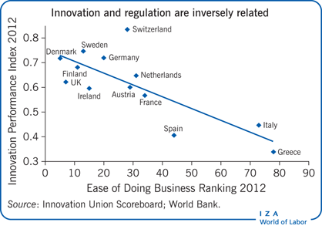
Entrepreneurs and their impact on jobs & economic growth

Slide 29
Class Activity
What are your
Ideas to start a business?
Any Idea???

Slide 30
Thank you

